Slide 1

Web Page Development CRN: 22781
AlBaha University
Faculty of Computer Science and Information Technology
Department of Computer Science.
2nd Semester/1439

Slide 2
Web Page Development
Part 1: HTML5 and Modern Web

Slide 3
Course objectives
This course covers concepts and techniques used in constructing interactive web applications. Browser-side web facilities such as HTML, cascading stylesheets, javascript, and the document object model

Slide 4
After successful completion of the course, you will be able to:
Understand the Web site creation process,
Develop web pages using HTML, HTML5
Use Cascading Style Sheets, including CSS, CSS3
Enhance their visual design skills,
Design the layout of web sites,
Design navigation of web sites,
Use web typography, colors, and images to best effect,
How to make standards-based web sites that are portable across different operating systems, browsers, and web-enabled devices.
How to connect a web site to a database.

Slide 5
What will we cover?
HTML and the Modern Web.
Web Site Design Principles.
Site Planning.
Cascading Style Sheets.
Web Typography.
Box Properties.
Page Layouts.

Slide 6
What will we cover?
Graphics and Color.
Site Navigation.
Data Tables.
Web Forms.
Web Page Design Studio.
JavaScript.
PHP.
Not necessarily in that order

Slide 7
Assessment
Unseen exam 40%
Exercise / Assignment (During the term) 10%
2 Mid term exam 30%
Project 20%
Web site creation exercise including your work!

Slide 8
Learning Resources – Required Text
Principles of Web Design: The Web Technologies Series, 5th Edition
Joel Sklar
ISBN-10: 1111528705
ISBN-13: 9781111528706
616 Pages Paperback
©2012 Cengage
PHP, MySQL, JavaScript & HTML5 All-in-One For Dummies
Steve Suehring, Janet Valade
ISBN: 978-1-118-21370-4
Paperback
720 pages
April 2013, Wiley

Slide 9
Learning Resources – Essential References
Computer Science Curriculum 2013 – http://cs2013.org
ACM (Association for Computer Machinery) Curricula Recommendations - http://www.acm.org/education/curricula-recommendations

Slide 10
Learning Resources – Recommended Books and references
Communications of ACM (Association for Computer Machinery) http://cacm.acm.org/
Journal of the ACM - http://jacm.acm.org/
ACM SIGCSE (Special Interest Group on Computer Science Education) bulletin - http://www.sigcse.org/Bulletin
ACM Transactions

Slide 11
Learning Resources –Electronic Materials, Web Sites
ACM (Association for Computer Machinery) web site - http://www.acm.org/
ACM SIGCSE (Special Interest Group on Computer Science Education) resource web site - http://www.sigcse.org/SIGresources
IEEE Computer Society web site - http://www.computer.org/portal/web/guest/home
Intel The Journey Inside web site (has a collection of interactive, online lessons about technology, computers, and society) - http://educate.intel.com/en/TheJourneyInside/
Google Code University Curriculum Resource web site - http://code.google.com/edu/resources/index.html

Slide 12
Learning Resources – Other learning Materials
Companion web site for Sklar book.

Slide 13
Web languages/ technologies
★
Hypertext Markup Language (HTML): used for writing web pages
Cascading Style Sheets (CSS): stylistic info for web pages
PHP Hypertext Processor (PHP): dynamically create pages on a web server
JavaScript: interactive and programmable web pages
Asynchronous JavaScript and XML (Ajax): accessing data for web applications
eXtensible Markup Language (XML): metalanguage for organizing data
Structured Query Language (SQL): interaction with databases
Notes:
web server: software that listens for web page requests
Apache
Microsoft Internet Information Server (IIS) (part of Windows)
web browser: fetches/displays documents from web servers
Mozilla Firefox
Microsoft Internet Explorer (IE)
Apple Safari
Google Chrome
Opera

Slide 14
What is HTML?
★
HTML is the standard markup language for creating Web pages.
HTML stands for Hyper Text Markup Language.
HTML describes the structure of Web pages using markup.
HTML elements are the building blocks of HTML pages.
HTML elements are represented by tags.
HTML tags label pieces of content such as “ heading”, “paragraph”, “table”, and so on
Browsers do not display the HTML tags, but use them to render the content of the page.

Slide 15
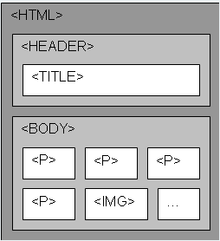
What is HTML?
The differences between HTML and other programming languages include:
HTML is not compiled. It is written and used without any changes.
HTML is human readable.
HTML is a rich and complex language that can describe :
standard text documents
tables of data
forms for sending information to server (such as for purchasing items from an online store)
complex images and multimedia
Interactive games
And more

Slide 16
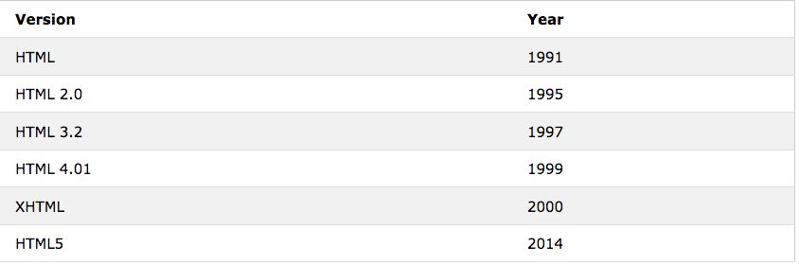
HTML Versions

Slide 17

HTML and the Modern Web HTML5
HTM5 is a markup language used for structuring and presenting content on the World Wide Web. It is the fifth and current version of the HTML standard.
It was published in October 2014 by the World Wide Web Consortium (W3C) to improve the language with support for the latest multimedia, while keeping it easily readable by humans- and consistently understood by computers and devices such as web browsers, parsers, etc.
HTML5 is intented to subsume not only HTML4, but also XHTML 1 and DOM level 2 HTML.
https://en.wikipedia.org/wiki/HTML5
Notes:
when the W3C HTML working group decided to merge the HTML and XHTML tree to make HTML a purely XML-based language. This left designers and browser manufacturers who wanted a more flexible solution with the choice to give up or create their own new specification.
They created a new group called the Web Hypertext Application Technology Working Group or WHATWG.

Slide 18
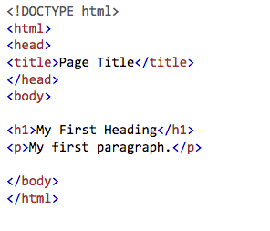
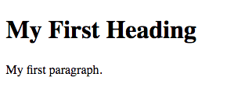


A simple HTML Document
★
Notes:
- markup tags that structure docs
browsers read them and display according to rules

Slide 19
Explanation of tags
★
The <!DOCTYPE html> declaration defines this document to be HTML5
The <!DOCTYPE> Declaration represents the document type, and helps browsers to display web pages correctly.
It must only appear once, at the top of the page (before any HTML tags).
The <!DOCTYPE> declaration is not case sensitive.
The <!DOCTYPE> declaration for HTML5 is : < !DOCTYPE html>

Slide 20
Explanation of tags
★
The <html> element is the root element of an HTML page
The <head> element contains meta information about the document
The <title> element specifies a title for the document
The <body> element contains the visible page content
The <h1> element defines a large heading
The <p> element defines a paragraph

Slide 21
HTML Tags
★
HTML tags are element names surrounded by angle brackets:
HTML tags normally come in pairs like <p> and </p>
The first tag in a pair is the start tag, the second tag is the end tag.
The end tag is written like the start tag, but with a forward slash inserted before the tag name

Slide 22

Web servers and browsers
★
web server: software that listens for web page requests
Apache
Microsoft Internet Information Server (IIS) (part of Windows)
web browser: fetches/displays documents from web servers
Mozilla Firefox
Microsoft Internet Explorer (IE)
Apple Safari
Google Chrome
Opera

Slide 23
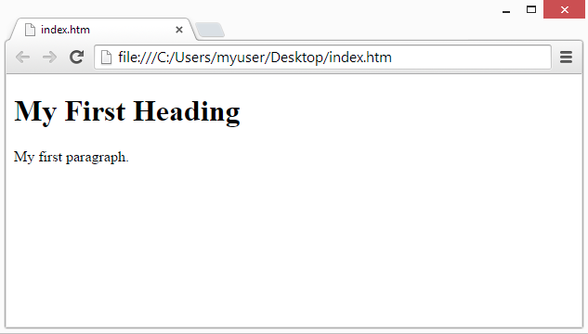
Web Browsers
The purpose of a web browser is to read HTML documents and display them.
The browser does not display the HTML tags, but uses them to determine how to display the document.

Slide 24
Local server/Production server
★
Local server: working locally
Work "offline"
On his own computer
Not visible change on internet
Interest: do not directly impact its site
Production Server: Production work
Working on the version “on line” of its site
Any changes impact the site

Slide 25
Site Hosting
Site Hosting on a web server:
You can choose a free host or rent a storage space for the site on a paid web host.
Select a URL for the site.
Transfer all files of the website on the host who makes sure that the server is ALWAYS functional so that your website is for all time accessible via internet.
In case you want to change a previously hosted site: If your site is already put into production and want to make changes or add modifications, you can make a copy of your files, insert updates, test the site locally, and then, transfer a new version on the server.

Slide 26
HTML Editors
For learning HTML we recommend a simple text editor:
Notepad (PC)
Step 1: Open Notepad (PC)
Windows 8 or later:
open the stat screen the window symbol at the bottom left on your screen). Type Notepad.
Windows 7or earlier:
open Start > Programs > Accessories > Notepad
2. TextEdit (Ma)
Step 1: Open TextEdit (Mac)
Open Finder > Applications> TextEdit
Notes:
Web pages can be created and modified by using professional HTML editors.
However, for learning HTML we recommend a simple text editor like Notepad (PC) or TextEdit (Mac).
We believe using a simple text editor is a good way to learn HTML.
Follow the four steps below to create your first web page with Notepad or TextEdit.

Slide 27
HTML Editors
For learning HTML we recommend a simple text editor:
2. TextEdit (Ma)
Step 1: Open TextEdit (Mac)
Open Finder > Applications> TextEdit
Also change some preferences to get the application to save files correctly. In Preferences> format> choose “ Plain Text”
Than under “ open and save”, check the box that says “ Ignore rich text commands in HTML files”.
Then open a new document to place the code.
Notes:
Web pages can be created and modified by using professional HTML editors.
However, for learning HTML we recommend a simple text editor like Notepad (PC) or TextEdit (Mac).
We believe using a simple text editor is a good way to learn HTML.
Follow the four steps below to create your first web page with Notepad or TextEdit.

Slide 28
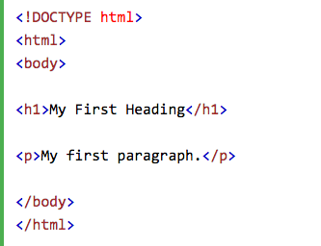
HTML Editors
For learning HTML we recommend a simple text editor:
Notepad (PC)
Step 1: Open Notepad (PC)
2. TextEdit (Ma)
Step 1: Open TextEdit (Mac)
Step 2: Write Some HTML
Notes:
Web pages can be created and modified by using professional HTML editors.
However, for learning HTML we recommend a simple text editor like Notepad (PC) or TextEdit (Mac).
We believe using a simple text editor is a good way to learn HTML.
Follow the four steps below to create your first web page with Notepad or TextEdit.

Slide 29
HTML Editors: creating first HTML File
For learning HTML we recommend a simple text editor:
Notepad (PC)
Step 1: Open Notepad (PC)
2. TextEdit (Ma)
Step 1: Open TextEdit (Mac)
Step 2: Write Some HTML
Step 3: Save the HTML Page
Save the file in your computer.
File > save as > name the file “index.htm” and set the encoding to UTF-8 (which is the preferred encoding for HTML files).
Notes:
Web pages can be created and modified by using professional HTML editors.
However, for learning HTML we recommend a simple text editor like Notepad (PC) or TextEdit (Mac).
We believe using a simple text editor is a good way to learn HTML.
Follow the four steps below to create your first web page with Notepad or TextEdit.

Slide 30
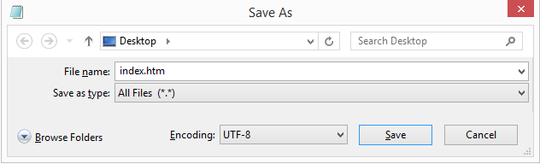
HTML Editors: creating first HTML File
Step 3: Save the HTML Page
Save the file in your computer.
File > save as > name the file “index.htm” and set the encoding to UTF-8 (which is the preferred encoding for HTML files).
Notes:
Web pages can be created and modified by using professional HTML editors.
However, for learning HTML we recommend a simple text editor like Notepad (PC) or TextEdit (Mac).
We believe using a simple text editor is a good way to learn HTML.
Follow the four steps below to create your first web page with Notepad or TextEdit.

Slide 31

HTML Editors: creating first HTML File
Step 4: View the HTML Page in Your Browser
Open the saved HTML file in your favorite browser ( double click on the file, or right-click-and choose “open with”).
Notes:
Web pages can be created and modified by using professional HTML editors.
However, for learning HTML we recommend a simple text editor like Notepad (PC) or TextEdit (Mac).
We believe using a simple text editor is a good way to learn HTML.
Follow the four steps below to create your first web page with Notepad or TextEdit.

Slide 32
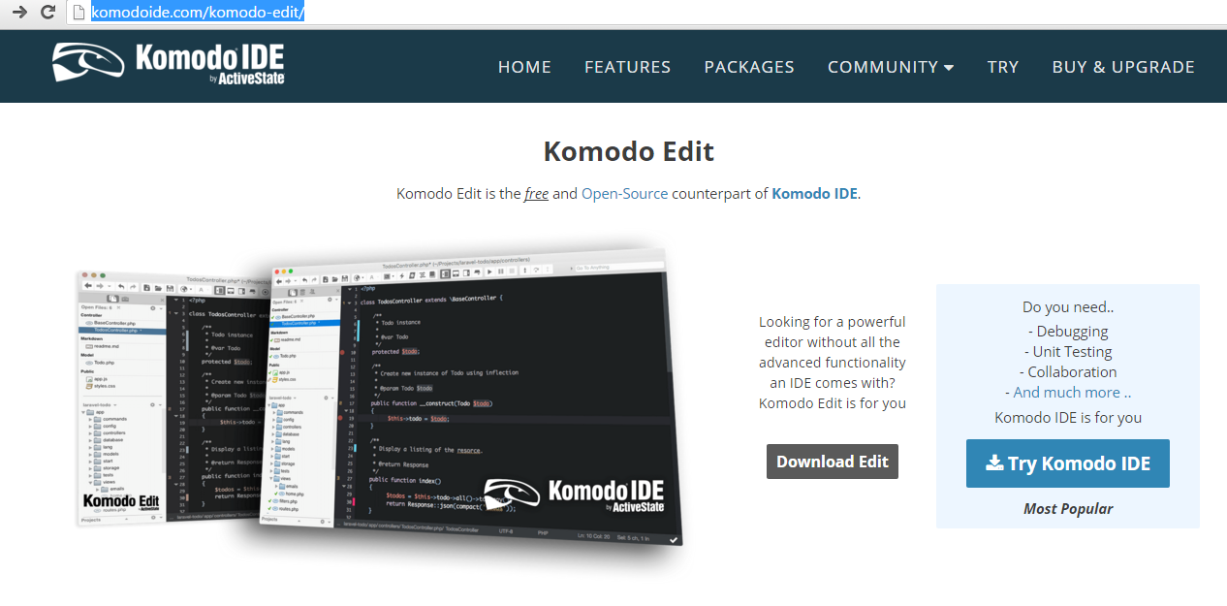
HTML Editors
I also would recommend Komodo Edit (any system), Dreamweaver or notepad ++
To download komodo editor (free version) on the site : http://komodoide.com/komodo-edit/

Slide 33
Important link
https://www.w3schools.com/html/html_intro.asp

Slide 34

Thank You

