Slide 1

Web Page Development CRN: 22781
AlBaha University
Faculty of Computer Science and Information Technology
Department of Computer Science.
2nd Semester/1439

Slide 2
Web Page Development
Part 2: Web Site Design Principles

Slide 3
HTMl Page Structure
objectives:
Understanding the importance of creating valid WebPages;
Minimal structure of a valid HTML page;
Understand the principle of nesting different HTML elements.

Slide 4
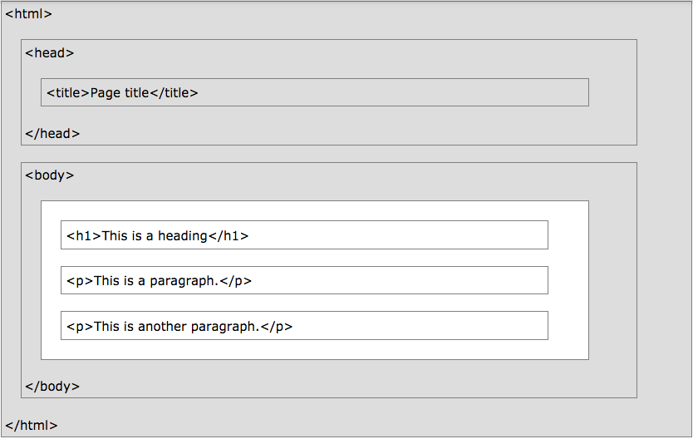
HTMl Page Structure
Notes:
Below is a visualization of an HTML page structure

Slide 5
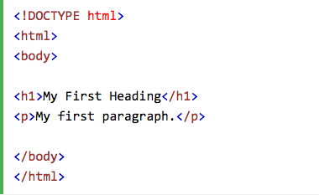
HTML Basic Example
HTML Documents:
All HTML documents must start with a document type declaration: <!DOCTYPE html>
The document itself begins with <html> and ends with </html>
The visible part of HTML document is between <body> and </body>

Slide 6
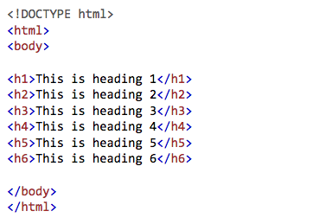
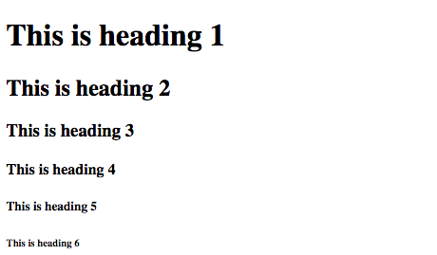
HTML Basic Example HTML Headings
HTML headings are defined with <h1> to </h1> tags
<h1> defines the most important heading
<h6> defines the least important heading

Slide 7
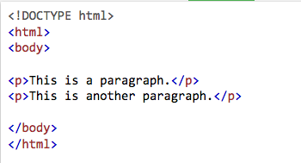
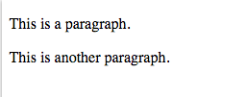
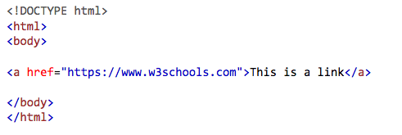

HTML Basic Example HTML Paragraphs, links and Images
★
HTML paragraphs are defined with the <p> tag:
2. HTML links are defined with the <a> tag:

Slide 8
HTML Basic Example HTML Paragraphs, links and Images
★
HTML links are defined with the <a> tag:
The link’s destination is specified in the href attribute.
Attributes are used to provide additional information about HTML element.

Slide 9

HTML Basic Example HTML Paragraphs, links and Images
★
HTML images are defined with the <img> tag:
The source file (src), alternative text (alt), width, and height are provided as attributes:

Slide 10
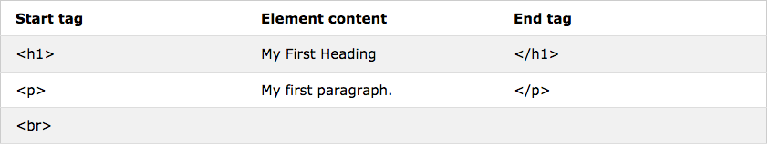
HTML Elements, attribute and value
An HTML element usually consists of a start tag and end tag, with the content inserted in between:
<tagname> Content goes here… </tagname>
The HTML element is everything from the start tag to the end tag

Slide 11
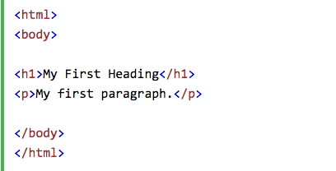
HTML Elements, attribute and value
★
The <html> element defines the whole document.
It has a start tag <html> and an end tag </html>.
The element content is another HTML element (the <body> element).

Slide 12
HTML Elements, attribute and value
★
The <body> element defines the document body.
It has a start tag <body> and an end tag </body>
The element content has two other HTML elements (<h1> and <p>).

Slide 13
HTML Elements, attribute and value
★
The <h1> element defines a heading.
It has a start tag <h1> and an end tag </h1>
The element content is: My First Heading

Slide 14
HTML Elements, attribute and value
★
HTML element with no content are called empty elements.
<br> is an empty element without a closing tag ( the <br> tag defines a line break).
<!DOCTYPE html>
<html>
<head>
<title> My first web page </title>
<meta charset=‘’utf-8’’>
</head>
<body>
<!-- This is a principal title -->
<h1> principal title </h1>
<p> A paragraph </p> <br>
<p> A paragraph <br> ddddddddd</p>
</body>
</html>
Notes:
HTML5 does not require empty elements to be closed. But if you want stricter validation, or if you need to make your document readable by XML parsers, you must close all HTML elements properly.

Slide 15
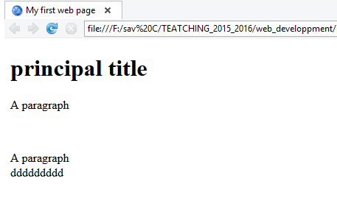
HTML Elements, attribute and value
HTML element with no content are called empty elements.
<br> is an empty element without a closing tag ( the <br> tag defines a line break).
Notes:
HTML5 does not require empty elements to be closed. But if you want stricter validation, or if you need to make your document readable by XML parsers, you must close all HTML elements properly.

Slide 16
HTML Elements, attribute and value
★
All HTML elements can have attributes
Attributes provide additional information about an element
Attributes are always specified in the start tag
Attributes usually come in name/value pairs like: name="value"

Slide 17
HTML Elements, attribute and value
★
An element can contain sometimes required attributes.
The attribute will always contain values.
Example 1: a element
<a href= ‘‘https://fr.wikipedia.org/wiki/Hypertext_Markup_Language’’>
</a>
Value: The website address to which we will make the link
href : attribute to which we give a value with the sign = and a value between “” with the website address to which we will make the link
Notes:
L’adresse du site auquel on va faire le lien
Un élément peut contenir des attributs parfois même obligatoires. L’attribut va toujours contenir des valeurs.

Slide 18
HTML Elements, attribute and value
★
HTML images are defined with the <img> tag:
The source file (src), alternative text (alt), width, and height are provided as attributes:
img element : to insert images, we need to specify two attributes: src and alt.
src : (source) to contain the address of the image
alt: (alternative) to give a title to the image (in case of problems
when opening the image,...)
img consists of an orphan tag.
Notes:
Images in HTML have a set of size attributes, which specifies the width and height of the image:
The image size is specified in pixels: width="500" means 500 pixels wide.
Alt The alt attribute specifies an alternative text to be used, when an image cannot be displayed.
The value of the attribute can be read by screen readers. This way, someone "listening" to the webpage, e.g. a blind person, can "hear" the element.
Also we have style attribute, the lang attribute, the title attribute use lowercase attributes

Slide 19
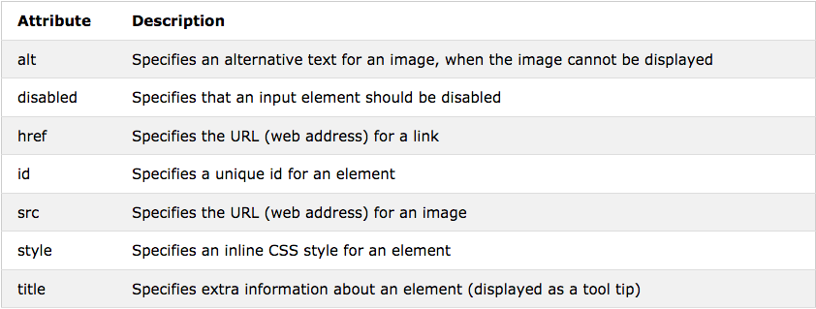
HTML Elements, attribute and value
★

Slide 20
Indentation and comment
objectives:
Understanding the interest of the indentation
Knowing how to indent
Understanding a comment
Understanding the interest of good comments of his code
Learn how to comment

Slide 21
Indentation
★
<!DOCTYPE html>
<html>
<head>
<title> My first web page </title>
<meta charset=‘’utf-8’’>
</head>
<body>
<h1> principle title </h1>
<p> A paragraph </p>
</body>
</html>
<!DOCTYPE html>
<html>
<head>
<title> My first web page </title>
<meta charset=‘’utf-8’’>
</head>
<body>
<h1> principle title </h1>
<p> A paragraphe </p>
</body>
</html>
Example1

Slide 22
Comments
★
Comments: will not be visible to your site visitors, but it is very important to care for: it's more professional.
<!DOCTYPE html>
<html>
<head>
<title> My first web page </title>
<meta charset=‘’utf-8’’>
<!-- This is a comment -->
</head>
<body>
<!-- This is a principle title -->
<h1> principle title </h1>
<!-- This is a paragraph -->
<p> A paragraph </p>
</body>
</html>

Slide 23
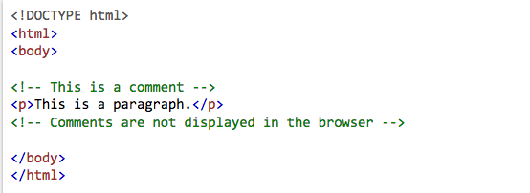
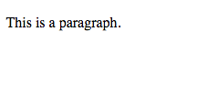
Comments
★
Comments: will not be visible to your site visitors, but it is very important to care for: it's more professional.
Example:

Slide 24
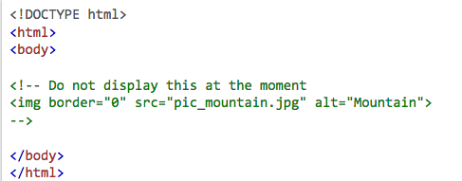
Comments
★
Comments: will not be visible to your site visitors, but it is very important to care for: it's more professional.
Exercise : try this code, and discuss the result.

Slide 25
Manage important texts
objectives:
Understand the principle of "important texts"
Understand the interest to define differing importance for our texts.
Discovery of HTML elements: <strong>, <em> and <mark>

Slide 26
<strong>, <em> and <mark>
★
Referencing : Search engines constantly index web pages.
Whenever someone accesses a Web page, the engine will send a web page listed on the selection search to be well classified in a search engine, the engine must understand your page and understand its structure
The more you give information to the search engine, the higher your site will be ranked higher !! will be defined on the most important terms!
The <Strong> before a word: to say that the text is very important !!
➔ it will be in bold, </Strong>
The <em> before a word: to say that the text is relatively important!!
➔ it will be in Italic, </em>
The <mark> before a word: used to highlight certain content by marking
➔ will be highlighted in yellow!. , </mark>

Slide 27
<Strong>, <em> and <mark>
★
<!DOCTYPE html>
<html>
<head>
<title> Html </title>
<meta charset=‘’utf-8’’>
</head>
<body>
<h1> principal title </h1>
<p> a paragraph with <strong> very important content text </strong>
</p>
<p> a paragraph with <em> relatively important content text </em>
</p>
<p> a paragraph with <mark> by marking important content text </mark>
</p>
</body>
</html>

Slide 28
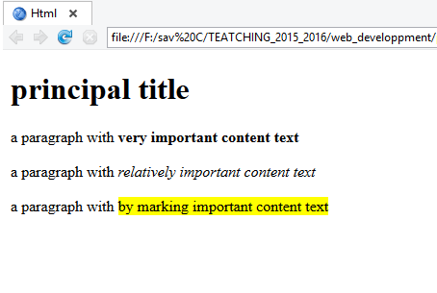
<Strong>, <em> and <mark>
★

Slide 29
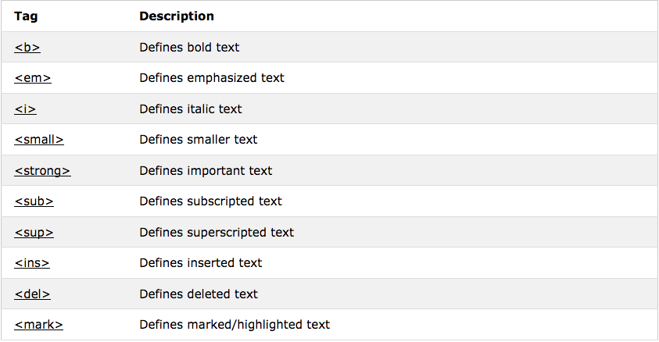
HTML Text format elements
★

Slide 30
Important link
https://www.w3schools.com/html/html_intro.asp

Slide 31

Thank You

