Slide 1

Web Page Development CRN: 22781
AlBaha University
Faculty of Computer Science and Information Technology
Department of Computer Science.
2nd Semester/1439

Slide 2
Web Development
Part 3

Slide 3
content
HTML Link
Creating Lists
HTML Iframes
HTML Head

Slide 4
HTML Elements, attribute and value
★
An element can contain sometimes required attributes.
The attribute will always contain values.
Example 1: a element
<a href= ‘‘https://fr.wikipedia.org/wiki/Hypertext_Markup_Language’’>
</a>
Value: The website address to which we will make the link
href : attribute to which we give a value with the sign = and a value between “” with the website address to which we will make the link
Notes:
L’adresse du site auquel on va faire le lien
Un élément peut contenir des attributs parfois même obligatoires. L’attribut va toujours contenir des valeurs.

Slide 5
HTML Links - hyperlinks
★
Definition: A link allows visitors to access new pages by clicking on it.
Example 1: a element
<a href= ‘‘https://fr.wikipedia.org/wiki/Hypertext_Markup_Language’’>
</a>
href: hypertext reference:
href : attribute to which we give a value with the sign = and a value between “” with the website address to which we will make the link

Slide 6
HTML Links - hyperlinks
★
Two types of links:
Internal Link (Local link) : to move from one page to another page in the same website.
External link: to move from a page to another page in an other website.
Notes:
A local link (link to the same web site) is specified with a relative URL (without http://www....).

Slide 7
Internal link (local)
★
It is used to create links between different pages in a site.
You will inform a relative value for the href attribute. when we say relative, this is because we need to indicate the destination page on the start page; it's the page from which we make our connection.
The website is a set of files that are linked together. These files will be located in different folders. To create internal links, we have to distinguish between three cases:
1- Start page and destination page are in the same folder.
2- Destination page in a subfolder from the start page.
3- Destination page is a parent folder from the Start page.

Slide 8
HTML LINKs - hyperlinks
★
Link color:
By default, a link will appear like this (in all browsers):
An unvisited link is underlined and blue
A visited link is underlined and purple
An active link is underlined and red
However, we can change our link by using CSS

Slide 9
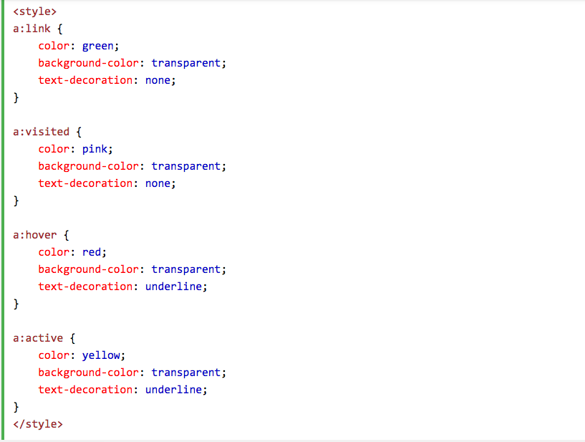
HTML LINKs - hyperlinks
★
Notes:
We put our CSS style between head tags and our link between body tags

Slide 10
Internal link
To view all cases, you must have 3 different folders and 4 html pages to create the links.
Parent folder
3
Parent.html
Middle folder
start.html
Middle. html
1
Sub folder
Sub.html
2

Slide 11
Internal link
★
<!DOCTYPE html>
<html>
<head>
<title> start page </title>
<meta charset="utf-8">
</head>
<body>
<p> a link to the page in the <a href="middle.html"> same folder </a>
</p>
<p> a link to the page in the <a href="sub/sub.html"> sub folder </a>
</p>
<p> a link to the page in the <a href="../parent.html"> parent folder</a>
</p>
</body>
</html>
Ex: " sub1/sub2/page_name.html " "../../parent.html"

Slide 12
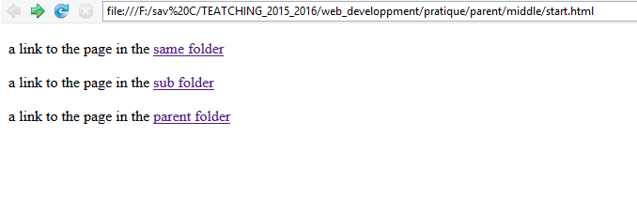
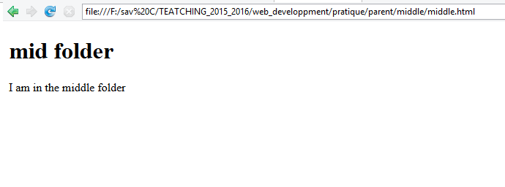
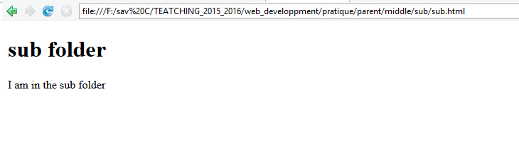
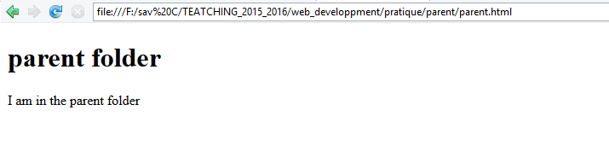
Internal link

Slide 13
HTML LINKs – The target attribute
★
The target attribute can have one of the following values:
_blank : Opens the linked document in a new window or tab
_self : Opens the linked document in the same window/tab as it was clicked (this is default)
_parent : Opens the linked document in the parent frame
_top : Opens the linked document in the full body of the window
Framename : Opens the linked document in a named frame
Notes:
The target attribute specifies where to open the linked document.

Slide 14
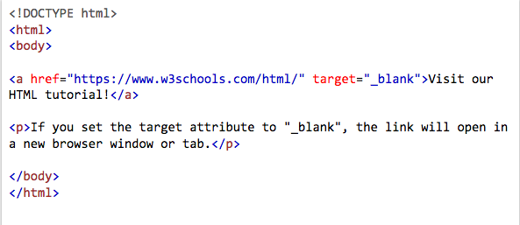
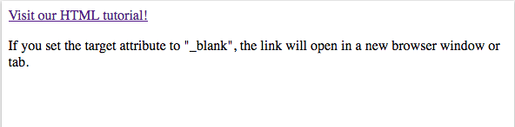
HTML LINKs – The target attribute
★
⬇
Notes:
The target attribute specifies where to open the linked document.

Slide 15
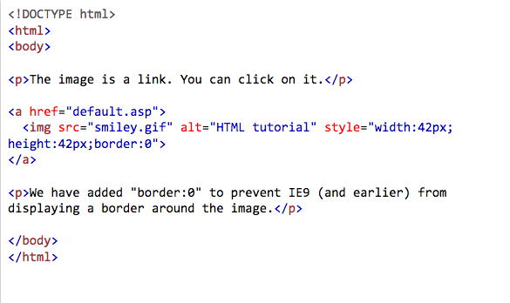
HTML Links – Image as link
★

Slide 16
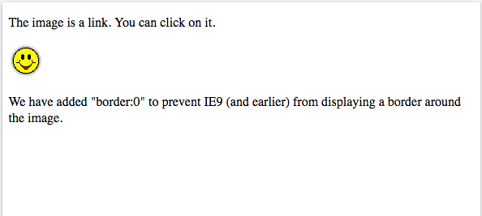
HTML Links – Image as link


Slide 17
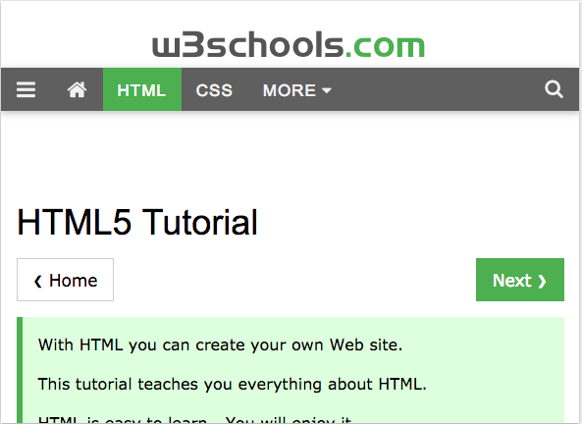
HTML Links – Image as link

Slide 18
Other types of links in HTML
Objectives:
Discover other possible uses of <a> element;
Understand what an anchor and learn to create it;
Use the element <a> to allow your visitors to send you an email;
Link to enable the download of a file.

Slide 19
Other types of links in HTML - anchor
★
When moving in an HTML page, the page is sometimes too long, we can propose shortcuts to visitors, and so by clicking on the anchor link, visitors will be redirected to a specific location of the page;
➔ this will be very helpful.
Example: in the case of a summary of the top of the page, you can add anchors on this summary to send visitors to different parts of this summary.

Slide 20
Other types of links in HTML - anchor
★
To create it, we must have first of all an anchor by adding an id attribute within the opening tag of the element where you want to send the visitor.
You have to give a unique value for the id in order to use this value to find the anchor.
The value of the id must have a real meaning,
must not contain spaces or special characters
and must begin with a letter

Slide 21
Other types of links in HTML - anchor
<!DOCTYPE html>
<html>
<head>
<title> HTML bases</title>
<meta charset="utf-8">
</head>
<body>
<h1> HTML anchors </h1>
<p> direct access to our anchor <a href=“#anchor1” > “anchor1” </a> </p>
<p> <br><br><br><br><br><br><br><br><br><br><br></p>
<h2 id= “anchor1”> a first anchor </h2>
</body>
</html>
create the link that will take us back to the anchor
create the anchor

Slide 22
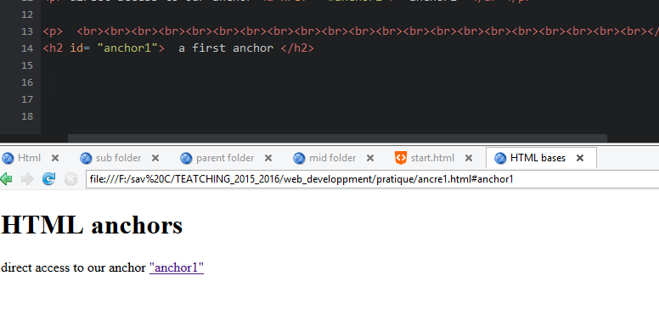
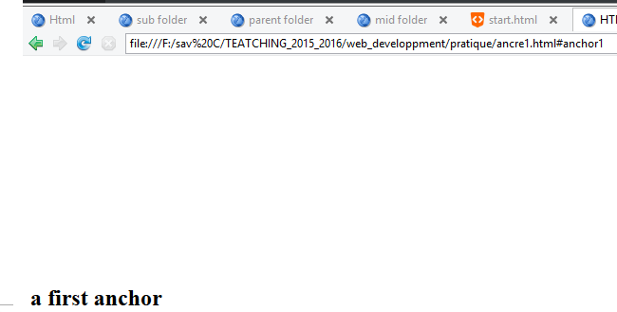
Other types of links in HTML - anchor

Slide 23
Other types of links in HTML - To send email
★
<!DOCTYPE html>
<html>
<head>
<title> HTML bases</title>
<meta charset="utf-8">
</head>
<body>
<h1> To send email </h1>
<p> Send me <a href=“mailto:nouf.nma26@gmail.com” > email </a> </p>
</body>
</html>
If you have not configured your default e-mail, the link does not work !!

Slide 24
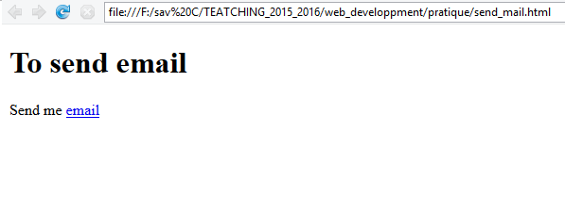
Other types of links in HTML - To send email
★

Slide 25
Other types of links in HTML – download a file
★
If you want to allow visitors to upload word, pdf or xls files…, you must just specify the address of the file with its extension as a relative link in value of the href attribute of the element <a>
To do this it is necessary to have a file (zip, pdf, xls or other) that we will put in the same folder as the web page from which the link is created.
Then, create a link using a relative path in the value of the href attribute.

Slide 26
Other types of links in HTML - download a file
★
<!DOCTYPE html>
<html>
<head>
<title> HTML bases</title>
<meta charset="utf-8">
</head>
<body>
<h1> To download a file </h1>
<p> You can download <a href=“fichier.pdf” > chapter 1 </a> </p>
</body>
</html>

Slide 27
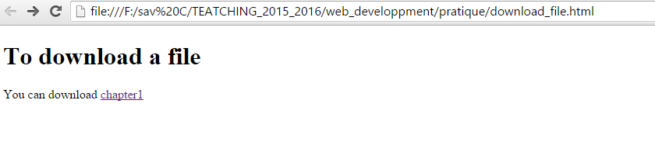
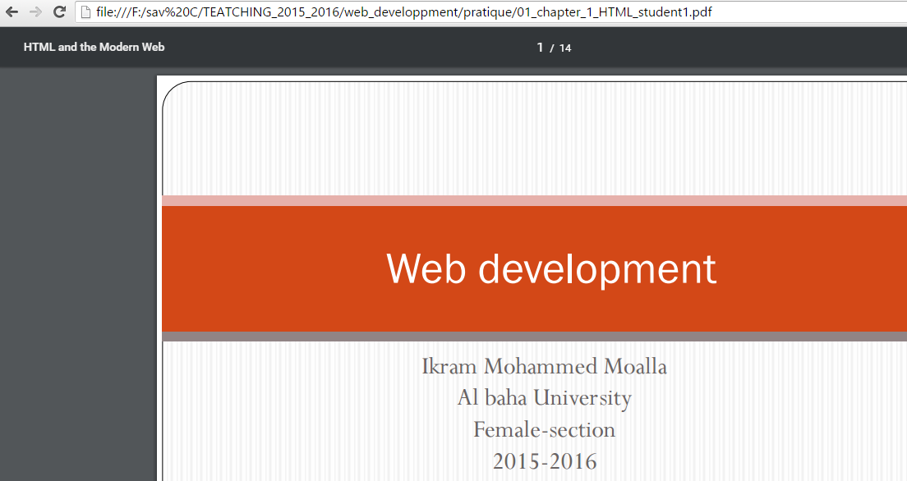
Other types of links in HTML - download a file

Slide 28
HTML Lists
★
Objectives:
Understanding a list;
Define the different types of lists (ordered, unordered and definition list);
Learn how to create lists in HTML.
What is List?
List: ordered content by performing the data in list form.
Very useful to bring order and clarity of the document and to create menus for a better navigation.

Slide 29
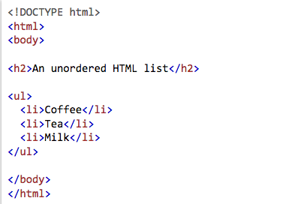
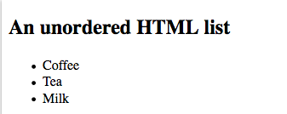
HTML Lists: Unordered list
★
Unordered List (ul): useful to list the elements that have no hierarchy or logical order (eg. apple, car, flower ...)
By the use of the tag <ul>…</ul> and <li>…</li>
➔

Slide 30
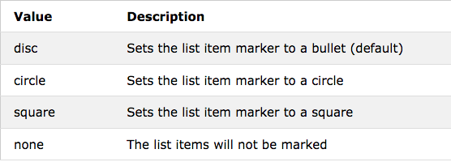
HTML Lists: Unordered list
★
The CSS list-style-type property is used to define the style of the list item maker:

Slide 31
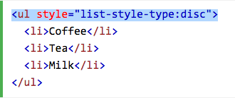
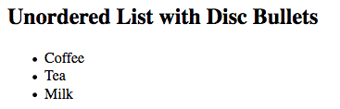
HTML Lists: Unordered list
★
The CSS list-style-type property is used to define the style of the list item maker:
➔

Slide 32

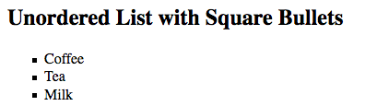
HTML Lists: Unordered list
★
The CSS list-style-type property is used to define the style of the list item maker:⬇
⬇

Slide 33
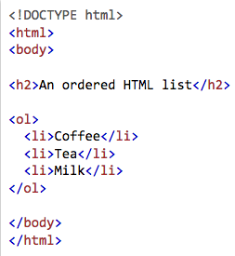
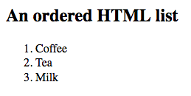
HTMl Lists: Order list
★
Ordered List (ol): useful to create a list with elements having a certain logical progression.
example: creating a summary
By the use of the tag <ol>…</ol> and <li>…</li>
➔

Slide 34
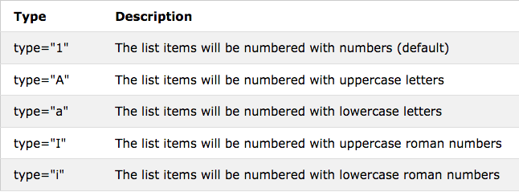
HTMl Lists: Order list They Type Attribute
★
The Type attribute of the <ol> tag, defines the type of the list item marker:

Slide 35
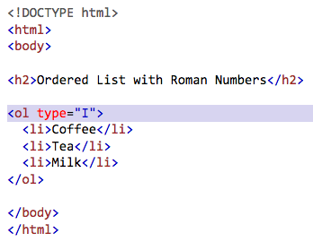
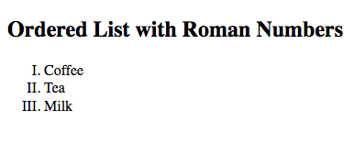
HTMl Lists: Order list They Type Attribute
★
The Type attribute of the <ol> tag, defines the type of the list item marker:
➔

Slide 36
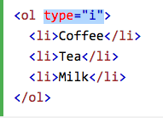
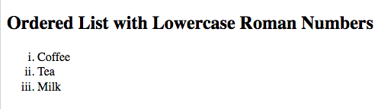
HTMl Lists: Order list They Type Attribute
★
The Type attribute of the <ol> tag, defines the type of the list item marker:
➔

Slide 37
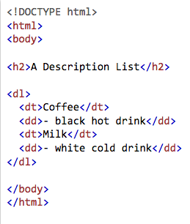
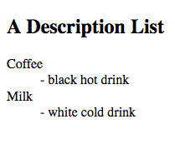
HTML Lists: Description Lists
★
A description list: is a list of terms and definitions for each add-term.
By the use of the tag <dl>…</dl> , <dt>…</dt> and <dd>…</dd>
The <dl> tag defines the description list, the <dt> tag defines the term (name), and the <dd> tag describes each term:
➔

Slide 38
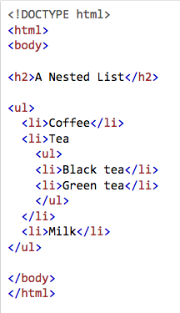
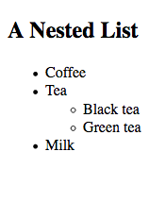
HTML Lists
★
Nested HTML List: list can be (lists inside lists):
➔

Slide 39
HTML Lists
★
Horizontal List: One popular way is to style a list horizontally, to create a menu,

Slide 40
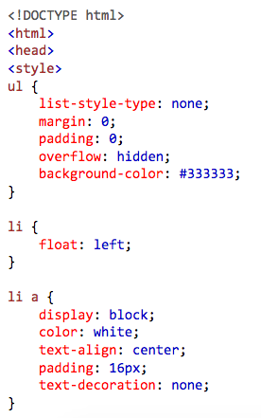
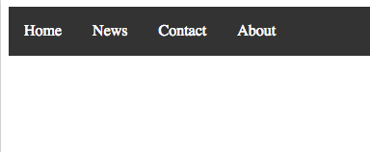
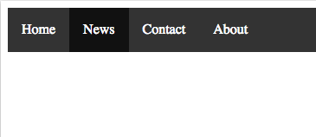
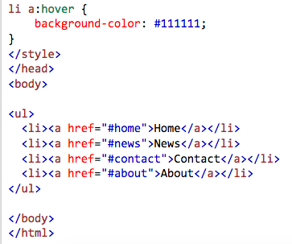
★
➔
⬇

Slide 41
HTMl Lists: Summary
★
Use the HTML <ul> element to define an unordered list
Use the CSS list-style-type property to define the list item marker
Use the HTML <ol> element to define an ordered list
Use the HTML type attribute to define the numbering type
Use the HTML <li> element to define a list item
Use the HTML <dl> element to define a description list
Use the HTML <dt> element to define the description term
Use the HTML <dd> element to describe the term in a description list
Lists can be nested inside lists
List items can contain other HTML elements
Use the CSS property float:left or display:inline to display a list horizontally

Slide 42

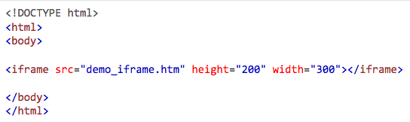
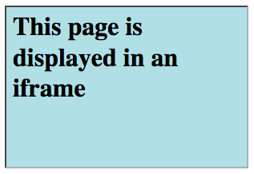
HTML Iframe
★
An HTML Iframe is defined with the <iframe> tag:
Iframe – Set Height and Width


Slide 43
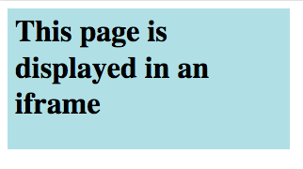
HTML Iframe
★
Iframe – Remove the Border
To remove the border, add the style attribute and use the CSS border property:
Before After
⬇
➔

Slide 44
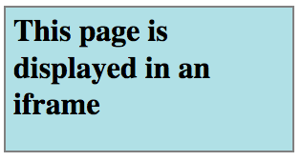
HTML Iframe
★
Iframe – Size, Style and color of the iframe’s border
⬇

Slide 45
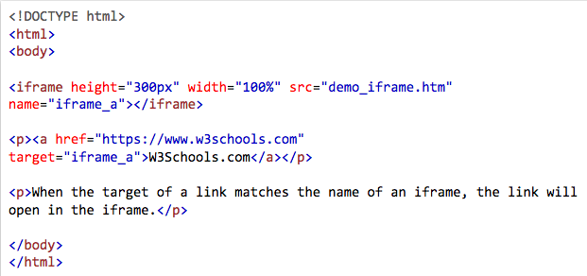
HTML Iframe: Target a link
★
An iframe can be used as the target frame for a link.
The target attribute of the link must refer to the name attribute of the iframe:

Slide 46
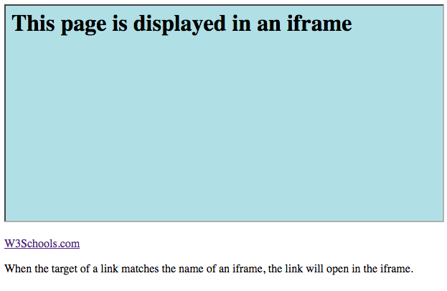
HTML Iframe: Target a link


Slide 47
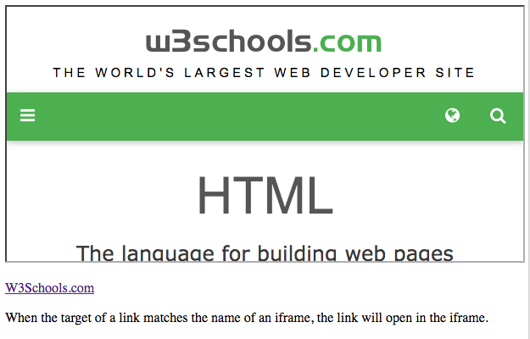
HTML Iframe: Target a link

Slide 48

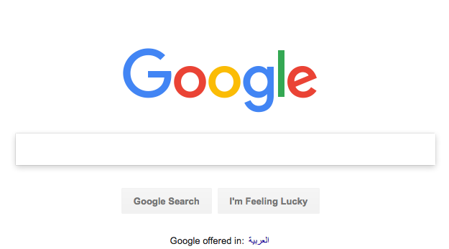
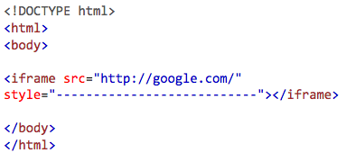
Homework
Edit the code for this picture?

Slide 49
HTML Head
★
<head> element is a container for metadata (data about data) and is placed between the <html> tag and the <body> tag.
HTML metadata is data about the HTML document. Metadata is not displayed.
Metadata typically define the document title, character set, styles, links, scripts, and other meta information.
The following tags describe metadata: <title>, <style>, <meta>, <link>, <script>, and <base>

Slide 50
HTML Head: <title> Element
★
defines a title in the browser tab
provides a title for the page when it is added to favorites
displays a title for the page in search engine results
Notes:
The <title> element defines the title of the document, and is required in all HTML/XHTML documents.

Slide 51
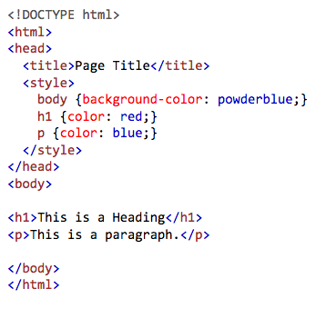
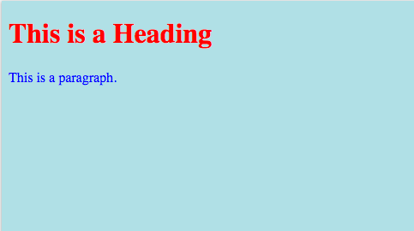
HTML Head: <style> Element
★
The <style> element is used to define style information for a single HTML page:
➔
Notes:
The <title> element defines the title of the document, and is required in all HTML/XHTML documents.

Slide 52
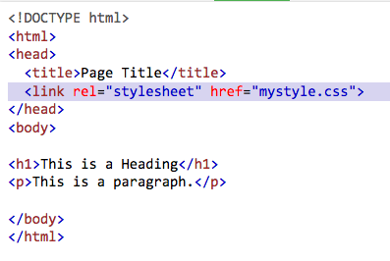
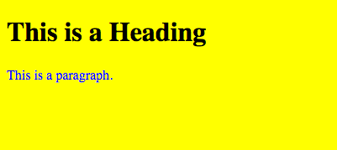
HTML Head: <link> Element
★
The <link> element is used to link to external style sheets:
➔
Notes:
The <title> element defines the title of the document, and is required in all HTML/XHTML documents.

Slide 53


HTML Head: <meta> Element
★
<meta> element is used to specify which character set is used, page description, keywords, author, and other metadata.
Define the character set used:
Define a description of your web page:
Define keywords for search engines:
Define the author of a page:
Refresh document every 30 seconds:
Notes:
The <title> element defines the title of the document, and is required in all HTML/XHTML documents.

Slide 54
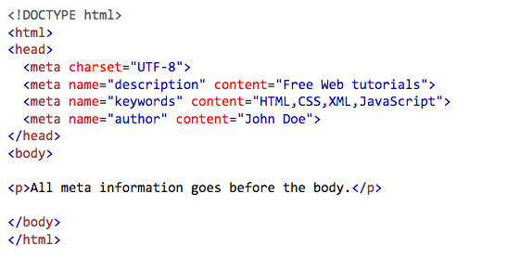
HTML Head: <meta> Element
★
This is how to write it in HTML file :
Notes:
The <title> element defines the title of the document, and is required in all HTML/XHTML documents.
Viewport:

Slide 55
Validation and browser compatibility
Browser Compatibility
The same code interpreted by different browsers can produce different results.
So, It is possible that a code is displayed differently depending on the browser used by your visitors.
Remember to test your code with different browsers and different versions of each browser when in doubt: it does not cost much and not doing so can be catastrophic!

Slide 56
Validation and browser compatibility
Validation
In order to always have a clean code that works well: always remember to check its validity.
For this, the W3C (World Wide Web Consortium - the authority on codification of computer languages) puts at your disposal various tools, including HTML and CSS validators.
Validators :
• For HTML validator: http://validator.w3.org
• For the CSS validator: http://jigsaw.w3.org/css-validator
Everything is free, feel free to use it!

Slide 57

Validation

Slide 58

Validation

Slide 59
Reference
https://www.w3schools.com/html/default.asp

Slide 60

Thank You

