Slide 1
Web Development
Unit 2 – Part 1 CSS

Slide 2
Content
Cascading Style Sheets (CSS)
Adding Styles and Classes to Your Web Pages
HTML Media

Slide 3
CSS
★
CSS stands for Cascading Style Sheets
CSS describes how HTML elements are to be displayed on screen, paper, or in other media
CSS saves a lot of work. It can control the layout of multiple web pages all at once
External stylesheets are stored in CSS files
CSS is is used to define styles for your web pages, including the design, layout and variations in display for different devices and screen sizes.
So, the CSS allows you to change the look of your text, add boarders or change the layout of the elements on your page.
CSS3 is the latest standard for CSS.

Slide 4
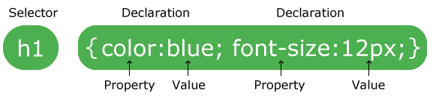
CSS: Syntax
★
A CSS rule-set consists of a selector and a declaration block:
The selector points to the HTML element you want to style.
The declaration block contains one or more declarations separated by semicolons.
Each declaration includes a CSS property name and a value, separated by a colon.
A CSS declaration always ends with a semicolon, and declaration blocks are surrounded by curly braces.

Slide 5
CSS: Selectors, properties and values
★
A selector is used to determine which HTML element (s) or what type of elements you want to apply a particular style. If you want to apply a style to all paragraphs, for example, use the "p" selector.
A property will help us to change the style of an element by focusing a very specific criteria such as the size of text, font or color, for example.
A value will be used to complete a property and will determine its behavior. For the property used to change the color of text, for example, the value will be the new color to apply.

Slide 6
CSS: selectors, properties and values
★
P {
color : blue;
font-size : 16px;
}
The selector “p” :means that we want to apply a style to all paragraphs of our pages.
The property ”color” :used to change the color of text.
The property “font-size” :is used to change the size of text.
The value “blue” : indicates that our paragraphs are blue
The value “16px” : indicates that our text has a size of 16px.

Slide 7
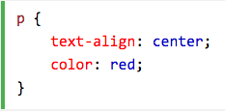
CSS: selectors, properties and values
★
The element selector: selects elements based on the element name.

Slide 8
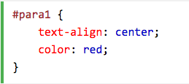
CSS: selectors, properties and values
★
The element selector: selects elements based on the element name.
The id selector: uses the id attribute of an HTML element to select a specific element.
The id of an element should be unique within a page, so the id selector is used to select one unique element!
To select an element with a specific id, write a hash (#) character, followed by the id of the element.
The style rule below will be applied to the HTML element with id="para1”

Slide 9
CSS: selectors, properties and values
★
The element selector: selects elements based on the element name.
The id selector: uses the id attribute of an HTML element to select a specific element.
The class selector: selects elements with a specific class attribute.
To select elements with a specific class, write a period (.) character, followed by the name of the class.
In the example below, all HTML elements with class="center" will be red and center-aligned:
Notes:
You can also specify that only specific HTML elements should be affected by a class.
In the example below, only <p> elements with class="center" will be center-aligned:
Example
p.center { text-align: center; color: red; }
HTML elements can also refer to more than one class.
In the example below, the <p> element will be styled according to class="center" and to class="large":
Example
<p class="center large">This paragraph refers to two classes.</p>

Slide 10
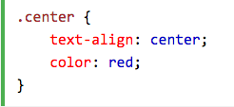
CSS: selectors, properties and values
★
The element selector: selects elements based on the element name.
The id selector: uses the id attribute of an HTML element to select a specific element.
The class selector: selects elements with a specific class attribute.
To select elements with a specific class, write a period (.) character, followed by the name of the class.
In the example below, all HTML elements with class="center" will be red and center-aligned:
Notes:
You can also specify that only specific HTML elements should be affected by a class.
In the example below, only <p> elements with class="center" will be center-aligned:
Example
p.center { text-align: center; color: red; }
HTML elements can also refer to more than one class.
In the example below, the <p> element will be styled according to class="center" and to class="large":
Example
<p class="center large">This paragraph refers to two classes.</p>

Slide 11
CSS: selectors, properties and values
★
The element selector: selects elements based on the element name.
The id selector: uses the id attribute of an HTML element to select a specific element.
The class selector: selects elements with a specific class attribute.
The grouping selector: If you have elements with the same style definitions, like this:
Notes:
It will be better to group the selectors, to minimize the code.
To group selectors, separate each selector with a comma.
In the example below we have grouped the selectors from the code above:

Slide 12
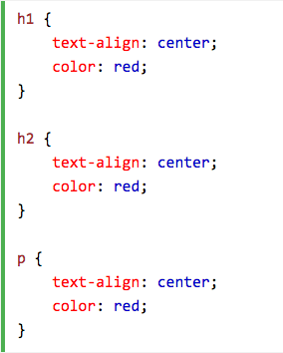
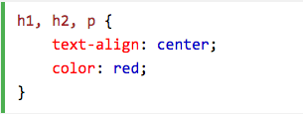
CSS: selectors, properties and values
★
The element selector: selects elements based on the element name.
The id selector: uses the id attribute of an HTML element to select a specific element.
The class selector: selects elements with a specific class attribute.
The grouping selector: If you have elements with the same style definitions, like this:
Notes:
It will be better to group the selectors, to minimize the code.
To group selectors, separate each selector with a comma.
In the example below we have grouped the selectors from the code above:

Slide 13
Where to write the CSS?
★
We have three possibilities to write our CSS code.
We can write the CSS:
Internal style sheet: Inside the head element of our HTML document;
Inline style: In the opening tag of the HTML file of our members;
External style sheet: In a separate file with .css extension.
For reasons of code performance, clarity and time saving,
➔It is highly recommend using the last method !!!

Slide 14
Where to write the CSS : Internal style sheet
Write the CSS code in the head element of your HTML page.
To do this, simply insert a style element in our head element and place our CSS declarations within the style element:
<!DOCTYPE html>
<html>
<head>
<title> HTML bases</title>
<meta charset="utf-8">
<style>
P {
color : blue;
font-size : 16px;
}
</style>
</head>
<body>
<h1> To download a file </h1>
<p> My color and may size </p>
</body>
</html>

Slide 15
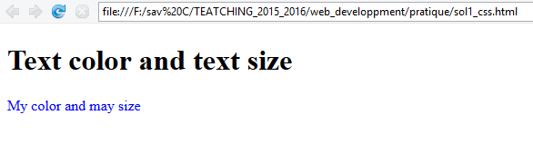
Where to write the CSS : Internal style sheet
Write the CSS code in the head element of your HTML page.
To do this, simply insert a style element in our head element and place our CSS declarations within the style element:
⬇

Slide 16
Where to write the CSS : Inline style
★
Write CSS code in the opening tag of an HTML element.
Use a style attribute and assign the CSS properties to its value.
<!DOCTYPE html>
<html>
<head>
<title> Css illustration </title>
<meta charset="utf-8">
</head>
<body>
<p style=“color:blue; font-size:16px; ‘’> a paragraphe style: My color and may size</p>
</body>
</html>

Slide 17
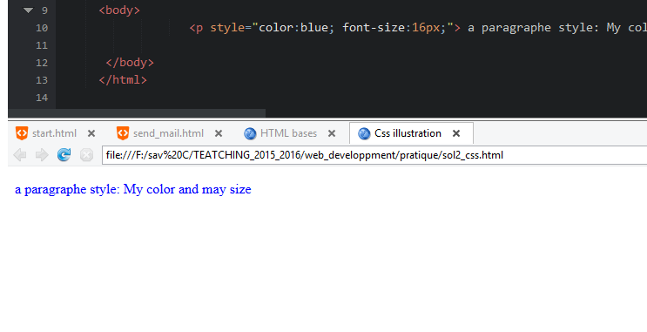
Where to write the CSS : Inline style
Write CSS code in the opening tag of an HTML element.
Use a style attribute and assign the CSS properties to its value.
⬇

Slide 18
Where to write the CSS : External style sheet
★
Write CSS code in a separate file. The file is in ".css" format.
e.g. "style.css"
Save this file in the same folder as your HTML file to avoid problems.
Bind our two HTML and CSS files using a link element placed in the head element.

Slide 19
Where to write the CSS : External style sheet
★
Write CSS code in a separate file. The file is in ".css" format.
e.g. "style.css"
Save this file in the same folder as your HTML file to avoid problems.
Bind our two HTML and CSS files using a link element placed in the head element.
<!DOCTYPE html>
<html>
<head>
<title> Css illustration </title>
<meta charset="utf-8">
<link rel=“stylesheet“ href= “style.css“/>
</head>
<body>
<p> a paragraphe style: My color and may size</p>
</body>
</html>

Slide 20
Where to write the CSS : External style sheet
★
The link element is represented as an orphan tag and must be specified by his two attributes "rel" and "href".
rel attribute : is used to specify the style of the linked file (in our case it is a style sheet, so "stylesheet").
href attribute : is used to make the link with the corresponding CSS file.
P {
color : red;
font-size : 22px;
}

Slide 21
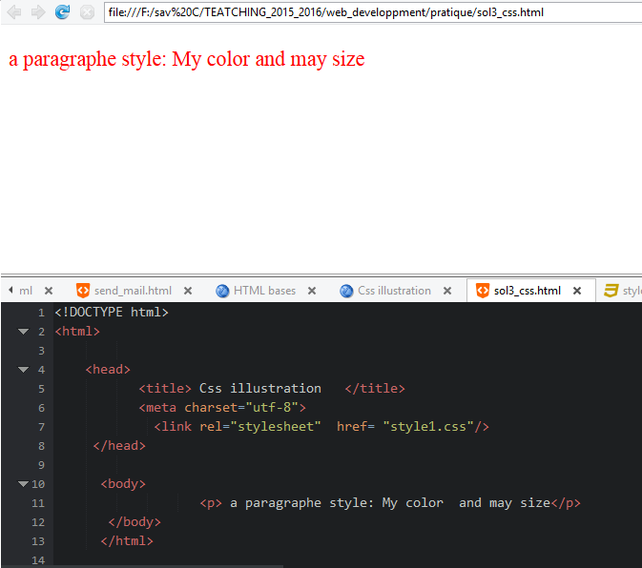
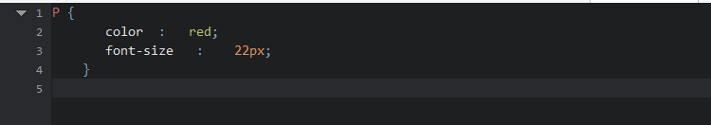
Where to write the CSS : External style sheet

Slide 22
Where to write the CSS : External style sheet
⬆

Slide 23
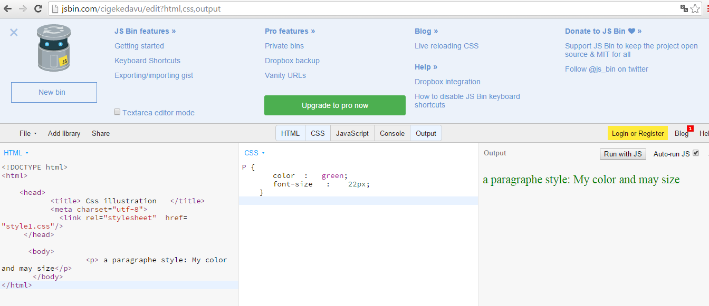
Where to write the CSS : the best solution
I recommend again to use JsBin.com
Notes:
Multiple Style Sheets
If some properties have been defined for the same selector (element) in different style sheets, the value from the last read style sheet will be used.
Example
Assume that an external style sheet has the following style for the <h1> element:
h1 { color: navy; }
then, assume that an internal style sheet also has the following style for the <h1> element:
h1 { color: orange; }
If the internal style is defined after the link to the external style sheet, the <h1> elements will be "orange":
Example
<head> <link rel="stylesheet" type="text/css" href="mystyle.css"> <style> h1 { color: orange; } </style> </head>
However, if the internal style is defined before the link to the external style sheet, the <h1> elements will be "navy":
Example
<head> <style> h1 { color: orange; } </style> <link rel="stylesheet" type="text/css" href="mystyle.css"> </head>

Slide 24
The comments in CSS
★
/* a comment */
/* a paragraph style */
P {
color : red;
font-size : 22px;
}

Slide 25
HTML Class: The attributes 'class' and 'id'
★
The problem is that we are still very limited with simple selectors: how to apply a different style to two elements of the same type,
eg two paragraphs? It is not possible !!
Class and Id: HTML attributes that have been created in order to
apply different styles to the same type of elements.

Slide 26
The attributes 'class' and 'id'
★
In the opening tag of an HTML element, we write the name of the attribute (class and id), and given a consistent value.
This value should not contain special characters (accents, etc.) or space. For example

Slide 27
The attributes 'class' and 'id'
★
In the opening tag of an HTML element, we write the name of the attribute (class and id), and given a consistent value.
This value should not contain special characters (accents, etc.) or space. For example
<!DOCTYPE html>
<html>
<head>
<title> Css illustrations </title>
<meta charset="utf-8">
<link rel=“stylesheet“ href= “style1.css“/>
</head>
<body>
<p class=“para_1”> a paragraph </p>
<p id=“para_2”> an other paragraph </p>
</body>
</html>

Slide 28
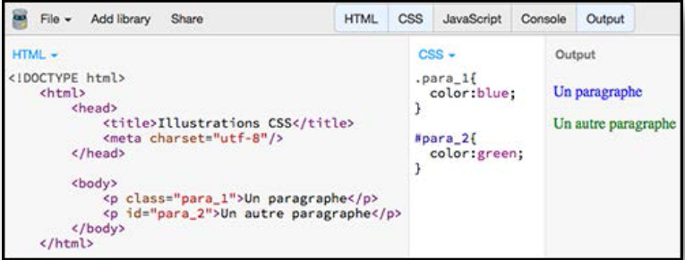
The attributes 'class' and 'id'
★
In the CSS file:
- Start our statement by one point for a class attribute
- Begin our statement with a sharp for an id attribute.
After the point or sharp, you write the value of the attribute

Slide 29
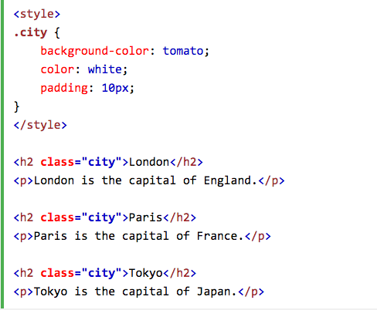
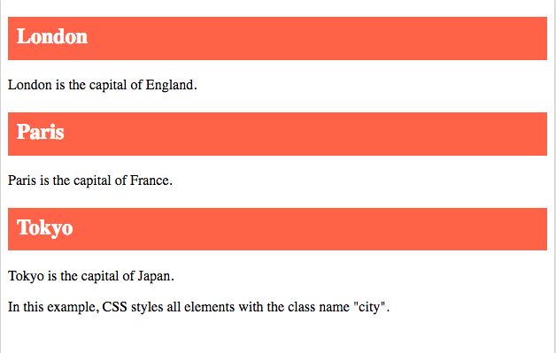
Example 2:
↵

Slide 30
The attributes 'class' and 'id'
★
Why create two attributes to do the same thing?
What is the difference between class and id? : An id attribute with a specific value can only be used once in a page, in contrast to the notion of class.
Id: will be used for single elements in a web page, such as the logo for example.
Class: can be used for multiple identical attributes (ie having the same value) per page.
➔This allows you to apply the same style to different elements.

Slide 31
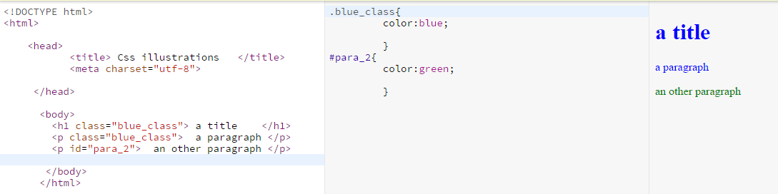
The attributes 'class' and 'id'

Slide 32
div and span elements
★
The div and span elements have no semantic value as element <p> or <h1>
The div and span elements will be our containers.
We're going to use to surround blocks of code and be able to assign individual styles to these blocks.
The use of div and span elements is very simple:
Surrounding the desired block of code with a pair of opening tags
and closing </div> or </span>.

Slide 33
div and span elements
<!DOCTYPE html>
<html>
<head>
<title> Css illustrations </title>
<meta charset="utf-8”>
</head>
<body>
<div class="container">
<h1 class="blue_class"> a title for <span class="underline"> span </span> and div
</h1>
<p class="blue_class"> a paragraph </p>
<p id="para_2"> an other paragraph </p>
</div >
</body>
</html>
➔ We can apply a particular style to any portion of code in our HTML page.
Notes:
on peut appliquer un style particulier à n’importe quel bout de code dans notre page HTML.

Slide 34
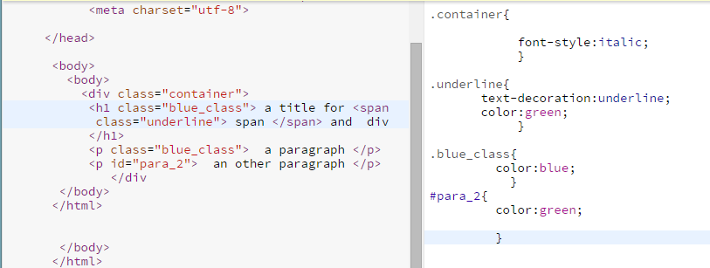
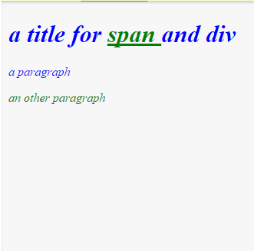
div and span elements

Slide 35
Format text and position elements through CSS
- Use of " font-size ";
- Use of " font-style ";
- Use of " font-weight ";
- web safe fonts

Slide 36
Font-size property
★
The font-size: to change the size of text.
This property accepts two types of values:
Absolute value (in pixels or point): fix the size of a text definitively
Relative value (in em, ex, or percentage): allow the text to fit in relation to preferences of your visitors; If you fix the size of a text to 100%, the text can have different sizes depending on the settings made by your visitors on their browsers.
px: pixel,
em and ex depend on the font and may be different for each document element
ex: express sizes on the x-height of the font. The x-height is schematically height smaller letters like a, c, m, o.
em is simply the size of the font

Slide 37
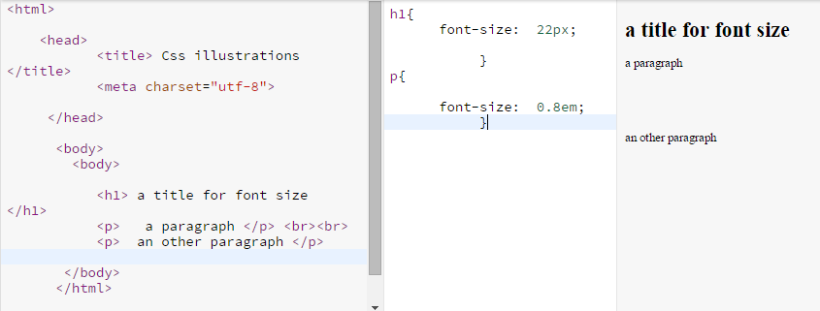
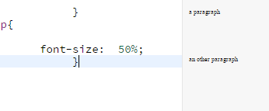
Font-size property
★

Slide 38
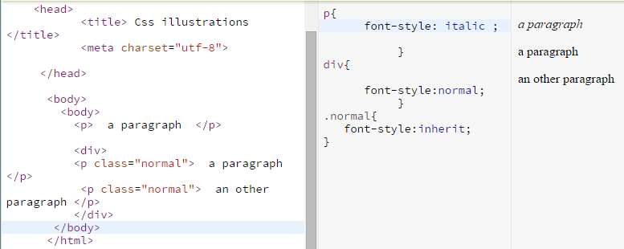
Font-style property
★
Font-style allows to fix the inclination of a text.
Font-style accepts four different values:
• Normal (default);
• Italic (changes in italics);
• Oblique (bends the text);
• Inherit (inherits properties of the parent element).

Slide 39
Font-weight property
★
The property font-weight used to fix the weight of a text.
This property accepts 6 different values:
Normal (the default);
Lighter (lighter version of the police);
Bold (the font is bold);
Bolder (the police is even more bold);
One hundred between 100 and 900 (the lightest to fat);
Inherit (inherits the styles of his parents).

Slide 40
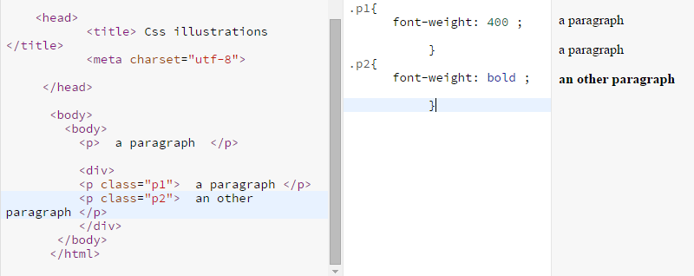
Font-weight property
★
Using numeric values allow better calibration (more flexible).
Note that 400 correspond to normal and 700 correspond to bold.

Slide 41
The « web safe fonts »
Web Safe Fonts are a set of fonts, a "pack" which is pre-installed on all machines to go online.
So are fonts read by everyone, hence the word "safe", "out of danger".
Among the Web Safe Fonts fonts: Arial, Times New Roman, Courier New, Verdana, Georgia, Lucida, Tahoma, Trebuchet and Garamond among others.

Slide 42
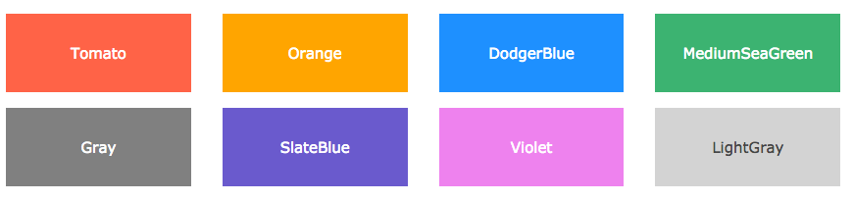
The color property
★
How to change the color of text in CSS with the color property?
There are several ways to manage the color of text,
First: by assigning a color name value of the color property.
Second: by assigning an hexadecimal number value to the color property.

Slide 43
The color property
★
How to change the color of text in CSS with the color property.
There are several ways to manage the color of text,
First: by assigning a color name value of the color property.
⬇

Slide 44

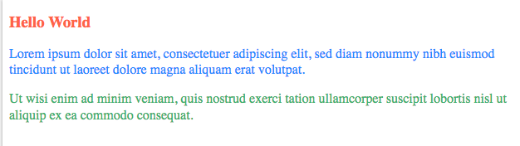
The color property
★
⬇

Slide 45
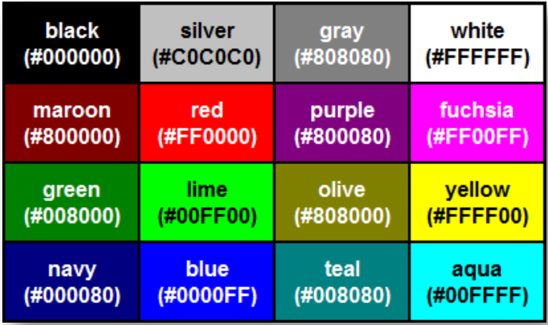
The color property
➔ Sixteen color names: this method is very limited

Slide 46
The color property
How to change the color of text in CSS with the color property?
There are several ways to manage the color of text,
First: by assigning a color name value of the color property.
Second: by assigning an hexadecimal number value to the color property.
"Hexadecimal" means "functioning in base 16".
A hexadecimal system is a system that uses 16 symbols to count, that in our case the numbers 0 through 9 and the letters A through F.
The letter A is equal to10, B to 11, C to 12, D to13, E to14 and E to15. This makes us 16 symbols by counting the zero.
Now we can give a hexadecimal value of the color property, so choosing precisely the desired color.
This value must begin with a number, followed by 6 symbols chosen from 0 to F.

Slide 47
The color property
★
FF 00 00
the intensity of red
the intensity of blue
the intensity of green
You can imagine that this happens as when you mix paint to obtain a precise color.
The advantage of this type of value to choose from over 16 million different shades.
The intensity scale is from 0 to 255 for each pair of values, 00 being the lowest intensity FF and the strongest intensity.

Slide 48
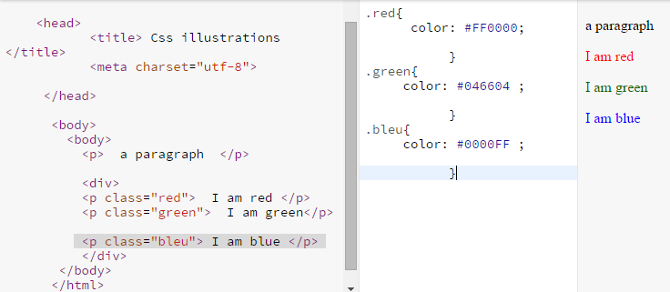
The color property

Slide 49
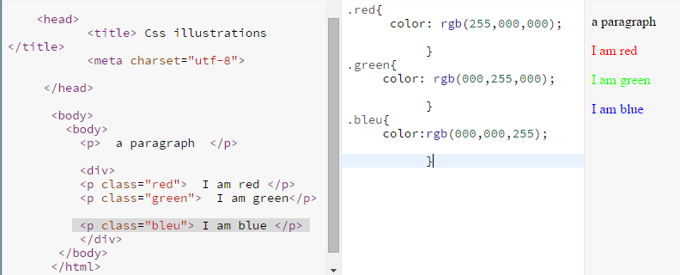
The color property
★
Third way: give three numbers between 0 and 255 in value.
The three numbers form the final color.
rgb(255,000,000)
the intensity of red
the intensity of blue
the intensity of green

Slide 50
The opacity of a text
★
CSS offers two methods to fix the opacity of texts.
1. If we used a color name or hexadecimal value with the property color
➔ we will use the opacity property to fix the opacity of our texts.
This property takes a value between 0 (fully transparent) to 1 (fully opaque).
2. If we used an RGB value type with the color property,
➔ We will use a RGBa type value.
.violet{
color: rgba(175,51,175,0.2);
}
.violet{
color: red ;
opacity: 0.5;
}
2
1

Slide 51
The opacity of a text
In practice, the property is therefore used in this way:
<!DOCTYPE html>
<html>
<head>
<title> Colors</title>
<meta charset="utf-8">
</head>
<body>
<p class=“red"> I’am red </p>
<p class=“red2"> I’am red too! </p>
<p class=“purple"> I’am purple</p>
</body>
</html>
.red{
color:red;
opacity:1;
}
.red2 {
color:#FF0000;
opacity:0.5;
}
.purple{
color:rgba(175,51,175,0.2);
}

Slide 52
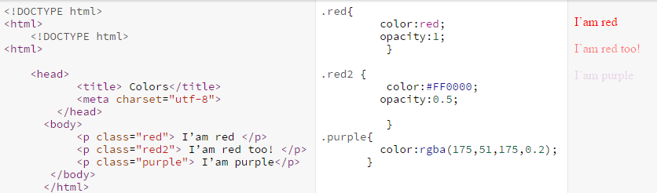
The opacity of a text
In practice, the property is therefore used in this way:

Slide 53
The CSS properties of “text” type
★
Type properties "text" are used to fix the appearance of our texts.
- Use of "text-align";
- Use of "text-transform";
- Use of "text-decoration";
- Use of "text-indent";
- Use of "text-shadow";

Slide 54
Manage the alignment of text
★
To change the alignment of text, we use the property text-align.
This property can take five different values:
• Left: the text is aligned to the left; default value ;
• Center: the text will be centered;
• Right: the text will be aligned on the right;
• Justify: text will be justified;
• Inherit: inherits the properties of the parent element.
➔It is good to note that the centering or alignment is always relative to the nearest parent element of the text.

Slide 55
Manage the alignment of text
<!DOCTYPE html>
<html>
<head>
<title> Text</title>
<meta charset="utf-8">
</head>
<body>
<div>
<p class=“pdiv"> A paragraph in div </p>
</div>
<p>An other paragraph</p>
</body>
</html>
div{
width:300px;
border:1px solid black;
}
.pdiv {
text-align:right;
}
p {
text-align:center;
}

Slide 56
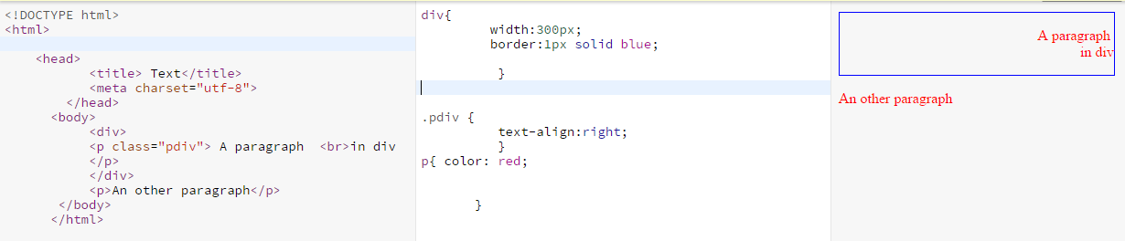
Manage the alignment of text

Slide 57
The text-decoration property
★
Decoration we will be able to change a text through ownership
text-decoration.
One can choose from six values for this property:
• Underline: text will be highlighted;
• Overline: a line will appear above the text;
• Line-through: text will be crossed out;
• Blink: the text will flash (do not work on all browsers);
• Inherit;
• None: no decoration, default behavior.
Notes:
On peut choisir parmi six valeurs pour cette propriété :
• Underline : le texte sera souligné ;
• Overline : une ligne apparaîtra au dessus du texte ;
• Line-through : le texte sera barré ;
• Blink : le texte clignotera (attention, ne fonctionne pas sur tous
les navigateurs) ;
• Inherit ;
• None : pas de décoration, comportement par défaut.

Slide 58
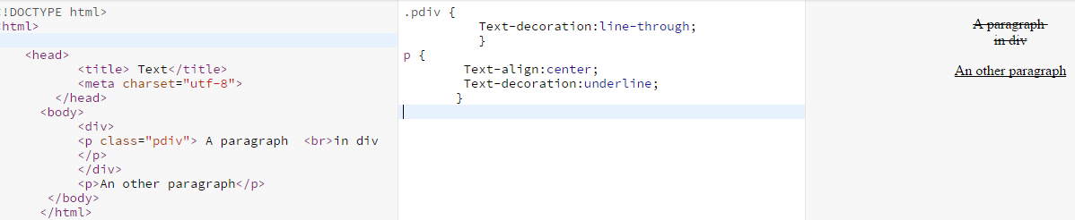
The text-decoration property
<!DOCTYPE html>
<html>
<head>
<title> Text</title>
<meta charset="utf-8">
</head>
<body>
<div>
<p class=“pdiv"> A paragraph in div </p>
</div>
<p>An other paragraph</p>
</body>
</html>
.pdiv {
Text-decoration:line-through;
}
p {
Text-align:center;
Text-decoration:underline;
}

Slide 59
The text-indent property
★
The text-indent property is used to manage the indentation of text.
The indentation is the offset of text on the right generally.
This property accepts the absolute values of type (px, pt) and relative (em, ex,%).
You can also assign negative values to shift your text on the left.

Slide 60
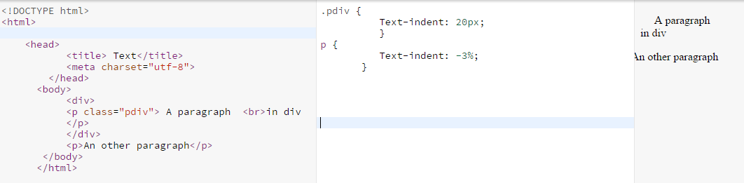
The text-indent property
<!DOCTYPE html>
<html>
<head>
<title> Text</title>
<meta charset="utf-8">
</head>
<body>
<div>
<p class=“pdiv"> A paragraph in div </p>
</div>
<p>An other paragraph</p>
</body>
</html>
.pdiv {
Text-indent: 20px;
}
p {
Text-indent: -7%;
}

Slide 61
The text-transform property
★
We use the text-transform property to change the appearance of text characters (uppercase or lowercase).
We can choose from five values:
• Uppercase: converts any text to uppercase;
• Lowercase: put all the text lowercase;
• Capitalize: sets only the first letter of each word In capital letters ;
• None: no transformation;
• Inherit: inherits the styles of the parent element

Slide 62
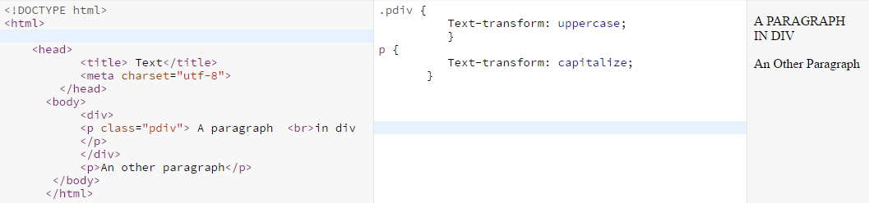
The text-transform property
<!DOCTYPE html>
<html>
<head>
<title> Text</title>
<meta charset="utf-8">
</head>
<body>
<div>
<p class=“pdiv"> A paragraph in div </p>
</div>
<p>An other paragraph</p>
</body>
</html>
.pdiv {
Text-transform: uppercase;
}
p {
Text-transform: capitalize;
}

Slide 63
The properties letter-spacing and word-spacing
★
The letter-spacing and word-spacing properties allow respectively, to adjust the space between letters and between words.
These properties behave similarly and accept absolute values (px, pt) and relative (ex, em, %).

Slide 64
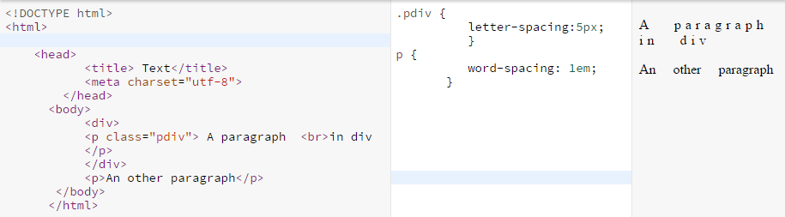
The properties letter-spacing and word-spacing
<!DOCTYPE html>
<html>
<head>
<title> Text</title>
<meta charset="utf-8">
</head>
<body>
<div>
<p class=“pdiv"> A paragraph in div </p>
</div>
<p>An other paragraph</p>
</body>
</html>
.pdiv {
letter-spacing:5px;
}
p {
word-spacing: 1em;
}

Slide 65
Shadows of texts
★
We can add shadow effects to text by using the property
text-shadow.
This property requires a minimum of two values to function.
In most cases, we use four in the order given below.
The first three values are lengths and last is the color of the shadow:
• 1st value: horizontal displacement of the shadow;
• 2nd value: vertical displacement of the shadow;
• 3rd value: propagation radius (Gaussian Blur) of the shadows;
• 4th value: shadow color (that accepts the same values of the property "color").

Slide 66
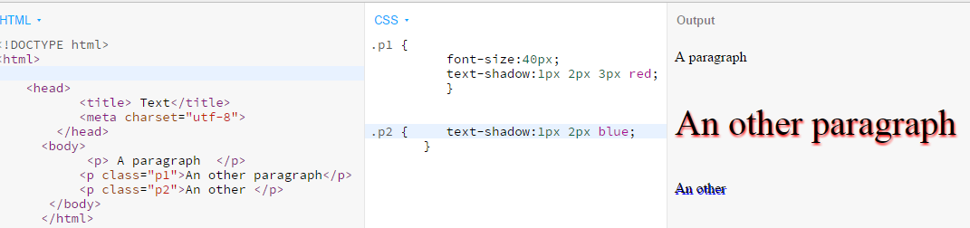
Shadows of texts
<!DOCTYPE html>
<html>
<head>
<title> Text</title>
<meta charset="utf-8">
</head>
<body>
<p> A paragraph </p>
<p class=“p1”>An other paragraph</p>
<p class=“p2”>An other </p>
</body>
</html>
.p1 {
font-size:40px;
text-shadow: 1px 2px 3px red
}
p {
text-shadow: 1px 20px blue;
font-size: 40px;
}

Slide 67
The model of boxes
The box model is a key concept that lets you dispose and position the different elements of your web page.
The box model tells us that "every element of a page is a
rectangular box and may have a padding, a margin and borders ".
A block-level element or inline-level element, is a rectangular box.
The properties for specifying the length, width, margin,
padding and borders of an element form what is called the
box model.

Slide 68
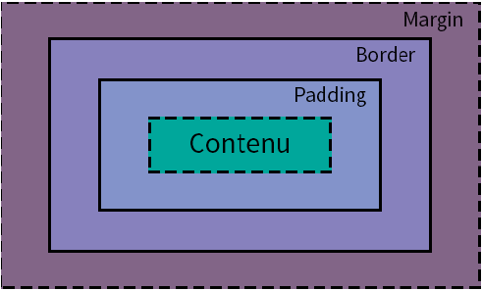
The box model
Content
The first enclosure is defined by the length and the width of an element.
The padding forms the second box.
The borders that constitute the third box.
The outer margin comes to form the fourth and last box.
Notes:
La première boîte est définie par la longueur et la largeur d’un élément.
La padding, ou marge intérieure, forme ensuite la seconde boîte.
Puis viennent les bordures qui constituent la troisième boîte.
Enfin, la marge extérieure vient former la quatrième et dernière boîte.

Slide 69
Height and width of an element
★
Every element has a height and width default.
The height of an element is determined by its content.
(paragraphs one line or two lines do not occupy the same height)
The default width of an element is primarily determined by its type (block or inline) and its content if the element is inline type.
The block-level elements automatically occupy the entire available width.
To change the height of an item, use the height property to which is assigned a value in px,% or auto.
Using the value "auto", we let the browser of our visitors decide the height to be taken by the target element. This is useful if you want to keep the proportions of an image while adapting it to the screen size of our visitors.
To change the width of an element, use the width property.
This property takes the same types of values ​​that height.

Slide 70
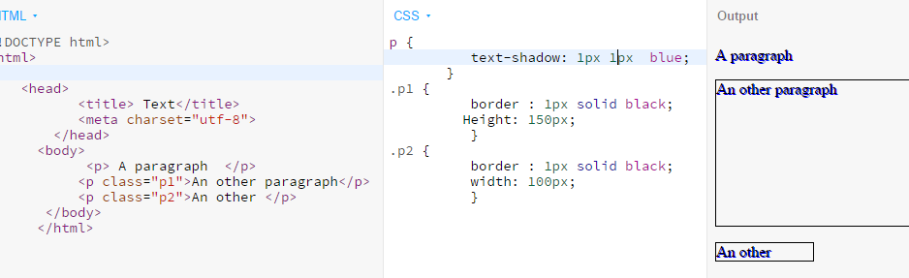
Height and width of an element
<!DOCTYPE html>
<html>
<head>
<title> Boxes</title>
<meta charset="utf-8">
</head>
<body>
<p> A paragraph </p>
<p class=“p1”>An other paragraph</p>
<p class=“p2”>An other </p>
</body>
</html>
p {
text-shadow: 1px 20px blue;
}
.p1 {
border : 1px solid black;
Height: 150px;
}
.p2 {
border : 1px solid black;
width: 100px;
}

Slide 71
Borders and rounded edges
★
There are many kinds of borders some of which are more or less well supported by some browsers.
To create and adjust borders, we will need three properties:
• Border-width, which will define the thickness of the border (in value px);
• Border-style, which will define the style of the border;
• Border-color, which will define the border color (accept same values as the property "color").

Slide 72
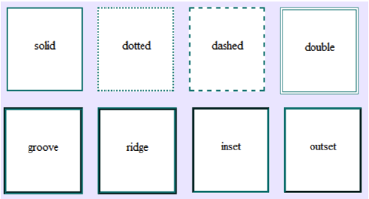
Borders
★

Slide 73
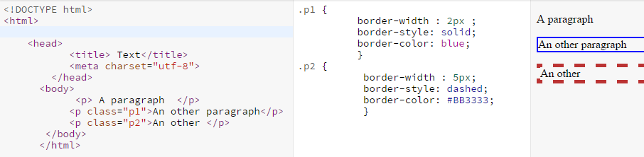
6.2 Borders
<!DOCTYPE html>
<html>
<head>
<title> Boxes</title>
<meta charset="utf-8">
</head>
<body>
<p> A paragraph </p>
<p class=“p1”>An other paragraph</p>
<p class=“p2”>An other </p>
</body>
</html>
.p1 {
border-width : 2px ;
border-style: solid;
border-color: blue;
}
.p2 {
border-width : 3px ;
border-style: dashed;
border-color: #BB3333;
}

Slide 74
Borders style
The following values are allowed:
dotted - Defines a dotted border
dashed - Defines a dashed border
solid - Defines a solid border
double - Defines a double border
groove - Defines a 3D grooved border. The effect depends on the border-color value
ridge - Defines a 3D ridged border. The effect depends on the border-color value
inset - Defines a 3D inset border. The effect depends on the border-color value
outset - Defines a 3D outset border. The effect depends on the border-color value
none - Defines no border
hidden - Defines a hidden border

Slide 75
Borders and rounded edges
★
A long awaited feature by webmasters and developers, which has emerged with CSS3 is the ability to create rounded borders.
To do this, we will use the border-radius property.
This property will have a value: the size of the angle, in px.
Note that different angles can be defined for each side of our borders using the keywords top-left, top-right, bottom-left and bottom-right.

Slide 76
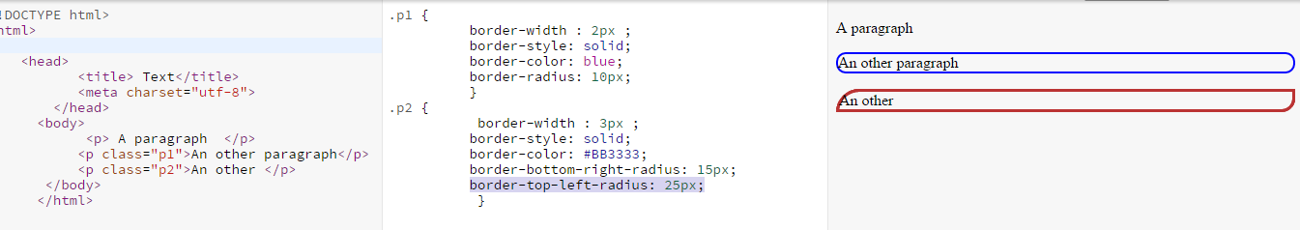
Borders and rounded edges
<!DOCTYPE html>
<html>
<head>
<title> Boxes</title>
<meta charset="utf-8">
</head>
<body>
<p> A paragraph </p>
<p class=“p1”>An other paragraph</p>
<p class=“p2”>An other </p>
</body>
</html>
.p1 {
border-width : 2px ;
border-style: solid;
border-color: blue;
border-radius: 10px;
}
.p2 {
border-width : 3px ;
border-style: solid;
border-color: #BB3333;
border-top-left-radius: 25px; border-bottom-right-radius: 25px;
}

Slide 77
The inner margins
★
To set the inner margins of an element, we use the padding property.
It can be considered an HTML element always has an edge.
It may be explicit, that is to say materialized using CSS properties previously seen or implicit (invisible).
The padding property will define the space between itself and its component edge.
This property should be used only for this purpose, and never to position elements on a page or in relation to each other.
We usually give a value for padding px.
Note that we can define different spacing for each margin interior of our elements using the padding-right property, padding-bottom, padding-left and padding-top.

Slide 78
The inner margins
<!DOCTYPE html>
<html>
<head>
<title> Boxes</title>
<meta charset="utf-8">
</head>
<body>
<p class=“p1”> A paragraph </p>
<p class=“p2”>An other paragraph</p>
<p class=“p3”>An other </p>
</body>
</html>
.p1 { border-width : 2px ;
border-style: solid;
border-color: blue;
}
.p2 {
border-width : 3px ;
border-style: solid;
border-color: #BB3333;
padding: 20px;
}
.p2 {
border-width : 3px ;
border-style: solid;
border-color: #BB3333;
padding-bottom: 10px;
}

Slide 79
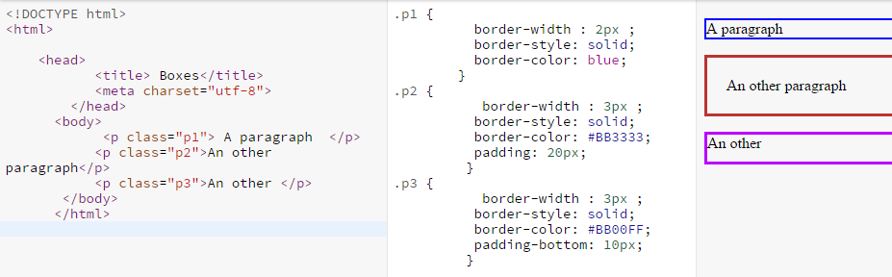
The inner margins
Result

Slide 80
The outer margins
★
To define the size of the outer margins, space
outside the borders of an element we will use the margin property.
Unlike the padding property, the margin property can
be used to position elements in a page or relative to each other.
We usually assign values in px or % in this property.
We can add different margins on each side of our elements with the margin-right properties, margin-bottom, margin-left and margin-top.

Slide 81
The outer margins
<!DOCTYPE html>
<html>
<head>
<title> Boxes</title>
<meta charset="utf-8">
</head>
<body>
<p class=“p1”> A paragraph </p>
<p class=“p2”>An other paragraph</p>
<p class=“p3”>An other </p>
</body>
</html>
.p1 { border-width : 2px ;
border-style: solid;
border-color: blue;}
.p2 { border-width : 3px ;
border-style: solid;
border-color: #BB3333;
padding: 20px;
margin-bottom:100px;
}
.p3 {
border-width : 3px ;
border-style: solid;
border-color: #BB3333;
padding-bottom: 10px;
margin:10px;
}

Slide 82
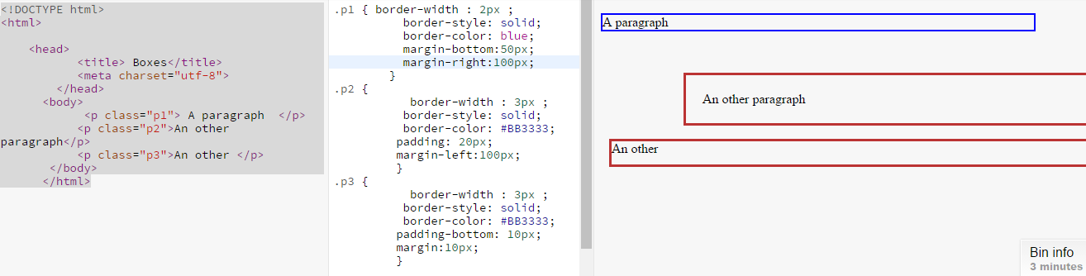
The outer margins
Result

Slide 83
Shadows boxes
★
We can create shadows around the boxes, just as we did for our texts before using the box-shadow property.
The latter works like text-shadow, with two mandatory values and recommended four to walk:
• 1st value: horizontal displacement of the shadow;
• 2nd value: vertical displacement of the shadow;
• 3rd value: propagation radius (Gaussian Blur) of the shadows;
• 4th value: shadow color (accepts the same values as the 'color' property).

Slide 84
Shadows boxes
.p1 { border-width : 2px ;
border-style: solid;
border-color: blue;}
.p2 { border-width : 3px ;
border-style: solid;
border-color: #BB3333;
padding: 20px;
margin-bottom:100px;
box-shadow:2px 2px 3px blue;
}
.p3 { border-width : 3px ;
border-style: solid;
border-color: #BB3333;
padding-bottom: 10px;
margin:10px;
box-shadow:4px 4px 3px red;
}
<!DOCTYPE html>
<html>
<head>
<title> Boxes</title>
<meta charset="utf-8">
</head>
<body>
<p class=“p1”> A paragraph </p>
<p class=“p2”>An other paragraph</p>
<p class=“p3”>An other </p>
</body>
</html>

Slide 85
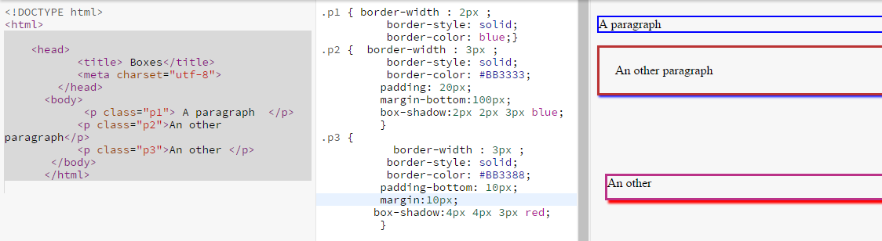
Shadows boxes
Result

Slide 86
Management background?
★
Add color or image for the background
To add a background color, we will use the background-color property.
This property accepts the same values as the color property we have seen, namely color, name type values, hexadecimal or RGB.

Slide 87
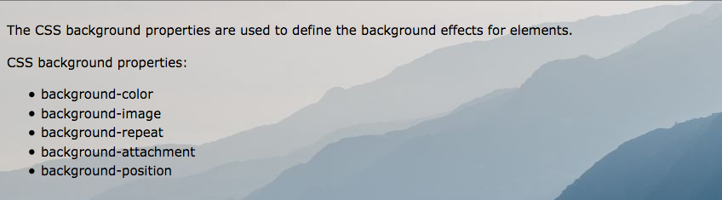
Background Elements
★

Slide 88
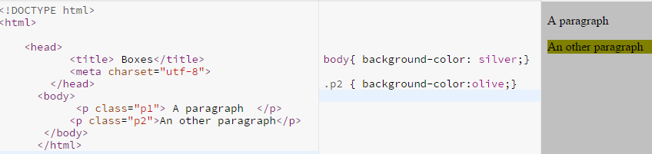
Management background?
<!DOCTYPE html>
<html>
<head>
<title> Boxes</title>
<meta charset="utf-8">
</head>
<body>
<p class=“p1”> A paragraph </p>
<p class=“p2”>An other paragraph</p>
</body>
</html>
body{ background-color: silver;}
.p2 { background-color:olive;}
Result

Slide 89
Management background?
One can also add a background image with background-image property.
It gives him value the URL of the image, in this case, takes the form of a relative path as we had seen for links.

Slide 90
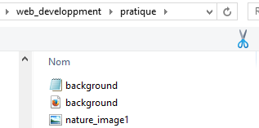
Management background?
★
<!DOCTYPE html>
<html>
<head>
<title> Background</title>
<meta charset="utf-8">
<link rel=“stylesheet” href=“background.css”/>
</head>
<body>
<p class=“p1”> A paragraph </p>
</body>
</html>
background.css
Body{
background-image:url(“nature_image1.jpg”);
}

Slide 91
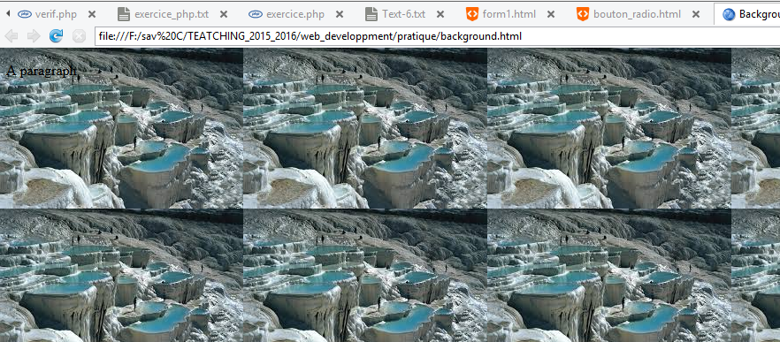
Management background?
By default, the image is repeated horizontally and vertically to fill the entire space of our web page since we have inserted in our body element.
If your original image occupies more space than the element in which you insert it, it will not be repeated but instead clipped.
Result

Slide 92
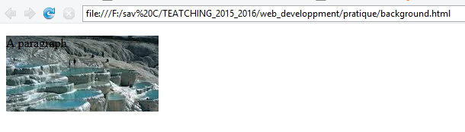
Management background?
This is what happens in the following example where we have inserted our background image of our p element to which we have given the dimensions of 200px * 100px:
P{
height:100px;
width:200px;
background-image:url("nature_image1.jpg");
}
↵
Result

Slide 93
Position and background repeat
★
The background-repeat property allows us to manage the repeat of our background.
This property accepts four values:
• Repeat: the background is repeated horizontally and vertically,
this is the default behavior;
• Repeat-x: the background repeated horizontally;
• Repeat-y: the background repeats only vertically;
• No-repeat: the background is not repeated.

Slide 94
Position and background repeat
★
↵
Result

Slide 95
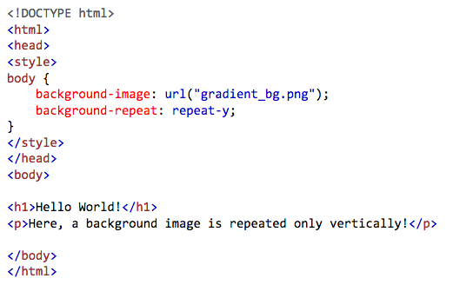
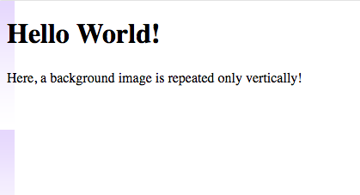
Position and background repeat
★
↵
Result

Slide 96
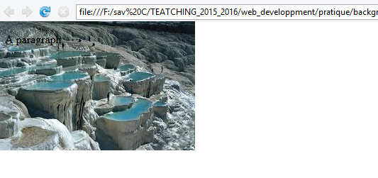
Management background?
★
body{
background-image:url("nature_image1.jpg");
background-repeat:no-repeat;
}
↵

Slide 97
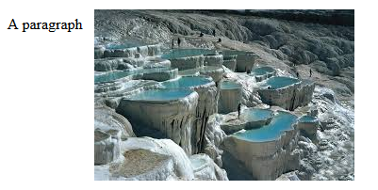
Management background?
To control the position of our background image, we use the background-position property.
This property requires two values to work: a horizontal coordinate and a vertical coordinate.
The background will be offset from the top edge to the left of its parent element.
body{
background-image:url("nature_image1.jpg");
background-repeat:no-repeat;
background-position: 100px 10px;
}
In this example, I shifted my 100px image to the right and 10px down from the top left corner of the body element, its parent. Remember that the body element occupies the hole of the page.

Slide 98
Insert multiple background images
It is possible, thanks to CSS3, to insert multiple background images.
we will take two new images that will be placed in a subfolder and a parent folder for a change and see all the cases.
In practice, if your site is well built and not too complicated, you should have all your images in a folder named "images"

Slide 99

Insert multiple background images
body{
background:
url("nature_image1.jpg") fixed no-repeat 300px 0,
url(“../image_nature2.jpg") fixed no-repeat top left,
url(“parent/image_nature3.jpg") fixed no-repeat top right;
}
⬇

Slide 100
HTML Media <Audio> <video>

Slide 101
HTML Media: Audio
★
The HTML5 <audio> element specifies a standard way to embed audio in a web page.
There are different audio formats (mp3, ogg, wav, …)
But there is no format supported by all browsers.
This means it will take several formats indicate when it will insert audio in HTML.

Slide 102
HTML Media: Audio
★
The audio element: is used to add audio to a web page.
The src attribute: will ask an audio component to function.
This attribute value take the audio URL.
If you do not write it, you will not see anything on the screen.
By default, the audio element is not displayed on web pages.
So we have to use other attributes.
The controls attribute: will be used to display the control buttons such as play, pause and volume among others.
This attribute is of course mandatory.

Slide 103


HTML Media: Audio
★
↵

Slide 104
HTML Media: Video
★
Before HTML5, a video could only be played in a browser with a plug-in (like flash).
The HTML5 <video> element specifies a standard way to embed a video in a web page.
To create and view a video, it is mandatory to us three things:
an audio codec (mp3, ogg, etc.),
a video codec (H.264, OGG thoera, WEBM)
and a Container format in which it will store these two elements (usually avi, mp4 or mkv).
Again, there is no format supported by all browsers, so it is recommended to use several to be sure that the video is displayed correctly.

Slide 105
HTML Media: Video
To add a video, the video element is used.
The attributes taken by this element are exactly the same as those taken by the audio element, namely: src, autoplay, controls, loop, preload and width.
Unlike audio, a video will be displayed by default on a web page.
It is also possible to add an attribute to post your video.
The poster attribute can download and display an image that will be displayed before the launch of the video.

Slide 106


HTML Media: Video
★
↵

Slide 107
HTML Media: Video (How it works?)
★
The controls attribute adds video controls, like play, pause, and volume.
It is a good idea to always include width and height attributes. If height and width are not set, the page might flicker while the video loads.
The <source> element allows you to specify alternative video files which the browser may choose from. The browser will use the first recognized format.
The text between the <video> and </video> tags will only be displayed in browsers that do not support the <video> element.

Slide 108


HTML Media: Video attribute
★
HTML <video> Autoplay: To start a video automatically use the autoplay attribute:
↵

Slide 109

HTML Media: Video – Browser Support

Slide 110

HTML Media: Video – Media type

Slide 111

HTML Media: Video
<!DOCTYPE html>
<html>
<head>
<title> Insert image</title>
<meta charset="utf-8">
</head>
<body>
<video controls=“controls” preload=“auto” poster=“pixar.jpg” , width=“380px”>
<source src=“https://ia902708.us.archive.org/7/items/Tom_and_Jerry_Sing__in_1932_Cartoon/MagicMummyTomJerry_512kb.mp4” />
</body>
</html>
Notes:
Une autre alternative, beaucoup plus simple, pour ajouter de la vidéo
ou de l’audio sur son site est de stocker ces contenus sur des sites
comme YouTube, Dailymotion ou Vimeo puis de les intégrer à votre
site grâce au code d’intégration fourni.
De cette manière, vous n’aurez plus aucun problème d’affichage
quelque soit le navigateur de vos visiteurs puisque la transcription
dans différents formats est effectuée par les sites hébergeurs (et autant
vous dire que c’est très complet !).

Slide 112
HTML Media: Video – Methods, Properties, and Events
HTML5 defines DOM methods, properties, and events for the <video> element.
This allows you to load, play, and pause videos, as well as setting duration and volume.
There are also DOM events that can notify you when a video begins to play, is paused, etc.
Read more : https://www.w3schools.com/tags/ref_av_dom.asp

Slide 113
<html>
<body>
<div style="text-align:center">
<button onclick="playPause()">Play/Pause</button>
<button onclick="makeBig()">Big</button>
<button onclick="makeSmall()">Small</button>
<button onclick="makeNormal()">Normal</button>
<br><br>
<video id="video1" width="420">
<source src="mov_bbb.mp4" type="video/mp4">
<source src="mov_bbb.ogg" type="video/ogg">
Your browser does not support HTML5 video.
</video>
</div>
<script>
var myVideo = document.getElementById("video1");
function playPause() {
if (myVideo.paused)
myVideo.play();
else
myVideo.pause();
}
function makeBig() {
myVideo.width = 560;
}
function makeSmall() {
myVideo.width = 320; }
function makeNormal() {
myVideo.width = 420;
}
</script>
<p>Video courtesy of <a href="https://www.bigbuckbunny.org/" target="_blank">Big Buck Bunny</a>.</p>
</body>
</html>

Slide 114


Slide 115
References
https://www.w3schools.com/html/default.asp
Moalla , I. (2016). Web Development course.

Slide 116

Thank You

