Slide 1

Graduation projects management system
Students work :
1- Naif Al-Ghamdi 2- Faisal Al-Ghamdi
3- Hamad Al-Ayyaf
4- Muhammad Al-Subhi 5- Ahmed Al-Ghamdi
Supervisor :
Dr. Fahad Al-Ghamdi
Years: 1441 – 1442
Notes:
احمد

Slide 2
Introduction
Notes:
احمد

Slide 3
Outline:
Project Idea
Problem area
Objectives
Requirements specifications
System analysis
Use Case Diagram
Database Design
Prototype
Framework
Live Demo
Gantt chart
Notes:
احمد

Slide 4
Gantt chart | Live demo | framework | Prototype | Database Design | Use Case Diagram | System analysis | Requirements specifications | Objectives | Problem area | Project Idea
Project Idea
The idea of the project is to develop a system for managing the gradation projects in the Faculty of Computer Science and Information Technology at AlBaha University.
The system aims to ease the process of assigning the graduation projects to the professors.
Also, The project will ease the process of forming student groups based on certain criteria, e.g., the area of interest of either the professor or the students.
Moreover, the system will be used as an electronic repository. This repository will include all the projects and the ideas that have been introduced by the students of the faculty in the previous years.
Notes:
محمد

Slide 5
Gantt chart | Live demo | framework | Prototype | Database Design | Use Case Diagram | System analysis | Requirements specifications | Objectives | Problem area | Project Idea
Problem area
All the graduation project related paper works and tasks in the departments of the Faculty of Computer Science and Information Technology are done manually by the graduation projects chair committee, supervisors, examiner professors, and students. Some Examples for these papers and tasks are the following:
Assigning supervisor professors to student groups.
Grouping students to create student teams.
Showing the project ideas proposed by the professors to all students.
Submitting the evaluation forms by the examiner professors.
Our system will solve all these issues by automating all these tasks, and hence the process of managing the graduation projects work.
Notes:
محمد

Slide 6

Gantt chart | Live demo | framework | Prototype | Database Design | Use Case Diagram | System analysis | Requirements specifications | Objectives | Problem area | Project Idea
Objectives
Facilitate the process of forming the graduation projects groups between professors and students.
Facilitate the process of managing the graduation projects for the
graduation project committee chair.
Create an electronic archive that includes all graduation projects.
Enable the examiner professors to evaluate the groups using electronic evaluations forms, and hence ease the process of the students’ evaluation.
Notes:
محمد

Slide 7

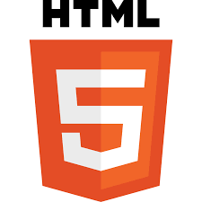




Gantt chart | Live demo | framework | Prototype | Database Design | Use Case Diagram | System analysis | Requirements specifications | Objectives | Problem area | Project Idea
Requirements specifications (software & hardware)
The software:
MySQL, Django, HTML, CSS , Bootstrap , Git , GitHub
The hardware:
Personal computer
Notes:
محمد

Slide 8

Gantt chart | Live demo | framework | Prototype | Database Design | Use Case Diagram | System analysis | Requirements specifications | Objectives | Problem area | Project Idea
System analysis
Use Case Diagram
State Transition Diagram
Entity-Relationship Diagram
Sequence Diagram
Data flow Diagram
Class Diagram
Notes:
فيصل

Slide 9
Gantt chart | Live demo | framework | Prototype | Database Design | Use Case Diagram | System analysis | Requirements specifications | Objectives | Problem area | Project Idea
Use Case Diagram
Notes:
فيصل

Slide 10
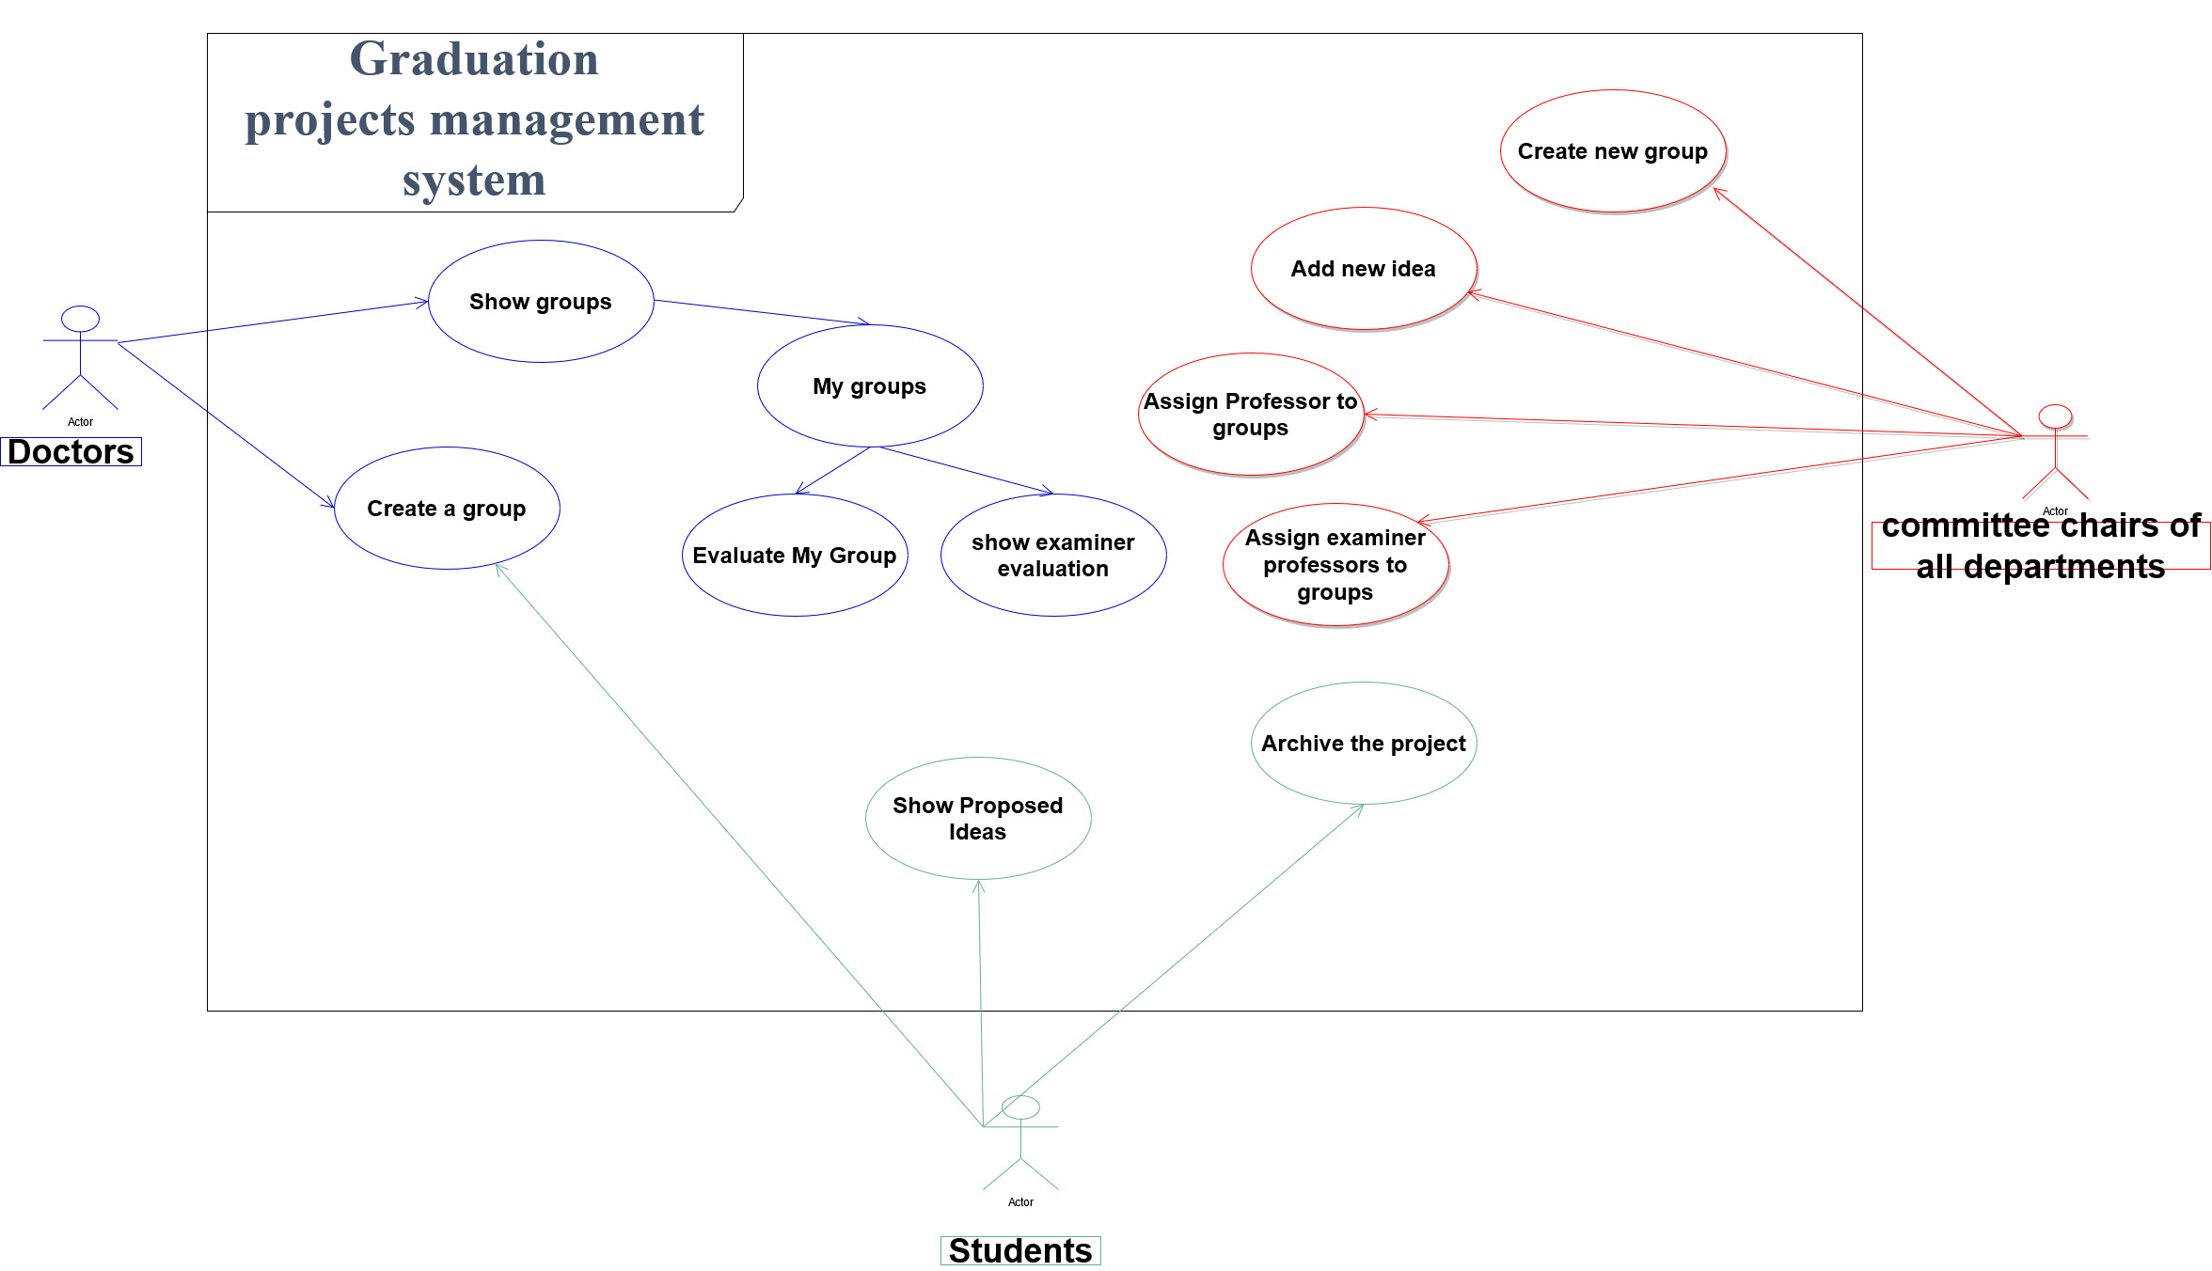
Gantt chart | Live demo | framework | Prototype | Database Design | Use Case Diagram | System analysis | Requirements specifications | Objectives | Problem area | Project Idea
Notes:
فيصل

Slide 11
Gantt chart | Live demo | framework | Prototype | Database Design | Use Case Diagram | System analysis | Requirements specifications | Objectives | Problem area | Project Idea
Database Design
Notes:
فيصل

Slide 12
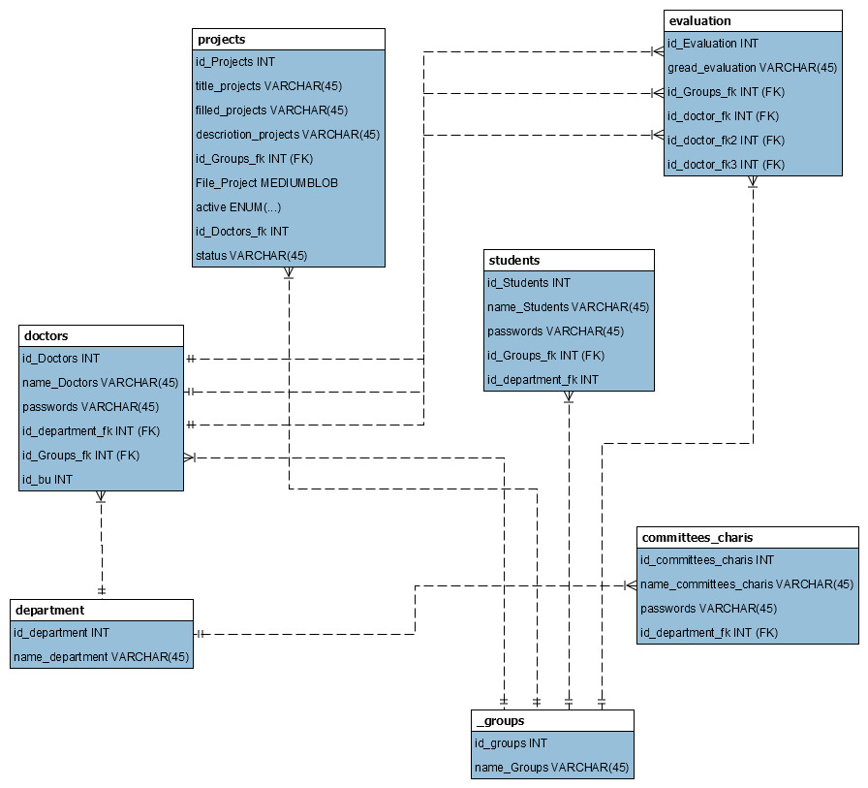
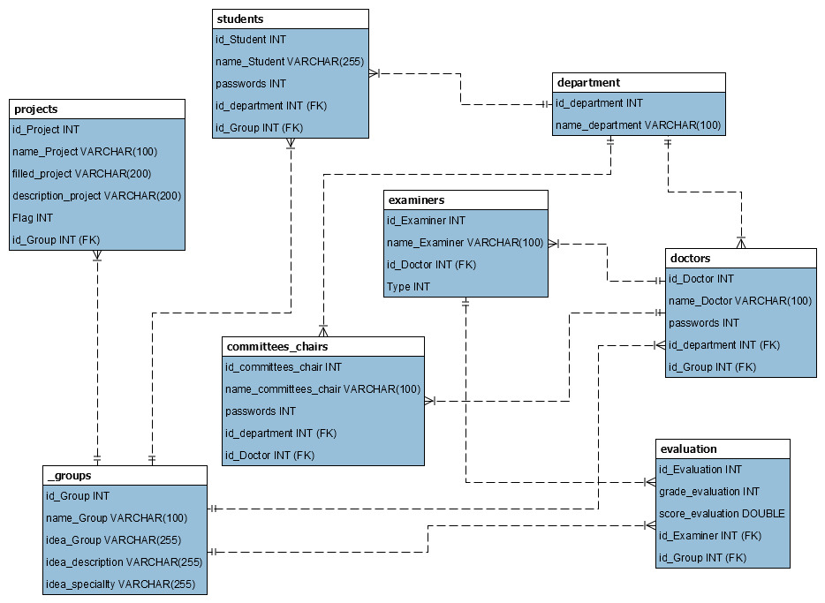
Gantt chart | Live demo | framework | Prototype | Database Design | Use Case Diagram | System analysis | Requirements specifications | Objectives | Problem area | Project Idea
Notes:
فيصل

Slide 13
Gantt chart | Live demo | framework | Prototype | Database Design | Use Case Diagram | System analysis | Requirements specifications | Objectives | Problem area | Project Idea
Prototype
Notes:
فيصل

Slide 14
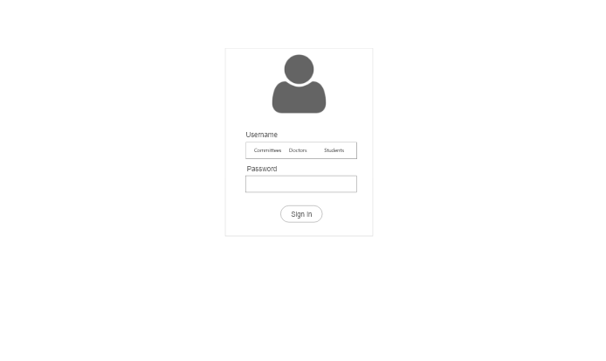
Gantt chart | Live demo | framework | Prototype | Database Design | Use Case Diagram | System analysis | Requirements specifications | Objectives | Problem area | Project Idea
sign in
Notes:
فيصل

Slide 15
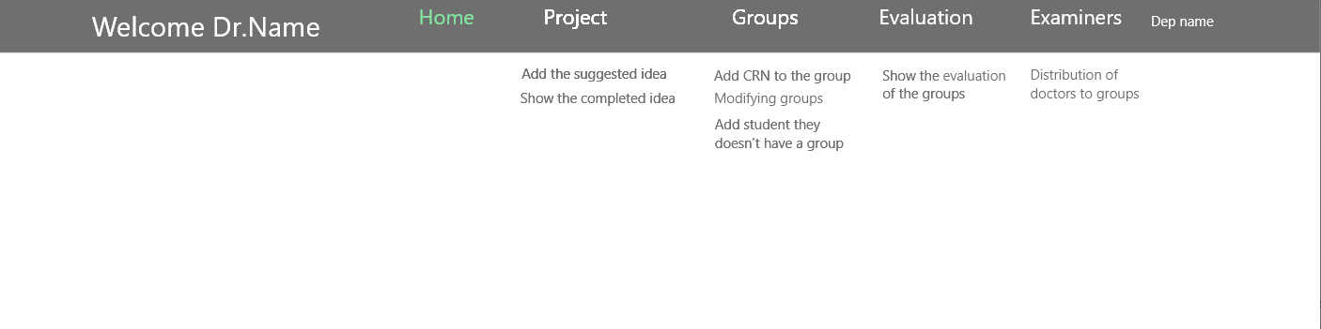
Gantt chart | Live demo | framework | Prototype | Database Design | Use Case Diagram | System analysis | Requirements specifications | Objectives | Problem area | Project Idea
Committee Chair
Notes:
فيصل

Slide 16
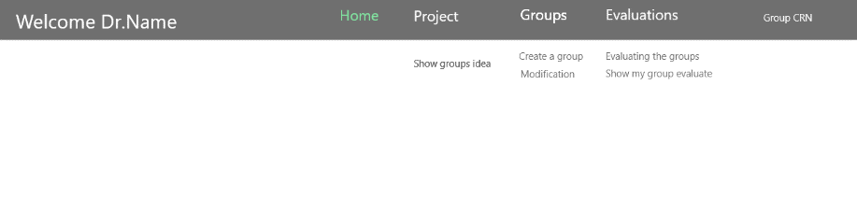
Gantt chart | Live demo | framework | Prototype | Database Design | Use Case Diagram | System analysis | Requirements specifications | Objectives | Problem area | Project Idea
Doctors
Notes:
فيصل

Slide 17
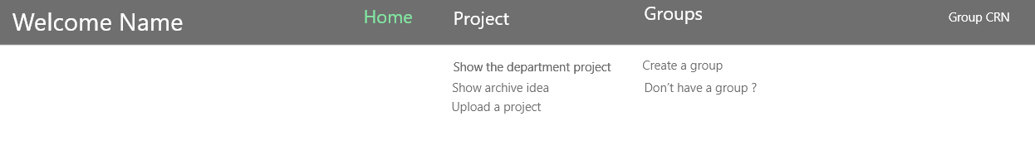
Gantt chart | Live demo | framework | Prototype | Database Design | Use Case Diagram | System analysis | Requirements specifications | Objectives | Problem area | Project Idea
Students
Notes:
فيصل

Slide 18
Gantt chart | Live demo | framework | Prototype | Database Design | Use Case Diagram | System analysis | Requirements specifications | Objectives | Problem area | Project Idea
Github Repository Protype
Notes:
فيصل

Slide 19
Gantt chart | Live demo | framework | Prototype | Database Design | Use Case Diagram | System analysis | Requirements specifications | Objectives | Problem area | Project Idea
What is Framework
A Framework is a platform used as a foundation for developing application software frameworks are versatile, robust, and efficient.
Notes:
نايف

Slide 20
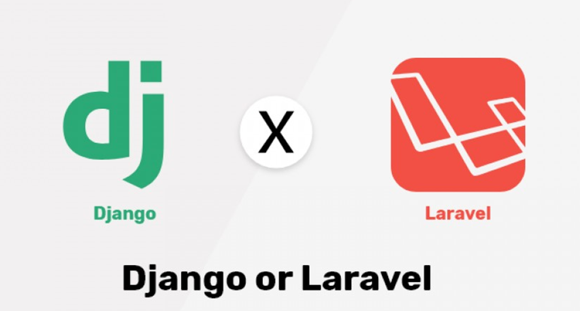
Notes:
نايف

Slide 21
Gantt chart | Live demo | framework | Prototype | Database Design | Use Case Diagram | System analysis | Requirements specifications | Objectives | Problem area | Project Idea
Django is a model view template framework built with python. It’s a free and open-source framework that encourages rapid development and helps developers write efficient cleaner code. used by some of the enterprises in . Pinterest, Udemy, NASA, and Instagram.
Laravel is model-view-controller framework built with PHP which is one of the most famous languages of the web. It’s also a powerful framework used by 9GAG, UNION, Toyota Hall of fame.
Notes:
نايف

Slide 22
Gantt chart | Live demo | framework | Prototype | Database Design | Use Case Diagram | System analysis | Requirements specifications | Objectives | Problem area | Project Idea
Django vs Laravel
Laravel | Django | Technology
A Framework built with PHP | A framework built with python | Technology type
Implements basic security features | Highly secure for enterprise level applications | Security
34,292 | 43,384 | GitHub Stars
Steep learning curve | Fairly easy to pick up | Learning Curve
Relatively slow | Quite fast | Performance
121,173 | 205,106 | Number of websites
Notes:
نايف

Slide 23
Gantt chart | Live demo | framework | Prototype | Database Design | Use Case Diagram | System analysis | Requirements specifications | Objectives | Problem area | Project Idea
Why Django Framework
Notes:
حمد

Slide 24
Gantt chart | Live demo | framework | Prototype | Database Design | Use Case Diagram | System analysis | Requirements specifications | Objectives | Problem area | Project Idea
Easy to Use
It’s fast and simple‏
Excellent Documentation for real-world application‏
It’s secure‏
It suits any web application project‏
Notes:
حمد

Slide 25
Gantt chart | Live demo | framework | Prototype | Database Design | Use Case Diagram | System analysis | Requirements specifications | Objectives | Problem area | Project Idea
Django Framework Difficulties Solutions
Notes:
حمد

Slide 26
Gantt chart | Live demo | framework | Prototype | Database Design | Use Case Diagram | System analysis | Requirements specifications | Objectives | Problem area | Project Idea
Modifying user data through the form
calling library that is responsible for manipulating the input data > from Django import forms
Establishing the connection between database and framework
we switch to use MySQL database after facing some difficulties with establishing the connection between SQLite and Django framework
Notes:
حمد

Slide 27
Gantt chart | Live demo | framework | Prototype | Database Design | Use Case Diagram | System analysis | Requirements specifications | Objectives | Problem area | Project Idea
sending / retrieving data from database
Applying some properties on some of the columns in our database to resolve the problem of retrieving and sending the data to/from the database. For example, applying the auto-increment properties with primary keys.
Notes:
حمد

Slide 28
Gantt chart | Live demo | framework | Prototype | Database Design | Use Case Diagram | System analysis | Requirements specifications | Objectives | Problem area | Project Idea
Live Demo
Notes:
حمد

Slide 29
Gantt chart | Live demo | framework | Prototype | Database Design | Use Case Diagram | System analysis | Requirements specifications | Objectives | Problem area | Project Idea
Gantt chart
Notes:
حمد

Slide 30

Gantt chart | Live demo | framework | Prototype | Database Design | Use Case Diagram | System analysis | Requirements specifications | Objectives | Problem area | Project Idea
A refined and modified form of the report up to system development level
Jan 1
Jan 11
2021
Creating flowcharts for software development
2021
Jan 12
Jan 24
Complete details of the developed prototype
Jan 25
Feb 10
Implementing the prototype
Feb 11
Feb 24
Testing the developed prototype
Feb 25
Today
Mar 6
Writing the Report
Mar 7
Mar 15
A finalized report following the Faculty
Mar 16
Mar 24
7 days
Demo (video)
Mar 25
Apr 1
A finalized presentation presenting the whole work done
Apr2
Apr 9
10 days
poster
Apr 18
Apr10
publicizing the project.
Apr 25
Apr19
13 days
CD
22 days
Apr26
Apr 29
10 days
14 days
Notes:
حمد

Slide 31

Gantt chart | Live demo | framework | Prototype | Database Design | Use Case Diagram | System analysis | Requirements specifications | Objectives | Problem area | Project Idea
Thank you

