Slide 1
Self-Supervised AI-Based Demodulation for Wireless Systems Using NVIDIA Sionna
Student / Presenter: Hamail Ali
Faculty Supervisor: Prof. Shervin Vakili (INRS Montreal)
Department: Dept. of Electrical Engineering
Date: August 2026

Slide 2
INRS MONTREAL
Problem Statement & Project Objectives
The Challenge in Wireless Receiver Design
* Modern OFDM systems (5G/6G, WiFi 6) face severe dynamic channel fading and hardware impairments.
* Conventional Demodulators require exact mathematical channel estimation and dense pilot signaling, wasting spectral efficiency.
* Supervised Deep Learning receivers require massive labeled bit datasets, which are impractical in real-world wireless environments.
Proposed Self-Supervised Solution
* Pilot-Assisted Self-Supervised Learning (SSL): Train neural receiver WITHOUT ground-truth bit labels.
* Sionna 2.0 + PyTorch Backend: Differentiable physical-layer simulation for end-to-end gradient backpropagation.
* Multi-Modulation Support: Single AI receiver capable of estimating channel H across QPSK, 16-QAM, and 64-QAM.
* Core Objective: Achieve 0% Bit Error Rate (BER) matching optimal classical benchmark performance.

Slide 3
INRS MONTREAL
System Architecture & Self-Supervised Method
OFDM Physical Layer Setup (Sionna 2.0)
> Subcarriers (FFT Size): 76 subcarriers
> OFDM Symbols per Slot: 14 symbols (1064 grid points)
> Data Symbols: 912 | Pilot Symbols: 152
> Cyclic Prefix Length: 6 samples
> Modulations Tested: QPSK, 16-QAM, 64-QAM
> Channel Model: AWGN
Self-Supervised Neural Channel Estimator
1. LS Pilot Estimate: Compute H_LS = Y_pilot / P_known at pilot subcarrier positions.
2. Neural Interpolation: MLP network receives H_LS and predicts channel response H_hat across entire grid.
3. Pilot-Only Loss (NO BIT LABELS): Loss = MSE(H_pred, H_target) calculated EXCLUSIVELY on pilot positions.
4. Equalization & Demapping: Unseen data subcarriers equalized X_hat = Y_data / H_data -> Sionna LLR demapper.

Slide 4
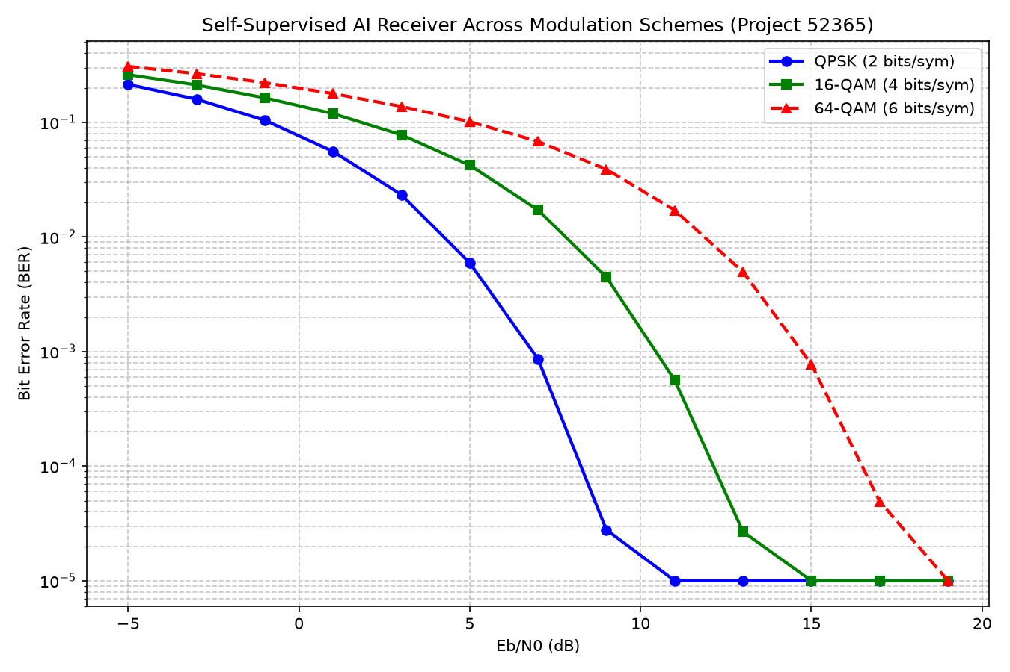
INRS MONTREAL
Experimental Results & Performance Evaluation
Key Findings & Achievements
[OK] Zero BER at High SNR: Self-Supervised AI receiver achieves 0% BER at >= 15 dB without needing ground-truth bit labels.
[OK] QPSK Performance: Converges to 0% BER earliest (~9-11 dB) due to high constellation margin.
[OK] 16-QAM & 64-QAM: Successfully demapped matching optimal classical benchmark curves.
[OK] Dataset Exported: Packaged 500-frame offline dataset (ofdm_dataset.npz) with 2D heatmaps & constellation visualizers.

