Slide 1
CPO Mobile Design
Draft – 3, OCT 06 for review

Slide 2

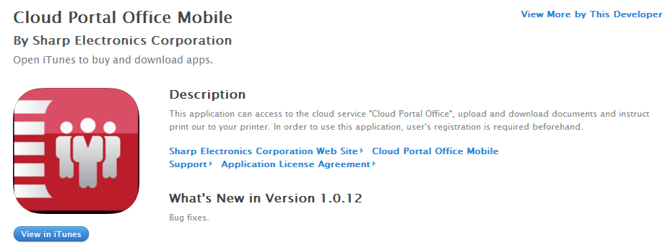
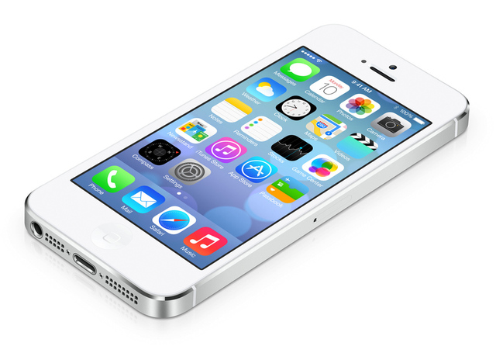
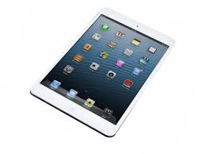
TARGET
Target GOAL
2015 April Timeframe Development Ending
Replace existing iOS App, iPhone and iPad with new UI design
Support existing functionality and more
Detail
Hybrid app on App-Store, supported iPhone and iPad by one App
Uses REST API for server side connection
Require Nuxeo Core 5.9 on service side. Uses SDK for REST API Nuxeo 5.9
iOS 8 full supporting, for legacy iOS supporting, iOS 6 and later supported.
Direct “Sharpdesk Mobile” application data exchanges for MFP print & scan.
Single TAP application data exchanges to pass (get from) Sharpdesk Mobile for MFP printing & scanning
Note
No Android and iPad design now.
REST API

Slide 3
GOAL for Development
Main GOAL
Complete pre-developed CPO-REST-iOS-SDK
Develop CPO iOS mobile user interface with pre-developed CPO-REST-iOS-SDK
Targeted Dec Release with full testing.
With Same level manpower until Dec/E
Detail
Complete pre-developed CPO-REST-iOS-SDK
Finish to develop postpone functionality or API, xxxx, xxxx
Develop CPO iOS mobile user interface with…
Develop complete CPO iOS mobile UI with SHARP proposal.
SHARP will provide 50 level UI & functional requirement with rough design.
UI is better to do as iPhone & iPad hybrid mode UI development.
Uses architecture for design based UI development not as code base UI development.
iOS 8 full supporting, for legacy iOS supporting, should be discussion
REST API

Slide 4
Supported Functionality & Views
Major views
category | name | information | Now
Login | Splash SCREEN | Show Splash SCREEN when startup | YES
 | EULA Screen | Show EULA when startup with first time | YES
 | Login Screen | Show Login screen when app does not have login account or auto-login = off on setting. | YES
Setting | Setting Screen | Account information, Cash Size, Download Setting | YES
Views | Top Folder List View Screen | Top Folder View after Login | YES
 | Notification List View Screen | Show notification result View | NO
 | Folder Browse History Screen | History View which includes browsed folder list | NO
 | Doc & Folder List View Screen | Generic Document & Folder view | YES
 | Local List View Screen | Local File View to show downloaded files. | YES
 | Document View Screen | View Downloaded Doc View | YES
 | Take camera for Update
category | name | information | Now
 | Search | Search Document | YES
Core function | Delete Folder | Delete selected folder | YES
 | Rename Folder | Rename selected folder | NO
 | Delete Document | Delete selected document | YES
 | Rename Document | Rename selected document | NO
 | Open & View | Open server document & view with using iOS quick-View | YES
 | Download & Open & View | Download and open for viewing with using iOS quick-View | YES
 | Download All with Selection | Download selected file or folder & contents | YES
External app relation | Send to external App | Send downloaded document to external application with iOS document share. | YES
 | Upload doc from external App | From external application | YES
 | Upload from picture folder | From picture folder | YES
Print | Print with Air Printing | Print with Air Printing, automatic download included | NO
 | Print with Sharpdesk Mobile | Print with Sharpdesk Mobile, automatically invoked Sharpdesk Mobile with downloaded document. | NO
New | Share Document | Share selected document to other CPO users. | NO
 | Send Link to other user | Send document or folder shared link to other non CPO users. | NO
Functions
Major views
category | name | information | Now
Badge | Notification badge | Show notification badge on icon to show notification | NO
NOTE: On Now column “YES” means it already provided by current CPO mobile. “NO” means it does not provided by current CPO mobile. All function should be implemented by new CPO mobile which was explained by this documentation.

Slide 5
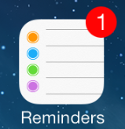
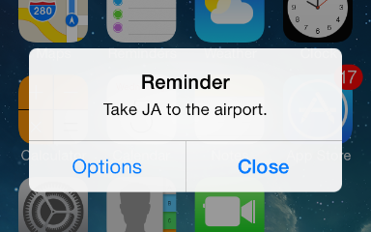
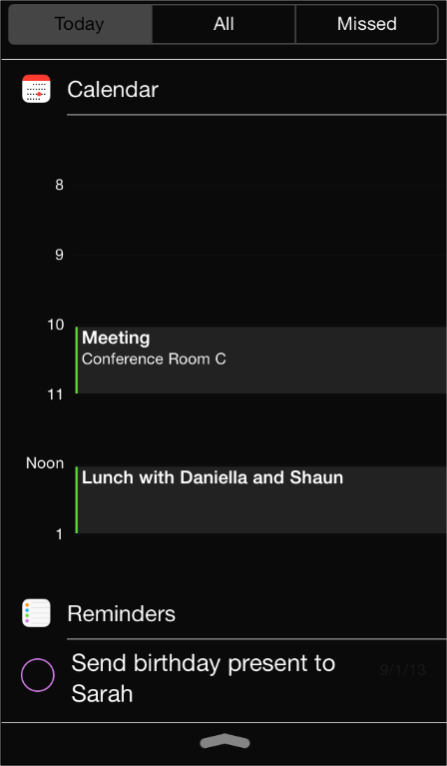
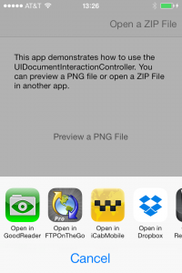
Basic iOS related basic Function
Supported Function
Notification
Show notification badge on ICON to show # of notification for document (or folder) update. Also shows notification information into iOS notification area (top area, depend by user setting). View will be transitioned to notification view when user TAP this area.
Only notification area & badge will be supported.
Application Exchanges
Supported external application data exchanged, like as “UIDocumentInteractionController”. CPO app can send (or receive) selected document to (from) other application with depending DOCUMENT-TYPE.
Valid Screen Rotation
Supported screen HOLIZONTAL / LANDSCAPE view also UPSIDE-DOWN view

Slide 6
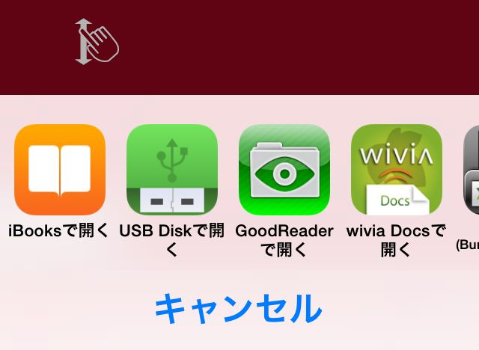
Screen Transition Overview
Setting
Screen
Modal Transition
By user setting, directly move to Doc & Folder view
Other Apps
Start
Same View Transition
Splash
Screen
Doc& Folder List View Screen
Doc& Folder List View Screen
Doc& Folder List View Screen
Application Exchanges
CPO -> Other App
Splash
Screen
Top Folder List View Screen
Local List View Screen
Document View Screen
Login
Screen
Application Exchanges
Other App -> CPO
Folder Browse History Screen
Camera
Notification List View Screen

Slide 7

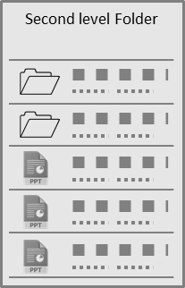


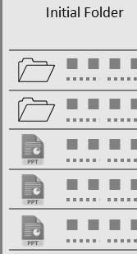

Doc & Folder List View Transition
Use same view type folder browsing transition. When tap folder area, transition to next folder view after progress.
To back previous folder list, user can flick left to right on left edge of screen to show last view. In this case, no folder list update from server, just shows last cash.
Initial Folder
Initial Folder
Initial Folder
Second level Folder
Updating…
Second level Folder
Second level Folder
Initial Folder
Updating Folder information w/ progress
Same view with new contents (Folder List)
Flick left to right on left edge of screen. Then shows last screen

Slide 8


UI Design Concept
Concept
Standard UI parts
Use standard iOS GUI widget as possible as we can.
Also follows standard behavior for basic operation,
Ex: Pull Down List View to update
Ex: Flick right to left on List View Item to show DELETE / or OTHER button.
Ex: Flick right to left on left edge of screen to show LAST SCREEN.
Second level Folder
Second level Folder
削除

Slide 9
Color Design Concept
Concept
Use PRODUCT color, RED.
Use flat style design schema.
Follow original Lipstick design as possible as they can.

Slide 10

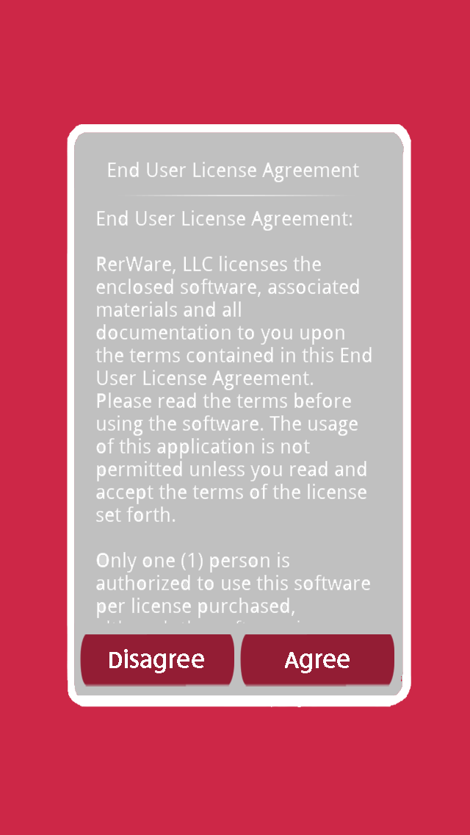
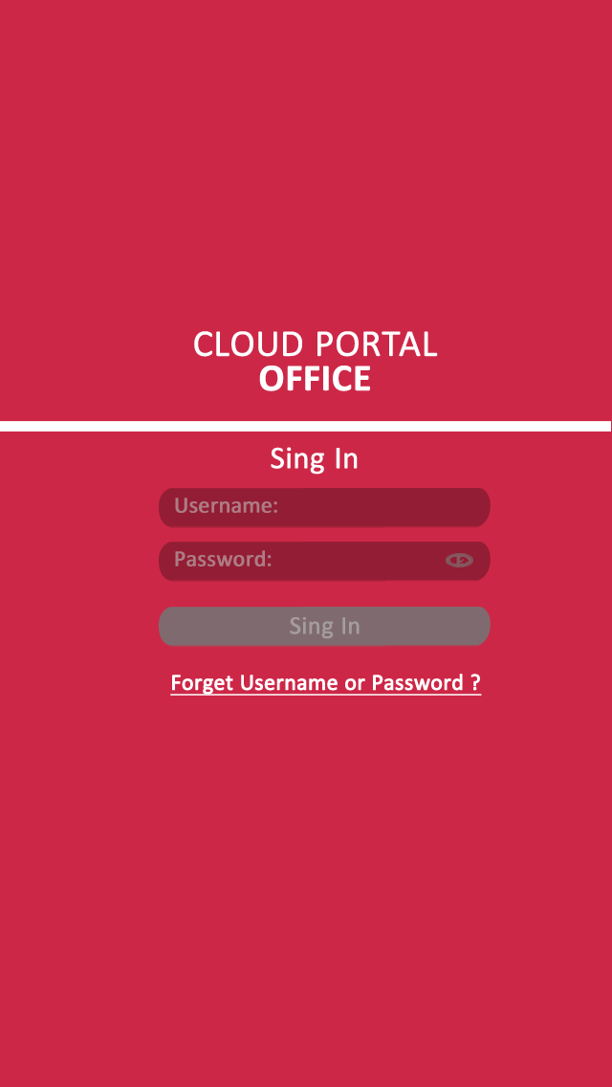
UI-Design: Start to Login
Start to Login
Use CPO concept color “RED: xx,xx,xx,xx”. This also will be used for main screen.
When initial stating up, show EURA screen to show “End User License Agreement”.
Login
Ask user “Username” and “Password” for sign-in to CPO service.
“Username” & “Password” field are automatically filled if user set them on “Account Information” on “Setting”.
“Sign in” button is grayed out until user “Username” & “Password” fields are filled.
Help account resetting functionality if user forgot account information. Address Web view with default browser. (TBD)
Start
Screen design is made as iPhone5, 4 inch

Slide 11
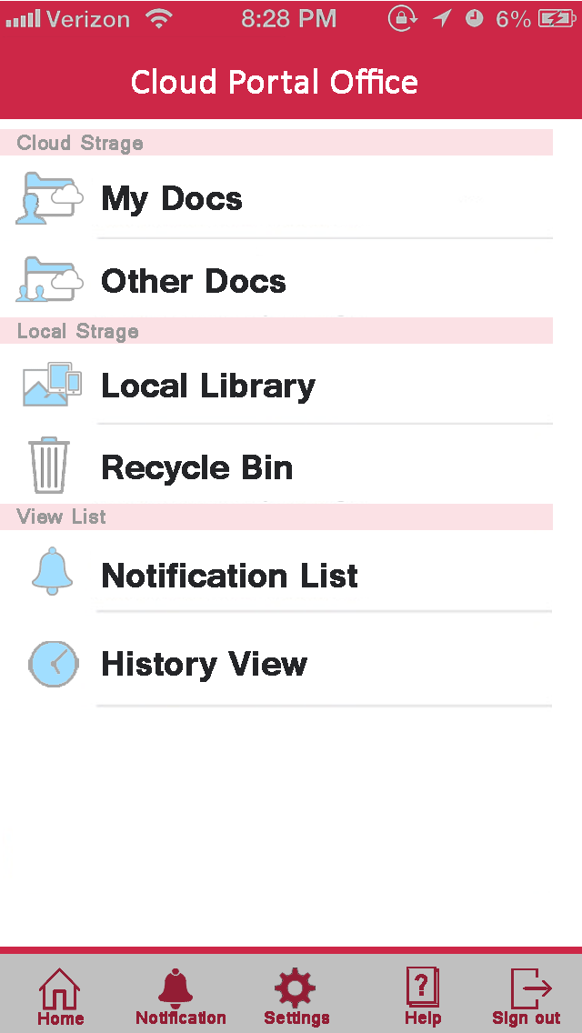
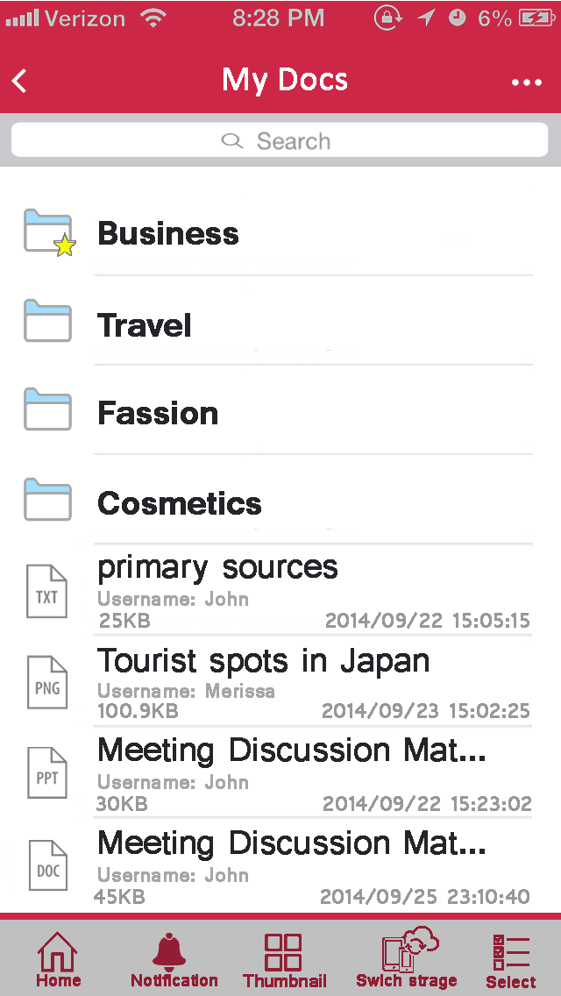
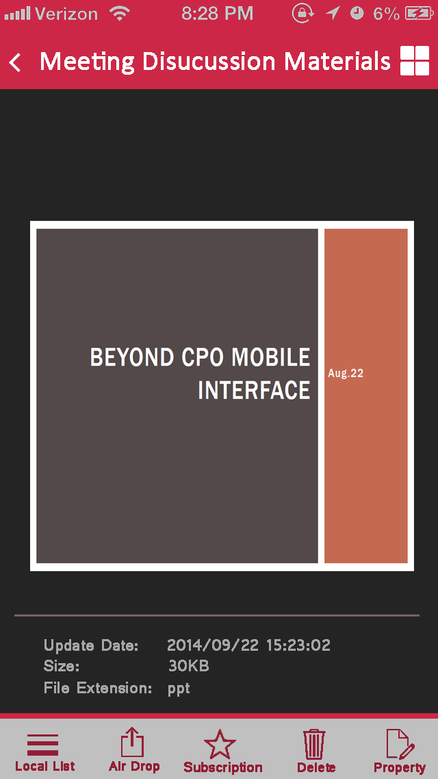
UI-Design: Top Folder, Doc & Folder List, Document View
Top Folder List View
This is root folder in CPO storage. User can navigate to “My Docs” or “Other Docs”. This screen can be skip by user setting.
Doc & Folder List View
Folder browsing & document browsing. User can address folder.
On Document List, shows “name” “size” “date” and “document owner”
When tap folder area, transition to next folder view after progress.
When tap document area, transition to “Document View Screen”
Document View
After downloaded shows document with iOS-Quick-View.
Main Screen
Screen design is made as iPhone5, 4 inch

Slide 12
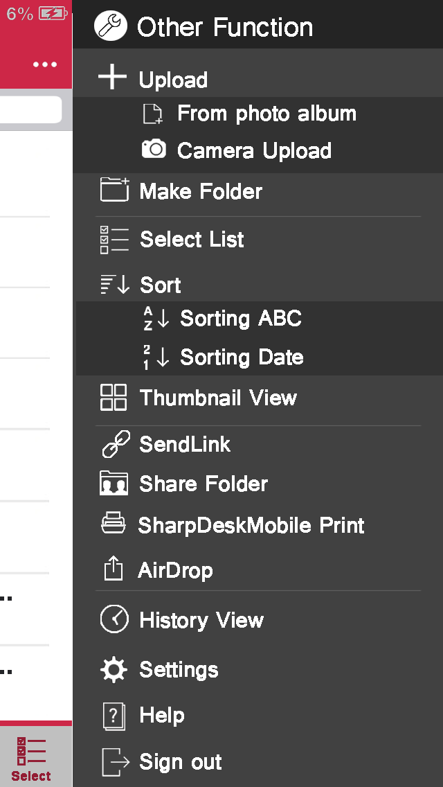
UI-Design: Doc & Folder List View
Doc & Folder List View
By tapping Top-LEFT icon, User can open “RIGHT-SIDE” menu tree after slide animation to operate several document managing functions.
Upload: Add document to Cloud Storage from “Photo Album” or “Camera”
Make Folder: Make Folder on Cloud
Select List: Show selectable view for multiple File action (DELETING…)
Sort: Change Sort order, By Name, By Date
Thumbnail View: Change view style as “thumbnail” / “icon list”
Send Link: Send document link to no-CPO users with addressed e-Mail
Share Folder: Manage Folder Permissions to share select folder
Sharpdesk Mobile Print: Send document to Sharpdesk Mobile for printing.
AirDrop: Send selected document to other application
History View: Jump History List view
Settings: Open Setting Screen as modal view
Help: Show Help
Sign out: Sign out from service and navigate to Login Screen.
Screen design is made as iPhone5, 4 inch

Slide 13
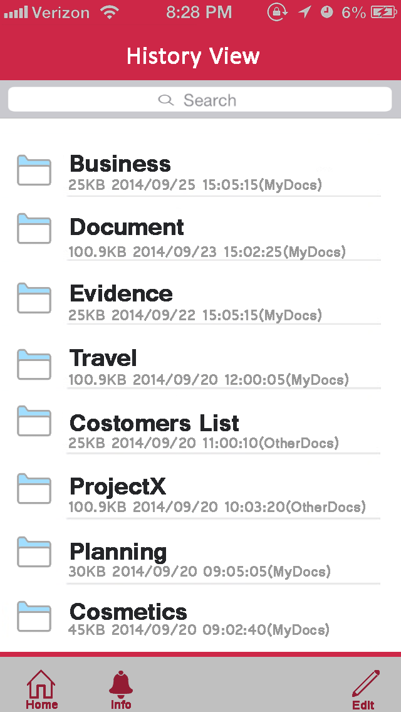
UI-Design: History View
History View
This views shows HISTORY LIST for browsed folder. Here is basic specs.
While user logged-on to service, HISTORY list is automatically updated for “HISTORY-VIEW” when user walkthrough folders. User visited folder is automatically added into “HISTORY-VIEW”.
It is only valid while user logged in to service. It is automatically cleared when user logged out.
NOTE for “HISTORY-VIEW”, same folder is automatically be filtered to avoid duplicated SAME “FOLDER” in “HISTORY-VIEW”. This means that, FOLDER is not archived into “HISTORY-VIEW” when user visited folder just as showing previous screen.
Screen design is made as iPhone5, 4 inch
Newer arrived folder
These folder is user visited folders, old visited folder is pushed down to end of list. This means that newer arrived FOLDER is showed top of LIST.
Older arrived folder

Slide 14
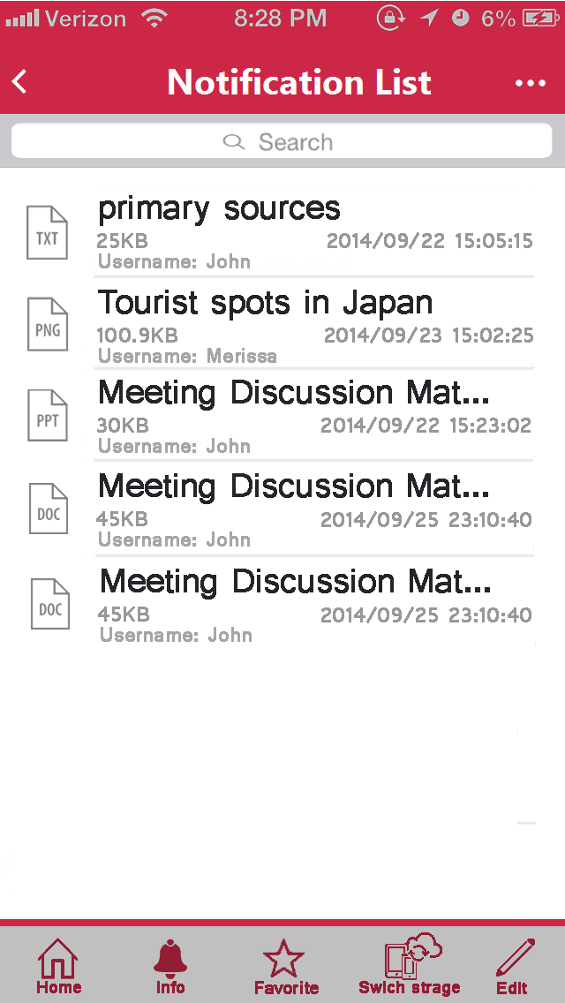
UI-Design: Notification List View
Notification View
This views shows Notification List View Here is basic specs.
At first user needs to set “SUBSCRIBE” folder for their favorites. And when contents document is updated (or added to subscribed folder), document automatically added into “Notification List View” as favorites list. User can easily watch documents updates.
Document on Notification List will be archived until user removes document link in this list. This is archived as server side notification list. So it should be kept, even if user logged out from service.
Screen design is made as iPhone5, 4 inch
Newer arrived docs
Older arrived docs
These document list is updated file. When user set folder as “Subscribe” and contents document is update (or added). Document is automatically added into “Notification List”.

Slide 15
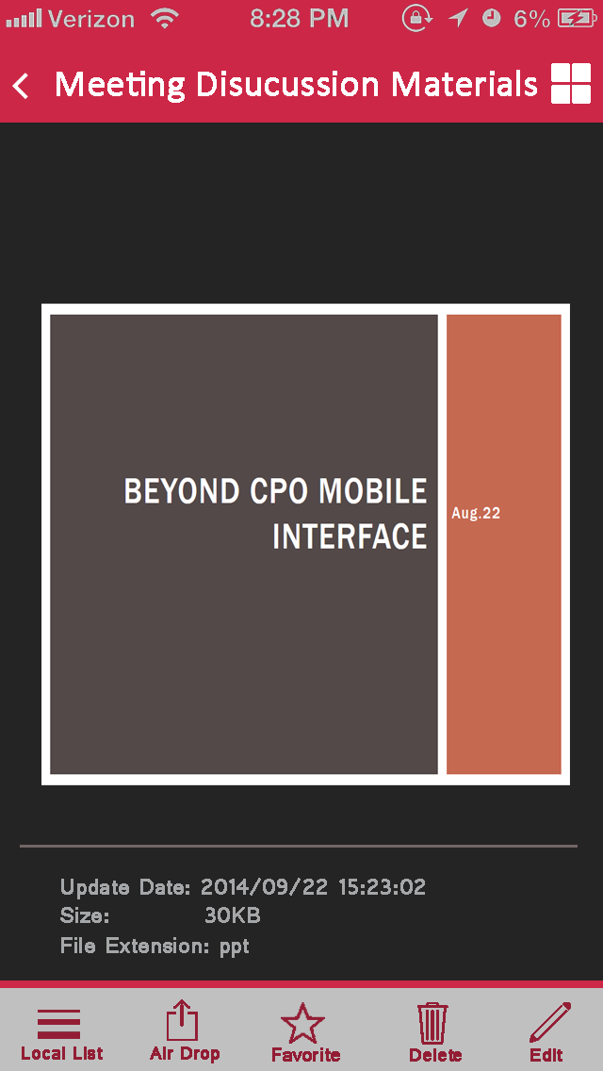
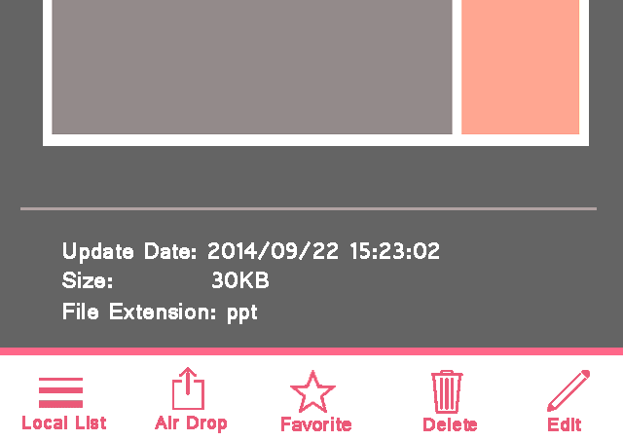
UI-Design: Document View
Document View
This views shows downloaded document by using iOS QUICK-VIEW.
When user TAP document on “Doc & Folder List View”, “Notification List View“ or “Local List View Screen”, view will transition to “Document View” after downloaded (if required). Actually after with progress message, view will be transitioned with animation (show from bottom) to show document contents.
There are two part of area in this view. One is document preview, other is document meta-data preview.
For “document preview area”, it uses as iOS QUICK-VIEW for document previewing. This means, it is almost same as preview document on iOS, thus, only supported document is shown. Type of PDF, almost every document is OK for preview. Type of OFFICE, it is same level of iOS preview.
Document View also has a capability to show as FULL-SCREEN. When user TAPs QUICK-VIEW area, view enlarge as FULL-SCREEN.
On this view, user can invoke “Application Exchanges” iOS functionality as follows.
Screen design is made as iPhone5, 4 inch
QUICK-VIEW area

Slide 16


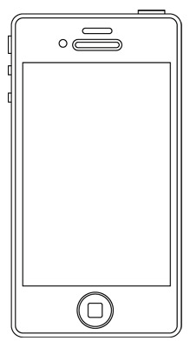


Send Link
Send Link
Send Link functionality is that allow CPO user to share document to NO-CPO users with expired date. When CPO user set document to share on CPO storage with expired DATE/TIME on his mobile. Mail will be sent from CPO service to selected NO-CPO user. Here is detail for explanation.
On mobile side, user selects documents on CPO storage to share.
Select or input deliver mail address for NO-CPO user to share selected document.
Set expired date for this shared link.
Then submit to share.
CPO service send shared link e-mail to addressed user.
NO CPO User received e-mail. And click shared link to access shared document.
NOTE: shared document automatically will be expired after expired date.
NOTE: multiple distribution also supported.
CPO
2. Create shared Link
1. Share Document
3. Send Mail W/ shared link
CPO User
NO CPO User

Slide 17
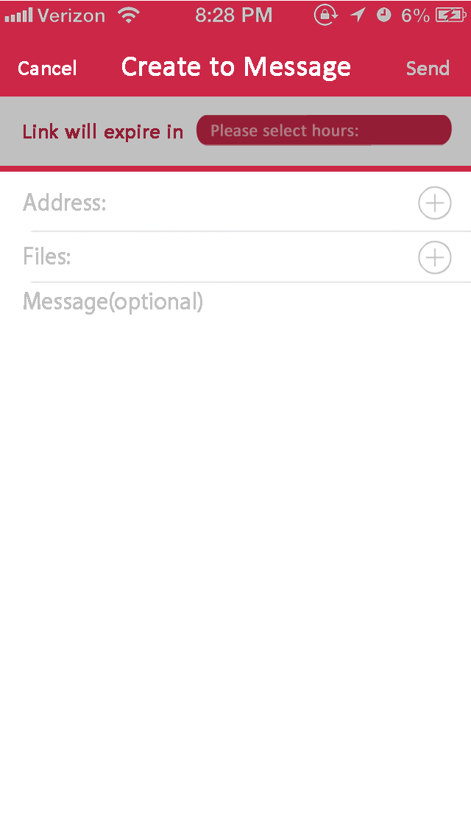
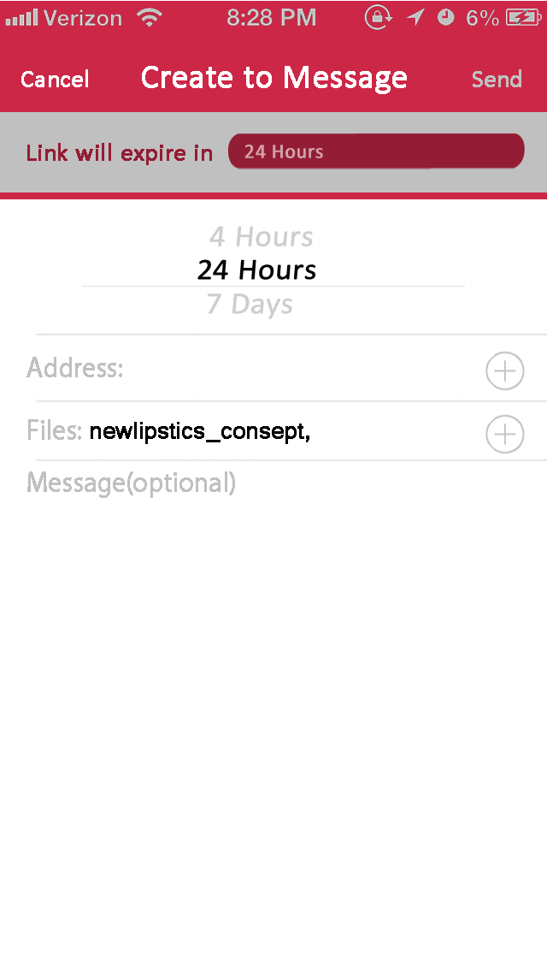
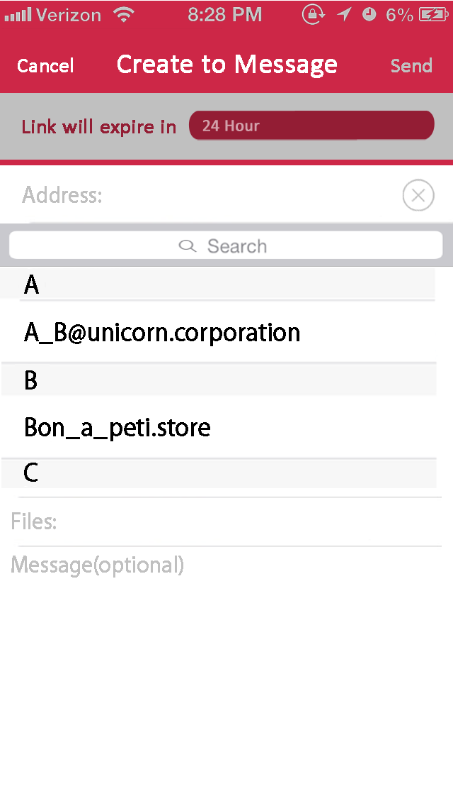
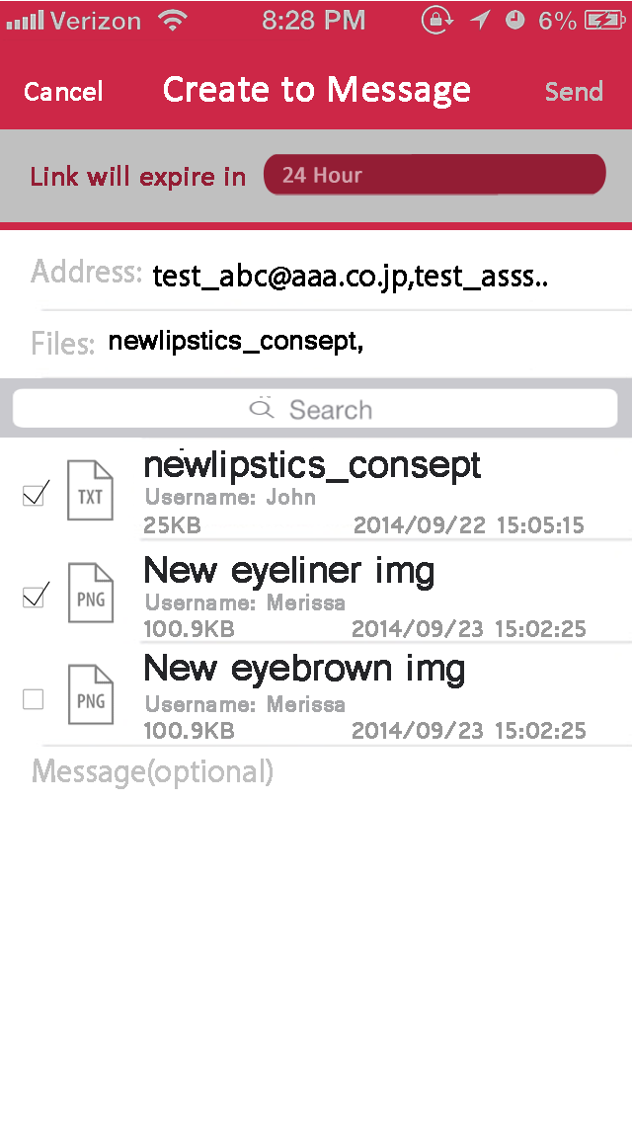

UI-Design: Send Link
Send Link
There are three steps for send link usability.
Set expired date
Add send e-mail address
Add document if required more.
Set expired date:
TAP expired addressed button, the drum control is showed after moved down below control area.
Add send e-mal address:
TAP add button address selection area is showed after moved down below control area. User can select e-mail from address list. Also can input directly.
Add document if required more:
Selected document file was automatically selected, but user can add more document if required. Document list is showed with same folder of initial selected document.

Slide 18
Manage share permission & Share Folder
Manage share permission & Share Folder
Share Folder is a function to share addressed folder to other CPO users. Any folder on CPO storage can share other CPO user. User can manage folder permission to share folder contents to other CPO users.
Manage folder permission to set shared level, VIEW/MODIFY/DELETE
Select CPO user for shared target.
Submit to server.
Then, shared folder will be showed under “Other Docs” on targeted users view.
NOTE: multiple distribution also supported.
CPO
2. Update folder permission
1. Manage Folder Permission
3. Shared folder is under “Other Docs”
CPO User
CPO User

Slide 19
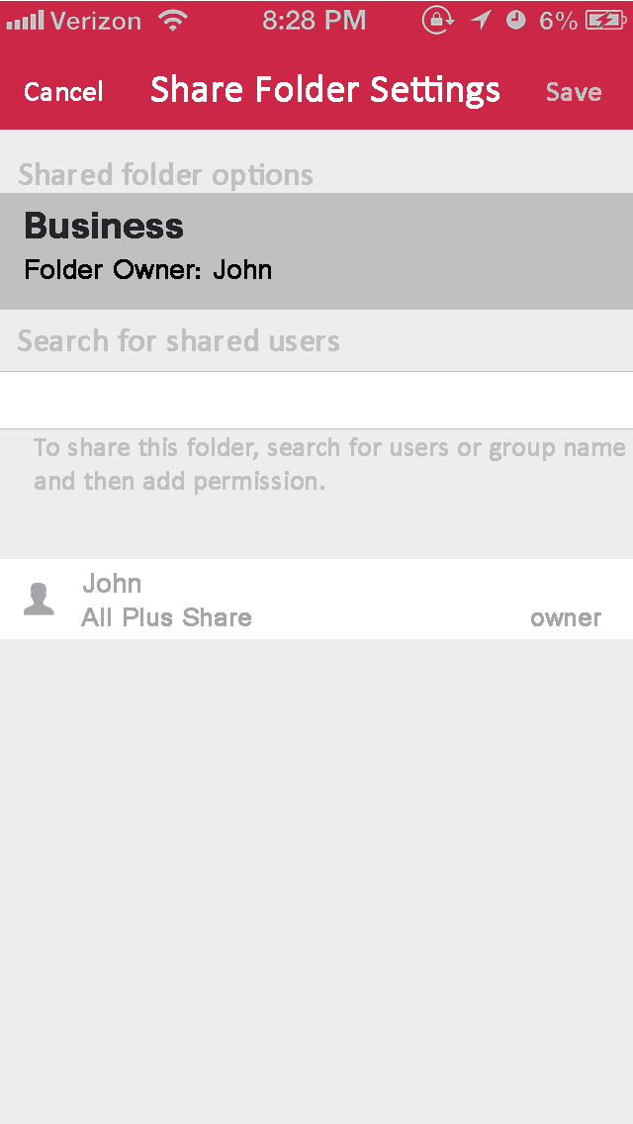
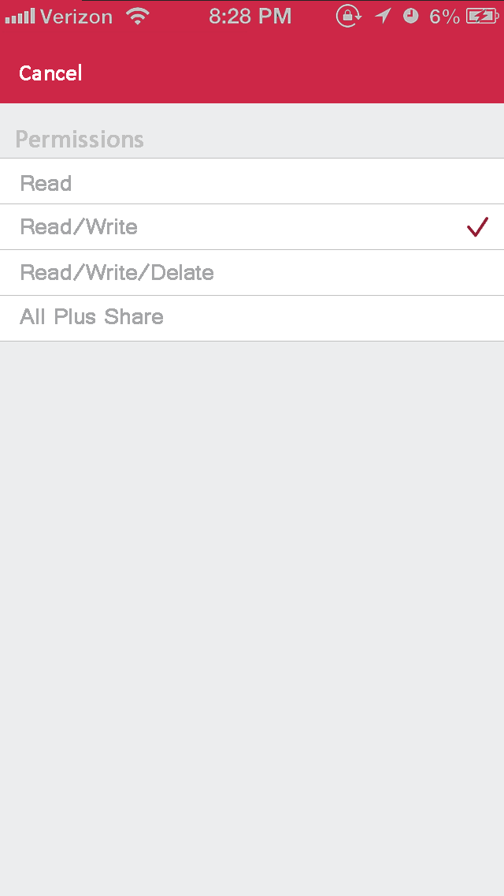
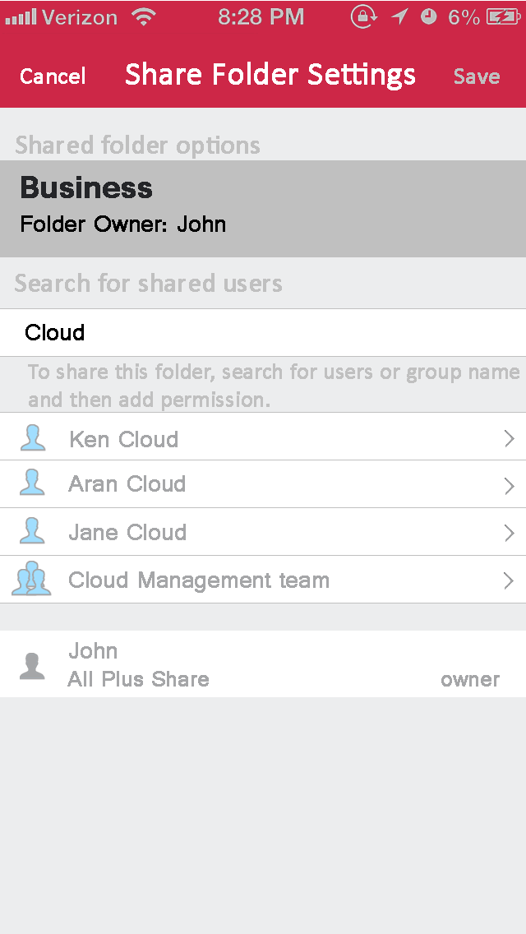
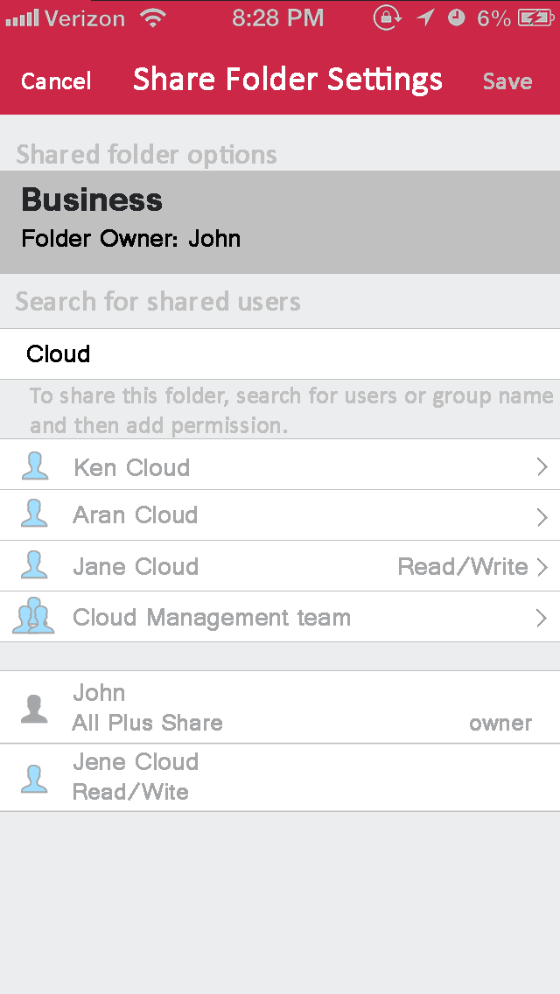
UI-Design: Manage Folder Permission & Shared Folder
Manage Folder Permission
There are three steps for send link usability.
Set Folder Permission
Select target user for share
Submit folder permission
Set Folder Permission:
At first user select folder permission to share, permission LEVEL is selected from READ/WRITE/Delete with iOS control. View was changed W/ modal to select permission LEVEL.
Select target user for share:
When typed shared user on edit-box, view will expand to show pre-matched user list to select CPO user. Ex: because of “Cloud” matched user was showed.
Submit folder permission
Finally, the combination USER & shared level was submitted to server to share folder.
NOTE: multiple permission can be set for folder permission.

Slide 20
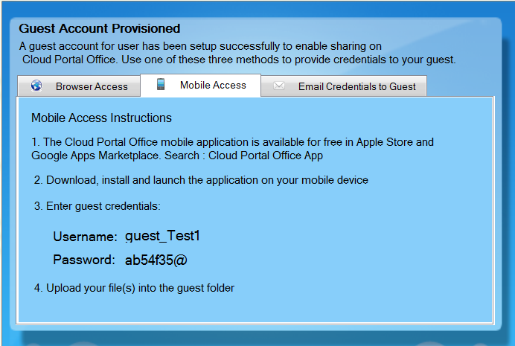
Guest user setup
Guest user setup
Even if from mobile-UI, “Guest user setup” function can be executed to submit service. For “Guest user setup” functionality, mobile user invite TENTATIVE guest user. This allows ADHOC-meeting preparation, so NO-CPO user can be invited for limited access time for document share.
Ask service to create TENTATIVE CPO user for guest setup
TENTATIVE CPO account was generated on service
Created TENTATIVE account was showed on mobile-UI.
User can send invitation to user with E-Mail Credential to Guest.
NOTE: TENTATIVE guest user can be allowed only 3 Upload files into guest folder.
CPO
2. Create Guest user account
Guest User Setup
3. Send invitation mail
CPO User
NO CPO User

Slide 21
UI-Design: Setting screen
Setting Screen
Several setting is addressed on Setting Screen. User can achieve account information also several settings to modify CPO-Mobile application.
User Information: Login user name & password
Cash Size: Modify cash size on mobile-app. Cash allows user for quick browsing.
Download Setting: Allow or Not Allow file download and password when file was downloaded. If selected “Not Allow”, there is no local downloaded file, even if user shows DOUMENT on server folder. This is security protection.
Initial view Screen: Select to show or not “Top Folder”. If user selected NOT to show “Top Folder”, last accessed folder will be showed on initial screen after logged in to service. This means that “Top Folder” is skipped.

Slide 22
EOF

