Slide 1
Just Enough Programming Logic & Design
Chapter 1
An Overview of Computers and Logic

Slide 2
Objectives
After completing this chapter, you will be able to:
Explain computer components and operations
Discuss the steps involved in the programming process
Use pseudocode statements and flowchart symbols
Use and name variables and constants
Explain data types and declare variables
End a program by using sentinel values
Discuss the evolution of programming techniques

Slide 3
Understanding Computer Components and Operations
Components of a computer system
Hardware
Equipment or devices associated with a computer
Software
Computer instructions
Tells hardware what to do
Programs: instruction sets written by programmers
Programming: writing computer instructions

Slide 4
Understanding Computer Components and Operations (cont’d)
Application software
Programs applied to a task
Includes word processing programs, spreadsheets, payroll and inventory programs, and even games
System software
Programs used to manage your computer
Includes operating systems such as Windows, Linux or UNIX

Slide 5
Understanding Computer Components and Operations (cont’d)
Input
Hardware devices, such as keyboards and mice, perform input operations
Data, or facts, enter the computer system through input devices
Processing
Processing data items may involve organizing them, checking them for accuracy, or performing mathematical operations on them

Slide 6
Understanding Computer Components and Operations (cont’d)
Processing continued
The hardware that performs these tasks is the central processing unit, or CPU
Output
Sending information resulting from processing to a printer or monitor so people can view, interpret, and use the results
Can be stored on disks or flash media for later retrieval

Slide 7
Understanding Computer Components and Operations (cont’d)
Computer instructions are written in a computer programming language
Computer instructions you write are program code, also called source code
Coding a program is when you write a program
Syntax are the rules governing the word usage and punctuation of a programming language

Slide 8
Understanding Computer Components and Operations (cont’d)
Each programming language uses a piece of software to translate the specific programming language statements into object code
Object code is the computers on/off circuitry language, or machine language
Machine language is represented as a series of 0s and 1s, also called binary form
The language translation software is called a compiler or interpreter

Slide 9
Understanding Computer Components and Operations (cont’d)
When a program’s instructions are carried out, the program runs or executes
A program that is free of syntax errors can be executed, but it might not produce the correct results
For a program to work, the programmer must give the instructions to the computer in a specific sequence called the logic of the computer program

Slide 10
Understanding Computer Components and Operations (cont’d)
Logic errors include instructions that are out of sequence, missing instructions, and instructions not part of the procedure
Using an otherwise correct statement that does not make sense in the current context is called a semantic error
Logical errors are much more difficult to locate than syntax errors

Slide 11
Understanding Computer Components and Operations (cont’d)
To use a computer program, it must first be loaded into the computer’s memory
Memory is the internal storage in a computer
Also called main memory or random access memory (RAM)
Internal memory is temporary and volatile – its contents are lost when the computer loses power
Programmers often refer to memory locations, or addresses using hexadecimal notation

Slide 12
Understanding the Programming Process
The programmer’s job can be broken down into seven development steps
Understanding the problem
Planning the logic
Coding the program
Using software (a compiler or interpreter) to translate the program into machine language
Testing the program
Putting the program into production
Maintaining the program

Slide 13
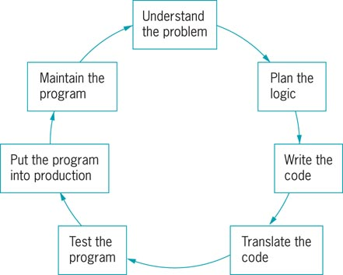
Understanding the Programming Process (cont’d)
Figure 1.1 The program development cycle

Slide 14
Understanding the Problem
Professional computer programmers write programs to satisfy the needs of others
Really understanding the problem may be one of the most difficult aspects of programming
On any job, the description of what the user needs may be vague, or the users may not even really know what they want
Users frequently change their minds after seeing sample output
A good programmer is often part counselor, part detective

Slide 15
Planning the Logic
The heart of the programming process lies in planning the program’s logic
During this phase of the programming process, the programmer plans the steps of the program, deciding what steps to include and how to order them
An algorithm is the sequence of steps needed to solve any problem
The two most common planning tools are flowcharts and pseudocode

Slide 16
Planning the Logic (cont’d)
Programmer should define the sequence of events that will lead to the desired output
Planning a program’s logic includes:
Thinking carefully about all the possible data values a program might encounter
How you want the program to handle each scenario
The process of walking through a program’s logic on paper before you actually write the program is called desk-checking

Slide 17
Coding the Program
Only when the programmer has developed the logic of a program, can he or she code the program
In one of more than 400 programming languages
Programmers choose a particular language because some languages have built-in capabilities that make them more efficient than others at handling certain types of operations

Slide 18
Using Software to Translate the Program into Machine Language
Even though there are many programming languages, each computer is built knowing only one language – its machine language
Machine language consists of many 1s and 0s
A translator program (a compiler or interpreter) changes the English-like high-level programming language in which the programmer writes into the low-level machine language that the computer understands

Slide 19
Using Software to Translate the Program into Machine Language (cont’d)
A computer program must be free of syntax errors before you can execute it
Typically, a programmer develops a program’s logic, writes the code, and then attempts to compile or interpret the program using language-interpreting software

Slide 20
Testing the Program
A program that is free of syntax errors is not necessarily free of logical errors
Selecting test data is something of an art in itself, and it should be done carefully
Many companies do not know that their software has a problem until an unusual circumstance occurs

Slide 21
Putting the Program into Production
Once the program is tested adequately, it is ready for the organization to use
Putting the program into production might mean simply running the program once
The process might take months if the program will be run on a regular basis
Conversion, the entire set of actions an organization must take to switch over to using a new program or set of programs, can sometimes take months or years to accomplish

Slide 22
Maintaining the Program
After programs are put into production, changes may be required
Maintenance is the process of updating programs
When maintaining programs others have written, programmers appreciate the effort the original programmer put into writing clear code, using reasonable identifiers for values, and documenting his or her work

Slide 23
Maintaining the Program (cont’d)
Changes to existing programs repeat the development cycle
Understand the changes
Plan
Code
Translate
Test
Put into production
Maintenance

Slide 24
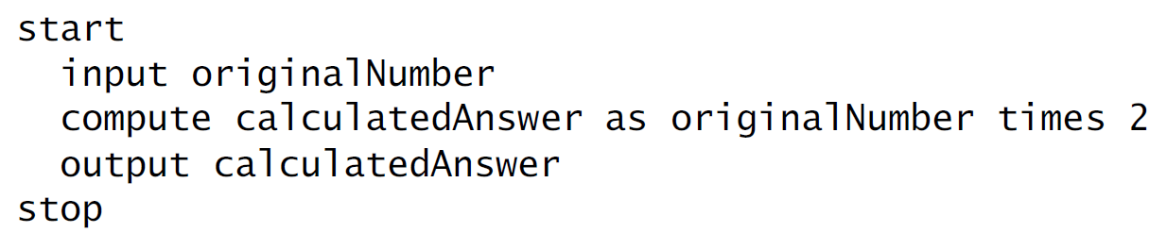
Using Pseudocode Statements and Flowchart Symbols
Pseudocode is an English-like representation of the logical steps it takes to solve a problem
Example: Pseudocode for program doubling a number
A flowchart is a pictorial representation of the same thing

Slide 25

Using Pseudocode Statements and Flowchart Symbols (cont’d)
When creating a flowchart, draw geometric shapes around individual statements and connect them with arrows
Input symbol
Parallelogram
Indicates input operation
Figure 1.2 Input symbol

Slide 26


Using Pseudocode Statements and Flowchart Symbols (cont’d)
Processing symbol
Rectangle
Processing statement
Output symbol
Parallelogram
Often called I/O symbol or input/output symbol
Indicates output operation
Figure 1.3 Processing symbol
Figure 1.4 Output symbol

Slide 27
Using Pseudocode Statements and Flowchart Symbols (cont’d)
To show the correct sequence of these statements, use arrows, or flowlines, to connect the steps
To be complete, a flowchart should include two more elements:
Terminal symbols, or start/stop symbols, at each end

Slide 28
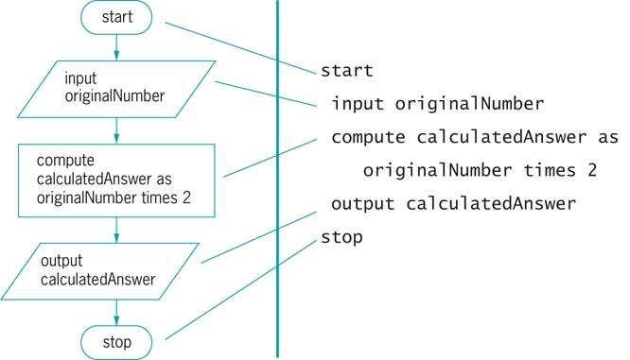
Using Pseudocode Statements and Flowchart Symbols (cont’d)
Figure 1.5 Flowchart and pseudocode of a program that doubles a number

Slide 29
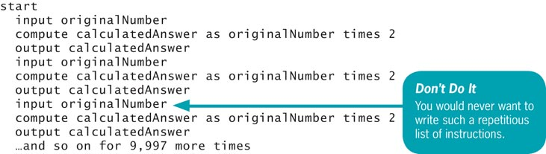
The Advantages of Repetition
Writing a number-doubling computer program is worth the effort only if a user has many numbers to double in a limited amount of time
Figure 1.6 Inefficient pseudocode for program that doubles 10,000 numbers

Slide 30
Using and Naming Variables and Constants
Variables are named memory locations whose contents can vary over time
A variable name is also called an identifier
Different languages put different limits on the length of identifiers, although in general, newer languages allow longer names
Every language has its own rules for naming variables

Slide 31
Using and Naming Variables and Constants (cont’d)
Variable name formats:
Camel casing has a “hump” in the middle – hourlyWage
Pascal casing is where the first letter of each name is upper case – HourlyWage
Names must be one word
Names should have some appropriate meaning
When designing logic, do not be concerned with the syntax of any particular computer language

Slide 32
Assigning Values to Variables
Assigning values to variables:
Assignment statements
calculatedAnswer = originalNumber * 2
The assignment operator is the equal sign
A named constant can be assigned a value only once
A magic number is an unnamed constant, like 0.08, whose meaning is not immediately apparent

Slide 33
Performing Arithmetic Operations
Most programming languages use the following standard arithmetic operators:
+ (plus sign)—addition
– (minus sign)—subtraction
* (asterisk)—multiplication
/ (slash)—division
Every operator follows rules of precedence that dictate the order in which operations in the same statement are carried out

Slide 34
Understanding Data Types and Declaring Variables
Computers deal with two basic types of data: numeric and text (or string)
A specific numeric value is often called a numeric constant (or a literal numeric constant or an unnamed numeric constant) because it does not change
A specific text value, or string of characters, enclosed in quotation marks is a string constant

Slide 35
Understanding Data Types and Declaring Variables (cont’d)
A variable’s data type describes the kind of values the variable can hold, how much memory the value occupies, and the types of operations that can be performed with the data stored there
A numeric variable is one that can have mathematical operations performed on it
Can hold digits, and usually can hold a decimal point and a sign indicating positive or negative

Slide 36
Understanding Data Types and Declaring Variables (cont’d)
A string variable is a separate type of variable that can hold letters of the alphabet and other special characters such as punctuation marks
To declare the variable is to tell the computer what type of variable to expect
Variables must always be declared before the first time they are used in a program

Slide 37

Understanding Data Types and Declaring Variables (cont’d)
After a variable is declared, you can assign a value to it, send it to output, or perform any operations that are allowed for its data type
Variables are initialized when you assign initial values to them
Example:

Slide 38
Understanding Data Types and Declaring Variables (cont’d)
In some languages uninitialized variables are a assigned a default value
More commonly, uninitialized variables have an unknown, or garbage value, until a valid assignment is made

Slide 39
Ending a Program by Using Sentinel Values
Infinite loop: repeating flow of logic with no end
Sentinel value: predetermined value that means “Stop the program!”
Dummy value: preselected value that stops the program
Testing a value is also called making a decision
Decision symbol: a diamond shape in a flowchart that represents a decision

Slide 40
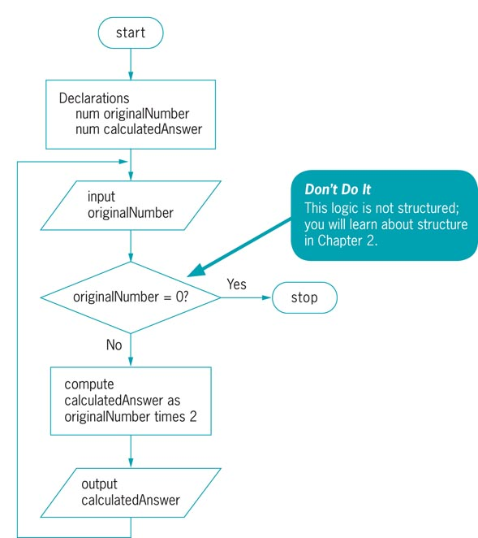
Ending a Program by Using
Sentinel Values (cont’d)
Figure 1.8 Flowchart of number-doubling program with sentinel value of 0

Slide 41
Ending a Program by Using Sentinel Values (cont’d)
Many programming languages use the term eof (for “end of file”) to refer to a marker that automatically acts as a sentinel

Slide 42
Understanding the Evolution of Programming Techniques
People have been writing modern computer programs since the 1940s
The oldest programming languages required programmers to work with memory addresses and to memorize awkward codes associated with machine languages
Newer programming languages look much more like natural language and are easier for programmers to use

Slide 43
Understanding the Evolution of Programming Techniques (cont’d)
Modern programs use modularity - the ability to build programs from smaller segments
Techniques used to develop programs:
Procedural programming focuses on the procedures that programmers create by breaking down processes into manageable tasks
Object-oriented programming focuses on objects and describes their attributes and behaviors

Slide 44
Summary
Hardware and software are the two major components of any computer
The programmer’s job can be broken down into seven development steps
Pseudocode and flowcharts are used to plan the logic for a solution
Variables are named memory locations, whose contents can vary
Two major techniques used to develop programs:
Procedural programming
Object-oriented programming

