Slide 1
Just Enough Programming Logic & Design
Chapter 2
Understanding Structure
Notes:
1

Slide 2
Objectives
After completing this chapter you will be able to:
Describe the features of unstructured spaghetti code
Identify the three basic structures: sequence, selection, and loop
Use a priming input
Discuss the need for structure
Recognize structure and structure unstructured logic

Slide 3
Understanding Unstructured Spaghetti Code
The popular name for logically snarled program statements is spaghetti code
Difficult to alter when changes are required
Shorter life span than structured code
Programs that use spaghetti code logic are unstructured programs

Slide 4
Understanding the Three Basic Structures: Sequence, Selection, and Loop
A structure is a basic unit of programming logic
Sequence
Selection
Loop
One can diagram each structure with a specific configuration of flowchart symbols

Slide 5
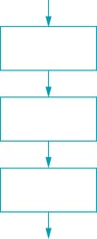
The Sequence Structure
Perform an action or task, and then perform the next action, in order
Can contain any number of tasks
No chance to branch off and skip any of the tasks
Continue step-by-step until the sequence ends
Figure 2.3 Sequence structure

Slide 6
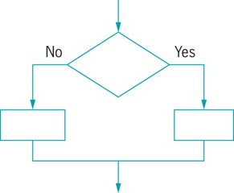
The Selection Structure
Ask a question and, depending on the answer, take one of two courses of action
No matter which path followed, continue with the next task
Some people call the selection structure an if-then-else structure
Figure 2.4 Selection structure

Slide 7
The Selection Structure (con’t)
Dual-alternative ifs (dual-alternative selections)
Contain two alternatives
True action resides in the if clause
False action resides in the else clause
Example:
if hours worked are more than 40 then
calculate regular pay and overtime pay
else
calculate regular pay

Slide 8
The Selection Structure (con’t)
Single-alternative ifs (single-alternative selections)
Contain one question
True action resides in the if clause
No special action taken if false
Example:
if employee belongs to the dental plan then
deduct $40 from employee gross pay

Slide 9
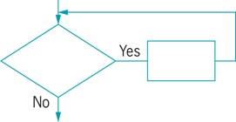
The Loop Structure
Continues to repeat actions while a condition remains true
Action or actions that occur within the loop are known as the loop body
Programmers refer to looping as repetition or iteration
Some programmers call this structure a while...do, or more simply, a while loop
Figure 2.6 Loop structure

Slide 10
Combining Structures
Attaching structures end-to-end is called stacking structures
End-structure statements
Use an endif statement to clearly show where the actions that depend on a decision end
Use an endwhile statement to show where a loop structure ends

Slide 11
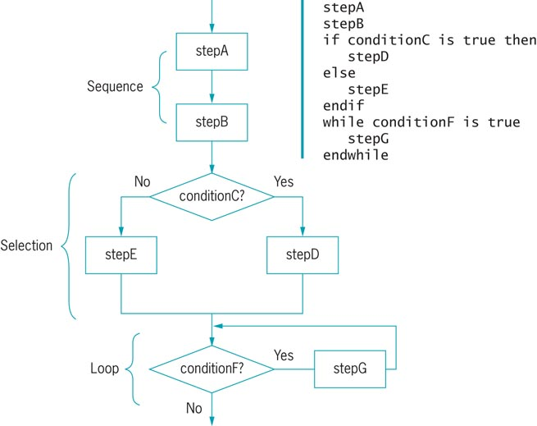
Combining Structures (cont’d)
Figure 2.7 Structured flowchart and pseudocode

Slide 12
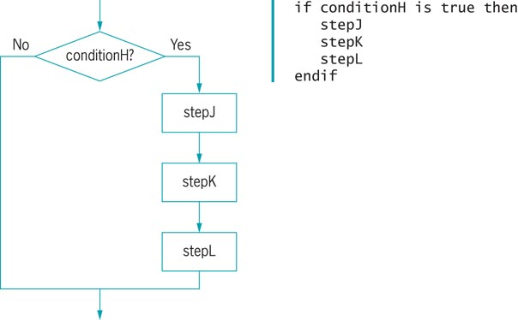
Combining Structures (cont’d)
Placing a structure within another structure is called nesting structures
Block: Group of statements that executes as a single unit
Figure 2.8 Flowchart and pseudocode showing a sequence nested within a selection

Slide 13
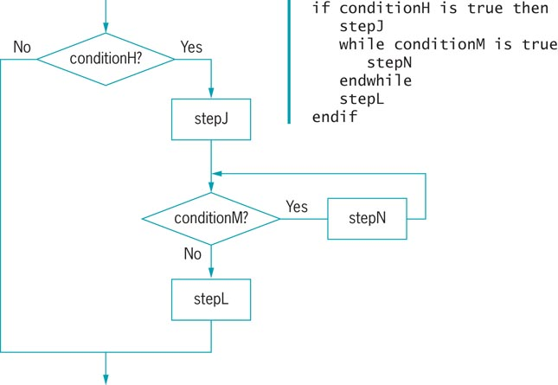
Combining Structures (cont’d)
Figure 2.9 Selection in a sequence within a selection

Slide 14
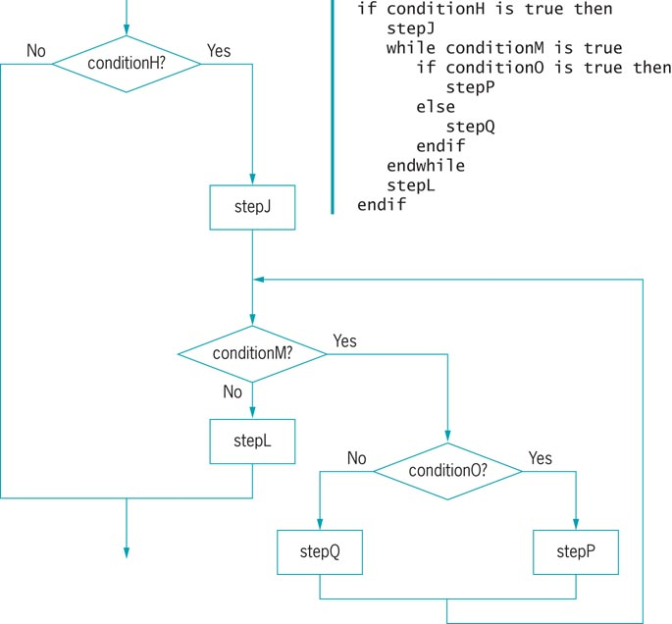
Combining Structures (cont’d)
Figure 2.10 Flowchart and pseudocode for loop within selection within sequence
within selection

Slide 15
Combining Structures (cont’d)
A structured program includes only combinations of the three basic structures: sequence, selection, and loop
Any structured program might contain one, two, or all three types of structures
Structures can be stacked or connected to one another only at their entry or exit points
Any structure can be nested within another structure

Slide 16
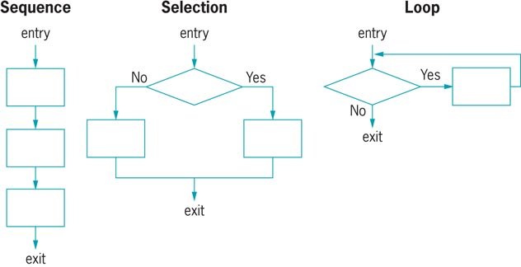
Combining Structures (cont’d)
Figure 2.12 The three structures

Slide 17
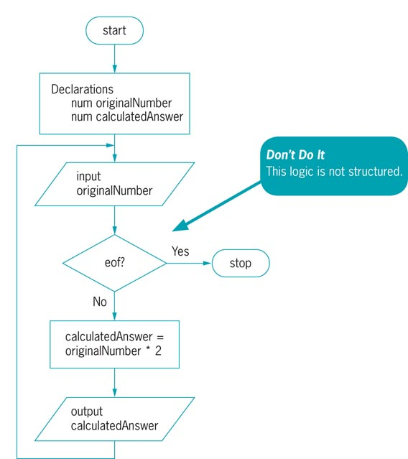
Using the Priming Input
A priming input, or priming read, is the statement that reads the first input value in a program
Figure 2.13 Unstructured flowchart of a number-doubling program

Slide 18
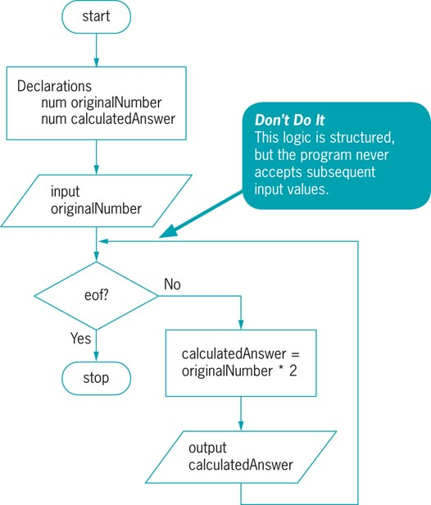
Using the Priming Input (cont’d)
Figure 2.16 Structured, but nonfunctional, flowchart of number doubling problem

Slide 19
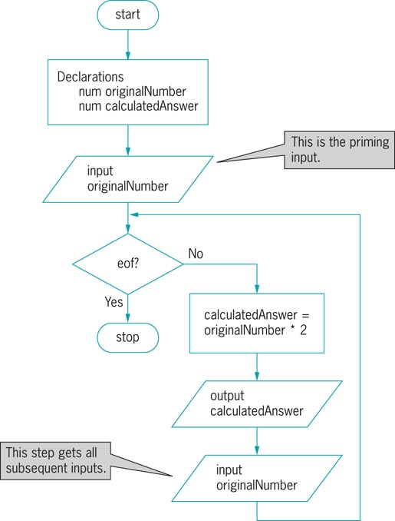
Using the Priming Input (cont’d)
Figure 2.18 Functional, structured flowchart and pseudocode for the number-doubling problem

Slide 20
Understanding the Reasons for Structure
Staying with the three structures is better for the following reasons:
Clarity
Professionalism
Efficiency
Maintenance
Modularity
Structured programs can be easily broken down into routines, or modules

Slide 21
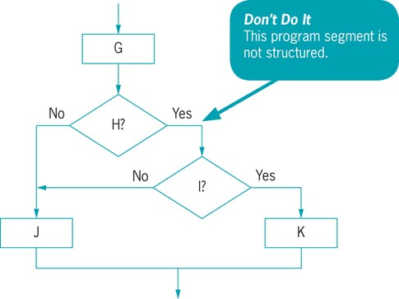
Recognizing Structure and Structuring Unstructured Logic
Figure 2.22 Example 3

Slide 22

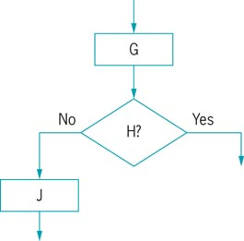
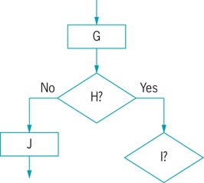
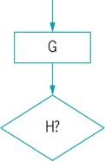
Recognizing Structure and Structuring Unstructured Logic (cont’d)
Figure 2.23 First step
Figure 2.25 Third step
Figure 2.26 Fourth step
Figure 2.24 Second step

Slide 23
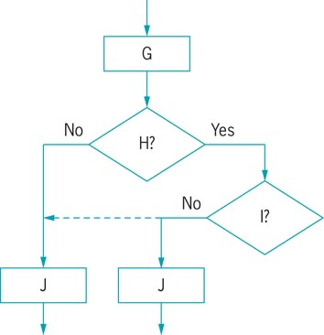
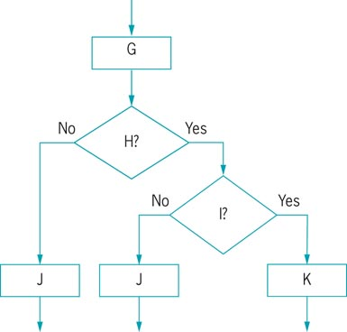
Recognizing Structure and Structuring Unstructured Logic (cont’d)
Figure 2.27 Fifth step
Figure 2.28 Sixth step

Slide 24
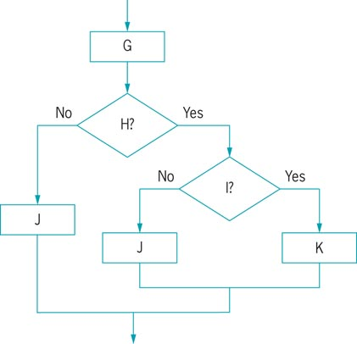
Recognizing Structure and Structuring Unstructured Logic (cont’d)
Figure 2.29 Finished flowchart and pseudocode for untangling Example 3

Slide 25
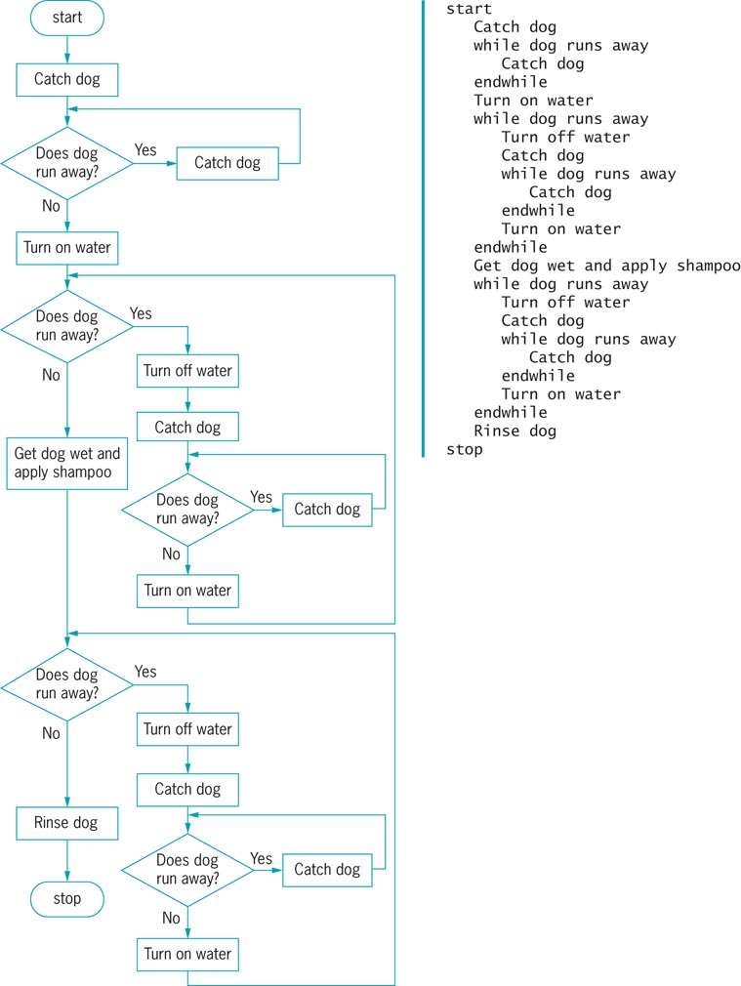
Structuring the Dog-Washing Process
Figure 2.34 Structured dog-washing flowchart and pseudocode

Slide 26
Summary
Programs that use spaghetti code logic are unstructured programs
A structure is a basic unit of programming
Each structure is a sequence, selection, or loop
All problems can be reduced to combinations of the three basic structures
Structures can be nested and stacked in an infinite number of ways to describe the logic of any process
Structures attach to each other only at the entry or exit point

Slide 27
Summary (cont’d)
A priming input is the statement that reads the first input value in a program
Programmers use structured techniques to promote clarity, professionalism, efficiency, maintenance and modularity
It is important to recognize unstructured logic and correct it

