Slide 1
Chapter 14
How to define classes

Slide 2
Objectives (part 1)
Applied
Code the data members, member functions, constructors, and destructors of a class that defines an object.
Write code that creates objects from a class and then uses the public members of the objects to accomplish the required tasks.
Use the three functions for converting between numbers and strings that were presented in this chapter.
Given the specifications for a class, code the class in header and source files.
Given the specifications for a class, create a UML class diagram for it.
Work with object composition in your C++ programs.

Slide 3
Objectives (part 2)
Given the C++ code for a program that uses any of the language elements presented in this chapter, explain what each statement in the program does.
Knowledge
Explain how encapsulation works and how it’s implemented in C++.
Differentiate between an object’s identity, state, and behavior.
Describe the basic components of a class.
Explain when you need to use the this keyword and the member access operator in a setter function.
Explain what helper functions are.
Explain how you can code setter functions that provide for different data types.

Slide 4
Objectives (part 3)
Describe two ways that you can code a default constructor.
Explain why you might want to store a class in header and source files.
Explain what inline functions are and describe the pros and cons of using them.
Explain what UML is and what UML class diagrams are used for.
Explain what object composition is.

Slide 5
A Movie structure
struct Movie {
string title = ""; // data member
int year = 0; // data member
bool equals(const Movie&); // member function declaration
};
// member function definition
bool Movie::equals(const Movie& to_compare) {
return (title == to_compare.title && year == to_compare.year);
}

Slide 6
Create an object from the Movie structure and use it
Movie movie; // create Movie object
movie.title = "Roundhay Garden Scene"; // set title
movie.year = 1776; // set year
// invalid - too old
cout << "MOVIE DATA\n"
<< "Title: " << movie.title << endl // get title
<< "Year: " << movie.year << endl; // get year
The console
MOVIE DATA
Title: Roundhay Garden Scene
Year: 1776

Slide 7
A Movie class (part 1)
class Movie {
private: // data members are private
string title = "";
int year = 0;
public: // member functions are public
void set_title(string);
string get_title();
void set_year(int);
int get_year();
bool equals(const Movie&);
};
// member function definitions
void Movie::set_title(string title_param) {
title = title_param;
}
string Movie::get_title() {
return title;
}

Slide 8
A Movie class (part 2)
void Movie::set_year(int year_param) {
if (year_param < 1888) {
throw invalid_argument("Year must be 1888 or later.");
}
year = year_param;
}
int Movie::get_year() {
return year;
}
bool Movie::equals(const Movie& to_compare) {
return (title == to_compare.title &&
year == to_compare.year);
}

Slide 9
Create an object from the Movie class and use it
Movie movie;
movie.set_title("Roundhay Garden Scene"); // set title
// movie.year = 1776; // illegal – no direct access
// movie.set_year(1776); // invalid – throws exception
movie.set_year(1888); // set year
cout << "MOVIE DATA\n"
<< "Title: " << movie.get_title() << endl // get title
<< "Year: " << movie.get_year() << endl; // get year

Slide 10
The syntax for defining private and public members
class ClassName {
[private:]
// private members go here
public:
// public members go here
[private:
// you can also code private members here]
};

Slide 11
A class that places all private members before public members
class Movie {
string title; // private members
int year;
public: // public members
void set_title(string);
string get_title();
void set_year(int);
int get_year();
bool equals(const Movie&);
};

Slide 12
A class that places all public members before private members
class Movie {
public: // public members
void set_title(string);
string get_title();
void set_year(int);
int get_year();
bool equals(const Movie&);
private: // private members
string title;
int year;
};

Slide 13
A setter function
void Movie::set_title(string title_param) {
title = title_param;
}
Another way to code this setter function
void Movie::set_title(string title) {
this->title = title;
}
A setter function that validates data
void Movie::set_year(int year_param) {
if (year_param < 1888) {
throw invalid_argument("Year must be 1888 or later.");
}
year = year_param;
}

Slide 14
A getter function that returns a string
string Movie::get_title() const {
return title;
}
A getter function that returns an int value
int Movie::get_year() const {
return year;
}

Slide 15
Code that calls the get and set functions
Movie movie;
movie.set_title("Roundhay Garden Scene");
movie.set_year(1888);
string title = movie.get_title();
int year = movie.get_year();

Slide 16
The console for the Movie List 1.0 program
The Movie List program
Enter a movie...
Title: Roundhay Garden Scene
Year: 1888
Enter another movie? (y/n): y
Title: Arrival of a Train
Year: 1895
Enter another movie? (y/n): n
TITLE YEAR
Roundhay Garden Scene 1888
Arrival of a Train 1895

Slide 17
The code for the Movie List 1.0 program (part 1)
#include <iostream>
#include <iomanip>
#include <string>
#include <vector>
using namespace std;
class Movie {
private:
string title;
int year;
public:
void set_title(string);
string get_title() const;
void set_year(int);
int get_year() const;
};
void Movie::set_title(string title_param) {
title = title_param;
}

Slide 18
The code for the Movie List 1.0 program (part 2)
string Movie::get_title() const {
return title;
}
void Movie::set_year(int year_param) {
if (year_param < 1888) {
throw invalid_argument("Year must be 1888 or later.");
}
year = year_param;
}
int Movie::get_year() const {
return year;
}
int main() {
cout << "The Movie List program\n\n"
<< "Enter a movie...\n\n";

Slide 19
The code for the Movie List 1.0 program (part 3)
// get movies from user
vector<Movie> movies;
char another = 'y';
while (tolower(another) == 'y') {
Movie movie;
string title;
cout << "Title: ";
getline(cin, title);
movie.set_title(title);
int year;
cout << "Year: ";
cin >> year;
try {
movie.set_year(year);
}
catch (const invalid_argument& e) {
cout << e.what() << "\n";
cout << "Exiting program...\n\n";
return 0;
}

Slide 20
The code for the Movie List 1.0 program (part 4)
movies.push_back(movie);
cout << "\nEnter another movie? (y/n): ";
cin >> another;
cin.ignore();
cout << endl;
}
// display the movies
const int w = 10;
cout << left
<< setw(w * 3) << "TITLE"
<< setw(w) << "YEAR" << endl;
for (Movie movie : movies) {
cout << setw(w * 3) << movie.get_title()
<< setw(w) << movie.get_year() << endl;
}
cout << endl;
}

Slide 21
The declarations for three more functions for the Movie class
private:
string to_upper(string); // helper function
public:
string get_title_upper() const;
bool iequals(const Movie&);

Slide 22
A private function that converts a string to uppercase
string Movie::to_upper(string str) {
string str_upper;
for (char c : str) {
str_upper.push_back(toupper(c));
}
return str_upper;
}
A public function that returns the title in uppercase
string Movie::get_title_upper() const {
return to_upper(title);
}

Slide 23
A public function that performs a case-insensitive equality comparison
bool Movie::iequals(const Movie& to_compare) {
return (to_upper(title) == to_upper(to_compare.title) &&
year == to_compare.year);
}

Slide 24
Code that calls the public functions
Movie m1;
Movie m2;
m1.set_title("Test");
m1.set_year(2018);
m2.set_title("test");
m2.set_year(2018);
if (m1.iequals(m2)) {
cout << "The test movies are equal (case-insensitive).\n";
}
// m1.to_upper() // illegal – can't call private member function
cout << "The title is " << m1.get_title() << endl;
cout << "The uppercase title is " << m1.get_title_upper() << endl;
The console
The test movies are equal (case-insensitive).
The title is Test
The uppercase title is TEST

Slide 25
Three functions for converting between numbers and strings
to_string(num)
stoi(str)
stod(str)

Slide 26
The declarations for more functions for the Movie class
public:
void set_year(int year_param);
void set_year(string year_param);
string to_str() const;
A set_year() function that accepts an int value
void Movie::set_year(int year_param) {
if (year_param < 1888) {
throw invalid_argument("Year must be 1888 or later.");
}
year = year_param;
}
An overload of the set_year() function that accepts a string
void Movie::set_year(string year_param) {
int yr = stoi(year_param); // string to int
set_year(yr);
}

Slide 27
A function that returns a string representation of an object
string Movie::to_str() const {
return title + " (" + to_string(year) + ')';
// int to string
}

Slide 28
Code that calls the three public functions
Movie movie;
movie.set_title("Arrival of a Train");
movie.set_year("1895");
cout << movie.to_str() << endl;
The console
Arrival of a Train (1895)

Slide 29
A default constructor (zero parameters)
The declaration
Movie();
The definition
Movie::Movie() {
title = "";
year = 1888;
}

Slide 30
Another way to code a default constructor (zero required parameters)
The declaration
Movie(string title = "", int year = 1888);
The definition
Movie::Movie(string title, int year) {
set_title(title);
set_year(year);
}

Slide 31
Three ways to call the default constructor (no arguments)
Movie m1 = Movie(); // full syntax
Movie m2(); // partially abbreviated syntax
Movie m3; // abbreviated syntax
Examples that pass arguments to a constructor
Movie m4 = Movie("Wizard of Oz"); // 1 argument
Movie m5("Wizard of Oz"); // 1 argument
Movie m6 = Movie("Wizard of Oz", 1939); // 2 arguments
Movie m7("Wizard of Oz", 1939); // 2 arguments
An example that creates an object and stores it in a vector
movies.push_back(Movie("Wizard of Oz", 1939));

Slide 32
A destructor
The declaration
~Movie();
The definition
Movie::~Movie() {
// code that frees system resources goes here
}

Slide 33
An example of a class with a destructor (part 1)
The declaration
class MovieList {
private:
string filename = "movies.txt";
fstream file;
vector<Movie> movies;
public:
MovieList();
~MovieList();
void add_movie(Movie);
void delete_movie(Movie);
};

Slide 34
An example of a class with a destructor (part 2)
The definition for the constructor
MovieList::MovieList() {
file.open(filename, ios::in); // open a system resource
}
The definition for the destructor
MovieList::~MovieList() {
if (file.is_open())
file.close(); // close a system resource
}

Slide 35
The Movie.h file (part 1)
#ifndef MURACH_MOVIE_H
#define MURACH_MOVIE_H
#include <string>
class Movie {
private:
std::string title;
int year;
int stars;
std::string to_upper(std::string);
public:
Movie(std::string title = "", int year = 1888, int stars = 1);
Movie set_title(std::string);
std::string get_title() const;
Movie set_year(int);
int get_year() const;

Slide 36
The Movie.h file (part 2)
Movie set_stars(int);
int get_stars() const;
bool iequals(const Movie&);
};
#endif // MURACH_MOVIE_H

Slide 37
The Movie.cpp file (part 1)
#include "Movie.h"
#include <string>
using std::string;
using std::invalid_argument;
// private function
string Movie::to_upper(string str) {
string str_upper;
for (char c : str) {
str_upper.push_back(toupper(c));
}
return str_upper;
}
// public functions
Movie::Movie(string title, int year, int stars) {
set_title(title);
set_year(year);
set_stars(stars);
}

Slide 38
The Movie.cpp file (part 2)
void Movie::set_title(string title_param) {
if (title_param.size() > 120) {
throw invalid_argument(
"Title must not have more than 120 chars.");
}
title = title_param;
}
string Movie::get_title() const {
return title;
}
void Movie::set_year(int year_param) {
if (year_param < 1888) {
throw invalid_argument("Year must be 1888 or later.");
}
year = year_param;
}
int Movie::get_year() const {
return year;
}

Slide 39
The Movie.cpp file (part 3)
void Movie::set_stars(int stars_param) {
if (stars_param < 1 || stars_param > 5) {
throw invalid_argument("Stars must be from 1 to 5.");
}
stars = stars_param;
}
int Movie::get_stars() const {
return stars;
}
bool Movie::iequals(const Movie& to_compare) {
return (to_upper(title) == to_upper(to_compare.title) &&
year == to_compare.year);
}

Slide 40
A Movie.h file that uses inline function definitions
#ifndef MURACH_MOVIE_H
#define MURACH_MOVIE_H
#include <string>
class Movie {
private:
std::string title;
int year;
int stars;
std::string to_upper(std::string);
public:
Movie(std::string title = "", int year = 1888, int stars = 1);
void set_title(std::string);
std::string get_title() const { return title; } // inline
void set_year(int);
int get_year() const { return year; } // inline
// other function declarations go here
};
#endif // MURACH_MOVIE_H

Slide 41
Pros of inline functions
More concise code due to function being declared and defined in the same place.
Possible improved performance due to avoiding function call overhead.
Cons of inline functions
Larger executable file size because the inline function is duplicated each time it’s called.
Possible degraded performance due to larger executable file size.
Header file must be recompiled if you change any of the implementation code of the inline function.

Slide 42
Console for the Movie List 2.0 program (part 1)
The Movie List program
COMMANDS
v - View movie list
a - Add a movie
d - Delete a movie
x - Exit
Command: v
TITLE YEAR STARS
1 Casablanca 1942 5
2 Wonder Woman 2017 4
Command: a
Title: The Wizard of Oz
Year: 1939
Stars (1-5): 5
The Wizard of Oz was added.

Slide 43
Console for the Movie List 2.0 program (part 2)
Command: d
Number: 1
Casablanca was deleted.
Command: x
Bye!

Slide 44
The code for the Movie List 2.0 program (part 1)
#include <iostream>
#include <fstream>
#include <sstream>
#include <iomanip>
#include <string>
#include <vector>
#include "Movie.h"
using namespace std;
const string movies_file = "movies.txt";
vector<Movie> read_movies_from_file() {
vector<Movie> movies;
ifstream input_file(movies_file);
if (input_file) { // if file opened successfully...
string line;
while (getline(input_file, line)) {
stringstream ss(line);
string title;
int year;
int stars;

Slide 45
The code for the Movie List 2.0 program (part 2)
getline(ss, title, '\t'); // get title
ss >> year >> stars; // get year and stars
// add movie to vector
movies.push_back(Movie(title, year, stars));
}
input_file.close();
}
return movies;
}
void write_movies_to_file(const vector<Movie>& movies) {
ofstream output_file(movies_file);
if (output_file) { // if file opened successfully...
for (Movie movie : movies) {
output_file << movie.get_title() << '\t'
<< movie.get_year() << '\t'
<< movie.get_stars() << '\n';
}
output_file.close();
}
}

Slide 46
The code for the Movie List 2.0 program (part 3)
void view_movies(const vector<Movie>& movies) {
int col_width = 8;
cout << left
<< setw(col_width / 2) << " "
<< setw(col_width * 4) << "TITLE"
<< setw(col_width) << "YEAR"
<< setw(col_width) << "STARS" << endl;
int number = 1;
for (Movie movie : movies) {
cout << setw(col_width / 2) << number
<< setw(col_width * 4) << movie.get_title()
<< setw(col_width) << movie.get_year()
<< setw(col_width) << movie.get_stars() << endl;
++number;
}
cout << endl;
}

Slide 47
The code for the Movie List 2.0 program (part 4)
Movie get_movie() {
string title;
cout << "Title: ";
cin.ignore(1000, '\n');
getline(cin, title);
int year;
cout << "Year: ";
cin >> year;
int stars;
cout << "Stars (1-5): ";
cin >> stars;
Movie movie(title, year, stars);
return movie;
}

Slide 48
The code for the Movie List 2.0 program (part 5)
void add_movie(vector<Movie>& movies) {
Movie movie = get_movie();
// check if movie already exists
bool already_exists = false;
for (Movie& m : movies) {
if (m.iequals(movie)) {
already_exists = true;
m.set_stars(movie.get_stars());
break;
}
}
if (already_exists) {
write_movies_to_file(movies);
cout << movie.get_title() << " was updated.\n\n";
}
else {
movies.push_back(movie);
write_movies_to_file(movies);
cout << movie.get_title() << " was added.\n\n";
}
}

Slide 49
The code for the Movie List 2.0 program (part 6)
int get_movie_number(const vector<Movie>& movies) {
int number;
while (true) {
cout << "Number: ";
cin >> number;
if (number > 0 && number <= movies.size()) {
return number;
}
else {
cout << "Invalid movie number. Try again.\n";
}
}
}
void delete_movie(vector<Movie>& movies) {
int number = get_movie_number(movies);
int index = number - 1;
Movie movie = movies[index];
movies.erase(movies.begin() + index);
write_movies_to_file(movies);
cout << movie.get_title() << " was deleted.\n\n";
}

Slide 50
The code for the Movie List 2.0 program (part 7)
void display_menu() {
cout << "COMMANDS\n"
<< "v - View movie list\n"
<< "a - Add a movie\n"
<< "d - Delete a movie\n"
<< "x - Exit\n\n";
}
int main() {
cout << "The Movie List program\n\n";
display_menu();
vector<Movie> movies = read_movies_from_file();
char command = 'v';
while (command != 'x') {
cout << "Command: ";
cin >> command;
switch (command) {
case 'v':
view_movies(movies);
break;
case 'a':
add_movie(movies);
break;

Slide 51
The code for the Movie List 2.0 program (part 8)
case 'd':
delete_movie(movies);
break;
case 'x':
cout << "Bye!\n\n";
break;
default:
cout << "Not a valid command. Please try again.\n\n";
break;
}
}
}

Slide 52
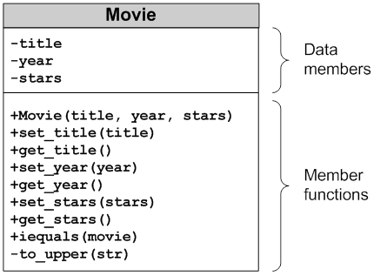
A UML diagram for the Movie class

Slide 53
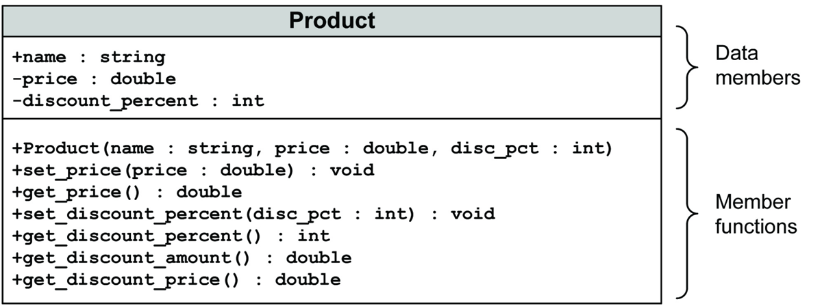
A UML diagram for the Product class

Slide 54
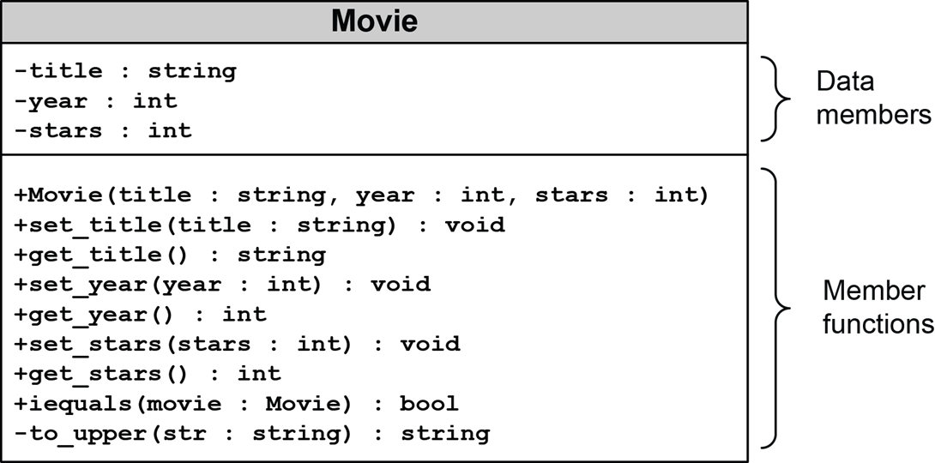
A UML diagram for the Movie class with data types

Slide 55
A UML diagram for the Product class with data types

Slide 56
The Product.h file (part 1)
#ifndef MURACH_PRODUCT_H
#define MURACH_PRODUCT_H
#include <string>
class Product {
double price;
int discount_percent;
public:
std::string name;
Product(std::string name = "", double price = 0.0,
int discount_pct = 0);
void set_price(double);
double get_price() const {
return price;
}

Slide 57
The Product.h file (part 2)
void set_discount_percent(int);
int get_discount_percent() const {
return discount_percent;
}
double get_discount_amount();
double get_discount_price();
};
#endif // MURACH_PRODUCT_H

Slide 58
The Product.cpp file (part 1)
#include <string>
#include <cmath>
#include "Product.h"
using std::string;
using std::invalid_argument;
Product::Product(string p_name, double price, int discount_percent) {
name = p_name;
set_price(price);
set_discount_percent(discount_percent);
}
void Product::set_price(double p_price) {
if (p_price >= 0.0)
price = round(p_price * 100) / 100;
else
throw invalid_argument("Price can't be negative.");
}

Slide 59
The Product.cpp file (part 2)
void Product::set_discount_percent(int p_discount_percent) {
if (p_discount_percent >= 0 && p_discount_percent <= 100)
discount_percent = p_discount_percent;
else
throw invalid_argument(
"Invalid range for discount percent.");
}
double Product::get_discount_amount() {
double discount_amount = price * discount_percent / 100;
return round(discount_amount * 100) / 100;
}
double Product::get_discount_price() {
double discount_price = price - get_discount_amount();
return round(discount_price * 100) / 100;
}

Slide 60
The console for the Product Viewer program
The Product Viewer program
PRODUCTS
1. Stanley 13 Ounce Wood Hammer
2. National Hardware 3/4" Wire Nails
3. Economy Duct Tape, 60 yds, Silver
Enter product number: 1
PRODUCT DATA
Name: Stanley 13 Ounce Wood Hammer
Price: 12.99
Discount percent: 62
Discount amount: 8.05
Discount price: 4.94
View another product? (y/n):

Slide 61
The code for the Product Viewer program (part 1)
#include <iostream>
#include <string>
#include <vector>
#include "Product.h"
using namespace std;
void show_products(const vector<Product>& products) {
cout << "PRODUCTS\n";
int number = 0;
for (Product product : products) {
cout << ++number << ". " << product.name << endl;
}
cout << endl;
}
void show_product(const Product& p) {
cout << "PRODUCT DATA\n"
<< "Name: " << p.name << endl
<< "Price: " << p.get_price() << endl
<< "Discount percent: " << p.get_discount_percent() << endl
<< "Discount amount: " << p.get_discount_amount() << endl
<< "Discount price: " << p.get_discount_price() << "\n\n";
}

Slide 62
The code for the Product Viewer program (part 2)
int main() {
cout << "The Product Viewer program\n\n";
vector<Product> products;
products.push_back(
Product("Stanley 13 Ounce Wood Hammer", 12.99, 62));
products.push_back(
Product("National Hardware 3/4\" Wire Nails", 5.06, 0));
products.push_back(
Product("Economy Duct Tape, 60 yds, Silver", 7.24, 0));
show_products(products);
char choice = 'y';
while (choice == 'y') {
int number;
cout << "Enter product number: ";
cin >> number;
cout << endl;

Slide 63
The code for the Product Viewer program (part 3)
if (number > 0 && number <= products.size()) {
Product product = products[number - 1];
show_product(product);
}
else {
cout << "There is no product with that number.\n\n";
}
cout << "View another product? (y/n): ";
cin >> choice;
cout << endl;
}
cout << "Bye!\n\n";
}

Slide 64
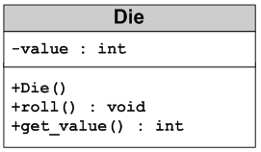
A UML diagram for a Die class

Slide 65
The Die.h file
#ifndef MURACH_DIE_H
#define MURACH_DIE_H
class Die {
private:
int value;
public:
Die();
void roll();
int get_value() const;
};
#endif // MURACH_DIE_H

Slide 66
The Die.cpp file
#include <cstdlib>
#include <ctime>
#include "Die.h"
Die::Die() {
srand(time(nullptr)); // seed the rand() function
value = 1;
}
void Die::roll() {
value = rand() % 6; // value is >= 0 and <= 5
++value; // value is >= 1 and <= 6
}
int Die::get_value() const {
return value;
}

Slide 67
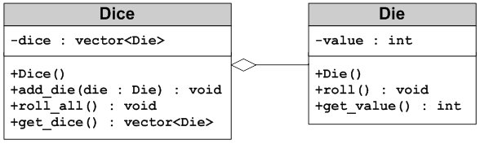
A UML diagram for two classes that use composition

Slide 68
The Dice.h file
#ifndef MURACH_DICE_H
#define MURACH_DICE_H
#include <vector>
#include "Die.h"
class Dice {
private:
std::vector<Die> dice;
public:
Dice();
void add_die(Die die);
void roll_all();
std::vector<Die> get_dice() const;
};
#endif // MURACH_DICE_H

Slide 69
The Dice.cpp file
#include "Dice.h"
Dice::Dice() {}
void Dice::add_die(Die die) {
dice.push_back(die);
}
void Dice::roll_all() {
for (Die& die : dice) {
die.roll();
}
}
std::vector<Die> Dice::get_dice() const {
return dice;
}

Slide 70
The console for the Dice Roller program
The Dice Roller program
Enter the number of dice to roll: 5
YOUR ROLL: 1 5 1 2 6
Roll again? (y/n): y
YOUR ROLL: 1 1 4 3 4
Roll again? (y/n): y
YOUR ROLL: 5 4 6 2 2
Roll again? (y/n): n
Bye!

Slide 71
The code for the Dice Roller program (part 1)
#include <iostream>
#include "Die.h"
#include "Dice.h"
using namespace std;
int main() {
cout << "The Dice Roller program\n\n";
// get number of dice from user
int count;
cout << "Enter the number of dice to roll: ";
cin >> count;
// create Dice object and add Die objects to it
Dice dice;
for (int i = 0; i < count; ++i) {
Die die;
dice.add_die(die);
}

Slide 72
The code for the Dice Roller program (part 2)
char choice = 'y';
while (choice == 'y') {
// roll the dice
dice.roll_all();
cout << "YOUR ROLL: ";
for (Die die : dice.get_dice()) {
cout << die.get_value() << " ";
}
cout << endl;
cout << "Roll again? (y/n): ";
cin >> choice;
}
cout << "Bye!\n\n";
}

Slide 73
The console for the Pig Dice game (part 1)
Let's Play PIG!
* See how many turns it takes you to get to 20.
* Turn ends when you hold or roll a 1.
* If you roll a 1, you lose all points for the turn.
* If you hold, you save all points for the turn.
TURN 1
Roll or hold? (r/h): r
Die: 5
Roll or hold? (r/h): r
Die: 4
Roll or hold? (r/h): r
Die: 5
Roll or hold? (r/h): h
Score for turn: 14
Total score: 14

Slide 74
The console for the Pig Dice game (part 2)
TURN 2
Roll or hold? (r/h): r
Die: 6
Roll or hold? (r/h): h
Score for turn: 6
Total score: 20
You finished in 2 turns!
Game over!

Slide 75
The code for the Pig Dice game (part 1)
#include <iostream>
#include "Die.h"
using namespace std;
// a struct for game variables
struct GameState {
int turn = 1;
int score = 0;
int score_this_turn = 0;
bool turn_over = false;
bool game_over = false;
Die die;
};
// declare functions
void display_rules();
void play_game(GameState&);
void take_turn(GameState&);
void roll_die(GameState&);
void hold_turn(GameState&);

Slide 76
The code for the Pig Dice game (part 2)
int main() {
display_rules();
GameState game;
play_game(game);
}
// define functions
void display_rules() {
cout << "Let's Play PIG!\n"
<< "\n"
<< "* See how many turns it takes you to get to 20.\n"
<< "* Turn ends when you hold or roll a 1.\n"
<< "* If you roll a 1, you lose all points for the turn.\n"
<< "* If you hold, you save all points for the turn.\n\n";
}
void play_game(GameState& game) {
while (!game.game_over) {
take_turn(game);
}
cout << "Game over!\n";
}

Slide 77
The code for the Pig Dice game (part 3)
void take_turn(GameState& game) {
cout << "TURN " << game.turn << endl;
game.turn_over = false;
while (!game.turn_over) {
char choice;
cout << "Roll or hold? (r/h): ";
cin >> choice;
if (choice == 'r')
roll_die(game);
else if (choice == 'h')
hold_turn(game);
else
cout << "Invalid choice. Try again.\n";
}
}

Slide 78
The code for the Pig Dice game (part 4)
void roll_die(GameState& game) {
game.die.roll();
cout << "Die: " << game.die.getValue() << endl;
if (game.die.getValue() == 1) {
game.score_this_turn = 0;
game.turn += 1;
game.turn_over = true;
cout << "Turn over. No score.\n\n";
}
else {
game.score_this_turn += game.die.getValue();
}
}

Slide 79
The code for the Pig Dice game (part 5)
void hold_turn(GameState& game) {
game.score += game.score_this_turn;
game.turn_over = true;
cout << "Score for turn: " << game.score_this_turn << endl;
cout << "Total score: " << game.score << "\n\n";
game.score_this_turn = 0;
if (game.score >= 20) {
game.game_over = true;
cout << "You finished in " << game.turn << " turns!\n\n";
}
else {
game.turn += 1;
}
}

