Slide 1
Chapter 15
How to work with inheritance

Slide 2
Objectives (part 1)
Applied
Write the code for a class that inherits another class and adds new data members and member functions.
Write the code for a class that inherits another class and overrides one or more of its functions.
Given one or more classes that inherit another class, create a UML diagram for the classes.
Given the specifications for a custom exception, define a class for the exception that inherits one of the classes in the exception hierarchy.
Given the C++ code for a program that uses any of the language elements presented in this chapter, explain what each statement in the program does.

Slide 3
Objectives (part 2)
Knowledge
In general terms, describe how inheritance works.
Describe the access modifiers that you can use for the members of a class.
Explain what polymorphism is and how it works.
Explain how abstract classes work.
Explain how multiple inheritance works.
Explain how to use inheritance to create custom exceptions.
Give three guidelines you can use to determine if it makes sense to use inheritance.

Slide 4
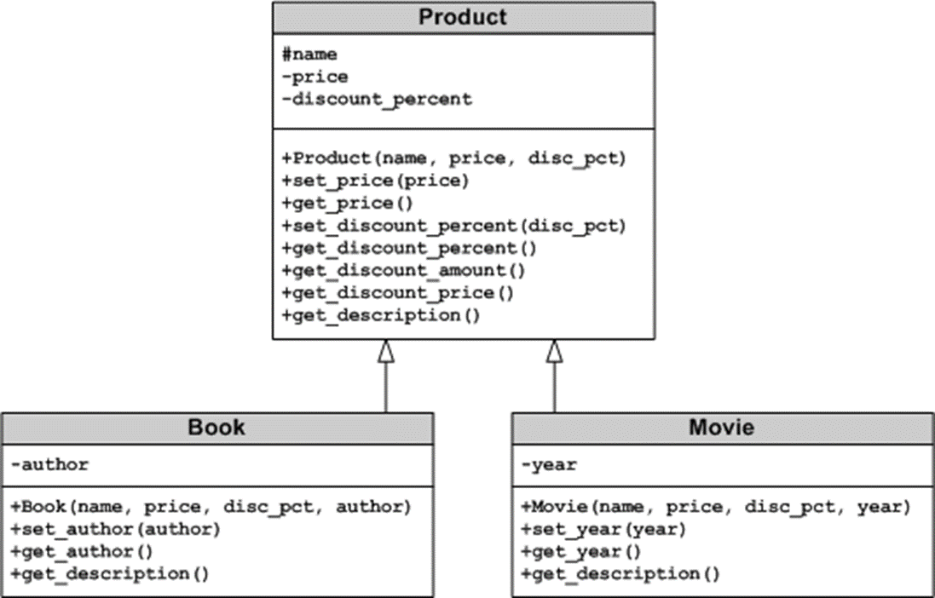
A UML diagram for three classes that use inheritance

Slide 5
Access modifiers
private
protected
public

Slide 6
The Product.h file for the Product superclass (part 1)
#ifndef MURACH_PRODUCT_H
#define MURACH_PRODUCT_H
#include <string>
class Product {
protected:
std::string name; // protected data member
private:
double price;
int discount_percent;
public:
Product(std::string name = "", double price = 0.0,
int discount_pct = 0);
void set_price(double);
double get_price() const { return price; }
void set_discount_percent(int);
int get_discount_percent() const {
return discount_percent;
}

Slide 7
The Product.h file for the Product superclass (part 2)
double get_discount_amount() const;
double get_discount_price() const;
// virtual function - necessary for polymorphism
virtual std::string get_description() const;
};
#endif // MURACH_PRODUCT_H
The get_description() function in the Product.cpp file
string Product::get_description() const {
return name;
}

Slide 8
The syntax for working with subclasses
To define a subclass
class SubclassName : public|protected|private SuperclassName {}
To define a subclass constructor that calls a superclass constructor
SubclassName([parameterList]) : SuperclassName(argumentList) {}
To call a superclass member function
SuperclassName::function_name(argumentList);

Slide 9
The Book.h file for the Book subclass (part 1)
#ifndef MURACH_BOOK_H
#define MURACH_BOOK_H
#include <string>
#include "Product.h"
class Book : public Product {
private:
std::string author;
public:
Book(std::string name = "", double price = 0.0,
int disc_pct = 0, std::string author_param = "") :
Product(name, price, disc_pct) {
author = author_param;
}
void set_author(std::string author_param) {
author = author_param;
}
std::string get_author() const { return author; }

Slide 10
The Book.h file for the Book subclass (part 2)
std::string get_description() const {
return name + " by " + author;
}
};
#endif // MURACH_BOOK_H
Another way to code get_description()
std::string get_description() const {
return Product::get_description() + " by " + author;
}

Slide 11
When coding a subclass…
You can add new members that aren’t in the superclass.
You can override existing member functions in the superclass by coding member functions that have the same name and signature.
You can directly access public and protected members of the superclass.
You can call member functions of the superclass by coding the name of the superclass, the scope resolution operator (::), and the name of the function.

Slide 12
The Movie.h file for the Movie subclass
#ifndef MURACH_MOVIE_H
#define MURACH_MOVIE_H
#include <string>
#include "Product.h"
class Movie : public Product {
private:
int year;
public:
Movie(std::string name = "", double price = 0.0, int disc_pct = 0,
int year_param = 1888) : Product(name, price, disc_pct) {
year = year_param;
}
void set_year(int year_param) {
year = year_param;
}
int get_year() const { return year; }
std::string get_description() const {
return name + " (" + std::to_string(year) + ')';
}
};
#endif // MURACH_MOVIE_H

Slide 13
Three definitions of get_description()
In the Product superclass
string Product::get_description() const {
return name;
}
In the Book subclass
string get_description() const {
return name + " by " + author;
}
In the Movie subclass
string get_description() const {
return name + " (" + std::to_string(year) + ')';
}

Slide 14
A function that calls the virtual function
void show_product(const Product& p) {
cout << "Description: " << p.get_description()
<< '\n';
cout << "Discount Price: " << p.get_discount_price()
<< "\n\n";
}

Slide 15
Code that passes three different object types to the function
int main() {
Product product("Stanley 13 Ounce Wood Hammer",
12.99, 62);
Book book("The Big Short", 15.95, 34,
"Michael Lewis");
Movie movie("The Wizard of Oz", 14.99, 50, 1939);
show_product(product);
show_product(book);
show_product(movie);
}

Slide 16
The console for code that passes three different object types
Description: Stanley 13 Ounce Wood Hammer
Discount Price: 4.94
Description: The Big Short by Michael Lewis
Discount Price: 10.53
Description: The Wizard of Oz (1939)
Discount Price: 7.49

Slide 17
The Product Viewer program (part 1)
PRODUCTS
1. Stanley 13 Ounce Wood Hammer
2. The Big Short by Michael Lewis
3. The Wizard of Oz (1939)
Enter product number: 2
PRODUCT DATA
Name: The Big Short by Michael Lewis
Price: 15.95
Discount percent: 34
Discount amount: 5.42
Discount price: 10.53
View another product? (y/n): y
Enter product number: 3

Slide 18
The Product Viewer program (part 2)
PRODUCT DATA
Name: The Wizard of Oz (1939)
Price: 14.99
Discount percent: 50
Discount amount: 7.5
Discount price: 7.49
View another product? (y/n): n
Bye!

Slide 19
Code for the Product Viewer program (part 1)
#include <iostream>
#include <string>
#include "Product.h"
#include "Book.h"
#include "Movie.h"
using namespace std;
const Product p1("Stanley 13 Ounce Wood Hammer", 12.99, 62);
const Book p2("The Big Short", 15.95, 34, "Michael Lewis");
const Movie p3("The Wizard of Oz", 14.99, 50, 1939);
void show_products() {
cout << "PRODUCTS\n"
<< "1. " << p1.get_description() << endl
<< "2. " << p2.get_description() << endl
<< "3. " << p3.get_description() << endl << endl;
}

Slide 20
Code for the Product Viewer program (part 2)
void show_product(const Product& p) {
cout << "PRODUCT DATA\n"
<< "Name: " << p.get_description() << endl
<< "Price: " << p.get_price() << endl
<< "Discount percent: " << p.get_discount_percent()
<< endl
<< "Discount amount: " << p.get_discount_amount()
<< endl
<< "Discount price: " << p.get_discount_price()
<< "\n\n";
}
int main() {
cout << "The Product Viewer program\n\n";
show_products();
char choice = 'y';
while (choice == 'y') {
int number;
cout << "Enter product number: ";
cin >> number;
cout << endl;

Slide 21
Code for the Product Viewer program (part 3)
switch (number) {
case 1:
show_product(p1);
break;
case 2:
show_product(p2);
break;
case 3:
show_product(p3);
break;
default:
cout << "Invalid product number.\n\n";
break;
}
cout << "View another product? (y/n): ";
cin >> choice;
cout << endl;
}
cout << "Bye!\n\n";
return 0;
}

Slide 22
A pure virtual function in the Product.h file
class Product {
protected:
std::string name; // protected data member
private:
double price;
int discount_percent;
public:
// other public functions and constructors
// pure virtual function
virtual std::string get_description() const = 0;
};

Slide 23
Two subclasses that override the pure virtual function
In the Book subclass
std::string get_description() const {
return name + " by " + author;
}
In the Movie subclass
std::string get_description() const {
return name + " (" + std::to_string(year) + ')';
}

Slide 24
Code that attempts to create Product, Book, and Movie objects
// Compile-time error! Cannot instantiate
// abstract Product class
Product p1("Stanley 13 Ounce Wood Hammer", 12.99, 62);
// Success! Can instantiate Book and Movie classes
Book p2("The Big Short", 15.95, 34, "Michael Lewis");
Movie p3("The Wizard of Oz", 14.99, 50, 1939);

Slide 25
Two functions that explicitly override another function
In the Book subclass
string get_description() const override {
return name + " by " + author;
}
In the Movie subclass
string get_description() const override {
return name + " (" + std::to_string(year) + ')';
}

Slide 26
A function that can’t be overridden
In the Book subclass
string get_description() const final {
return name + " by " + author;
}
In the Movie subclass
string get_description() const final {
return name + " (" + std::to_string(year) + ')';
}

Slide 27
A function that explicitly overrides and can’t be overridden
In the Book subclass
string get_description() const override final {
return name + " by " + author;
}

Slide 28
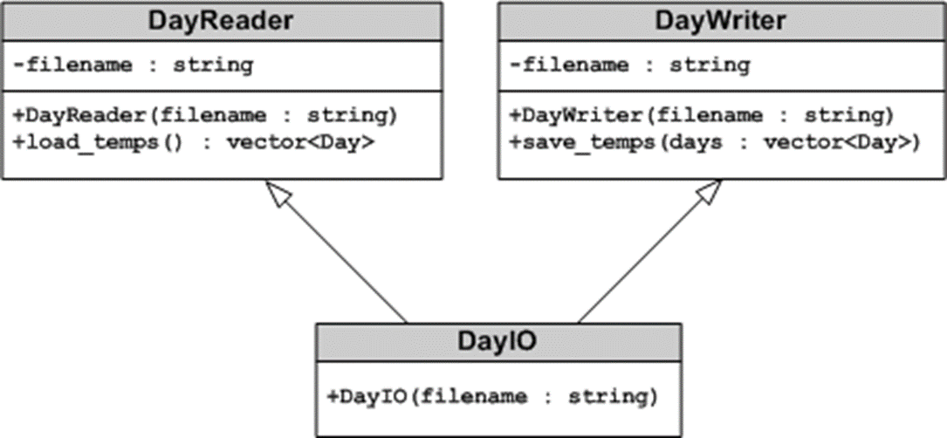
A UML diagram for a class that uses multiple inheritance

Slide 29
The Day structure
#ifndef MURACH_DAY_H
#define MURACH_DAY_H
struct Day {
double low_temp;
double high_temp;
};
#endif // MURACH_DAY_H

Slide 30
The DayReader superclass (part 1)
The DayReader.h file
#ifndef MURACH_DAYREADER_H
#define MURACH_DAYREADER_H
#include <string>
#include <vector>
#include "Day.h" // include Day structure
class DayReader {
private:
std::string filename;
public:
DayReader(std::string filename = "");
std::vector<Day> load_temps();
};
#endif // MURACH_DAYREADER_H

Slide 31
The DayReader superclass (part 2)
The DayReader.cpp file
#include <fstream>
#include <vector>
#include "DayReader.h"
#include "DayIOError.h"
using namespace std;
DayReader::DayReader(std::string filename_param) {
filename = filename_param;
}

Slide 32
The DayReader superclass (part 3)
The DayReader.cpp file
vector<Day> DayReader::load_temps() {
vector<Day> days;
Day day;
ifstream input_file(filename);
if (input_file) {
while (input_file >> day.low_temp >> day.high_temp) {
days.push_back(day);
}
input_file.close();
return days;
}
else {
throw DayIOError("Unable to open file: " + filename);
}
}

Slide 33
The DayWriter superclass (part 1)
The DayWriter.h file
#ifndef MURACH_DAYWRITER_H
#define MURACH_DAYWRITER_H
#include <string>
#include <vector>
#include "Day.h" // include Day structure
class DayWriter {
private:
std::string filename;
public:
DayWriter(std::string filename = "");
void save_temps(const std::vector<Day>& temps);
};
#endif // MURACH_DAYWRITER_H

Slide 34
The DayWriter superclass (part 2)
The DayWriter.cpp file
#include <fstream>
#include <vector>
#include "DayWriter.h"
using namespace std;
DayWriter::DayWriter(std::string filename_param) {
filename = filename_param;
}
void DayWriter::save_temps(const vector<Day>& days) {
ofstream output_file(filename);
for (Day day : days) {
output_file << day.low_temp << '\t'
<< day.high_temp << '\n';
}
output_file.close();
}

Slide 35
The DayIO subclass (part 1)
The DayIO.h file
#ifndef MURACH_DAYIO_H
#define MURACH_DAYIO_H
#include <string>
#include "DayReader.h"
#include "DayWriter.h"
class DayIO : public DayReader, public DayWriter
{
public:
DayIO(std::string filename = "");
};
#endif // MURACH_DAYIO_H

Slide 36
The DayIO subclass (part 2)
The DayIO.cpp file
#include <string>
#include "DayIO.h"
DayIO::DayIO(std::string filename) : DayReader(filename),
DayWriter(filename)
{}

Slide 37
Code that uses the DayIO subclass
Create a DayIO object
DayIO dayIO("temps.txt");
Use the DayIO object to get a vector of Day objects
vector<Day> days = dayIO.load_temps();
Use the DayIO object to save a vector of Day objects
dayIO.save_temps(days);

Slide 38
The hierarchy for some common exceptions
exception
logic_error
invalid_argument
out_of_range
runtime_error
range_error
overflow_error
underflow_error

Slide 39
A DayIOError.h file that defines a class for a custom exception
#ifndef MURACH_DAYIOERROR_H
#define MURACH_DAYIOERROR_H
#include <iostream>
#include <string>
class DayIOError : public std::runtime_error {
public:
DayIOError(std::string message = "") :
runtime_error(message) {};
};
#endif // MURACH_DAYIOERROR_H

Slide 40
Code that throws the custom exception
vector<Day> DayReader::load_temps() {
vector<Day> days;
Day day;
ifstream input_file(filename);
if (input_file) {
// code that reads data from the file goes here
return days;
}
else {
throw DayIOError("Unable to open file: " + filename);
}
}

Slide 41
Code that catches a custom exception
vector<Day> days;
try {
days = dayIO.load_temps();
}
catch (const DayIOError& e) {
cout << e.what() << "\n"
<< "Exiting program. Bye!\n\n";
return 0;
}

Slide 42
It makes sense to use inheritance when…
One object is a type of another object.
Both classes are part of the same logical domain.
The subclass primarily adds features to the superclass.

Slide 43
A Dice class that inherits the vector class (not recommended)
The Dice.h file
#include <vector>
#include "Die.h"
class Dice : public std::vector<Die>
{
public:
Dice() : vector<Die>() {};
void roll_all();
};
The Dice.cpp file
#include "Dice.h"
void Dice::roll_all() {
for (int i = 0; i < size(); ++i) {
// calls vector size() function
Die& die = at(i); // calls vector at() function
die.roll();
}
}

Slide 44
Code that uses this Dice class
Dice dice = Dice();
dice.push_back(Die()); // function from vector class
dice.push_back(Die()); // function from vector class
dice.roll_all();
Die die = dice[0]; // operator from vector class
dice.insert(dice.begin(), Die());
// function from vector class
dice.pop_back(); // function from vector class
cout << "Die value: " << die.get_value() << endl;
cout << "Dice count: " << dice.size() << endl;

Slide 45
A few problems with this approach
The Dice object is not a type of vector object.
Both classes are not part of the same logical domain.
The interface is too complex.
It violates encapsulation.

