Slide 1
What Do Audiences Reward?
SQL exploration of IMDB movies, 2010-2019
Part 2: exploratory findings, business question, and data cleaning plan
Notes:
Part 2 of the SQL summative lab: exploration of the IMDB movie database using SQL and pandas.

Slide 2
Initial exploration findings
65,720
movies analysed (2010-2019, with rating, genre and runtime)
Documentary, Biography, History and Sport rate highest; Horror (about 4.9), Sci-Fi and Thriller rate lowest.
Many top-rated genres have tiny audiences (median 21 votes for Documentary), so low-vote ratings are unreliable.
Longer films get far more votes: median 12 votes at 60 minutes or less vs about 229 at 150+ minutes.
Average rating is stable at about 6.3 across 2010-2018.
1,063
records dated after 2019, excluded
6.32
average IMDB rating across the set
Notes:
Genres are comma-separated, so each movie was split into one row per genre before grouping. Runtime and genre nulls were excluded, not filled.

Slide 3
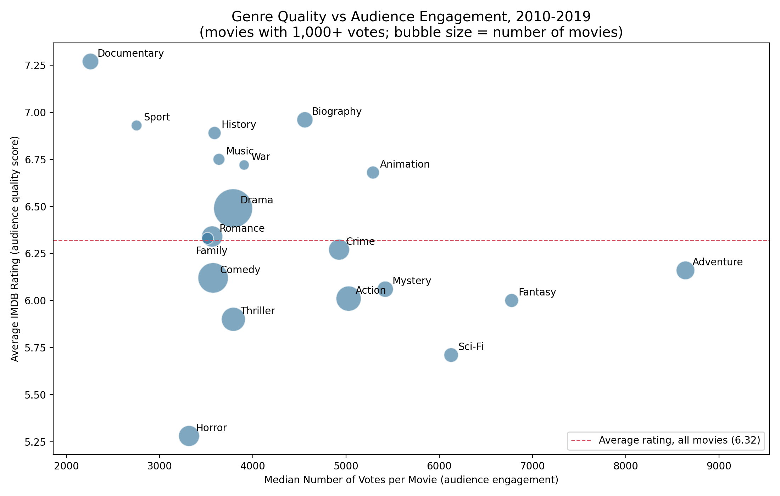
Genre quality vs. engagement
Business question
Which genres should a studio or streaming service prioritize: those that combine high ratings with strong engagement, or high-volume genres like Drama and Comedy? Does a longer runtime help?
Movies with 1,000+ votes; genres with 100+ movies. Documentary, Biography and Animation rate well; Adventure, Fantasy and Sci-Fi draw the most votes but rate below average; Horror is lowest.
Notes:
Follow-up analysis: join directors/principals to test whether talent explains rating differences, and split by year to check stability.

Slide 4
Data cleaning tasks identified
Out-of-range years
Nulls
1,063 movies start after 2019 (even 2115); filter them out
31,739 missing runtimes, 5,408 missing genres; drop, do not fill. Only 73,856 of 146,144 movies have a rating
Multi-valued genres
Runtime outliers
59,378 rows store several genres in one text field; split to one row per genre
Values from 1 to 51,420 minutes; set sensible bounds, separate shorts
Low-vote ratings
Types and titles
45,103 ratings rest on under 100 votes; apply a minimum vote threshold
Floats for years; 14,504 titles differ from original; check duplicates in link tables
Notes:
These tasks were identified but not performed, per the assignment.

Slide 5
Next steps
Apply the cleaning list, then rerun the genre and runtime analysis.
Join directors and principals to test whether talent explains rating differences.
Split by release year to check whether the genre pattern holds across the decade.

