Slide 1
Preliminary Data Analysis on NCI-60 and TCGA dataset

Slide 2
Previously discussed..
Hypothesis: Centrosome amplification leads to changes in the expression pattern of cell junction genes.
Aim of the proposed study is to find association between gene expression of centrosomal genes (a validated CA20 gene panel) and CJ genes.
CA20 Genes – group of 20 genes related to centrosome amplification, published in Ogden et al., 2017 PMID:28325915.
In Ogden et al., CA20 score is developed that is based on the log2 normalized expression value of all the genes in the CA20 panel. CA20 genes work as a ‘group’

Slide 3
Datasets
NCI-60 , 60 cancer cell lines data, No controls
TCGA data, 11,315 samples for 32 Cancer cohorts

Slide 4
CA20 and CJ30
CA20
AURKA, CCNA2,CCND1, CCNE2, CDK1, CEP63, CEP152, E2F1, E2F2, LMO4, MDM2, MYCN, NDRG1, NEK2, PIN1, PLK1,PLK4,SASS6, STIL,TUBG1
CJ30
CLDN1, CLDN3, CLDN4, CLDN7, OCLN, TJP1, F11R, CGN, CXADR, MARVELD3, CRB3, PARD3, SCRIB, SFN, CDH1, CTNNB1, CTNNA1, JUP, DSG2, DSG3, GJA1, PECAM1, EPCAM, NCAM1, ICAM1, VCAM1, SELE, ITGB3, ITGB1, ITGAV

Slide 5
Initial Experiments Performed – NCI-60
Calculate cross correlation between expression of each gene in CA20 panel with each gene in CJ30 group
Calculate cross correlation between the sum of expressions of all the genes in CA20 panel with each individual gene in CJ30 group
Calculate the correlation between CA20 score and score for each gene in the CJ30 panel.
Correlation between CA20 Score and biological readout of CA

Slide 6
Motivation to use correlation and Differential expression analysis
Hypothesis: Centrosome amplification leads to changes in the expression pattern of cell genes.
We want to find if the CJ30 genes are associated with the CA20 genes. Measuring the correlation between the expression of CA20 genes and C30 genes will give us an idea if the genes are related.

Slide 7
Initial Experiments performed on TCGA Data
Pan Cancer
Cross Correlation b/w CA20 and CJ30 Genes
Cross Correlation b/w CA20Score and CJ30 genes
Differential expression analysis of CJ30 genes b/w Cancer and Non-Cancer samples
Breast Cancer
Cross Correlation b/w CA20 and CJ30 Genes
Cross Correlation b/w CA20Score and CJ30 genes
Differential expression analysis of CJ30 genes b/w BRCA and Normal Samples
Luminal A, Luminal B, Her2 and Basal Subgroup
Cross Correlation b/w CA20 and CJ30 Genes
Cross Correlation b/w CA20Score and CJ30 genes
Differential expression analysis of CJ30 genes b/w BRCA-subgroup and Normal Samples

Slide 8
CA20 Score
Ogden et al., 2017
CA20 is a significant predictor of BCSS
CA20 score is calculate by stratifying the log2 normalized CA20 expression values by optimal and average cut points
average cut points: Any value below the average is put it the category “Low” and every value above it is labelled “High.” If we calculate the scores on NCI-60 cell lines, these will be divided into high and low CA20 scores
NIC-60: 59 cell lines (complete data) , 27 with high CA20 score and 32 with low

Slide 9
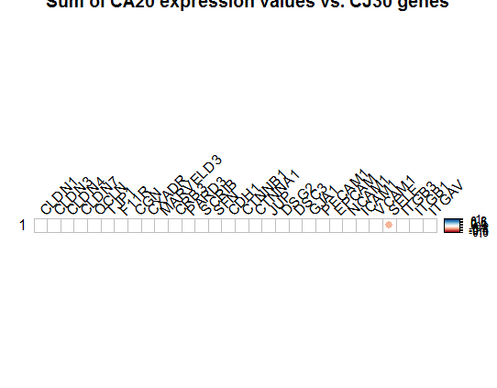
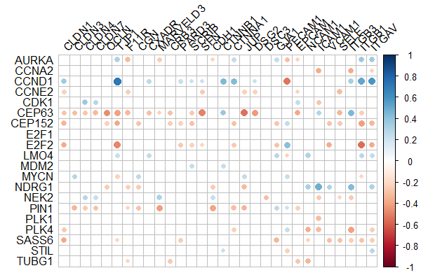
Cross Correlation between CA20 and CJ30 – NCI-60
Cor: -0.339
p-val = 0.0086
The difference in the correlation results from previous graphs is because, some of the CA20 genes are negatively correlated with some of the CJ30 genes, and some positively. This also shows that CA20 taken as a group or taken as individual gene expressions shows different association with each gene in CJ30 panel
CA20 Score
CA20 Panel
Observations:
SELE gene is only gene in CJ30 panel that is significantly (negatively) correlated with the overall CA20 score on NCI-60 data.
CJ30 Panel

Slide 10
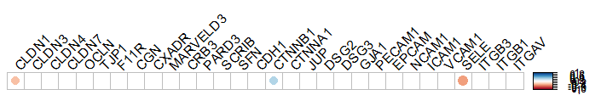
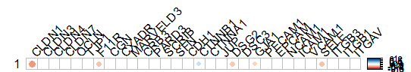
Correlation between stratified CA20 score and individual expression values of each of CJ30 genes stratified on basis of average value
Spearman’s Correlation, because:
Variables are ordinal (high or low)
There is a monotonic relationship between the two variables. A monotonic relationship exists when either the variables increase in value together, or as one variable value increases, the other variable value decreases.
Observations:
SELE and CLDN1 genes in CJ30 panel are significantly (negatively) correlated with the stratified CA20 score on NCI-60 data.
CTNNB1 is significantly (positively) correlated with stratified CA20 Score.
CTNNB1
Cor = 0.29, p-val = 0.025
Stratified CA20 Score
CLDN1
Cor = -0.29 , p-val = 0.025
SELE
Cor = -0.41 , p-val = 0.0010
CJ30 panel: Stratified gene expression
<- These are results after changing the gene DSG3 to DSC3, since individual gene scores are depenedent on the average of the group, and the average changes when I replaced a gene, therefore there is a change in the results of all the genes.

Slide 11
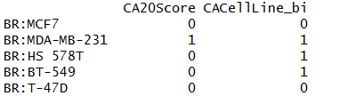
Measuring Association of CA20 score with biological readout of CA
Correlation between sum of CA20 expression and percentage of CA (from biological readout) – no linear correlation found
Cor = 0.0153
P-val 0.9
Correlation between stratified CA20 Score and CA (from biological readout) – no correlation found
Cor = -0.0571
P-val 0.6859
Discussion:
There seems to be no correlation between the CA readout and CA20 score in the NCI-60 dataset. Possible reasons?
Small sample size:
CA20 was developed on Breast cancer patients (TCGA-BRCA and METABRIC). NCI-60 cell lines include 60 cell lines of 9 different cancer types. Only 5 of these are breast cancer samples, 4 of these have low CA20Score and only 1 has high CA20Score . The one that has high CA20 Score also has high CA (readout). Unable to conclude due to small sample size.
Error in calculation on CA20 score?

Slide 12
Next steps?
Extend the analysis on TCGA data because:
Bigger resource of data than NCI-60
CA20 Score was developed on TCGA (and METABRIC) data
There are multiple samples of each cancer type in TCGA

Slide 13
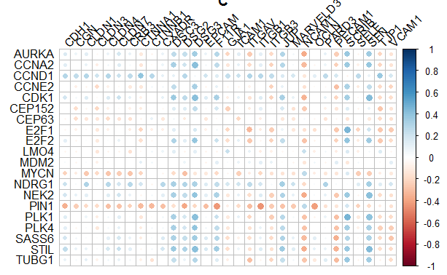
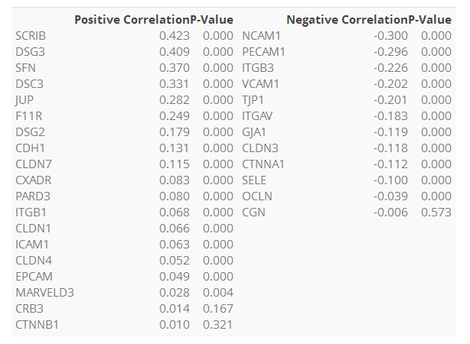
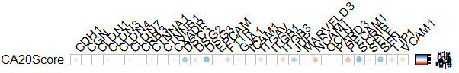
Pan Cancer Cross Correlation b/w CA and CJ genes
Correlation betweenCA20 gene expression and CJ30 Gene expression
CJ30 Panel
Table: (Left) Positively correlated genes, (Right) Negatively correlated genes sorted in descending order.
CA20 Score
CA20 Score
CA20 Score
CA20 Panel
Observations
SCRIB, DSG3, SFN significantly positively correlated with CA20 score in Pan cancer analysis.
NCAM1, PECAM1 significantly negatively correlated with CA20 Score.

Slide 14
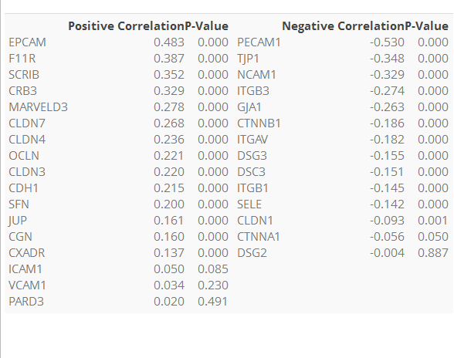
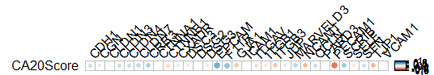
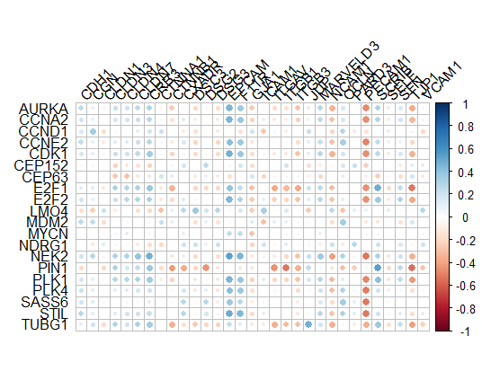
Breast Cancer Cohort - Cross Correlation b/w CA-CJ genes
The previous slide shows correlation between gene expression of all cancer types and CA20 score, now we extract only the 1212 breast cancer samples.
Table: (Left) Positively correlated genes, (Right) Negatively correlated genes sorted in descending order.
Observations
EPCAM, F11R, SCRIB and CRB3 are significantly positively correlated with CA20 score in BRCA samples analysis.
PECAM1, TJP1, NCAM1 are negatively correlated with CA20Score.

Slide 15
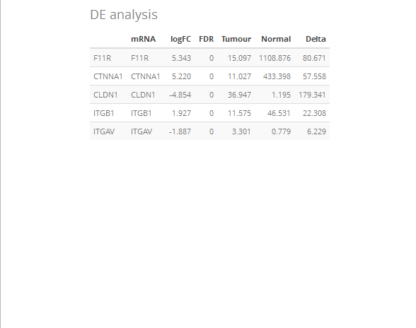
Differential Expression analysis
Differential gene expression (DGE) analysis is the comparison of the gene expression values between two sample groups types. Differential gene expression analysis between different cells can help to uncover driver genes.
For example: Tumour vs. Matched Normal
It might be useful to see which of the CJ30 genes are differentially expressed (dysregulated) in tumour cells when analysed against matched normal samples.
log Fold change
Fold change is a measure describing how much a quantity changes between an original and a subsequent measurement. It is defined as the ratio between the two quantities
Log2 ratios are often used for analysis and visualization of fold changes, a doubling in the original scaling is equal to a log₂ fold change of 1, a quadrupling is equal to a log₂ fold change of 2 and so on.
FDR :False Discovery rate
It is the expected proportion of type I errors.
Observations
The above 5 genes from CJ30 are significantly dysregulated in in BRCA tumour vs. matched normal DE analysis. F11R has down regulated in tumour samples, and is also seen to be significantly correlated with the CA20Score.

Slide 16
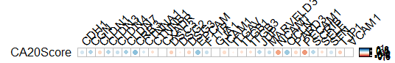
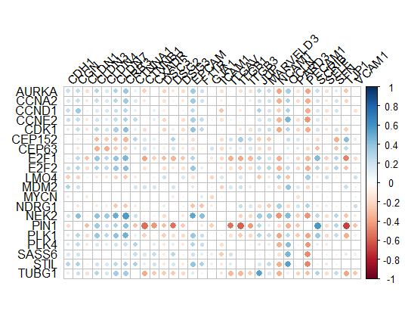
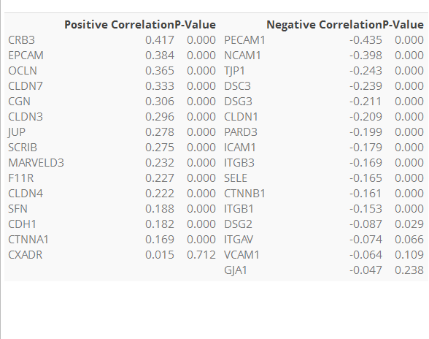
Subtypes Lum A
625 samples (564 tumour, 61 normal)
In luminal A cancer subtypes, 230 out of 564 tumour samples have a higher CA20Score while 60 out of 61 Normal samples have a lower CA20Score.
Table: (Left) Positively correlated genes, (Right) Negatively correlated genes sorted in descending order.
Observations
CRB3, EPCAM, OCLN, CLDN7 are strongly +vely correlated whereas PECAM1, NCAM1 are negatively correlated with CA20 score in BRCA luminal A samples.

Slide 17
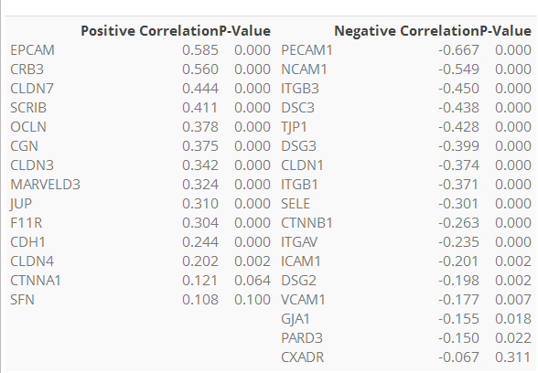
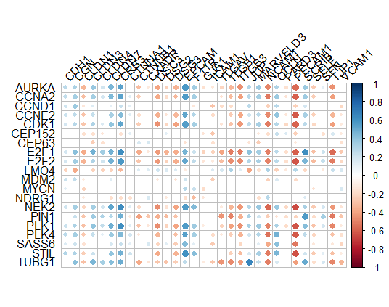
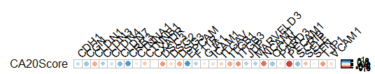
Subtypes Lum B
233 samples only (211 tumor, 22 matched normal)
In luminal B cancer subtypes, 207 out of 211 tumour samples have a higher CA20Score while all 22 matched Normal samples have a lower CA20Score.
Table: (Left) Positively correlated genes, (Right) Negatively correlated genes sorted in descending order.
Observations
CRB3, EPCAM, CLDN7, SCRIB, OCLN, CGN are strongly +vely correlated whereas PECAM1, NCAM1, ITGB3, TJP1, DSC3, DSG3, CLDN1 are negatively correlated with CA20 score in BRCA luminal B samples.

Slide 18
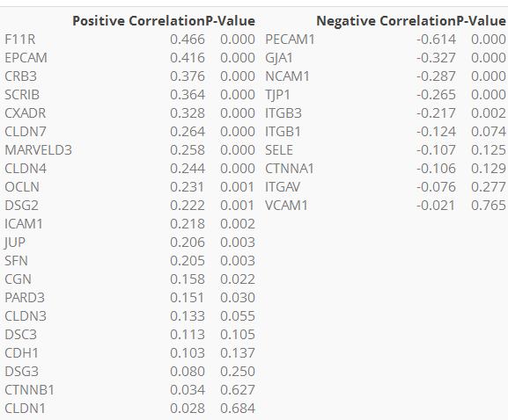
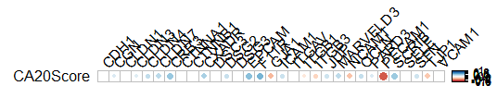
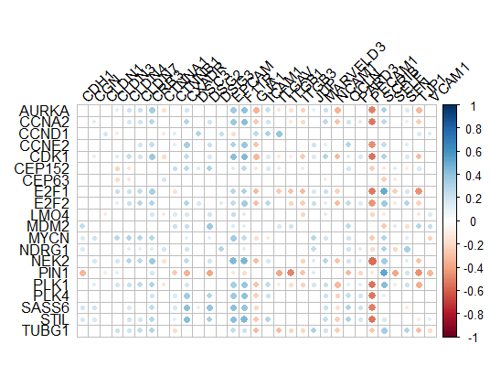
Subtypes Basal
208 samples, 191 Tumour and 17 matched Normal
In Basal samples, 188 out of 191 samples have a higher CA20Score while all 17 normal samples have a lower CA20Score.
Table: (Left) Positively correlated genes, (Right) Negatively correlated genes sorted in descending order.
Observations
F11R, CRB3, EPCAM, SCRIB, CXADR are +vely correlated whereas PECAM1, GJA1 are negatively correlated with CA20 score in BRCA Basal samples.

Slide 19
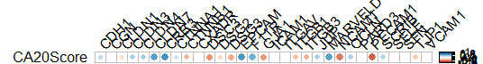
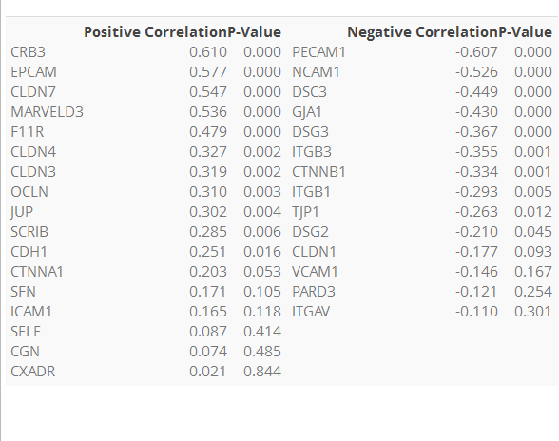
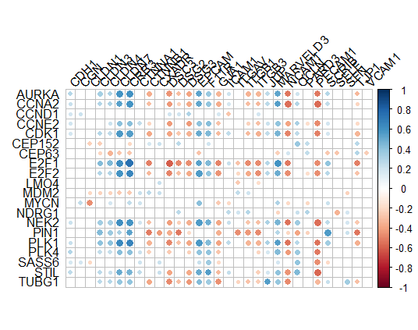
Subtypes Her2
91 samples, 82 tumour and 9 matched normal samples
In Her2 BRCA Subtype, all 9 normal samples have a lower CA20Score while 79 out of 82 tumour samples have a high CA20Score.
Table: (Left) Positively correlated genes, (Right) Negatively correlated genes sorted in descending order.

