Slide 1
Preliminary Data Analysis on NCI-60 and TCGA dataset

Slide 2
Previously discussed..
Hypothesis: Centrosome amplification leads to changes in the expression pattern of cell junction genes.
Aim of the proposed study is to find association between gene expression of centrosomal genes (a validated CA20 gene panel) and CJ genes.
CA20 Genes – group of 20 genes related to centrosome amplification, published in Ogden et al., 2017 PMID:28325915.
In Ogden et al., CA20 score is developed that is based on the log2 normalized expression value of all the genes in the CA20 panel. CA20 genes work as a ‘group’

Slide 3
Datasets
NCI-60 , 60 cancer cell lines data, No controls
TCGA data, 11,315 samples for 32 Cancer cohorts

Slide 4
CA20 and CJ30
CA20
AURKA, CCNA2,CCND1, CCNE2, CDK1, CEP63, CEP152, E2F1, E2F2, LMO4, MDM2, MYCN, NDRG1, NEK2, PIN1, PLK1,PLK4,SASS6, STIL,TUBG1
CJ30
CLDN1, CLDN3, CLDN4, CLDN7, OCLN, TJP1, F11R, CGN, CXADR, MARVELD3, CRB3, PARD3, SCRIB, SFN, CDH1, CTNNB1, CTNNA1, JUP, DSG2, DSG3, GJA1, PECAM1, EPCAM, NCAM1, ICAM1, VCAM1, SELE, ITGB3, ITGB1, ITGAV

Slide 5
Initial Experiments Performed – NCI-60
Calculate cross correlation between expression of each gene in CA20 panel with each gene in CJ30 group
Calculate cross correlation between the sum of expressions of all the genes in CA20 panel with each individual gene in CJ30 group
Calculate the correlation between CA20 score and score for each gene in the CJ30 panel.
Correlation between CA20 Score and biological readout of CA

Slide 6
Motivation to use correlation and Differential expression analysis
Hypothesis: Centrosome amplification leads to changes in the expression pattern of cell genes.
We want to find if the CJ30 genes are associated with the CA20 genes. Measuring the correlation between the expression of CA20 genes and C30 genes will give us an idea if the genes are related.
Additionally, on TCGA data, we do DE analysis to see which genes in the CJ30 group are dysregulated in tumour samples, when compared against matched normal samples.
DE analysis: statistical analysis to discover quantitative changes in expression levels between experimental groups

Slide 7
Initial Experiments performed on TCGA Data
Pan Cancer
Cross Correlation b/w CA20 and CJ30 Genes
Cross Correlation b/w CA20Score and CJ30 genes
Differential expression analysis of CJ30 genes b/w Cancer and Non-Cancer samples
Breast Cancer
Cross Correlation b/w CA20 and CJ30 Genes
Cross Correlation b/w CA20Score and CJ30 genes
Differential expression analysis of CJ30 genes b/w BRCA and Normal Samples
Luminal A, Luminal B, Her2 and Basal Subgroup
Cross Correlation b/w CA20 and CJ30 Genes
Cross Correlation b/w CA20Score and CJ30 genes
Differential expression analysis of CJ30 genes b/w BRCA-subgroup and Normal Samples

Slide 8
CA20 Score
Ogden et al., 2017
CA20 is a significant predictor of BCSS
CA20 score is calculate by stratifying the log2 normalized CA20 expression values by optimal and average cut points
average cut points: Any value below the average is put it the category “Low” and every value above it is labelled “High.” If we calculate the scores on NCI-60 cell lines, these will be divided into high and low CA20 scores
NIC-60: 59 cell lines (complete data) , 27 with high CA20 score and 32 with low

Slide 9
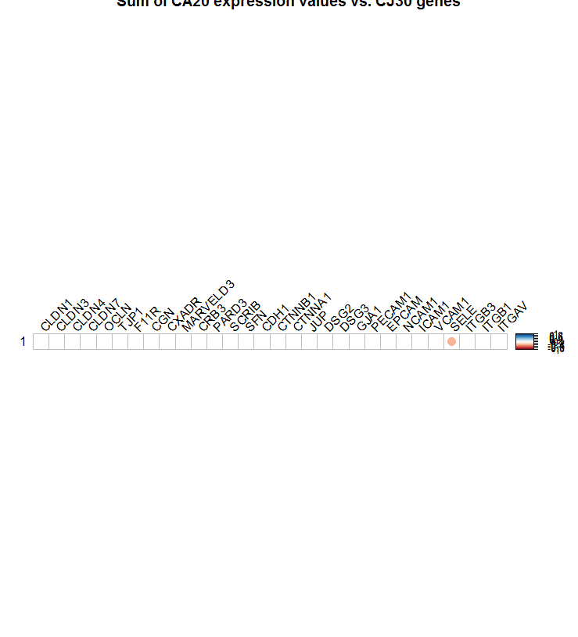
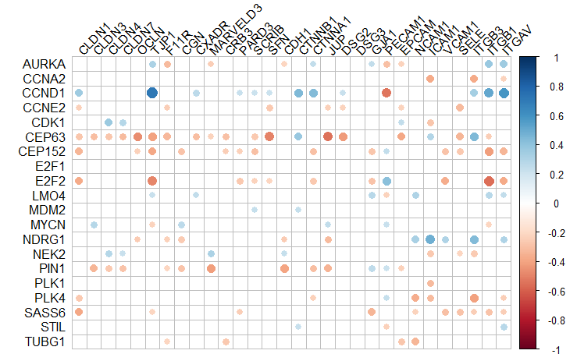
Cross Correlation between CA20 and CJ30 – NCI-60
The difference in the correlation results from previous graphs is because, some of the CA20 genes are negatively correlated with some of the CJ30 genes, and some positively. This also shows that CA20 taken as a group or taken as individual gene expressions shows different association with each gene in CJ30 panel
CA20 Score
CA20 Panel
Observations:
SELE gene is only gene in CJ30 panel that is significantly (negatively) correlated with the overall CA20 score on NCI-60 data.
CJ30 Panel

Slide 10
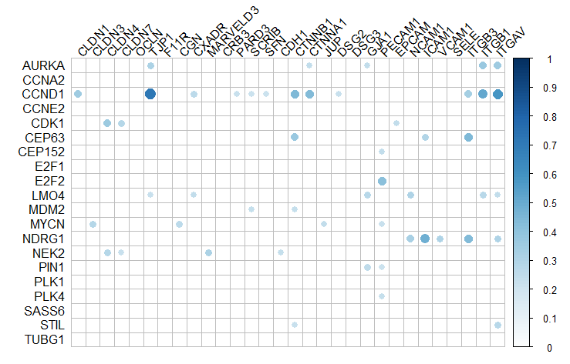
Positive Cross Correlation between CA20 and CJ30
CJ30 Panel
CA20 Panel

Slide 11
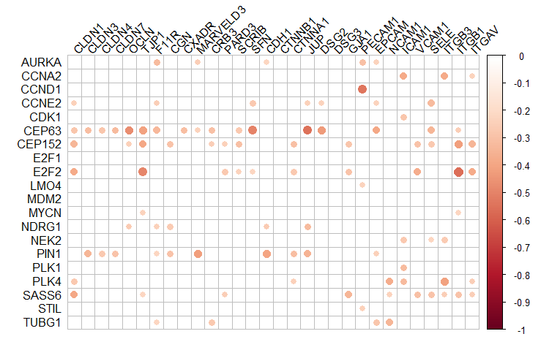
Negative Cross Correlation between CA20 and CJ30
CJ30 Panel
CA20 Panel

Slide 12
Correlation b/w Sum of CA20 expression and individual CJ Genes
Correlation
-0.339
P-val 0.0086
Sum CA20
Panel
The difference in the correlation results from previous graphs is because, some of the CA20 genes are negatively correlated with some of the CJ30 genes, and some positively. According to this graph, sum of all CA20 genes is negatively correlated with SELE gene only.
This also shows that CA20 taken as a group or taken as individual gene expressions shows different association with each gene in CJ30 panel

Slide 13
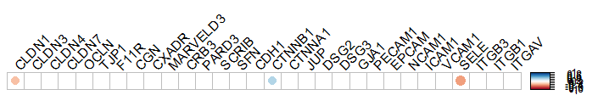
Correlation between stratified CA20 score and individual expression values of each of CJ30 genes stratified on basis of average value
Spearman’s Correlation, because:
Variables are ordinal (high or low)
There is a monotonic relationship between the two variables. A monotonic relationship exists when either the variables increase in value together, or as one variable value increases, the other variable value decreases.
Observations:
SELE and CLDN1 genes in CJ30 panel are significantly (negatively) correlated with the stratified CA20 score on NCI-60 data.
CTNNB1 is significantly (positively) correlated with stratified CA20 Score.
Stratified CA20 Score
CJ30 panel (stratified)

Slide 14
Correlation between CA20 score and CJ30 Score
Kendall's rank correlation = -0.1489611 ,
p-value = 0.2566
Alternative hypothesis rejected, i.e. no correlation found between CA20 score and CJ30 score categorized

Slide 15
Notes for Self
Co-expression network is a class of coarse-scale, simplistic models that relies directly on pairwise or low-order conditional pairwise association measures, such as the (partial) correlation or (conditional) mutual information, for inferring the connectivities between genes. These methods have the advantage of low computational complexity, and can scale up to very large networks of thousands of genes. However, their major limitation is that they do not model the network dynamics, and hence cannot perform prediction.
Differential equation (DE) based approaches are a class of sophisticated, well established methods which have long been used for modeling biochemical phenomena, including GRNs [4, 5]. A particularly salient feature of DE-based approaches is that they can accurately model the detailed dynamics of biochemical systems in continuous time. However, these methods are also much more computationally intensive, and so far are only applicable to relatively small networks of a handful genes (i.e., 5–30).
Lying in-between these two extremes are Bayesian networks (BN), a class of models that are based on solid principles of probability and statistics. A BN represents accurately and compactly the joint distribution of a set of variables, using probability and graph theories. BN can also perform prediction of the GRN behavior in unknown conditions, albeit not at as detailed level as DE-based approaches.

Slide 16
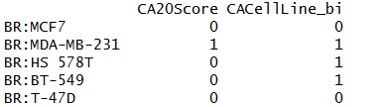
Measuring Association of CA20 score with biological readout of CA
Correlation between sum of CA20 expression and percentage of CA (from biological readout) – no linear correlation found
Cor = 0.0153
P-val 0.9
Correlation between stratified CA20 Score and CA (from biological readout) – no linear correlation found
Cor = 0.0571
P-val 0.6859
Discussion:
There seems to be no correlation between the CA readout and CA20 score in the NCI-60 dataset. Possible reasons?
Small sample size:
CA20 was developed on Breast cancer patients (TCGA-BRCA and METABRIC). NCI-60 cell lines include 60 cell lines of 9 different cancer types. Only 5 of these are breast cancer samples, 4 of these have low CA20Score and only 1 has high CA20Score . The one that has high CA20 Score also has high CA (readout). Unable to conclude due to small sample size.
Error in calculation on CA20 score?

Slide 17
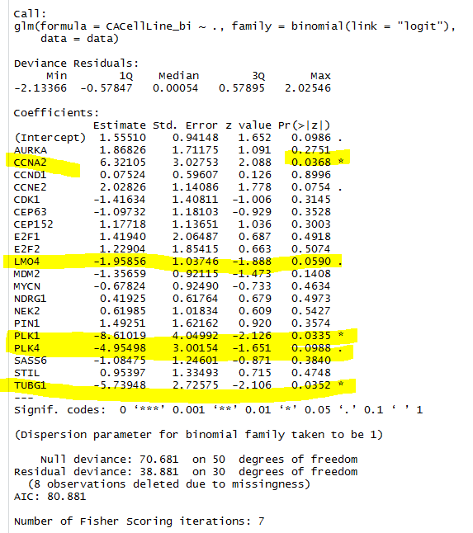
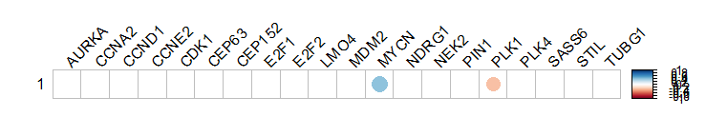
Measuring Association of CA20 score with biological readout of CA
Correlation between expression of each individual gene in CA20 and CA (from biological readout) – logistic regression.
The genes highlighted below show significant genes responsible for determining the value of CA (binomial), these are CCND1, CCNE2, PLK1, PLK4 and TUBG1. The PLK1, PLK4, and TUBG1 has negative correlation with the value of CA (binomial).
Correlation between expression of each individual gene in CA20 and percentage of CA (from biological readout) – Only MYCN has statistically significant positive correlation at p-val 0.0029. PLK1 has inverse correlation.

Slide 18
Next steps?
Extend the analysis on TCGA data because:
Bigger resource of data than NCI-60
CA20 Score was developed on TCGA (and METABRIC) data
There are multiple samples of each cancer type in TCGA

Slide 19
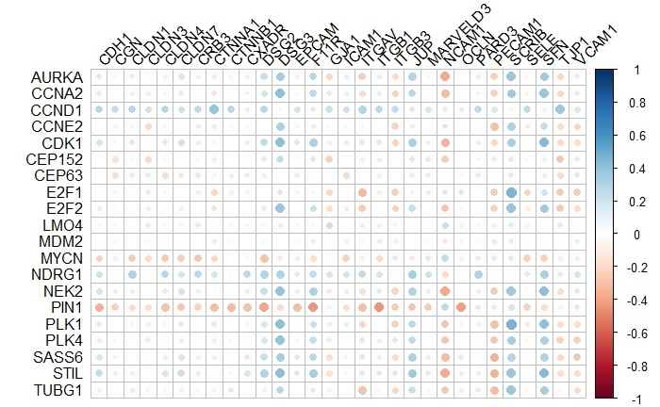
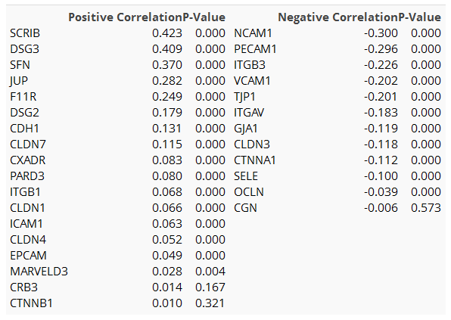
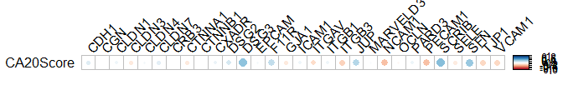
Pan Cancer Cross Correlation b/w CA and CJ genes
Correlation betweenCA20 gene expression and CJ30 Gene expression
Table: (Left) Positively correlated genes, (Right) Negatively correlated genes sorted in descending order.
Observations
SCRIB, DSG3, SFN significantly positively correlated with CA20 score in Pan cancer analysis.
NCAM1, PECAM1 significantly negatively correlated with CA20 Score.

Slide 20
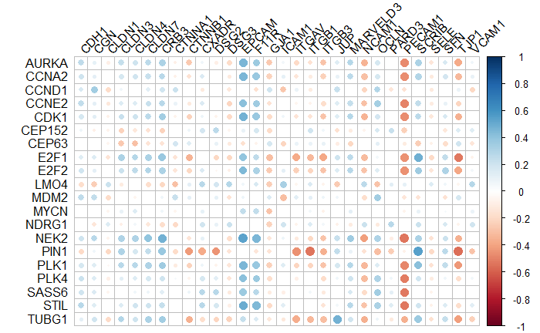
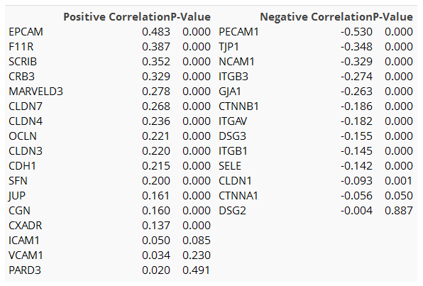
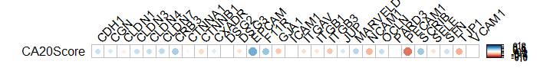
Breast Cancer Cohort - Cross Correlation b/w CA-CJ genes
The previous slide shows correlation between gene expression of all cancer types and CA20 score, now we extract only the 1212 breast cancer samples.
Table: (Left) Positively correlated genes, (Right) Negatively correlated genes sorted in descending order.
Observations
EPCAM, F11R, SCRIB and CRB3 are significantly positively correlated with CA20 score in BRCA samples analysis.
PECAM1, TJP1, NCAM1 are negatively correlated with CA20Score.

Slide 21
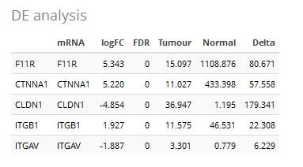
Differential Expression analysis
Differential gene expression (DGE) analysis is the comparison of the gene expression values between two sample groups types. Differential gene expression analysis between different cells can help to uncover driver genes.
For example: Tumour vs. Matched Normal
It might be useful to see which of the CJ30 genes are differentially expressed (dysregulated) in tumour cells when analysed against matched normal samples.
log Fold change
Fold change is a measure describing how much a quantity changes between an original and a subsequent measurement. It is defined as the ratio between the two quantities
Log2 ratios are often used for analysis and visualization of fold changes, a doubling in the original scaling is equal to a log₂ fold change of 1, a quadrupling is equal to a log₂ fold change of 2 and so on.
FDR :False Discovery rate
It is the expected proportion of type I errors.
Observations
The above 5 genes from CJ30 are significantly dysregulated in in BRCA tumour vs. matched normal DE analysis. F11R has down regulated in tumour samples, and is also seen to be significantly correlated with the CA20Score.

Slide 22
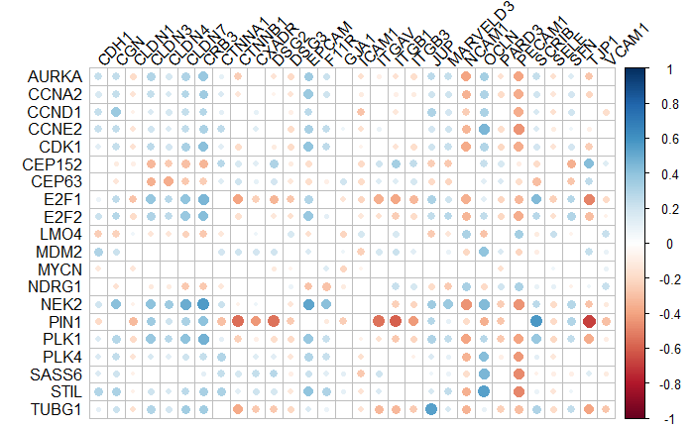
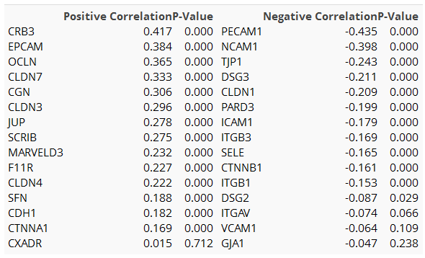
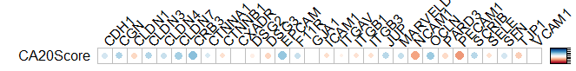
Subtypes Lum A
625 samples (564 tumour, 61 normal)
In luminal A cancer subtypes, 230 out of 564 tumour samples have a higher CA20Score while 60 out of 61 Normal samples have a lower CA20Score.
Table: (Left) Positively correlated genes, (Right) Negatively correlated genes sorted in descending order.
Observations
CRB3, EPCAM, OCLN, CLDN7 are strongly +vely correlated whereas PECAM1, NCAM1 are negatively correlated with CA20 score in BRCA luminal A samples.

Slide 23
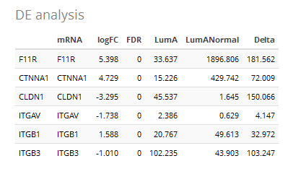
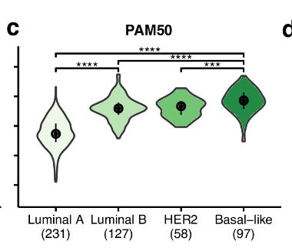
Differential Expression analysis
Figure 2c from the paper “Pan-cancer association of a centrosome amplification gene expression signature with genomic alterations and clinic..”
Shows that Luminal A subtype has lower CA20Score as compared to other subtypes.
Observations
The above 6 genes from CJ30 are significantly dysregulated in in BRCA Luminal-A tumour vs. matched normal DE analysis. CLDN1 is upregulated in Luminal A tumour samples, it is also –vely correlated with CA20 score (cor: -0.209)
F11R is down regulated in tumour samples, it is also +vely correlated with CA20Score (cor: 0.22)

Slide 24
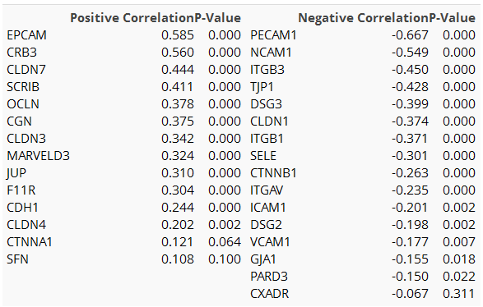
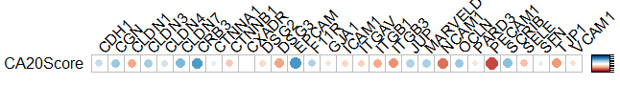
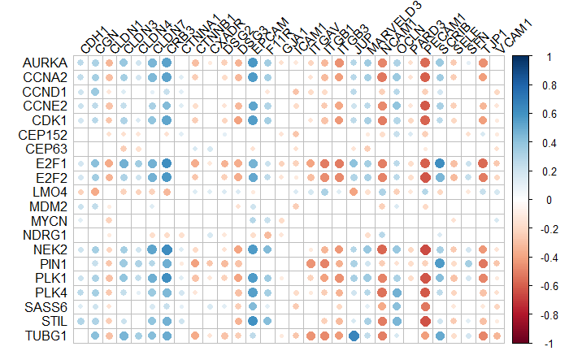
Subtypes Lum B
233 samples only (211 tumor, 22 matched normal)
In luminal B cancer subtypes, 207 out of 211 tumour samples have a higher CA20Score while all 22 matched Normal samples have a lower CA20Score.
Table: (Left) Positively correlated genes, (Right) Negatively correlated genes sorted in descending order.
Observations
CRB3, EPCAM, CLDN7, SCRIB, OCLN, CGN are strongly +vely correlated whereas PECAM1, NCAM1, ITGB3, TJP1, DSG3, CLDN1 are negatively correlated with CA20 score in BRCA luminal B samples.

Slide 25
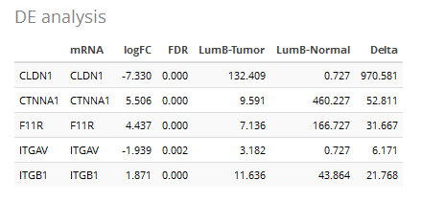
DE analysis
Observations
The above 5 genes from CJ30 are significantly dysregulated in in BRCA Luminal-B tumour vs. matched normal DE analysis. CLDN1 is upregulated in Luminal B tumour samples, it is also –vely correlated with CA20 score (cor: -0.374)
F11R is down regulated in tumour samples, it is also +vely correlated with CA20Score (cor: 0.304)

Slide 26
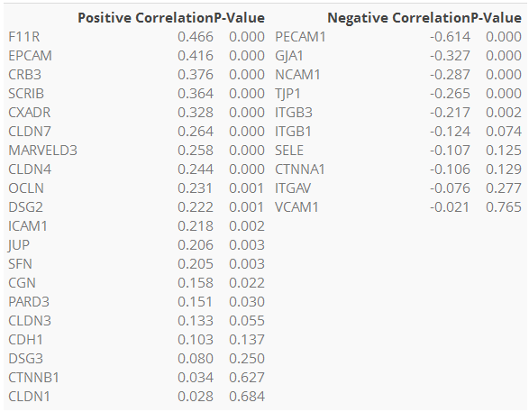
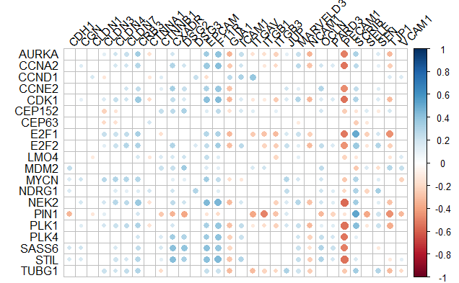
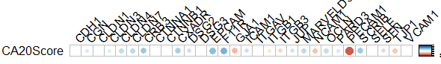
Subtypes Basal
208 samples, 191 Tumour and 17 matched Normal
In Basal samples, 188 out of 191 samples have a higher CA20Score while all 17 normal samples have a lower CA20Score.
Table: (Left) Positively correlated genes, (Right) Negatively correlated genes sorted in descending order.
Observations
F11R, CRB3, EPCAM, SCRIB, CXADR are +vely correlated whereas PECAM1, GJA1 are negatively correlated with CA20 score in BRCA Basal samples.

Slide 27
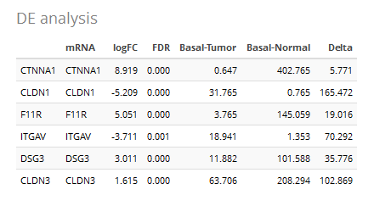
DE Analysis
Observations
F11R is upregulated in basal-like tumour samples, it is also strongely correlated with CA20Score (cor: 0.466)

Slide 28
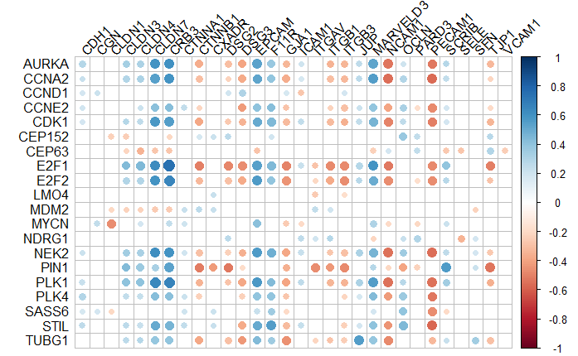
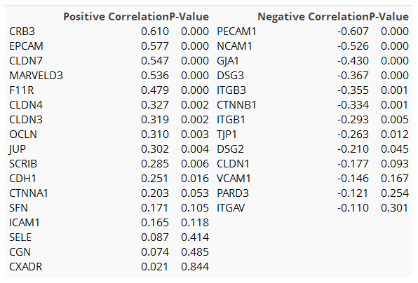
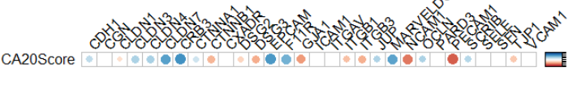
Subtypes Her2
91 samples, 82 tumour and 9 matched normal samples
In Her2 BRCA Subtype, all 9 normal samples have a lower CA20Score while 79 out of 82 tumour samples have a high CA20Score.
Table: (Left) Positively correlated genes, (Right) Negatively correlated genes sorted in descending order.

Slide 29
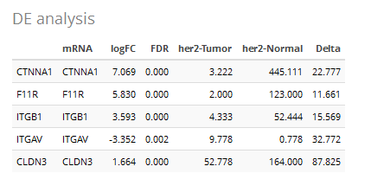
DE analysis
Observations
F11R is upregulated in Her2 tumour samples, it is also strongely correlated with CA20Score (cor: 0.47)

