Slide 1
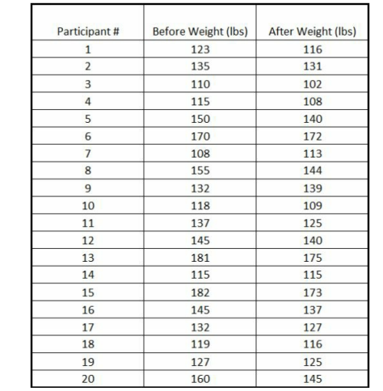
Example 3 – Paired T Test You weigh 20 people before and after a diet.
You want to determine with 99% confidence if the participants lost weight while on the diet.
The key things to note are
This is a paired T test because we have a before and after of each individual
We are testing to see if they lost weight, not just if their weight changed Data

Slide 2
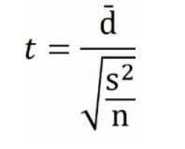
Solving The Paired T-Test Step 1 – Determine What Test To Use
For this problem we will use a Paired T test. The reason – we have a before measurement, and an after measurement for the same participants.
Step 2 – Find The Test Statistic The equation for t for a paired T test is
Where d̄ is the average of the difference between the after sample and the before sample
s is the sample standard deviation
n is the test sample size

Slide 3
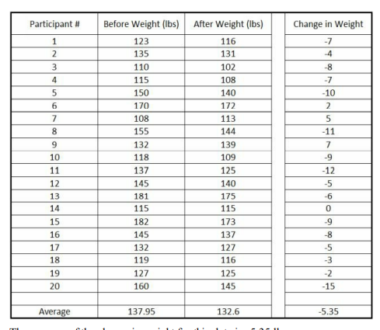
Sample Standard Deviation To calculate the sample standard deviation the question is, which set of data should you take the standard deviation on? The before data? Or the after data? The answer is neither.
Take the standard deviation on the difference, the d̄ column.
Note that this is the real reason that this equation is different from the previous ones. This is the reason you need to subtract each pair of data individually instead of just taking the difference of the mean values
Number of Samples The number of samples is 20. This is a little bit tricky because we actually have 40 measurements. But for this Paired T Test, n is representing each pair of measurements, and we have 20 pairs of measurements.

Slide 4
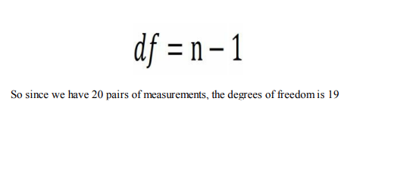
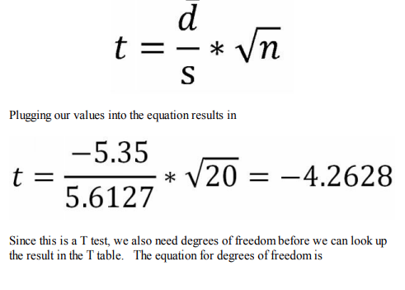
So for this example the values are
d̄ = -5.35
s = 5.6127
n = 20

Slide 5
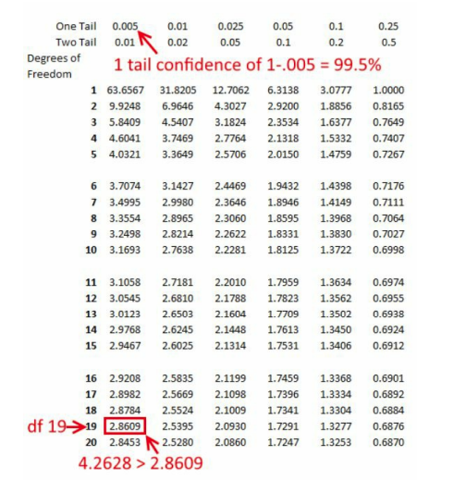
Step 3 - 1 Tailed or 2 Tailed Since we want to determine if the participants lost weight on the diet, and not just if their weight changed, we want a 1 tailed p value
, we can say that we are 99% confident that the participants lost weight

