Slide 1
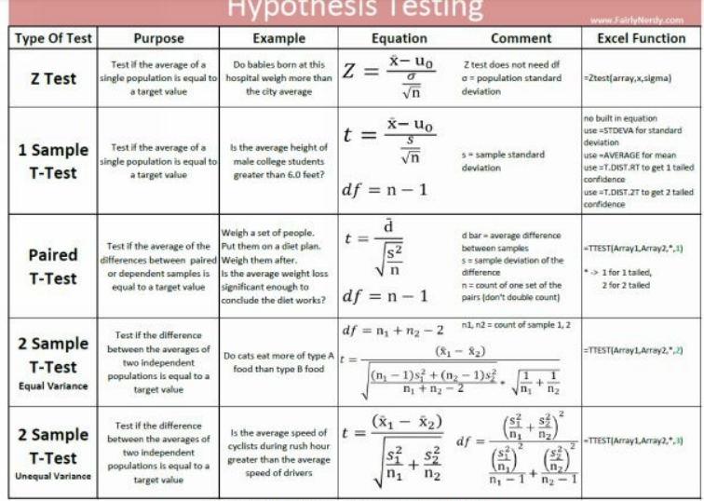

Slide 2
Problem 1
imagine you are working at a hospital looking at the birth weights of the 30 most recent male babies at your hospital. You would like to conclude that mothers give birth to heavier babies at your hospital than they do nationwide, on average. (Doubtless, this is due to your exceptional care, but since that is hard to prove, let’s start by just determining if the babies are heavier)
The average birth weight for an American boy is 7.5 lbs., with a standard deviation of 1.25 lbs.
Using the table below, can you determine, with at least 95% confidence, if male babies born at your hospital exceed the national average weight?

Slide 3
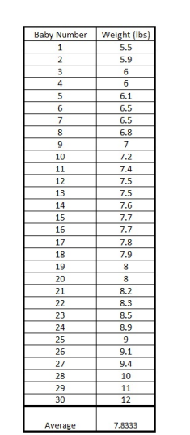
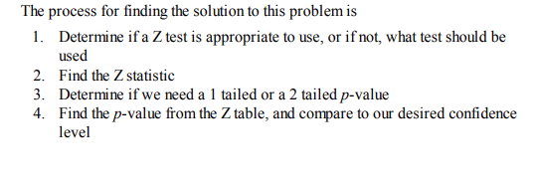

Slide 4
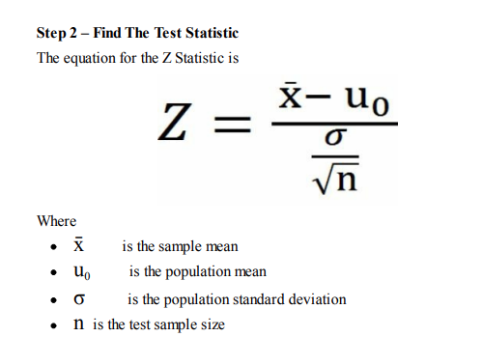
The reason we are using a Z test instead of a T-test like we do in the later examples is that the standard deviation of the population is provided for us, and we expect that our sample matches the population. Some sources will state that you can use a Z-test if you have more than 20-50 data points. (The exact number is a bit of a judgment call). This is not exactly true. What is actually occurring is that as the number of samples increases, the T test converges on the Z test.

Slide 5
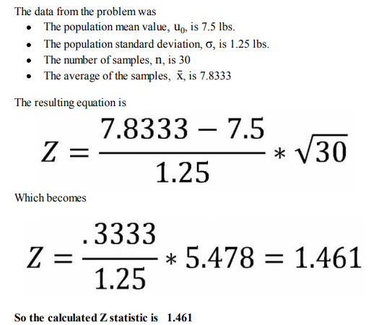
The reason we are using a Z test instead of a T-test like we do in the later examples is that the standard deviation of the population is provided for us, and we expect that our sample matches the population. Some sources will state that you can use a Z-test if you have more than 20-50 data points. (The exact number is a bit of a judgment call). This is not exactly true. What is actually occurring is that as the number of samples increases, the T test converges on the Z test.

Slide 6
Step 3 - 1 Tailed or 2 Tailed 1 tailed or 2 tailed is asking the question if you just want to find out if you are different than the baseline value, or if you care which side of the mean your measured average is on.
For instance, if you want to determine if filling your pickup truck with rocks changes your gas mileage, you would use a 2 tailed distribution. Theoretically, it could improve or reduce your gas mileage.
If you want to determine if the rocks improve your gas mileage, you would use a 1 tailed distribution. (Side note, they don’t)
Since the problem asks us to conclude if we are greater than the average, not just different than the average, we will use a 1 tailed Z value

Slide 7
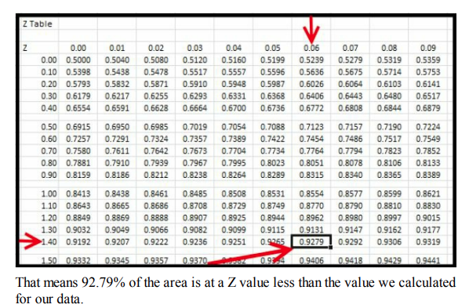
Since our Z statistic is 1.46, we look up 1.40 going down the left-hand column, and .06 going across the top row. Where that column and row matches is the cumulative probability which is .9279 in this case.
Subtracting .9279 from 1 results in a 1 tailed p-value of .0721. Since we want 95% confidence or greater, we would need a p-value of .05 or less to satisfy that condition. So we cannot say with 95% confidence that the weights in this hospital are greater than average

Slide 8
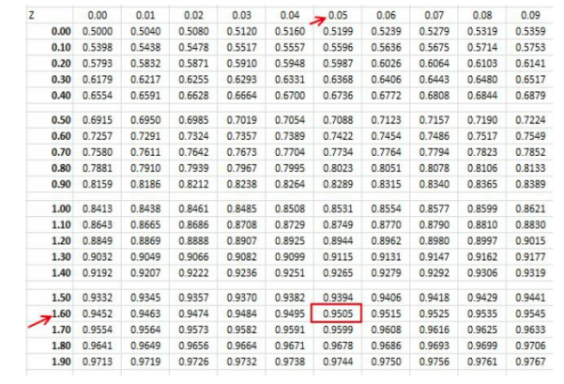
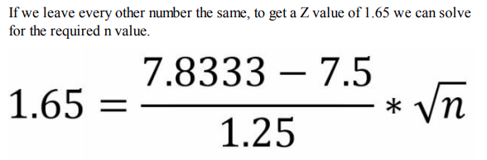
What Can Change The Results We did not get our desired 95% confidence. How can we get higher confidence? Let's work the problem backward to see what would need to change for us to have 95% confidence that our hospital had heavier babies. That result would require a value of .95 on the Z table. That value equates to having a Z value of at least 1.65, which we know by looking up .95 and the Z table and seeing the column and row Z values that generate the .95 confidence
This results in an n value of 38.3. Since we can't have a partial sample, this would require 39 samples. We already have 30 samples, so if we measured 9 more babies and got the same average we have now, we could make the claim with 95% confidence that babies born in our hospital were heavier than the national average.

Slide 9
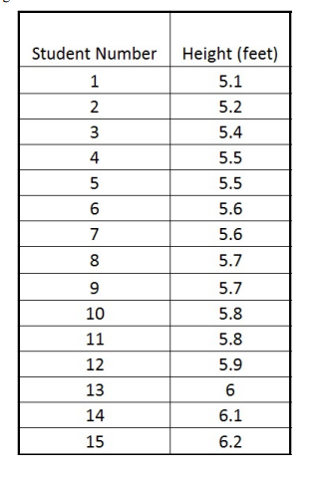
This results in an n value of 38.3. Since we can't have a partial sample, this would require 39 samples. We already have 30 samples, so if we measured 9 more babies and got the same average we have now, we could make the claim with 95% confidence that babies born in our hospital were heavier than the national average.
Here we know the population mean, 5.5 feet, but not the population standard deviation. We will have to derive that from our data. (With this type of test there is an assumption that the population standard deviation is not systematically different from the data that we have. For instance, we didn't intentionally admit students based on their height in order to make a narrow distribution.
The process for finding the solution to this problem is very similar to what we did for the Z test. 1. Determine what test to use 2. Find the test statistic 3. Determine if we need a 1 tailed or a 2 tailed p-value 4. Find the p-value from the table, and compare to our desired confidence level

Slide 10
Step 1 – Determine What Test To Use
We have 1 sample set of data. That sample set is only 15 measurements. We have a population mean, but not a population standard deviation. Since we don’t have a population standard deviation, and we have fewer than 20 samples, we will want to do a T test.
Since we have 1 sample, and we have a population mean, it will be a 1 Sample T Test
These are the key points of our problem
We have exactly 1 set of data.
We don’t have a before and after.
We don’t have a test group and a control group.
We have 1 and only 1 set of data. We do have a population mean to calculate our difference off of We do not have a population standard deviation These factors mean we should do a 1 sample T test.

Slide 11
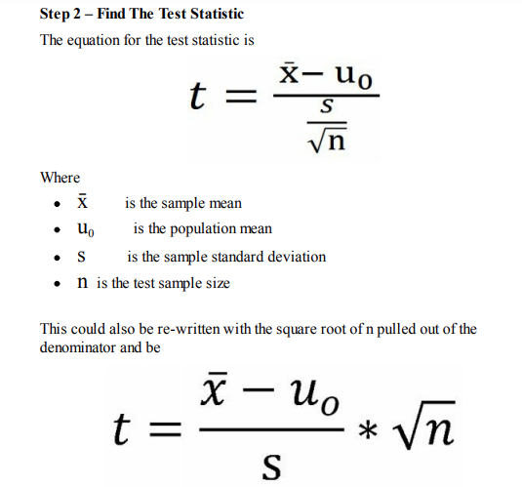
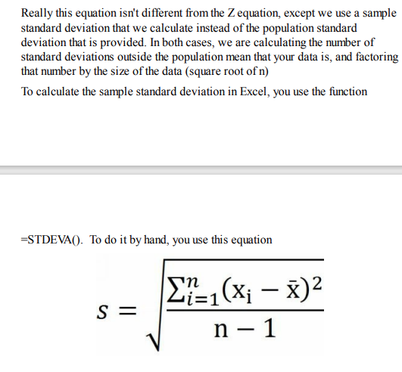

Slide 12
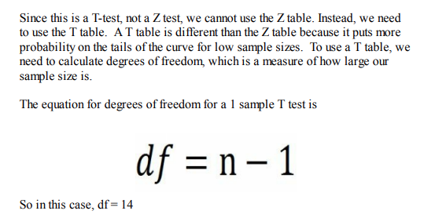
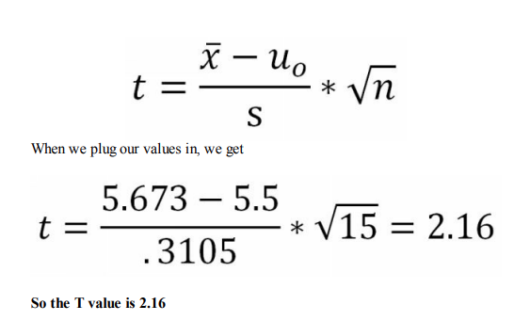
So in this example
x̄ = sample mean = 5.673
u0 = population mean = 5.5 (from problem statement)
s = sample standard deviation = .3105
n = test sample size = 15

Slide 13
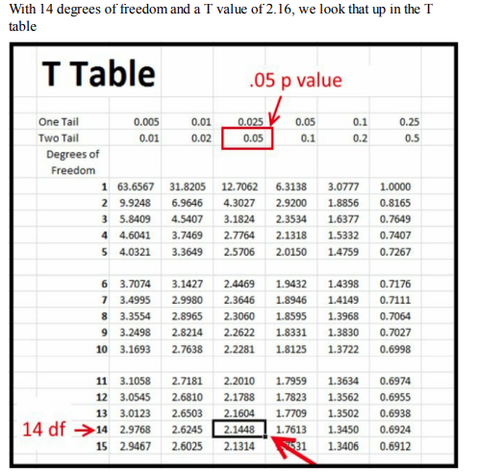
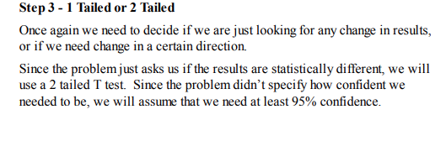
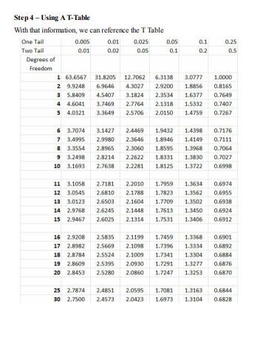
The value of 2.16 isn’t in the T table, but the value of 2.144 is close enough. We can read up to see that the two-tailed confidence at this T value is .05. This means that we are at least 95% confident that this college has a statistically different height than the average

Slide 14
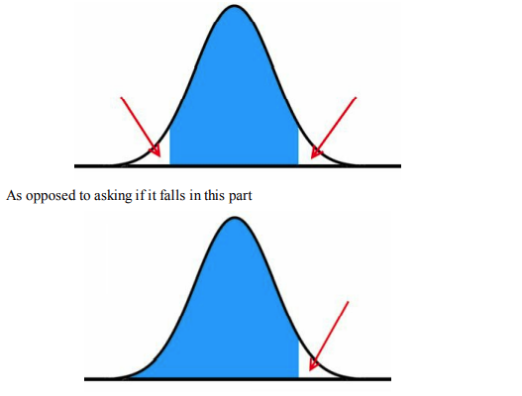
2 Tailed vs 1 Tailed Result Noting that the previous problem asked us if the results were statistically different than the mean, rather than statistically greater was important.
It meant that we are asking the question to see if our mean value falls in either of these parts of the probability distribution

