Slide 1


Vector Diagnostics
June 6, 2007

Slide 2
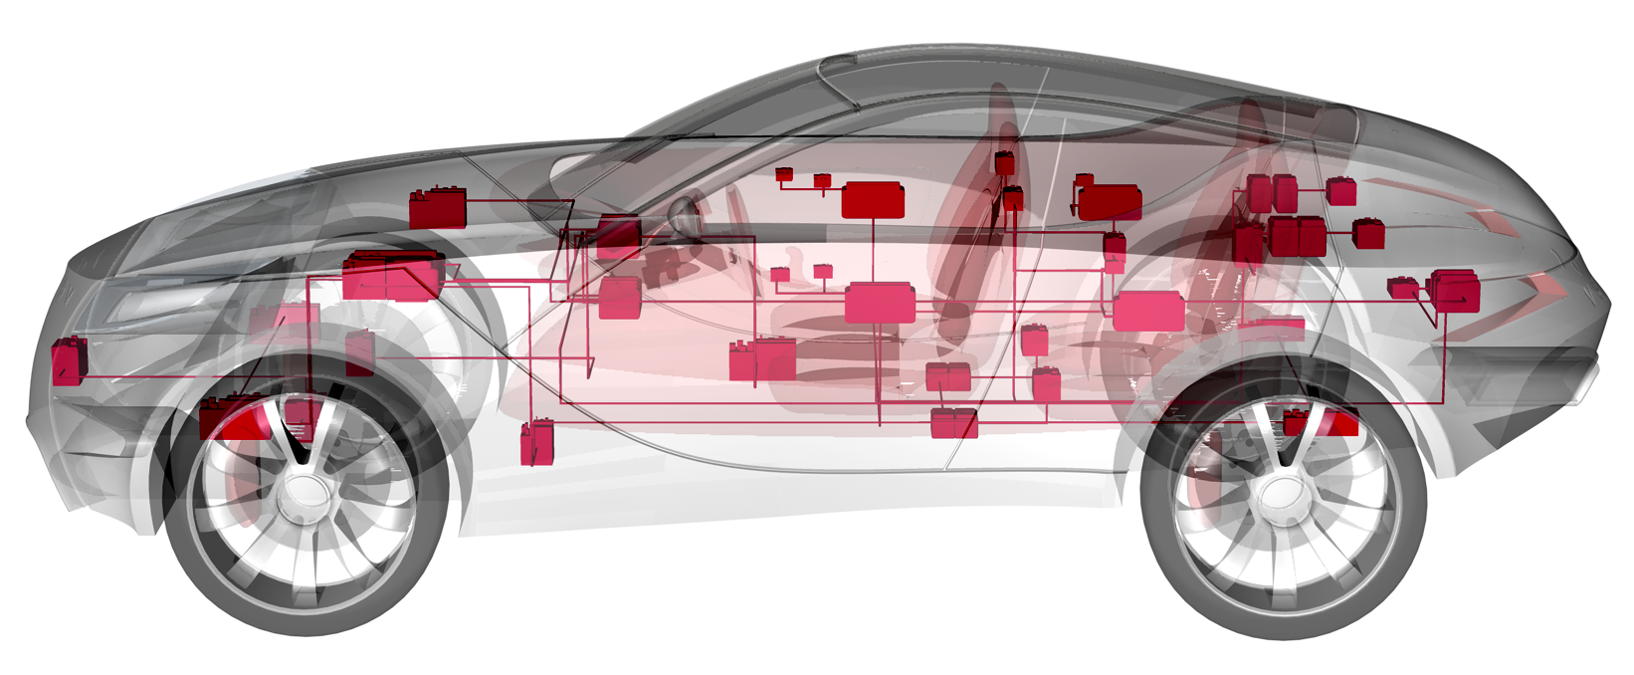
Vector Diagnostics
Who is Vector ?
What is the vehicle diagnostic development process ?
How does Vector support you in the development process ?

Slide 3

Who is Vector ?
Vector is...
The global leader in vehicle networking tools and embedded software
Providing solutions for:
Over 40 automotive and commercial vehicle OEMs
Over 60 Tier 1 ECU suppliers
Over 50,000,000 vehicles built
with Vector tools and software
Company snapshot:
  Founded in 1988 in Stuttgart, Germany
  100% privately held by management
  Over 700 employees world wide
  Over $120,000,000 in annual revenue

Slide 4



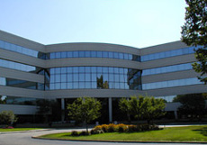

Vector Locations
Vector Informatik
Stuttgart, Germany
Braunschweig, Germany
Munich, Germany
Regensburg, Germany
Vector Scandinavia
Gothenburg, Sweden
Vector France
Paris
Vector Japan
Tokyo
Nagoya
Vector CANtech
Novi, Michigan

Slide 5
Vector Products & Services
● Tools for Networks & Distributed Systems
Software tools for design, development, diagnostic, and testing of networks and distri-buted systems in the automotive sector.
● Network Interfaces
Hardware interfaces for connecting different bus systems.
● Tools for Measurement & Calibration
Tools for measurement and calibration of elec-tronic control units.
● Training
Workshops and seminars about Vector software products and for theoretical basics of bus systems.
● Diagnostics
Versatile and process-oriented software tools for diagnostics in the automobile industry.
● Software & Integration Factory
Development of customer-individual software for electronic control units (components, ECU integrations, and vehicle networks).
● Embedded Software Components
Embedded software components for networked systems in the automobile industry.
● Consulting
Optimization of the development process of elec- tronic systems, particularly in the automotive sector.
● Tools & Components for Open Networking
Software and services for open, CAN-based protocols, e.g. in transport, control and agricul-tural technology.
● Process Tools
Process tools, that support all phases of the development process, reduce complexity and provide transparency.
Notes:
© Vector Informatik GmbH. All rights reserved. Any distribution or copying is subject to prior written approval by Vector.
6

Slide 6
Diagnostic Development Process
(1)
define
OEM
diagnostic
requirements
(2)
define
ECU
diagnostic
requirements
(3)
implement
diagnostics
in ECU
software
(4)
ECU
diagnostic
validation
testing
(5)
vehicle
integration
testing

Slide 7
Diagnostic Development Process
(1)
define
OEM
diagnostic
requirements
(1)
define
OEM
diagnostic
requirements
(2)
define
ECU
diagnostic
requirements
(3)
implement
diagnostics
in ECU
software
(4)
ECU
diagnostic
validation
testing
(5)
vehicle
integration
testing
Define OEM diagnostic requirements
  Each generation of vehicles from each OEM has its own set of requirements
  These requirements must be specified early in the vehicle development cycle
  These requirements become the baseline requirements for every ECU
  Based on industry and company standards for protocols and data dictionaries
  These requirements are defined by a central authority within the OEM
  Errors here are usually not detected until very late in integration testing (5)

Slide 8
Diagnostic Development Process
(1)
define
OEM
diagnostic
requirements
(2)
define
ECU-specific
diagnostic
requirements
(2)
define
ECU
diagnostic
requirements
(3)
implement
diagnostics
in ECU
software
(4)
ECU
diagnostic
validation
testing
(5)
vehicle
integration
testing
Define ECU-specific diagnostic requirements
  Each ECU has its own specific set of diagnostic requirements
  These requirements are on top of the OEM requirements defined in step (1)
  These requirements must be specified early in the ECU development cycle
  Specifies the diagnostics required for the ECU’s application (engine, ABS, etc.)
  These requirements are defined by the release engineer and supplier
  Errors here are usually not detected until very late in vehicle integration (5)

Slide 9
Diagnostic Development Process
(1)
define
OEM
diagnostic
requirements
(2)
define
ECU
diagnostic
requirements
(3)
implement
diagnostics
in ECU
software
(3)
implement
diagnostics
in ECU
software
(4)
ECU
diagnostic
validation
testing
(5)
vehicle
integration
testing
Implement diagnostics in ECU software
Each ECU contains software that implements the requirements from (1) & (2)
This diagnostic software makes up ~50% of all of the software in the ECU
Diagnostics are complicated, detailed and difficult to implement correctly
~50% of the software development cycle goes to implementing diagnostics
This implementation is done by the ECU supplier
  Errors here are usually not detected until later in validation testing (4)

Slide 10
Diagnostic Development Process
(1)
define
OEM
diagnostic
requirements
(2)
define
ECU
diagnostic
requirements
(3)
implement
diagnostics
in ECU
software
(4)
ECU
diagnostic
validation
testing
(4)
ECU
diagnostic
validation
testing
(5)
vehicle
integration
testing
rework
ECU diagnostic validation testing
Each ECU is tested against the requirements defined in (1) & (2)
Diagnostic requirements are complicated, detailed and difficult to validate
  Even for simple ECUs, diagnostic validation requires many test cases
  Executing, documenting and analyzing these tests is a large effort
  This testing is done first by the ECU supplier and then again by the OEM
  Errors detected here mean reworking implementation (3) and re-testing

Slide 11
Diagnostic Development Process
(1)
define
OEM
diagnostic
requirements
(2)
define
ECU
diagnostic
requirements
(3)
implement
diagnostics
in ECU
software
(4)
ECU
diagnostic
validation
testing
(5)
vehicle
integration
testing
(5)
vehicle
integration
testing
rework
Vehicle integration testing
  Each ECU is tested for interoperability with the vehicle electrical system
  Each ECU must support its native functions and interact with other ECUs
  Even for simple ECUs, the interface to the vehicle is complicated
  Testing these interfaces is done interactively in real-world scenarios
  Vehicle integration engineers must have random access to all ECU diagnostics
  Errors detected here can mean reworking parts of the entire process

Slide 12
Vector Support for the Diagnostic Development Process
(1)
define
OEM
diagnostic
requirements
(1)
define
OEM
diagnostic
requirements
(2)
define
ECU
diagnostic
requirements
(3)
implement
diagnostics
in ECU
software
(4)
ECU
diagnostic
validation
testing
(5)
vehicle
integration
testing
CANdelaStudio
Admin
Edition

Slide 13
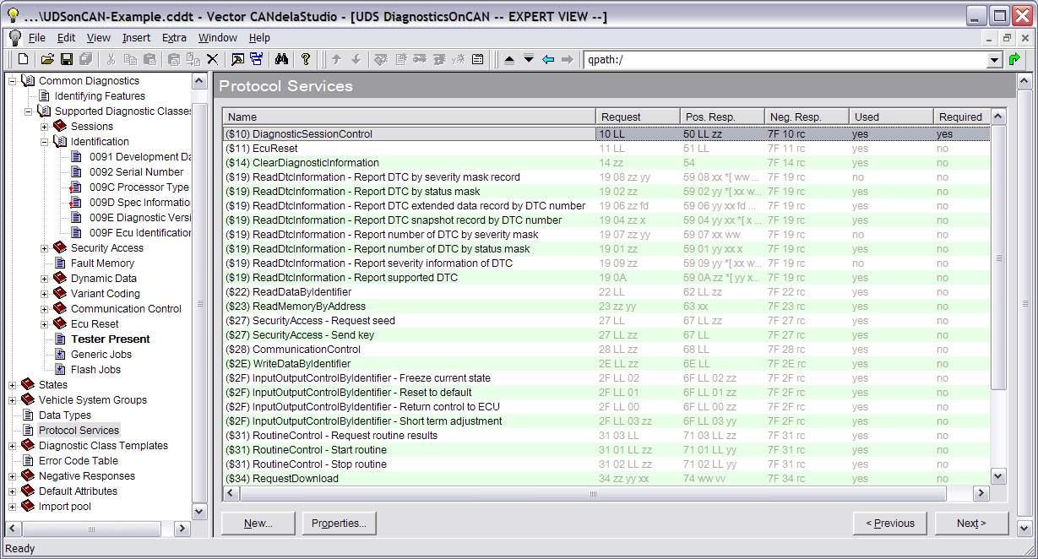
CANdelaStudio Admin Edition – Build OEM Templates
  CANdelaStudio Admin Edition builds OEM-specific templates
  Template ensures ECU diagnostics comply with OEM requirements
  Templates structure ECU data to give OEM’s desired look & feel
  Templates define diagnostic protocol and standard data
  Vector works with OEMs to build these templates to the OEM’s specs
  There are templates for almost all car companies

Slide 14
Vector Support for the Diagnostic Development Process
(1)
define
OEM
diagnostic
requirements
(1)
define
OEM
diagnostic
requirements
(2)
define
ECU
diagnostic
requirements
(3)
implement
diagnostics
in ECU
software
(4)
ECU
diagnostic
validation
testing
(5)
vehicle
integration
testing
CANdelaStudio
Admin
Edition
CANdela
Template
(*.cddt)

Slide 15
Vector Support for the Diagnostic Development Process
(1)
define
OEM
diagnostic
requirements
(2)
define
ECU-specific
diagnostic
requirements
(2)
define
ECU
diagnostic
requirements
(3)
implement
diagnostics
in ECU
software
(4)
ECU
diagnostic
validation
testing
(5)
vehicle
integration
testing
CANdelaStudio
Admin
Edition
CANdelaStudio
Standard
Edition
CANdela
Template
(*.cddt)

Slide 16
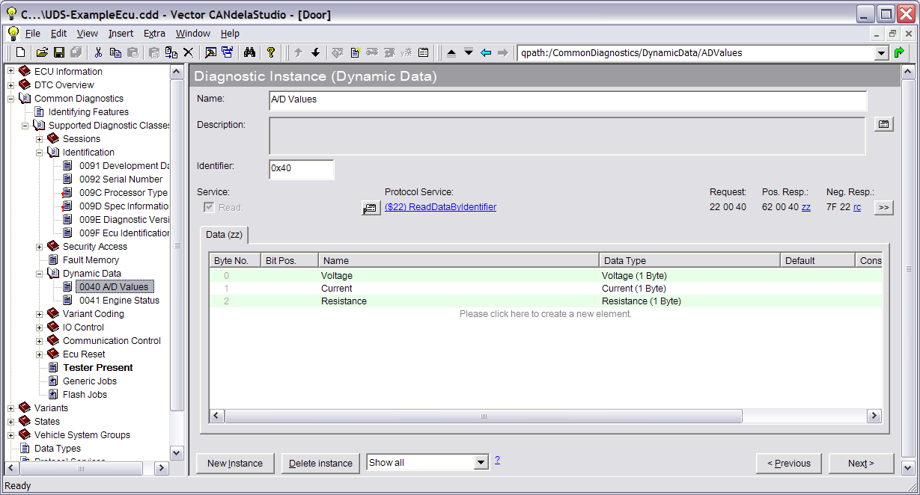
CANdelaStudio Standard Edition – Build ECU Databases
  CANdelaStudio Standard Edition builds an ECU-specific database
  Start with an OEM template and fill it in with ECU-specific information
  Capture all services, PIDs, DTCs, test routines, etc.
  Capture non-protocol data – scripts, descriptive text, attachments, etc.
  XML database (.cdd file) is machine-readable for downstream automation
  Many data import/export possibilities

Slide 17
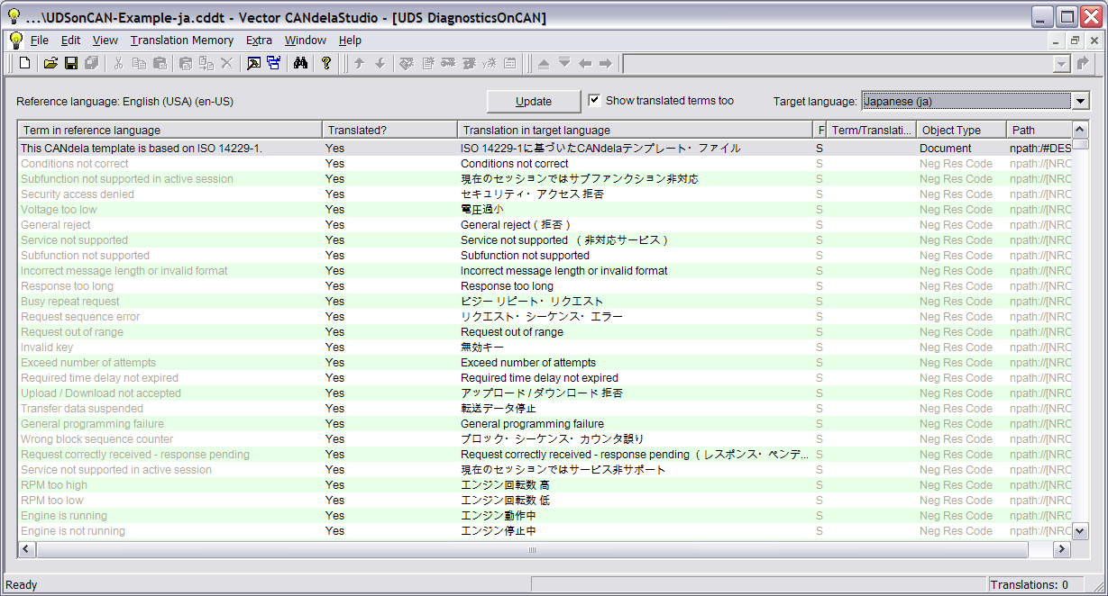
CANdelaStudio Pro Edition – Manage Multi-language Text
  CANdelaStudio Pro Edition manages multi-language text
  All textual data can be entered in multiple languages
  Side-by-side view all text strings in any two languages
  CANdelaStudio tracks changes and knows what text may be out of date
  Supports Asian Unicode fonts
  Multi-language data stored in standard TMX translation table format

Slide 18





CANdelaStudio Data Import / Export Options
Vector is a world leader in ODX !
Export
Import
X
customer
specific
(.mdx, .sgm)
ASAP2
.a2l
.cdi
.rtf
.cdi
.csv
.html
.cdd
.csv
.tmx

Slide 19
Vector Support for the Diagnostic Development Process
(1)
define
OEM
diagnostic
requirements
(2)
define
ECU-specific
diagnostic
requirements
(2)
define
ECU
diagnostic
requirements
(3)
implement
diagnostics
in ECU
software
(4)
ECU
diagnostic
validation
testing
(5)
vehicle
integration
testing
CANdelaStudio
Admin
Edition
CANdelaStudio
Standard
Edition
GM
CANdelaStudio is used to specify the diagnostics for all body controls
Ford
Ford mandates the use of CANdelaStudio to create the MDX Part 2 spec for all ECUs
CANdela
Template
(*.cddt)
CANdela
Document
(*.cdd)

Slide 20
Vector Support for the Diagnostic Development Process
(1)
define
OEM
diagnostic
requirements
(2)
define
ECU
diagnostic
requirements
(3)
implement
diagnostics
in ECU
software
(3)
implement
diagnostics
in ECU
software
(4)
ECU
diagnostic
validation
testing
(5)
vehicle
integration
testing
CANdelaStudio
Admin
Edition
CANdelaStudio
Standard
Edition
CANdesc
CANdela
Template
(*.cddt)
CANdela
Document
(*.cdd)

Slide 21
CANdesc – Computer Generated Source Code
Diagnostic Software Development with CANdesc
Diagnostic Software Development w/o CANdesc
20% Hand-Written
Hand-Written
Diagnostic
Kernel
ECU development effort
Support from OEM
Testing effort
Re-work & re-test effort
80%
CANdesc
Generated
Source
Code
80%
Reduction in
Manpower,
Cycle Time,
Errors
CAN Diagnostic Embedded Software Component
  Source code is completely generated from CANdela .cdd file
  Easily configurable for ECU-specific integration
  Generated code handles all diagnostic communication processing
  Completely automates many typical diagnostic functions
  Huge savings in development time and cost

Slide 22
Vector Support for the Diagnostic Development Process
(1)
define
OEM
diagnostic
requirements
(2)
define
ECU
diagnostic
requirements
(3)
implement
diagnostics
in ECU
software
(3)
implement
diagnostics
in ECU
software
(4)
ECU
diagnostic
validation
testing
(5)
vehicle
integration
testing
CANdelaStudio
Admin
Edition
CANdelaStudio
Standard
Edition
CANdesc
Ford
CANdesc is required for use in all new Ford FNOS ECUs
GM
CANdesc is strongly recommended for new ECUs
Chrysler
CANdesc is available as an option in new ECUs
CANdela
Template
(*.cddt)
CANdela
Document
(*.cdd)
Embedded
Source Code
(*.c, *.h)

Slide 23
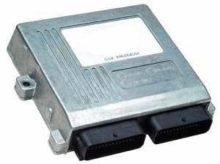
Vector Support for the Diagnostic Development Process
(1)
define
OEM
diagnostic
requirements
(2)
define
ECU
diagnostic
requirements
(3)
implement
diagnostics
in ECU
software
(4)
ECU
diagnostic
validation
testing
(4)
ECU
diagnostic
validation
testing
(5)
vehicle
integration
testing
CANdelaStudio
Admin
Edition
CANdelaStudio
Standard
Edition
CANdesc
CANoe.DiVa
CANdela
Template
(*.cddt)
CANdela
Document
(*.cdd)
Embedded
Source Code
(*.c, *.h)

Slide 24
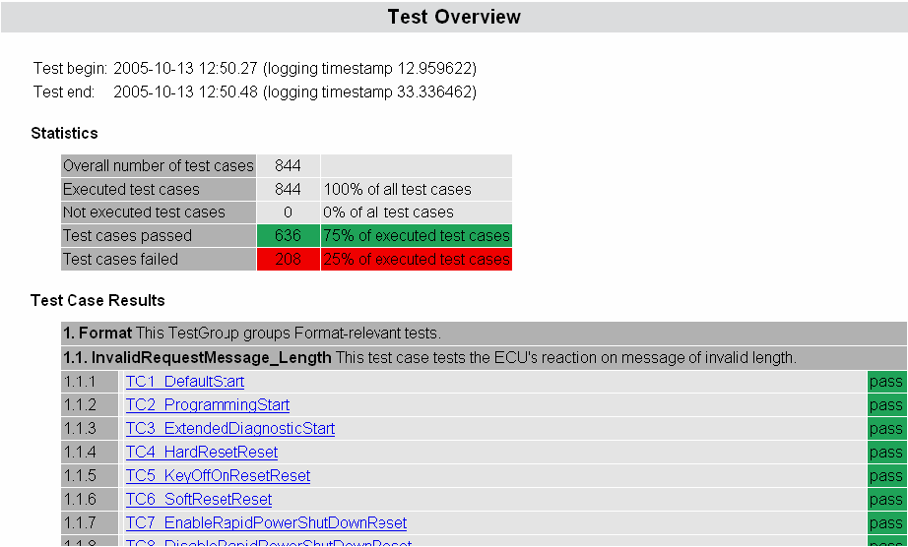
CANoe.DiVa – Automated ECU Diagnostic Validation Testing
  CANoe.Diva – “lights out” over-night validation testing
  Complete validation test sequence generated from CANdela .cdd file
  Sets up in minutes, press start, go home and DiVa runs overnight
  HTML report is generated with results and data for all tests
  DiVa framework allows customer-specific tests to be plugged in
  90% savings in manpower, eliminate weeks of test time

Slide 25
Vector Support for the Diagnostic Development Process
(1)
define
OEM
diagnostic
requirements
(2)
define
ECU
diagnostic
requirements
(3)
implement
diagnostics
in ECU
software
(4)
ECU
diagnostic
validation
testing
(5)
vehicle
integration
testing
(5)
vehicle
integration
testing
CANdelaStudio
Admin
Edition
CANdelaStudio
Standard
Edition
CANdesc
CANoe.DiVa
CANdito
CANape
CANoe
CANdela
Template
(*.cddt)
CANdela
Document
(*.cdd)
Embedded
Source Code
(*.c, *.h)

Slide 26
Vector Test Tools – Take Your Pick
  Vector test tools
  CANdito – high-power low-cost diagnostic test tool for engineers
  CANoe – network development tool / diagnostic test tool
  CANape – ECU calibration tool / diagnostic test tool
  Vector test tools all share the same “diagnostic feature set”
  Diagnostic console – scan tool functionality
  Fault window – monitor and erase DTCs, read snapshot data
  Trace window – monitor and analyze raw bus messages
  ODX support – all Vector test tools can work with ISO/ASAM ODX files
  Take your pick –
  all Vector test tools provide the same diagnostic capabilities

Slide 27
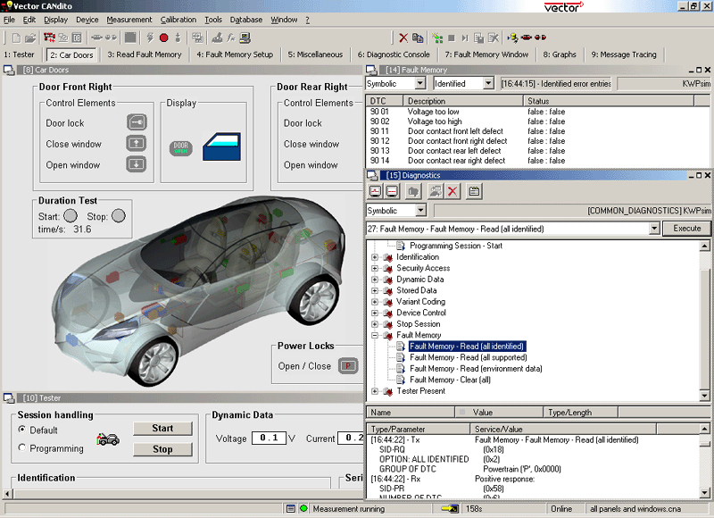
Vector Test Tools – Loads of Features and Functions
cover your
scripts
and functions
with panels
to make
your own
custom test
applications
Fault Window
monitor and
log DTCs
Diagnostic
Console
point ‘n click
scantool

Slide 28
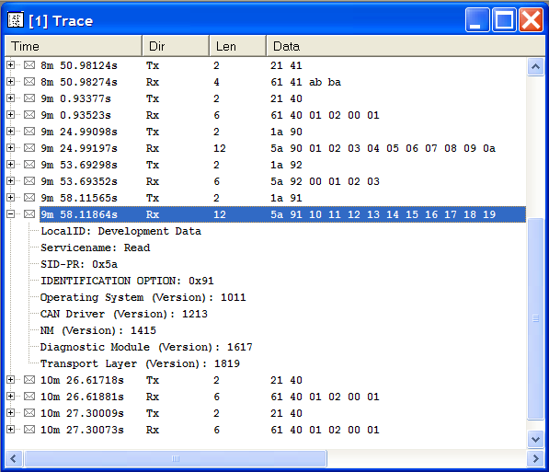
Vector Test Tools – Diagnostic Trace Window
see multi-frame
diagnostic messages
on a single line
expand
diagnostic messages
to decode them

Slide 29
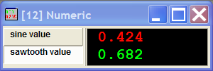

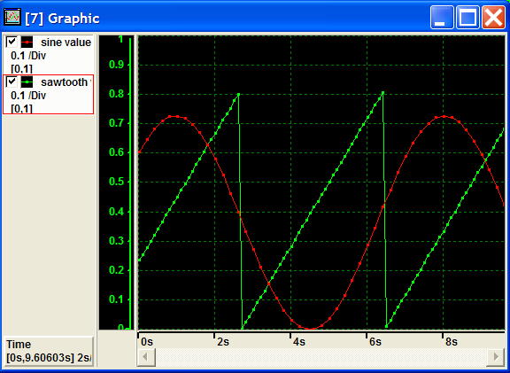
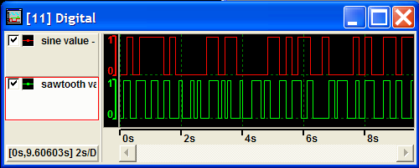
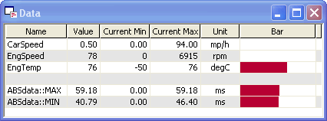
Vector Test Tools – Data Measurement and Display
see live data
in real time
in any format

Slide 30
Vector Support for the Diagnostic Development Process
(1)
define
OEM
diagnostic
requirements
(2)
define
ECU
diagnostic
requirements
(3)
implement
diagnostics
in ECU
software
(4)
ECU
diagnostic
validation
testing
(5)
vehicle
integration
testing
(5)
vehicle
integration
testing
CANdelaStudio
Admin
Edition
CANdelaStudio
Standard
Edition
CANdesc
CANoe.DiVa
CANdito
CANape
CANoe
CANdela
Template
(*.cddt)
CANdela
Document
(*.cdd)
Embedded
Source Code
(*.c, *.h)
Vector supports the complete diagnostic development process !

Slide 31
Training Classes – Vector is Your Diagnostics Education Resource
Introduction to Diagnostics on CAN
  ISO 15765 – Diagnostics on CAN
  UDS (ISO 14229 – Unified Diagnostic Services) Communication Protocol
  CAN Transport Protocol (ISO 15765-2)
  Emissions-related Diagnostics (ISO 15031)
  Introduction to CANdelaStudio and CANdito
  Learn to author ECU diagnostic specifications in CANdelaStudio
  Learn to perform ECU diagnostic testing with CANdito
  Ford Diagnostic Strategy and Process
  Learn the Ford GGDS diagnostic requirements specification
  Learn the Ford diagnostic development process and tools
  Fully sanctioned and approved by Ford
  Find out more at www.vector-cantech.com and click on “Training”

Slide 32
Support for Standards – Vector Has You Covered
Open Standards
  ODX (ISO 22901) – Open Diagnostic Data Exchange
  ISO 15765 – Diagnostics on CAN
  UDS (ISO 14229) – Unified Diagnostic Services
  KWP2000 (ISO 14230) – Key Word Protocol 2000
OEM Standards
  GM GMW3110
  Ford GGDS and MDX
  DC KWP2000, UDS, Diogenes and DDT
  Plus Toyota, FIAT, Porsche, BMW, more…
Coming Soon…
  SAE J2534 – Pass-Thru Flash Programming
  WWH-OBD (ISO 27145) – World-wide Harmonized OBD
  Nobody supports more diagnostic standards than Vector !

Slide 33
Links
Vector CANtech, Inc.
www.vector-cantech.com
ISO
International Standards Organization
www.iso.org
SAE
Society of Automotive Engineers
www.sae.org
ASAM
Association for Standardization of Automation and Measuring Systems
www.asam.net

Slide 34

Looking for More Help? Vector CAN Help!
Vector Expertise
  Vector works with the world’s latest technologies & strategies
  We know the pros and cons of each approach
  We know the tradeoffs and decisions you face
  Let us bring our knowledge of the world’s best practices to you
Support Packages
  Fast start – on-site tool installation, testing and customized training
  Black belt – hands-on workshop takes your team through a project
  Gold club – complete tool maintenance and personal support staff
  Consulting Services
  Process improvement and automation
  Custom tool-to-process integration
  Requirements specification authoring
  Let Vector be your diagnostics development partner!

Slide 35
Find Out More
On the web
www.vector-cantech.com and click on Vehicle Diagnostics
Vector CANtech, Inc.
39500 Orchard Hill Place - Suite 550
Novi, Michigan 48375
Phone: (248) 449-9290
Fax: (248) 449-9704
E-mail: info@vector-cantech.com
Sales
To check prices or place an order, please contact our sales representatives.
Phone: (248) 449-9290 and press “1”
E-mail: sales@vector-cantech.com
Technical Support
For technical assistance with any of our products.
Phone: (248) 449-9290 and press “2”
E-mail: support@vector-cantech.com

