Slide 1

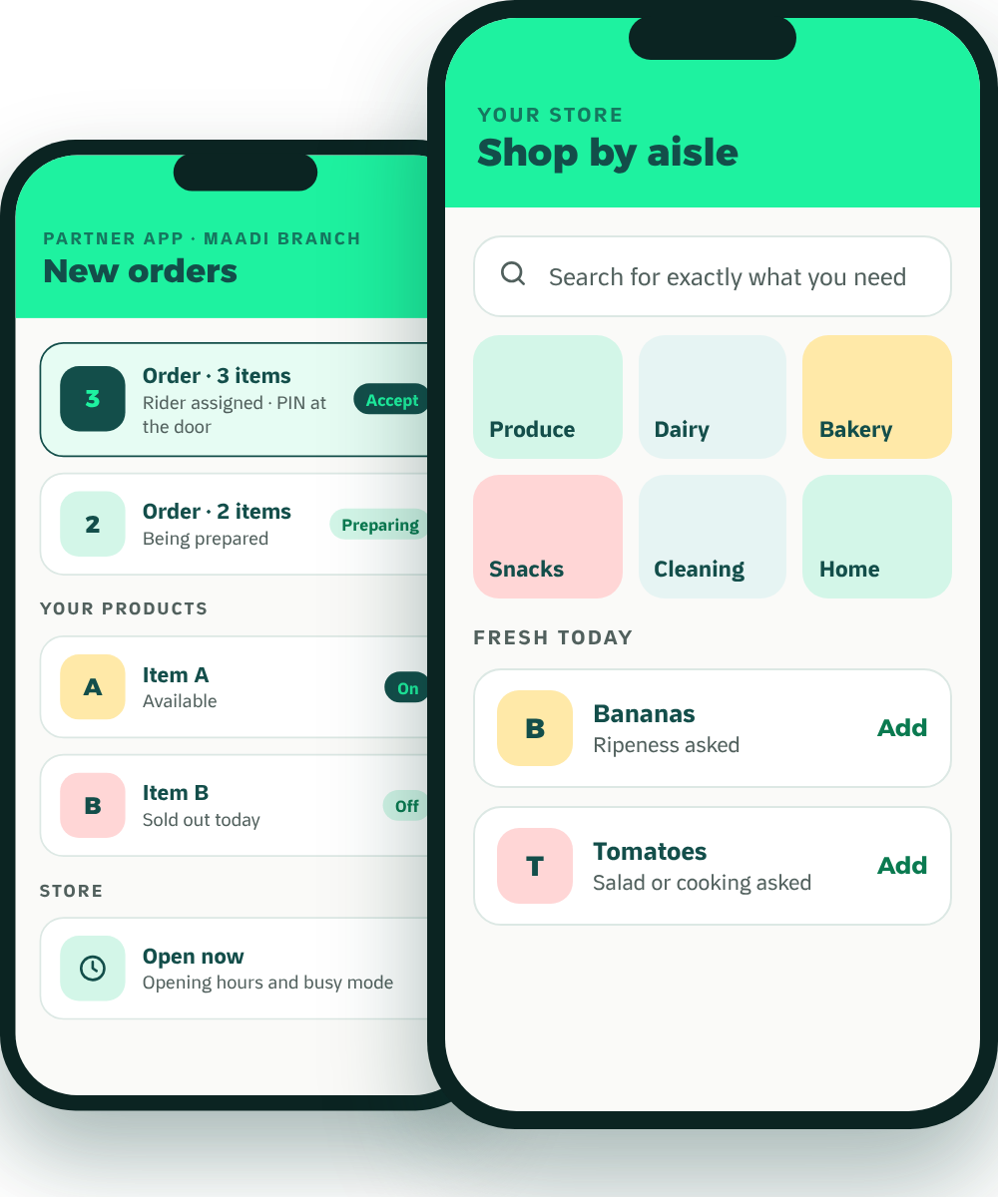
Waddy
FOR SUPERMARKETS & GROCERS
The local growth partner
Grow Your Store
Beyond the Counter.
Meet Waddy, the neighborhood delivery and growth platform that lets your fresh aisle sell online the way it sells in store.
Ripeness choice
Salad or cooking
Local advertising
Our own riders
Founding partners
No setup fee
Reduced launch commission
Keep your other apps
MADE IN MAADI · BUILT AROUND YOU

Slide 2





WADDY IN ONE PAGE
Why Add Waddy? The Short Version.
Your neighborhood, not the city
We advertise in Maadi
We deliver
Customers in Maadi see Maadi. You compete with your street.
Waddy-funded local Instagram and Facebook campaigns. You never have to buy ads to be listed.
Our own riders, live tracking, a PIN at the door, and cash collected for you.
Keep every app you’re on.
Customers come back
Built for grocers
Waddy is non-exclusive. Add it alongside the channels you already use.
XP, weekly quests and scratch cards give them reasons to reorder.
Ripeness and salad-or-cooking choices let your fresh aisle sell online, with fewer complaints.
Founding partners: no setup fee and a reduced launch commission. Full offer overleaf.
Waddy · For supermarkets & grocers
02

Slide 3


THE OFFER
What It Costs. How to Start Risk-Free.
WHAT IT COSTS
AGREED IN WRITING
START RISK-FREE
None
Before
No setup fee
Joining, onboarding, catalogue and photos cost nothing.
Setup fee
you start, not after
Reduced launch commission
Commission
Delivery fee
A lower rate for founding partners while you get started.
One rate when Waddy delivers, another when you deliver yourself. Agreed with you before you start.
Agreed with you, in writing
Settlement
Stay on your other apps
Agreed with you, in writing. Cash orders are collected by our riders and included in your payout
Waddy adds Maadi customers. It doesn’t replace anyone.
Monthly fee
None
30-day review
Advertising
Refunds and exit
After 30 days we show you every order that came through Waddy, and you decide.
Optional, never required
Agreed with you, in writing
We’re new, so there are no case studies yet. Founding partners get these terms agreed in writing.
Waddy · For supermarkets & grocers
03

Slide 4
JOIN WADDY
Let’s Grow
Maadi Together.
WHATSAPP
Message our partner team
Send us a WhatsApp message. Then:
DAYS 1–14
DAYS 15–30
DAY 30
DAYS 31–90
Founding partners: no setup fee and a reduced launch commission.
Set up
Launch
30-day review
Build
Catalogue, photos and training. Free.
Live in Maadi from day one.
Every order that came through Waddy. You decide.
Offers and partner promotion, planned together.
PHONE
EMAIL
WEB
waddyapp.com
Your brand. Your local branch. Your neighborhood.
Your growth partner.
Waddy · For supermarkets & grocers
04

