Slide 1

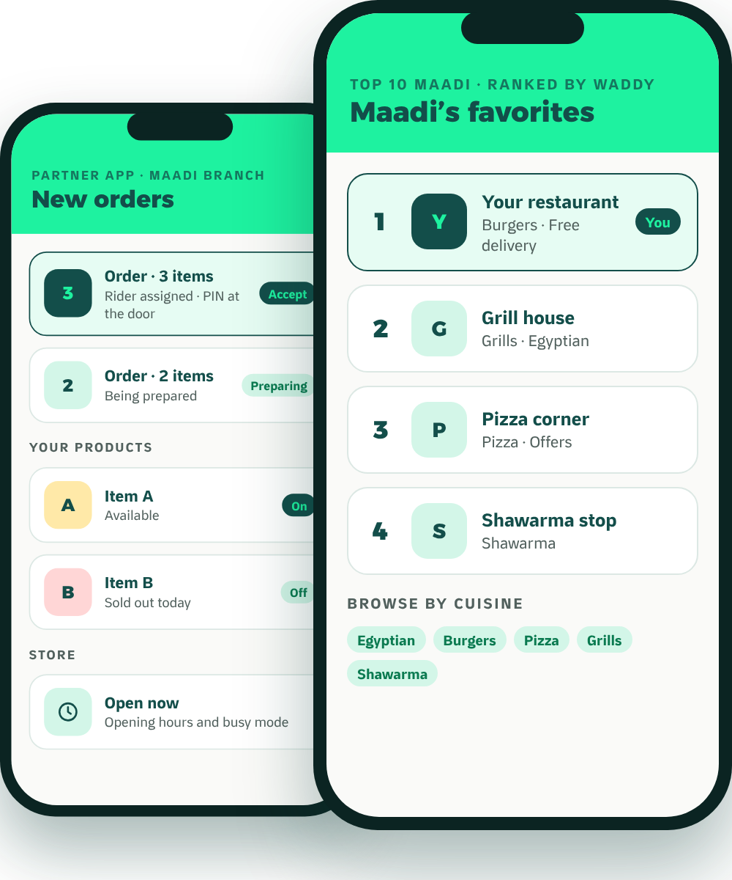
Waddy
PARTNER BROCHURE
The local growth partner
Grow Your Business
Beyond the Counter.
Meet Waddy, the neighborhood delivery and growth platform built for Maadi.
Restaurants
Cafés
Grocery
Pet shops
Founding partners
No setup fee
Reduced launch commission
Keep your other apps
MADE IN MAADI · BUILT AROUND YOU

Slide 2
WHY WADDY
WHAT IS WADDY
Maadi first
A Delivery Platform
Built Only for Maadi.
1
Customers see businesses near them, not the whole city.
2
We promote your branch
Our advertising is for Maadi, and for the branch that serves Maadi.
Customers open Waddy and see restaurants, cafés, grocery and pet shops from their own streets. We run the app, the marketing and the riders.
Riders who only work four areas
3
Degla, Sarayat, Nerco and Corniche. Short, familiar routes mean faster deliveries.
Big apps list your business. Waddy helps your neighborhood discover it.
Waddy · Partner brochure
02

Slide 3
THE WADDY DIFFERENCE
Big Marketplace Thinking vs.
Neighborhood-First Growth.
A citywide list wasn’t built for a business whose customers live a few streets away.
Citywide marketplace model
Waddy: neighborhood-first
Discovery
Customers browse a catalogue that spans many areas.
Customers browse businesses relevant to where they live.
Promotion
Spend goes on the platform and big brands across the whole city.
Waddy advertises in Maadi only.
Local brand
Limited room to build a distinct neighborhood identity.
Partners can become familiar names in their own neighborhood.
Branches
Promotion is usually brand-level: it promotes the chain, not its Maadi branch.
Waddy promotes the Maadi branch to Maadi customers.
Delivery
Fleets cover the whole city.
Waddy’s riders cover four areas: Degla, Sarayat, Nerco and Corniche.
Repeat orders
Loyalty belongs mostly to the marketplace as a whole.
Rewards, weekly quests and scratch cards are built around local habits.
Commission
What you pay on your current apps.
Compare what you pay today with what we offer.
This page compares two business models. It describes structural differences and is not a statement about any particular company.
Waddy · Partner brochure
03

Slide 4
WHERE THE EXTRA ORDERS COME FROM
One Neighborhood. Five Ways to Grow.
1
2
3
4
5
DISCOVER
PROMOTE
DELIVER
RETAIN
GROW
New Maadi customers find you in local discovery, the Top 10 and search that stays local.
Waddy-funded ads in Maadi, Partner Spotlight, and optional paid visibility.
Our riders reach customers beyond walking distance. No rider team to run.
XP, weekly quests, scratch cards and one-tap reorder bring customers back.
The Partner App runs your orders, products, prices and opening hours.
PAGE 05
PAGE 05
PAGE 06
ASK FOR A DEMO
ASK FOR A DEMO
Waddy is non-exclusive, so these are orders on top of the ones you already get. How many depends on your business; we will show you the real count at your 30-day review.
Waddy · Partner brochure
04

Slide 5
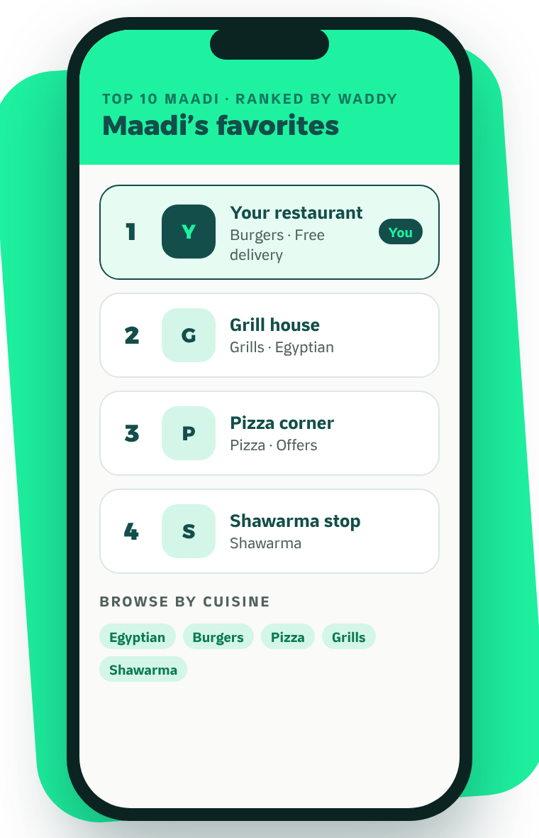




DISCOVER + PROMOTE
Found in Maadi.
Promoted in Maadi.
Maadi’s favorites sit at the top of the food home. The Waddy team sets the order, and the app says so.
A · Waddy-funded local ads
Instagram and Facebook campaigns targeted to Maadi.
FUNDED BY WADDY
B · Partner Spotlight
Selected partners are featured in Waddy’s own content and social channels.
BY SELECTION
C · Optional paid visibility
Sponsored placements, always labelled, if you want extra reach.
OPTIONAL
You never have to buy ads to be listed. Ad concepts are proposals, not past campaigns; results vary and are not guaranteed.
Waddy · Partner brochure
05

Slide 6
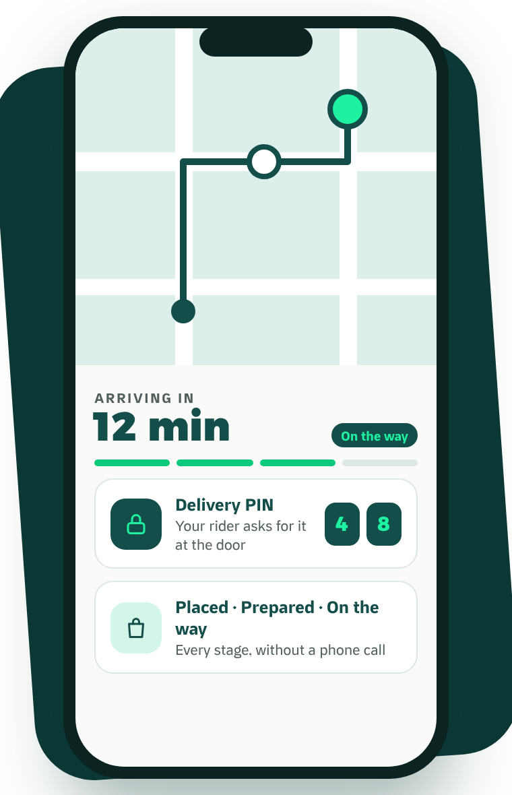




DELIVER
We Deliver.
You Focus on Your Business.
Extend your reach without building and managing a rider team of your own.
Waddy’s own riders
They only work Degla, Sarayat, Nerco and Corniche: short, familiar routes.
Live tracking for the customer
A live map and ETA, so they watch the order instead of calling you.
A delivery PIN at the door
The rider asks for it, so the order reaches the right person.
Cash handled for you
Riders collect cash on delivery; it is included in your payout (page 07).
WHAT IT MEANS FOR YOU
Fewer phone calls, fewer disputes, and a strong last impression.
Waddy · Partner brochure
06

Slide 7



THE OFFER
What It Costs. How to Start Risk-Free.
WHAT IT COSTS
AGREED IN WRITING
START RISK-FREE
None
Before
No setup fee
Joining, onboarding, catalogue and photos cost nothing.
Setup fee
you start, not after
Reduced launch commission
Commission
Delivery fee
A lower rate for founding partners while you get started.
One rate when Waddy delivers, another when you deliver yourself. Agreed with you before you start.
Agreed with you, in writing
Settlement
Stay on your other apps
Agreed with you, in writing. Cash orders are collected by our riders and included in your payout
Waddy adds Maadi customers. It doesn’t replace anyone.
Monthly fee
None
30-day review
Advertising
Refunds and exit
After 30 days we show you every order that came through Waddy, and you decide.
Optional, never required
Agreed with you, in writing
We’re new, so there are no case studies yet. Founding partners get these terms agreed in writing.
Waddy · Partner brochure
07

Slide 8
JOIN WADDY
Let’s Grow
Maadi Together.
WHATSAPP
Message our partner team
Send us a WhatsApp message. Then:
DAYS 1–14
DAYS 15–30
DAY 30
DAYS 31–90
Founding partners: no setup fee and a reduced launch commission.
Set up
Launch
30-day review
Build
Catalogue, photos and training. Free.
Live in Maadi from day one.
Every order that came through Waddy. You decide.
Offers and partner promotion, planned together.
PHONE
EMAIL
WEB
waddyapp.com
Your brand. Your local branch. Your neighborhood.
Your growth partner.
Waddy · Partner brochure
08

Slide 9
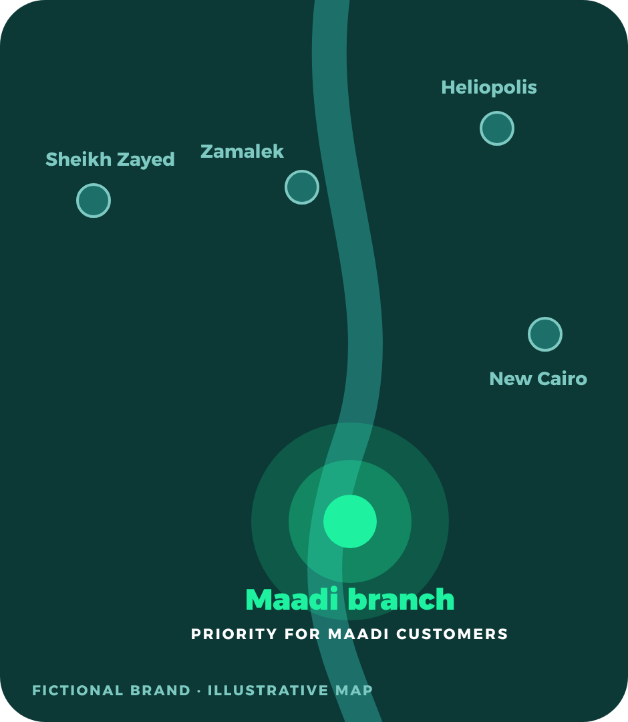
FOR BRANDS WITH MORE THAN ONE BRANCH
Your Maadi Branch
Gets Priority.
One brand. Multiple branches. Your neighborhood comes first. Whether you have one location or twenty, Waddy is built around the branch that serves the customer’s neighborhood. Big apps tend to promote the brand, not your Maadi branch.
1
A brand with several branches
Maadi, New Cairo, Heliopolis, Zamalek, Sheikh Zayed.
2
The customer opens Waddy in Maadi
Waddy shows the marketplace for that neighborhood.
3
The Maadi branch is the one they see
A dedicated branch presence, with local promotions.
4
The order goes to the right branch
Prepared and delivered by the branch that serves them.
Priority means local-branch relevance and designated visibility for Maadi customers. It is not a guaranteed ranking position. Other branches join as Waddy opens in their areas.
Waddy · Partner brochure
Appendix · A1

