Slide 1

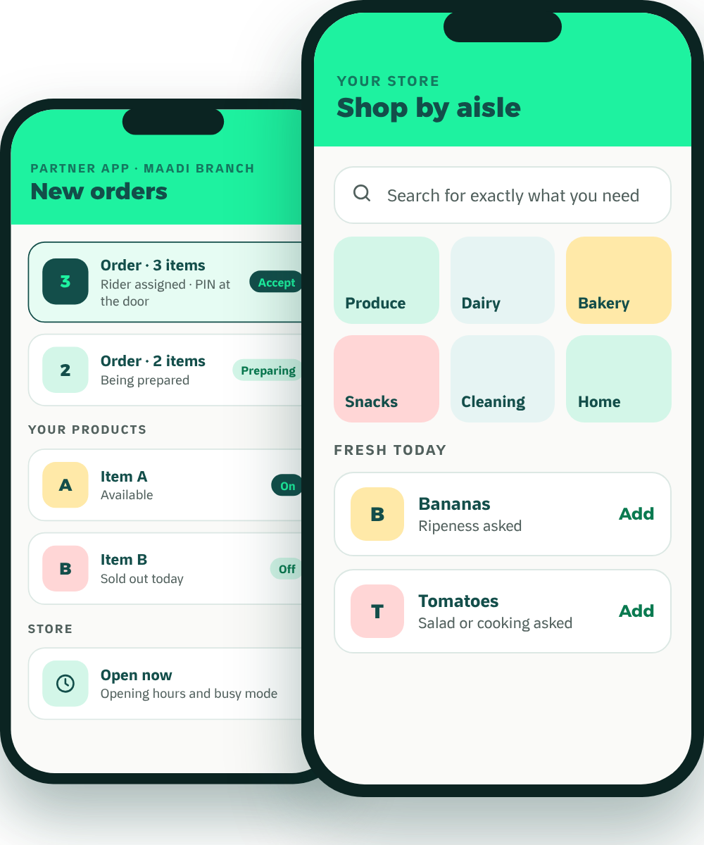
Waddy
FOR SUPERMARKETS & GROCERS
The local growth partner
Grow Your Store
Beyond the Counter.
Meet Waddy, the neighborhood delivery and growth platform that lets your fresh aisle sell online the way it sells in store.
Ripeness choice
Salad or cooking
Local advertising
Our own riders
Founding partners
No setup fee
Reduced launch commission
Keep your other apps
MADE IN MAADI · BUILT AROUND YOU

Slide 2
WHY WADDY
WHAT IS WADDY
Maadi first
A Delivery Platform
Built Only for Maadi.
1
Customers see businesses near them, not the whole city.
2
We promote your branch
Our advertising is for Maadi, and for the branch that serves Maadi.
Customers open Waddy and see restaurants, cafés, grocery and pet shops from their own streets. We run the app, the marketing and the riders.
Riders who only work four areas
3
Degla, Sarayat, Nerco and Corniche. Short, familiar routes mean faster deliveries.
Big apps list your business. Waddy helps your neighborhood discover it.
Waddy · For supermarkets & grocers
LIVE IN THE APP
02

Slide 3
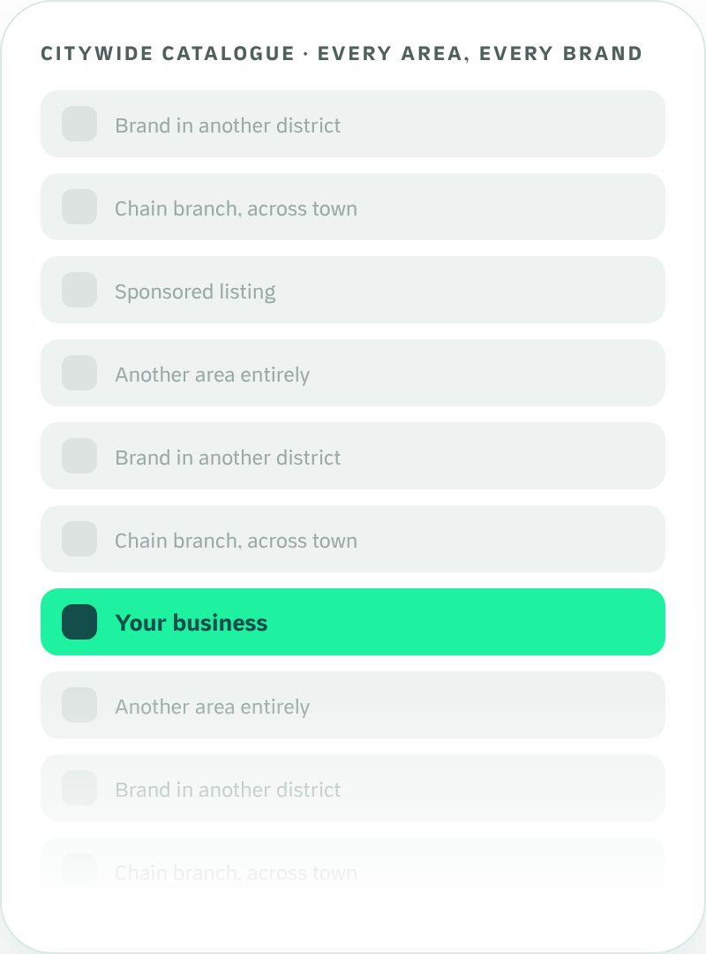
THE PROBLEM
Your Business Deserves
More Than Another Listing.
A marketplace that covers a whole city is built for breadth. That structure creates real challenges for a business whose customers live a few streets away.
01
A much larger catalogue to compete in
Your listing shares attention with brands from every district.
02
Advertising in a crowded room
Promotion has to be heard above everyone else’s.
03
Little room for a neighborhood identity
It is hard to become “our local place” inside a citywide list.
Waddy · For supermarkets & grocers
03

Slide 4
THE WADDY DIFFERENCE
Big Marketplace Thinking vs.
Neighborhood-First Growth.
Citywide marketplace model
Waddy: neighborhood-first
Discovery
Customers browse a catalogue that spans many areas.
Customers browse businesses relevant to where they live.
Promotion
Spend goes on the platform and big brands across the whole city.
Waddy advertises in Maadi only.
Local brand
Limited room to build a distinct neighborhood identity.
Partners can become familiar names in their own neighborhood.
Branches
Promotion is usually brand-level: it promotes the chain, not its Maadi branch.
Waddy promotes the Maadi branch to Maadi customers.
Delivery
Fleets cover the whole city.
Waddy’s riders cover four areas: Degla, Sarayat, Nerco and Corniche.
Repeat orders
Loyalty belongs mostly to the marketplace as a whole.
Rewards, weekly quests and scratch cards are built around local habits.
Commission
What you pay on your current apps.
Compare what you pay today with what we offer.
This page compares two business models. It describes structural differences and is not a statement about any particular company.
Waddy · For supermarkets & grocers
04

Slide 5




WHERE THE EXTRA ORDERS COME FROM
Four Sources of Orders On Top of Today’s.
1
2
3
4
New Maadi customers who find you
Repeat orders
Delivery without a rider team
Optional paid visibility
XP, weekly quests, scratch cards and one-tap reorder bring the same customers back.
Customers beyond walking distance can order. Our riders bring it to them.
When you want more, sponsored placements put you at the top of the screen.
People nearby who didn’t know you, finding you in local discovery and in Waddy’s Maadi campaigns.
Waddy is non-exclusive, so these are orders on top of the ones you already get. How many depends on your business; we will show you the real count at your 30-day review.
Waddy · For supermarkets & grocers
05

Slide 6


THE OFFER
What It Costs. How to Start Risk-Free.
WHAT IT COSTS
AGREED IN WRITING
START RISK-FREE
None
Before
No setup fee
Joining, onboarding, catalogue and photos cost nothing.
Setup fee
you start, not after
Reduced launch commission
Commission
Delivery fee
A lower rate for founding partners while you get started.
One rate when Waddy delivers, another when you deliver yourself. Agreed with you before you start.
Agreed with you, in writing
Settlement
Stay on your other apps
Agreed with you, in writing. Cash orders are collected by our riders and included in your payout
Waddy adds Maadi customers. It doesn’t replace anyone.
Monthly fee
[None: confirm]
30-day review
Advertising
Refunds and exit
After 30 days we show you every order that came through Waddy, and you decide.
Optional, never required
Agreed with you, in writing
We’re new, so there are no case studies yet. Founding partners get these terms agreed in writing.
Waddy · For supermarkets & grocers
OPERATING POLICY · CONFIRM BEFORE PRINT
06

Slide 7
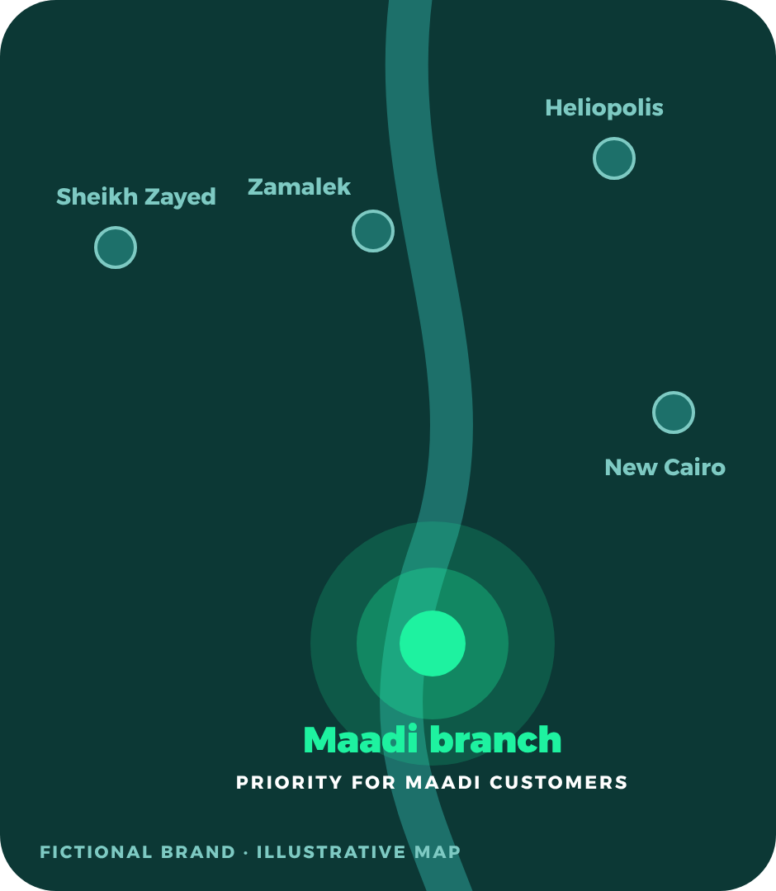
FOR BRANDS WITH MORE THAN ONE BRANCH
Your Maadi Branch
Gets Priority.
One brand. Multiple branches. Your neighborhood comes first. Whether you have one location or twenty, Waddy is built around the branch that serves the customer’s neighborhood. Big apps tend to promote the brand, not your Maadi branch.
1
A brand with several branches
Maadi, New Cairo, Heliopolis, Zamalek, Sheikh Zayed.
2
The customer opens Waddy in Maadi
Waddy shows the marketplace for that neighborhood.
3
The Maadi branch is the one they see
A dedicated branch presence, with local promotions.
4
The order goes to the right branch
Prepared and delivered by the branch that serves them.
Priority means local-branch relevance and designated visibility for Maadi customers. It is not a guaranteed ranking position. Other branches join as Waddy opens in their areas.
Waddy · For supermarkets & grocers
OPERATING POLICY · CONFIRM BEFORE PRINT
07

Slide 8
THE WADDY LOCAL GROWTH ECOSYSTEM
One neighborhood. Five ways to grow.
1
2
3
4
5
DISCOVER
PROMOTE
DELIVER
RETAIN
GROW
Customers find nearby restaurants, cafés, grocery stores and pet shops.
Local advertising, social content, Partner Spotlights and neighborhood campaigns.
Waddy’s own riders carry the order, tracked live to the door.
Rewards, weekly quests, scratch cards and wallet bring customers back.
Your Partner App runs your orders, products, prices and opening hours.
PAGE 09
PAGE 10
PAGE 11
PAGE 12
PAGE 13
Waddy · For supermarkets & grocers
08

Slide 9
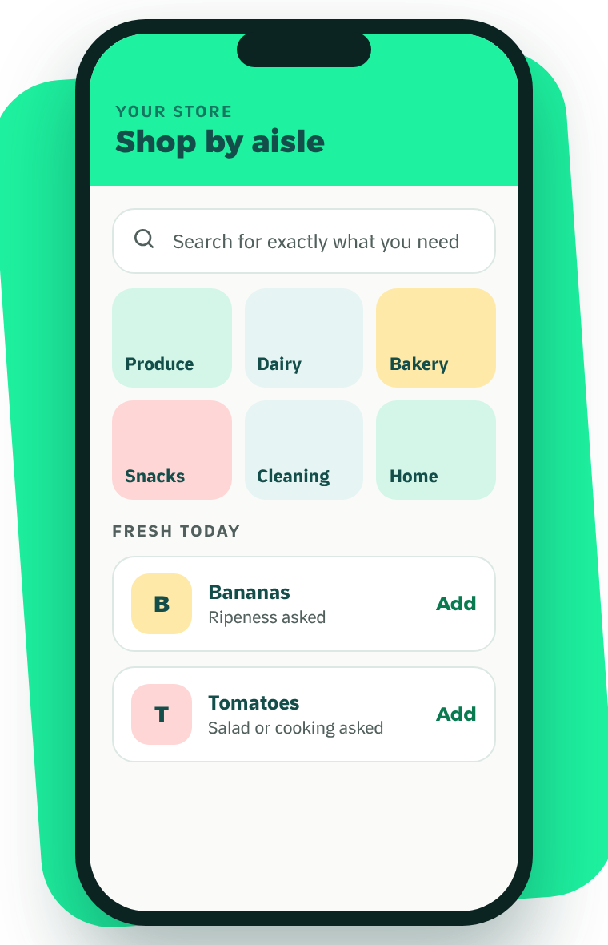




1 · DISCOVER
Be Where Your
Neighborhood Shops.
Your store on Waddy is laid out the way people already shop it, in front of the households around you.
Shop by aisle
Produce, dairy, bakery, snacks, cleaning and home essentials, each with its own shelf.
Search that stays local
Customers who know what they want find it at a store nearby.
Clear prices before the cart
What they see is what they pay. Trust builds basket by basket.
Your offers, shown up front
Offers and free delivery appear on your listing before the store opens.
WHAT IT MEANS FOR YOU
They came for milk and found the rest of your store.
Waddy · For supermarkets & grocers
LIVE IN THE APP
09

Slide 10
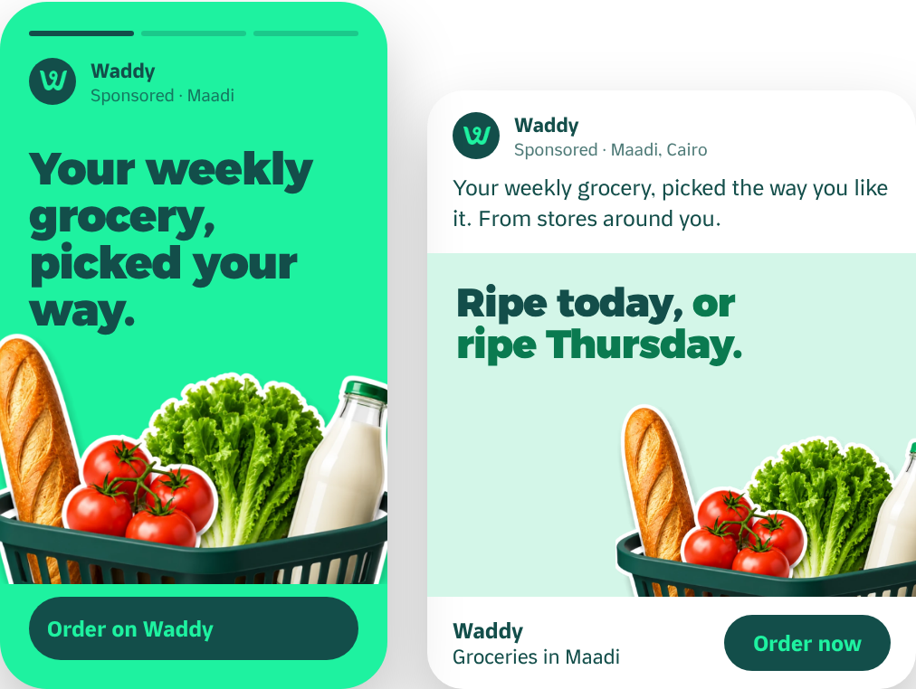



2 · PROMOTE
We Don’t Just List You.
We Promote You in Maadi.
Waddy advertises in the areas it serves, and puts its partners in front of the people who live there.
A · Waddy-funded local ads
Instagram and Facebook campaigns targeted to Maadi: food discovery, coffee, weekly grocery, pet essentials, new on Waddy.
FUNDED BY WADDY
B · Partner Spotlight
Selected partners are featured in Waddy’s own content and social channels: your brand, your products, your location.
BY SELECTION
C · Optional paid visibility
Sponsored home-screen and category placements, always labelled, if you want extra reach.
OPTIONAL
ADVERTISING CONCEPTS · STORY AND FEED FORMATS
Pick partners
→
Create content
→
Target Maadi
→
Review results
You never have to buy ads to be listed. Ad concepts shown are proposals, not past campaigns; results vary and are not guaranteed.
Waddy · For supermarkets & grocers
MARKETING PLAN · FOR APPROVAL
10

Slide 11
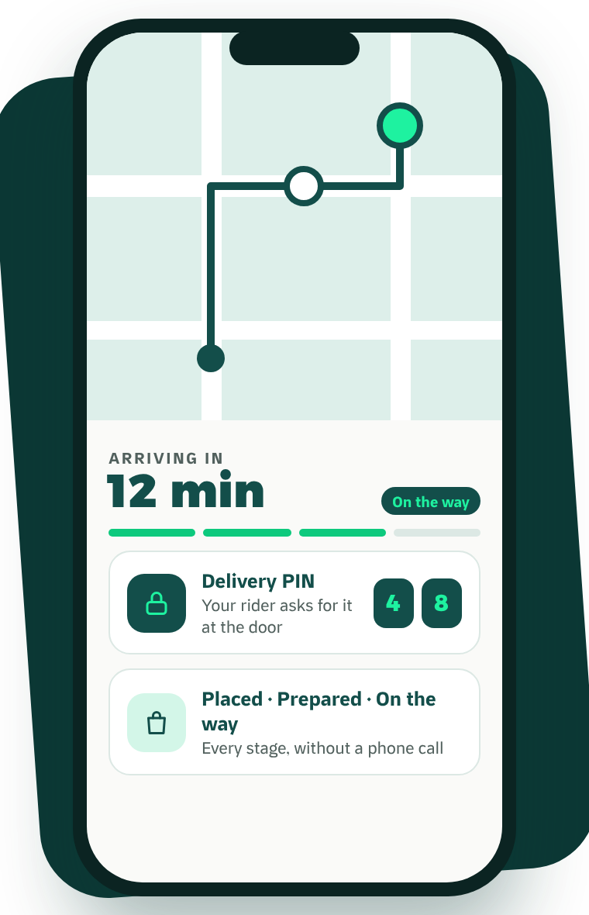




3 · DELIVER
We Deliver.
You Focus on Your Business.
Extend your reach without building and managing a rider team of your own.
Waddy’s own riders
They only work Degla, Sarayat, Nerco and Corniche: short, familiar routes.
Live tracking for the customer
A live map and ETA, so they watch the order instead of calling you.
A delivery PIN at the door
The rider asks for it, so the order reaches the right person.
Cash handled for you
Riders collect cash on delivery; it is included in your payout (page 06).
WHAT IT MEANS FOR YOU
Fewer phone calls, fewer disputes, and a strong last impression.
Waddy · For supermarkets & grocers
LIVE IN THE APP
11

Slide 12
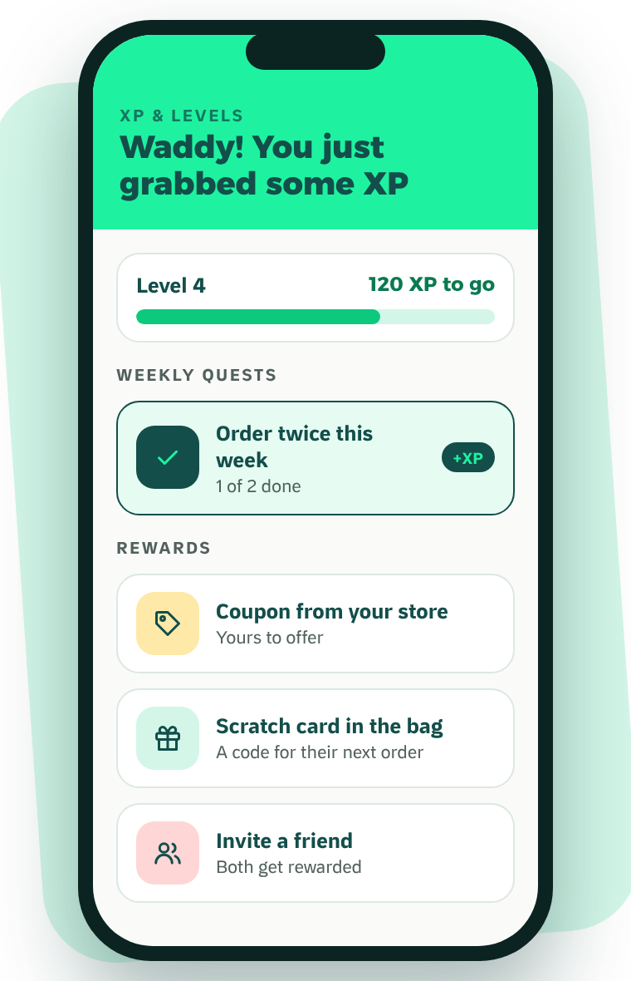




4 · RETAIN
Turn First Orders Into
Repeat Customers.
Waddy gives customers reasons to come back that do not depend on you cutting your prices.
XP and levels
Customers earn XP on every order and unlock rewards as they level up.
Weekly quests
Challenges that bring people back to the app within the week.
Scratch cards
A printed code in the bag that turns one order into a reason for the next.
Wallet, referrals and reorder
Balance to spend, friends to invite, and past orders one tap away.
WHAT IT MEANS FOR YOU
More of tonight’s customers become next week’s.
Waddy · For supermarkets & grocers
LIVE IN THE APP
12

Slide 13
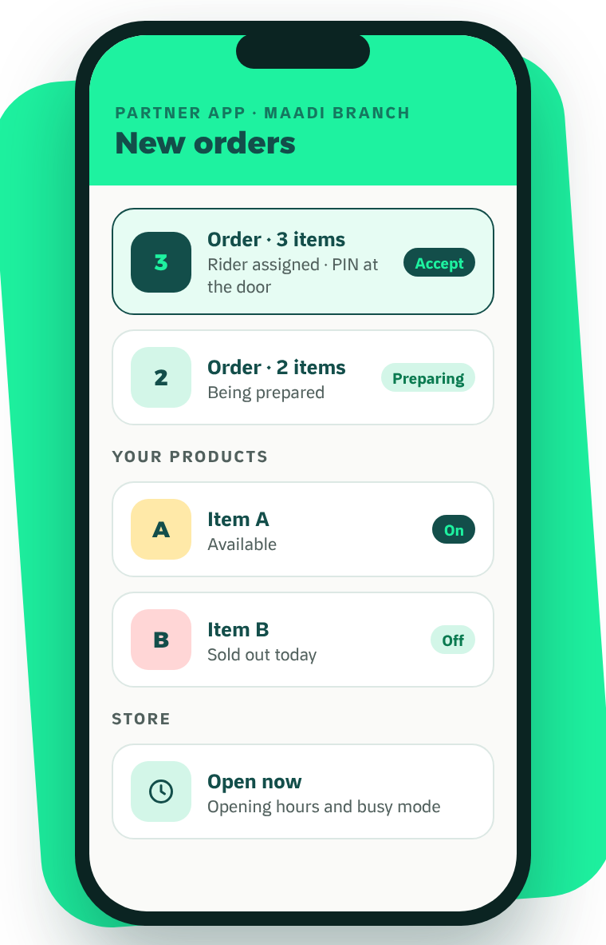



5 · GROW
Your Business. Under Your Control.
Run your Waddy presence from the Partner App.
Orders
Receive, accept and follow every order.
Products and prices
Keep your catalogue current.
Availability
Mark items sold out and set your opening hours.
WHAT IT MEANS FOR YOU
Your menu, your prices and your hours stay in your hands.
PARTNER APP · CONCEPT VIEW
Waddy · For supermarkets & grocers
CONCEPT MOCKUP
13

Slide 14
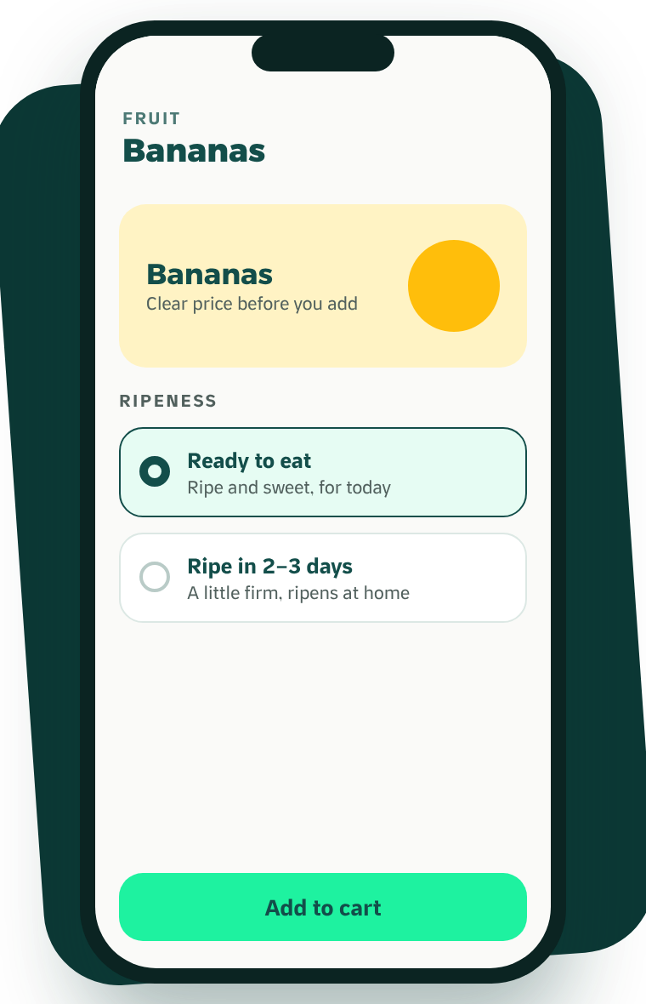



BUILT FOR GROCERY · ONLY ON WADDY
Ripe Today, or Ripe Thursday.
Salad, or Sauce.
Nobody trusts a stranger to pick their tomatoes. Waddy asks the question a good greengrocer asks across the counter, before the item reaches the cart.
Ripeness, on fruit
Ready to eat today, or ripe in 2–3 days.
Use it for, on vegetables
For salad: firm and crisp. For cooking: riper and softer.
Only where it is needed
Fruit and vegetables ask. Milk and rice ask nothing, so shopping stays fast.
WHAT IT MEANS FOR YOU
Customers trust you with fresh produce online, and fresh is what fills a weekly basket.
Waddy · For supermarkets & grocers
LIVE IN THE APP
14

Slide 15
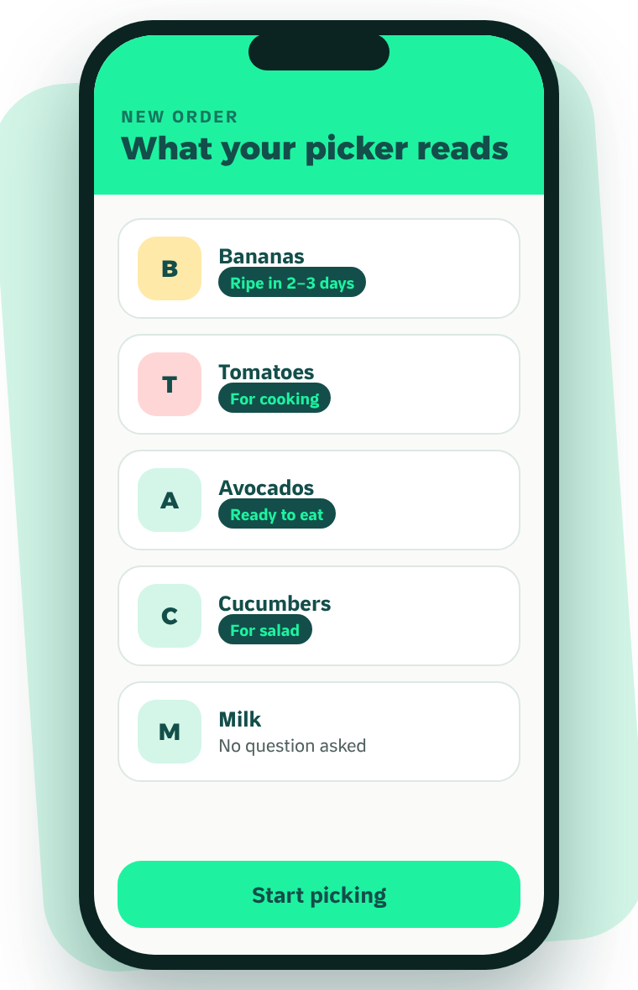

BUILT FOR GROCERY · ON YOUR SIDE OF THE COUNTER
One Question for Them.
Zero Guessing for You.
The customer’s answer travels with the item, all the way to whoever picks the order in your store.
Written on the order line
“Bananas · Ripe in 2–3 days.” The instruction sits next to the item it belongs to.
Never touches price or stock
It is a picking note, not a new product. Nothing extra to manage in your catalogue.
Sell the whole crate
Softer produce goes to the cooks who want it instead of staying on the shelf.
WHAT IT MEANS FOR YOU
Fewer complaints and refunds for you, and less waste on your shelf.
Waddy · For supermarkets & grocers
LIVE IN THE APP
15

Slide 16
YOUR ROADMAP
Your First 90 Days With Waddy.
DAYS 1–14
DAYS 15–30
DAY 30
DAYS 31–90
Set up
Launch
30-day review
Build
Agreement, catalogue, photos and prices. Partner App training for your team.
Go live in Maadi. Your store appears in local discovery from day one.
We show you every order that came through Waddy, and you decide.
Offers and eligibility for Waddy’s partner promotion, planned together.
An indicative roadmap. Actual timing depends on your catalogue and readiness.
Waddy · For supermarkets & grocers
MARKETING PLAN · FOR APPROVAL
16

Slide 17
JOIN WADDY
Let’s Grow
Maadi Together.
WHATSAPP
[WhatsApp QR]
Message our partner team
1
Message us on WhatsApp
Talk to our partner team directly about your business and your branches.
[Partner WhatsApp]
2
Set up your store, free
Founding partners: no setup fee and a reduced launch commission.
We build your catalogue with you and train your team. No setup fee.
3
Go live in Maadi
PHONE
[Partner Team Phone]
Start receiving orders from your neighborhood. Keep every other app you use.
EMAIL
[Partner Email]
Your brand. Your local branch. Your neighborhood.
Your growth partner.
WEB
waddyapp.com
Waddy · For supermarkets & grocers
17

