Slide 1

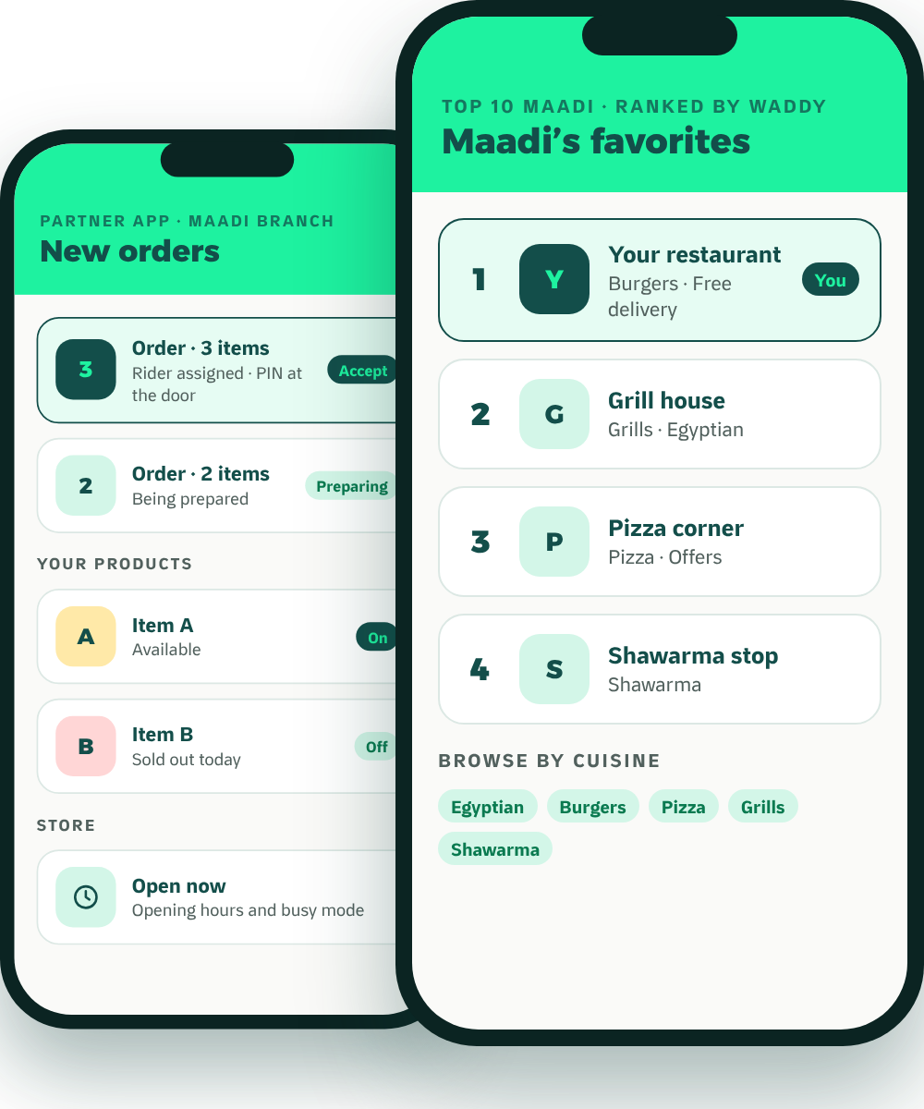
Waddy
PARTNER BROCHURE
The local growth partner
Grow Your Business
Beyond the Counter.
Meet Waddy, the neighborhood delivery and growth platform built for Maadi.
Restaurants
Cafés
Grocery
Pet shops
Founding partners
No setup fee
Reduced launch commission
Keep your other apps
MADE IN MAADI · BUILT AROUND YOU

Slide 2





WADDY IN ONE PAGE
Why Add Waddy? The Short Version.
Your neighborhood, not the city
We advertise in Maadi
We deliver
Customers in Maadi see Maadi. You compete with your street.
Waddy-funded local Instagram and Facebook campaigns. You never have to buy ads to be listed.
Our own riders, live tracking, a PIN at the door, and cash collected for you.
Keep every app you’re on.
Customers come back
Built for your trade
Waddy is non-exclusive. Add it alongside the channels you already use.
XP, weekly quests and scratch cards give them reasons to reorder.
Ripeness choice for grocers, pet profiles for pet shops, a ranked local stage for restaurants.
Founding partners: no setup fee and a reduced launch commission. Full offer overleaf.
Waddy · Partner brochure
02

Slide 3


THE OFFER
What It Costs. How to Start Risk-Free.
WHAT IT COSTS
AGREED IN WRITING
START RISK-FREE
None
Before
No setup fee
Joining, onboarding, catalogue and photos cost nothing.
Setup fee
you start, not after
Reduced launch commission
Commission
Delivery fee
A lower rate for founding partners while you get started.
One rate when Waddy delivers, another when you deliver yourself. Agreed with you before you start.
Agreed with you, in writing
Settlement
Stay on your other apps
Agreed with you, in writing. Cash orders are collected by our riders and included in your payout
Waddy adds Maadi customers. It doesn’t replace anyone.
Monthly fee
[None: confirm]
30-day review
Advertising
Refunds and exit
After 30 days we show you every order that came through Waddy, and you decide.
Optional, never required
Agreed with you, in writing
We’re new, so there are no case studies yet. Founding partners get these terms agreed in writing.
Waddy · Partner brochure
OPERATING POLICY · CONFIRM BEFORE PRINT
03

Slide 4
JOIN WADDY
Let’s Grow
Maadi Together.
WHATSAPP
[WhatsApp QR]
Message our partner team
1
Message us on WhatsApp
Talk to our partner team directly about your business and your branches.
[Partner WhatsApp]
2
Set up your store, free
Founding partners: no setup fee and a reduced launch commission.
We build your catalogue with you and train your team. No setup fee.
3
Go live in Maadi
PHONE
[Partner Team Phone]
Start receiving orders from your neighborhood. Keep every other app you use.
EMAIL
[Partner Email]
Your brand. Your local branch. Your neighborhood.
Your growth partner.
WEB
waddyapp.com
Waddy · Partner brochure
04

