Slide 1

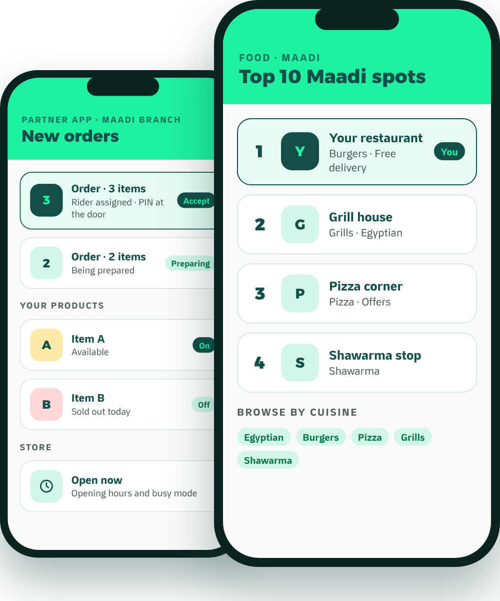
Waddy
FOR RESTAURANTS & CAFÉS
The local growth partner
Grow Your
Restaurant
Beyond the Counter.
Meet Waddy, the neighborhood delivery and growth platform that puts Maadi’s restaurants and cafés in front of Maadi.
Top 10 Maadi
Waddy Spots
Local advertising
Our own riders
Founding partners
No setup fee
Reduced launch commission
Keep your other apps
MADE IN MAADI · BUILT AROUND YOU

Slide 2





WADDY IN ONE PAGE
Why Add Waddy? The Short Version.
Your neighborhood, not the city
We advertise in Maadi
We deliver
Customers in Maadi see Maadi. You compete with your street.
Waddy-funded local Instagram and Facebook campaigns. You never have to buy ads to be listed.
Our own riders, live tracking, a PIN at the door, and cash collected for you.
Keep every app you’re on.
Customers come back
Built for restaurants
Waddy is non-exclusive. Add it alongside the channels you already use.
XP, weekly quests and scratch cards give them reasons to reorder.
Top 10 Maadi and weekly Waddy Spots votes put your kitchen on a ranked local stage.
Founding partners: no setup fee and a reduced launch commission. Full offer overleaf.
Waddy · For restaurants & cafés
02

Slide 3



THE OFFER
What It Costs. What You Keep.
How to Start Risk-Free.
WHAT IT COSTS
WHAT YOU KEEP
START RISK-FREE
None
No setup fee
[100% minus commission]
Joining, onboarding, catalogue and photos cost nothing.
Setup fee
of every order’s value
Reduced launch commission
Commission
Paid out
[Rate] for your first [Period].
[Rate] per completed order
[Settlement Schedule]
Non-exclusive
Cash orders
Keep every app you sell on today. Add Waddy alongside them.
Monthly fee
Collected by our riders, included in your payout
[If any]
Clear exit
Delivery fee
Refunds
[Contract Term & Notice]
[Delivery Fee Model]
[Refund Policy]
Advertising
Optional, never required
We’re new, so there are no case studies yet. Founding partners get these terms in writing.
Waddy · For restaurants & cafés
OPERATING POLICY · CONFIRM BEFORE PRINT
03

Slide 4
JOIN WADDY
Let’s Grow
Maadi Together.
WHATSAPP
[WhatsApp QR]
Message our partner team
1
Message us on WhatsApp
Talk to our partner team directly about your business and your branches.
[Partner WhatsApp]
2
Set up your store, free
Founding partners: no setup fee and a reduced launch commission.
We build your catalogue with you and train your team. No setup fee.
3
Go live in Maadi
PHONE
[Partner Team Phone]
Start receiving orders from your neighborhood. Keep every other app you use.
EMAIL
[Partner Email]
Your brand. Your local branch. Your neighborhood.
Your growth partner.
WEB
waddyapp.com
Waddy · For restaurants & cafés
04

