Slide 1

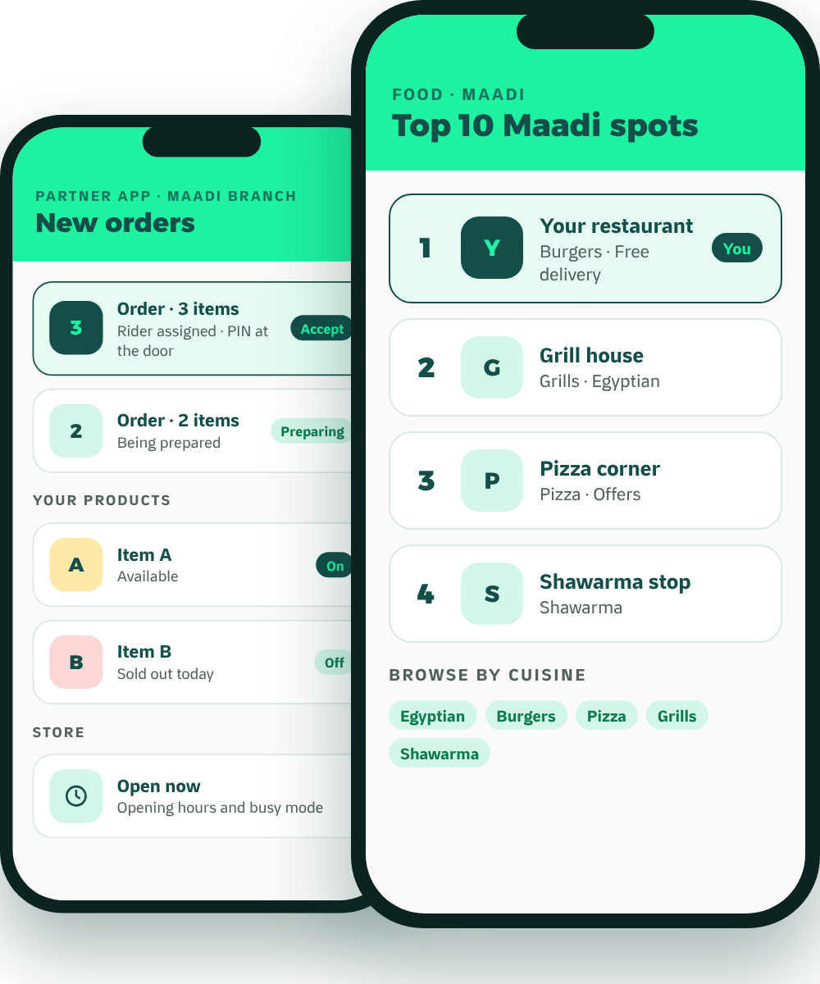
Waddy
FOR RESTAURANTS & CAFÉS
The local growth partner
Grow Your
Restaurant
Beyond the Counter.
Meet Waddy, the neighborhood delivery and growth platform that puts Maadi’s restaurants and cafés in front of Maadi.
Top 10 Maadi
Waddy Spots
Local advertising
Our own riders
Founding partners
No setup fee
Reduced launch commission
Keep your other apps
MADE IN MAADI · BUILT AROUND YOU

Slide 2




A customer app
Discover nearby businesses, order, and track every delivery live.
WHO WE ARE
Made in Maadi.
Built Around Local Business.
A Partner App
Manage your orders, products, availability and daily operations.
Waddy is a hyperlocal, multi-category delivery platform. We connect the people of one neighborhood with the restaurants, cafés, grocery stores and pet shops that serve it, and we concentrate our marketplace, our marketing and our riders on that neighborhood.
Our own riders
Waddy operates its delivery network inside the areas it serves.
Four categories, one app
Food, coffee, groceries and pet supplies, side by side.
Big apps list your business. Waddy helps your neighborhood discover it.
Waddy · For restaurants & cafés
LIVE IN THE APP
02

Slide 3
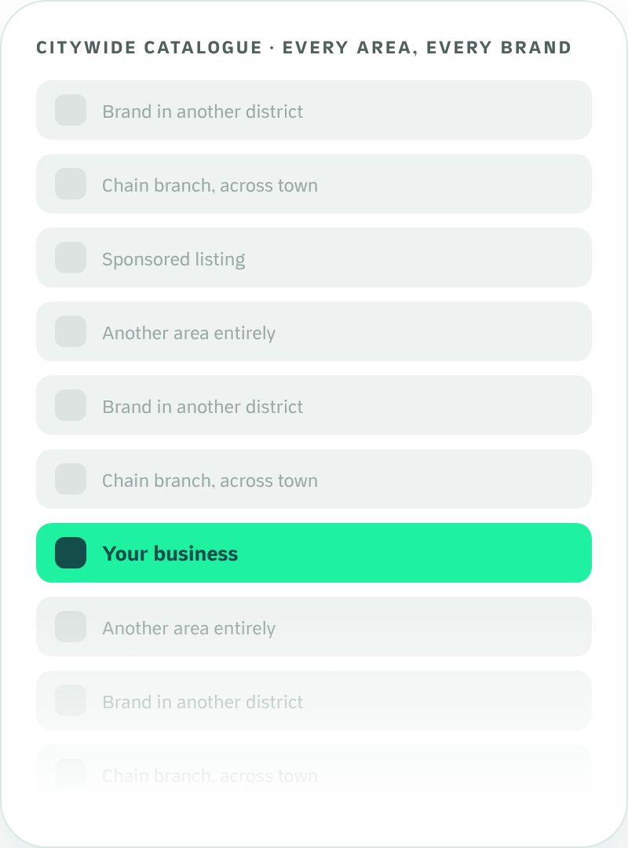
THE PROBLEM
Your Business Deserves
More Than Another Listing.
A marketplace that covers a whole city is built for breadth. That structure creates real challenges for a business whose customers live a few streets away.
01
A much larger catalogue to compete in
Your listing shares attention with brands from every district.
02
Advertising in a crowded room
Promotion has to be heard above everyone else’s.
03
Little room for a neighborhood identity
It is hard to become “our local place” inside a citywide list.
Waddy · For restaurants & cafés
03

Slide 4
THE WADDY DIFFERENCE
Big Marketplace Thinking vs.
Neighborhood-First Growth.
Citywide marketplace model
Waddy: neighborhood-first
Discovery
Customers browse a catalogue that spans many areas.
Customers browse businesses relevant to where they live.
Marketing
Promotion competes for attention across a crowded marketplace.
Waddy concentrates its advertising on the areas it serves.
Local brand
Limited room to build a distinct neighborhood identity.
Partners can become familiar names in their own neighborhood.
Branches
A brand’s branches sit inside one broad, citywide presence.
The Maadi branch is the designated branch for Maadi customers.
Delivery
Fleet and coverage are organized around the whole city.
Waddy’s own riders work inside its delivery areas.
Repeat orders
Loyalty belongs mostly to the marketplace as a whole.
Rewards, weekly quests and Spots are built around local habits.
This page compares two business models. It describes structural differences and is not a statement about any particular company.
Waddy · For restaurants & cafés
04

Slide 5


THE OFFER
What It Costs. What You Keep.
How to Start Risk-Free.
WHAT IT COSTS
WHAT YOU KEEP
START RISK-FREE
None
No setup fee
[100% minus commission]
Joining, onboarding, catalogue and photos cost nothing.
Setup fee
of every order’s value
Reduced launch commission
Commission
Paid out
[Rate] for your first [Period].
[Rate] per completed order
[Settlement Schedule]
Non-exclusive
Cash orders
Keep every app you sell on today. Add Waddy alongside them.
Monthly fee
Collected by our riders, included in your payout
[If any]
Clear exit
Delivery fee
Refunds
[Contract Term & Notice]
[Delivery Fee Model]
[Refund Policy]
Advertising
Optional, never required
We’re new, so there are no case studies yet. Founding partners get these terms in writing.
Waddy · For restaurants & cafés
OPERATING POLICY · CONFIRM BEFORE PRINT
05

Slide 6
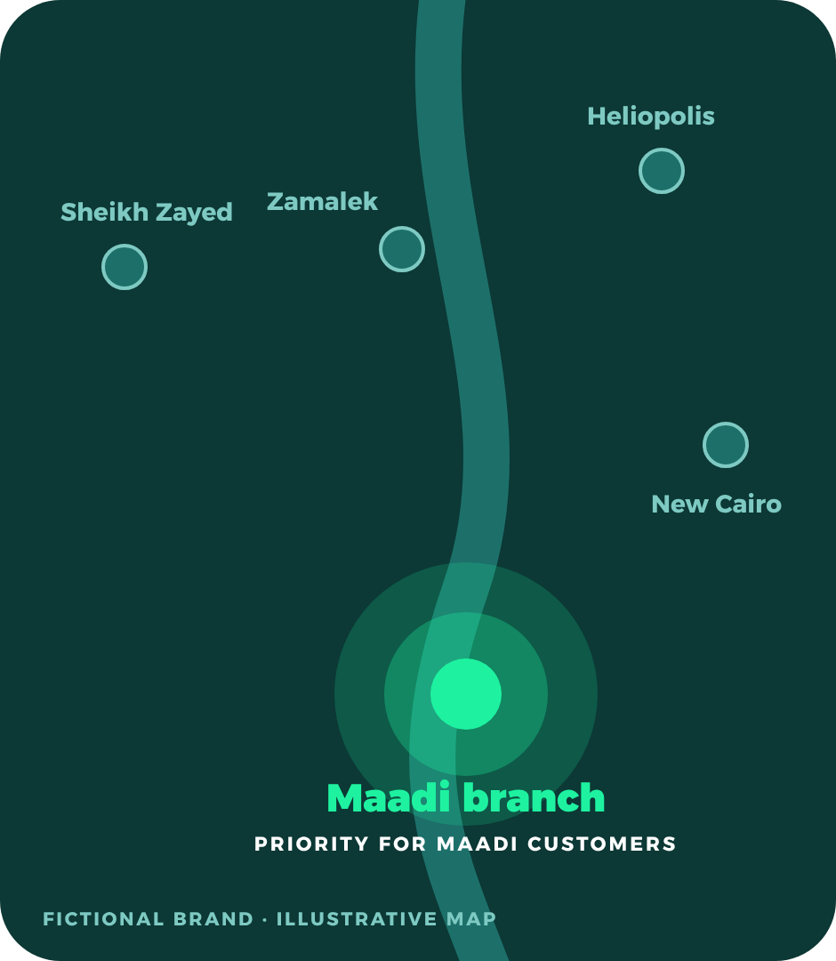
FOR BRANDS WITH MORE THAN ONE BRANCH
Your Maadi Branch
Gets Priority.
One brand. Multiple branches. Your neighborhood comes first. Whether you have one location or twenty, Waddy is built around the branch that serves the customer’s neighborhood.
1
A brand with several branches
Maadi, New Cairo, Heliopolis, Zamalek, Sheikh Zayed.
2
The customer opens Waddy in Maadi
Waddy shows the marketplace for that neighborhood.
3
The Maadi branch is the one they see
A dedicated branch presence, with local promotions.
4
The order goes to the right branch
Prepared and delivered by the branch that serves them.
Priority means local-branch relevance and designated visibility for Maadi customers. It is not a guaranteed ranking position. Other branches join as Waddy opens in their areas.
Waddy · For restaurants & cafés
OPERATING POLICY · CONFIRM BEFORE PRINT
06

Slide 7
THE WADDY LOCAL GROWTH ECOSYSTEM
One neighborhood. Five ways to grow.
1
2
3
4
5
DISCOVER
PROMOTE
DELIVER
RETAIN
GROW
Customers find nearby restaurants, cafés, grocery stores and pet shops.
Local advertising, social content, Partner Spotlights and neighborhood campaigns.
Waddy’s own riders carry the order, tracked live to the door.
Rewards, weekly quests, scratch cards and wallet bring customers back.
Your Partner App and available insights help you run and understand your business.
PAGE 08
PAGES 09–10
PAGE 13
PAGE 11
PAGE 14
Waddy · For restaurants & cafés
07

Slide 8
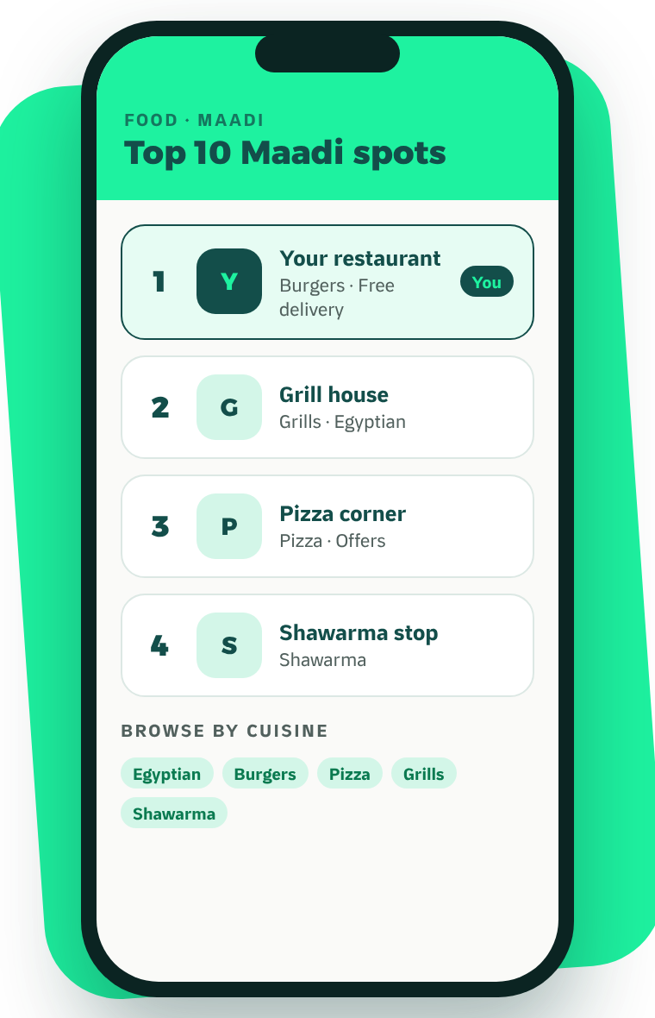




1 · DISCOVER
Be Where Your
Neighborhood Shops.
Waddy’s customer app is organized around what is near the customer, so being found does not depend on outspending a whole city.
Top 10 Maadi, ranked
A ranked list of neighborhood favorites at the top of the food home.
Found by category
By cuisine for restaurants, by aisle for grocery, by pet for pet shops.
Your offers, shown up front
Offers and free delivery appear on your listing before the menu opens.
Search that stays local
Customers looking for something specific find who sells it nearby.
WHAT IT MEANS FOR YOU
You compete with your street, not with the city.
Waddy · For restaurants & cafés
LIVE IN THE APP
08

Slide 9
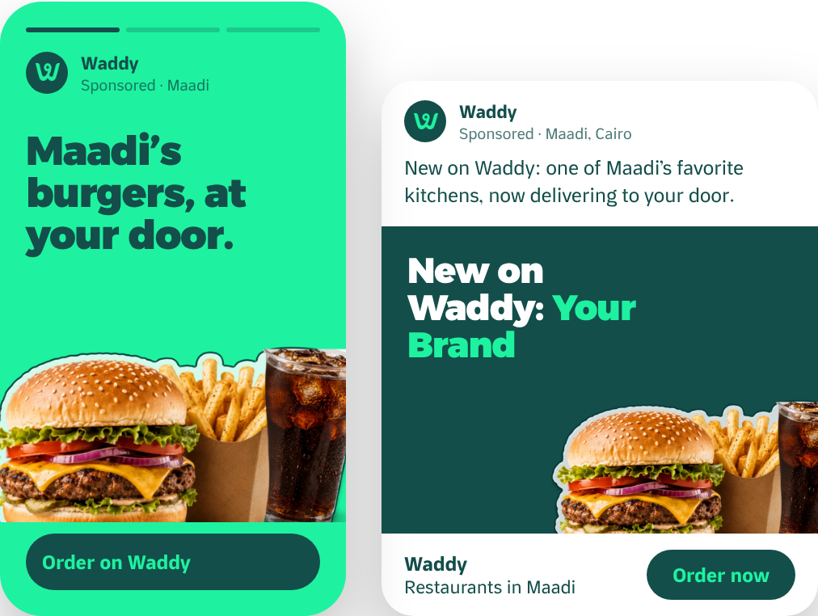



2 · PROMOTE
We Don’t Just List You.
We Promote You in Maadi.
Waddy advertises in the areas it serves, and puts its partners in front of the people who live there.
A · Waddy-funded local ads
Instagram and Facebook campaigns targeted to Maadi: food discovery, coffee, weekly grocery, pet essentials, new on Waddy.
FUNDED BY WADDY
B · Partner Spotlight and Waddy Spots
Selected partners are featured in Waddy’s content, and every week Maadi votes for its favorite places.
BY SELECTION
C · Optional paid visibility
Sponsored home-screen and category placements, always labelled, if you want extra reach.
OPTIONAL
Pick partners
→
Create content
→
Target Maadi
→
Review results
ADVERTISING CONCEPTS · STORY AND FEED FORMATS
You never have to buy ads to be listed. Ad concepts shown are proposals, not past campaigns; results vary and are not guaranteed. Budget: [Monthly Advertising Budget] · Cadence: [Campaign Frequency]
Waddy · For restaurants & cafés
MARKETING PLAN · FOR APPROVAL
09

Slide 10
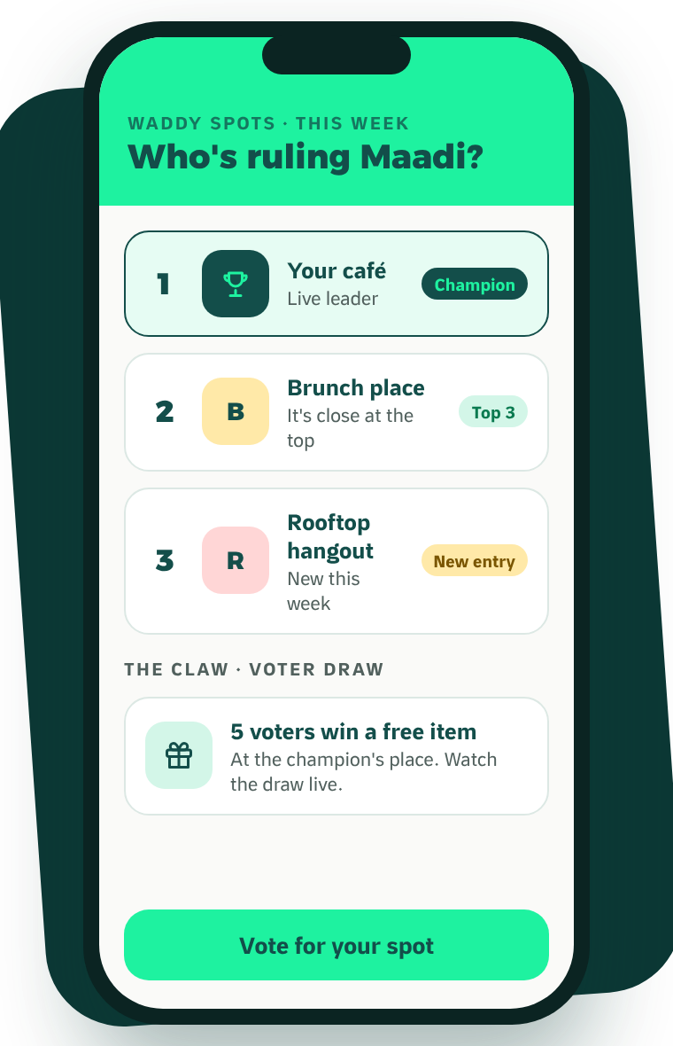



2 · PROMOTE · WADDY SPOTS
Let Your Neighborhood
Choose Its Favorites.
Every week, Waddy customers vote for their favorite local places. It gives the neighborhood something to talk about, and gives you something to win.
One vote per person, every week
A live leaderboard your regulars want to move.
Recognition for the winner
The spot with the most votes is crowned champion of the week inside Waddy.
A reason to visit
Five of the champion’s voters are drawn at random to win a voucher for a free item there. Waddy runs the draw.
WHAT IT MEANS FOR YOU
Community attention you did not have to buy, and new faces at your door.
Waddy · For restaurants & cafés
LIVE IN THE APP
10

Slide 11
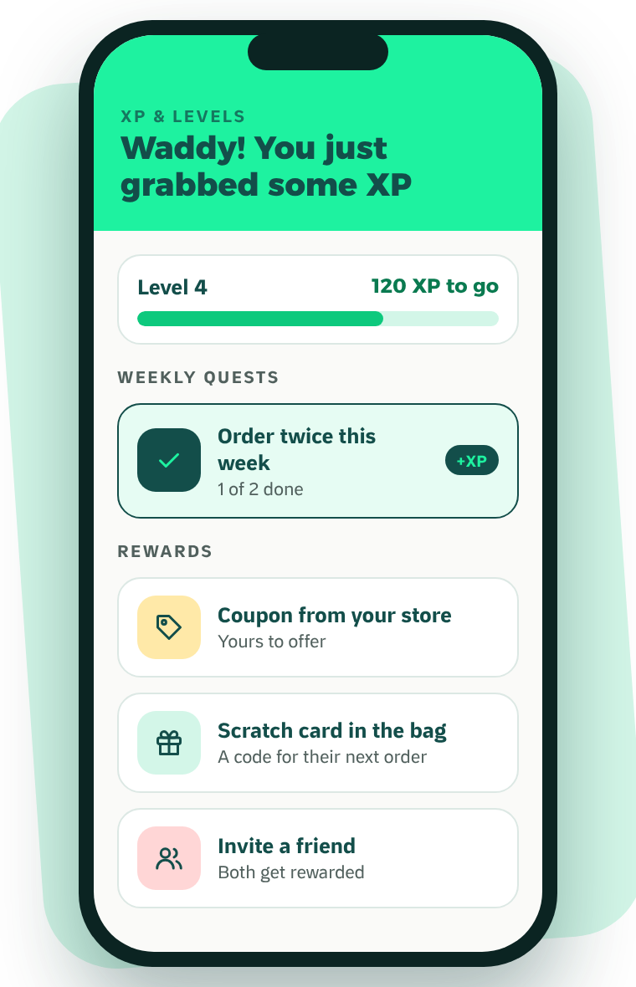




4 · RETAIN
Turn First Orders Into
Repeat Customers.
Waddy gives customers reasons to come back that do not depend on you cutting your prices.
XP and levels
Customers earn XP on every order and unlock rewards as they level up.
Weekly quests
Challenges that bring people back to the app within the week.
Scratch cards
A printed code in the bag that turns one order into a reason for the next.
Wallet, referrals and reorder
Balance to spend, friends to invite, and past orders one tap away.
WHAT IT MEANS FOR YOU
More of tonight’s customers become next week’s.
Waddy · For restaurants & cafés
LIVE IN THE APP
11

Slide 12
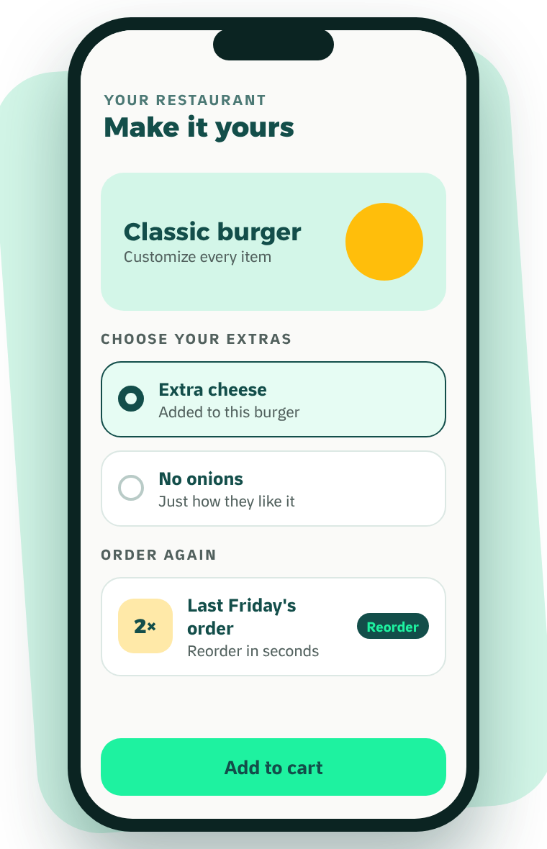



BUILT FOR RESTAURANTS · YOUR MENU
Your Menu,
Exactly How They Like It.
An order that arrives right is an order that gets repeated. Waddy makes it easy for customers to ask for it properly the first time.
Every item customizable
Extras, removals and choices are set by the customer, not guessed by your kitchen.
Reorder in seconds
Last Friday’s order is one tap away. Habits form around the places that make it easy.
Clear before checkout
Prices, offers and delivery are visible before they commit.
WHAT IT MEANS FOR YOU
Fewer wrong orders, fewer refunds, and regulars who order again and again.
Waddy · For restaurants & cafés
LIVE IN THE APP
12

Slide 13
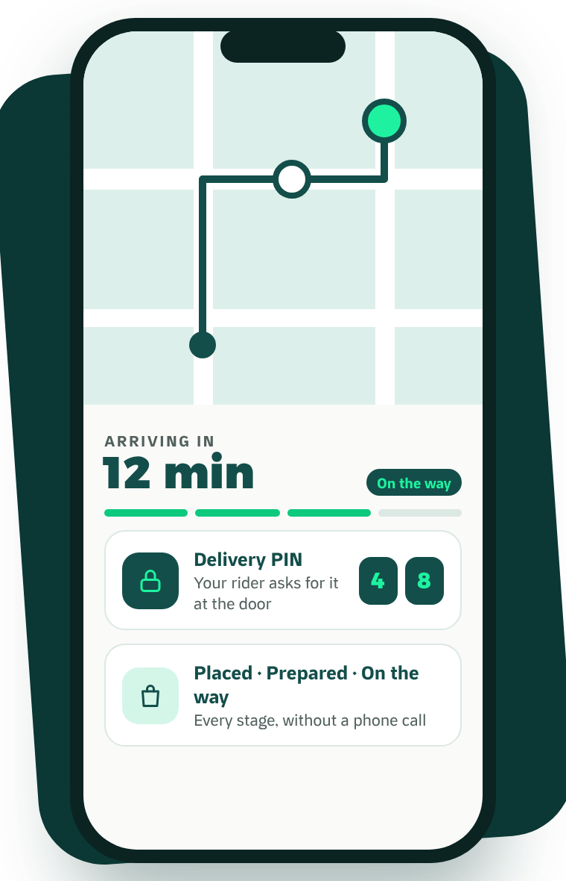




3 · DELIVER
We Deliver.
You Focus on Your Business.
Extend your reach without building and managing a rider team of your own.
Waddy’s own riders
A delivery network that works inside the neighborhood.
Live tracking for the customer
A live map and ETA, so they watch the order instead of calling you.
A delivery PIN at the door
The rider asks for it, so the order reaches the right person.
Cash handled for you
Riders collect cash on delivery; it is included in your payout (page 05).
WHAT IT MEANS FOR YOU
Fewer phone calls, fewer disputes, and a strong last impression.
Waddy · For restaurants & cafés
LIVE IN THE APP
13

Slide 14
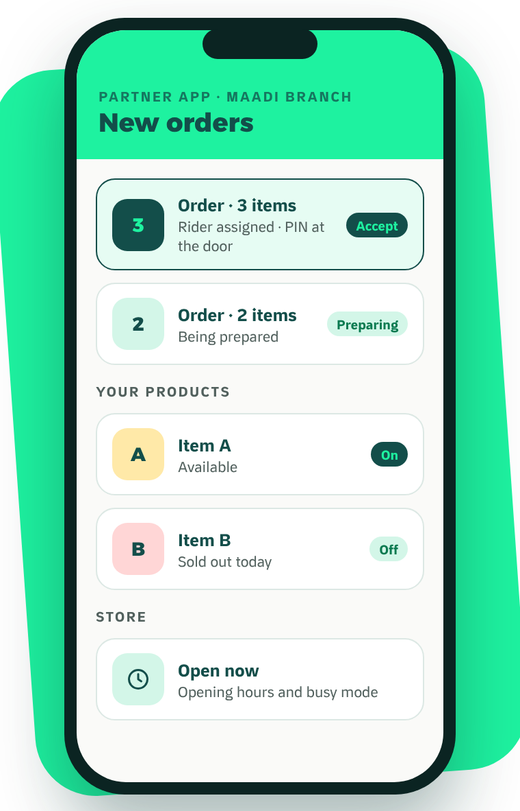
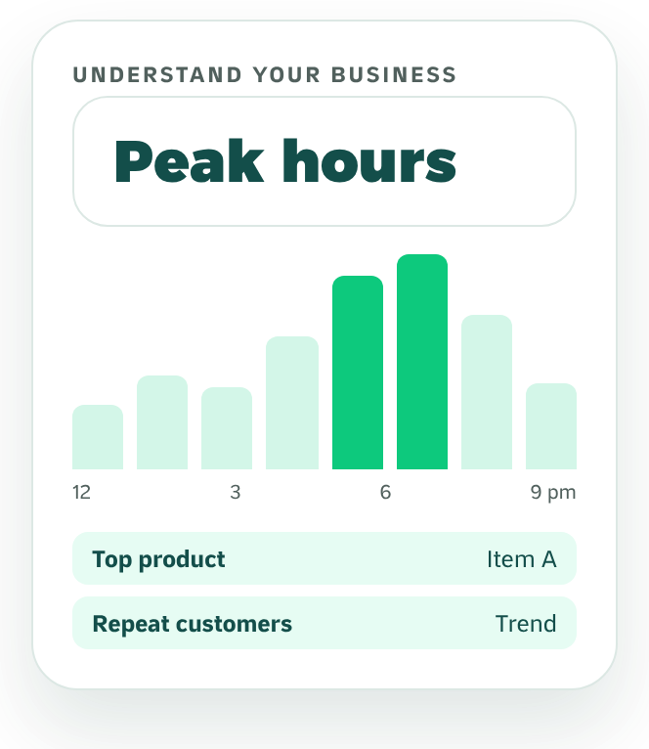



5 · GROW
Your Business.
Under Your Control.
Run your Waddy presence from the Partner App, and use the insights available to make better decisions.
Orders
Receive, accept and follow every order.
Products and prices
Keep your catalogue current.
Availability
Mark items sold out and set your opening hours.
Insights shown where supported: [Confirmed Analytics: sales, peak hours, top products, customer insights]
INSIGHTS · CONCEPT VIEW
PARTNER APP · CONCEPT VIEW
Waddy · For restaurants & cafés
CONCEPT MOCKUP
14

Slide 15
YOUR ROADMAP
Your First 90 Days With Waddy.
DAYS 1–14
DAYS 15–30
DAYS 31–60
DAYS 61–90
Set up
Launch
Build
Review
Agreement, catalogue, photos and prices. Partner App training for your team.
Go live in Maadi. Your store appears in local discovery from day one.
Offers, Spots and eligibility for Waddy’s partner promotion.
Look at your orders and insights together and plan the next quarter.
An indicative roadmap. Actual timing depends on your catalogue and readiness: [Onboarding Timeline]
Waddy · For restaurants & cafés
MARKETING PLAN · FOR APPROVAL
15

Slide 16
JOIN WADDY
Let’s Grow
Maadi Together.
WHATSAPP
[WhatsApp QR]
Message our partner team
1
Message us on WhatsApp
Talk to our partner team directly about your business and your branches.
[Partner WhatsApp]
2
Set up your store, free
Founding partners: no setup fee and a reduced launch commission.
We build your catalogue with you and train your team. No setup fee.
3
Go live in Maadi
PHONE
[Partner Team Phone]
Start receiving orders from your neighborhood. Keep every other app you use.
EMAIL
[Partner Email]
Your brand. Your local branch. Your neighborhood.
Your growth partner.
WEB
waddyapp.com
Waddy · For restaurants & cafés
16

