Slide 1
NORTHEASTERN UNIVERSITY · EECE 5642 DATA VISUALIZATION
Visual
11
7
Profiling
Sequences
Metrics
94.3%
k=3
of KITTI Odometry Sequences
PCA Var.
Clusters
Multi-Metric Difficulty Visualization & Cluster Analysis
SYED HAMED ALI

Slide 2
02
WHAT IS SLAM?
2
Simultaneous Localization and Mapping — the core challenge in autonomous navigation
🤖
SLAM answers: "Where am I?" and "What does the world around me look like?" — simultaneously, in real time, from noisy sensors.
01
🔄
The Circular Dependency
02
📈
Trajectory Drift
To build a map, you need to know where you are. But to know where you are, you need a map.
Formally: p(xₜ, m | z₁:ₜ, u₁:ₜ) — estimating pose and map jointly from sensor data.
Every sensor reading has noise. Small per-frame errors compound over time. A robot driving 2km can end up 100m from its true position.
This is the PRIMARY difficulty metric in our analysis.
03
🔁
Loop Closure
04
🚗
Why It Matters
When a robot revisits a known location, SLAM corrects accumulated drift — recognizing landmarks. This is why urban sequences (turns, loops) have LOWER drift than straight highway routes.
Seq 01 has NO loop closure → 1,980m drift.
SLAM is the backbone of every autonomous vehicle, drone, and mobile robot. Tesla Autopilot, Waymo, Boston Dynamics, Mars rovers — ALL rely on SLAM. Getting benchmarking right advances the entire field.

Slide 3
03
WHY KITTI?
3
The world's most important autonomous driving benchmark — and why researchers rely on it
🏆 What Makes KITTI Special
Why Researchers Choose KITTI
✅ Real-world complexity — not simulation
✅ Diverse environments: urban, highway, campus
✅ Standardized t_err / r_err evaluation protocol
✅ Fair comparison across all published algorithms
✅ Free & open-access since 2012
✅ Ground truth from GPS/IMU — not from vision
✅ 10,000+ papers cite KITTI (Google Scholar)
📅 Year:
2012 — Geiger et al., KIT, Germany
🚗 Platform:
VW Passat with full sensor suite
📷 Cameras:
Stereo grayscale, 10Hz, 1.4MP
📡 LiDAR:
Velodyne HDL-64E, 10Hz, 64 beams
🌐 GPS/IMU:
RTK — centimeter-level ground truth
📐 How Pose Files Work
Each line = 1 frame = 12 numbers:
[ R R R Tx ] [ R R R Ty ] [ R R R Tz ]
→ R=rotation matrix · T=translation (X,Y,Z per frame)

Slide 4
04
THE PROBLEM
4
Why standard benchmarking tables fail multi-metric analysis
❓
"Which KITTI sequence is hardest — and WHY?" · 7 metrics × 11 sequences = 77 numbers. A table cannot answer this. Visualization can.
01
🔢
Information Overload
02
🔍
Clusters Are Invisible
03
📊
Redundancy Undetectable
11 sequences × 7 metrics = 77 numbers per comparison. Human working memory handles ~7 items. Tables create cognitive overload before any insight can form.
Natural Easy/Medium/Hard groupings exist in the data — but no table can reveal them. Visualization with K-Means clustering makes them immediately legible.
Accum. Drift and Late Error have r=0.95 correlation. A table never reveals this. The heatmap shows it as a single bright cell.
04
⏱
Temporal Patterns Hidden
05
⚡
Outliers Blend In
06
🧩
No Geometric Context
Whether error grows early or late in a sequence changes algorithmic interpretation completely. This dimension is invisible in summary statistics.
Seq 01 (0.793) and Seq 04 (0.137) differ by 5.8×. In a sorted column Seq 01 is just "the highest number." In a bar chart its exceptionality is unmistakable.
Summary statistics cannot show that Seq 01's high drift is caused by straight-line driving with zero turns. Trajectory plots reveal this physical cause instantly.

Slide 5
05
DATA VISUALIZATION IN CONTEXT
5
Every data-driven field reaches its limits without visualization — here is why
💡
Visualization is not a reporting tool — it is the scientific bridge between raw data and human understanding, essential in every data-driven discipline.
ML
🤖
Machine Learning
CV
👁
Computer Vision
DS
📊
Data Science
Loss curves, confusion matrices, feature importance — all invisible as raw numbers. Visualization reveals overfitting, bias, and model behavior in seconds.
Bounding boxes, attention maps, segmentation masks — the core outputs of CV models are inherently spatial. They MUST be visualized to be evaluated.
Anscombe's Quartet proved it in 1973: identical summary statistics can describe completely different datasets. Plots reveal what numbers hide.
RL
🎮
Reinforcement Learning
NLP
💬
Natural Language / LLMs
🤖
🚗
Robotics & SLAM
Reward trajectories, policy maps, value functions — understanding agent behavior requires animated trajectories and heatmaps, never just scalars.
Embedding spaces, attention weights, token probability distributions — transformer internals only become interpretable through dimensionality reduction and heatmaps.
Trajectory drift, map quality, loop closure events — this is OUR domain. Standard tables hide the structure that our visualizations expose.

Slide 6
06
OBJECTIVES
6
Six goals — each addressing a gap in current benchmarking practice
O1
📐
Extract Difficulty Features
O2
🔵
Cluster into Difficulty Tiers
O3
📈
Reveal Hidden Patterns
Compute 7 heterogeneous metrics from raw KITTI pose files — RMSE, drift slope, accumulated drift, early/late error, curvature, entropy — no estimated trajectory required.
Apply K-Means (k=3) to objectively separate sequences into Easy, Medium, Hard tiers. Validate with silhouette coefficient ≈ 0.61, optimal over k=2–5.
Design 5 complementary visualizations each revealing one finding invisible in tables: radar, heatmap, PCA scatter, ranked bars, runtime scatter.
O4
🔬
Argue for Visual Analytics
O5
✅
Validate the Metric Set
O6
🌍
Build Transferable Tools
Demonstrate with Anscombe's Quartet logic that 4 of 6 key benchmarking questions are unanswerable from tabular data. Visualization is science, not decoration.
Confirm via PCA that 7 metrics explain 94.3% of difficulty variance in 3 components — proving the feature set is complete and minimally redundant.
Deliver open-source Python pipeline + interactive HTML dashboard applicable to EuRoC, TUM-RGBD, or any ground-truth pose dataset worldwide.

Slide 7
07
DATASET OVERVIEW
7
11 KITTI sequences — real ground-truth poses from instrumented vehicle
🚗 Sensor Suite
Sequence Frames & Difficulty — Real Computed Values
📷 Cameras:
Stereo grayscale, 1.4MP, 10Hz, B=0.54m baseline
Seq
Frames
Score
Cluster
📡 LiDAR:
Velodyne HDL-64E, 64 beams, 10Hz, 360°
Seq 00
4,541
0.258
Medium
Seq 01
1,101
0.793
Hard
🌐 GPS/IMU:
RTK-GPS ±2cm accuracy — centimeter ground truth
Seq 02
4,661
0.444
Medium
🚘 Vehicle:
VW Passat, up to 90 km/h
Seq 03
801
0.222
Easy
📊 Sequences:
11 training (labeled 00–10)
Seq 04
271
0.137
Easy
Seq 05
2,761
0.274
Medium
🗺️ Total:
22,202 frames total
Seq 06
1,101
0.171
Easy
📐 Format:
3×4 SE(3) matrix per frame
Seq 07
1,101
0.355
Medium
⚙️ GT Method:
GPS/LiDAR/IMU fusion
Seq 08
4,071
0.276
Medium
Seq 09
1,591
0.271
Medium
Seq 10
← Frames
Score →
1,201
0.333
Medium
Easy (3 seqs)
Medium (7 seqs)
Hard (1 seq)

Slide 8
08
METHODOLOGY
8
5-step pipeline: raw poses → metrics → clusters → visualizations
01 Load Poses
02 7 Metrics
03 Normalize
04 K-Means k=3
05 Visualize
📂
📐
⚖️
🔵
📊
Read KITTI .txt files
3×4 SE(3) matrices
Extract XYZ translation
Per-frame positions
RMSE · Drift Slope
Accum. Drift
Early + Late Error
Curvature · Entropy
Min-Max → [0,1]
Equal weighting
Unit-independent
Composite score
Easy / Medium / Hard
20 random restarts
Fixed seed=42
Silhouette ≈ 0.61
Radar · Heatmap
3D PCA Scatter
Ranked Bars
Runtime Scatter
▶
▶
▶
▶
P = [R|t]
κ, H, σ(Δt)
m̂=(m−min)/(max−min)
argmin Σ||x−μ||²
5 charts × 1 insight
⚡ Algorithm-agnostic: works with ANY ground-truth pose dataset — EuRoC · TUM-RGBD · Newer College · Custom deployment

Slide 9
09
VISUALIZATION 1 — RADAR CHART
9
See all 7 metrics for all 3 clusters simultaneously — impossible from a table
🟢 Easy Cluster
Uniformly flat across all 7 axes — all metrics near zero. Short paths (Seq 03, 04, 06) with simple geometry and low drift. Ideal for algorithm development and debugging.
🟡 Medium Cluster
Moderate polygon with elevated entropy from urban turns and diverse headings. 7 sequences span 0.258–0.444. High heterogeneity suggests further sub-clustering may be valuable.
🔴 Hard Cluster — Seq 01 ONLY
Extreme asymmetric profile: maximum on Drift Slope, Accum. Drift, Early/Late Error, RMSE — but near-ZERO on Curvature (0.005). Physical signature of straight highway: no turns = no loop closure = 1,980m drift.
💡 This single chart replaces 3 table columns and reveals cluster structure the table hides.

Slide 10
10
VISUALIZATION 2 — CORRELATION HEATMAP
10
Pearson r between all metric pairs — discovering redundancy and independence
r = 0.95
HIGH IMPACT
Accum. Drift ↔ Late Error
RMSE
1.00
0.32
0.62
0.56
0.70
0.12
0.29
Near-REDUNDANT — same phenomenon captured twice. One metric can be dropped from future benchmarks without information loss.
Drift
0.32
1.00
0.78
0.33
0.78
-0.26
-0.62
Accum.
0.62
0.78
1.00
0.76
0.95
-0.31
-0.18
★
r = −0.62
PHYSICAL INSIGHT
Drift Slope ↔ Entropy
Early
0.56
0.33
0.76
1.00
0.80
-0.30
0.36
INVERSE — urban routes with diverse headings self-correct via near-loop-closure events, reducing linear drift accumulation.
Late
0.70
0.78
0.95
0.80
1.00
-0.29
-0.06
★
Curv.
0.12
-0.26
-0.31
-0.30
-0.29
1.00
0.28
r = 0.12
KEEP BOTH
RMSE ↔ Curvature
Entr.
0.29
-0.62
-0.18
0.36
-0.06
0.28
1.00
Nearly INDEPENDENT — these metrics capture orthogonal difficulty dimensions. Both must be retained for a complete evaluation.
RMSE
Drift
Accum.
Early
Late
Curv.
Entr.
-1.0 -0.5 0 +0.5 +1.0

Slide 11
11
VISUALIZATION 3 — DIFFICULTY RANKING
11
Composite scores ranked — revealing the shocking gap at the top
🔴 Seq 01: CATEGORICAL OUTLIER
Score 0.793 — the ONLY Hard sequence.
Gap to next: 0.349 (> entire Medium spread 0.186).
Cause: straight highway, zero turns, zero loop closure.
→ Not "just hard" — a different category of issue.
🟠 Medium: Wide Spread
7 sequences, scores 0.258–0.444.
Seq 02 (0.444) nearly 3× harder than Seq 00 (0.258).
High heterogeneity suggests further sub-clustering.
→ "Medium" is a heterogeneous group.
🟢 Easy: Tight Cluster
3 sequences, scores 0.137–0.222.
Seq 04 = simplest: 271 frames, low entropy.
Seq 01 is 5.8× harder than Seq 04.
→ Ideal for algorithm development.

Slide 12
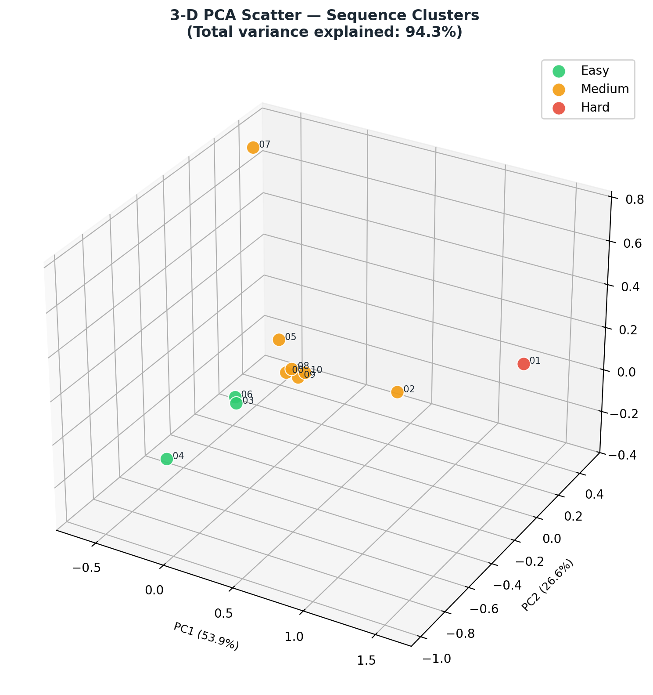
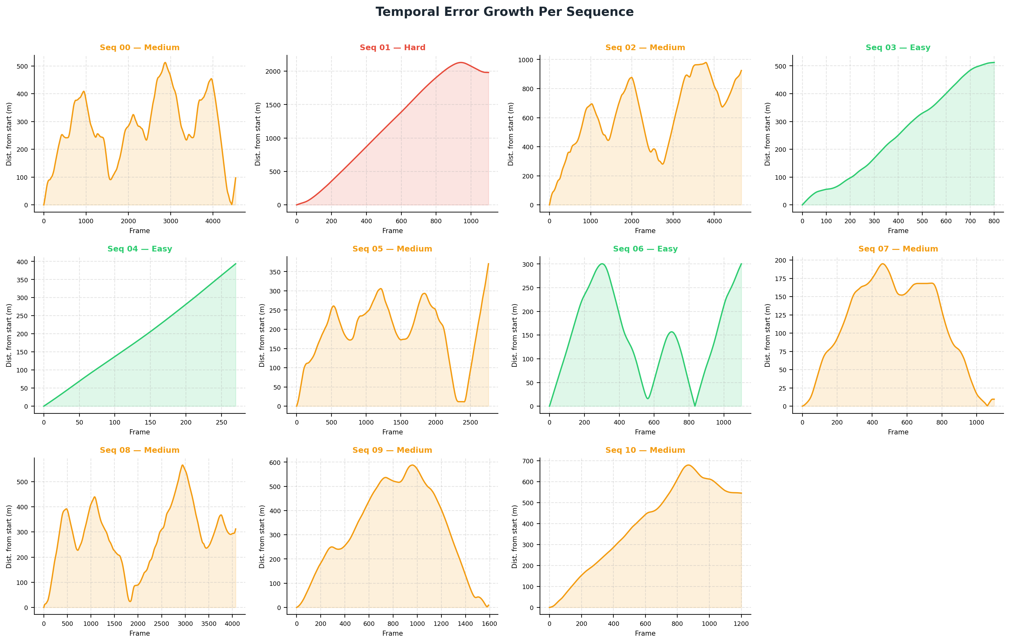
12
VISUALIZATIONS 4 & 5 — PCA + TEMPORAL DYNAMICS
12
3D cluster separation & error growth patterns across all sequences

Slide 13
13
VISUALIZATIONS 4 & 5 — PCA + TEMPORAL DYNAMICS
12
3D cluster separation & error growth patterns across all sequences
3-D PCA — 94.3% Variance Explained
3 Temporal Error Patterns
53.9%
Loads: Drift Slope · Accum. Drift · Late Error
→ PRIMARY difficulty axis
Pattern 1: MONOTONIC GROWTH
PC1
Sequences: Seq 01, 03, 10
Distance from start increases continuously — no return. Algorithm never gets to correct errors. Seq 01 reaches 2,000+ meters.
PC2
26.6%
Loads: Curvature · Entropy · RMSE
→ PATH GEOMETRY axis
Pattern 2: OSCILLATING
Sequences: Seq 00, 02, 05, 08, 09
Multiple peaks and valleys — complex urban routes with partial loop returns. Error grows, shrinks, grows again, reflecting city road loops.
PC3
13.8%
Loads: Early Error · Late Error ratio
→ TEMPORAL GROWTH axis
Pattern 3: V-SHAPE RETURN
Sequences: Seq 06, 07
Distance rises then returns near zero — near-complete loop closure. Vehicle returns to its starting area, correcting drift geometrically.
!
Seq 01 is SPATIALLY ISOLATED in PC1 — not just "the hardest" — a qualitatively different failure mode.
💡 The SAME accumulated drift number can arise from all 3 patterns — summary statistics hide this completely.

Slide 14
14
KEY INSIGHTS & PATTERNS
13
Four discoveries that only visualization could reveal
F1
Seq 01 is Categorically Hard
F2
Two Metrics Are Redundant
0.793
vs 0.137 (Seq 04)
r = 0.95
Accum. Drift ↔ Late Error
The ONLY Hard sequence. 1,980m accumulated drift — caused by straight-line, high-speed highway driving with near-zero curvature (0.005) and no loop closure. Score is 5.8× higher than the easiest. The gap to Seq 02 (0.349) exceeds the entire Medium cluster spread.
These two standard evaluation metrics capture essentially the same phenomenon (Pearson r=0.95). Future benchmarks could safely drop one — reducing researcher burden without any information loss. Direct implication for streamlining KITTI evaluation protocol.
💡 Bar chart immediately shows this — a table buries it among 10 other numbers.
💡 Invisible without the heatmap — the r=0.95 bright red cell is unmistakable.
F3
Runtime ≠ Difficulty
F4
Metric Set is Complete
r = −0.045
p = 0.895 (not significant)
94.3%
Variance in 3 PCA dims
Processing time has near-zero correlation with difficulty score (r=−0.045, p=0.895). Runtime is driven entirely by frame count (r≈0.97). Hard sequences are NOT slower to process — they're harder for the algorithm, not the computer. Computational budgeting by difficulty tier would be misguided.
Three PCA components explain 94.3% of all difficulty variance: PC1=drift (53.9%), PC2=geometry (26.6%), PC3=temporal (13.8%). This validates our 7-metric framework as comprehensive — no important difficulty dimension is missing, and dimensionality reduction is fully justified.
💡 Only the runtime scatter reveals this counterintuitive non-relationship.
💡 Only PCA scatter reveals the dimensionality structure of difficulty space.

Slide 15
15
COMPARATIVE ANALYSIS
14
Table vs. Visualization — a scientific argument for visual analytics
Research Question
From Raw Table
From Our Visualizations
Which sequence is hardest?
❌ Scan 11 numbers manually — 10+ sec
✅ Fig.11 ranked bar: Seq 01 bar is 5.8× longer — 0.3 sec
Are any metrics redundant?
❌ Impossible — need 21 Pearson computations
✅ Fig.10 heatmap: r=0.95 bright cell — instant
Do clusters exist?
❌ Impossible — need clustering algorithm
✅ Fig.12 PCA: 3 groups spatially separated — visible
Does harder = slower to process?
❌ Cannot determine from scores alone
✅ Runtime scatter: flat trend, r≈0 — counterintuitive
How does error grow over time?
❌ Completely invisible in summary stats
✅ Temporal chart: 3 qualitatively different patterns
What does the actual path look like?
❌ Completely invisible — no spatial info
✅ Trajectory viewer: geometry and loops legible
Verdict: 4 of 6 research questions are COMPLETELY UNANSWERABLE from raw tabular data. Visualization is not a presentation choice — it is a scientific necessity.

Slide 16
16
REAL-WORLD IMPACT & APPLICATIONS
15
Six areas where this work changes practice
Industry
Research
Development
🚗
AV Testing
🎓
Curriculum Learning
🔬
Algorithm Debugging
AV test teams can pre-select sequences by difficulty tier, focusing expensive vehicle hours on Hard sequences that expose algorithmic weaknesses.
Train deep odometry networks ordering KITTI by ascending composite score (0.137→0.793). Easier-first training provably improves convergence.
If an algorithm fails only on Seq 01, this framework immediately identifies the cause: loop-closure failure on straight-highway sequences. Saves weeks of debugging.
📏
Metric Pruning
🌍
Cross-Dataset
📊
Paper Communication
The r=0.95 finding enables dropping Late Error from future KITTI evaluations, reducing overhead while retaining all discriminative information.
Framework transfers to EuRoC, TUM-RGBD, Newer College with zero modification — any dataset with ground-truth poses can be profiled identically.
Authors can include a single difficulty radar chart to instantly communicate why their algorithm excels on certain sequences — replacing 3 dense pages of tables.

Slide 17
NORTHEASTERN UNIVERSITY · EECE 5642 · PROF. Y. RAYMOND FU
C O N C L U S I O N
Visualization transforms
benchmarks into science.
SLAM + KITTI :
Profiled all 11 sequences of the world-standard benchmark using real ground-truth poses
7 Metrics :
Captured error, drift, temporal dynamics, geometric complexity, and heading diversity
Seq 01 Outlier :
Score 0.793 — 5.8× harder than Seq 04 — 1,980m drift — explained by zero curvature
r = 0.95 :
Accum. Drift & Late Error are near-redundant — metric pruning is scientifically justified
94.3% PCA :
7 metrics span difficulty space — validated by 3-component PCA decomposition
Thank You
Questions & Discussion

