Slide 1
DataPath.
DataPath
A learning workspace for data careers
Personalized paths, hands-on practice and portfolio preparation
PRE-LAUNCH PRODUCT REVIEW
01 Local product preview / September 2026
Notes:
Positioning based on implemented product, not validated commercial demand. Sources: client/src/pages/Home.tsx; shared/learning.ts.
Application baseline 88c1d89; documentation checkout 844dee8. Reviewed 27 September 2026. Existing DataPath_Technical_Reference.pdf supplemented by current source and local capture. Production deployment and live AI quality are unverified.

Slide 2
DataPath.
The learner problem
Where do I start?
What should I practise?
What work can I show?
Product hypothesis: learners benefit from a connected route through these questions.
02 Local product preview / September 2026
Notes:
Product hypothesis. No customer research, market size, user counts or learning-outcome metrics supplied or inferred. Sources: Home.tsx; LearningDashboard.tsx.
Application baseline 88c1d89; documentation checkout 844dee8. Reviewed 27 September 2026. Existing DataPath_Technical_Reference.pdf supplemented by current source and local capture. Production deployment and live AI quality are unverified.

Slide 3
DataPath.
The learning journey
01
02
03
04
05
Choose
Plan
Learn
Practise
Demonstrate
Career or focused skill
Starting point and pace
Lessons and foundations
Exercises and reviews
Project and career tools
Industry context shapes examples and project direction. Learners can adjust their plan.
03 Local product preview / September 2026
Notes:
Editable journey derived from Home.tsx onboarding, shared/intro-progress.ts, pace.ts, learning.ts and project-blueprint.ts. Planning uses curated rules, not AI-generated curriculum.
Application baseline 88c1d89; documentation checkout 844dee8. Reviewed 27 September 2026. Existing DataPath_Technical_Reference.pdf supplemented by current source and local capture. Production deployment and live AI quality are unverified.

Slide 4
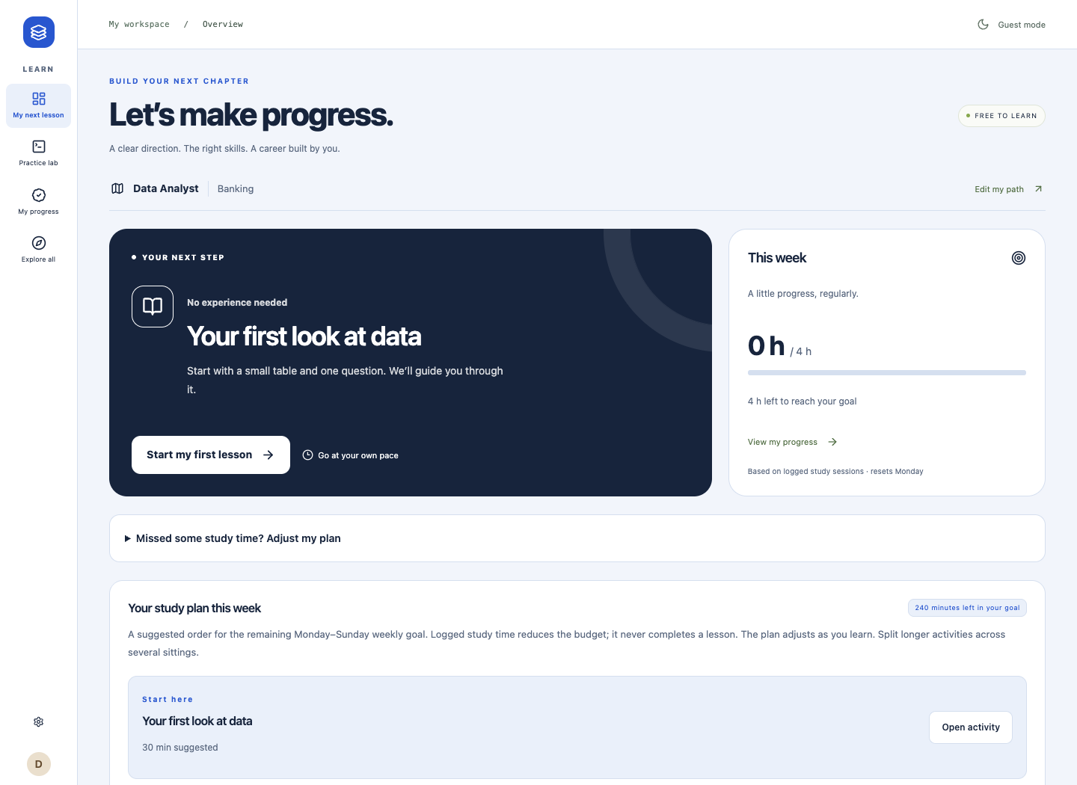
DataPath.
One clear next step
A personal path
and a manageable
weekly plan
Current local guest UI
Data Analyst / Banking
04 Local product preview / September 2026
Notes:
Current isolated local guest screenshot captured 27 September 2026. Source: LearningDashboard.tsx; shared/weekly-plan.ts. Times are authored estimates, not efficacy evidence.
Application baseline 88c1d89; documentation checkout 844dee8. Reviewed 27 September 2026. Existing DataPath_Technical_Reference.pdf supplemented by current source and local capture. Production deployment and live AI quality are unverified.

Slide 5
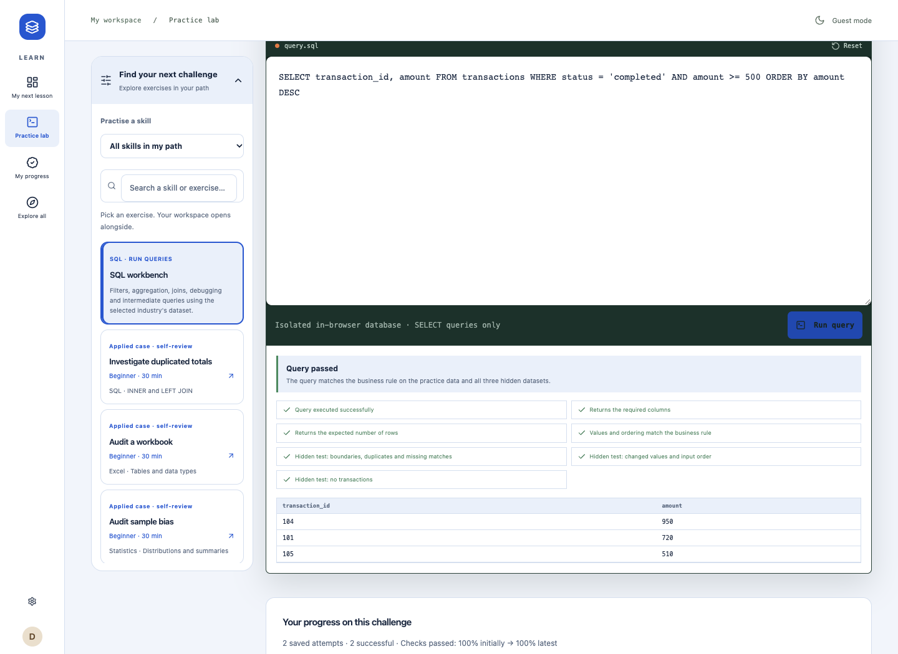
DataPath.
Practice with executable checks
Real SQL execution
in the browser
The captured answer passed.
Python exercises also run locally.
Synthetic example data
05 Local product preview / September 2026
Notes:
Current isolated local guest screenshot captured 27 September 2026. Source: client/src/lib/sql-worker.ts; shared/sql-engine.ts; run-python.ts; shared/python-practice.ts. Actual SQL Query passed observed. Separate Python sum exercise passed four datasets.
Application baseline 88c1d89; documentation checkout 844dee8. Reviewed 27 September 2026. Existing DataPath_Technical_Reference.pdf supplemented by current source and local capture. Production deployment and live AI quality are unverified.

Slide 6
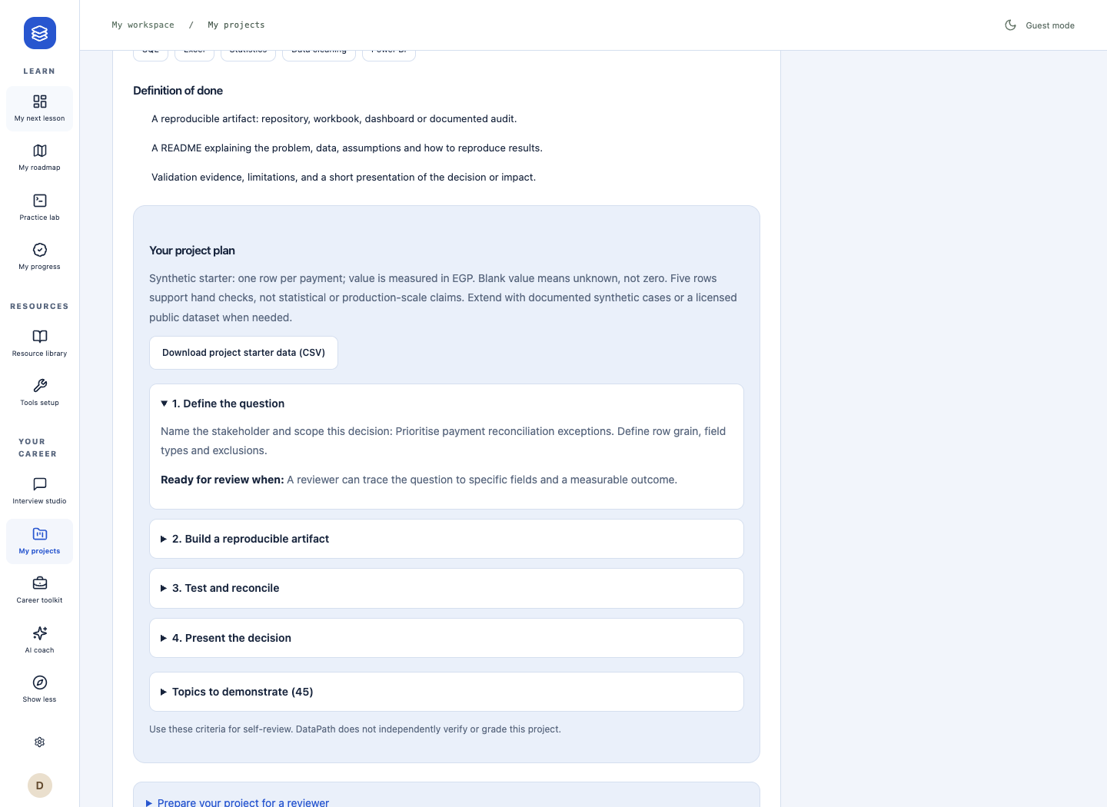
DataPath.
Learning can become work to show
Project milestones
with review criteria
Starter data, evidence notes
and downloadable checklists
Learner self-review
No independent certification
06 Local product preview / September 2026
Notes:
Current isolated local guest screenshot captured 27 September 2026. Source: ProjectBlueprint.tsx; ProjectChecklist.tsx. Exports do not automatically publish or package a hosted portfolio.
Application baseline 88c1d89; documentation checkout 844dee8. Reviewed 27 September 2026. Existing DataPath_Technical_Reference.pdf supplemented by current source and local capture. Production deployment and live AI quality are unverified.

Slide 7
DataPath.
Technical foundation
Learner browser
Application server
React workspace
PGlite SQL and Pyodide Python
Express and tRPC
Validation and revocable sessions
Practice runs on the learner device.
Account data uses the server.
PostgreSQL
Accounts, snapshots and AI accounting
Backend implemented; preview unconnected
07 Local product preview / September 2026
Notes:
Editable simplified architecture. Optional AI and Sentry omitted from this summary only. Sources: drizzle/schema.ts; server/db.ts; server/_core/index.ts; worker adapters.
Application baseline 88c1d89; documentation checkout 844dee8. Reviewed 27 September 2026. Existing DataPath_Technical_Reference.pdf supplemented by current source and local capture. Production deployment and live AI quality are unverified.

Slide 8
DataPath.
Catalog scope
22
28
254
9
careers
skills
topics
industry contexts
Catalog coverage, not traction. Content depth varies by topic.
08 Local product preview / September 2026
Notes:
Counts recomputed from shared/catalog.ts: 22 careers, 28 skills, 254 topic entries, 9 industry contexts including general. Version 2026.09.23. No market-sizing or adoption evidence supplied.
Application baseline 88c1d89; documentation checkout 844dee8. Reviewed 27 September 2026. Existing DataPath_Technical_Reference.pdf supplemented by current source and local capture. Production deployment and live AI quality are unverified.

Slide 9
DataPath.
Built and still to verify
Implemented and locally demonstrated
Pre-launch acceptance work
Path planning and learning workspace
SQL and Python practice
Progress records and project exports
CV draft and application tracker
Connect and verify the intended database
Validate production deployment
Configure and evaluate optional AI
Refresh the complete browser smoke test
282 unit tests passed. That is not production acceptance.
09 Local product preview / September 2026
Notes:
Unit suite passed 25 September: 282 tests, 40 files. Prior disposable PostgreSQL integration passed. Current normal preview DB and production Neon are unconfigured/unverified. Smoke test has stale selectors. Sources: VALIDATION.md; tests.log; e2e/learning.smoke.spec.ts.
Application baseline 88c1d89; documentation checkout 844dee8. Reviewed 27 September 2026. Existing DataPath_Technical_Reference.pdf supplemented by current source and local capture. Production deployment and live AI quality are unverified.

Slide 10
DataPath.
Optional AI with defined boundaries
Explain gaps
Review interview answers
Help improve CV wording
Consent before sharing
Explicit model configuration
Timeout and one retry
Usage limit and monthly spend cap
Unconfigured in this preview. Live accuracy and provider billing are unverified.
10 Local product preview / September 2026
Notes:
Coach requires authentication and consent. Topic allowlist and structured validation. No RAG, model tools or plan mutation. Monthly dollar cap is application-wide, not per user. Sources: routers.ts; ai-config.ts; ai-budget.ts; _core/llm.ts.
Application baseline 88c1d89; documentation checkout 844dee8. Reviewed 27 September 2026. Existing DataPath_Technical_Reference.pdf supplemented by current source and local capture. Production deployment and live AI quality are unverified.

Slide 11
DataPath.
Near-term engineering milestones
01
Verify the operating environment
Database connection, migrations and restore rehearsal
02
Close the acceptance loop
Current signup, practice and save smoke test; production worker checks
03
Evaluate AI before making quality claims
Representative examples, schema compatibility and usage reconciliation
04
Improve learner coverage
Account recovery, worked examples and Arabic review
11 Local product preview / September 2026
Notes:
Recommendations, not scheduled commitments or completed milestones. Sources: Technical Reference section 22; CONTENT_AUDIT.md; schema/routers and e2e test. No dates or budgets invented.
Application baseline 88c1d89; documentation checkout 844dee8. Reviewed 27 September 2026. Existing DataPath_Technical_Reference.pdf supplemented by current source and local capture. Production deployment and live AI quality are unverified.

Slide 12
DataPath.
Team and funding conversation
[Founder and team]
Add names, roles and relevant experience.
[Funding ask and use of funds]
Add the amount, runway, milestones and contact details.
12 Local product preview / September 2026
Notes:
Intentional placeholders requested by the user. No team credentials, amount, business model, revenue or runway were provided. Complete with substantiated facts before external circulation.
Application baseline 88c1d89; documentation checkout 844dee8. Reviewed 27 September 2026. Existing DataPath_Technical_Reference.pdf supplemented by current source and local capture. Production deployment and live AI quality are unverified.

