Slide 1

Genre Dynamics and Network Patterns: Unveiling Relationships Between Books’ and Authors’ Networks and Discovering Popularity Trends on Goodreads midterm in-class presentation Data analytics and visualization
Hamed Taherkhani
hamedth@yorku.ca
Reza Abbaszadeh Darban
rezaab@yorku.ca
Mahdiye Khalajiolyaie
mahdiye7@yorku.ca
Abdullah Tauqeer
abdullatauqir@gmail.com

Slide 2

Motivation
Goodreads has over 1.5 million books and 15 million reviews
Identifying patterns to enhance user experience and literary market growth
Identifying genre trends and influential entities
Identifying Reading preferences
Recommendation System for users

Slide 3

Goodreads Dataset
Authors’ dataset:
average_rating
rating_count
author_id
name
Books dataset:
text_review_count
publication_year
publisher
authors
language
description
Reviews:
number_of_votes
number_of_comments
date_added
review_text
user_id
book_id
rating
Genre dataset:
book_id
genres
2

Slide 4
Goodreads Dataset
Methodology
Nodes: Books
Edges: Shared user ratings/reviews
Analysis: Understanding user interests and book trends
Nodes: Users
Edges: Commonly read/reviewed books
Analysis: Building recommendations through shared interests
Nodes: Authors
Edges: Co-authorship links
Analysis: Investigating connections between authors and book similarities
Books network
Users network
Authors network

Slide 5
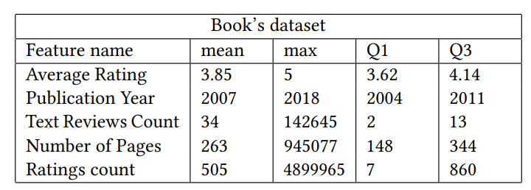
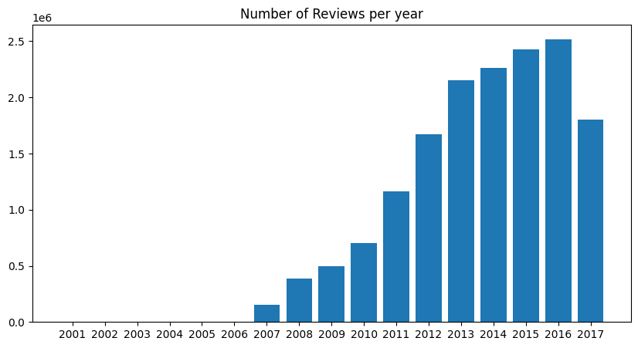
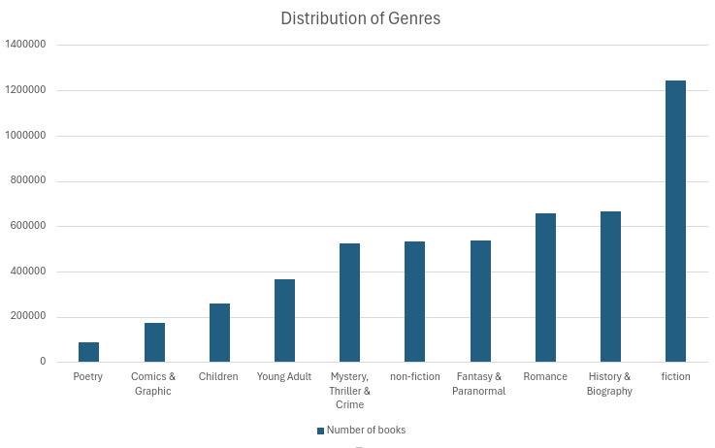
Books Network- Statistical Analysis
Figure 4: Distribution of Genres
Figure 5: Year Distribution

Slide 6
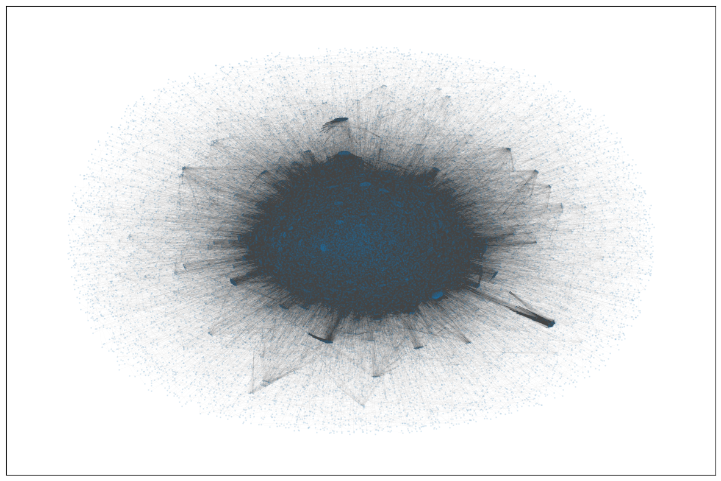
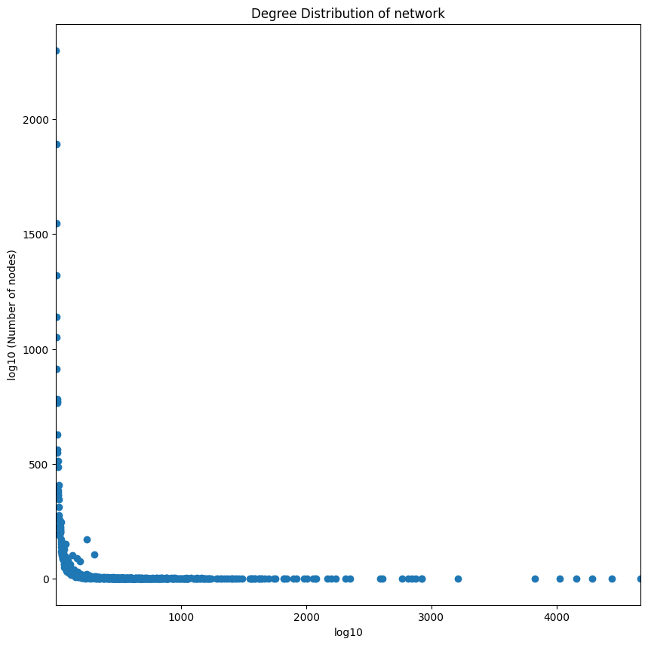
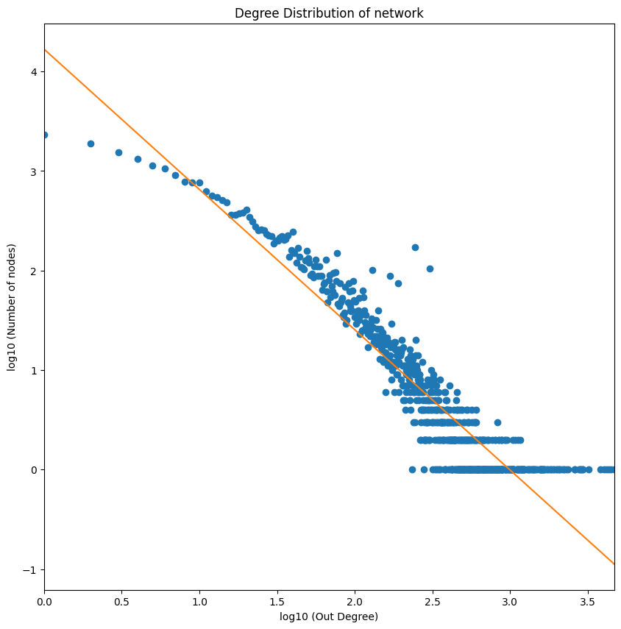
Books Network
Figure 1: Book’s graph visualization
Figure 2: Distribution of edges on book’s graph
Figure 3: Log Distribution of edges on book’s graph
Nodes: 30778
Edges: 856080
Density: 0.0018
Measured alpha of distribution: 1.41
Average degree of nodes: 27.8
Average clustering coefficient: 0.70

Slide 7
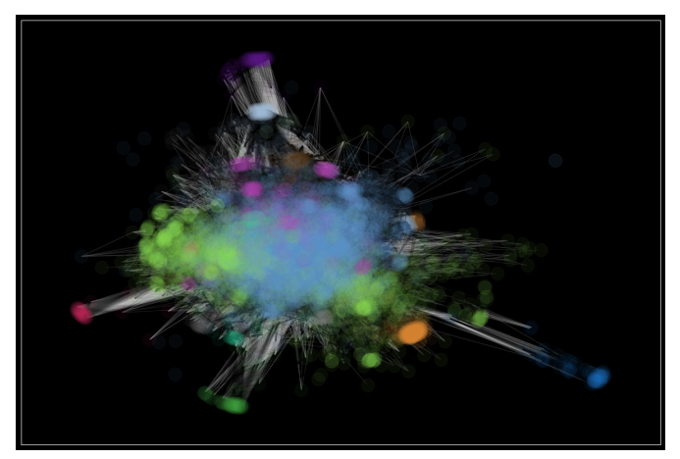
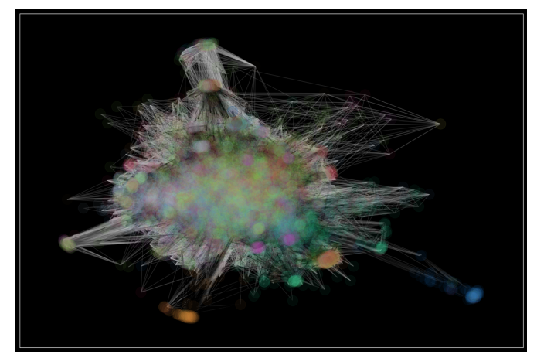
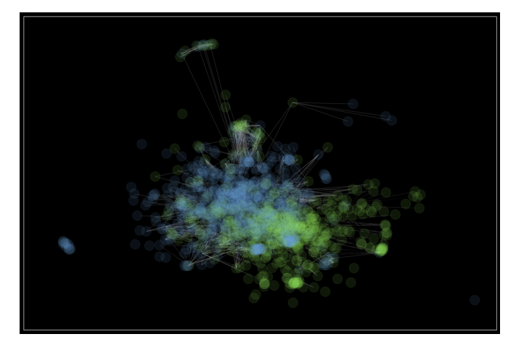
Books Networks- Community Detection
Do the communities in the graph represent different genres of books?
Visual differentiation of a two-genre book network via the greedy modularity algorithm.
Figure 6: Community detection using greedy modularity
Figure 7: Books separated by different genres
Figure 8: Thriller vs Romance

Slide 8
Books Networks- Results
Based on conductance measurement:
Fiction genre is the most discernible genre, meaning that it is less likely to overlap with other genres
Pagerank, closeness centrality, degree centrality and betweenness centrality were used to find the most important nodes.
The most important node on the graph:
The Girl Who Played with Fire (Millennium, #2) – 2009

Slide 9
Users’ Network
High Data Volume: Primary challenge in network creation.
Heuristic Reductions: Implemented to manage network size.
Rating Proportions: We considered only 4-5 star ratings.
Temporal Focus: Analyses on reviews up to 2016, excluding pre-2007 data.
User Activity: Prioritized users active in 2016 for potential 2017 activity.
User Selection: 160,000 users identified, 5,000 selected for computational feasibility.

Slide 10
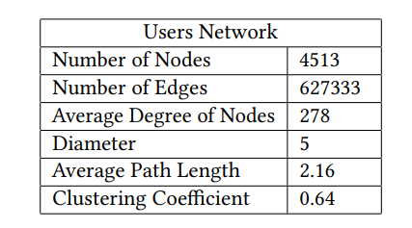
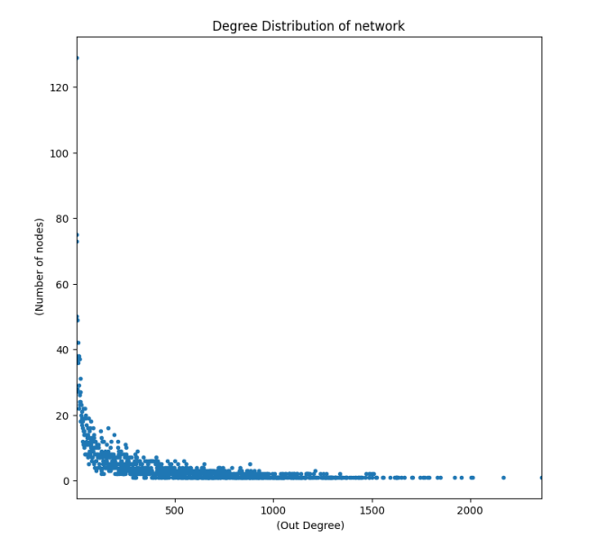
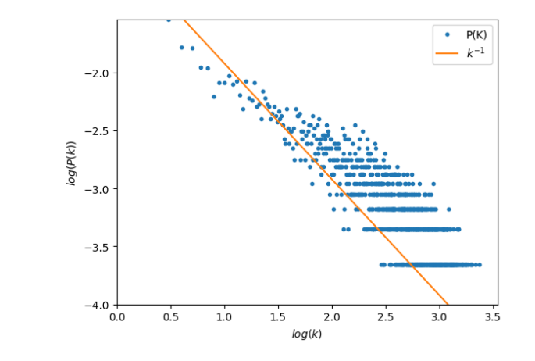
Users’ Network- Properties
Figure 10: Users Network Degree Distribution
Figure 11: Users Network Power Law

Slide 11
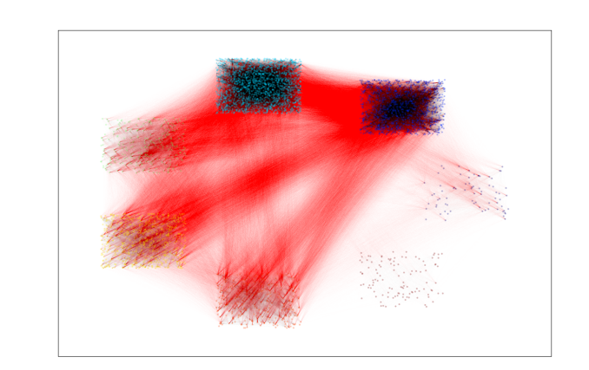
Users’ Network- Community Detection
Louvain Algorithm: Identified communities, modularity 0.2.
Community Insight: Moderate structure, high inter-group connections.
Sizes: 7 Communities ranging from 75 to 2028 members.
Edges: 336,119 internal, 291,214 external.
Figure 12: Users Clustering

Slide 12
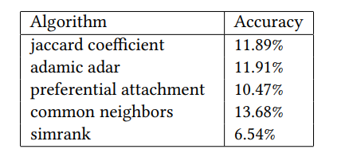
Users’ Network- Recommendation System

Slide 13
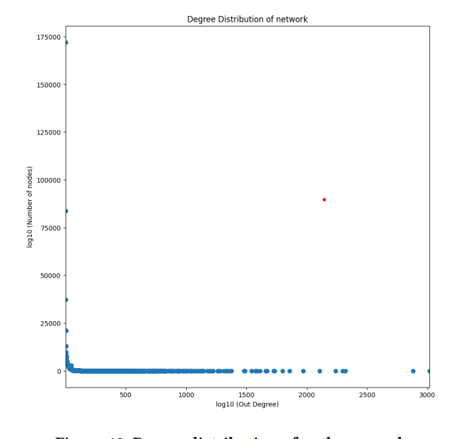
Authors Network
Network Structure: Authors as nodes, connections based on co-authorships.
Size & Connectivity: Network comprises 470,275 nodes and 2,628,626 edges.
Clustering Coefficient: 0.46, suggesting non-random graph structure.
Pagerank Analysis: Applied to identify key authors within the network.
William Shakespeare
Figure 13: Degree distribution of authors’ graph

Slide 14

Thanks for your attention ☺

