Slide 1

SMART CAR PARKING SYSTEM USING ARDUINO
PRESENTED BY UNDER THE GUIDANCE OF
RENANGI VENKATA NIVAS DR.K.SRAVAN KUMAR
(192U1A04D2) ASSOCIATE PROFESSOR
SANAMPUDI SIVA SAI ECE DEPARTMENT
(192U1A04D4)
SHAIK ABDUL HAMEED
(192U1A04D6)
SHAIK ANWAR BABU
(192U1A04D7)

Slide 2
CONTENT
INTRODUCTION
1
6
SERVO MOTOR
2
7
BLOCK DIAGRAM
LCD
DISPLAY
3
COMPONENTS
REQUIRED
8
PROS
4
ARDUINO UNO
9
FUTURE WORK
5
IR SENSOR
CONCLUSION
10

Slide 3
INTRODUCTION
The goal of parking system project is to reserve parking spot for a car/vehicle before it arrives.
One of the most problems that the driver faces is finding a free parking spot, so many drivers stopping their cars at the edges of the street.
Therefore we choose this to prevent the frustration of finding a parking spot and they can reserve a spot when they stay at home.

Slide 4
WHAT IS SMART CAR PARKING SYSTEM ?
Smart Car Parking is an integrated system to organize cars in public parks.
The system will be used for every slot in park.
The motivation of this project is to help drivers. And make the payment way easier.

Slide 5
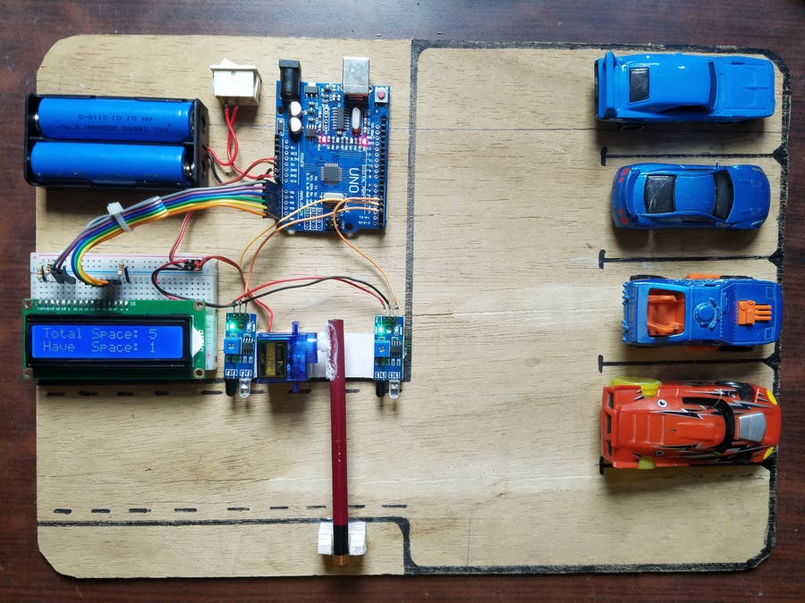

Slide 6
BLOCK DIAGRAM AND WORKING
A
LCD
ARDUINO
IR 1
POWER SUPPLY
(BATTERY)
IR 2
SERVO
MOTOR

Slide 7
COMPONENTS REQUIRED
ARDUINO UNO
IR SENSOR
SERVO MOTOR
LCD DISPLAY
JUMPER WIRES
BATTERY

Slide 8
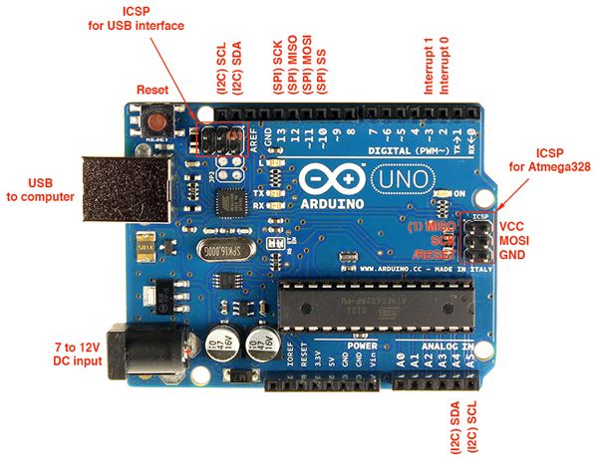
ARDUINO UNO

Slide 9
ARDUINO UNO
Arduino is an open source hardware and software company, project and user community that designs and manufactures single microcontrollers and microcontroller kits for building digital devices.
Arduino UNO is based on an ATmega328P microcontroller . It is easy to use compared to other boards, such as the Arduino Mega board, etc. The board consists of digital and analog Input/Output pins (I/O), shields, and other circuits.
The Arduino UNO includes 6 analog pin inputs, 14 digital pins, a USB connector, a power jack, and an ICSP (In-Circuit Serial Programming) header. It is programmed based on IDE, which stands for Integrated Development Environment. It can run on both online and offline platforms.

Slide 10
IR SENSOR
An infrared sensor is an electronic instrument which is used to sense certain characteristics of its surroundings by either emitting and/or detecting infrared radiation. Infrared sensors are also capable of measuring the heat being emitted by an object and detecting motion.
Principle of IR Sensor :
We have already discussed how a light sensor works. IR Sensors work by using a specific light sensor to detect a select light wavelength in the Infra-Red (IR) spectrum. By using an LED which produces light at the same wavelength as what the sensor is looking for, you can look at the intensity of the received light. When an object is close to the sensor, the light from the LED bounces off the object and into the light sensor. This results in a large jump in the intensity, which we already know can be detected using a threshold.

Slide 11
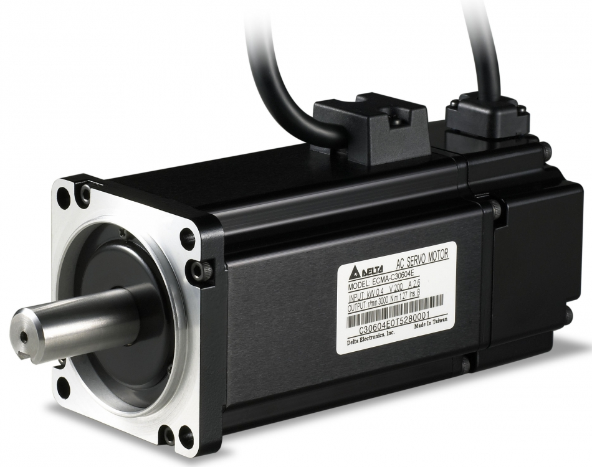
SERVO MOTOR
A servomotor (or servo motor) is a simple electric motor, controlled with the help of servomechanism. If the motor as a controlled device, associated with servomechanism is DC motor, then it is commonly known as a DC Servo Motor. If AC operates the controlled motor, it is known as a AC Servo Motor.
The servo motor is usually a simple DC motor controlled for specific angular rotation with the help of additional servomechanism. Nowadays, servo systems are used widely in industrial applications.
Servo motor applications are also commonly seen in remote-controlled toy cars for controlling the direction of motion, and it is also very widely used as the motor which moves the tray of a CD or DVD player. Besides these, there are hundreds of servo motor applications we see in our daily life.

Slide 12
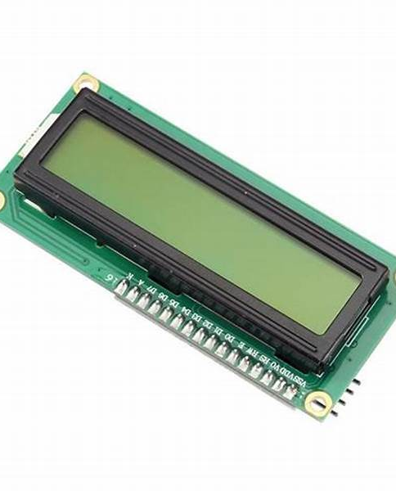
LCD DISPLAY
The LCD (Liquid Crystal Display) is a type of display that uses the liquid crystals for its operation. Here, we will accept the serial input from the computer and upload the sketch to the Arduino. The characters will be displayed on the LCD.
Here we are using this LCD display to show the driver the number of available slots for parking the vehicle.
There are some application of LCD which are given below:
The LCDs are commonly used in all the digital wrist watches for displaying time.
It is used for displaying images used in digital cameras.
It is used as display screen in calculators.

Slide 13
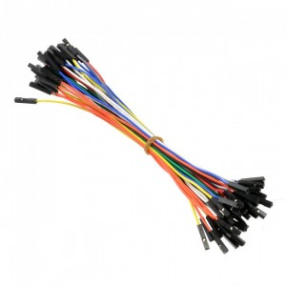
JUMPER WIRES
A jump wire (also known as jumper, jumper wire, jumper cable) is an electrical wire with a connector or pin at each end, which is normally used to interconnect the components of a breadboard or other prototype or test circuit, without soldering.

Slide 14
PROS
User friendly system.
Guides residents and visitors to available parking.
Optimize Parking Space Usage.
Smart Parking enables better and real time monitoring and managing of available parking space, resulting in significant revenue generation.
Reduces fuel consumption.

Slide 15
FUTURE WORK
The users can book a parking space from a remote location.
Add more features as SMS notifications.
Some more features like GPS, reservation facilities can be included in the future.

Slide 16
CONCLUSION
The concepts of smart cities have always been a dream. There have been advancements made from the past couple of years to make smart city dream to reality. Smart parking facilities have always been the core of constructing smart cities. The system provides a real time process and information of the parking slots. It helps to resolve the growing problem of traffic congestion.

Slide 17
THANK YOU

