Slide 1
CAR FEATURES AND PRICE..
Ammar Helal , Hameeda Ebrahim, Abdulnasser
DAB - 16

Slide 2
Problem Statement:
Between 1990 and 2017, vehicle efficiency trends in the USA reveal that Non-Electric vehicles have 52% lower fuel efficiency and produce higher CO₂ emissions, highlighting the growing importance of electric technology in reducing environmental pollution.
Between 1990 and 2017, vehicle efficiency trends in the USA reveal that non-electric vehicles have 78% lower fuel efficiency and produce higher CO₂ emissions, highlighting the growing importance of electric technology in reducing environmental pollution.

Slide 3
Approaches:
02
03
04
06
01
Fuel Efficincy vs. Brand
Fuel Efficincy vs. Model
Fuel Efficincy vs. Vehicl Size
05
Fuel Efficincy vs. Horsepower
Fuel Efficincy vs. Price
Price VS. Horsepower

Slide 4
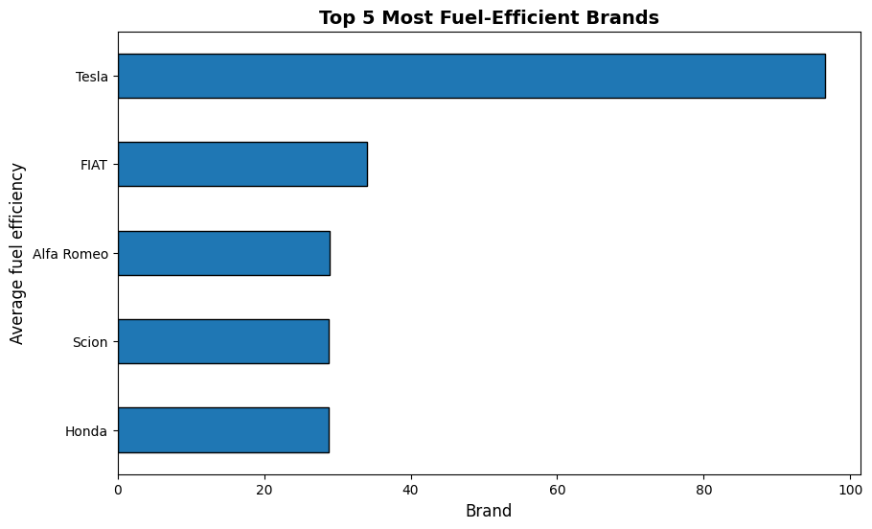






Slide 5
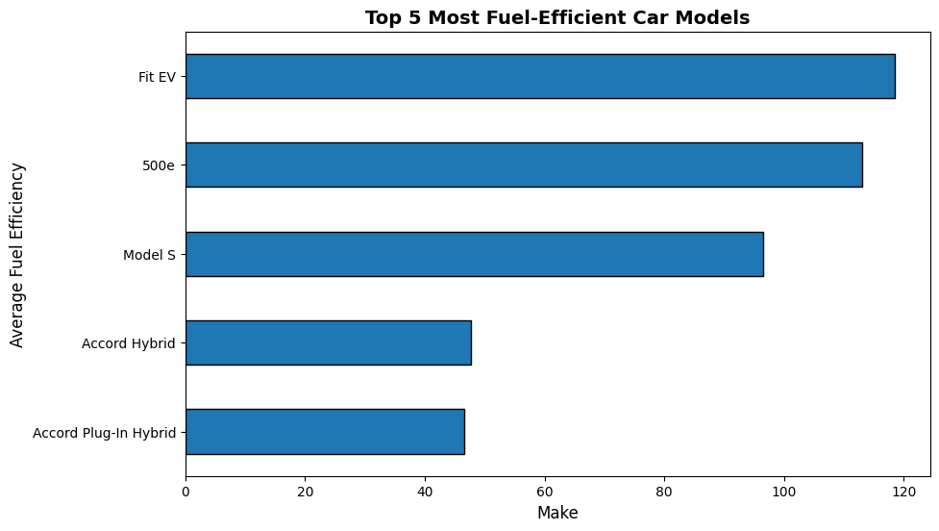

Slide 6
Electric vs. Non Electric Cars…
Electric
Non Electric
# Of Cars
403
10,796
Median Price
33,810
30,530
Average Efficiency
46
22

Slide 7
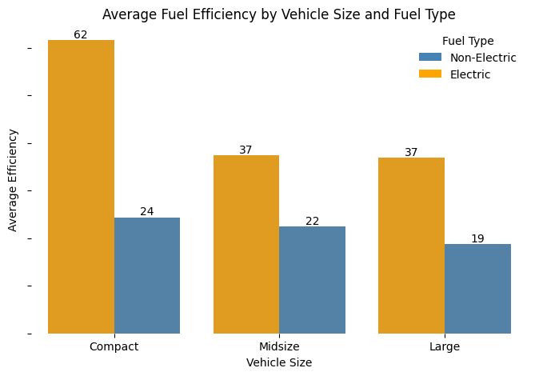


Slide 8
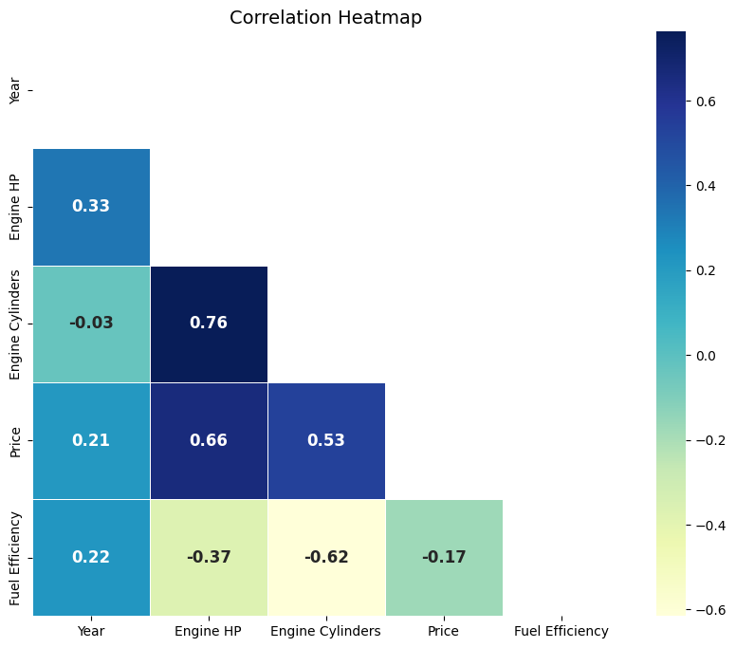

Slide 9
Luxury vs. Non-Luxury Cars…
Electric
Non Electric
Luxury
8
624
Non-Luxury
395
10172

Slide 10
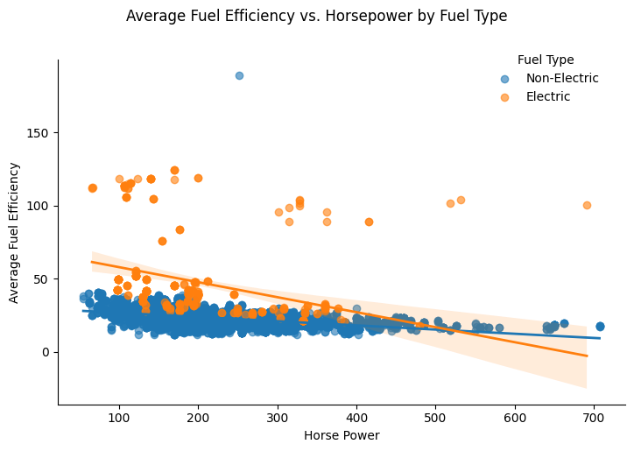

Slide 11
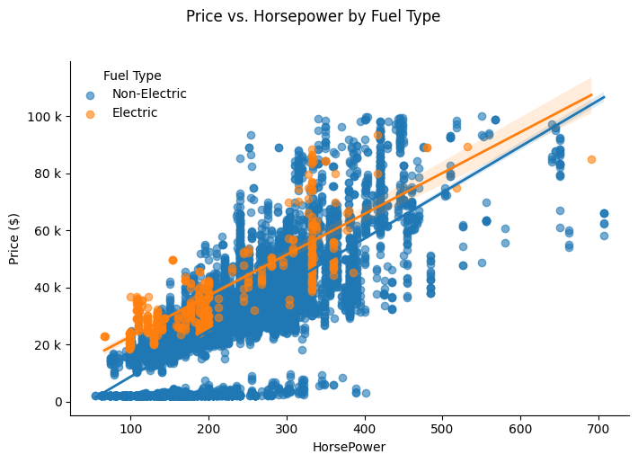

Slide 12
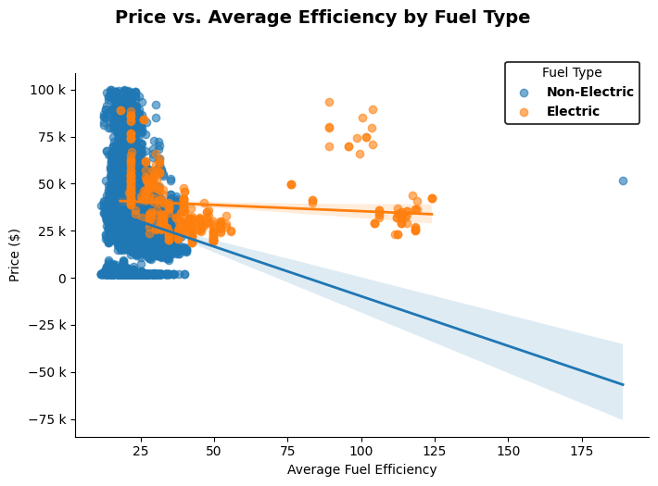

Slide 13
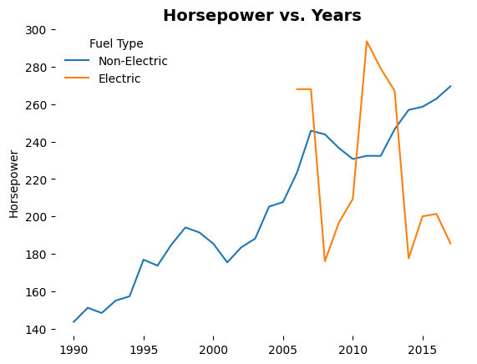

Slide 14
Recommendation
Manufacturers
Consumers
Continue investing in electric and hybrid technology.
Invest in electric technologies.
Manufacturers
Manufacturers
Invest more in fuel efficiency researches.
implement regenerative braking system.

Slide 15
Conclusion
Electric cars show higher fuel efficiency.
Electric cars have a smaller share market share.
Vehicle size have a direct effect on efficiency.
Horsepower is increasing overtime.

Slide 16
Whoa!!
Thank You For Listening…

