Slide 1
ANALYSTLAB AFRICA | EXPERIENCE LAB INTERNSHIP PROGRAMME
Consumer Complaint
Trends and Response
Intelligence Platform
Bank of America | CFPB consumer complaints
1 May 2017 – 28 August 2023
DATA ANALYTICS TRACK • WEEK 4
BY HAMEEDAT ISA-USMAN
Source: supplied CFPB complaint dataset and project brief
Notes:
This presentation summarises my Week 4 Data Analytics project, the Consumer Complaint Trends and Response Intelligence Platform. It uses 62,516 consumer complaints relating to Bank of America, recorded from 1 May 2017 through 28 August 2023. I will explain the validated key performance indicators, walk through the four dashboard pages, discuss the strongest findings and conclude with three evidence-based recommendations. A consumer complaint is an allegation or reported issue; it does not establish wrongdoing.

Slide 2
KPI DEFINITIONS
The dashboard measures volume, recorded timeliness and forwarding
All results shown for the complete unfiltered dataset
COMPLAINT VOLUME
TIMELY RESPONSE RATE
MEAN FORWARDING
MEDIAN FORWARDING
62,516
96.06%
1.22 days
0 days
Distinct Complaint IDs
Yes ÷ (Yes + No)
CFPB receipt to company forwarding
Calendar-day difference
THE CORRECT TIMELINESS DENOMINATOR
96.06%
58,619 Yes
2,403 No
1,494 excluded
eligible only
61,022 records with valid Yes/No response indicators
Forwarding days = Date received − Date submitted; not company response or resolution time.
ANALYSTLAB AFRICA / WEEK 4 / DATA ANALYTICS
02 / 10
Notes:
The report counts distinct complaint IDs, giving a total of 62,516. The recorded timely-response rate is 96.06 percent, calculated as 58,619 Yes responses divided by 61,022 records with either Yes or No. The 1,494 blank indicators all belong to In progress complaints and are excluded, not classified as late. The average CFPB forwarding interval is 1.22 calendar days and the median is zero. These intervals measure the time between CFPB receipt and forwarding to the company; they are not the company's response or resolution time.

Slide 3
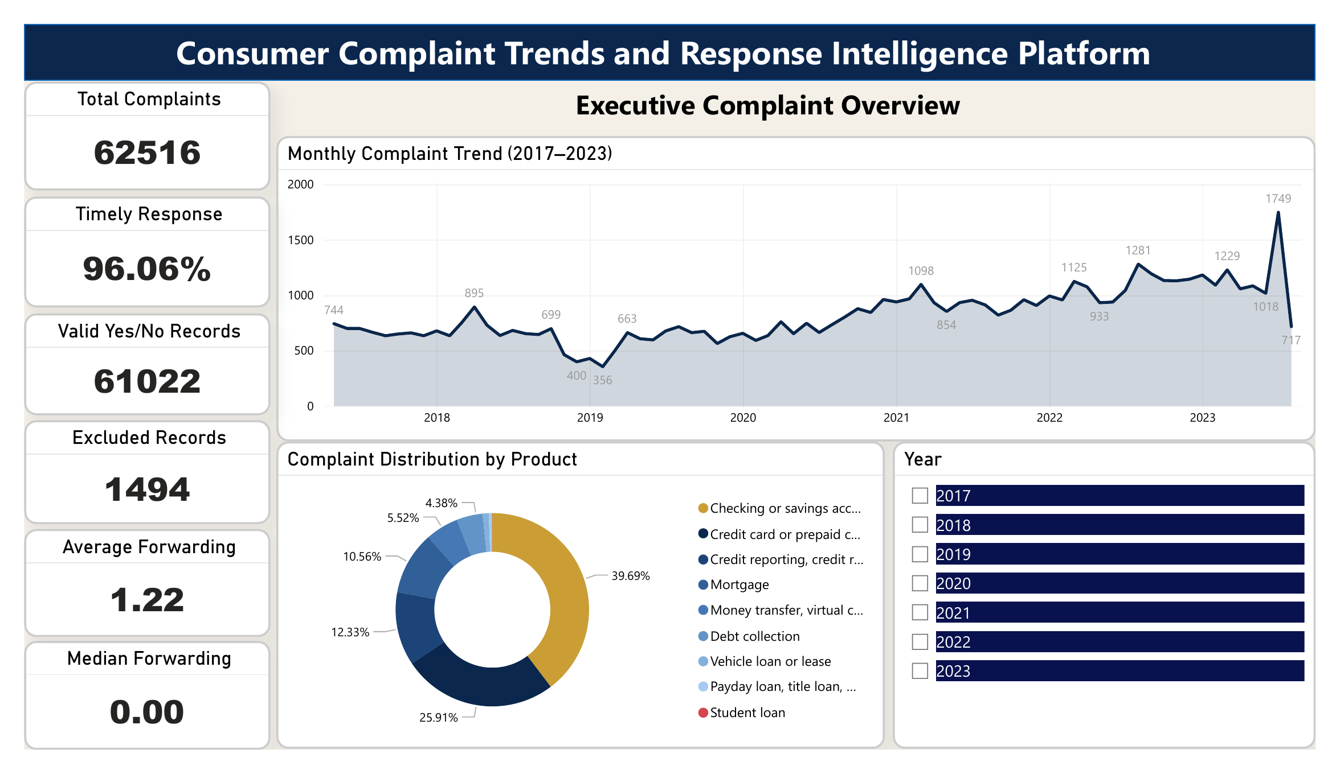
POWER BI DASHBOARD / PAGE 1
Executive Complaint Overview
Overall scale, monthly trend, product distribution and headline KPIs
65.60%
checking/savings + credit/prepaid card complaints
Largest product
24,814 complaints relate to checking or savings accounts.
Recorded timeliness
96.06% among the 61,022 eligible complaints.
Time perspective
The monthly line shows stronger volume in later years.
SUPPLIED POWER BI DASHBOARD · PAGE 1 OF 4
ANALYSTLAB AFRICA / WEEK 4 / DATA ANALYTICS
03 / 10
Notes:
Page one is the executive overview. We recorded 62,516 complaints and a 96.06 percent timely-response rate among eligible cases. Checking or savings accounts generated 24,814 complaints, 39.69 percent. Credit or prepaid cards generated another 16,197, or 25.91 percent. Together they represent 65.60 percent of all records, so the complaints are not evenly distributed across products. The line chart also provides a monthly view of how the complaint count evolved. Its recent months should be interpreted alongside their in-progress status.

Slide 4
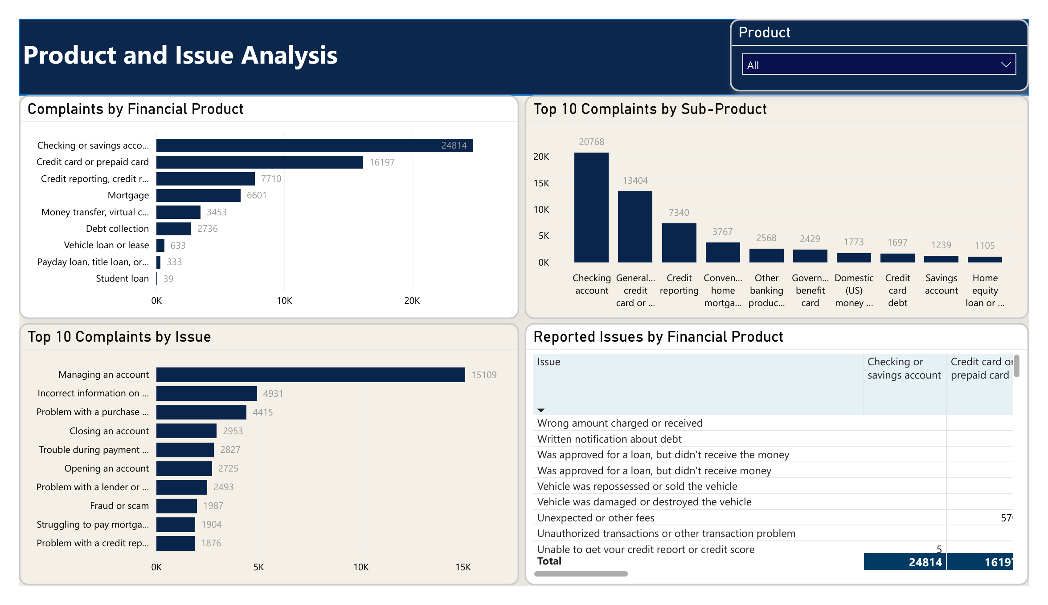
POWER BI DASHBOARD / PAGE 2
Product and Issue Analysis
Financial products, sub-products, leading issues and product × issue detail
15,109
complaints reported “Managing an account”
High-volume products
Checking/savings: 24,814; credit/prepaid: 16,197.
Leading reported issue
“Managing an account” represents 24.17% of records.
Useful drill-down
The product-by-issue matrix supports focused review.
SUPPLIED POWER BI DASHBOARD · PAGE 2 OF 4
ANALYSTLAB AFRICA / WEEK 4 / DATA ANALYTICS
04 / 10
Notes:
The second page addresses which financial products and reported issues dominate the data. Checking or savings accounts have the most complaints, followed by credit or prepaid cards. The single most frequent issue is Managing an account, recorded 15,109 times, or about 24 percent of all complaints. The charts for sub-products and top issues provide a more specific view, while the product by issue matrix shows that distinct products have distinct patterns. This supports targeted issue reviews rather than applying one interpretation to every financial product.

Slide 5
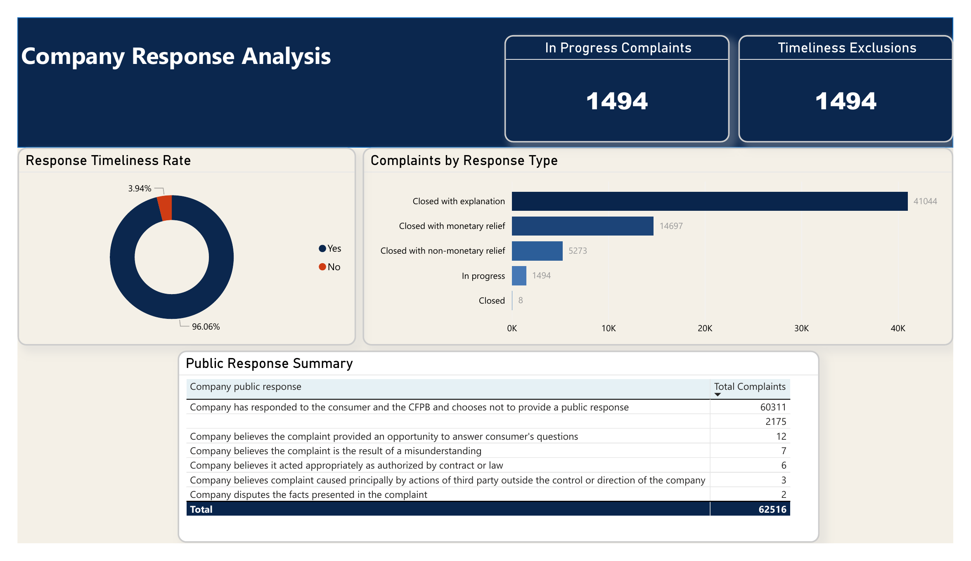
POWER BI DASHBOARD / PAGE 3
Company Response Analysis
Response categories, Yes/No timeliness and public response classifications
41,044
complaints “Closed with explanation”
Other closures
Monetary relief: 14,697; non-monetary: 5,273.
In progress
1,494 complaints excluded from the timeliness rate.
Interpret carefully
Response categories do not prove satisfaction or resolution.
SUPPLIED POWER BI DASHBOARD · PAGE 3 OF 4
ANALYSTLAB AFRICA / WEEK 4 / DATA ANALYTICS
05 / 10
Notes:
The third page examines recorded company response classifications. The largest category is Closed with explanation, with 41,044 complaints. Monetary relief occurs in 14,697 cases and non-monetary relief in 5,273. The timeliness visual separates the Yes and No classifications and excludes 1,494 In progress records with blank timeliness. The public response table must also be interpreted carefully: choosing not to provide a public response is different from failing to respond. Crucially, none of these response categories independently establishes that the consumer was satisfied or that the complaint was proven.

Slide 6
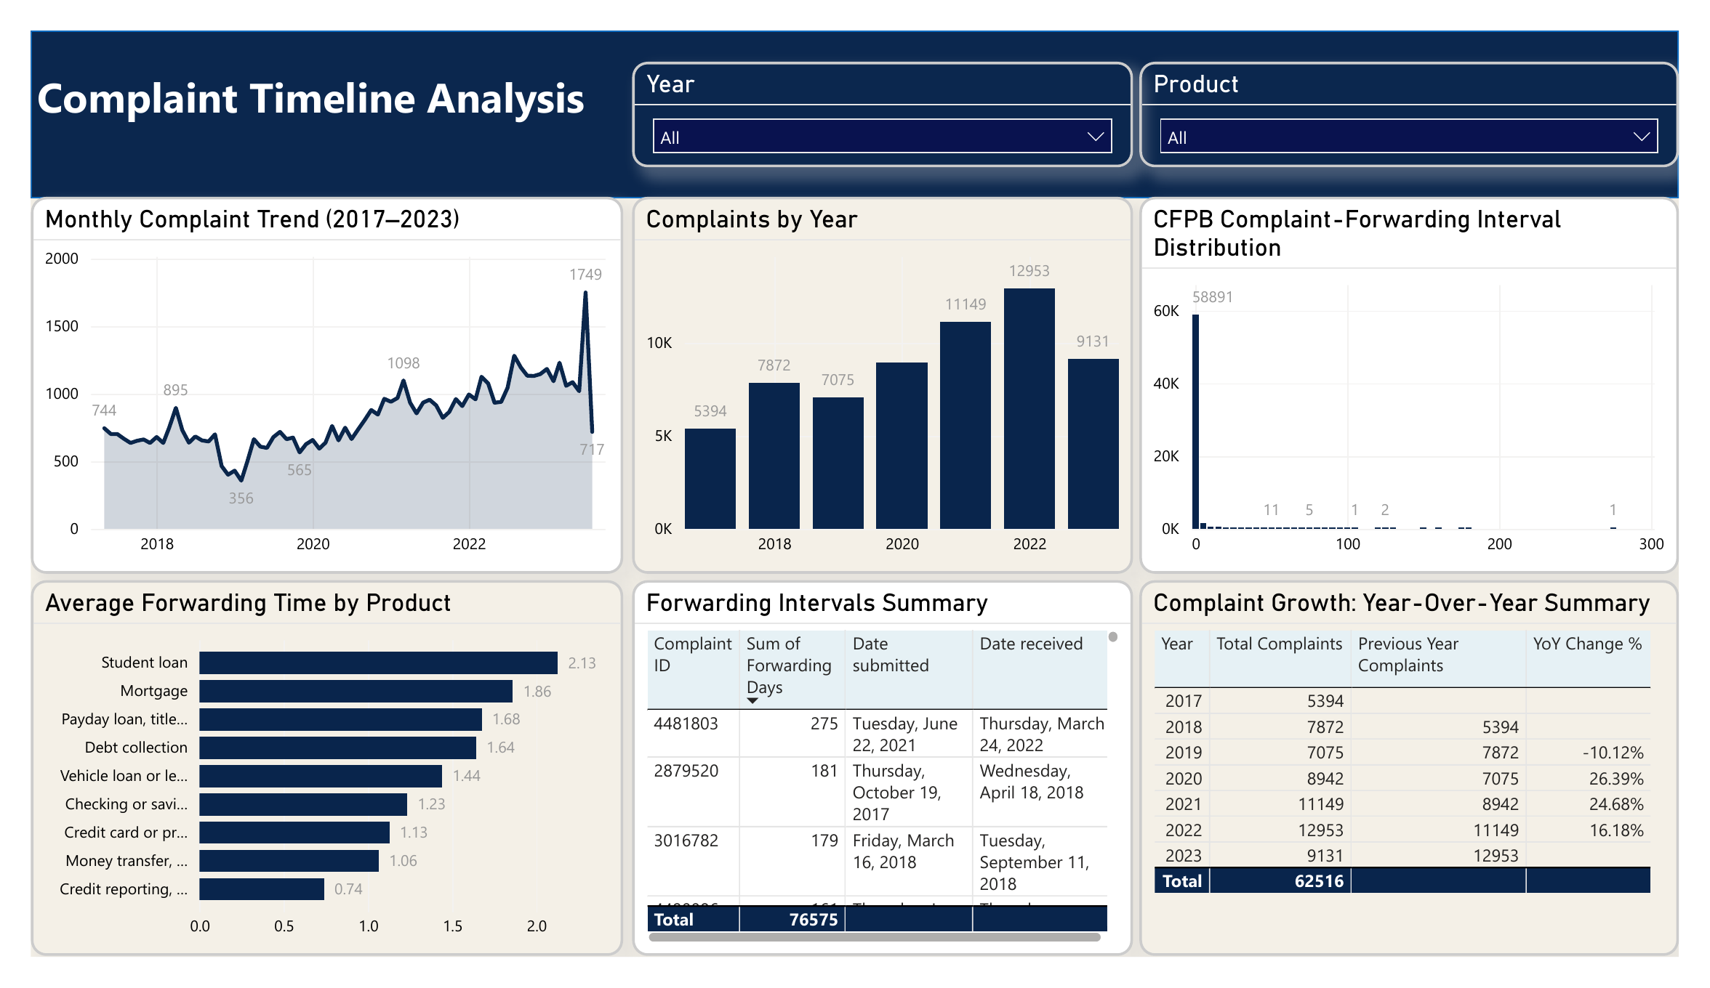
POWER BI DASHBOARD / PAGE 4
Complaint Timeline Analysis
Annual and monthly trends, forwarding distribution and exceptional intervals
12,953
complaints in 2022 (highest complete year)
Typical forwarding
Median 0 days; average 1.22 calendar days.
Longest observation
275 days between CFPB receipt and forwarding.
Year coverage
2017 and 2023 are partial years; avoid direct full-year YoY.
SUPPLIED POWER BI DASHBOARD · PAGE 4 OF 4
ANALYSTLAB AFRICA / WEEK 4 / DATA ANALYTICS
06 / 10
Notes:
The fourth page presents complaint timelines. Among complete calendar years, 2022 has the highest count at 12,953. The monthly trend explains when spikes occurred. Separately, forwarding intervals have a median of zero days and an average of 1.22 calendar days, so most complaints moved quickly from the CFPB to the company. The longest observed interval is 275 days. That is an unusually long CFPB forwarding interval, not company resolution time. We also recognise that 2017 starts in May and 2023 ends in August, making year-on-year comparisons with those boundary years misleading.

Slide 7
EVIDENCE-BASED FINDINGS
Complaint volume rose 83.08%, led by four product families
Comparable full-calendar-year baseline: 2019 versus 2022
ANNUAL COMPLAINT COUNT
CONTRIBUTIONS TO THE 5,878 ADDITIONAL COMPLAINTS
7,075
Checking/savings
+2,106
2019
Credit/prepaid card
+1,656
12,953
Credit reporting
+1,231
2022
Money transfer
+702
+83.08%
Other products, net
+183
Four products account for 96.89% of the net increase
ANALYSTLAB AFRICA / WEEK 4 / DATA ANALYTICS
07 / 10
Notes:
Looking beyond a single KPI, complaint volume increased from 7,075 in the complete year 2019 to 12,953 in 2022. That is an increase of 5,878 complaints, or 83.08 percent. The growth was concentrated: checking or savings accounts added 2,106; credit or prepaid cards 1,656; credit reporting 1,231; and money transfer 702. Together those four categories explain about 96.89 percent of the net increase. These are complaint counts, not complaint rates per customer, because the dataset has no account or customer population denominator. The finding identifies where further investigation is most practical.

Slide 8
EVIDENCE-BASED FINDINGS
Three patterns the overall KPIs would otherwise hide
Monthly timeliness, in-progress cohorts and long CFPB forwarding intervals
JUNE 2021
JULY 2023
FORWARDING EXCEPTIONS
58.35%
49.34%
623
recorded timely Yes
of complaints In progress
complaints exceeded 25 days
545 Yes among 934 valid Yes/No complaints.
863 In progress among 1,749 complaints.
Maximum CFPB forwarding interval: 275 days.
Overall 96.06% masks this monthly decline.
Recent eligible-only rates exclude many open cases.
The threshold is analytical, not regulatory.
These are recorded distributions, not evidence of why the patterns occurred.
ANALYSTLAB AFRICA / WEEK 4 / DATA ANALYTICS
08 / 10
Notes:
Three less obvious patterns matter to interpretation. First, the overall 96.06 percent timely-response figure masks a marked dip in June 2021: only 545 of 934 eligible complaints, or 58.35 percent, were classified Yes. The extract alone does not explain why. Second, 863 of 1,749 July 2023 complaints were marked In progress, or 49.34 percent. An eligible-only timely percentage for recent months can therefore be misleading unless exclusions are displayed. Third, 623 complaints had forwarding intervals longer than 25 calendar days, with a maximum of 275 days. That 25-day reference comes from the dataset distribution and is not a legal deadline.

Slide 9
ACTIONABLE RECOMMENDATIONS
Prioritise the products, monitor response cohorts, inspect outliers
Actions based on observed complaint distributions, not unverified allegations
01
Review high-volume product issues
Investigate checking/savings account management, card transactions, credit reporting and money-transfer issue patterns.
Evidence: four products drove 96.89% of 2019–2022 growth.
02
Monitor monthly recorded timeliness
Show Yes, No, eligible denominator and In progress exclusions together; investigate the mid-2021 shift.
Evidence: June 2021 recorded 58.35% timely Yes.
03
Review exceptional CFPB forwarding
Validate long date intervals by product and submission channel; separately track records above 25 days.
Evidence: 623 observations exceed the analytical cutoff.
ANALYSTLAB AFRICA / WEEK 4 / DATA ANALYTICS
09 / 10
Notes:
The analysis points to three practical actions. First, prioritise product-specific issue reviews for checking or savings accounts, credit or prepaid cards, credit reporting and money transfer. These categories explain most of the growth and should be assessed using a monthly product-by-issue breakdown. Second, monitor timeliness by month and product with Yes, No and the valid denominator, while displaying In progress complaints separately. The June 2021 shift needs investigation, not an assumed explanation. Third, audit the exceptional CFPB forwarding intervals by checking the underlying dates, product and submission channels, using the greater-than-25-day threshold as an analytical screening rule.

Slide 10
CONCLUSION
From complaint counts
to focused intelligence
The dashboard connects products, issues, response classifications and CFPB forwarding intervals in one evidence-based view.
65.60%
96.06%
1.22 days
Complaints in checking/savings + credit/prepaid cards
Recorded timely Yes among valid Yes/No records
Mean CFPB forwarding interval
Interpretation limits
Consumer-reported issues are not verified misconduct; company resolution time and customer denominators are not available. 2017 and 2023 are partial years.
ANALYSTLAB AFRICA / EXPERIENCE LAB INTERNSHIP / WEEK 4
Notes:
In conclusion, the four-page intelligence dashboard changes raw complaint records into a clearer view of volume, issue concentration, response categories and forwarding patterns. Checking and savings accounts plus credit and prepaid cards account for 65.60 percent of complaints. The overall recorded timely response rate is 96.06 percent among eligible records, and mean CFPB forwarding takes 1.22 days. The most important next steps are focused product-by-issue review, transparent monitoring of eligible and in-progress responses, and review of unusually long forwarding intervals. The analysis supports informed prioritisation. It does not verify misconduct or measure consumer satisfaction or company resolution time.

