Slide 1
TicketWeb

Slide 2
Overview
Goals of the project
How it works
Test cases

Slide 3
Goals
Be able to load an mTicket with the correct information:
Correct timing
Correct code
Correct Name
Be able to authenticate users such that:
They can log in
They can log out
Check who has paid
Inform the user about how to use the app.
Have a page dedicated to information that the user need not be authenticated for
Inform the user about how to pay
Inform them of the account to pay into
Inform them of which month they need to pay for
Inform them of how much they need to pay
Inform the user of how to setup and send cryptocurrency

Slide 4
How it works?
The app is based on a state machine:
State Name | State Number | Description
AUTH | 0 | Prompt the user to sign in/sign up/forgotten password etc. Also auto logs in user if possible.
TICKET_MENU | 1 | Display the Ticket selection menu.
TICKET | 2 | Display the ticket chosen by the user.
INFO | 3 | Display information to the user about how they can display the ticket properly and how to use crypto payment.
PAYMENT | 4 | Display payment to the user about how they can pay, along with what they owe and where to pay into.
ERROR | 5 | Display an Error to the user.

Slide 5
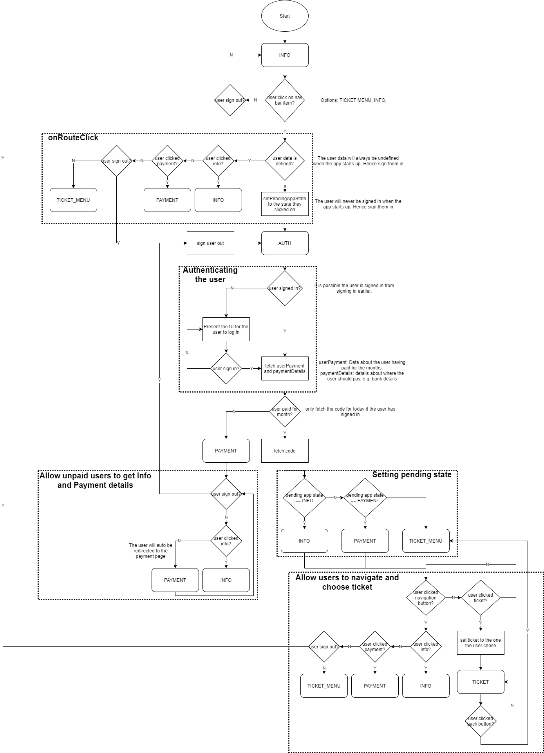
State Machine Diagram
Note that this is not perfectly accurate because some things are fetched asynchronously which is hard to model with a state diagram.
The main idea:
The user is always presented the Info screen on start up.
When the user clicks on the nav bar, it will check if they are signed in (they never are). The user can also sign out and that will take them to Auth state.
Then we authenticate the user, when that is complete we fetch data from back end.
We check if the user has paid and if so, we get the code.
If the user has paid we let them have free reign with the app, else they can only see the info and payment pages.

Slide 6
Test Cases – On app start
User has Paid & signed in
Test Case Description | Passes
Test the app displays the info page | Y
Test the user can sign out | Y
Test the user will sign in when they click a navigation button (except the sign out) | Y
Test the user will be presented the page they clicked from the navigation button after they have signed in. | Y
User is signed out
Test Case Description | Passes
Test the app displays the info page | Y
Test the user can sign out | Y
Test the user will be prompted to sign in when clicking navigation button (except sign out) | Y
User has not paid & signed in
Test Case Description | Passes
Test the app displays the info page | Y
Test the user can sign out | Y
Test the user will sign in when they click a navigation button (except the sign out) | Y
Test the user will be presented the payment because they have not paid | Y

Slide 7
Test Cases – Signing in the User
User is signing in after being signed out
Test Case Description | Paid | Passes
Test when the user signs in, the app fetches the paymentDetails, userDetails only once. | Y | Y
 | N | Y
Test the code is fetched once for paid, none for not paid | Y | Y
 | N | Y
The first screen shown is the ticket menu for payers and payment for non-payers | Y | Y
 | N | Y
User is signing in after app start
Test Case Description | Paid | Passes
Test when the user signs in, the app fetches the paymentDetails, userDetails only once. | Y | Y
 | N | Y
Test the code is fetched once for paid, none for not paid | Y | `Y
 | N | Y
The first screen shown is the one selected for payers and payment for non-payers | Y | Y
 | N | Y

Slide 8
Test Cases – Signing out the User
When the user signs out they are shown the sign in UI.
Test Case Description | Paid | Passes
When the user signs out they are shown the sign in UI | Y | Y
 | N | Y

Slide 9
Test Cases – Navigation between pages
Test Case Description | Paid | Passes
Test that the user still has access to the info page | Y | Y
 | N | Y
Test that the user still has access to the payment page | Y | Y
 | N | Y
Test that the user does not have access to the ticket menu for non-payers and they do have access if payers | Y | Y
 | N | Y
Test that the user does not have access to display a ticket if non-payer else they do have access | Y | Y
 | N | Y
Test that the code was not fetched if non payer but the code is fetched if they have paid | Y | Y
 | N | Y

Slide 10
Test Cases – User Payment
Test Case Description | Passes
Test that for a user who has not paid, the month shown is the current and the price is correct. | Y
Test that for a user who has paid and it is more than 5 days before the end of the month, the month shown is the current and the amount is 0. | Y
Test that for a user who has paid for the current month but not the next month and it is less than 5 days before the end of the month, the month shown is the next month and the amount is correct. | Y
Test that for a user who has paid for the current month and the next month and it is less than 5 days before the end of the month, the month shown is the next month and the amount 0. | Y
Allow a user to change their btc wallet address. | N

