Slide 1
Reactive AI Agent for Fraud Detection
DONE BY
HAMI YASIR
24MCA1020
MOHAMMED ARSHAD M
24MCA1011

Slide 2
Introduction
Financial fraud is a major challenge in today’s digital world. With millions of transactions happening every second, detecting suspicious activity in real time is crucial to protect users and prevent financial losses.
Traditional rule-based systems are often slow and inflexible. Artificial Intelligence allows systems to learn patterns of fraud and adapt to new, unseen fraudulent behaviors with high accuracy. AI makes fraud detection faster, smarter, and more reliable.

Slide 3
Project Goal
To develop a Reactive AI Agent that:
Continuously processes a stream of credit card transactions
Predicts whether a transaction is fraudulent using an ML model (XGBoost)
Instantly takes action by sending fraud alert emails and updating a real-time web dashboard

Slide 4
Components
Artificial Intelligence:
The overall project will be a Reactive AI Agent where Environment is a stream of transactions that the AI Agent will be processing
Inferences will be made using an XGBoost model trained to detect fraudeulent transactions
Action will be taken in the form of mail sent from AI Agent Email to a Client Email when a fraudulent transaction is detected.

Slide 5
Components
Java:
We will be using SpringBoot as middleware between frontend and backend. ‘Kafka’ a Java Technology is used for Data stream from producer to consumer.
Machine Learning:
We trained a model (XGBoost) to detect fraudulent transaction based on anonymised credit card transaction dataset.

Slide 6
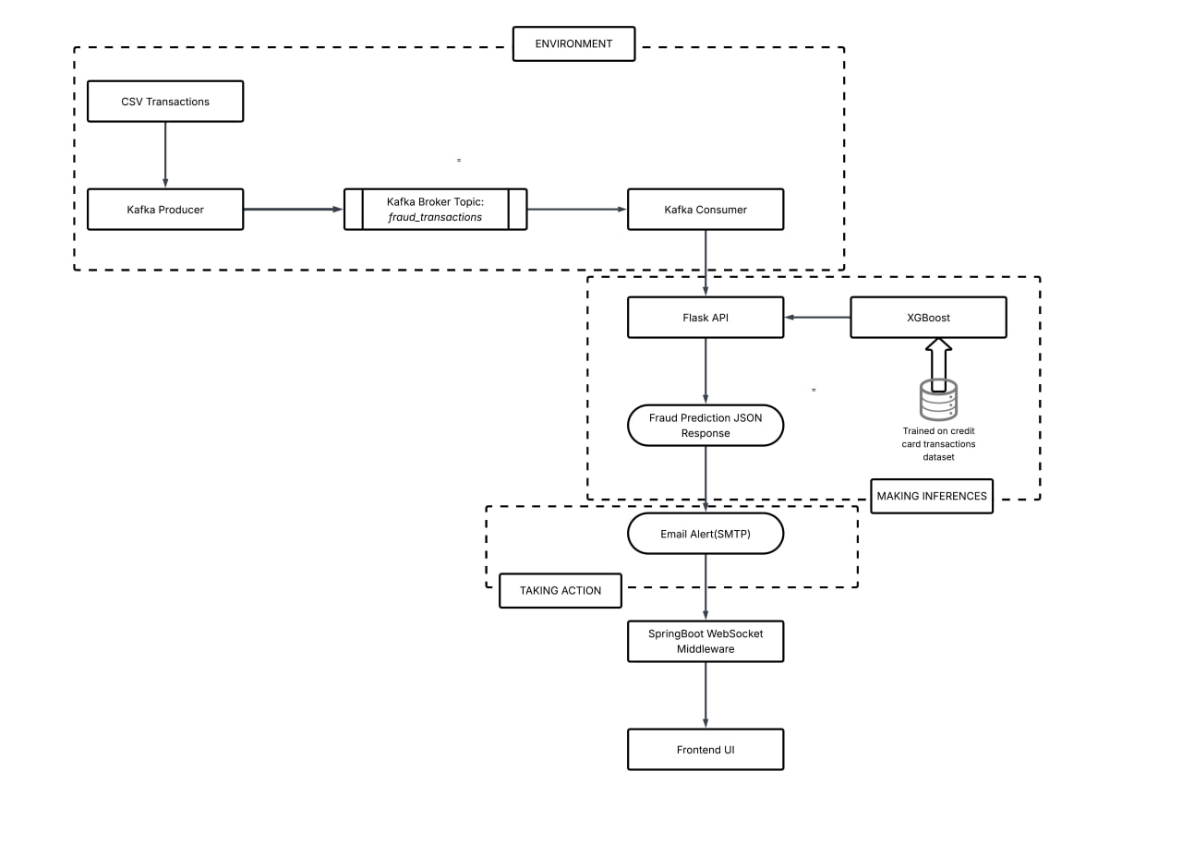
SYSTEM ARCHITECTURE

Slide 7
WORKFLOW
Step 1: Data from creditcard_test.csv that contains transaction data is fed into Kafka Producer. The data is supposed to simulate transactions that happens in real time.
Step 2: Kafka Producer(stream_to_producer.py) sends the transactions row by row to a Kafka topic broker fraud_transactions every second. This simulates a real time stream of transactions.
Step 3: Kafka Consumer(stream_to_consumer.py) is subscribed to fraud_transactions. This makes it so that the transactions received by the broker is extracted by Kafka Consumer.
Step 4: An XGBoost Model is trained on creditcard dataset to predict fraudulent transactions..

Slide 8
WORKFLOW
Step 5: The transactions extracted by Kafka Consumer is sent to the trained model using Flask API(app.py) which returns a probability and whether the transaction was fraudulent or not.
Step 6: If the transaction was fraudulent, then an email is sent from an AI Agent Email(fraud.detection.agent.2024@gmail.com) to a client email(fraud.detection.client.2024@gmail.com) using SMTP protocol.
Step 7: The transaction data received by Kafka Consumer and the prediction is also sent to a SpringBoot REST API(FraudDetectionController.java). Using SimpMessagingTemplate, the SpringBoot Controller broadcasts the transactions & predictions to the Web UI using WebSocket(/topic/transaction)
Step 8: The HTML connects to /fraud-websocket. It listens to /topic/transactions. When the message is received, it renders the Transaction details, Prediction and Probability

Slide 9
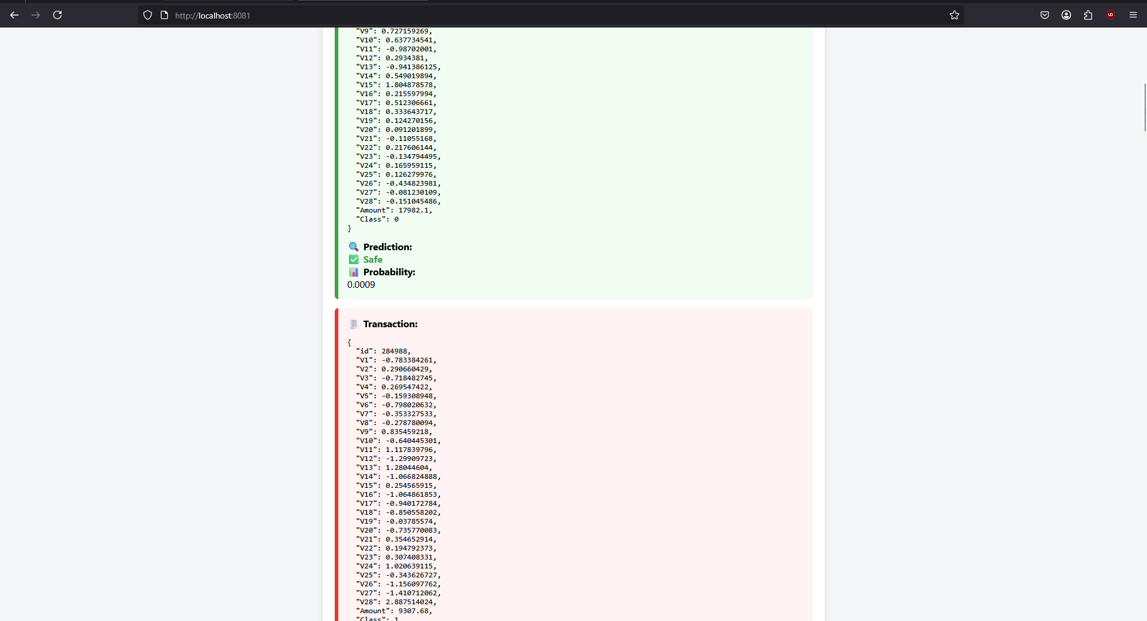
OUTPUT

Slide 10
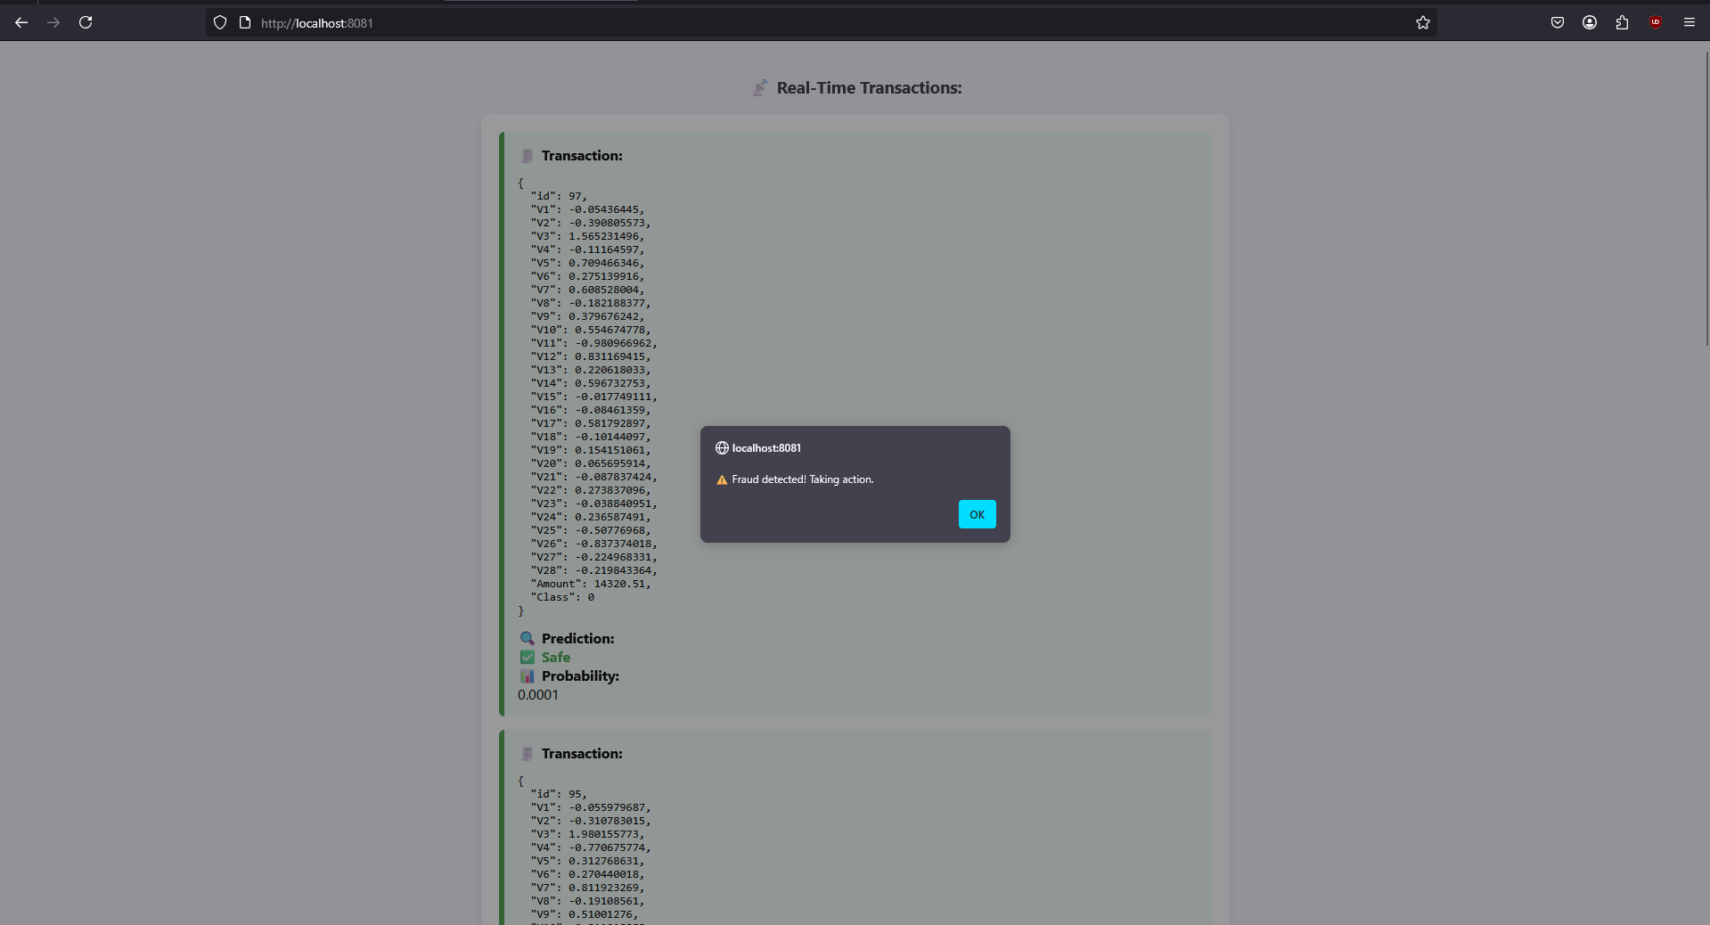

Slide 11
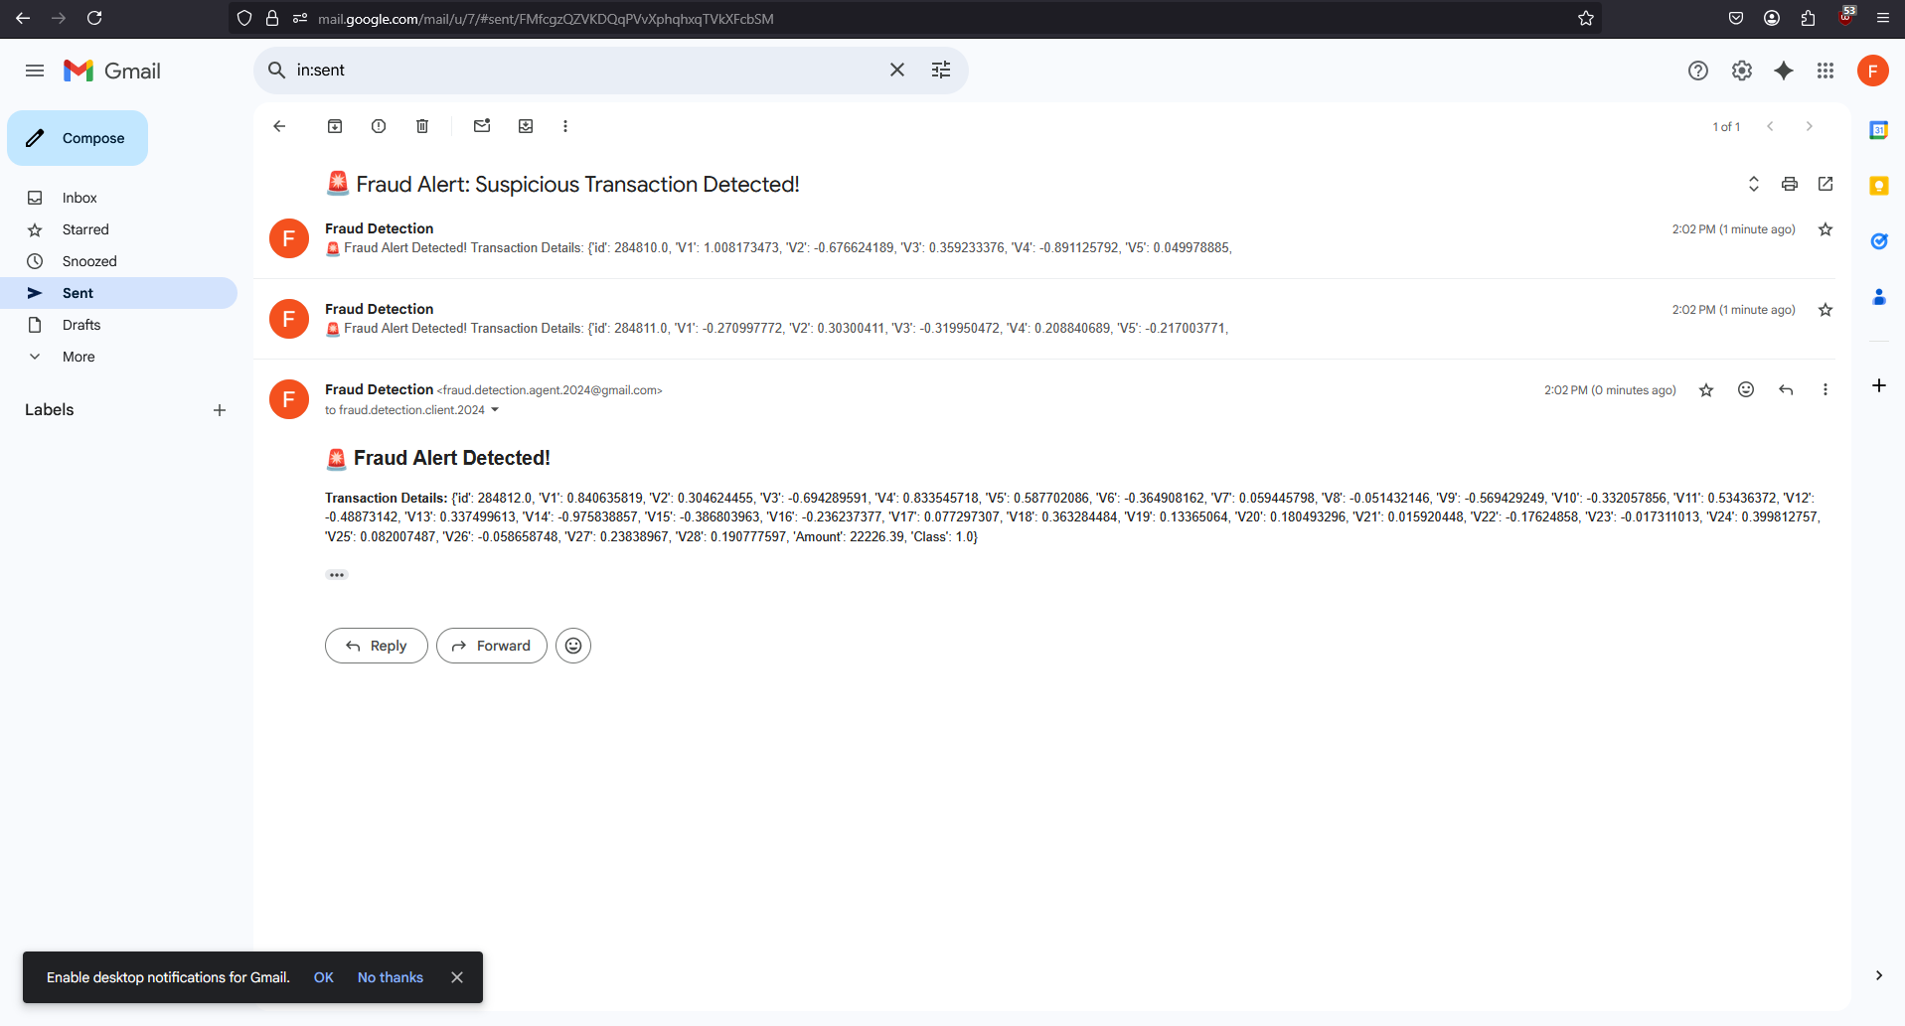
AI AGENT RESPONSE

Slide 12
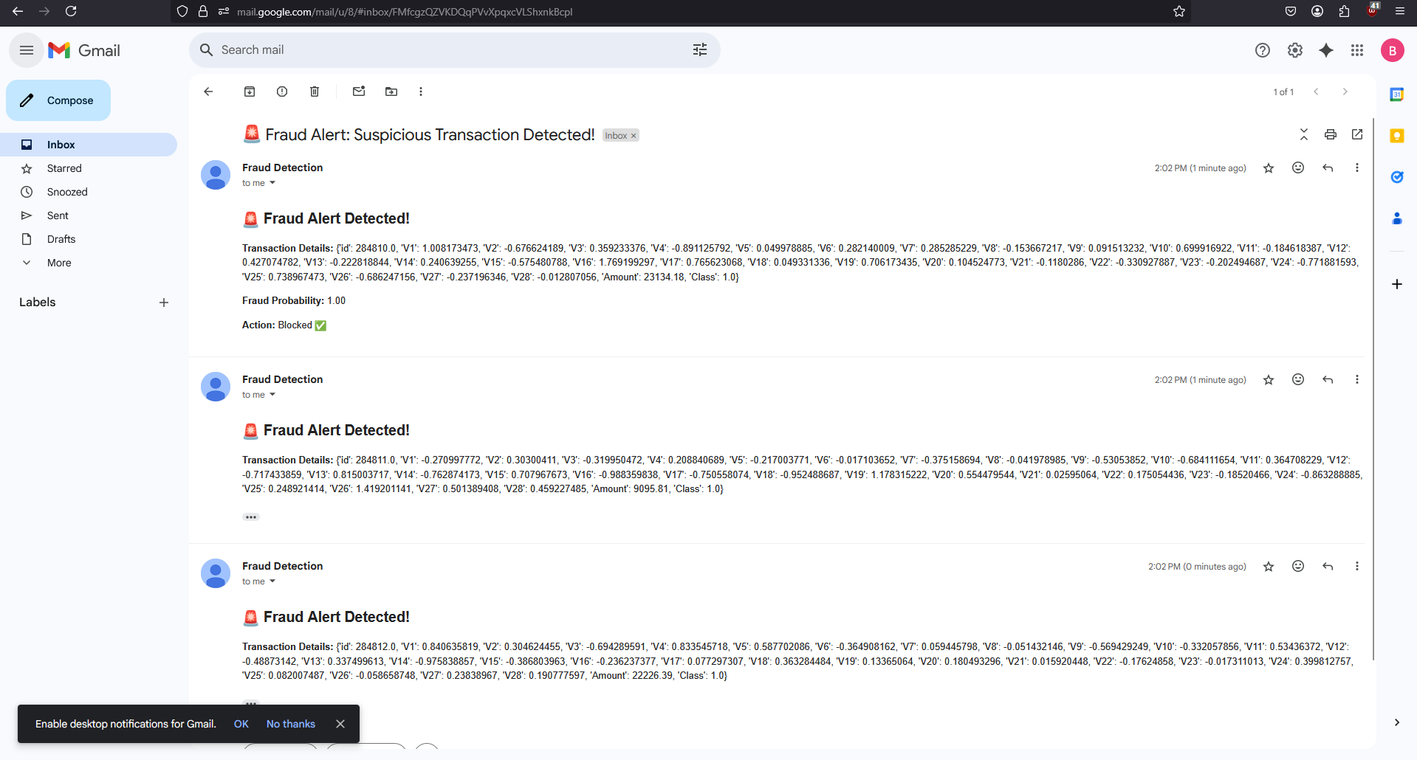
CLIENT RECEIVING RESPONSE/ALERTED

