Slide 1
FINAL PROJECT
Section B groupe 56
CHERIFI Kaouther
HAMIDI Assala
KAHLI Meriem Aya
OUGOUR Sarah
TABTI Sabrina

Slide 2

Information and communication technology
the content
Introduction
What is ICT ?
History
Benefits of ICT
Disadvantages of ICT
Information on ICT policies and regulation

Slide 3
Information and communication technology
the content
Introduction
What is ICT ?
History
Benefits of ICT
Disadvantages of ICT
Information on ICT policies and regulation

Slide 4

introduction
ICT plays a crucial role in our modern society as it enables the creation, storage, retrieval, and transmission of data. It has revolutionized how we access information and communicate across distances. With ICTULTIMATE, individuals and businesses can collaborate on a global scale like never before

Slide 5
Information and communication technology
the content
Introduction
What is ICT ?
History
Benefits of ICT
Disadvantages of ICT
Information on ICT policies and regulation

Slide 6
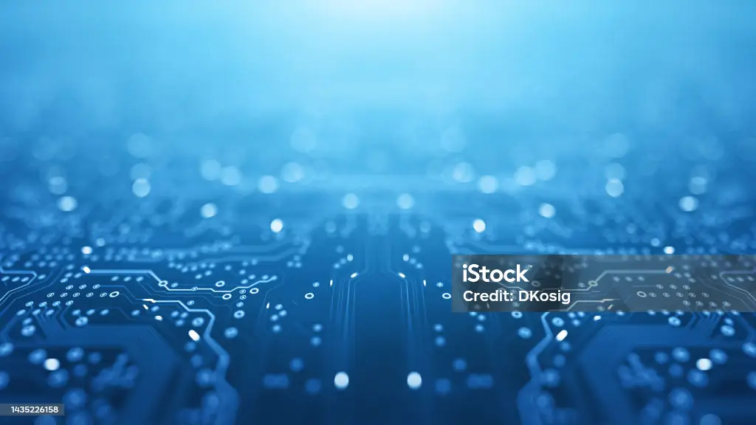
What is ICT ?
CT, or Information and Communications Technology, refers to the infrastructure and components that enable modern computing. It encompasses a diverse set of technological tools and resources used to transmit, store, create, share, and manage information . ICT involves the use of computing and telecommunication technologies, systems, and tools to facilitate various processes and activities .
In simpler terms, ICT is the combination of hardware, software, networks, and communication devices that allow us to process information efficiently. It plays a crucial role in our daily lives by enabling us to access information quickly, communicate with others across distances, store data securely, collaborate on projects remotely, and much more.

Slide 7
Information and communication technology
the content
Introduction
What is ICT ?
History
Benefits of ICT
Disadvantages of ICT
Information on ICT policies and regulation

Slide 8

history
The History of information and communication technologies is marked ba a diversity of innovations. It begins in 19th century with inventions such as Telegraph and telephone, which revolutionized communication by enabling near real time, long distance exchanges. The mid 20th century witnessed the rise of mass communication through radio and television. By the end of the cetury, the inter- net had become an essential tool for communication, commerce, and leisurs. Since then, these technologies have rapidly evolved, transforming our work methodologies, interactions, and commu- nication prectices, thereby contributing to shaping the modern world.

Slide 9
Information and communication technology
the content
Introduction
What is ICT ?
History
Benefits of ICT
Disadvantages of ICT
Information on ICT policies and regulation

Slide 10
Benefits of ICT
Information and Communications Technology, offers numerous benefits across various domains. Here are some advantages of ICT:
Improved Efficiency ICT automates manual tasks, streamlines processes, and increases productivity. It enables organizations to store and retrieve data easily, manage resources effectively.
Education Enhancement: In the field of education, ICT has revolutionized teaching methods by providing interactive learning tools such as educational software applications, online courses, virtual classrooms, and multimedia resources
Access to Information: With ICT, accessing information has become easier than ever before. The internet provides a vast amount of information at our fingertips, allowing quick research on any topic. This facilitates learning opportunities for students and professionals alike
Enhanced Communication: ICT enables fast and efficient communication through various channels such as email, instant messaging, video conferencing, and social media platforms. It allows individuals and businesses to connect with people globally, fostering collaboration and knowledge sharing

Slide 11
Information and communication technology
the content
Introduction
What is ICT ?
History
Benefits of ICT
Disadvantages of ICT
Information on ICT policies and regulation

Slide 12
Disadvantages of ICT
While Information and Communications Technology (ICT) offers numerous benefits, it also has some disadvantages. Here are a few of them:
Security Risks With the increased reliance ICT, there is a risk of security breaches, such as hacking, data theft, and unauthorized access to sensitive information. Cybersecurity threats continue to evolve, requiring constant vigilance and robust security measures.
Dependency and Reliability: As we become more dependent on ICT systems for various tasks, any disruption or failure in these systems can have significant consequences. Power outages, hardware failures, or software glitches can disrupt operations and cause inconvenience or financial losses.
Job Displacement: While ICT brings automation and efficiency to many industries, it can also lead to job displacement as certain tasks become automated. This may require individuals to acquire new skills or adapt to changing job requirements.

Slide 13
Information and communication technology
the content
Introduction
What is ICT ?
History
Benefits of ICT
Disadvantages of ICT
Information on ICT policies and regulation

Slide 14
Information on ICT policies and regulation
Policies and regulations regarding Information and Communica-
tion Technologies (ICT) vary by country. Generally, they cover
areas such as data protection, cybersecurity, privacy, and equi-
table access to the internet.
Laws like GDPR in Europe or CCPA in California aim to safe-
guard individuals’ privacy. Telecommunications regulation and
combating cybercrime are also integral parts of these policies. It’s
crucial to stay updated on legislative developments to ensure eth-
ical and compliant use of ICT.

