Slide 1
BOOK RECOMMENDATION SYSTEM MARYAM GHAFOURIAN HAMIDREZA AMINORROAYAEI

Slide 2
MOTIVATION
The joy of discovering a book that perfectly matches your interests is unparalleled, yet with millions of options, finding that next read can be overwhelming. A book recommender system was created to simplify this process. It's designed to intuitively connect readers with books that reflect their preferences, reducing the time spent in search and enhancing the overall reading experience. At its core, this project aims to foster a love for reading by ensuring every book recommendation feels personal and well-suited to the reader. By bridging the gap between endless book lists and individual tastes, the system is not just promoting reading—it's personalizing it. This way, authors reach their ideal audience, and readers find their next favorite book effortlessly.

Slide 3
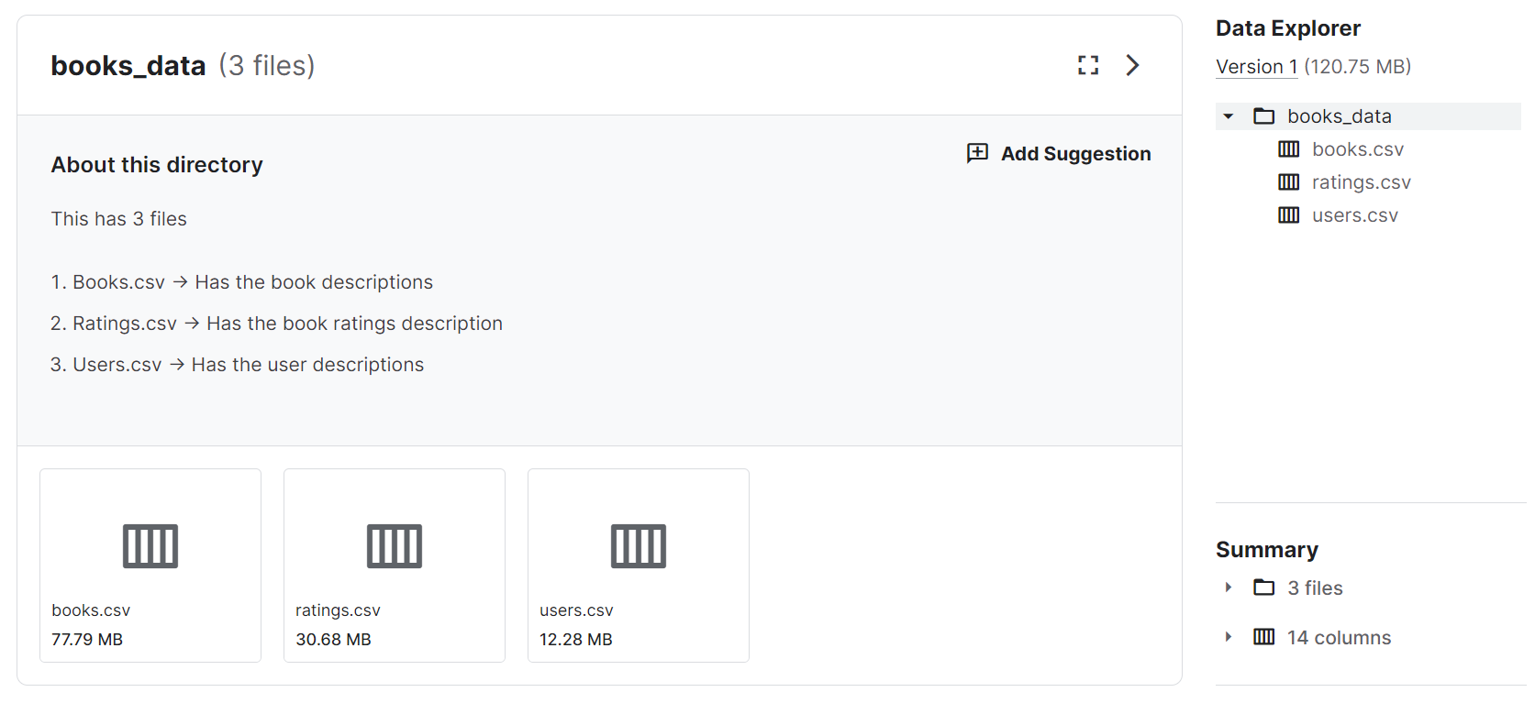
DATASETS
https://www.kaggle.com/datasets/saurabhbagchi/books-dataset/data

Slide 4
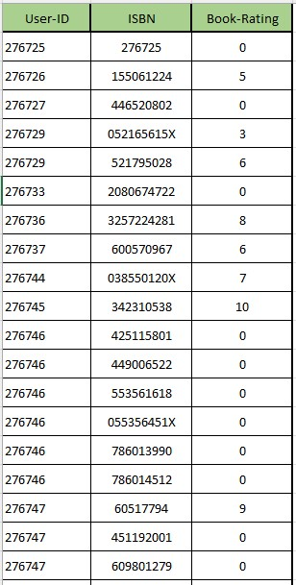
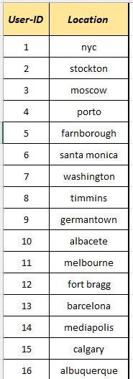
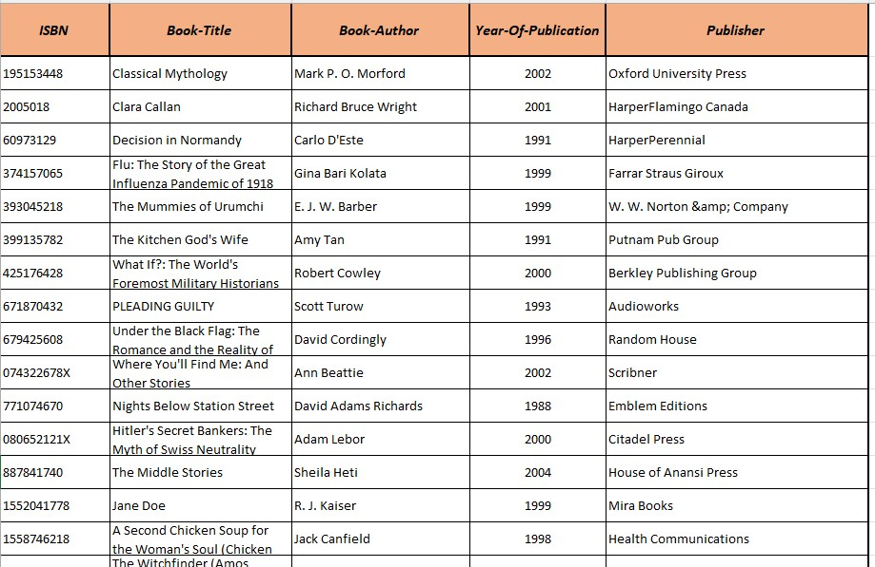
“Rating” table
“User” table
“Book” table

Slide 5
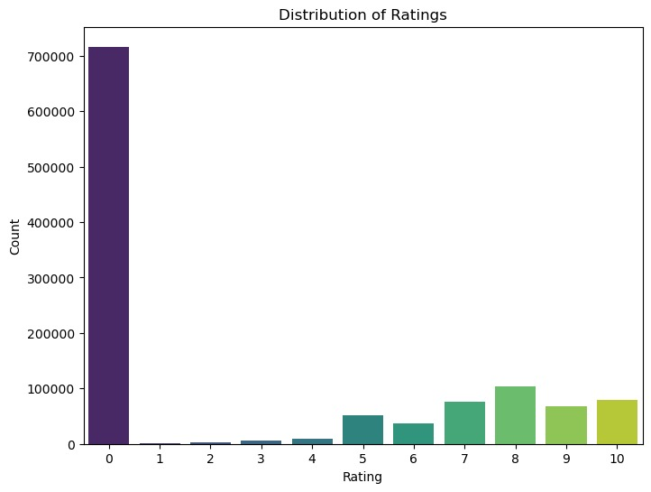
This histogram illustrates the distribution of ratings for a collection of books. The x-axis represents the rating scale from 0 to 10, and the y-axis shows the count of ratings received for each score. The chart reveals a notably high frequency of ratings at the lowest score, with a substantial number of books receiving a rating of 0. Following this, there is a marked decrease with fewer books receiving higher ratings, showing a general trend where books are rated less frequently as the rating scale increases. This could imply a tendency for users to rate only when they have a negative impression or possibly a default rating applied for non-reviewed books. The gradual increase in ratings count from 6 to 10 suggests that books receiving positive ratings are less common but show some variation among higher ratings.

Slide 6
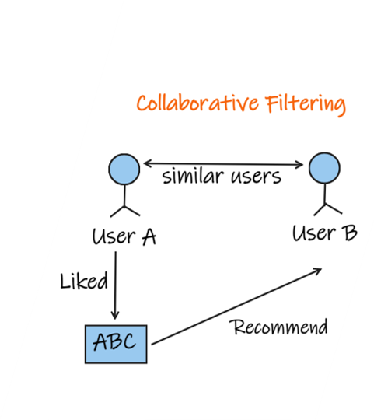
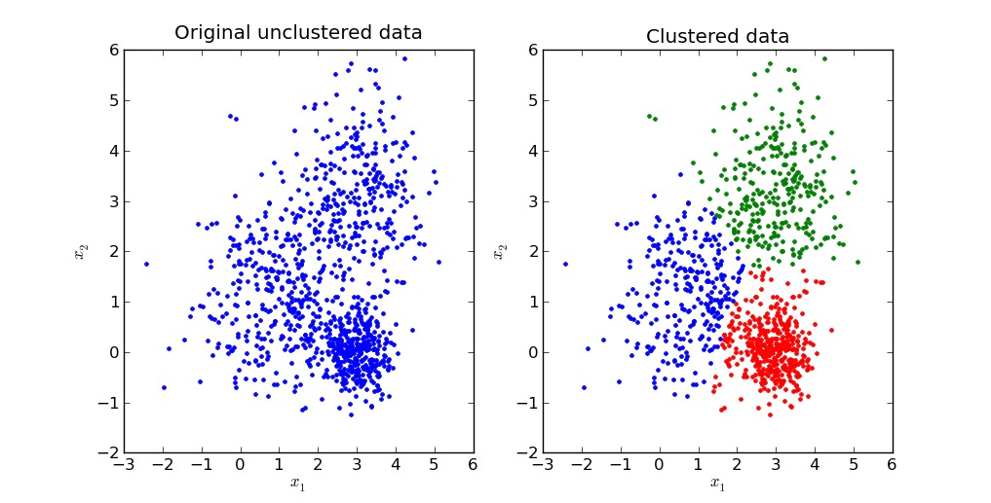
BRIEF INTRODUCTION OF METHODS
We employed clustering and collaborative filtering techniques to build our recommendation system.
Clustering: We used clustering to group similar users or books together based on their characteristics. This helps in identifying patterns and similarities within the dataset.
Collaborative Filtering: Collaborative filtering is a popular recommendation technique that predicts a user's interests by leveraging the preferences of similar users. We implemented nearest neighbors-based collaborative filtering to suggest books to users based on their past ratings and interactions.

Slide 7
SOFTWARE/LIBRARY
Pandas: For data manipulation and preprocessing.
NumPy: For numerical computations and array operations.
Matplotlib: For data visualization and plotting.
Seaborn: For enhancing the visual aesthetics of plots.
Scipy.sparse: For handling sparse matrices efficiently.
Scikit-learn: Specifically, we used the NearestNeighbors algorithm for collaborative filtering.

Slide 8
EXPERIMENTS
Data Preprocessing
Clustering and Collaborative Filtering
Testing and Deployment:
Notes:
Data Preprocessing: Wafter loading Books and Users and Ratings data we cleaned and preprocessed the datasets, ensuring consistency and quality.
Clustering and Collaborative Filtering: We applied clustering to group similar books or users and implemented collaborative filtering to generate book recommendations.
Model Training: We trained our recommendation model using the nearest neighbors algorithm and evaluated its performance.
Testing and Deployment: We tested the recommendation system with sample inputs to ensure its functionality and deployed it for practical use.

Slide 9
DATA PREPROCESSING
Loading Datasets
Selecting Relevant Columns
Renaming Columns
Filtering Ratings Data
Filtering ratings dataset for users who rated more than 200 books
Merging Datasets
Calculating Number of Ratings per Book
Filtering Books by Rating Count
Filtering books which are rated more than 50 times
Removing Duplicate Ratings
Filling NaN values with 0

Slide 10
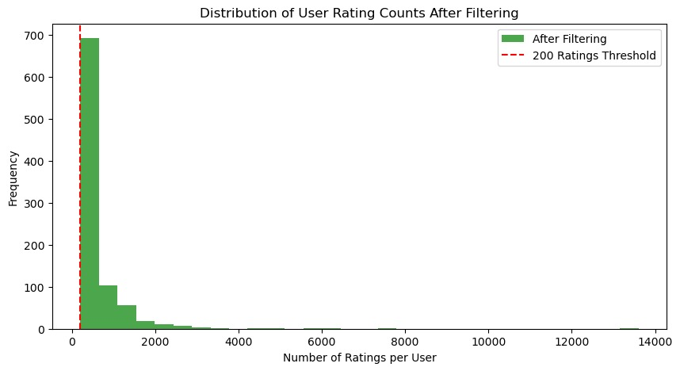
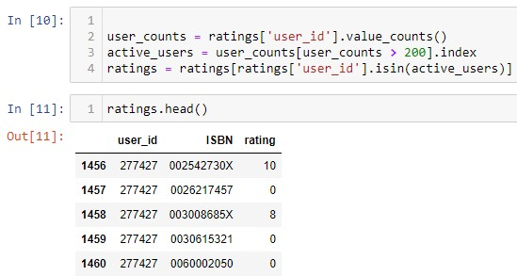
Filtering users who rated more than 200 books
The motivation behind using this code is to focus on users who have provided a significant number of ratings, under the assumption that their data will be more reliable in predicting preferences and making recommendations. Users with very few ratings may not provide enough information to make accurate predictions, and their sparse interaction could introduce noise into the recommendation system. By setting a threshold, such as requiring at least 200 ratings, you ensure that the dataset reflects more engaged users, which often leads to a higher quality recommendation system.
To ensure statistical significance, users with less than 200 ratings are excluded

Slide 11
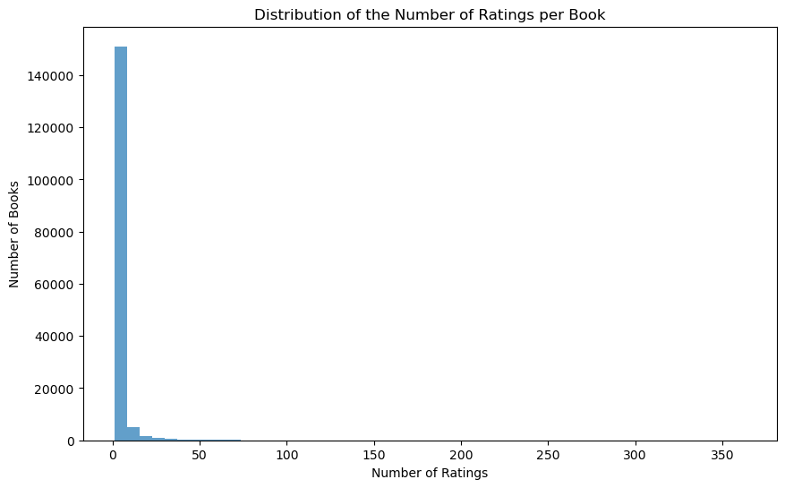
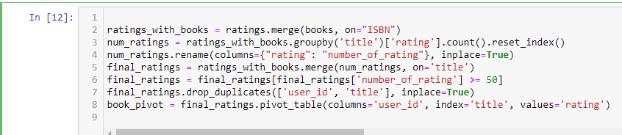
to only include books that have received 50 or more ratings
It ensures that the dataset focuses on books with a significant number of ratings, which might be more relevant for building a reliable recommender system

Slide 12
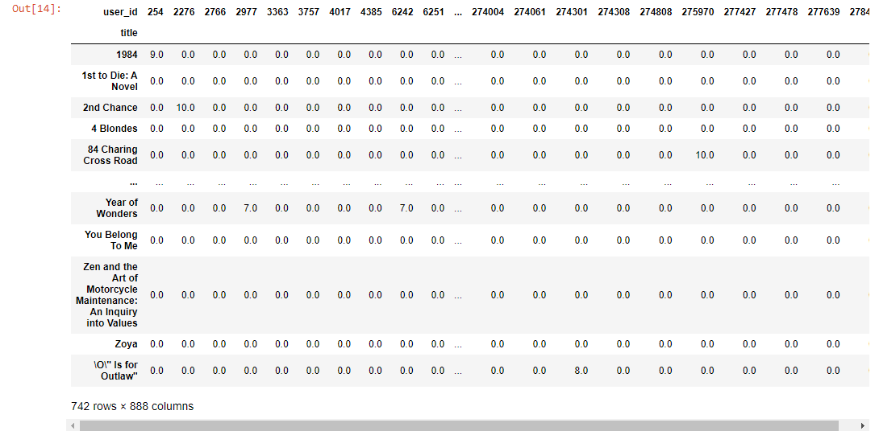
convert missing values
We convert our table to a 2D matrix, and fill the missing values with zeros (since we will calculate distances between rating vectors). We then transform the values(ratings) of the matrix dataframe into a scipy sparse matrix for more efficient calculations.

Slide 13
CLUSTERING AND COLLABORATIVE FILTERING
Creating Sparse Matrix
Nearest Neighbors Algorithm
Fitting the Model
Generating Recommendations
Outputting Recommendations

Slide 14
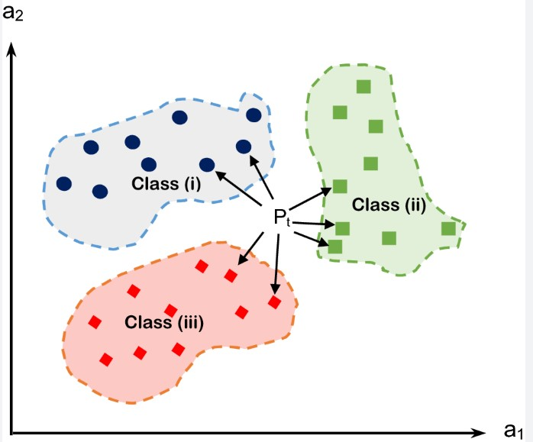
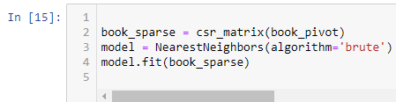
Model Training
This block converts the book_pivot DataFrame into a Compressed Sparse Row (CSR) matrix named book_sparse. A CSR matrix is a storage-efficient way to represent a sparse matrix where most of the elements are zeros. Sparse matrices are common in recommender systems, especially when using collaborative filtering, because not every user rates every item, leading to a lot of missing (implicitly zero) values. Converting to a CSR format helps manage memory usage and improve computation efficiency when dealing with large datasets.

Slide 15
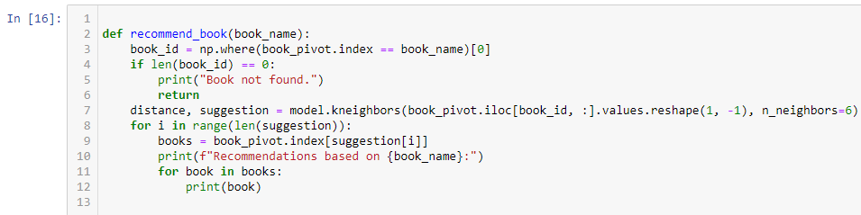
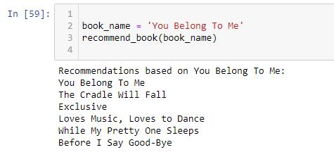
Recommendation Function :
Test the Recommendation Function :

Slide 16
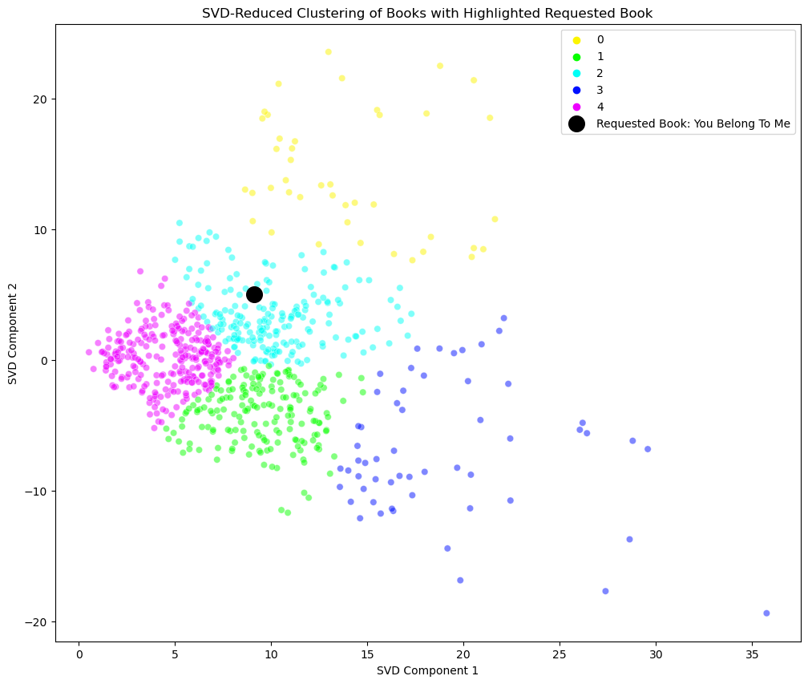
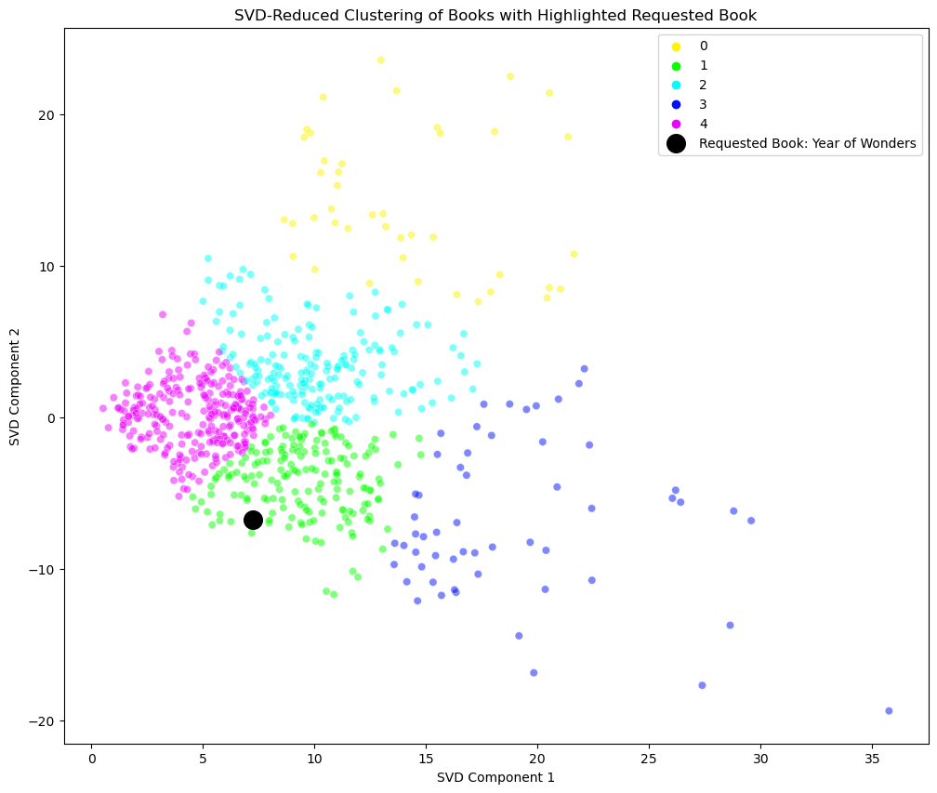
Clustering allocation :

Slide 17
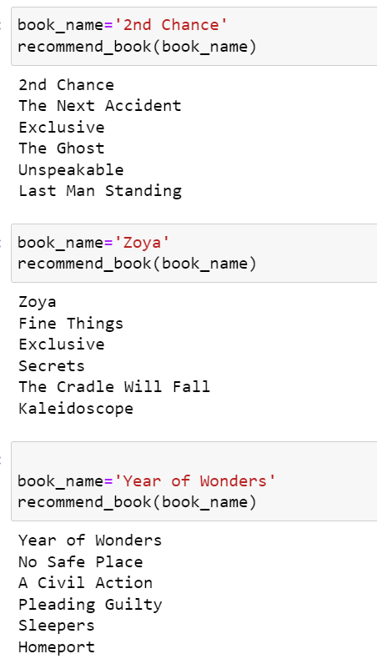
TEST THE RECOMMENDATION FUNCTION

Slide 18

THANK YOU

