Slide 1
Name: Abdul Hamid Naseem Shaikh Std: TY BSc CS Roll no: 90 Batch : E Project name: 2D Car Racing

Slide 2
Introduction
This 2D car racing game offers a nostalgic experience with simple, intuitive controls. Players move their vehicle left and right to avoid oncoming traffic and obstacles, aiming to cover more distance and score points. Crashing ends the game, displaying the player's score, creating an addictive challenge to beat previous high scores. It pays homage to the early era of racing games, when visual graphics were just beginning to shape the gaming industry

Slide 3
Objectives

Slide 4
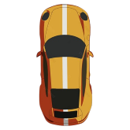

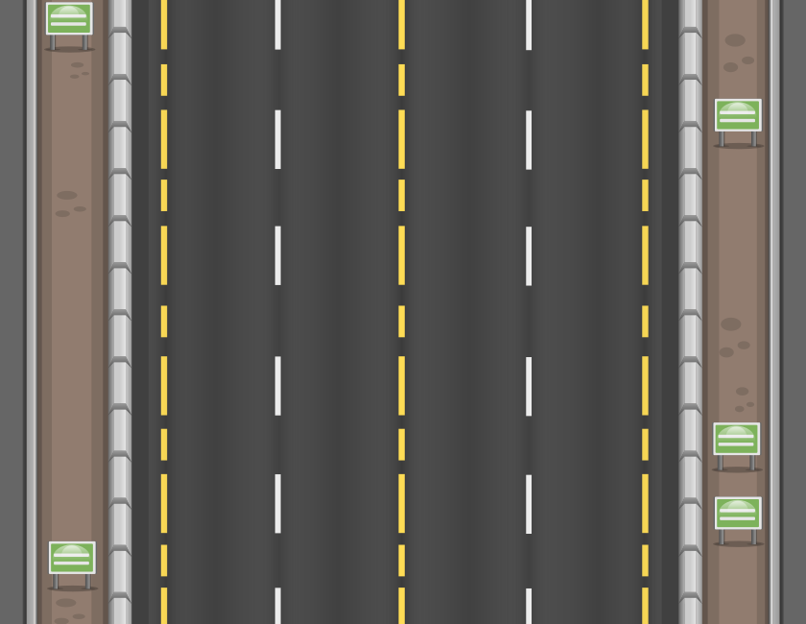
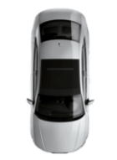
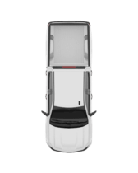
Components of the game
The Track
This is the players vehicle which moves as per the player with the help of the arrow keys
Each coin has 2 points. The player must collect coins to compete with the previous high score
The oncoming vehicles and traffic

Slide 5
Motive of this project
The primary objective of this project was to gain a deeper understanding of the underlying logic in game dynamics. Through the development of this game, I have acquired valuable knowledge about various aspects of game design, particularly in using the Python Pygame library. This project has provided me with significant insights into the field of game development, igniting a strong passion for it. As a result, I am now motivated to pursue game development as a potential career path for future growth and advancement.

