Slide 1
Source-level optimizations for high-level synthesis (HLS)
Kenshu Seto

Slide 2
Source-level code tuning for HLS
Usually required to maximize performance in HLS
Time consuming
Users of HLS are not expert in complex code tuning
Automatic source code optimization is important for wider acceptance of HLS
Shorten time-to-market further
Such code tunings include
Loop / memory / interface optimizations
I’ve been working on automating them
input …
output…
always @
begin
…
end
Mem
H/W
block
for ( …)
for ( … )
S1;
for( … )
for( … )
S2;
Source-level
compiler optimizations
for ( …)
for ( … )
S1;
S2;
HLS
Logic
Syn.
H/W
block
Mem
High-performance H/W

Slide 3
Various loop optimizations
Some loop optimizations are depicted below
Want to apply the best combination for optimal HLS results
for (i=1; i<=8; i++)
for (j=1; j<=8; j++)
x = x + Y[i]*Z[i];
for (t=1; t<=64; t++) {
i = …; j = …;
x = x + Y[i]*Z[i];
}
for (i=1; i<=N; i++)
Y[i] = Z[i];
for (j=1; j<=N; j++)
X[j] = Y[j];
for (i=1; i<=N; i++) {
Y[i] = Z[i];
X[j] = Y[j];
}
loop flattening
loop fusion
for (i=1; i<=N; i++) {
Y[i] = Z[i];
X[j] = Y[j];
}
for (i=1; i<=N; i++)
Y[i] = Z[i];
for (j=1; j<=N; j++)
X[j] = Y[j];
for (i=1; i<=N; i++)
for (j=0; j<=M; j++)
Z[i][j] = Z[i-1][j];
for (j=0; j<=M; j++)
for (i=1; i<=N; i++)
Z[i][j] = Z[i-1][j];
loop interchange
loop distribution
for (i=1; i>=N; i++)
Y[N-i] = Z[i];
for (j=0; j<=N; j++)
X[j] = Y[j];
for (i=N-1; i<=0; i--)
Y[i] = Z[N-i];
for (j=0; j<=N; j++)
X[j] = Y[j];
for (i=1; i<=N; i++) {
Y[i] = Z[i];
}
for (i=0; i<=N-1; i++) {
Y[i+1] = Z[i+1];
}
loop reversal
loop shifting

Slide 4
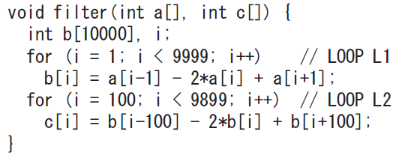
Combination of loop optimizations
Loop fusion is effective for a sequence of loops
Such as image processing / matrix computation programs
Challenge: What and which order should we apply loop opts.? ⇒Polyhedral approach is one of the most advanced ways
Loop shifting
Memory access optimization
Extend loop bounds
Loop fusion
Loop pipelining

Slide 5
Concept of polyhedral-based optimizations
Extract polyhedral model from input C program
C programs are limited to a subset (static control parts)
Extract data-dependency between statements
Perform loop optimizations on the polyhedral model
Multiple loop optimizations such as loop shift, interchange, fusion are applied at the same time in the model
Powerful to obtain the optimal loop structure
i
S1
S1
for ( i=0; i<4; i++)
for ( j=0; j<4; j++)
S1: A[ i ][ j ] = A[ i ][ j ]+１;
for ( i=0; i<4; i++)
for ( j=0; j<4; j++)
S2: x[ i ] = x[ i ]+A[ j ];
t1
S2
for (t1=0; t1<4; t1++)
for (t2=0; t2<5; t2++) {
if (t2 < 4)
A[t2,t1] = A[t2,t1]+1;
if (t2 > 0)
x[t1] = x[t1]+A[t2-1];
}
Polyhedral
model
Extraction
Clan
Polly
PPCG
Loop
Optimizations
Pluto
Code
Gen.
CLooG
ISL
j
t2
Input C code
i’
S2
Optimized loop
Optimal
Combination of
Loop opts.
j’
Polyhedral optimizations proposed for
SIMD, GPU, …
Polyhedral model

Slide 6
Static Control Parts (SCoP): Target of polyhedral optimization
for(i=0; i<8; i++)
for(j=0; j<8; j++){
for(k=0; k<8; ++k)
if (k==0) B[i][j]=0;
for(k=0; k<8; ++k)
B[i][j] = B[i][j] + A[i][k];
}
for(i=0; i<8; i++)
for(j=0; j<8; j++){
for (k=0; k<8; ++k)
if (k==0) D[i][j] = D[i][j];
for(k=0; k<8; ++k)
D[i][j] = D[i][j] + B[i][k];
}
Following items represented by the linear expression of loop indices
Loop bounds
for (j=0; j<i+1; j++)
if conditionals
if (i >= 2*j+k+1)
Array subscripts
B[i][j+2]
Extensions of SCoP were proposed

Slide 7
Polyhedral-based Loop Fusion with Outer Loop Shifting for High-level Synthesis
[3] Y. Kato and K. Seto, “Loop fusion with outer loop shifting for high-level synthesis,” IPSJ Trans. on SLDM, 2013

Slide 8
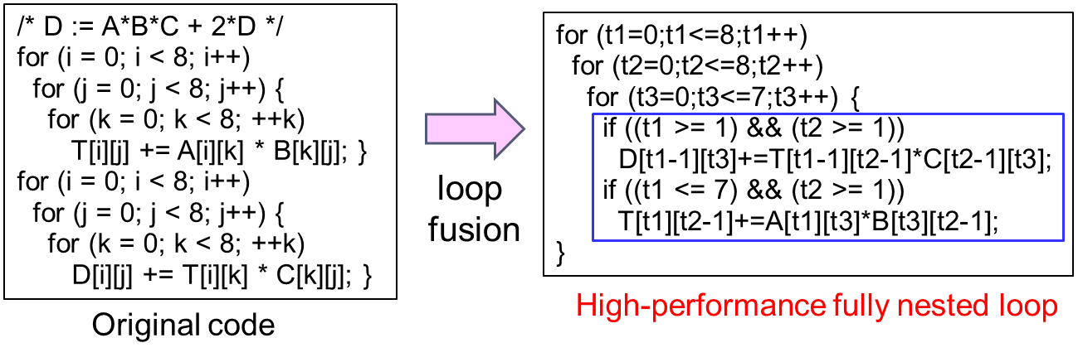
Advantage of loop fusion for accelerator synthesis
・ merges a sequence of loops into a single fully nested loops.
・ usually involves other loop transformations such as loop interchange, etc.
・ boosts performance by increasing parallelism before high-level synthesis .

Slide 9
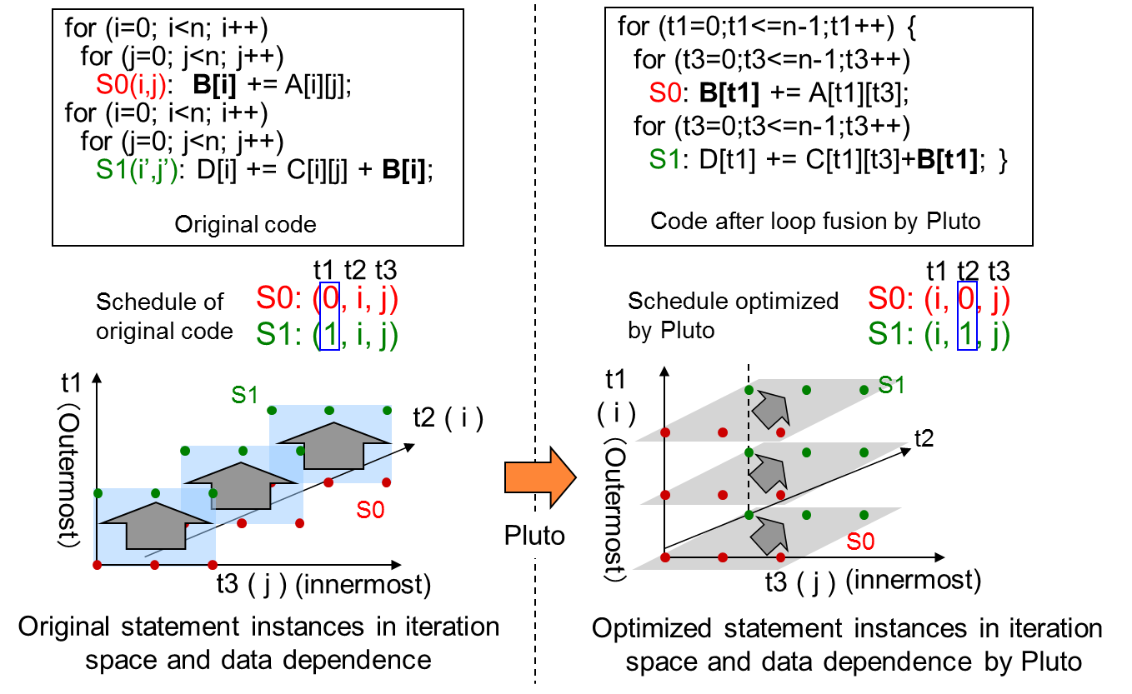
Previous polyhedral-based loop fusion : Pluto [1]
・ uses polyhedral model to represent loops and loop transformations.
・ reorders stmt. instances to enhance both outer parallelism and data locality.
・ emphasize on outer parallelism which causes negative impact on HLS.
[1] Bondhugula, et al. “"A Practical and Automatic Polyhedral Program Optimization System,” PLDI 2008

Slide 10
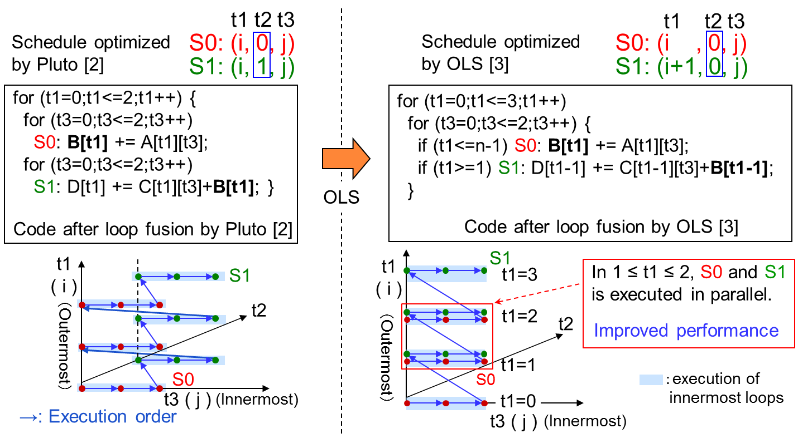
Loop fusion with Outer Loop Shifting (OLS) [2]
・ Outer Loop Shifting (OLS) modifies schedule produced by Pluto to facilitate loop fusion.
・ Constants in “scalar dimensions” are added to outer “loop dimension” when legal.
[3] Y. Kato and K. Seto, “Loop fusion with outer loop shifting for high-level synthesis,” IPSJ Trans. on SLDM, 2013

Slide 11
Experimental results

Slide 12
Scalar Replacement with polyhedral model for Hardware Synthesis
[3] K. Seto, “Scalar Replacement with polyhedral model for Hardware Synthesis,”
Submitted to IPSJ Trans. on SLDM

Slide 13
High-level synthesis and necessity of code tuning
High-level synthesis (HLS)
Vivado HLS(Xilinx), HLS compiler (Intel), Stratus (Cadence), CyberWorkBench (NEC)
Significantly reduces hardware design time
Time-consuming tuning is necessary for optimized RTL
Algorithm
C/C++
Manual code tuning
Optimized
C/C++
for HLS
High-level synthesis
Optimized RTL
Automatic code tuning is a
key to further enhancing HLS
Effective memory access optimizations
Memory partitioning
Partitions local memory to increase memory ports and bandwidth
Scalar replacement (window buffering)
Replaces repeated memory accesses into (shift) register accesses
Notes:
There are quite a few high-level synthesis tools out there.
They significantly reduce RTL coding time.
Unfortunately, time-consuming manual tuning is often necessary to obtain optimized RTL with HLS tools
and such tuning lowers the advantages of HLS tools.
Automating code tuning is a key to further enhancing the advantage of HLS tools
Memory access optimizations are one kind of such code tuning in HLS.
#Memory access optimizations includes memory partitioning and scalar replacement.
#Memory partitioning partitions a local memory into multiple banks in order to increase memory ports and hence memory bandwidth.
Scalar replacement, also called window buffering, replaces repeated memory accesses into register accesses.

Slide 14
Scalar replacement (SR)
In HLS, large arrays are mapped to local memories
int A[64][64];
SR replaces array accesses with scalar variable accesses
Completely eliminates local memories and memory access conflicts
Chip area reduction and latency reduction
for (i=0; i<n; i++) {
A[i+2] = in[i];
out[i] = A[i+2]+A[i+1]+A[i];
}
for (i=0; i<n; i++) {
a0 = in[i];
out[i] = a0+a1+a2;
a2 = a1;
a1 = a0;
}
Scalar
Replacement
(SR)
Shift
registers
Previous SR methods cannot handle real-life code including accesses with constant subscripts (ex. A[0], B[i][64]).
Byoungro So et al., “Increasing the applicability of Scalar replacement”, Compiler Construction, 2004
Notes:
Please note that in HLS, large arrays are mapped to local memories which have limited I/O ports, typically, at most two.
#Scalar replacement replaces array accesses with scalar variables, so that local memories and #memory access conflicts are completely eliminated. So, scalar replacement reduces both chip #area and latency.
I will explain scalar replacement with an example.
In the example on the left, the code has four array accesses to array A.
By applying scalar replacement to the code, all the array accesses are replaced with scalar variables, a0, a1, a2.
Scalar variables a0, a1, a2 are shifted in each iteration of the loop.
After scalar replacement, array A is completely removed.
Differently from local memories with limited number of I/O ports, scalar variables provides unlimited number of parallel accesses.
So, scalar replacement reduces both chip area and latency.
Unfortunately, previous scalar replacement methods cannot handle real-life code including accesses with constant subscripts.

Slide 15
Scalar replacement with polyhedral model
For subsets of C code, we completely analyze reuses between array accesses including constant subscripts.
We take conditions in If-statements into consideration in the analysis.
The analysis is based on polyhedral model.
We utilize the reuse information table in code generation.
 | Access type | Array access | Reuse distance | Scalar variable | Reuse condition
1 | Generator | A[y][x] | d1=0 | S0 | always
2 | … | … | … | … | …
3 | Reuse | A[0][x] | d3=10 | s10 | y==1
4 | Reuse | A[0][x] | d4=20 | s20 | y==2
5 | … | … | . | … | …
1 for(y=0; y<=9; y++){
2 for(x=0; x<=9; x++){
3 s0=……;
4 …
5 if (y>=1) {
6 if (y<=2) {
7 if (y==1) s10_s20=s10;
8 else if (y==2) s10_s20=s20;
9 t += s10_s20;
10 }
11 …
12 }
13 s30=s29;
…..
42 s1 = s0; } }
1 for(y=0; y<=9; y++){
2 for(x=0; x<=9; x++){
3 A[y][x] =……;
4 …
5 if (y>=1) {
6 if (y<=2) t+= A[0][x];
7 …
8 } } }
Proposed
scalar
replacement
Notes:
This is an example code including an array access with a constant subscript.
Previous scalar replacement method imposes a constraint on array accesses
That these accesses should re replaced with a single scalar variable.
Since array accesses with constant subscripts does not satisfy the constraint,
the previous scalar replacement method cannot handle array accesses with
constant subscripts.
The proposed method does not impose such constraint on array accesses,
so the array accesses with constant subscripts can be handled.
In addition, we analyze the conditions in if-statements for a subset of C code,
So that the number of multiplexers is minimized.

Slide 16
Preliminary experimental result
Applied the proposed method to a benchmark C code
4 image processing loop kernels were fused into a single loop.
src0
diff
tmp0
vfilter
tmp1
hfilter
tmp2
blend
out
src1
Synthesized optimized C code into gates with HLS
Local memories (tmp0, 1, 2) were completely eliminated.
Execution cycles and memory size were significantly reduced.
 | Execution cycles [cycles] | #gates [gates] | Memory size [bit] | Shift register size [bit]
Previous | 5.4M | 15k | 192M | 0
Propoed | 1.9M | 59k | 0 | 308K
Notes:
We applied the proposed scalar replacement method to a benchmark C code including constant array subscripts.
The code is a single doubly-nested loop which was made by fusing 4 image processing loop kernels.
The optimized code obtained by applying the proposed scalar replacement was synthesized with a commercial
high-level synthesis tool. After the optimization, large local memories corresponding to the local temporal arrays
tmp0, tmp1, and tmp2 were removed and smaller shift register were introduced instead.
Execution cycles were significantly reduced because memory access bottlenecks to the local memories
were eliminated. # of gates increased because of the enabled parallel execution.
Thank you for your attention.

Slide 17
Research project at DRG: Design space exploration and memory access optimization for Deep Neural Network (DNN)

Slide 18
Summary of the project
Problem
Many accelerator exists, but mostly based on fixed templates
DNN models are changing, so fixed template may be suboptimal
Need to provide a efficient framework which generates the best DNN accelerator for ever-changing DNN models
Solution
Given a DNN model, generate HLS and optimizer friendly C code
With the code, explore design space and generate the best one
Key techniques
Alladin-gem5
System level performance estimation of accelerators with caches/scratchpads
Explore DNN design space which have not been explored yet
Memory optimizations
Memory accesses are bottleneck in DNN but maybe not explored enough yet
Apply (extended) memory access optimizations to DNN

Slide 19
Plan
Get HLS-synthesizable C code for DNN
At first, simple one is better to proceed
Define a target system architecture
List up and survey of most relevant DNN accel. work
State-of-the-art system architectures, DSE
State-of-the-art optimizations
Research
System level Design Space Exploration of DNN C code with Aladdin-gem5
Further effective optimization of DNN C code for HLS
Ideas from Post-quantum cryptography (Hamid)
Ideas from memory access optimizations for HLS
Automate them if possible

Slide 20
Get HLS-synthesizable C code for DNN
Possible candidates
TensorFlow, Caffe
Strength: Complete framework used by many organizations
Weakness: may not be easy to rewrite the C++ into HLS-aware C
YOLO
Strength: Complex application (image detection) written in C
Weakness: may not be easy to rewrite the code into HLS-aware C
GUINESS
Strength: Generates HLS-friendly simple C code, easy to modify
Weakness: Simple network (good starting point), binarized only
Provides both learning and inference
Network with conv layer (binalized), pooling layer supported

