Slide 1
PYTHON BOT
A Chatbot for Teaching Python Programming.

Slide 2
CONTENTS
INTRODUCTION
FEATURES
WORKING
ARCHITECTURE
HOW TO USE
EXAMPLES
CONCEPTS COVERED
CONCLUSION

Slide 3
CHATBOT : A Brief Introduction
Definition : A chatbot is a computer program that uses artificial intelligence (AI) and natural language processing (NLP) to understand customer questions and automate responses to them, simulating human conversation.
Purpose : Chatbots can make it easy for users to find the information they need by responding to their questions and requests—through text input, audio input, or both—without the need for human intervention.

Slide 4
FEATURES OF CHATBOT
Explains the concepts of Python
Easy to understand
Simple Interface
Autonomous reasoning
Pre-trained

Slide 5
WORKING OF THE CHATBOT
It works like a basic Chatbot but all the prompts teach you Python step-by-step
For example entering a input as “String” allows you to learn more about strings
It starts with the basic introduction of Python.

Slide 6
WORKING OF CHATBOTS - II
Over time, chatbots have integrated more rules and natural language processing.
Today’s AI chatbots use natural language understanding (NLU) to discern the user’s need. Then they use advanced AI tools like machine learning and deep learning.
This improves their ability to predict user needs accurately and respond correctly over time.
The AI chatbot identifies the language, context, and intent, which then reacts accordingly.

Slide 7
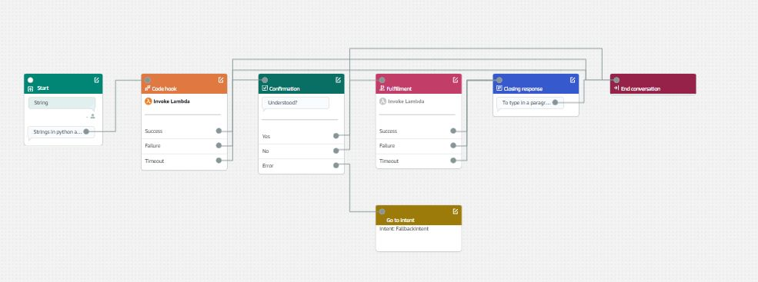
WORKING - ARCHITECTURE

Slide 8
HOW TO USE
Step 1 - You can begin conversing with the bot with a simple “Hi”
Step 2 - Further keywords to trigger the bot are provided by the bot itself.
Step 3 - Lambda function is invoked and the required explanation is provided.
Step 4 - The bot will ask whether you’ve understood the concept.
Step 5 - You can move on to the next concept or end the conversation.

Slide 9
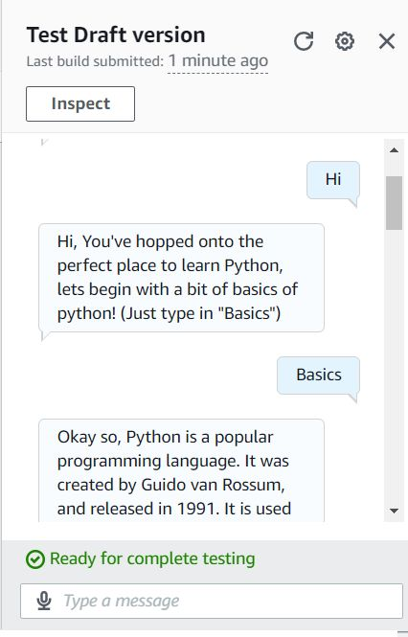
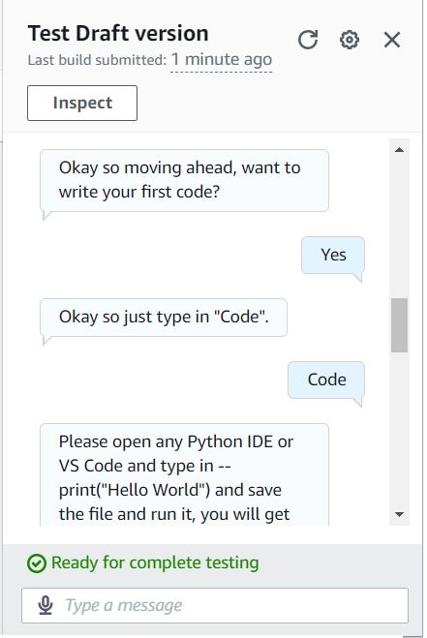
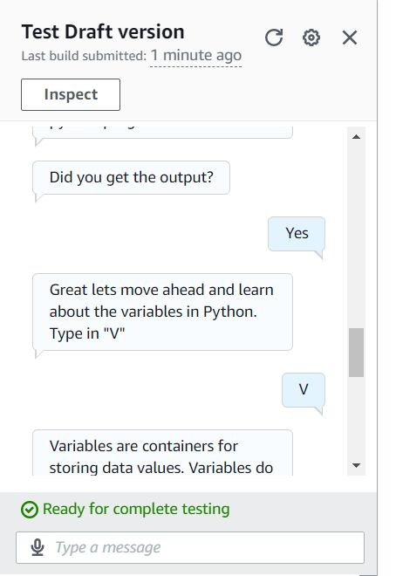
EXAMPLES

Slide 10
PROGRAMMING CONCEPTS COVERED
A brief history of Python
Basics of Python
Data Types
Variables
Strings

Slide 11
CONCLUSION
Over the duration of this project, we learned about the working, architecture, and various functions of chatbots.
We created a chatbot using AWS chatbot technology. Furthermore, we learned the lambda function in AWS chatbot.
We tried to provide the basic knowledge of Python programming language in an interactive environment.

