Slide 1
Computational Thinking
Week 5
Group Work Technologies
Hamilton Niculescu
Hamilton.Niculescu@ncirl.ie
(Please add “computational thinking” in the Subject line when emailing me)

Slide 2
Introduction
Group Work Technologies, or groupware, refer to tools and systems designed to better facilitate group work, both in-office, in-class, and remote
Advantages
Facilitate group work collaboration in a distributed environment
Trim the costs and time associated with facilitating group work
Allow for more intuitive and coordinated group problem solving across an entire team’s workflows

Slide 3
Cloud Computing
Cloud Computing is a set of computing services provided over the network whereby shared resources, software, and information are provided to computers and other devices on demand.
Can you think of any examples of cloud computing services?

Slide 4
Examples
Email
Gmail
Yahoo
Hotmail
Office Productivity Software
Microsoft Office 365
Google Docs
Storage
OneDrive
Google Drive
DropBox
Video Conferencing
Microsoft Teams
Zoom
Software Repository
GitHub
BitBucket
GitLab
Document Preparation
Overleaf
Reference Management
Zotero
Mendeley

Slide 5
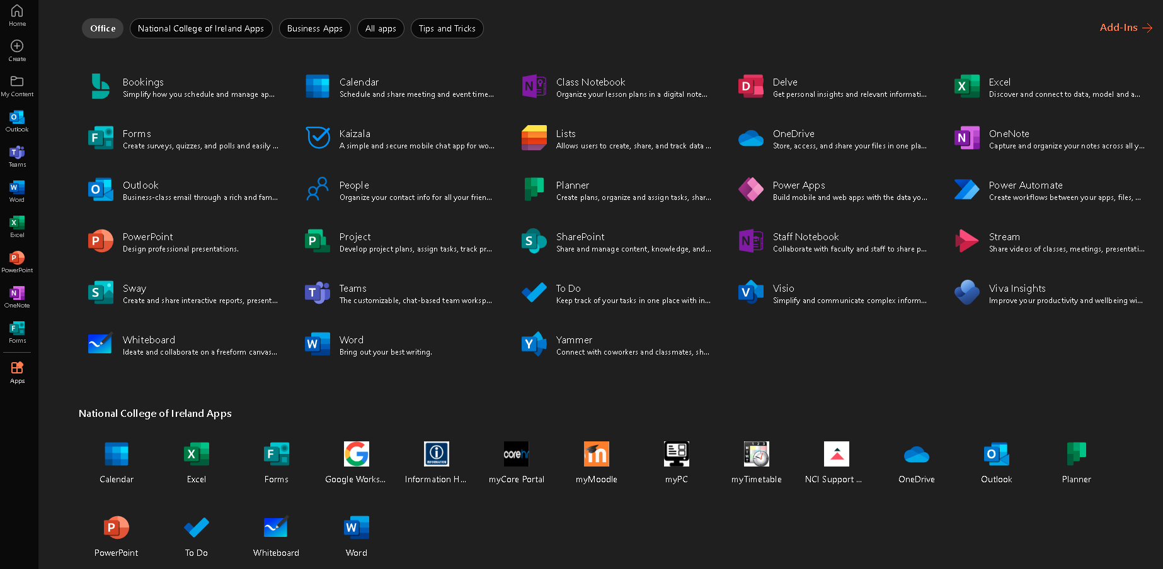
Microsoft Apps at NCI
Access NCI’s Microsoft Apps via https://www.office.com/apps?auth=2

Slide 6
Office Productivity Software
Microsoft Office 365

Slide 7
Microsoft Office 365
Microsoft Office 365 is a line of subscription services offered by Microsoft as part of the Microsoft Office product line.
The brand encompasses plans that allow use of the Microsoft Office software suite as well as cloud-based software as a service products
Word
Excel
PowerPoint
OneDrive
SharePoint, etc.

Slide 8
Open Microsoft Word

Slide 9
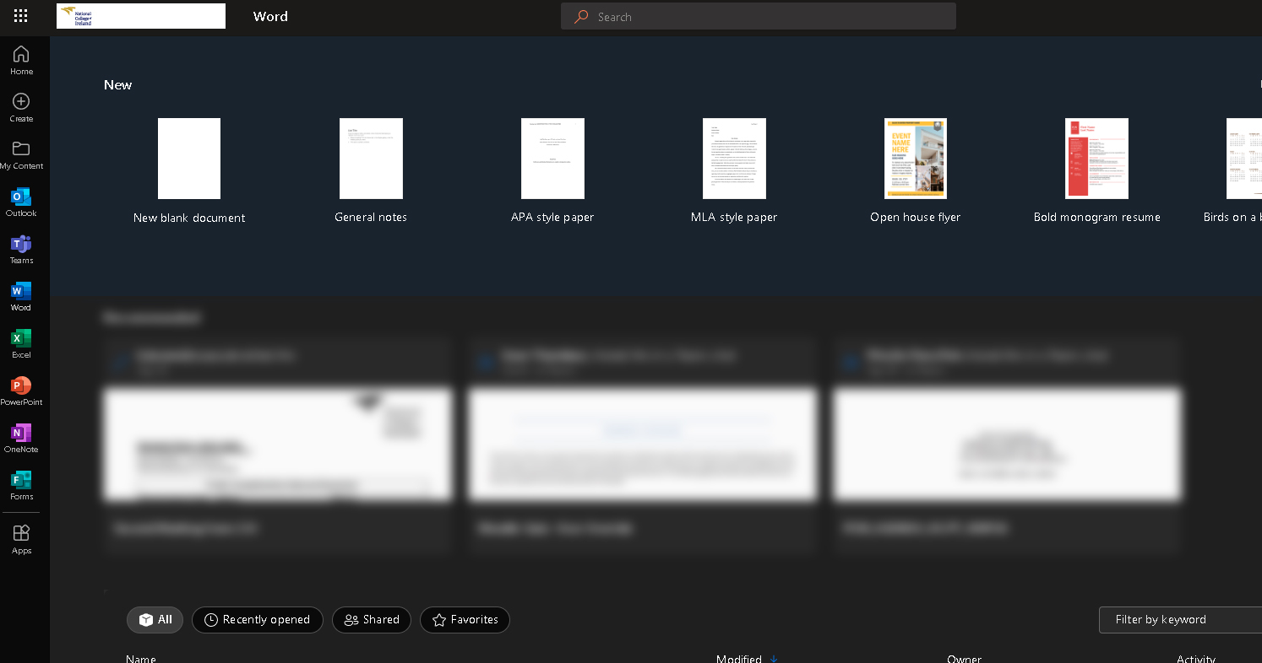
Create a new blank document

Slide 10
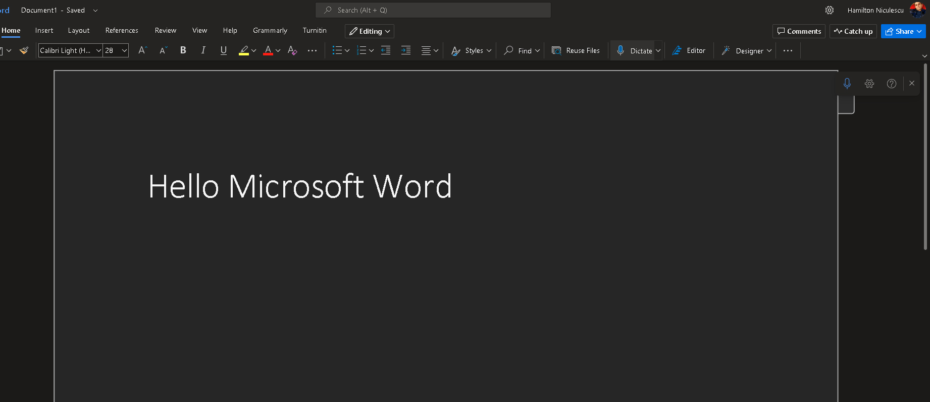
Share the document

Slide 11
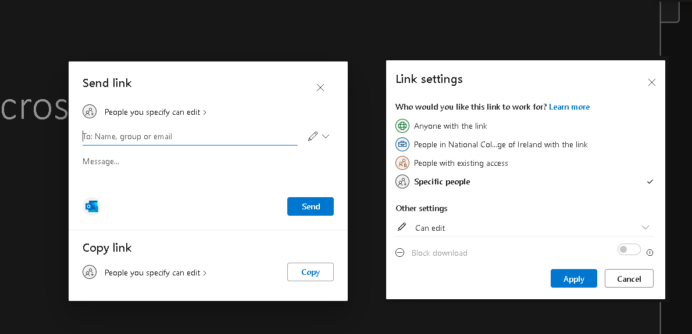
Share the document
Choose the people you want to share it with, and set privacy and read / write policies before sending the link

Slide 12
File Sharing
OneDrive

Slide 13
OneDrive
Microsoft OneDrive is a file hosting service and synchronization service
OneDrive allows users to store files and personal data in the cloud, share files, and sync files across Android, Windows Phone, and iOS mobile devices, Windows and macOS computers
OneDrive offers 5 GB of storage space free of charge

Slide 14
Open OneDrive

Slide 15
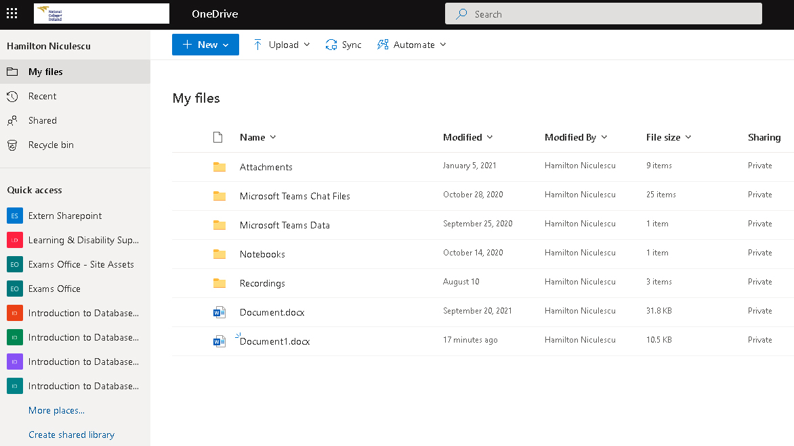
Navigate on OneDrive

Slide 16
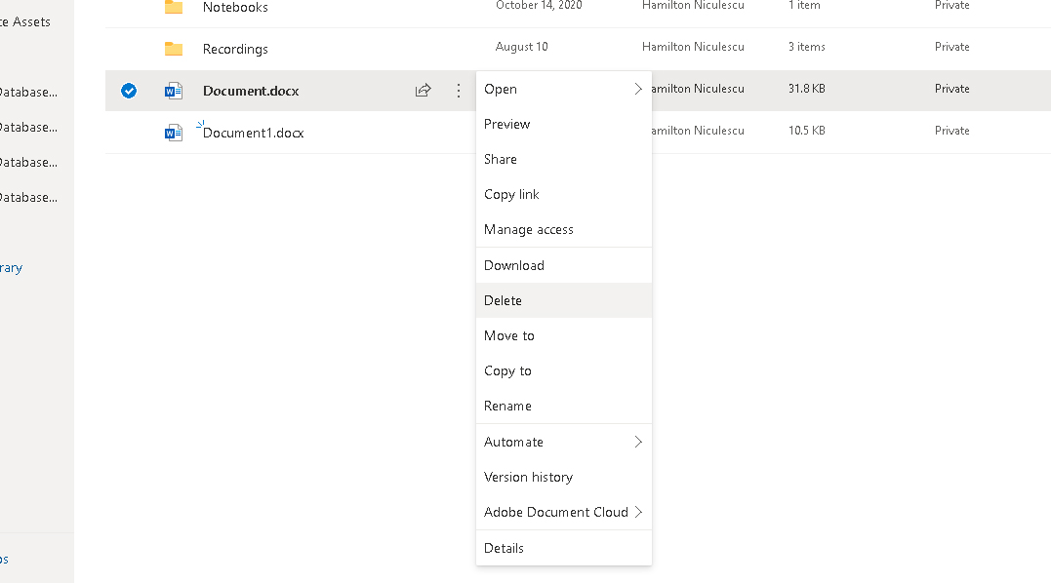
Manage files on OneDrive

Slide 17
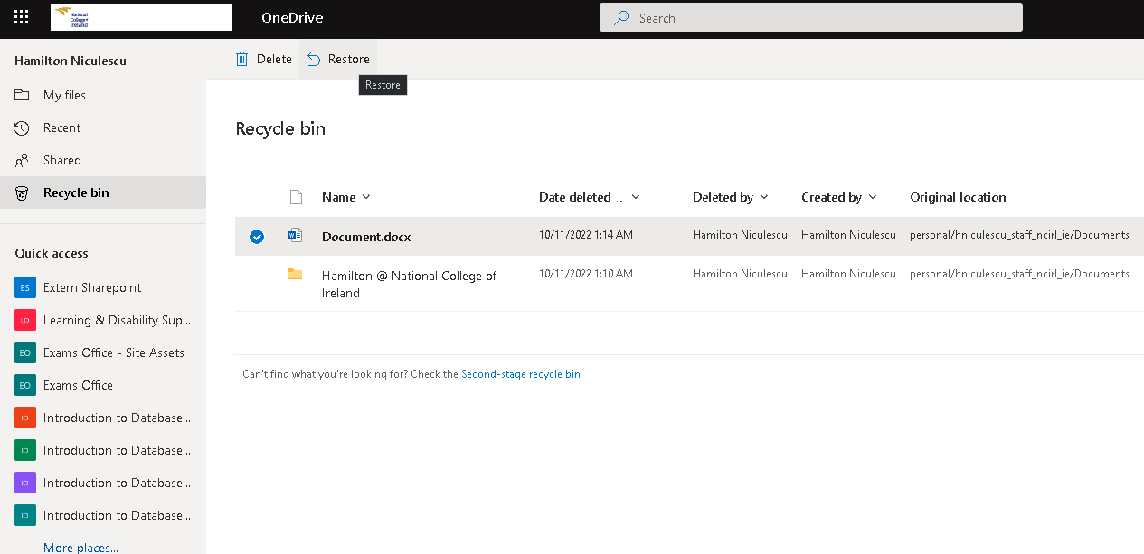
Restore Files on OneDrive

Slide 18
Video Conferencing
Microsoft Teams

Slide 19
Microsoft Teams
Teams allows communities, groups, or teams to join through a specific URL.
Channels within a Team – members can set up channels. Channels are topics of conversation that allow team members to communicate without the use of email or group SMS (texting). Users can reply to posts with text as well as images, GIFs and custom-made memes.
Chat allows users to send private messages to a specific user rather than a group of people.
Meeting can be scheduled or created ad-hoc and users visiting the channel will be able to see that a meeting is currently in progress.

Slide 20
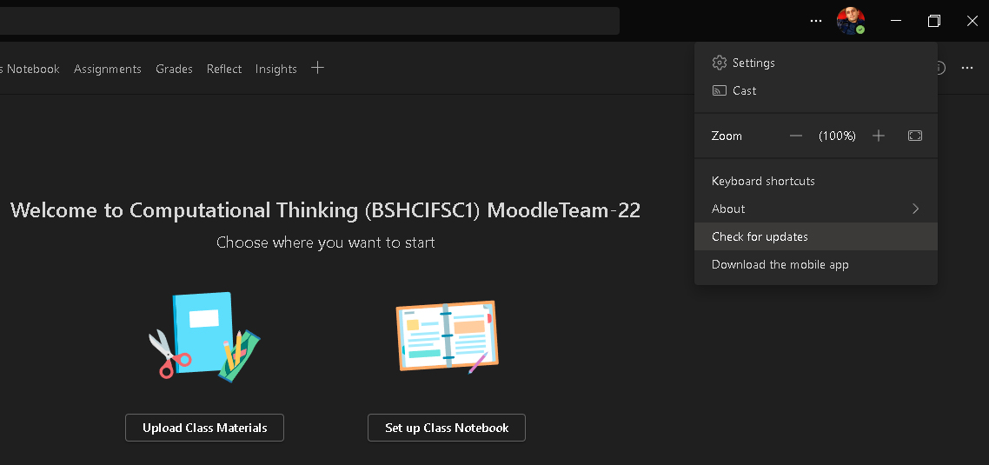
Check for updates regularly

Slide 21
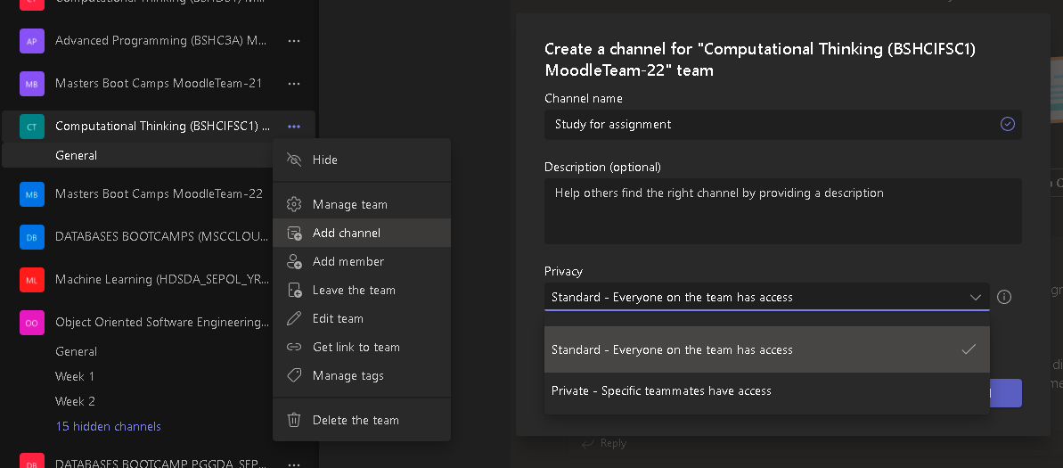
Add a Channel and set privacy

Slide 22
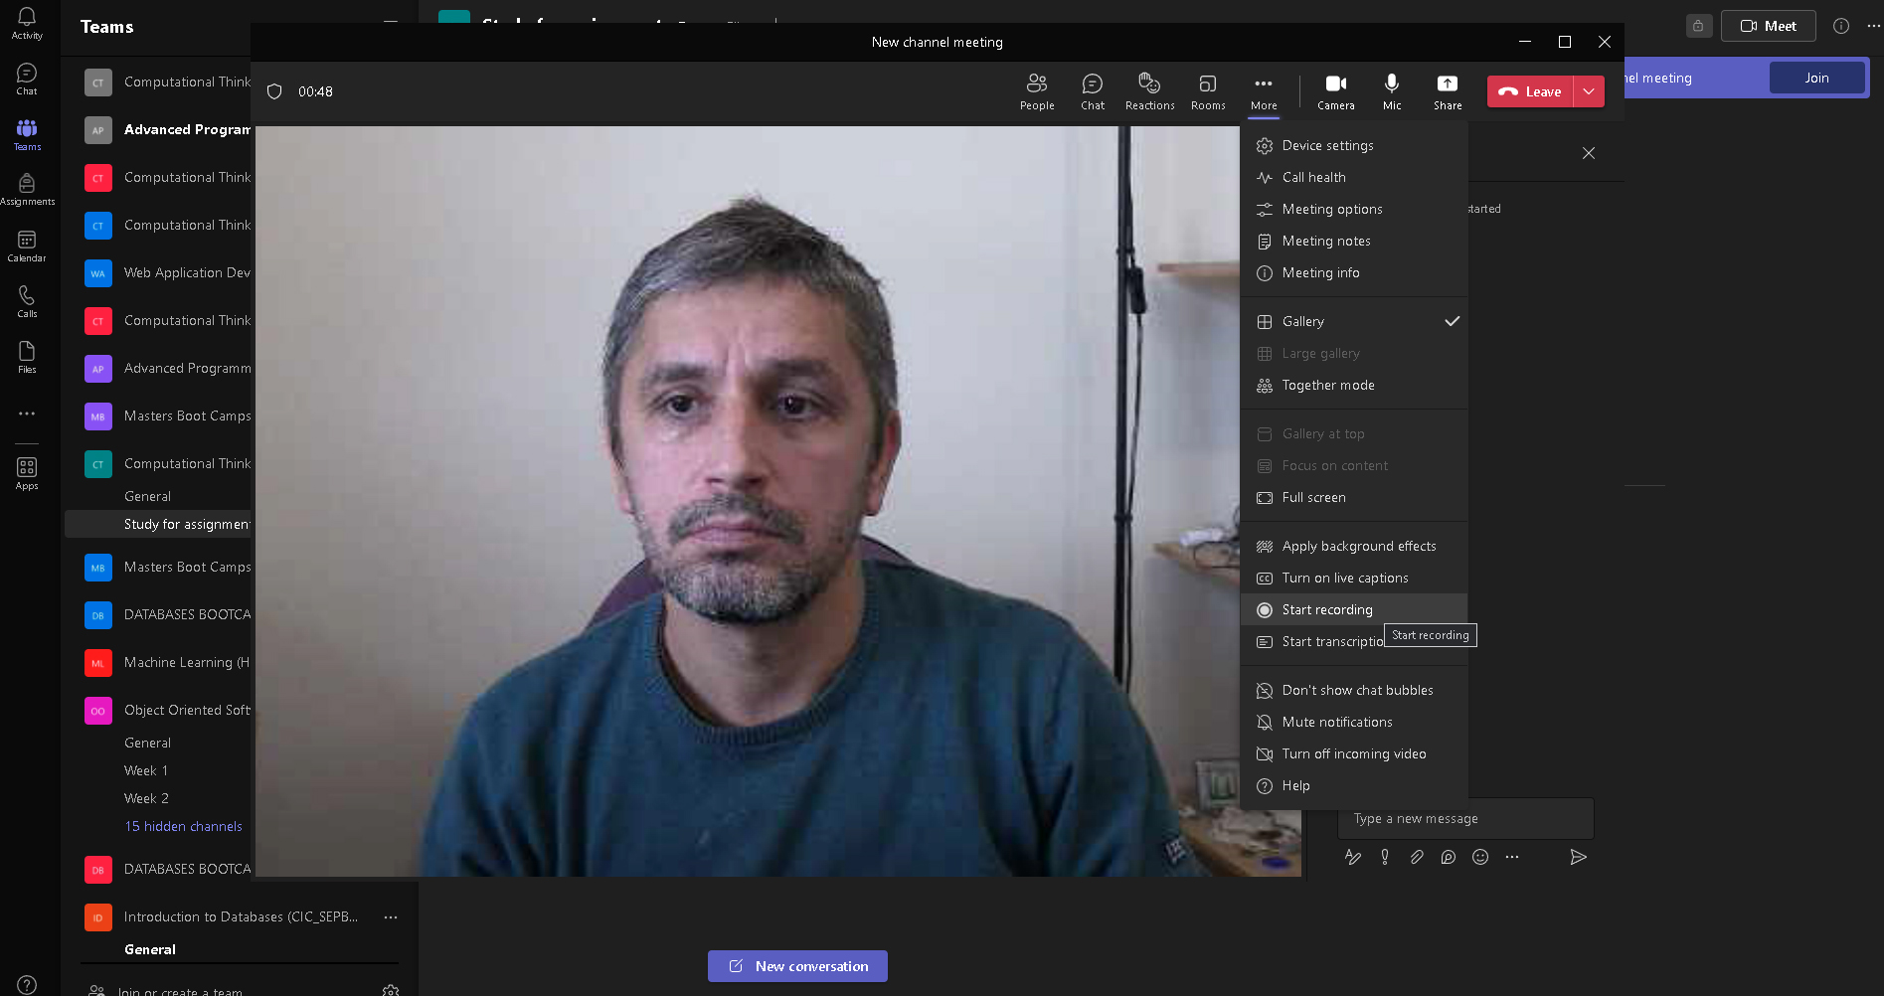
Meet through a Channel

Slide 23
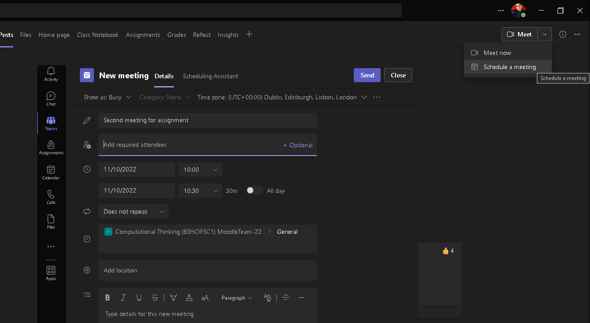
Schedule a Meeting

Slide 24
Software Repository
Version Control Systems

Slide 25
What is Version Control System?
A Version Control System (VCS) is a software utility that tracks and manages changes to a filesystem.
A VCS offers collaborative utilities to share and integrate these filesystem changes to other VCS users.
A VCS will track the addition, deletion, and updating actions applied to files and folders.

Slide 26
What is Version Control System?
A method to store and manage files centrally
Keeps a record of changes and tracks multiple versions. In particular, allows
old versions to be recovered
multiple versions to exist simultaneously
Keeps a record of who did what and when

Slide 27
When VCS is needed?
Complex documents, built up over time.
Multiple collaborators (or even just multiple machines)
Multiple versions that ‘co-evolve’
Reproducibility (‘snapshots’)

Slide 28
Why Version Control?
Makes working in a team easier!
Code without interference
Rollback to a previous version
Integrate code of multiple developers
Know who did what, when
Keep your code secure.

Slide 29
Network Architecture
Centralized
Distributed
Central Server
Remote Server
Source
Repo
Code
Files
Files
Files
PC 1
PC 2
PC 3
Repo
Repo
Repo

Slide 30
Software
Software | Website | Network Architecture | Conflict Resolution | Development Status
Git | https://git-scm.com/ | Distributed | Merge | Active
Mercurial | https://www.mercurial-scm.org/ | Distributed | Merge | Active
SVN | https://subversion.apache.org/ | Centralized | Merge or lock | Active
CVS | https://www.nongnu.org/cvs/ | Centralized | Merge | Maintenance only

Slide 31
Installing Git
Git website
https://git-scm.com
Free on-line book
https://git-scm.com/book
Git for Computer Scientists
https://eagain.net/articles/git-for-computer-scientists/

Slide 32
Version Control Hosting Services
GitHub (https://github.com)
BitBucket (https://bitbucket.org)
GitLab (https://gitlab.com)

Slide 33
Git Terminology
Repository (Repo)
A directory that contains your project work which is used to communicate with Git. Repositories can exist either locally on your computer or as a remote copy on another computer.
Commit
Git interprets its data as a set of snapshots of a mini file system.
SHA
An ID number for each commit, e.g., E2adf8ae3e2e4ed40add75cc44cf9d0a869afeb6
Working Directory
The files that you see in your computer's file system. When you open your project files up on a code editor, you are working with files in the Working Directory.

Slide 34
Git Terminology
Checkout
When the content in the repository has been copied to the Working Directory. It is possible to checkout many things from a repository: a file, a commit, a branch, etc.
Staging Area
You can think of the staging area as a prep table where Git will take the next commit. Files on the Staging Index are poised to be added to the repository.
Branch
A branch is when a new line of development is created that diverges from the main line of development. This alternative line of development can continue without altering the main line.

Slide 35
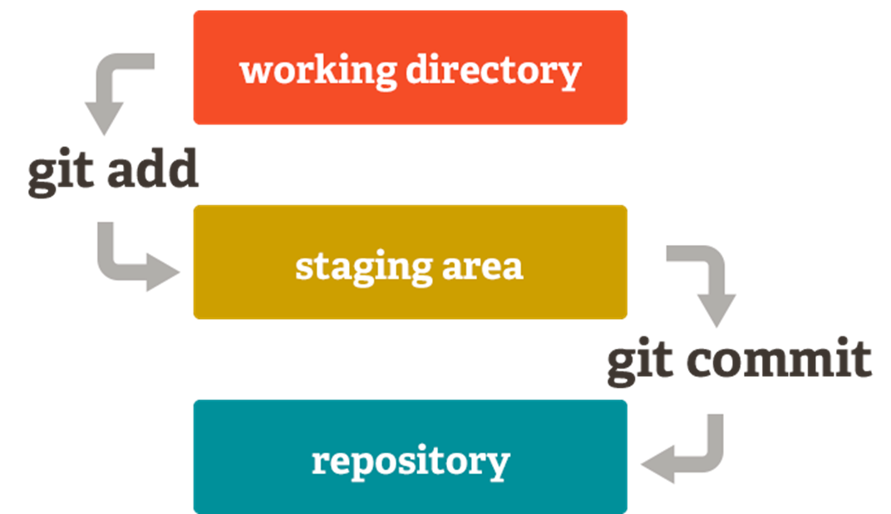
Basic Git model locally

Slide 36
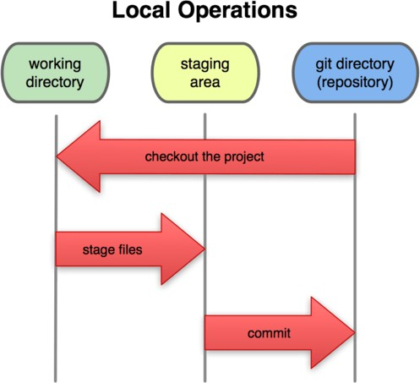
Basic Git model locally
Three trees of Git
Git Repository
last commit snapshot, next parent
Staging area
Proposed next commit snapshot
Working directory
Sandbox

Slide 37
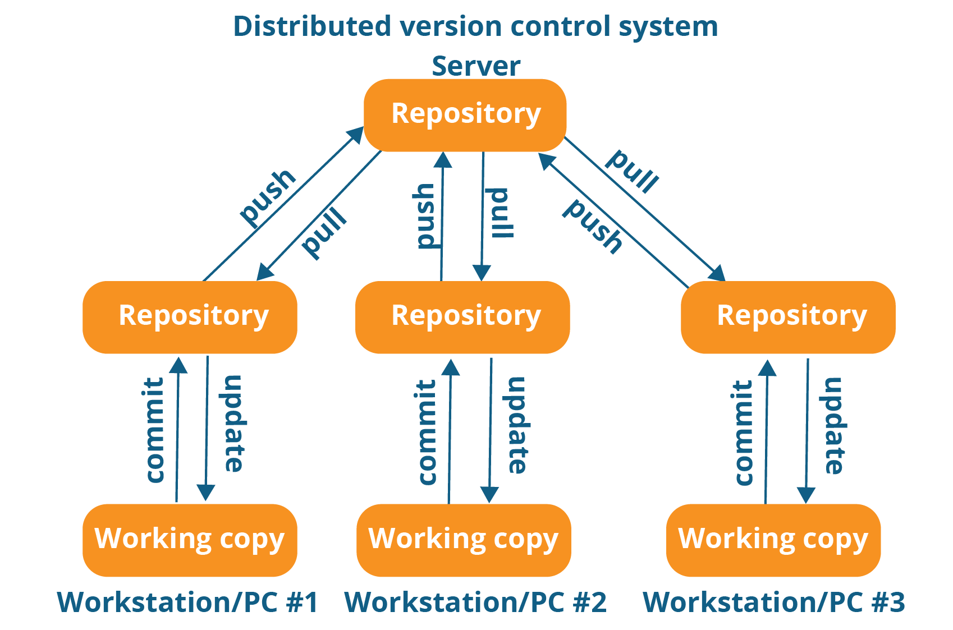
Basic Git model remotely

Slide 38
Task: Clone Repository
Install Git for Windows (https://git-scm.com/downloads)
Open Terminal (Mac) or Git Bash (Windows)
In the application window type “cd Desktop”
Run the command “git clone https://github.com/joshuacassidy/ClassExample.git”
Run the command “start .” on windows or “open .” on MAC to view the contents of the repository on your machine
Open the SampleFile.txt

Slide 39
Questions?

