Slide 1
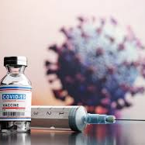
COVID-19 Vaccination Analysis
Hamim – Maxwell – Rukayat - Prav

Slide 2
Our project aim is to analyze the number of COVID-19 vaccinations administered worldwide and if there is a correlation with GDP per capita.
Project Outline:

Slide 3
How many people are partially vaccinated with only one dose of the COVID-19 vaccine per country in each continent?
Research Questions:
2. What is the number of fully vaccinated individuals who have received both doses of the COVID-19 vaccine per country in each continent?
3. Is there a correlation between the GDP per capita of a country and the percentage of its population that is partially vaccinated against COVID-19?

Slide 4

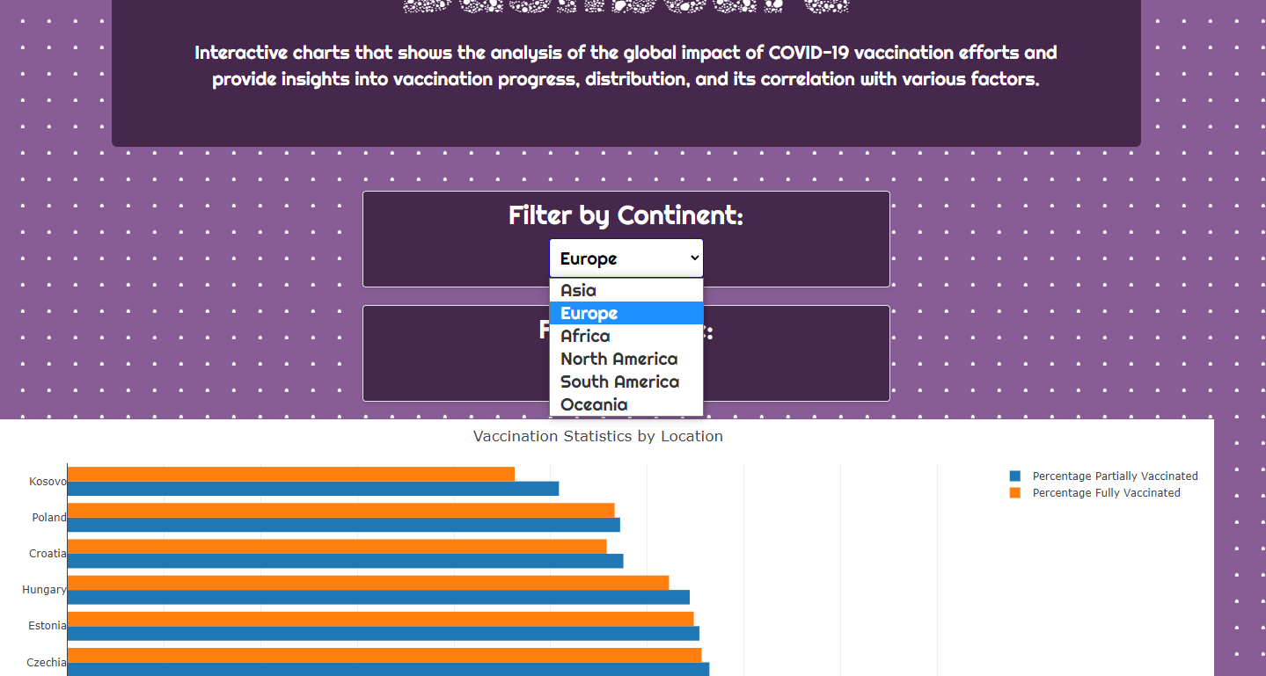
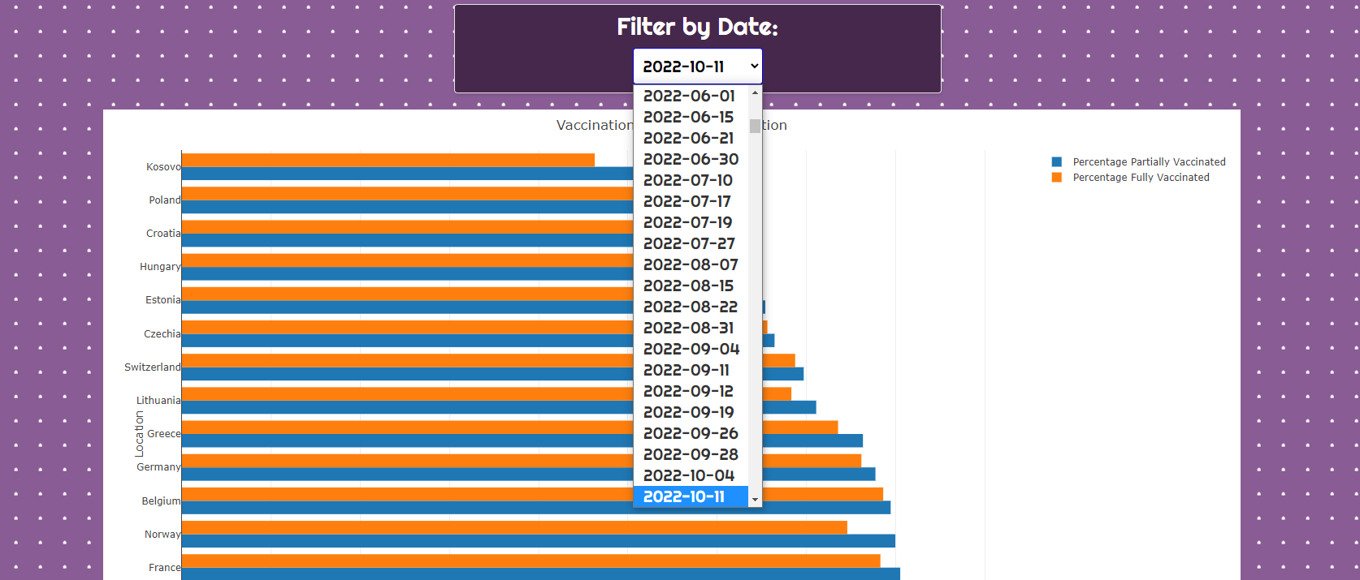

Slide 5
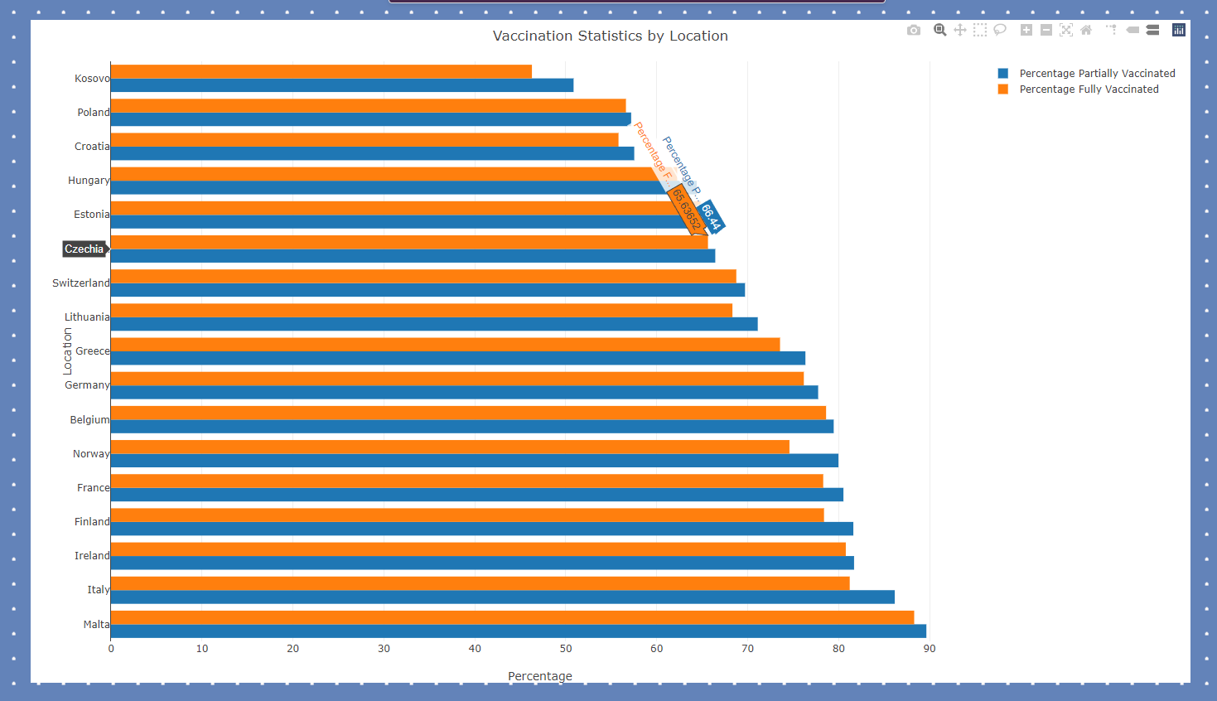
Vaccination numbers in Europe

Slide 6
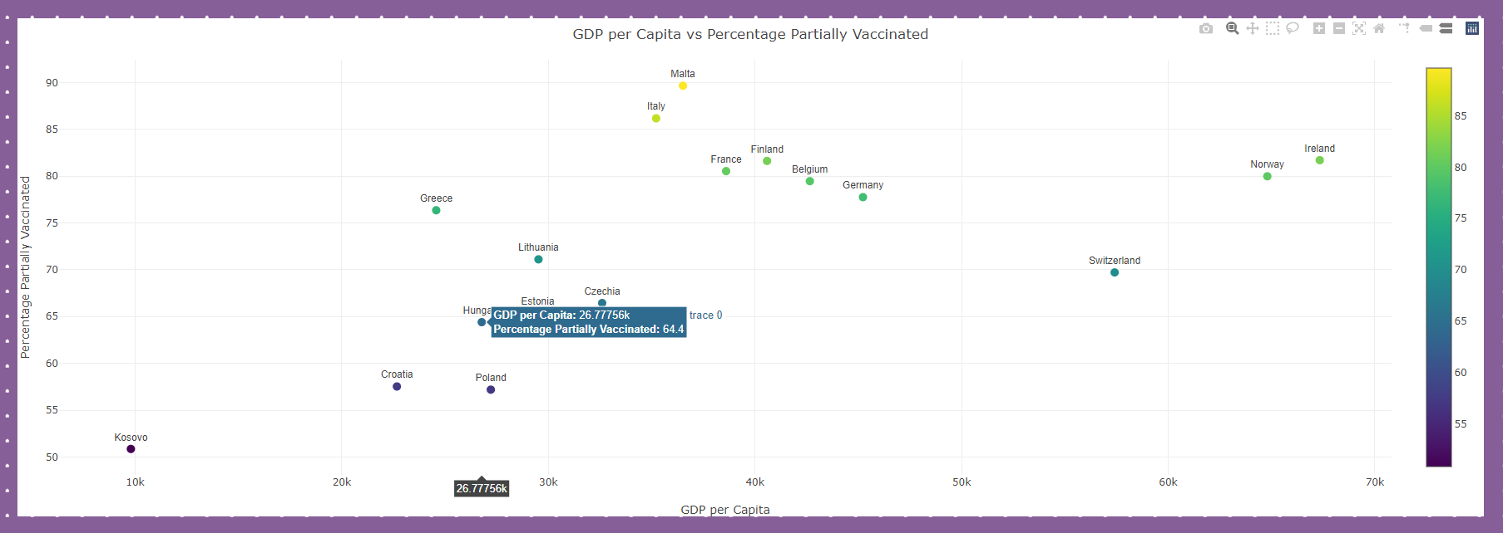
GDP per Capita vs Percentage Partially vaccinated - EUROPE

Slide 7
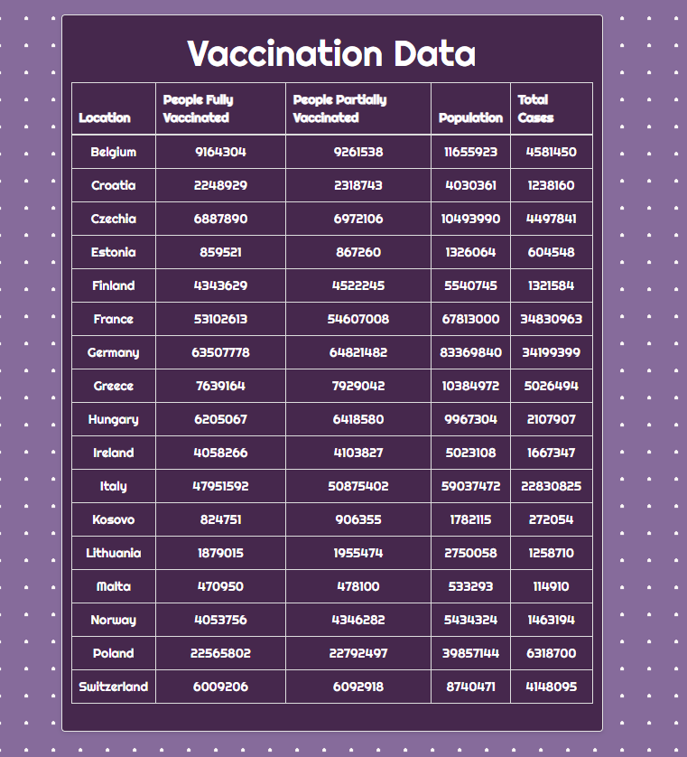
Full and Partial vaccines per country in Europe.

Slide 8
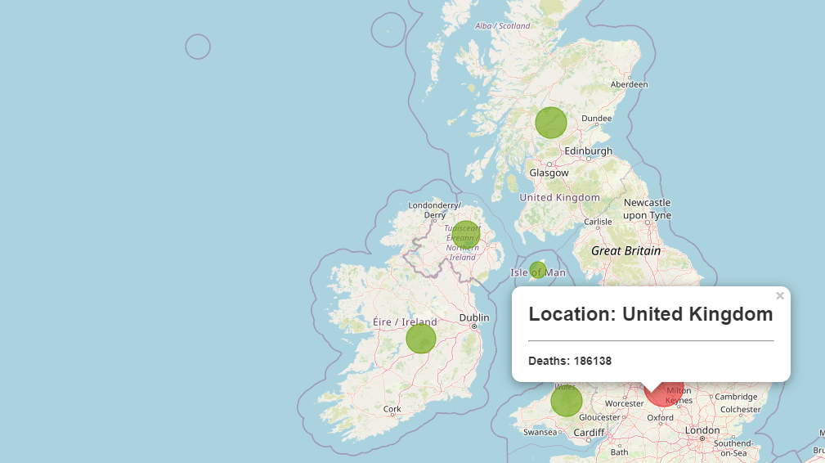
Covid Deaths Worldwide

Slide 9
CONCLUSION
In conclusion, the vaccination progress varies across different continents.
Higher GDP per capita generally indicates better healthcare resources, which can contribute to higher vaccination rates.
It would take further analysis to research in to why some countries achieved a higher level of vaccination coverage than others.

Slide 10
QUESTIONS?

