Slide 1
Logistic Regression and Neural Network

Slide 2

Introduction
Name: Munia Shaheen
ID : 20101050
Name: Akib Zabed Ifti
ID : 23341129
Name: Fateha Jannat Printia
ID : 20301357
Name: Rakibul Hassan Hredoy
ID : 20101357
Name: Hamim Ibne Nasim
ID : 20301443
Name: Rubaba Rashid
ID : 20301267

Slide 3
Problem Description
Dataset
Distribution
Problems of unbalanced data
Tackling unbalance data
Logistic Regression
Neural Network

Slide 4
Dataset
Data size: 2150 images(Train) 250 images(Test)
Image Shape: 64, 64, 3
Separate batch for train, test, and validation: Yes, there are separate batches for train and test. The validation set needs to be created manually.
5 Different classes: scoreboard, rocker, schoolbus, sombrero,remote

Slide 5
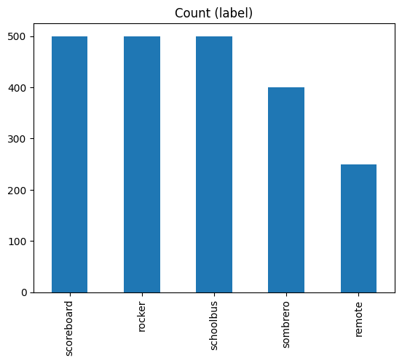
Distribution(Train)
Unbalanced
scoreboard 500
rocker 500
schoolbus 500
sombrero 400
remote 250

Slide 6
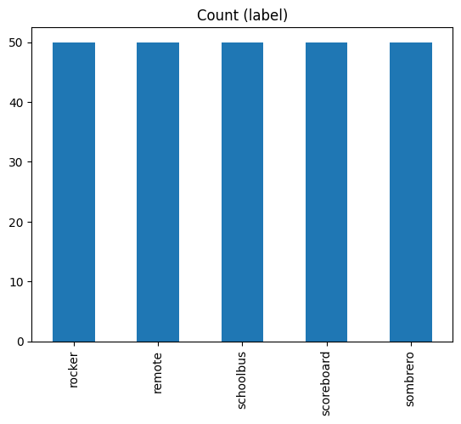
Distribution(test)
balanced
scoreboard 50
rocker 50
schoolbus 50
sombrero 50
remote 50

Slide 7
Unbalanced Dataset
Techniques to tackle this issue:
Undersampling
Hybrid Methods
Oversampling
Synthetic Data Generation
Weighted Loss Function
Transfer Learning
Anomaly Detection
Cluster-Based Methods
Unbalanced Dataset Issues:
Bias towards the Majority Class
The minority class may have low recall when dealing with classification issues because the model cannot detect minority class occurrences.

Slide 8
We will use-
Undersampling
Reducing the number of cases in the majority class by deleting examples at random
Why?
Computationally Efficient
Potential Overfitting Reduction

Slide 9
Logistic Regression
Sensitivity
0.46
Accuracy
46.40%
PPV
0.46
NPV
0.87
Specificity
0.86
F1 Score
0.46

Slide 10
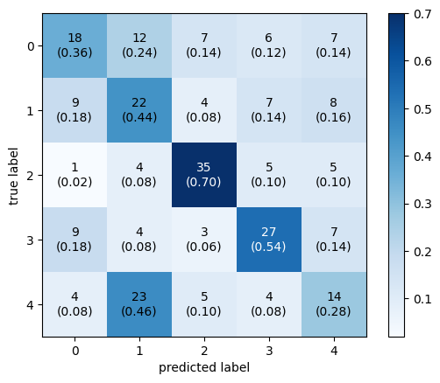
COnfusion Matrix

Slide 11
Neural network
Sensitivity
0.42
Accuracy
41.6%
PPV
0.42
NPV
0.86
Specificity
0.86
F1 Score
0.40

Slide 12
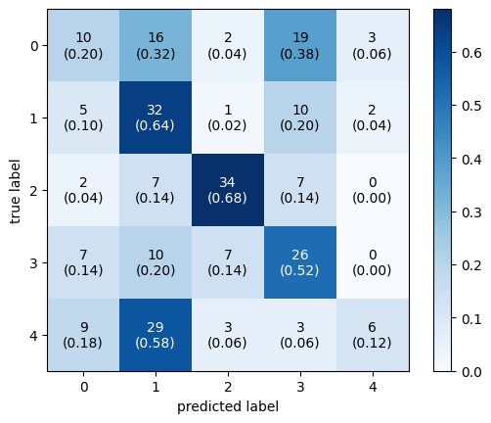
COnfusion Matrix

Slide 13
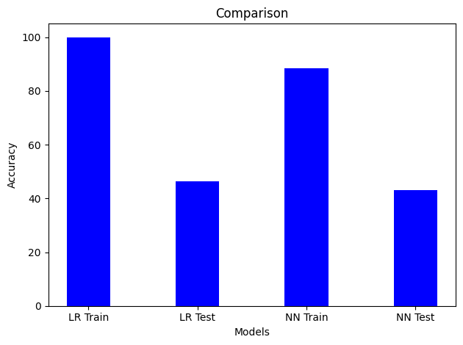
COmparison

Slide 14
THank you

