Slide 1
Modeling Space.
A precise definition of spatial characteristics requires an understanding of the notion of space.
We assume the space to be planar and bounded by an external perimeter.
The external perimeter can be characterized by a polygon whose vertices have a location in 2D space.
Because most spaces have some geometry and structure, we extend the definition by allowing the addition of edges circumscribed by the external perimeter.
Each edge may have attributes that will play a role in reasoning about spatial characteristics.
The edges may or may not be connected to the external perimeter and may form shapes that are cyclic (polygon) or acyclic (open).

Slide 2
Formalizing space.
Formally, the space is characterized as a planar graph G with vertices V and edges E such that
The outermost edges of G form a cycle which is defined as the external perimeter of G, we call it B= ep(G)
every vertex of G has a location inside B
every vertex must be a part of a nonzero lengthened edge (In other words, every vertex must have one adjacent edge)
each vertex is mapped to a location in the 2D plane: lambda : V -> L
The dynamics of the space are captured by allowing edges to have attributes (A) whose values may change over time
alpha : E -> PowerSet(A) — the attributes of a vertex
nu : A x E -> D — current attribute value nu(a,(x,y)) = v

Slide 3
Reasoning about Space.
Specific areas are important when talking about a characteristic. We define an area,
as a polygon circumscribed by a perimeter. Most often the vertices and edges associated with an area belong to the underlying space.
However, we sometimes find it useful to talk about areas that include vertices, and edges that are not part of the underlying geometry of the space and does nor intersect with the edges of the underlying space.
Now we can define an area as being
a polygon whose all vertices are in V, all edges are in E. (e.g., P1, P2)
a polygon whose all vertices are in V. Includes edges that are not in E. (e.g., S1, S4 or S2S3 combined)
a polygon that includes vertices that are not in V, but have locations within B. Includes edges that are not in E. (e.g., S5, S6, E1, E2)

Slide 6









$$S_{1}$$
$$S_{2}$$
$$S_{5}$$
$$S_{8}$$
$$S_{9}$$
$$S_{3}$$
$$S_{4}$$
$$S_{6}$$
$$S_{7}$$

Slide 7


$$A_{2}$$
$$A_{1}$$

Slide 8






$$A_{7}$$
$$A_{8}$$
$$A_{3}$$
$$A_{6}$$
$$A_{4}$$
$$A_{5}$$

Slide 9



$$A_{9}$$
$$A_{11}$$
$$A_{10}$$

Slide 11
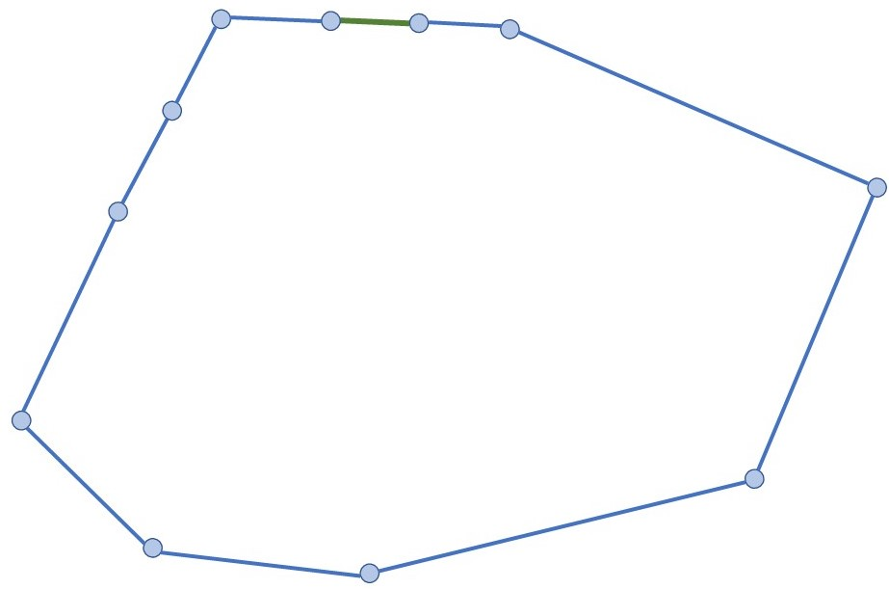
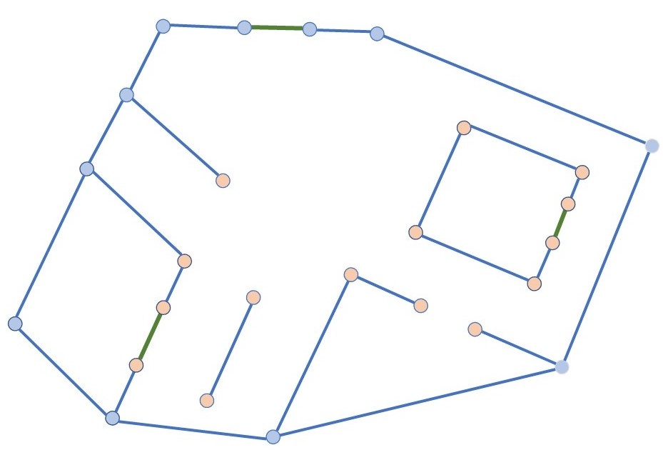
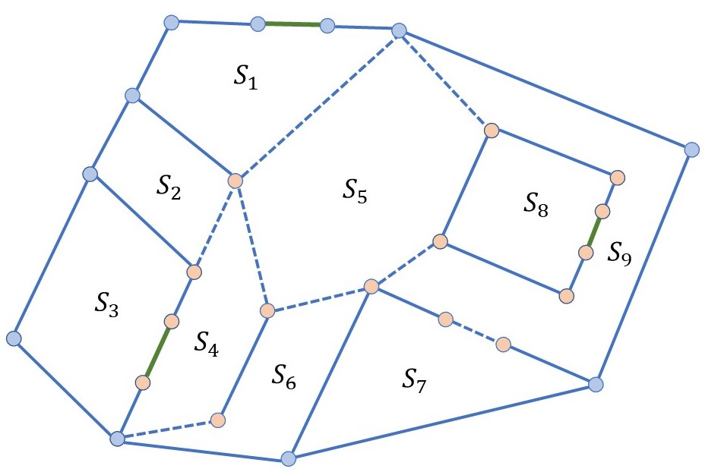
(a)
(b)
(c)

Slide 12
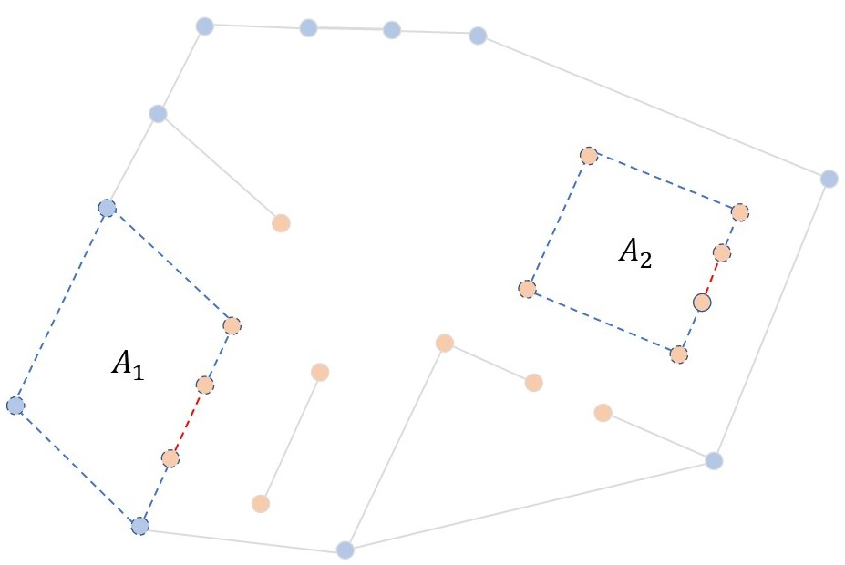
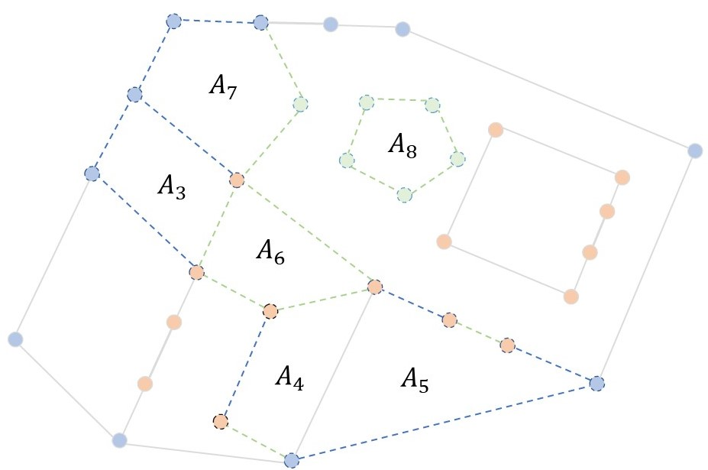
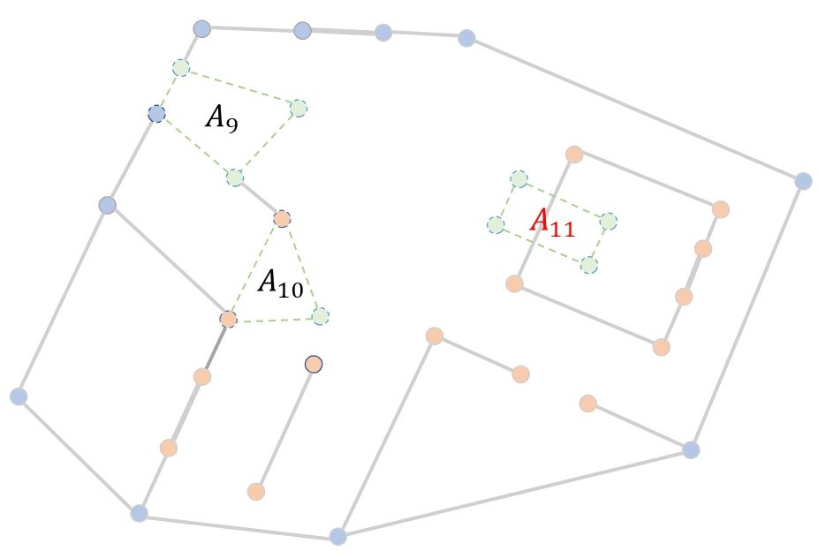
(a)
(b)
(c)
(d)

Slide 13
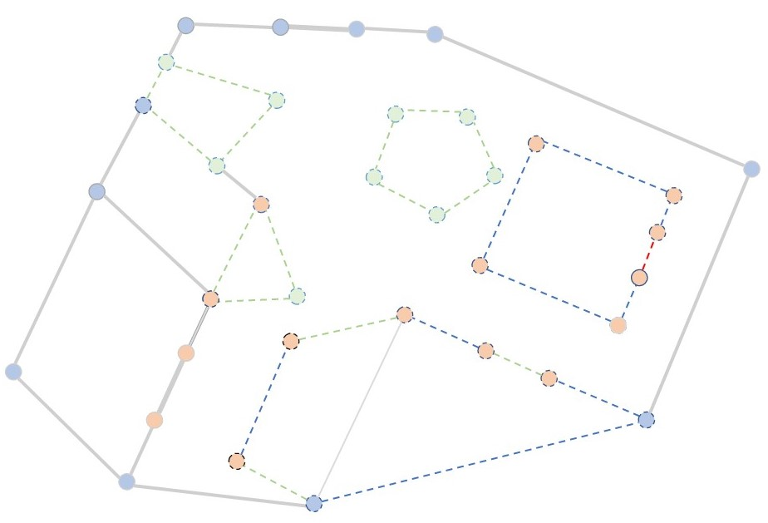
(a)
(b)

Slide 14
(a)
(b)

Slide 15


Slide 16
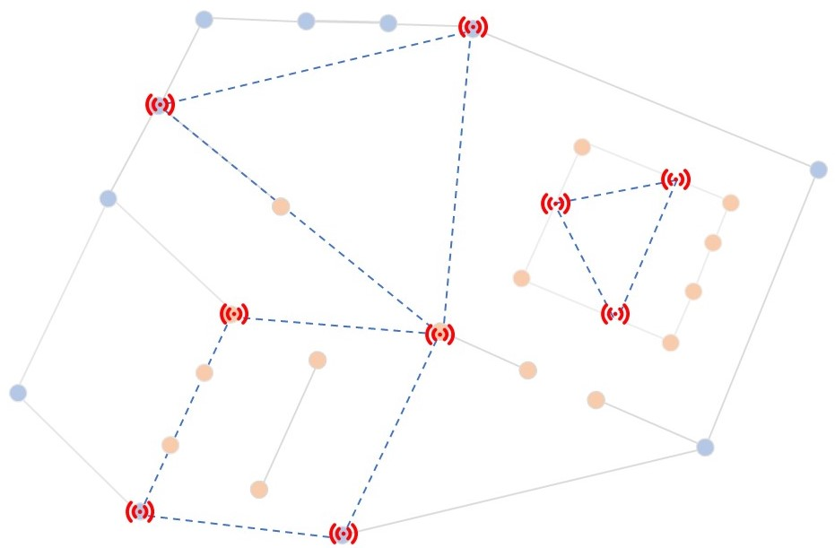
(a)
(b)

