Slide 1
LinkUp
Team: Six Warriors
Programming Hero
20-9-2024
1

Slide 2
Presented by:
Shah Arefin Ahmed (Team Leader)
Kazi Md Abul Hasib
Sheikh Safekuzzaman
Md. Hamim
Md: Shihab Shamim
Md : Shaharul Islam
Supervised By
Saurav Chandra
Jr. Project Executive
Programming Hero
2

Slide 3


Outline
1
Introduction
2
Objectives
3
Features
4
New Tools & Techniques
5
Project Implementation
Conclusion
6
LinkUp
3

Slide 4

Introduction
Linkup offers easy calendar sync, meeting link generation, and reminders.
Designed for individuals, professionals, and businesses, Linkup makes the booking and scheduling process more efficient and hassle-free.
LinkUp
4

Slide 5

Objectives
Create a user-friendly interface for easy scheduling and management.Enhance Problem-Solving Skills.
Improve Collaboration and Teamwork.
Gain Project Management Skills.
Promote Innovative Thinking.
5

Slide 6
Features:
1 Meeting Scheduling:
Details: Users can schedule and manage appointments, including one-on-one meetings, group sessions, and
recurring events. The scheduling feature will be customizable based on user availability.
2 Notifications:
Details: The system will automatically send notifications via email and SMS to remind users of upcoming
meetings, meeting confirmations, cancellations, or any changes.
3 Profile Management:
Details: Users can create and update their profiles, specifying availability, preferences, and
personal details for a more personalised experience.
4 Meeting History:
Details: Users will have access to a log of past meetings, allowing them to review and trac
their meeting history for future reference.
6

Slide 7
Features:
5 Calendar Integration:
Details: LinkUp will integrate with popular calendar services like Google Calendar and Outlook,
automatically syncing and updating meeting schedules.
6 Reminder Notifications:
Details: Automated reminders will be sent to both users and attendees before a scheduled meeting,
reducing the risk of missed appointments.
7 Time Zone Management:
Details: The platform will automatically adjust meeting times based on the users' time zones, preventing
confusion and scheduling conflicts.
8 Booking Modification:
Details: Users will be able to modify or reschedule their appointments, with real-time updates reflecting in
their calendars and notifications.
7

Slide 8











New Tools & Technologies
Frontend
Database
Backend
Tools
8

Slide 9
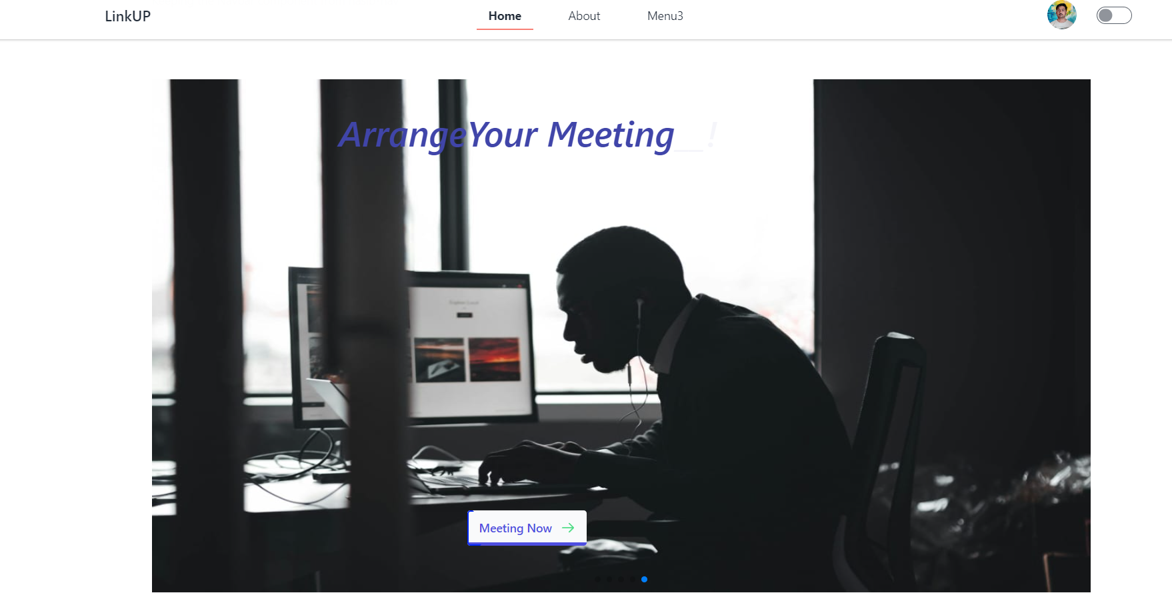
Project Implementation
9

Slide 10
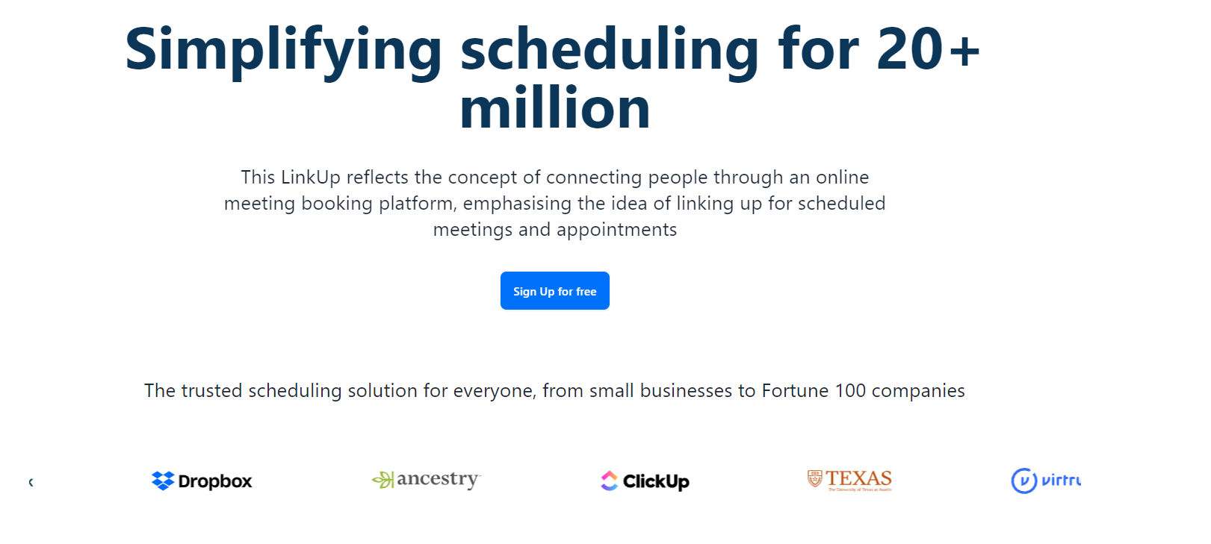
Project Implementation
10

Slide 11
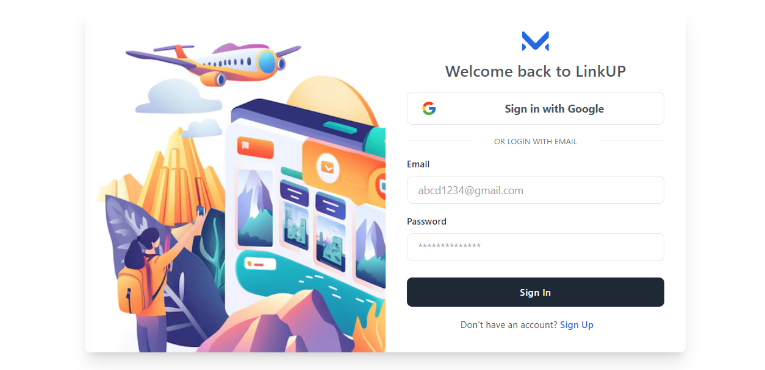
Project Implementation
11

Slide 12
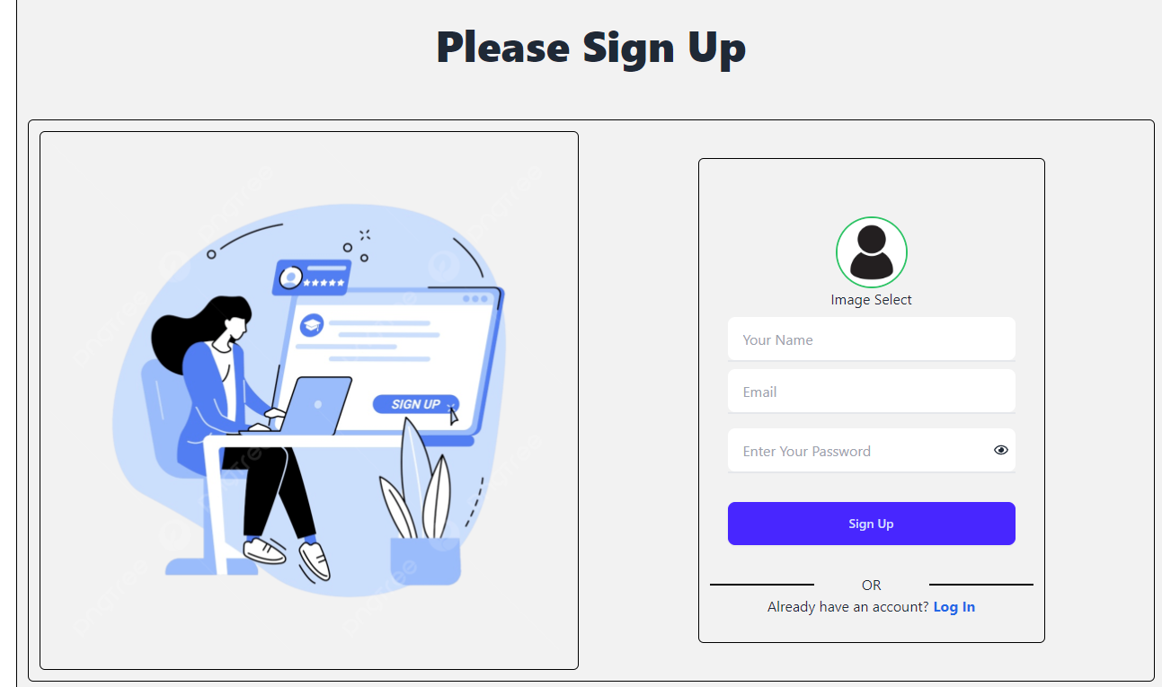
Project Implementation
12

Slide 13

Conclusion
Linkup provides an intuitive platform for scheduling and managing meetings efficiently across different sectors
The platform seamlessly integrates with popular calendar systems, ensuring synchronized and accessible meetings across devices.
Linkup enhances time management and boosts productivity in corporate, healthcare, and education.
13
LinkUp

Slide 14








Question
14

