Slide 1

Business proposal
Data-Driven Decisions:
Exploring consumer-focused Profit-maximizing strategies
Fadhil, Hamim, Shazif, Myri, Kamilla

Slide 2

What's our data?
Weekly
Sales
💸
45
Store 🏪
CPI 📈
05-02-2010
to
26-10-2012
📅
Holiday Flag 🎄
Fuel Price ⛽
Unemployment 💼
Temperature 🌡️

Slide 3

As data analysts, how do we utilize the information at our disposal?
Goal: To transform Walmart by leveraging data to optimize business operations.
Through data analysis, we sift through vast amounts of information to focus on key insights that directly drive strategic decisions and outcomes.
Key focus:
> Economic Trends for Sales Predictions 💼
> Holiday Sales 🎄 vs. Non-Holiday Sales 🏷️
> Temperature’s Effect on Sales 🌡️🛒

Slide 4
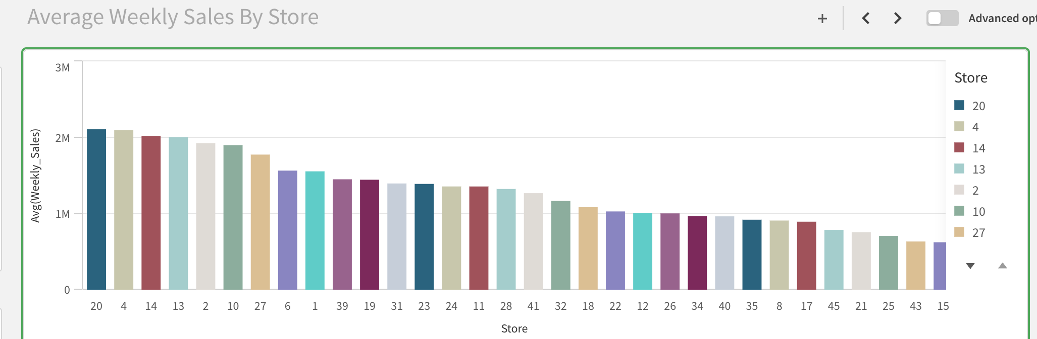
Dashboard: KPIs by Branch Comparative and Performance insights
KPI: Key Performance Indicator
​Stores 🏪​
Weekly Sales 💸

Slide 5
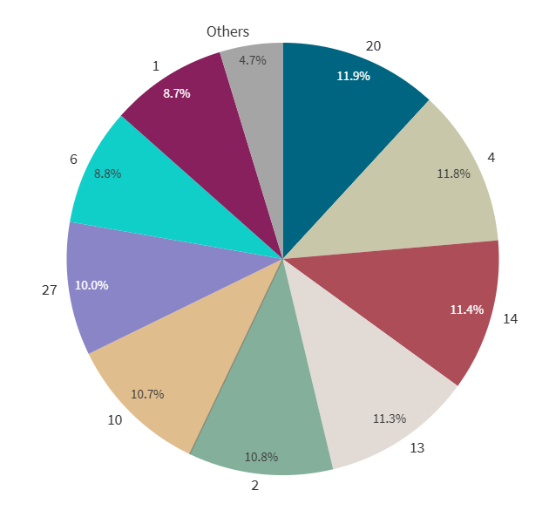
Avg. Sales in different Stores
​Stores 🏪​
Weekly Sales 💸

Slide 6
Temperature
🌡️
🌡️
🌡️
🌡️
🌡️
🌡️
🌡️
Temperature 🌡️
Weekly Sales 💸

Slide 7
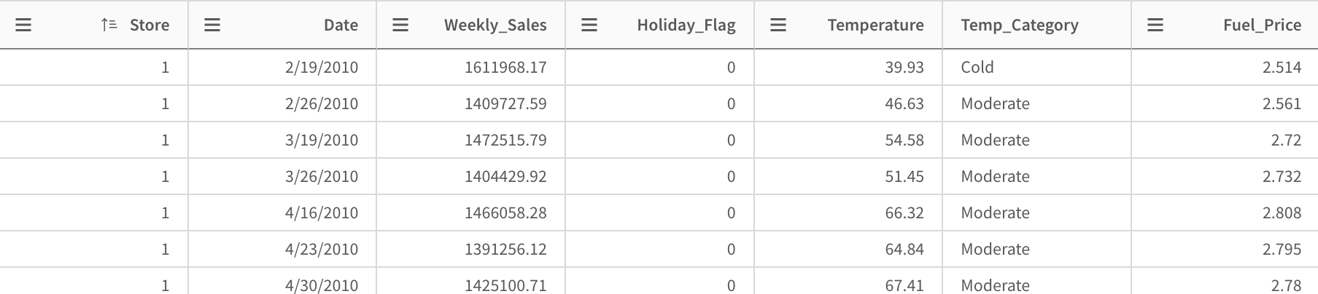
Preparing the Data Temperature vs. Weekly Sales
Temperature 🌡️
Weekly Sales 💸

Slide 8
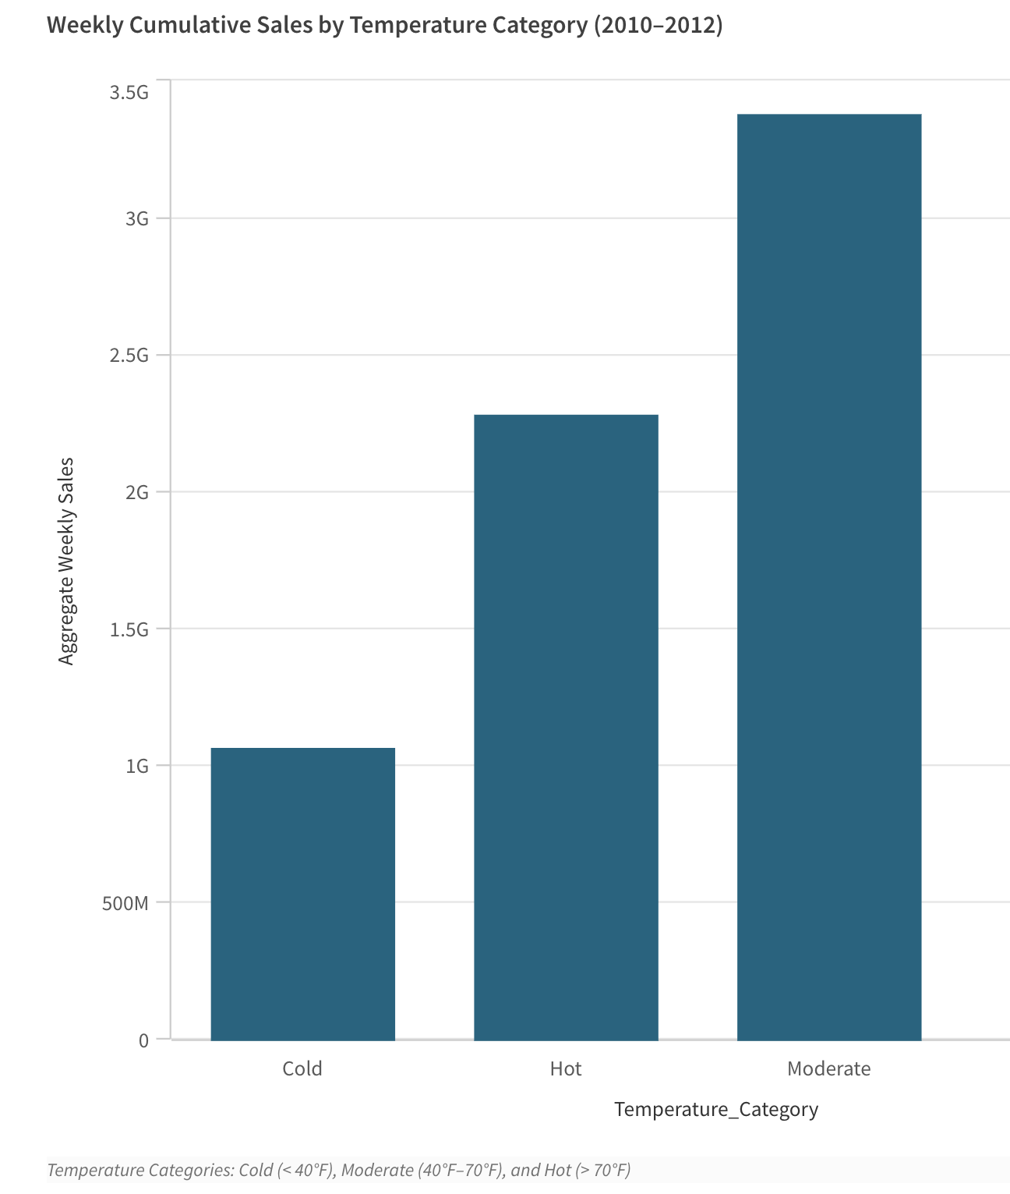
Temperature vs. Weekly Sales
Temperature 🌡️
Weekly Sales 💸

Slide 9
Insights for the Future
Unlocking Costumer Preferences: Exploring Product Trends to Optimize Inventory
Temperature 🌡️
Weekly Sales 💸

Slide 10
Holidays vs. Non-Holidays
🎄
🎄
🎄
🎄
🎄
🎄
🎄
🎄
​Stores 🏪​
Holiday Flag 🎄
Weekly Sales 💸

Slide 11
Correlation between Avg. Sales and Holidays
+9.17%
​Stores 🏪​
Holiday Flag 🎄
Weekly Sales 💸

Slide 12
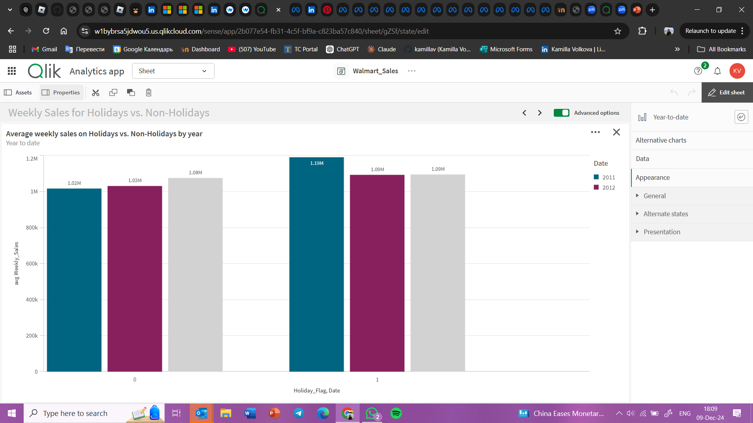
Avg. Sales 2011 vs 2012
🎄
​Stores 🏪​
Holiday Flag 🎄
Weekly Sales 💸

Slide 13
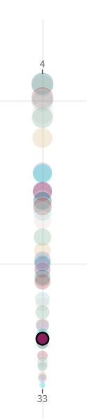
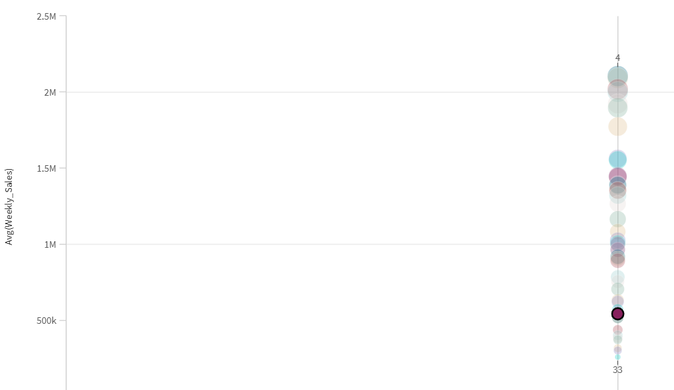
Avg. Sales from individual stores based on Holiday flag Store 9
🎄
​Stores 🏪​
Holiday Flag 🎄
Weekly Sales 💸

Slide 14
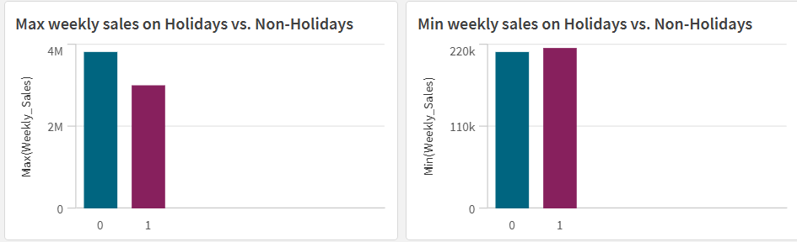
Lowest and highest sales depending on Holiday
🎄
🎄
​Stores 🏪​
Holiday Flag 🎄
Weekly Sales 💸

Slide 15
1. Having distinct categories like essential vs non-essensial goods.
2. Having Products by category to better understand what is usually purchased during periods where temperature is high, low, or moderate, etc.
Data We Wish Our Team Had ?
3. Having long term sales so we could extract more data from CPI
4. Having locations of the stores to extract socioeconomic and demographic relationships
5. Having specific Holiday flags (like 4 July, Christmas, etc)

Slide 16
Thank you!!
🌡️
🏪
💸
Any Question ? :D
💸
💸
🎄
🌡️
🏪
🌡️
💸
🎄

