Slide 1
Introduction to Statistics
Abhijit Dutt

Slide 2
Basic Concepts
Population & Sample
Why do we need sample?
Data and Data sets
Data are the facts and figures collected, analyzed, and summarized for presentation and interpretation.
All the data collected in a particular study are referred to as the data set for the study.

Slide 3
Data Sets, Variables, and Observations
A data set is usually a rectangular array of data, with variables in columns and observations in rows.
A variable (or field or attribute) is a characteristic of members of a population, such as height, gender, or salary.
An observation (or case or record) is a list of all variable values for a single member of a population.

Slide 4
Elements, Variables, and Observations
Elements are the entities on which data are collected.
A variable is a characteristic of interest for the elements.
The set of measurements obtained for a particular element is called an observation.
A data set with n elements contains n observations.
The total number of data values in a complete data set is the number of elements multiplied by the number of variables.

Slide 5
Data, Data Sets, Elements, Variables, and Observations
Element
Names
Observation
Variables
Stock Annual Earn/
Exchange Sales($M) Share($)
Company
Dataram
EnergySouth
Keystone
LandCare
Psychemedics
NQ 73.10 0.86
N 74.00 1.67
N 365.70 0.86
NQ 111.40 0.33
N 17.60 0.13
Data Set

Slide 6
Categorical and Quantitative Data
Data can be further classified as being categorical
or quantitative.
The statistical analysis that is appropriate depends
on whether the data for the variable are categorical
or quantitative.
In general, there are more alternatives for statistical
analysis when the data are quantitative.

Slide 7
Categorical Data
Labels or names used to identify an attribute of
each element
Often referred to as qualitative data
Use either the nominal or ordinal scale of
measurement
Can be either numeric or nonnumeric
Appropriate statistical analyses are rather limited

Slide 8
Quantitative Data
Quantitative data indicate how many or how much:
discrete, if measuring how many
continuous, if measuring how much
Quantitative data are always numeric.
Ordinary arithmetic operations are meaningful for
quantitative data.
Quantitative data are measured using interval/ratio scale

Slide 9
Scales of Measurement
Scales of measurement include:
Nominal
Interval
Ordinal
Ratio
The scale determines the amount of information
contained in the data.
The scale indicates the data summarization and
statistical analyses that are most appropriate.

Slide 10
Scales of Measurement - Nominal
Example:
Students of a university are classified by the school in which they are enrolled using a nonnumeric label such as Business, Humanities, Education, and so on.
Alternatively, a numeric code could be used for the school variable (e.g. 1 denotes Business, 2 denotes Humanities, 3 denotes Education, and so on).
Data are labels or names used to identify an
attribute of the element. A nonnumeric label or numeric code may be used.

Slide 11
Scales of Measurement -- Ordinal
Example:
Students of a university are classified by their class standing using a nonnumeric label such as Freshman, Sophomore, Junior, or Senior.
Alternatively, a numeric code could be used for the class standing variable (e.g. 1 denotes Freshman, 2 denotes Sophomore, and so on).
Ordinal data have the properties of nominal data and the order or rank of the data is meaningful.
A nonnumeric label or numeric code may be used.

Slide 12
Scales of Measurement - Interval
Interval data have the properties of ordinal data, and the interval between observations is expressed in terms of a fixed unit of measure.
Interval data are always numeric.
Example:
Melissa has an SAT score of 1985, while Kevin
has an SAT score of 1880. Melissa scored 105
points more than Kevin.

Slide 13
Scales of Measurement -- Ratio
Ratio data have all the properties of interval data and the ratio of two values is meaningful.
Variables such as distance, height, weight, and time use the ratio scale.
This scale must contain a zero value that indicates nothing exists for the variable at the zero point.
Example:
Melissa’s college record shows 36 credit hours
earned, while Kevin’s record shows 72 credit
hours earned. Kevin has twice as many credit
hours earned as Melissa.

Slide 14
Scales of Measurement for Data
Data
Qualitative/Categorical
Quantitative/
Numeric
Numeric
Non-numeric
Numeric
Nominal
Ordinal
Nominal
Ordinal
Interval
Ratio

Slide 15
Descriptive Statistics
Want to uncover or describe information
Two specific ways to do it
Numerical measures
Graphical & Tabular displays

Slide 16
Numerical Measures
Location
Variability
Mean
Median
Mode
Percentiles
Quartiles
Range
Variance
Standard Deviation
Coefficient of Variance

Slide 17
Descriptive Statistics – Tabular Display
Frequency Distribution
Applicable for both categorical and quantitative variable
Cumulative Frequency Distribution

Slide 18
Tabular and Graphical Displays
Data
Categorical Data
Quantitative Data
Tabular
Displays
Graphical
Displays
Tabular
Displays
Graphical
Displays
Frequency
Distribution
Rel. Freq. Dist.
% Freq. Dist.
Cum. Freq. Dist.
Cum. Rel. Freq.
Distribution
Cum. % Freq.
Distribution
Crosstabulation
Frequency
Distribution
Rel. Freq. Dist.
Percent Freq.
Distribution
Crosstabulation
Bar Chart
Pie Chart
Side-by-Side
Bar Chart
Stacked
Bar Chart
Dot Plot
Histogram
Stem-and-
Leaf Display
Scatter
Diagram

Slide 19
Modeling
There are many different types of models. For this course we are interested in mathematical models
Consider an example
Profit = Revenue – Expenses
Above is an example of Mathematical model (very simple)
Credit score is an example of a complicated mathematical model

Slide 20
Distribution
Summarize characteristics of a data set by describing how often certain values of a variable appear in a data set
For making decisions, knowledge of distribution is very important.
Most variables follow a pattern, say height, weight etc.
Once, we are able to identify a pattern it is possible to make predictions

Slide 21
Random Variables
A random variable is a numerical description of the
outcome of an experiment.
A discrete random variable may assume either a
finite number of values or an infinite sequence of
values.
A continuous random variable may assume any
numerical value in an interval or collection of
intervals.

Slide 22
Random Variables
Question
Random Variable x
Type
Family
size
x = Number of dependents
reported on tax return
Discrete
Distance from
home to store
x = Distance in miles from
home to the store site
Continuous
Own dog
or cat
x = 1 if own no pet;
= 2 if own dog(s) only;
= 3 if own cat(s) only;
= 4 if own dog(s) and cat(s)
Discrete
Notes:
Random variables do not follow uniform distribution in most cases; they follow normal distribution

Slide 23
Different distributions
Normal
Binomial
Poisson
t distribution
F distribution

Slide 24
Binomial Probability Distribution
Four Properties of a Binomial Experiment
1. The experiment consists of a sequence of n
identical trials.
2. Two outcomes, success and failure, are possible
on each trial.
3. The probability of a success, denoted by p, does
not change from trial to trial.
stationarity
assumption
4. The trials are independent.

Slide 25
Binomial Probability Distribution
Our interest is in the number of successes
occurring in the n trials.
We let x denote the number of successes
occurring in the n trials.

Slide 26
Binomial Probability Distribution
Binomial Probability Function
where:
x = the number of successes
p = the probability of a success on one trial
n = the number of trials
f(x) = the probability of x successes in n trials
n! = n(n – 1)(n – 2) ….. (2)(1)

Slide 27
Binomial Probability Distribution
Binomial Probability Function
Probability of a particular
sequence of trial outcomes
with x successes in n trials
Number of experimental
outcomes providing exactly
x successes in n trials

Slide 28
Binomial Probability Distribution
Expected Value
E(x) = μ = np
Variance
Var(x) = σ ² = np(1 − p)
Standard Deviation

Slide 29
Poisson Probability Distribution
A Poisson distributed random variable is often
useful in estimating the number of occurrences
over a specified interval of time or space
It is a discrete random variable that may assume
an infinite sequence of values (x = 0, 1, 2, . . . ).

Slide 30
Poisson Probability Distribution
Examples of Poisson distributed random variables:
the number of knotholes in 14 linear feet of
pine board
the number of vehicles arriving at a toll
booth in one hour
Bell Labs used the Poisson distribution to model
arrival of phone calls.

Slide 31
Poisson Probability Distribution
Two Properties of a Poisson Experiment
The probability of an occurrence is the same
for any two intervals of equal length.
The occurrence or nonoccurrence in any
interval is independent of the occurrence or
nonoccurrence in any other interval.

Slide 32
Poisson Probability Distribution
Poisson Probability Function
where:
x = the number of occurrences in an interval
f(x) = the probability of x occurrences in an interval
μ = mean number of occurrences in an interval
e = 2.71828
x! = x(x – 1)(x – 2) . . . (2)(1)

Slide 33
Poisson Probability Distribution
Poisson Probability Function
Since there is no stated upper limit for the number
of occurrences, the probability function f(x) is
applicable for values x = 0, 1, 2, … without limit.
In practical applications, x will eventually become
large enough so that f(x) is approximately zero
and the probability of any larger values of x
becomes negligible.

Slide 34
Poisson Probability Distribution
Example: Mercy Hospital
Patients arrive at the emergency room of Mercy
Hospital at the average rate of 6 per hour on
weekend evenings.
What is the probability of 4 arrivals in 30 minutes
on a weekend evening?

Slide 35

The Normal Distribution
The single most important distribution in statistics is the normal distribution.
It is a continuous distribution and the basis of the familiar symmetric bell-shaped curve.
Any particular normal distribution is specified by its mean and standard deviation.
By changing the mean, the normal curve shifts to the right or left.
By changing the standard deviation, the curve becomes more or less spread out.
There are really many normal distributions rather than just a single one.
The normal distribution is a two-parameter family, where the two parameters are the mean and standard deviation.

Slide 36
Continuous Distributions and Density Functions
For continuous distributions, instead of a list of possible values, there is a continuum of possible values, such as all values between 0 and 100, or all values greater than 0.
Instead of assigning probabilities to each individual value in the continuum, the total probability of 1 is spread over this continuum.
The key to this spreading is called a density function, which acts like a histogram.
The higher the value of the density function, the more likely this region of the continuum is.

Slide 37
Continuous Distributions and Density Functions (slide 2 of 2)
A density function, usually denoted by f(x), specifies the probability distribution of a continuous random variable X.
The higher f(x) is, the more likely x is.
The total area between the graph of f(x) and the horizontal axis, which represents the total probability, is equal to 1.
f(x) is nonnegative for all possible values of X.
Probabilities are found from a density function as areas under the curve.
Notes:
Figure ﻿5.2 Probability as the Area Under the Density

Slide 38
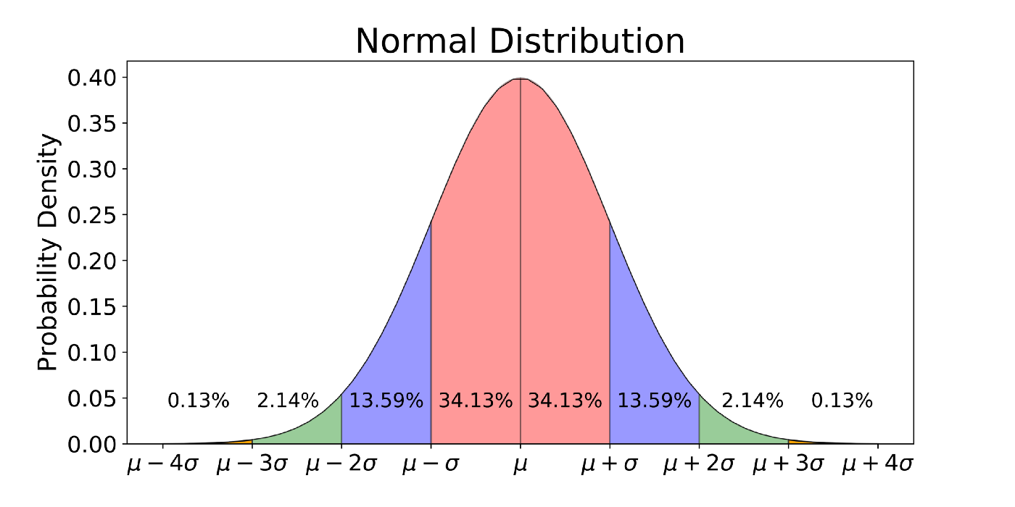
aaa
aaa

Slide 39

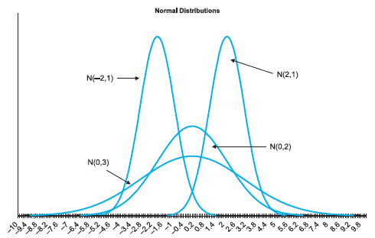

The Normal Density
The normal distribution is a continuous distribution with possible values ranging over the entire number line—from “minus infinity” to “plus infinity.”
Only a relatively small range has much chance of occurring.
The normal density function is actually quite complex, in spite of its “nice” bell-shaped appearance.
The formula for the normal density function, where μ and σ are the mean and standard deviation, is as follows:
Notes:
Figure ﻿5.3﻿ Several Normal Density Functions

Slide 40

Standardizing: Z-Values
The standard normal distribution has mean 0 and standard deviation 1, so it is denoted by N(0,1).
It is also referred to as the Z distribution.
To standardize a variable, subtract its mean and then divide the difference by the standard deviation:
Standardizing allows measuring variables with different means and/or standard deviations on a single scale.
A Z-value is the number of standard deviations to the right or left of the mean.
If Z is positive, the original value is to the right of the mean.
If Z is negative, the original value is the left of the mean.

Slide 41
Summary
For a distribution, note the difference between pdf and actual probability.

