Slide 1

Django Vs Flask
An entry level look into web frameworks
Notes:
Welcome.

Slide 2
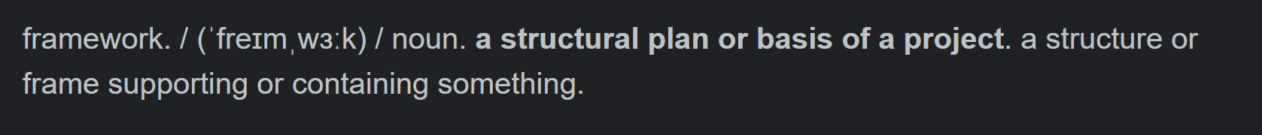
Introduction to Frameworks:
Frameworks are the foundation of any web application.
Frameworks provide the developer with functionalities to assist in the building of an application instead of creating one from scratch.
No one size fits all option.
A variety of options for every coding language.
Notes:
Frameworks are like tools.

Slide 3
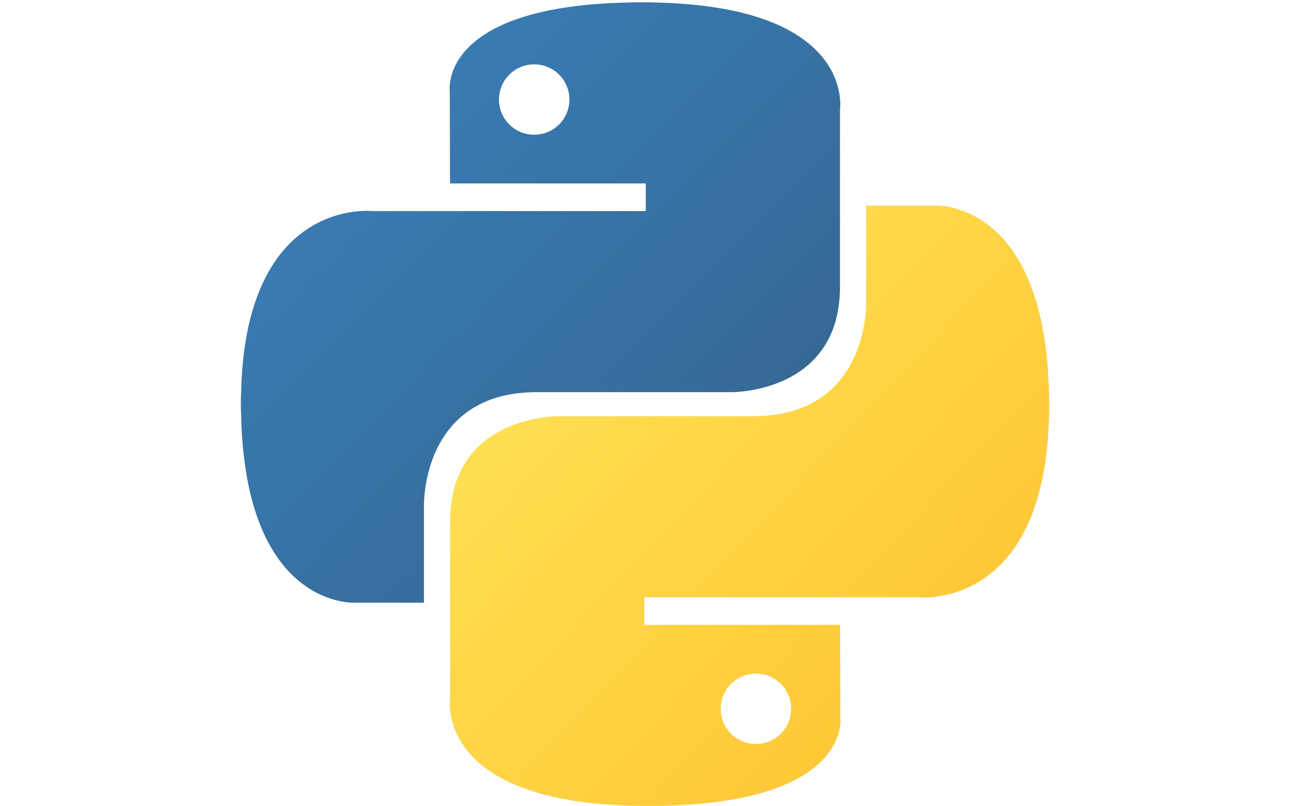
Django
“Django makes it easier to build better web apps more quickly and with less code” – Django home page
Python Web Development Framework

Slide 4

Flask
“Designed to get started quick and easy with the ability to scale” – Flask Project Page
Python Web Development Framework

Slide 5
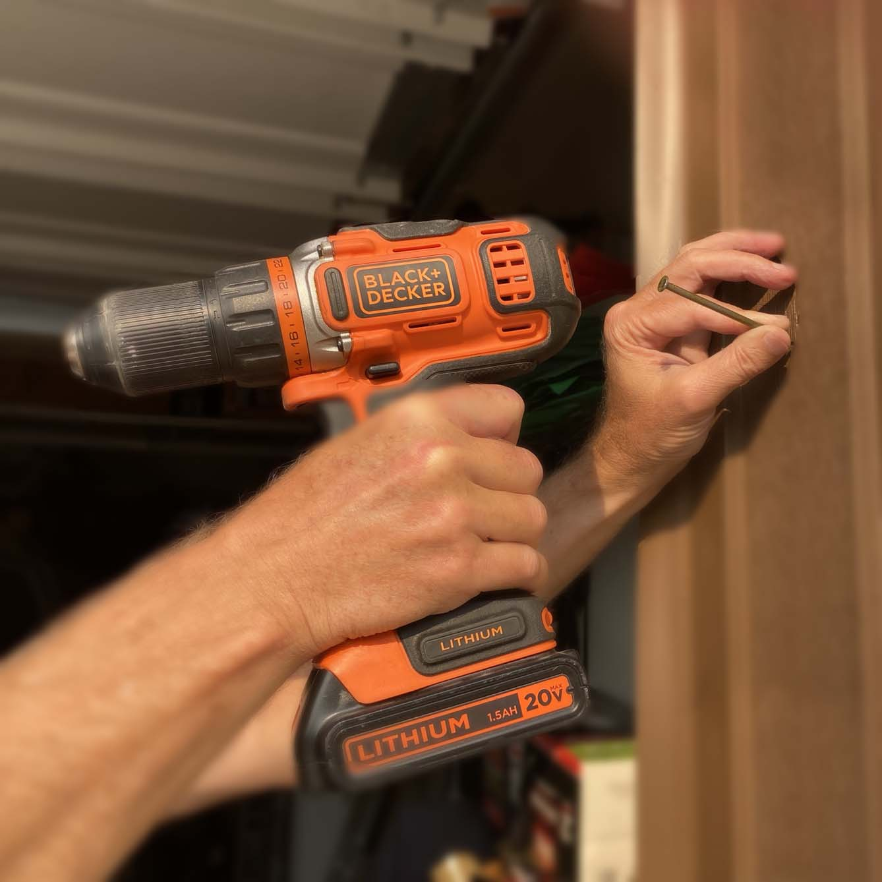
Project Types:
Large or small, business or personal, no two projects are the same.
What works exceptionally well for one may cause nightmares on the next.
To this end it is essential to have a variety of frameworks to choose from.
“You must accept that if the computer is a tool, it is the job of the tool user to know what to use it for” – Peter Drucker

Slide 6
Project Types:
Django:
+ Large Scale:
Great for large scale projects or projects that you wish to scale in the future.
Great base for secure applications.
Inbuilt Admin functionality.
Built for stability and uniformity.
Supports Dynamic HTML Pages
- Small Scale, Entry Level:
Amount of coding needed for an application makes this framework ill suited to smaller projects.
The learning process is deemed as a “one way only” deal and deviating without knowing can break or inhibit your application.
Flask:
+ Small to Medium Scale
Progressive, allowing for the application to grow as it’s needed preventing unneeded bloat which adds increased usability to smaller scale projects, the progressive approach also leaves room for the application to grow into a mid sized application.
Works extremely well for projects where you may need to experiment with new technologies, architectures or libraries.
Great for prototyping applications.
Supports API development
- Large Scale, Complex:
No admin functionality.
Less stable than Django.
Expensive for complex projects.
Flask has a singular source which means it will handle requests in turn. Increasing wait times.

Slide 7
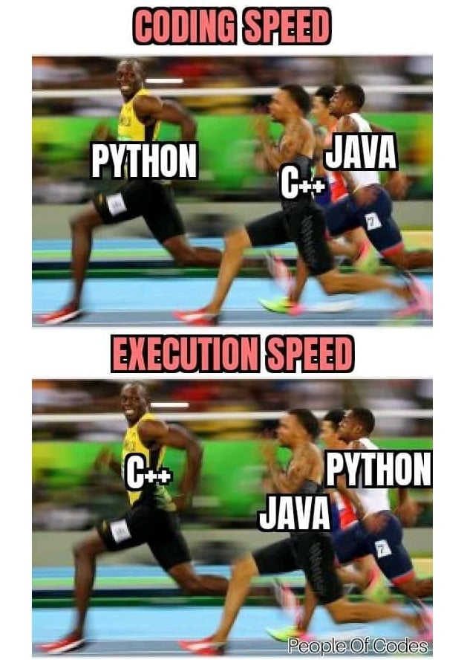
Execution Speed:
Execution speed is an essential element in any project. If you’re presenting something to your consumers then you want them to receive the best, users inconvenienced by long wait times will be more likely to go somewhere else.

Slide 8
Execution Speed:
Django:
+
Generates pages server side which assists with initial load time.
Many guides on code optimization.
-
Because of server side generation navigating pages can have decreased performance due to network latency.
Takes extra time when running requests through middleware.
Framework is “Heavier” when installed, may cause bloat.
Query sets are lazy, meaning they are not evaluated until you actually need the data, subsequent data requests for additional data will need to run again.
Flask:
+
Designed from the ground up to offer a less bloated environment.
Guides contained in documentation to help optimise performance.
2.5x smaller framework than Django.
Marginally faster.
-
Struggles with CPU intensive computing

Slide 9
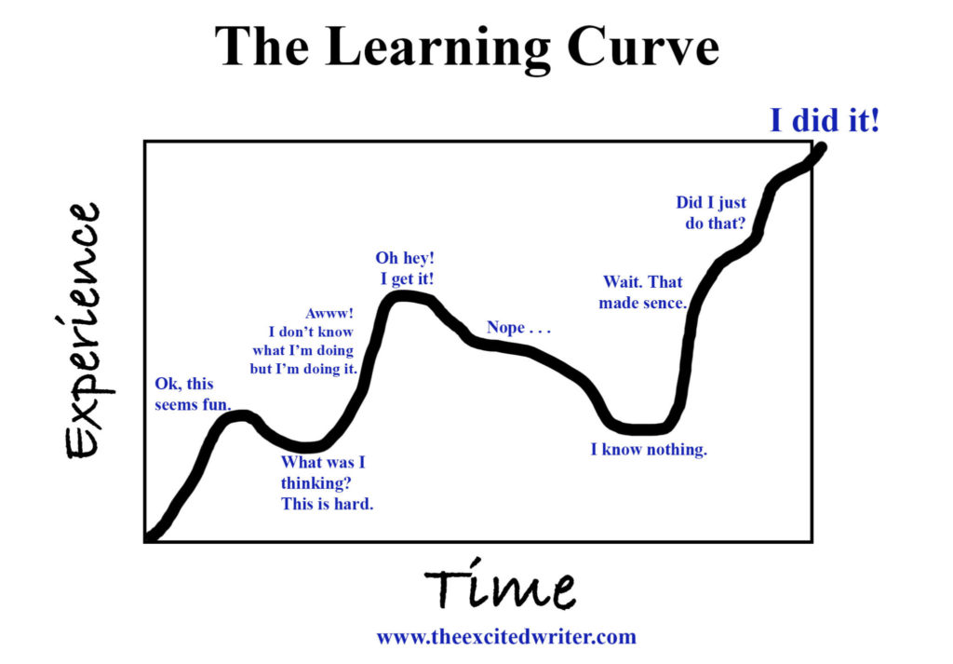
Learning Curve:
Everybody has to start somewhere, you can’t master something if you never start. However some things are easier to pick up than others. A steep learning curve can deter new people from learning new things.

Slide 10
Learning Curve:
Django:
+ General
Great documentation to reference.
A range of tutorials to assist with learning the framework.
Active community, able to field questions.
- Teams
Due to the larger nature of Django project it can be much harder to wrap your head around.
-
Some aspects of Django can be quite complex and hard to understand without prior experience in Python.
Commands are issued via the .\manage.py file which can be confusing for beginners.
Flask:
+ General
Shallowest learning curve among python frameworks.
Basics can be picked up in a few hours with subjects like Auth, ORM and restful taking a few days.
Easy to follow tutorials to cover setting up initial project and learning the basics, this project can also easily be converted to your own personal project with little effort.
+ Teams
Filesystem is easy to follow and intuitive when coming onto a project.
-
Extensions must be studied to develop a comprehensive application.

Slide 11
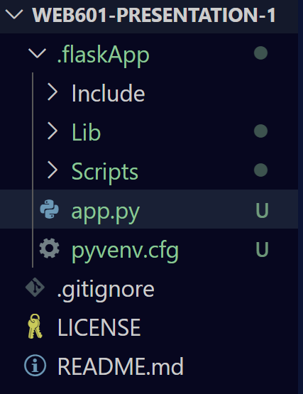
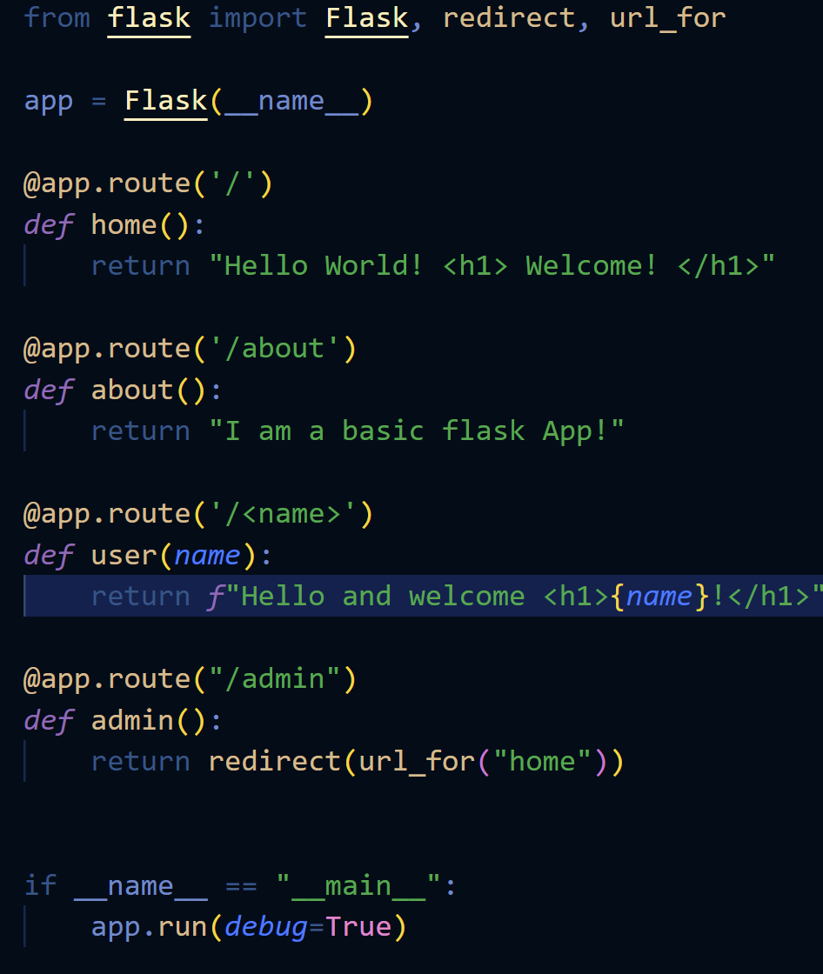
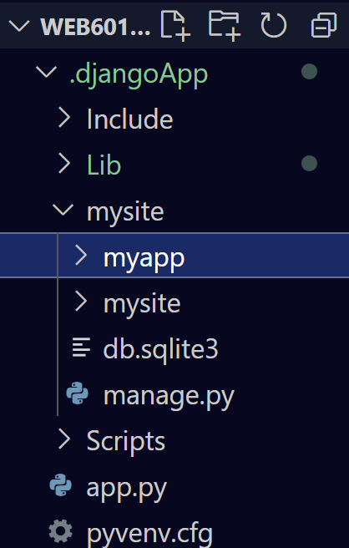
Hello World!:
The first milestone of any software project is the classic Hello World example, showing that you can log, write, post or present an output of your application. The below files show how large of a codebase you need to present a simple web application with each of the frameworks.
Django:
Flask:
5 Minute project:
3 pages
15 Minute Project:
Single landing page

Slide 12
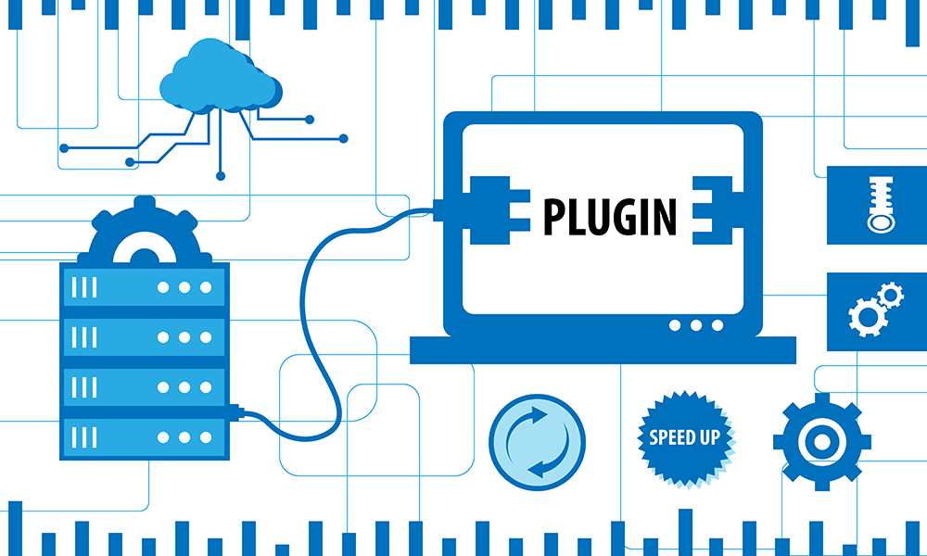
Plug Ins:
Plug ins are essential for tailoring your systems and projects to your needs. A good framework is the first step to creating your application however plugins are what will allow your application to thrive.

Slide 13
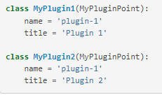

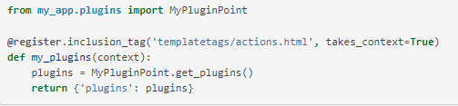

Plug Ins:
Django:
+
A massive range of available plugins.
Larger dev population means that a lot of plugins have accurate and helpful reviews.
-
Can be harder to find a diamond in the rough when looking for a plugin functionality.
Bigger learning curve when installing and utilising plugins.
Flask:
+
Wide range of available extensions.
Community driven lists that assist in finding the right plugins to achieve your goal.
Easy to develop extension templates that can be added to a new project.
Same process as installing Python libraries so easier to work with initially.
-
Less developers so less modules have been thoroughly tested and documented.

Slide 14

Scalability:
Scalability is essential for any project that you hope to spread to the masses. Basing your application off of a framework that lacks scalability could mean having to completely re-develop your application for a larger launch.

Slide 15
Scalability:
Django:
Vertical:
+
Scaling vertically entails adding more resources to the server as is standard.
-
With the scale of most Django projects vertical scaling is less effective.
Horizontal:
+
Able to be made stateless by caching backend which can greatly increase the number of requests the application can handle.
Can accommodate Millions of requests, Instagram currently has 1.44 Billion users.
-
Splitting application between differing services is required, leading to extra costs.
Flask:
Vertical:
+
Standard vertical scaling similar to Django.
More effective as projects are generally smaller.
Horizontal:
+
Easier to deploy instances across a multitude of servers.
Can also accommodate millions of requests, currently used by Netflix with 220 Million active users.
-
Modularising your application may cost you performance.

Slide 16

Security:
Now more than ever security is needed when developing web applications and the need will only continue to increase. To this end, a framework that helps alleviate some of the issues and roadblocks encountered when developing a secure application is always a huge bonus.

Slide 17
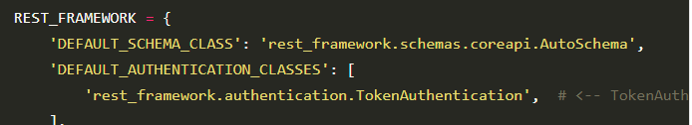
Security:
Django:
+
Inherently protects against a range of common threats:
Cross site scripting
SQL injection
Clickjacking
Inbuilt admin functionality.
-
Some functions within Django still provide work arounds to SQL injection.
Django logging can be extremely confusing.
Flask:
+
A range of extensions available that provide security for your application and API’s.
Great extensions for token authentication.
-
Does not come with native security solutions

Slide 18

Codebase-Size:
An application containing too much unnecessary code will become sluggish, especially when learning a new system and installing items to experiment.

Slide 19
Codebase-Size:
Django:
+
Codebase is broken down into more easily manageable Django “Apps”, designed to represent a single aspect of an application. Sort of like an abstraction of Object Oriented Programming.
Basic hello world application 44.4 mb when packed.
-
A large codebase for a project may mean getting lost or confused to somebody learning the framework or being onboarded onto a project.
Flask:
+
Codebase is easy to setup and can be achieved with a simple checklist of:
Create a project environment (Best practice)
Cd into project
Pip install flask
Create a python file for your application
This checklist will enable the creation of a basic web application that can be built upon.
Because of the minimal nature of Flask the codebase is relatively clean without too much bloat that would impact performance.
Basic hello world application 18.1 mb when packed
-
Because of the limited initial codebase you will have to research on what you can add and how to add it to the project.

Slide 20
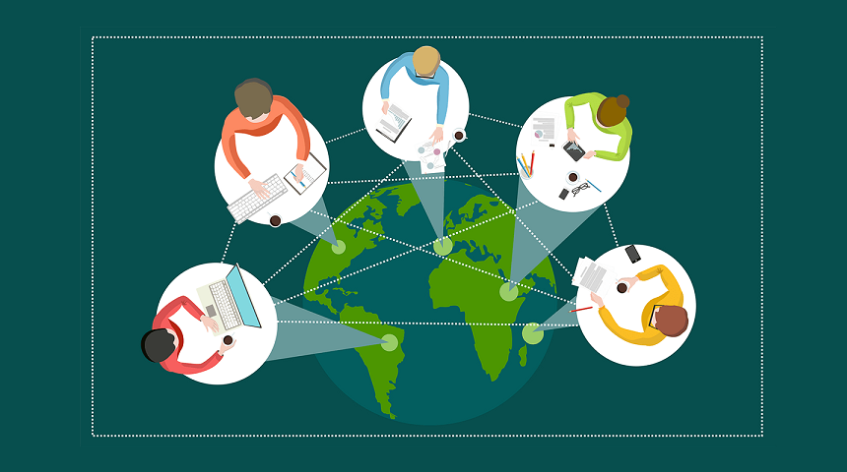
Community:
Community is a key aspect of any software but can be exceptionally helpful when learning a new skill. Key aspects that influence a community are the number of developers, the age of a community and the atmosphere that is promoted within it.

Slide 21
Community:
Django:
+
Because it is one of the biggest frameworks built with one of the most popular coding languages there are a great number of people within the community.
A large portion of experienced developers to discuss with and assist with questions.
A number of open source tutorials and projects that can be viewed to learn the framework.
-
Community can be daunting to engage with.
Just like any community, has some bad eggs that would rather insult people than help.
Flask:
+
A great interactive community.
A great number of exceptional tutorials.
Many problems encountered when using flask have been solved by the community.
Django Github
Flask Github

Slide 22
Personal Opinions:
Django is a great framework to have as part of your toolkit as it is widely used within the industry.
You can do a lot with the basic install of Django.
Flask is a minimalistic framework that provides a sturdy foundation that can be built on
Flask is amazing if you want to chop and change aspects of your application throughout development.
Overall I feel most drawn to learning and developing my skills in Flask as the minimal aspect and ability to have a web application evolve over time really works towards my philosophy when programming.
“When Vue’s user count reached a certain volume, it became a community. Suddenly all these people were counting on me: contributors, users, educators, students… It became bigger than I ever thought it could be.” – Evan You, Creator of Vue

Slide 23
Conclusion:
No Framework is perfect for every project.
Django is great for large scale projects.
Flask is great for prototyping and developing, publishing applications at speed.
Django is ill suited for small or simple projects.
Flask can provide you with too many options for projects which can get you lost.
Final Thoughts:
My recommendation would be to learn the basics of each so that no matter what kind of project you embark on you will have the necessary tools to help make the foundations of the project strong enough for the future.

