Slide 1
Code Generation on the JVM
Hamlet D'Arcy
Canoo Engineering AG
@HamletDRC

Slide 2

Hamlet D'Arcy
Canoo Engineering AG (looking for projects in 2011!)
http://hamletdarcy.blogspot.com
Groovy, CodeNarc, JConch Committer
Griffon, GPars, Gradle, etc. Contributor
http://www.hackergarten.net

Slide 3
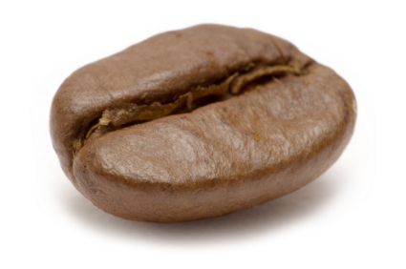

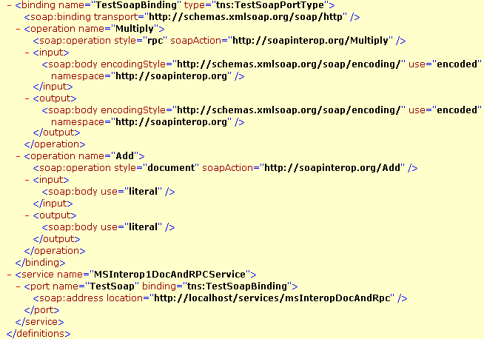
Bean
Generation
Stub
Generation
WSDL
Generation
I hate code generation too!

Slide 4
public class Person {
String firstName;
String lastname;
}

Slide 5
public class Person {
String firstName;
String lastname;
}
Person p = new Person();
p.setFirstName("Reinier");
p.setLastName("Zwitserloot");

Slide 6

@lombok.Person
public class Person {
String firstName;
String lastname;
}
Person p = new Person();
p.setFirstName("Reinier");
p.setLastName("Zwitserloot");

Slide 7
public class Person {
String firstName;
String lastname;
void setFirstName(String i){
this.firstName = i;
}
String getFirstName() {
return firstName;
}
void setFirstName(String i){
this.firstName = i;
}
String getFirstName() {
return firstName;
}
void setLastName(String i){
this.lastName = i;
}
String getLastName() {
return firstName;
}
}
@lombok.Person
public class Person {
String firstName;
String lastname;
}
Person p = new Person();
p.setFirstName("Reinier");
p.setLastName("Zwitserloot");

Slide 8
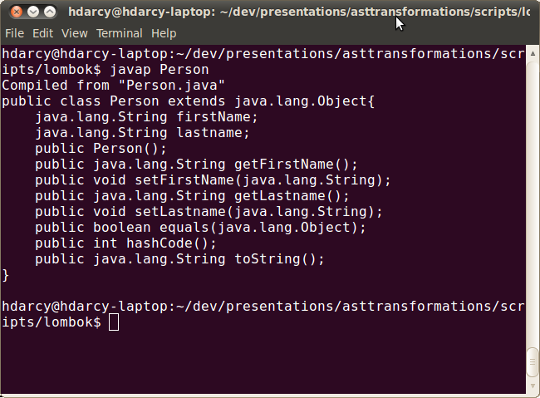

Slide 9
@Data
@Getter
@Setter
@NonNull
@SneakyThrows
@EqualsAndHashCode
@Synchronized
@ToString
@NoArgsConstructor
@RequiredArgsConstructor
@AllArgsConstructor

Slide 10
Compile Time Only
  For Eclipse and javac
delombok to remove
Read the fine print
  Know what's generated

Slide 11

class Event {
String title
}

Slide 12
class Event {
String title
}
class Event {
String title
public void getTitle() {
title
}
public String setTitle(String t) {
this.title = t
}
}

Slide 13
class Event implements Comparable, Clonable {
Date when
boolean after(Date when) {
this.when.after(when)
}
boolean before(Date when) {
this.when.before(when)
}
Object clone() {
this.when.clone()
}
int compareTo(Date anotherDate) {
this.when.compareTo(otherDate)
}
int getDate() {
this.when.date
}
int getDay() {
this.when.day
}
int getHours() {
this.when.hours
}
int getMinutes() {
this.when.minutes
}
int getMonth() {
this.when.month
}
int getSeconds() {
this.when.seconds
}
long getTime() {
this.when.time
}
int getTimezoneOffset() {
this.when.timezoneOffset
}
int getYear() {
this.when.year
}
void setDate(int date) {
this.when.date = date
}
void setHours(int hours) {
this.when.hours = hours
}
void setMinutes(int minutes) {
this.when.minutes = minutes
}
void setMonth(int month) {
this.when.month = month
}
void setSeconds(int seconds) {
this.when.seconds = seconds
}
void setTime(long time) {
this.when.time = time
}
void setYear(int year) {
this.when.year = year
}
String toGMTString() {
this.when.toGMTString()
}
String toLocaleString() {
this.when.toLocaleString()
}
}
class Event {
@Delegate Date when
}

Slide 14
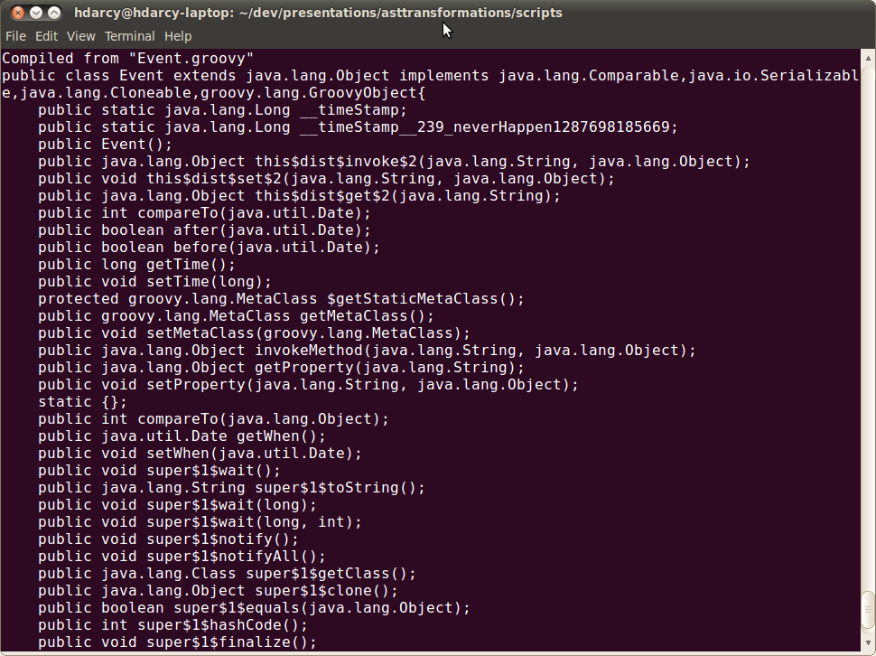

Slide 15
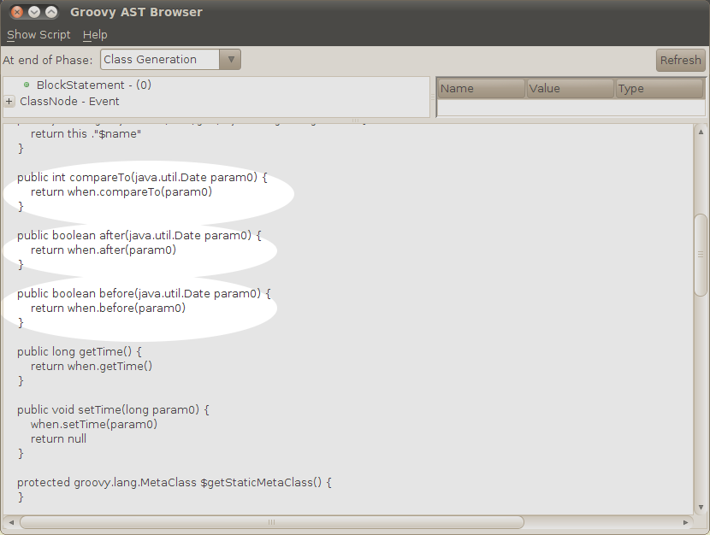

Slide 16
@Lazy
@Immutable
@Log
@Newify
@Category
@Package Scope
@Grab
@Bindable
@Mixin
@Log
@Synchronized
@IndexedProperty
@InheritConstructors
@EqualsAndHashCode
@Canonical
@AutoExternalize
@AutoClone
@ToString
@Field

Slide 17

US$370 million in damages
… from a integer overflow error

Slide 18
US$370 million in damages
… from a integer overflow error
Greece bailout is $145 billion
… so we look quite good
compared to the bankers.

Slide 19
class Ariane5 {
long speed = 0
boolean engineStarted
@Requires({ increase > 0 })
@Ensures({ old.speed < speed })
void accelerate(increase) {
speed += increase
}
@Requires({ engineStarted == false })
@Ensures( { engineStarted == true } )
void startEngine() {
engineStarted = true
}
}

Slide 20
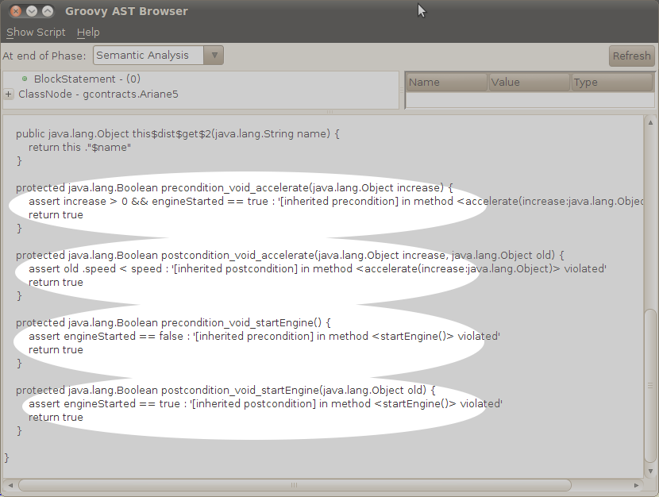

Slide 21
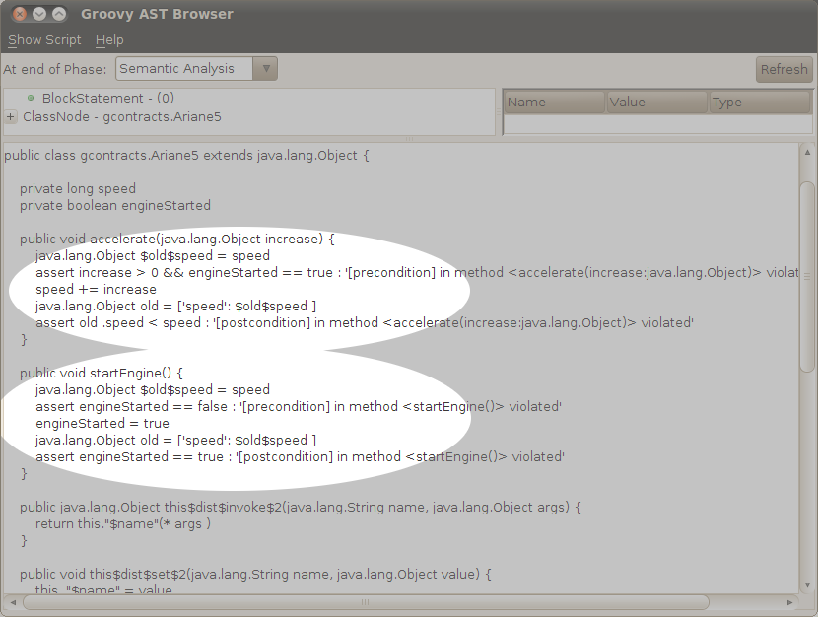

Slide 22

def "Does simple math work?"() {
expect:
def s = new ArithmeticShell()
s.evaluate(input) == output
where:
input | output
'1 + 1' | 2
'cos(2*PI)' | 1.0
}

Slide 23
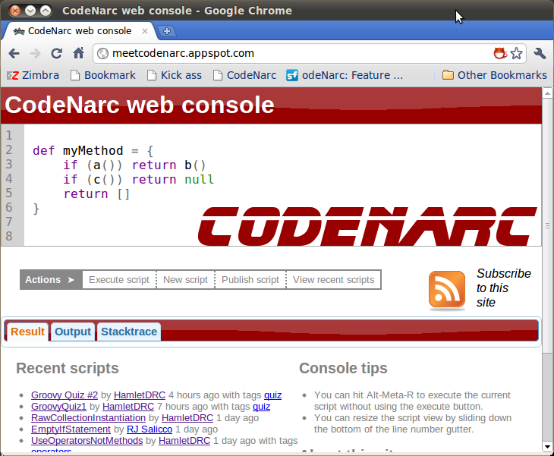

Slide 24
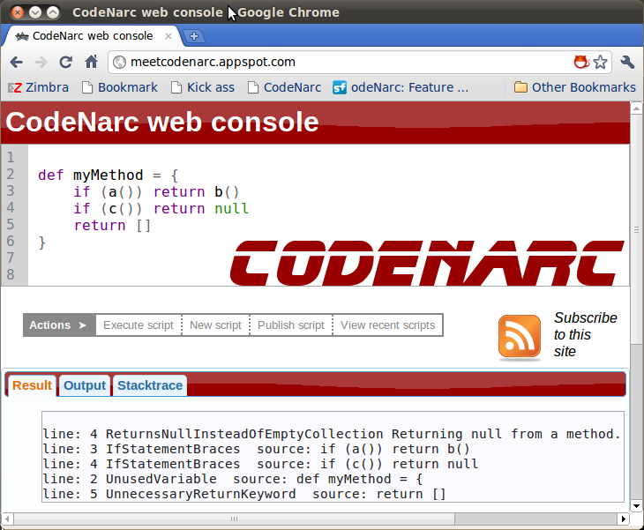

Slide 25
class EmptyCatchBlockAstVisitor extends AbstractAstVisitor {
void visitCatchStatement(CatchStatement node) {
if (isFirstVisit(node) && AstUtil.isEmptyBlock(node.code)) {
addViolation(catchStatement)
}
super.visitCatchStatement(node)
}
}

Slide 26
$ svn co https://codenarc.svn.sourceforge.net/svnroot/codenarc
cd codenarc
mvn install
groovy codenarc.groovy create-rule
Created ./src/main/groovy/org/codenarc/rule/basic/MyNewRuleRule.groovy
Created ./src/test/groovy/org/codenarc/rule/basic/MyNewRuleRuleTest.groovy
Updated ./src/main/resources/codenarc-base-messages.properties
Updated ./src/main/resources/rulesets/basic.xml
Updated ./src/site/apt/codenarc-rules-basic.apt
(fix the unit tests & write the visitor)
svn diff > mypatch.patch

Slide 27

My Blog - http://hamletdarcy.blogspot.com
Canoo Blog - http://canoo.com/blog
CodeNarc - http://codenarc.sourceforge.net
GContracts - http://is.gd/h44UA
Spock - http://spockframework.org
Lombok - http://projectlombok.org/
Twitter for slides: @HamletDRC
Groovy, Grails, Griffon, and Agile Consulting
info@canoo.com or hamlet.darcy@canoo.com

