Slide 1
Code Generation on the JVM
Hamlet D'Arcy
@HamletDRC
http://hamletdarcy.blogspot.com

Slide 2
Agenda
Lombok
Spring Roo
Cofoja
Groovy AST Transformations
    GContracts
    CodeNarc
    Spock
    Groovy++

Slide 3





About Me

Slide 4


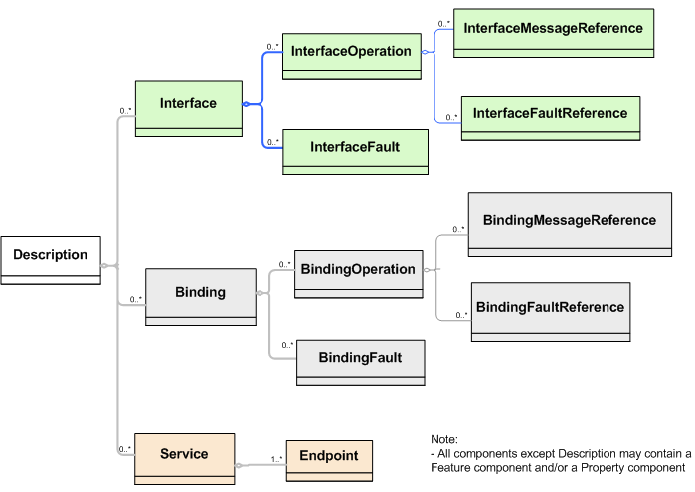
I hate code generation too!
Bean
Generation
Stub
Generation
WSDL
Generation

Slide 5




… but it isn't all bad.
cofoja

Slide 6
Project Lombok

Slide 7
public class Person {
private String firstName;
private String lastName;
void setFirstName(String fName) {
this.firstName = fName;
}
public String getFirstName() {
return firstName;
}
public void setLastName(String lName) {
this.lastName = lName;
}
public String getLastName() {
return firstName;
}
}
import lombok.Getter;
import lombok.Setter;
public class Person {
@Getter @Setter private String firstName;
@Setter @Setter private String lastname;
}

Slide 8
public class SynchronizedExample {
private final Object $lock = new Object[0];
public void doSomething() {
synchronized($lock) {
return ...;
}
}
}
import lombok.Synchronized;
public class SynchronizedExample {
@Synchronized
public void doSomething() {
return ...;
}
}

Slide 9
@Getter / @Setter
@ToString
@EqualsAndHashCode
@NoArgsConstructor
@RequiredArgsConstructor
@AllArgsConstructor
@Data
@Cleanup
@Synchronized
@SneakyThrows
@Log
@Delegate
val

Slide 10
Generates Java Boilerplate
Compile Time Only
  – For Eclipse and javac
Removable with delombok
Read the fine print
  – You should know what is generated

Slide 11
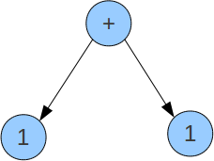
How it Works

Slide 12
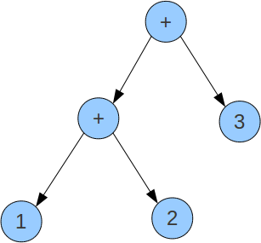
How it Works

Slide 13
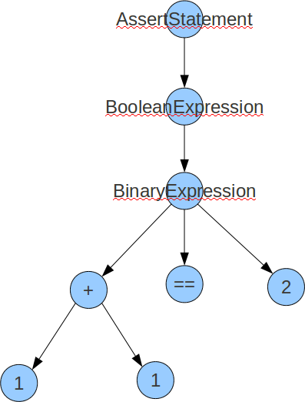
How it Works

Slide 14
How it Works
Annotation Processor
Eclipse Handler
Javac Handler

Slide 15
// javac
private void generatePropertyChangeSupportField(JavacNode node) {
if (fieldAlreadyExists(PROPERTY_SUPPORT_FIELD_NAME, node)) return;
JCExpression exp = chainDots(node.getTreeMaker(), node, "this");
JCVariableDecl fieldDecl = newField()
.ofType(PropertyChangeSupport.class)
.withName(PROPERTY_SUPPORT_FIELD_NAME)
.withModifiers(PRIVATE | FINAL)
.withArgs(exp)
.buildWith(node);
injectField(node, fieldDecl);
}
// ECJ
private void generatePropertyChangeSupportField(EclipseNode node) {
if (fieldAlreadyExists(PROPERTY_SUPPORT_FIELD_NAME, node)) return;
Expression exp = referenceForThis(node.get());
FieldDeclaration fieldDecl = newField()
.ofType(PropertyChangeSupport.class)
.withName(PROPERTY_SUPPORT_FIELD_NAME)
.withModifiers(PRIVATE | FINAL)
.withArgs(exp)
.buildWith(node);
injectField(node, fieldDecl);
}
Alex Ruiz – Custom AST Transformations with Project Lombok
http://www.ibm.com/developerworks/java/library/j-lombok/

Slide 17
How it Works
`-- contacts
|-- Person.java
|-- Person_Roo_Configurable.aj
|-- Person_Roo_Entity.aj
|-- Person_Roo_JavaBean.aj
|-- Person_Roo_ToString.aj
`-- web
|-- PersonController.java
`-- PersonController_Roo_Controller.aj

Slide 18
How it Works
public class Person implements ConfigurableObject {
...
public String toString() {
return Person_Roo_ToString....Person$toString(this);
}
...
}
public class Person_Roo_ToString {
static String Person_Roo_ToString....Person$toString(
Person ajc$this_) {
StringBuilder sb = new StringBuilder();
...
return sb.toString();
}

Slide 19
Moves Java Boilerplate to .aj files
  – Uses AspectJ's inter-type declaration (ITD) features
  – “Roo doesn't believe in magic!”
Compile Time Only
  – Not a runtime
  – Not an Annotation Processing library
  – No dynamic proxy objects
Removable with rollout mechanism
There is a lot of code on disk
  – Is this Roo's fault?

Slide 20
cofoja

Slide 21
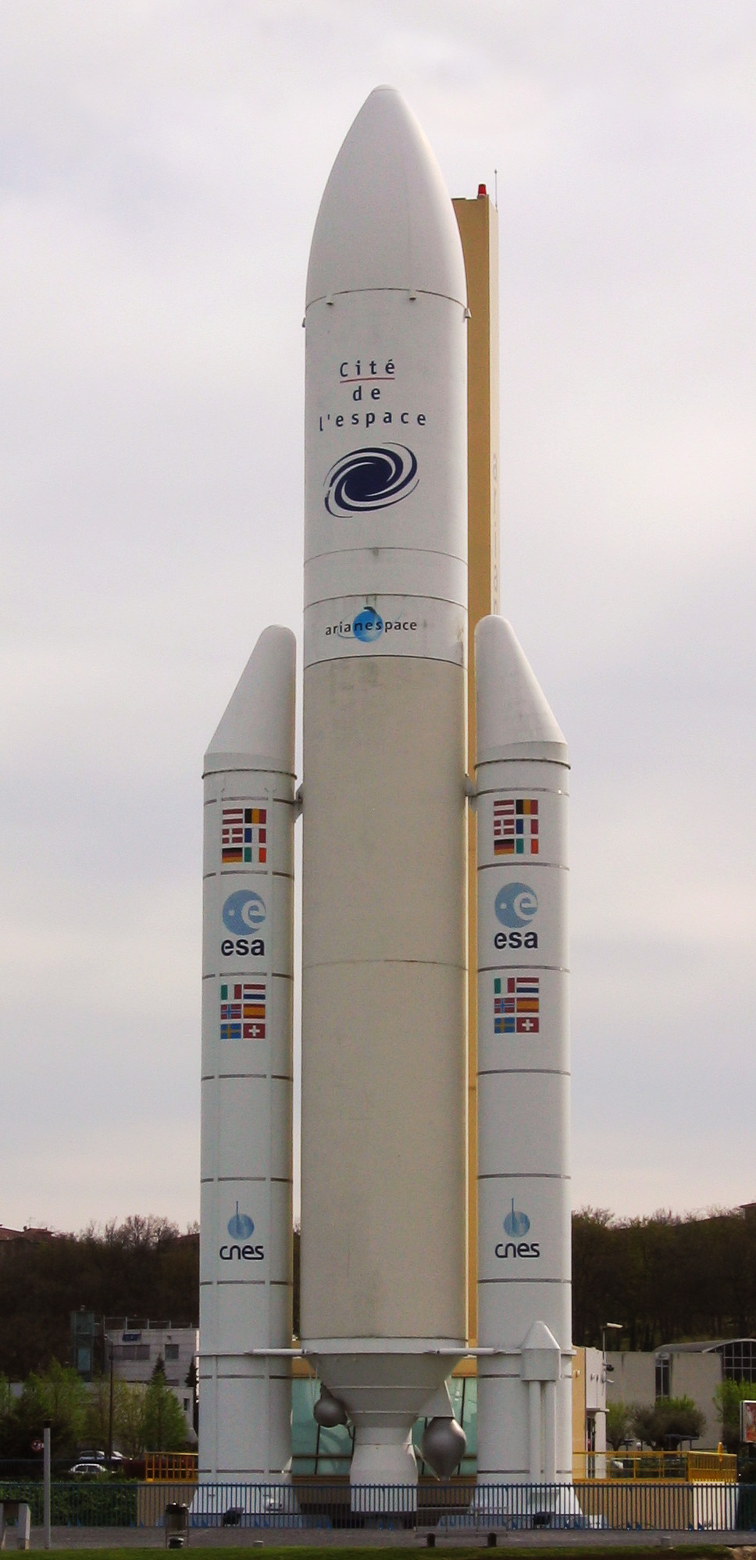

Slide 22


Slide 23
Ariane 5 Destroyed
US$370 million in damages
… from a integer overflow error

Slide 24
Ariane 5 Destroyed
US$370 million in damages
… from a integer overflow error
Greece bailout is $145 billion
… so we look quite good
compared to the bankers.

Slide 25

“Design by Contract and Eiffel
would have avoided the crash...”
Sincerely,
The Eiffel Guys
(not a direct quote)

Slide 26
How it works
Contract Applies-To Advice Inheritance
@Invariant Class Around &&
@Requires Method Before ||
@Ensures Method After &&

Slide 27
How it works
Annotation Processor
  Compiles strings to bytecode
  Writes a '.contract' file
Instrumentation Agent
  Weaves .contract file at JVM loadtime
Offline Bytecode Rewriter
  Produces pre-weaved .class files
cofoja

Slide 28
How it works
javac
-cp cofoja-1.0.jar
-processor com.google.java.contract.core.apt.AnnotationProcessor
Kettle.java
java -ea -javaagent:./cofoja-1.0.jar Kettle
or
java -cp cofoja-1.0.jar
-Dcom.google.java.contract.classoutput=compiled
com.google.java.contract.core.agent.PreMain
Kettle.class

Slide 29
How it works
JVM loads class as byte[ ]
ASM intercepts bytecode in pre-main
ASM visitors rewrite bytecode
JVM loads modified bytecode

Slide 30
public class Greeter {
@Main
public void greet() {
System.out.println("Greetings!");
}
}
hamlet:$ java -cp .:asm-3.3.1.jar \
-javaagent:./AtMainTransformation.jar asm.Greeter
Greetings!
hamlet:$

Slide 31
Jar MANIFEST.MF
Premain-Class:
asm.instrument.AtMainPreMain
class AtMainPreMain {
static void premain(...) {
instrumentation.addTransformer(
new AtMainTransformer()
);
}
}
class AtMainTransformer implements ClassFileTransformer {
byte[] transform(..., byte[] classBytes) { ... }
}
class AtMainBytecodeAdapter extends ClassAdapter {
@Override public void visit(...) { ... }
@Override public MethodVisitor visitMethod(...) { ... }
@Override public void visitEnd() { ... }
}

Slide 32
public static void main(String[] args) {
new Greeter().greet();
}
public void greet();
Code:
0: getstatic #2; //Field java/lang/System.out:Ljava/io/PrintStream;
3: ldc #3; //String Greetings!
5: invokevirtual #4; //Method java/io/PrintStream.println: Ljava/lang/String;)V
8: return
MethodVisitor mv = cv.visitMethod(
Opcodes.ACC_PUBLIC + Opcodes.ACC_STATIC,
"main",
"([Ljava/lang/String;)V", null, null);
if (mv != null) {
mv.visitCode();
mv.visitTypeInsn(Opcodes.NEW, currentClassName);
mv.visitInsn(Opcodes.DUP);
mv.visitMethodInsn(Opcodes.INVOKESPECIAL, "Greeter", "<init>", "()V");
mv.visitMethodInsn(Opcodes.INVOKEVIRTUAL, "Greeter", "greet", "()V");
mv.visitInsn(Opcodes.RETURN);
mv.visitMaxs(2, 2); // max stack size, max num locals
mv.visitEnd();
}

Slide 33
ASM Bytecode Generation
Fast, flexible, small
Low-level
Program close to bytecode

Slide 35
class Event {
String title
}

Slide 36
class Event {
String title
}
class Event {
String title
public void getTitle() {
title
}
public String setTitle(String t) {
this.title = t
}
}

Slide 37
class Event {
@Delegate Date when
}

Slide 38
class Event implements Comparable, Clonable {
Date when
boolean after(Date when) {
this.when.after(when)
}
boolean before(Date when) {
this.when.before(when)
}
Object clone() {
this.when.clone()
}
int compareTo(Date anotherDate) {
this.when.compareTo(otherDate)
}
int getDate() {
this.when.date
}
int getDay() {
this.when.day
}
int getHours() {
this.when.hours
}
int getMinutes() {
this.when.minutes
}
int getMonth() {
this.when.month
}
int getSeconds() {
this.when.seconds
}
long getTime() {
this.when.time
}
int getTimezoneOffset() {
this.when.timezoneOffset
}
int getYear() {
this.when.year
}
void setDate(int date) {
this.when.date = date
}
void setHours(int hours) {
this.when.hours = hours
}
void setMinutes(int minutes) {
this.when.minutes = minutes
}
void setMonth(int month) {
this.when.month = month
}
void setSeconds(int seconds) {
this.when.seconds = seconds
}
void setTime(long time) {
this.when.time = time
}
void setYear(int year) {
this.when.year = year
}
String toGMTString() {
this.when.toGMTString()
}
String toLocaleString() {
this.when.toLocaleString()
}
}
class Event {
@Delegate Date when
}

Slide 39
class Event {
@Lazy ArrayList speakers
}

Slide 40
class Event {
@Lazy ArrayList speakers
}
class Event {
ArrayList speakers
def getSpeakers() {
if (speakers != null) {
return speakers
} else {
synchronized(this) {
if (speakers == null) {
speakers = []
}
return speakers
}
}
}
}
Also handles:
  Initial values
  Volatile fields

Slide 41
@Immutable
class Event {
String title
}

Slide 42
Class is final
Properties must be @Immutable or effectively immutable
Properties are private
Mutatators throw ReadOnlyPropertyException
Map constructor created
Tuple constructor created
Equals(), hashCode() and toString() created
Dates, Clonables, and arrays are defensively copied on way in and out (but not deeply cloned)
Collections and Maps are wrapped in Immutable variants
Non-immutable fields force an error
Special handling for Date, Color, etc
Many generated methods configurable
@Immutable
class Event {
String title
}

Slide 43
Code Generation Transformations
@ToString
@EqualsAndHashCode
@Canonical
@Lazy
@InheritConstructors
@TupleConstructor

Slide 44
Class Design Annotations
@Delegate
@Singleton
@groovy.transform.Immutable

Slide 45
Logging Improvements
@Log
@Log4j
@Slf4j
@Commons

Slide 46
Declarative Concurrency
@Synchronized
@WithReadLock
@WithWriteLock

Slide 47
Easier Cloning and Externalizing
@AutoClone
@AutoExternalize

Slide 48
Safer Scripting
@TimedInterrupt
@ThreadInterrupt
@ConditionalInterrupt

Slide 49
@Package Scope
@Grab
@Category
@Mixin
@Bindable
@IndexedProperties
@ListenerList
@Vetoable
@Newify
… and many more as libraries

Slide 50
GroovyCodeVisitor
public interface GroovyCodeVisitor {
void visitBlockStatement(BlockStatement statement);
void visitForLoop(ForStatement forLoop);
void visitWhileLoop(WhileStatement loop);
void visitDoWhileLoop(DoWhileStatement loop);
...
}

Slide 51
GroovyCodeVisitor
… source in groovy/src/examples/groovyShell
public interface GroovyCodeVisitor {
void visitBlockStatement(BlockStatement statement);
void visitForLoop(ForStatement forLoop);
void visitWhileLoop(WhileStatement loop);
void visitDoWhileLoop(DoWhileStatement loop);
...
}
def s = new ArithmeticShell()
assert 2 == s.evaluate(' 1+1 ')
assert 1.0 == s.evaluate(' cos(2*PI) ')

Slide 52
static analysis for Groovy
class SystemRunFinalizersOnExitAstVisitor extends AbstractAstVisitor {
def void visitMethodCallExpression(MethodCallExpression call) {
if (call.objectExpression in VariableExpression) {
def target = call.objectExpression.variable
if (target == "System" && call.method in ConstantExpression) {
if (call.method.value == "runFinalizersOnExit") {
addViolation(call)
}
}
}
super.visitMethodCallExpression(call);
}
}

Slide 53
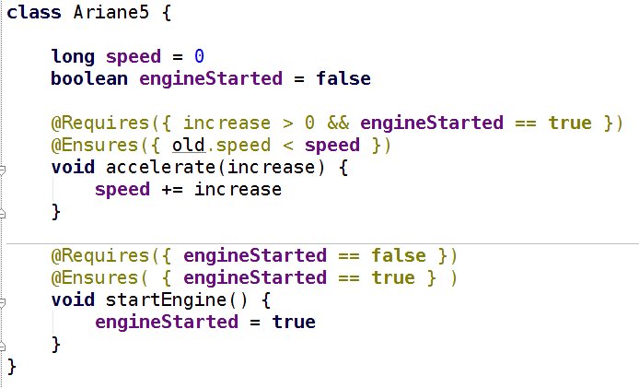
GContracts – Contract Driven Development

Slide 54
Spock – Groovy Testing Framework
… from “Hijacking Goto Labels”
def "Does simple math work?"() {
expect:
def s = new ArithmeticShell()
s.evaluate(input) == output
where:
input | output
'1 + 1' | 2
'cos(2*PI)' | 1.0
}

Slide 55


Slide 56
How it works
Bytecode Optimizations
Mix Dynamic and Typed code
AST Rewriting

Slide 57
Groovy is a compiled language
...oh yes it is
Compiled changes visible in .class file
...visible to all JVM users
Language semantics are a library feature
...not hardcoded into the language

Slide 58
How it Works
Local AST Transformations
Global AST Transformations
AST Builder
ANTLR Plugins?

Slide 59
Local AST Transformations
class Event {
@Delegate Date when
}
@GroovyASTTransformationClass("org.pkg.DelegateTransform")
public @interface Delegate {
...
}
@GroovyASTTransformation(phase = CompilePhase.CANONICALIZATION)
public class DelegateTransform implements ASTTransformation {
public void visit(ASTNode[] nodes, SourceUnit source) {
...
}
}

Slide 60
Global AST Transformations
Transform.jar
| - transforms
| - global
| - CompiledAtASTTransformation.class
| - CompiledAtASTTransformation$_visit_closure1.class
| - ...
| META-INF
| - services
| - org.codehaus.groovy.transform.ASTTransformation
| - org.codehaus.groovy.source.Extensions
@GroovyASTTransformation(phase = CompilePhase.SEMANTIC_ANALYSIS)
public class SpockTransform implements ASTTransformation {
public void visit(ASTNode[] nodes, SourceUnit sourceUnit) {
...
}
}

Slide 61
AST Builder
def ast = new ExpressionStatement(
new MethodCallExpression(
new VariableExpression("this"),
new ConstantExpression("println"),
new ArgumentListExpression(
new ConstantExpression("Hello World")
)
)
)
def ast = new AstBuilder().buildFromCode {
println "Hello World"
}

Slide 62
… from “Groovy ANTLR Plugins for Better DSLs”
given "some data" {
...
}
when "a method is called" {
...
}
then "some condition should exist" {
...
}

Slide 63
What to do next
Groovy Wiki
Groovy Mailing List is amazingly helpful
Use your creativity and patience
54 Pages of AST in GINA2 MEAP:

Slide 64
Agenda
Lombok
Spring Roo
Cofoja
Groovy AST Transformations
    GContracts
    CodeNarc
    Spock
    Groovy++

Slide 65
Thanks!
Twitter: @HamletDRC
Blog: http://hamletdarcy.blogspot.com
Work Blog: http://www.canoo.com/blog
JetBrains.tv Screencasts:
    http://tv.jetbrains.net/tags/hamlet
YouTube Screencasts:
    http://www.youtube.com/user/HamletDRC
Share-a-Canooie – http://people.canoo.com/share/
Hackergarten – http://www.hackergarten.net/

