Slide 1
Eliminating Software Waste
Hamlet D'Arcy
Canoo Engineering, AG
@HamletDRC
Notes:
Here's my bio, in case you're wondering:
Hamlet D'Arcy has been writing software for over a decade, and has spent considerable time coding in C++, Java, and Groovy. He's passionate about learning new languages and different ways to think about problems. Hamlet is the founder of the Basel-based Hackergarten open source coding group, and regularly participates and speaks at local and international user groups and conferences. Hamlet is a committer on the Groovy and CodeNarc projects, and is a contributor on a few other open source projects (including JConch and the IDEA Groovy Plugin). He blogs regularly at http://hamletdarcy.blogspot.com and can be found on Twitter as HamletDRC (http://twitter.com/hamletdrc).

Slide 2
We're here to talk about...
the process of writing software
the waste of writing software
improving how we write software
improving our team

Slide 3
Extreme Programming
Scrum
Waterfall
Lean
Agile
RUP
Kanban
Notes:
There is a large world of software process. All of the choices here are good choices depending on your context, even Waterfall. I believe knowing some details from all of these makes you a better decision maker regardless of your final choice.
The slide exists so that I can get a feel for the audience skill level and familiarity on the topic.

Slide 4
Extreme Programming
Scrum
Waterfall
Lean
Agile
RUP
Kanban
Notes:
The focus and narrative of the talk is based on Lean. However, Scrum, XP, and Kanban are discussed as well.

Slide 5

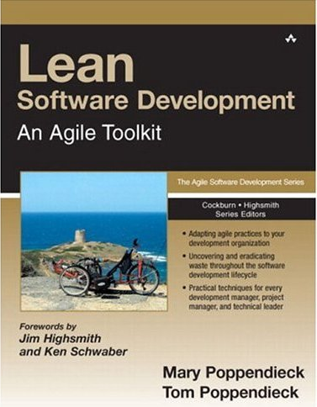
1988 – Japan 2003 – Minnesota
Notes:
Lean History
Lean grew out of the influential Toyota Production System, a set of philosophies and practices to weed out waste, inconsistency, and overburden from a manufacturing. In the 1990′s (in Minnesota) the Poppendieck's applied it to a software project. In 2003 they published “Lean Software Development”. The principles have been revised over time.
The Poppendieck's books are very good. Also, they are from Minnesota, where I used to live. Yeah Minnesota.

Slide 6
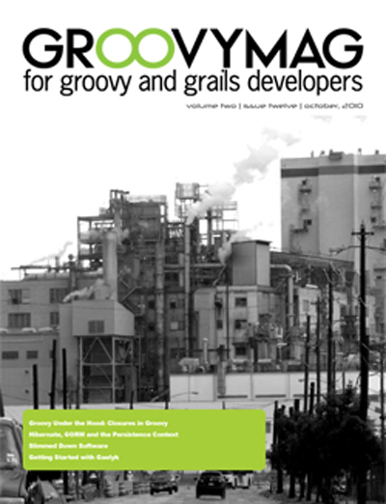
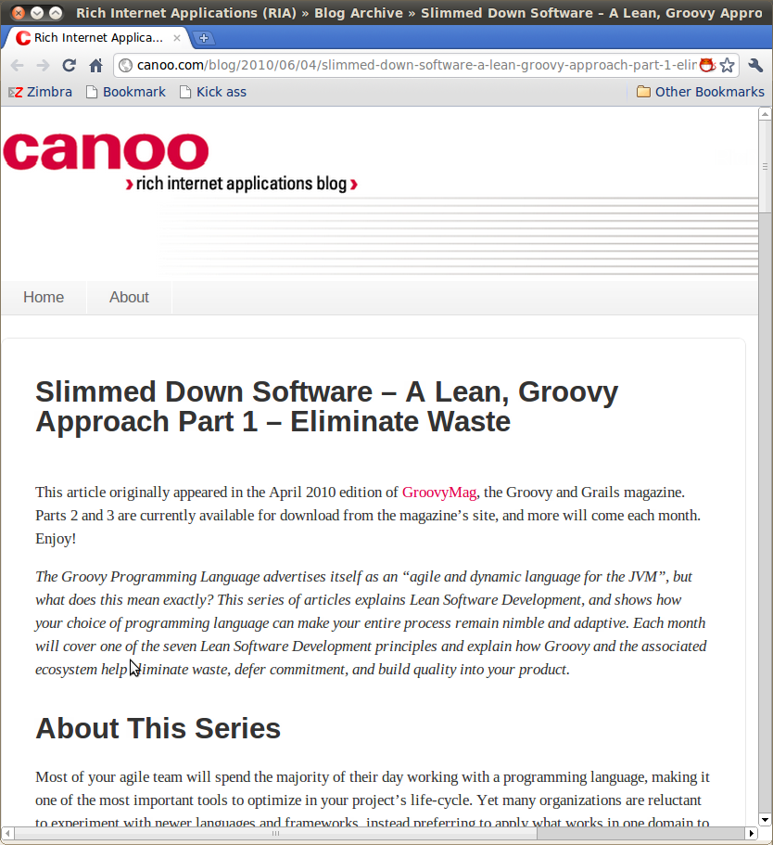
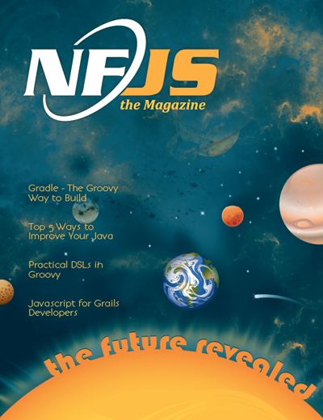
As seen in...
http://groovymag.com
http://canoo.com/blog
http://nofluffjuststuff.com/
Notes:
Some places to find more information:
Waste: http://www.canoo.com/blog/2011/03/08/waste/
Archives of agile related writings:
http://hamletdarcy.blogspot.com/search/label/craft
http://www.canoo.com/blog/tag/agile/
Lean Groovy Presentation (video): http://www.infoq.com/presentations/Lean-Groovy
Lean Groovy Blog Posts:
http://www.canoo.com/blog/2011/03/02/lean-groovy-7-optimize-the-whole/

Slide 7
7 Lean Principles
Eliminate Waste
Build Quality In
Create Knowledge
Defer Commitment
Deliver Fast
Respect People
Optimize the Whole
Notes:
1.Eliminate Waste – Reduce work in progress and half done work
2.Build Quality In – Instead of settling for finding defects, optimize your process to create fewer defects
3.Create Knowledge – Create fast feedback cycle and encode project information in executable form
4.Defer commitment – Delay decisions until the last responsible moment
5.Deliver Fast – Increase velocity by working in small batches and removing bottlenecks
6.Respect People – Create an environment that lets every single person contribute
7.Optimize the Whole – Measure up and avoid sub-optimization
I find it easy to embrace Lean across all levels of an organization, from CEO to Janitor. The principles are specific enough to align a team but broad enough to appeal across an organization. I once spent a three-hour car ride discussing eliminating waste with the senior manager and director of my development group, and then arrived at work to help an eager development team make practical changes to reach the goals we had discussed. Compare that to a methodology with principles of “Honesty” and “Communication”. I have yet to find a use for vague principles beyond their ability to make me feel a little better about a crummy process.

Slide 8
7 Lean Principles
Eliminate Waste
Build Quality In
Create Knowledge
Defer Commitment
Deliver Fast
Respect People
Optimize the Whole

Slide 9
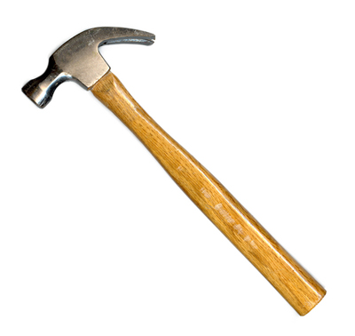
Eliminate Waste
Stop doing things that aren't worth the effort

Slide 10
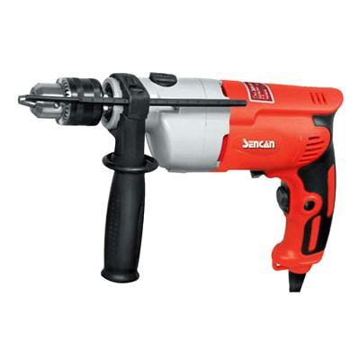
Eliminate Waste
Do the same things with less effort
Notes:
This is deceptively simple. If these two rules are simple, then why is making a lasting change so hard? Why aren’t we hurtling forward at work to ever higher levels of productivity? The reality is that we are good and seeing waste but not good at seeing its causes, and we often eliminate a wasteful practice without finding a suitable replacement.

Slide 11
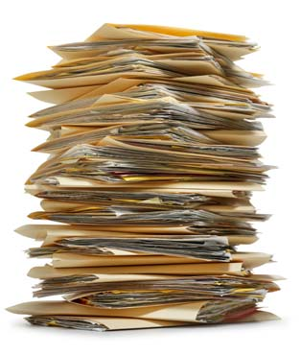
Who reads these?
Which parts?
Notes:
Some documents need to be written. But which sections of your document are essential to the success of the project, and which are just baggage? You should know the answer to this question (and they surely can't all be essential). Knowing the answer enables you to write a better document or take less time to get the same value out of a document.

Slide 12
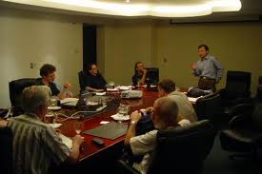
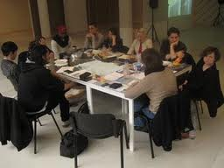
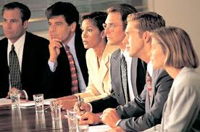
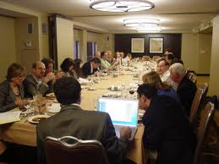

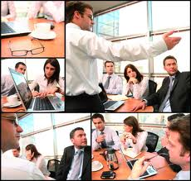
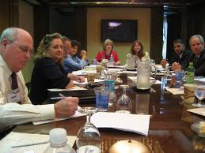
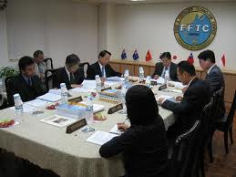
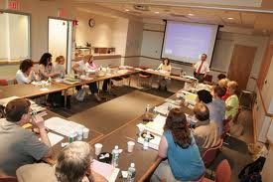
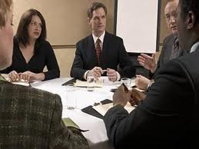
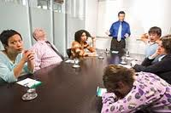

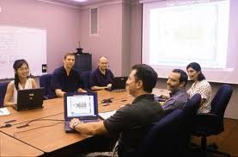
Deja Vu?
Notes:
Excessive meetings form another good example. Why do some workplaces have so many meetings? This is often a sign of a broken decision making process. Fixing a culture of meetings requires you to both find the cause and make a replacement. First identify the real problem, difficulties making decisions, and then experiment with new ways to solve the problem. Perhaps you need to discuss and embrace decision forms other than “unanimous”, or learn to hold shorter, more specific meetings, or just create a team decision board and handle issues in the team room instead of the conference room.

Slide 13
How to Make a Decision
Consensus
Majority
Plurality
Dictatorship
Gradients of Agreement
Notes:
Consensus – The most common in IT. Everyone agrees.
Majority – Decision is made when most people agree
Plurality – Decision is made by largest common group
Dictatorship – Decision is made by one person
Gradients of Agreement – From Agile Coaching
Identify the stakeholders for a decision. Not everyone gets to be involved with every decision. Tread lightly. Consensus gives everyone the illusion of equal power over an unproductive process.

Slide 14
Recognizing Waste
In-Process Inventory
Over-Production
Extra Processing
Transportation
Motion
Waiting
Defects
Notes:
To reduce cost and be more effective we must eliminate waste. By now you know we do this in two ways: find the real cause of software waste and find suitable replacements to eliminate the cause. To help us understand waste we can turn to the Lean community for inspiration. Lean is a broad and growing movement, and was first brought to the software world by Mary and Tom Poppendieck in the book Lean Software Development[1]. Lean provides, among other things, a set of categories for recognizing waste. Learning how these categories apply to software is a good first step for improvements.
These are the categories of waste within a manufacturing production system (not a software production system). The next slide shows how these categories from manufacturing map to software.

Slide 15
Recognizing Waste
In-Process Inventory
Over-Production
Extra Processing
Transportation
Motion
Waiting
Defects
Partially Done Work
Extra Features
Relearning
Handoffs
Task Switching
Delays
Defects
Notes:
The categories of software waste are different within different books. These are the categories provided by the Poppendieck's in (I think) Implementing Lean. I used to have the correct citation but I lost it now and I'm too lazy to stand up and search the bookshelf. Trust me on this one.
Let's talk about these 7 types of waste, starting with partially done work.

Slide 16
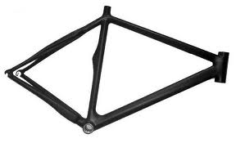
Partially Done Work
Notes:
So you own a bicycle factory and you make 1000 mountain bike frames with the plan to later make the handlebars and ship the whole units. When your customers decide they want road bikes instead you’re stuck with 1000 useless frames.
You didn't think it was waste when you were building the frames, but when demand changed you were left with a lot of useless metal. Anything ½ done is waste because there may not be a demand for the product by the time it is finally fully built.
It would have been better to produce one entire bike at a time. Then, you would never be left with excess inventory.

Slide 17

Partially Done Work
Notes:
Or maybe, instead of a bicycle tycoon, you are a humble developer needing to write a new fangled Service Oriented Architecture. Someone (usually a consultant) says “You need to design Contract First” so you spend two weeks creating ten different WSDL service descriptors by hand. Guess what happens when the architecture group decides to switch to REST and plain old XML services? Yup, you just worked for two weeks and have nothing to show for it. In-process inventory is a risk and a cost, whether it is half built bicycles or partially complete web services. Changing requirements and technologies will leave you with wasted effort sooner or later. When this happens to me I think, “I wish I’d spent two weeks at home instead, it would have had the same value to my company.” Partially done work manifests in many ways in software development.

Slide 18
Partially Done Work
Code without Tests
  TDD? ATDD?
Notes:
Work that has been started but not delivered eats up the time investment from developers but does not provide value to the client. Any work that has been started but not completed is a form of waste, and we must optimize our life-cycle to keep our user stories out of this state!
Done isn’t done until the unit and acceptance tests pass.

Slide 19
Partially Done Work
Code without Tests
  TDD? ATDD?
Code Not Checked In
  Continuous Integration (https://ci.canoo.com/teamcity/)? Code on a branch?
Notes:
Code not checked in is a form of waste. Code not on the main development is a form of waste. This is one reason I'm hesitant to embrace the branch-crazy world of distributed version control (I'm learning though).
A proper continuous integration and project automation system can help reduce partially done work. Developers can make small changes, check in, and have the system verify that no tests break.
CI is a bit topic, and project automation is an even bigger one. I've heard good reviews of Jez Humble's book on the topic but have not read it myself. Perhaps it's something to read of you want to know more.

Slide 20
Partially Done Work
Code without Tests
  TDD? ATDD?
Code Not Checked In
  Continuous Integration (https://ci.canoo.com/teamcity/)? Code on a branch?
Undeployed Code
  Automated acceptance tests? Automated deployments?
Notes:
It is logical that developing features in small increments means you deliver sooner, and there is value in that. Delivering a partial system on an earlier calendar date means the customer starts accruing a return on investment before project completion, and this can even result in the system paying for itself before the project is even finished. But will delivering smaller increments really increase or decrease your output in the long term? The answer from queuing theory research is that smaller batch size increases output.
Are you really delivering value at the end of each iteration?

Slide 21
Partially Done Work
Code without Tests
  TDD? ATDD?
Code Not Checked In
  Continuous Integration (https://ci.canoo.com/teamcity/)? Code on a branch?
Undeployed Code
  Automated acceptance tests? Automated deployments?
Concurrent, single-person projects
Notes:
Many 'teams' assign each developer on the team a different task. If there are 5 people then there are 5 small projects in parallel. The problem with this is that it extends the time that each project is partially done. If each mini-project is 60 hours in size (two weeks on the calendar), then the team velocity is 300 hours at the end of two weeks.
What happens during an emergency, when all work must be abandoned after 1 week for some other critical task? With single person projects nothing is delivered after one week. 150 hours were exerted writing software and resulted in zero value.
A better alternative is to have all 5 developers work on one task together until it is finished. That way partially done work is minimized. When the 2 week iteration is canceled after just one week, then the team has still delivered 150 hours of the project, or roughly half of the mini-projects.

Slide 22
Recognizing Waste
Partially Done Work
Extra Features
Relearning
Handoffs
Task Switching
Delays
Defects
Notes:
The next category of waste is extra features.

Slide 23
Extra Features
65% of software features are rarely to never used (Standish Group)
Notes:
This 'fact' was presented by Standish at an XP conference. It was the conference in Italy (I think XP 2002). Again, I have a citation, but it is buried somewhere on my machine. I can find it if you really need it.
The implication is that we could save 65% of our costs by simple not writing those features that no one uses. Easier said than done.

Slide 24
Extra Features
65% of software features are rarely to never used (Standish Group)
Avoid Big Design Up Front
  YAGNI, KISS
  Evolutionary Architecture? Emergent Design?
Notes:
Here are some ideas to avoid writing extra features.
YAGNI = You Ain't Gonna Need It
KISS = Keep it simple stupid
There have been several conference talks and blogs about Evolutionary Architecture and Emergent Design over the years. This seems to work best with a highly skilled team.

Slide 25
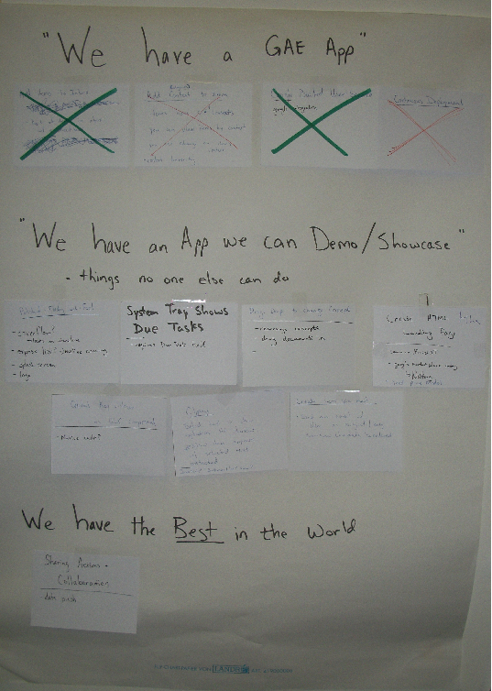

Notes:
Another technique to avoid feature bloat is “minimal marketable feature set”.
This picture is the minimal marketable feature set for the Canoo Finish product we worked on last Fall.
The idea is to define the absolute minimum features a product needs to be released and then do no more. This ensures that only the most important things get into your product.

Slide 26
Extra Features
65% of software features are rarely to never used (Standish Group)
Avoid Big Design Up Front
  YAGNI, KISS
  Evolutionary Architecture? Evolutionary Design?
  Define a Minimal Marketable Feature Set

Slide 27
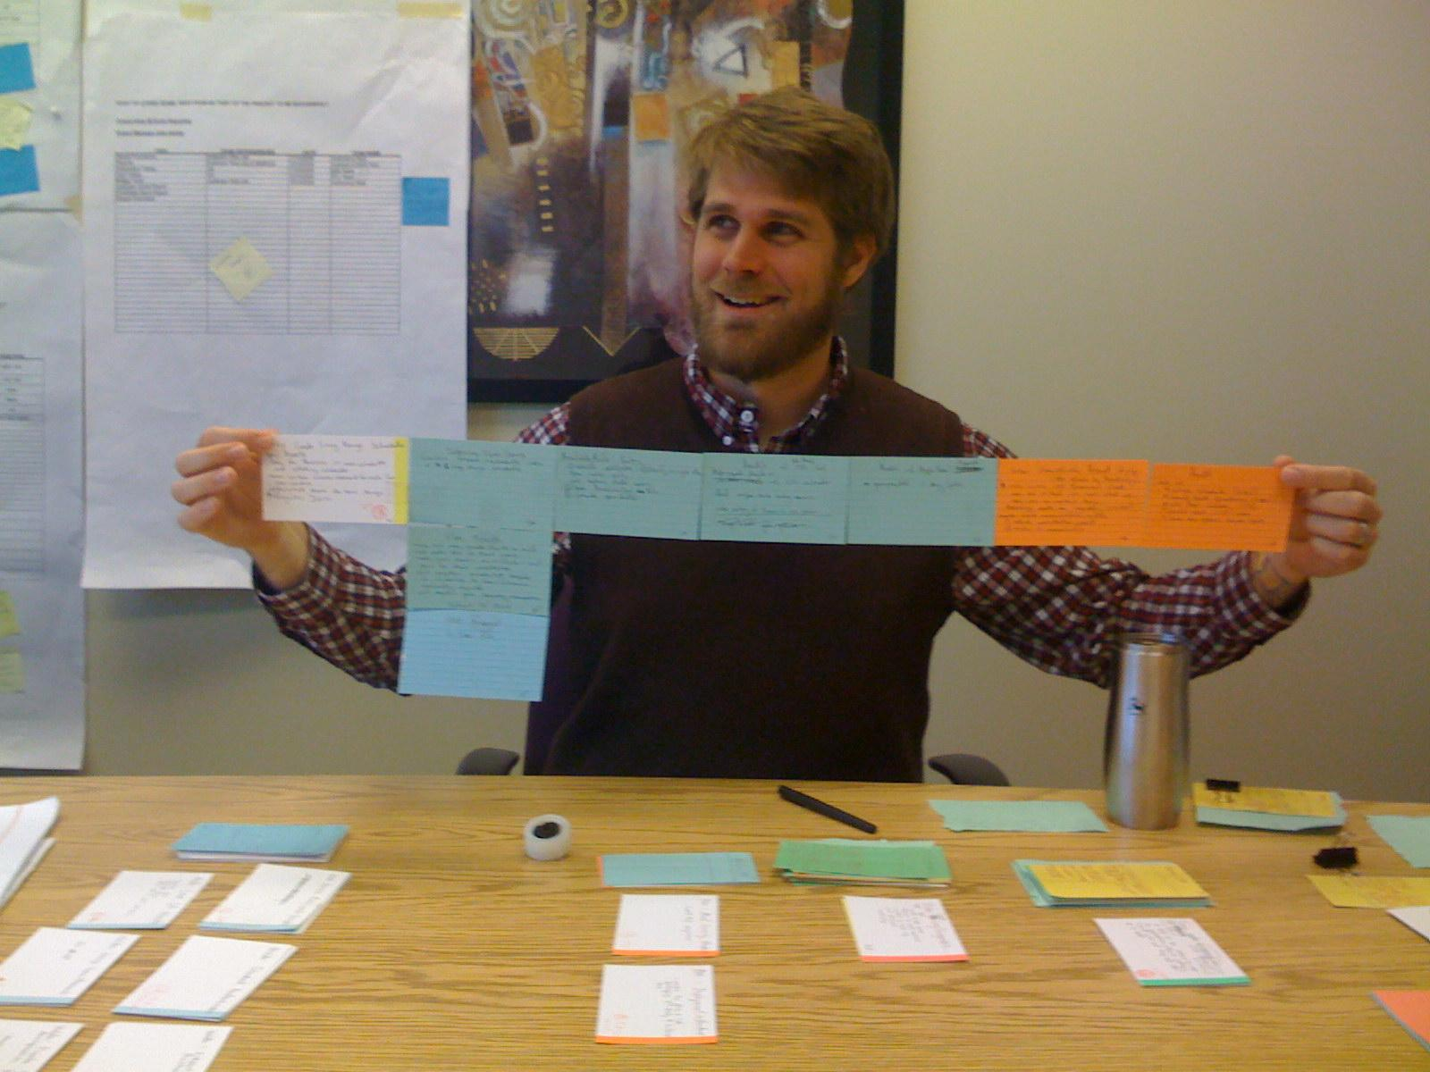
Notes:
Story cards are a lightweight alternative to requirements documents.
This is me with a “hamcordian”, a story card.

Slide 28
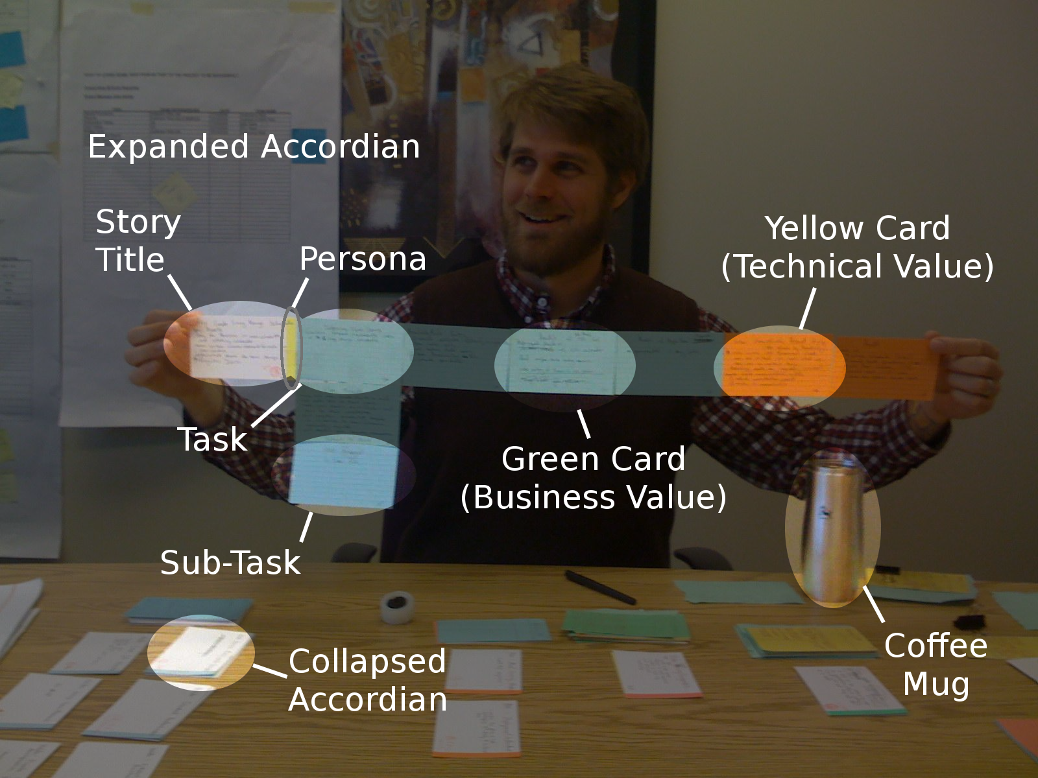
Notes:
There are many approaches to story cards.
Experiment and see what works best for you.

Slide 29
Extra Features
65% of software features are rarely to never used (Standish Group)
Avoid Big Design Up Front
  YAGNI, KISS
  Evolutionary Architecture? Evolutionary Design?
  Define a Minimal Marketable Feature Set
  Prefer Low-Ceremony Processes, like story cards

Slide 30
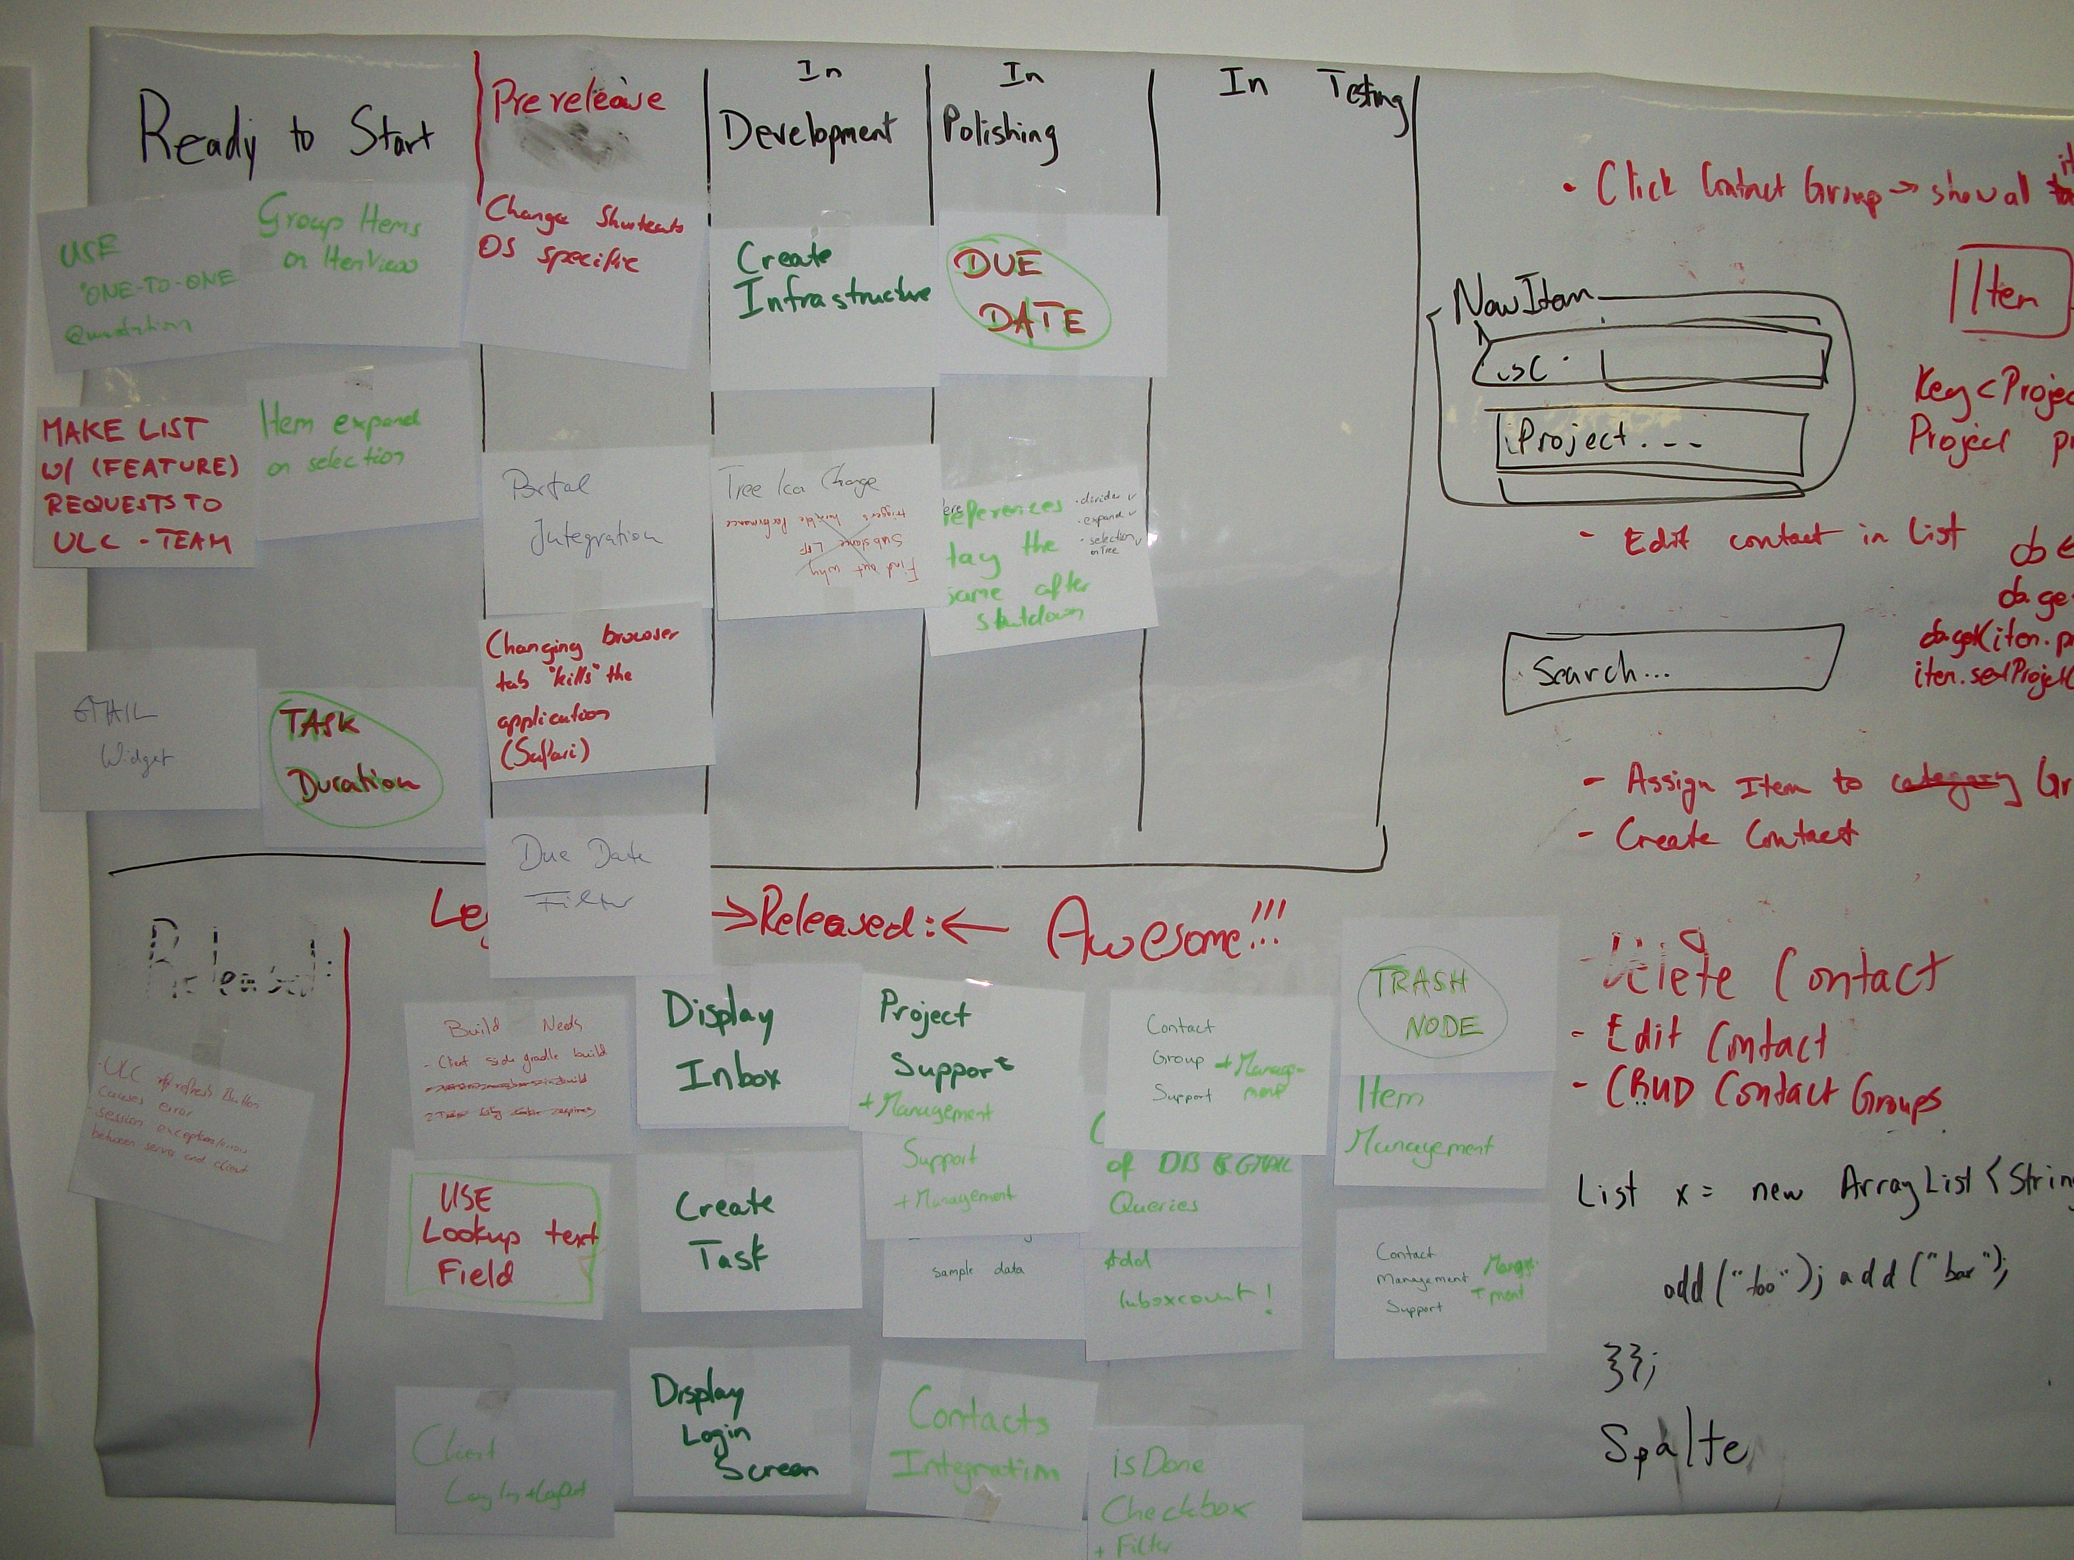
Flow of Value
Notes:
This is the Kanban board for our project. It helps us keep a minimal amount of work in progress and also focus on delivering full features one at a time to the users.
The problem with scrum iterations is that an iteration is not a unit of value, it is a unit of time. The customer is not asking to have time delivered, she is asking to have value delivered.
This is possibly good for maintenance team as well, where the team does not have tasks that fit well into a Scrum backlog. That's a guess though. I haven't tried it on a maintenance team myself.

Slide 31
Extra Features
65% of software features are rarely to never used (Standish Group)
Avoid Big Design Up Front
  YAGNI, KISS
  Evolutionary Architecture? Evolutionary Design?
  Define a Minimal Marketable Feature Set
  Prefer Low-Ceremony Processes, like story cards
  Deliver full features to users quickly

Slide 32
Recognizing Waste
Partially Done Work
Extra Features
Relearning
Handoffs
Task Switching
Delays
Defects
Notes:
Relearning is the next category.

Slide 33
Relearning
How do you not lose or forget information?
How do you chronicle successes and failures
Notes:
Rework in manufacturing is easy to identify. Sending a bike frame back through painting to turn it from blue to red is rework. You shouldn’t have painted it blue in the first place and now you’ve wasted time and paint. How does this map to software development? Discovering something we once knew but have now forgotten is one definition. In big companies it’s quite common to have two different groups independently verify a technical failure. You hear anecdotal evidence of it after work wherever developers gather to drink.
Dev #1 – Ugh, our new web framework sucks.
Dev #2 – Yes, we tried the same framework last year and it does suck.
How great would it be if this conversation could have happened six months ago before the second attempt at using the web framework. Sharing and broadcasting failures is just as important as broadcasting successes. Good decisions come from knowing what you should not do as much as what you should do.
For more, read this: http://www.canoo.com/blog/2011/03/08/waste/

Slide 34
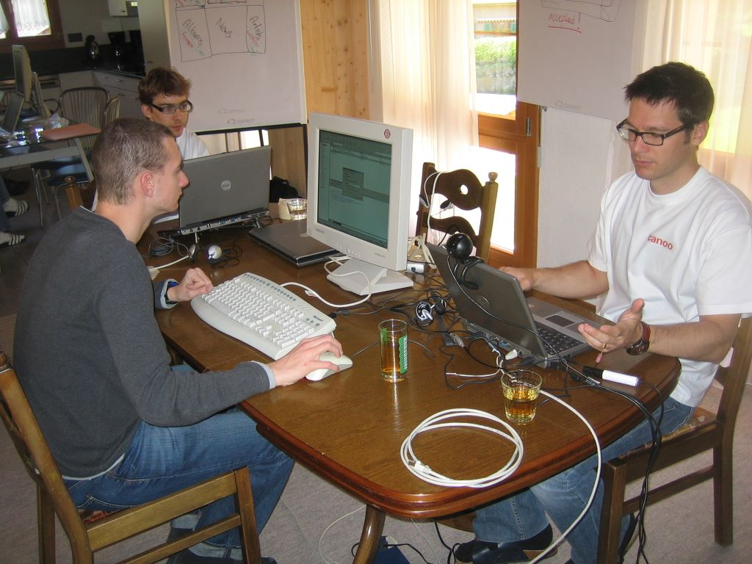
Notes:
A Team Room (sort of)
Team rooms create tacit knowledge. Creating knowledge is good.

Slide 35
Relearning
How do you not lose or forget information?
How do you chronicle successes and failures
Team rooms create tacit knowledge

Slide 36
Relearning
How do you not lose or forget information?
How do you chronicle successes and failures
Team rooms create tacit knowledge
Automated tests create explicit knowledge
  Every defect is fixed with a test
Notes:
The problem with tacit knowledge is that it is not executable or easily verified. But you know what is executable and easily verified? Automated tests.
You can avoid relearning by making sure that every defect fixed is accompanied by a passing unit test. This ensures that the defect will never again be introduced (in theory, at least).

Slide 37
Relearning
How do you not lose or forget information?
How do you chronicle successes and failures
Team rooms create tacit knowledge
Automated tests create explicit knowledge
  Every defect is fixed with a test
Can your documents have comments? Can they be marked out-of-date?
Notes:
I find Word to be a poor platform for software documentation. For some reason it is everywhere though.
How often have you read a document and thought, “This information is old and out-of-date.” Did you do anything about it? Probably not. What do you think the next person did with the document? Did they know it was out of date too, did they have to discover this information themselves?
You can't easily leave a comment on a Word document or mark a Word document out-of-date. A wiki allows you to do this though. I prefer wikis for project documentation because when you find false information you can at least leave a comment telling future readers when things aren't right.

Slide 38
Recognizing Waste
Partially Done Work
Extra Features
Relearning
Handoffs
Task Switching
Delays
Defects
Notes:
Next up: Handoffs.

Slide 39
Handoffs
Transferring information between people is lossy

Slide 40
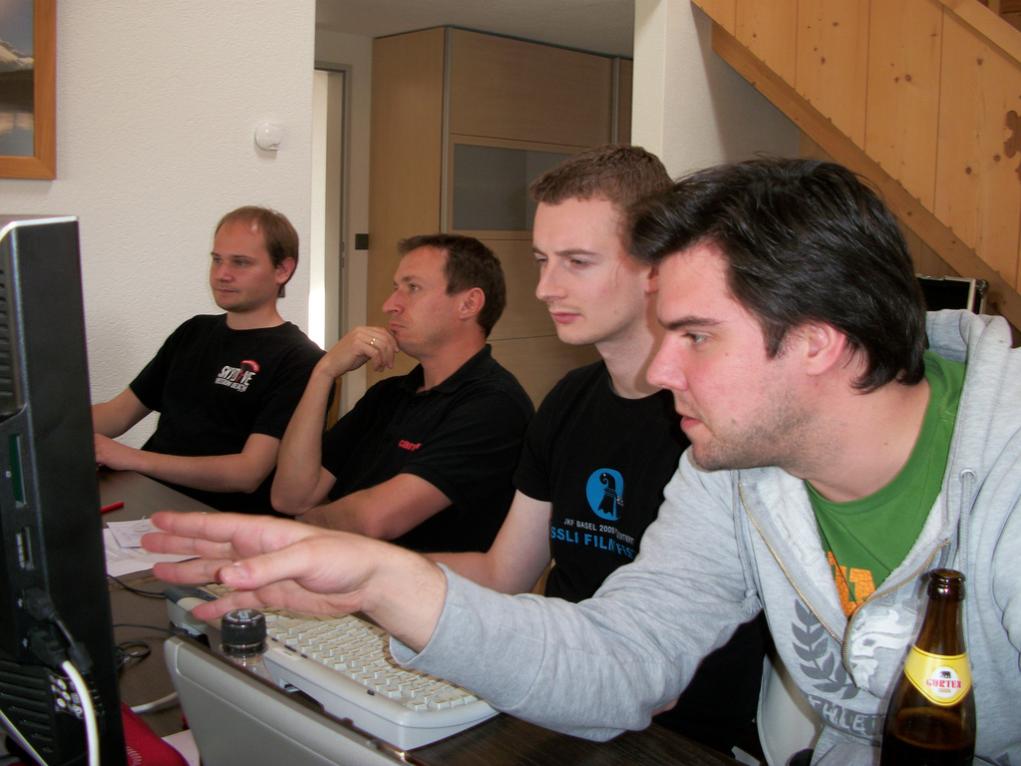
Notes:
Pair programming creates redundancy. With a pairing-team, I've seen new team members ramped up without a formal handoff. This is good; we need to avoid handoffs.
If you want to ensure just-in-time delivery of system knowledge to your new teammate then sit the entire team in the same room and let the newbie ask questions when they are needed.

Slide 41
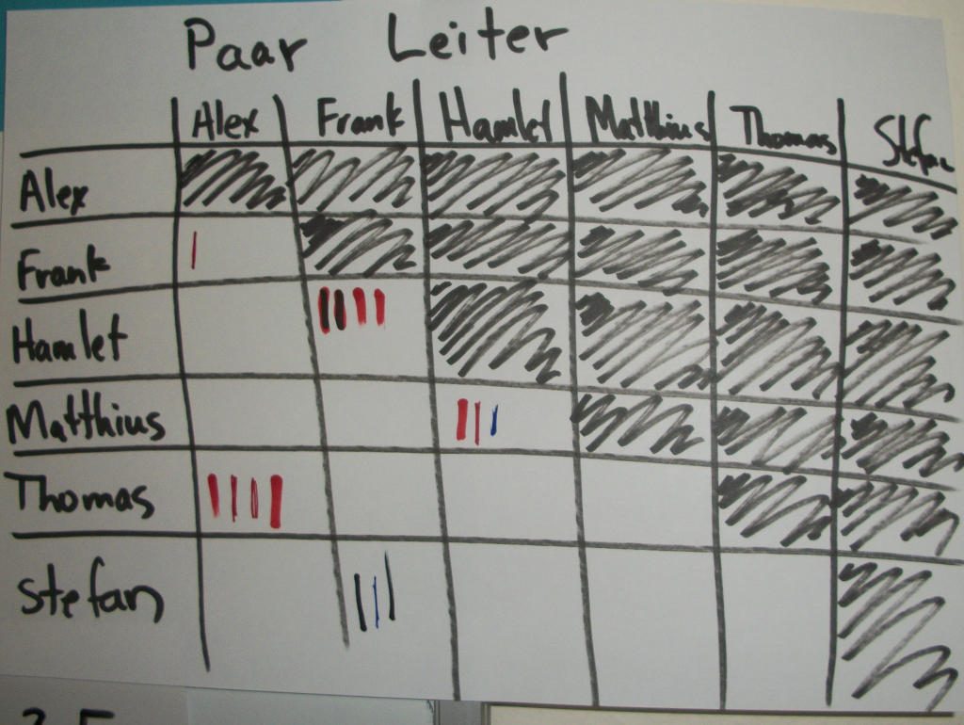
Notes:
A pair ladder helps you manage pairing, making sure cliques don't form and that people really are pairing together. If you're not getting traction or have low adoption with pairing, then perhaps try a pair-ladder to track who is pairing with whom.

Slide 42
Handoffs
Transferring information between people is lossy
Team Rooms & Pairing minimize handoffs
  'Pair Ladders' can be used to promote fair pairing

Slide 43
Handoffs
Transferring information between people is lossy
Team Rooms & Pairing minimize handoffs
  'Pair Ladders' can be used to promote fair pairing
Open Source & Non-Proprietary software reduces handoff cost
Notes:
Proprietary software increases handoffs. New people with the right skills cannot be hired when the only company using a technology is you.
Using open source and non-proprietary software reduces the need for handoffs. I wish more companies thought about this when they make the decision to build their own web framework.

Slide 44
Recognizing Waste
Partially Done Work
Extra Features
Relearning
Handoffs
Task Switching
Delays
Defects

Slide 45
Task Switching
3 one-week tasks always take longer than 3 weeks to deliver
Notes:
Even if the task switching time is 10 seconds, then 3 one-week tasks will take 3 weeks and 30 seconds.

Slide 46
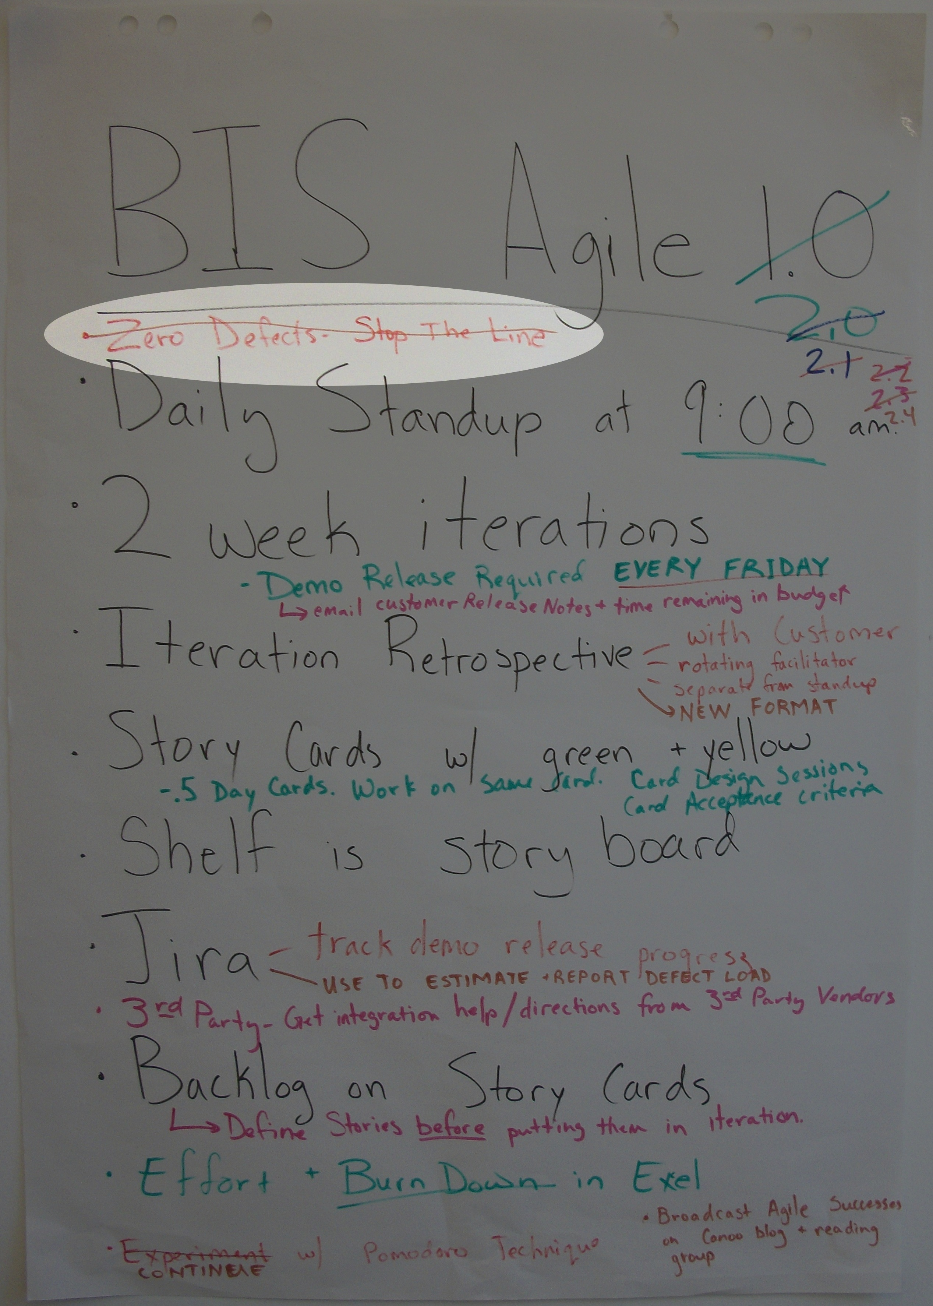
Zero Defects
Stop the Line
Notes:
We tried a zero-defect approach, where we would stop all feature work and fix defects immediately when they were found. But we found this to increase our task switching.
Defects and maintenance work is a big interruption.

Slide 47
Task Switching
3 one-week tasks always take longer than 3 weeks to deliver
Maintenance work often requires a task switch
  Maintenance Team?
  Defect Fridays?
Notes:
There is always maintenance work arriving at an uneven rate. You can’t eliminate that disruption but you can minimize it. One way is with a separate maintenance team, but I can’t imagine living through that drudgery for more than a few weeks before looking for a new job. Plus, living with your code in production brings valuable lessons. A temporary maintenance team where you serve for only a few weeks has worked for me in the past, mainly because there is a light at the end of the tunnel and you know when your tour of duty is up. A better solution is having maintenance days. For example, every Friday the team must work solely on defects and maintenance issues. Having everyone work maintenance is fair, and it also minimizes interruption. When a small team is needed to solve a problem then the right people are available and feature work isn’t being interrupted. Just be careful. Senior team members tend to have more vacation and sometimes take Fridays off near the end of the year. If this is the case, pick a different day. Also, some defects take longer than one day to fix. You may find defect Friday stretching into defect Monday as well, splintering the team.

Slide 48
Recognizing Waste
Partially Done Work
Extra Features
Relearning
Handoffs
Task Switching
Delays
Defects
Notes:
Wait for it...
Wait for it...
… delays.

Slide 49
Delays
Time waiting is time wasted

Slide 50
Delays
Time waiting is time wasted
Avoid large tasks
Beware documentation tasks
Create a Value Stream Map
Notes:
Waiting for approval on a document is a big source of wait times within big companies. If your large requirements document is not approved, then why have a large document in the first place? Why not break it up into smaller pieces, in which case portions of it can be approved and you can move on. If your design documents need approval, then why not break these up into manageable portions as well. In Waterfall shops, or other bureaucratic environments, the process police don’t normally care if you produce more, smaller documents. Just avoid having no documentation. Short iterations aren’t just for code. If you’re stuck with delays, break down the problem into smaller pieces and deliver less more often.

Slide 51
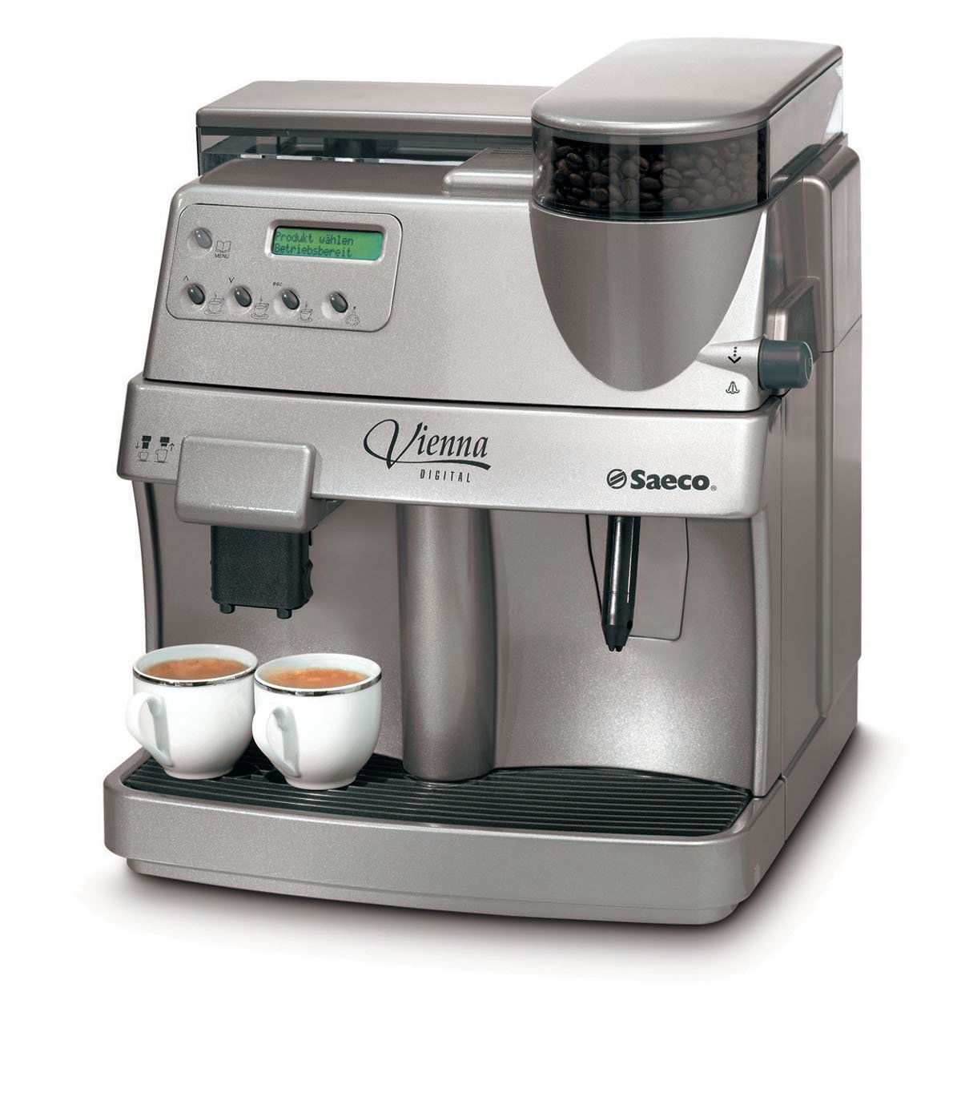



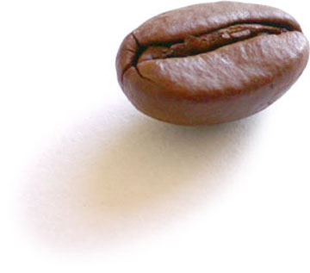
Value Stream Mapping
refill water
120 / 10
refill beans
120 / 10
Notes:
This is a value stream map of Canoo's coffee machine.
Walk to the machine (2 minutes)
Press the button and wait (30 seconds)
Every tenth time refill the water (2 minutes)
Every tenth time refill the beans (2 minutes)
On average, a cup of coffee takes 174 seconds.

Slide 52
Value Steam Mapping
174 Seconds Average
= CHF 43,000 a year
150 Seconds Average
= CHF 37,500 a year
Notes:
One particularly useful Lean practice for eliminating waste is Value Stream Mapping. Sit down at a whiteboard with your development team and write out your software process: the steps and time it takes to move an idea from inception to customer delivery. Where are the bottlenecks? What are the delays? Why does it take so long? Visualizing and quantifying your process helps everyone clearly see problem areas.
The bottlenecks in the coffee process are waiting for the coffee, refilling the water, and refilling the beans. Instead of waiting for the coffee a person could refill the beans just a little every time, or refill the water just a little every time. Viola, you're no longer waiting. This reduces the cost of coffee to 150 seconds on average.
We are a small company. But if we did this then we would save almost 6000 francs a year. Why wouldn't we do this?

Slide 53
Recognizing Waste
Partially Done Work
Extra Features
Relearning
Handoffs
Task Switching
Delays
Defects

Slide 54
Defects
Better use of meetings or documentation cannot produce higher quality
Quality comes from people caring
Notes:
These aren't quantified, but it's how I feel.

Slide 55
Defects
Better use of meetings or documentation cannot produce higher quality
Quality comes from people caring
Focus on prevention not discovery
  Code Quality Tools (Pylint, Pychecker, Pyflakes?)
  Code Reviews
  Pair-Programming as Code Review
Notes:
If quality is the domain of a single person or department, then it’s likely quality does not describe your product. Moving QA forward in the process needs to mean partnering on acceptance tests that constitute the design of the product. Having a developer and tester pairing on the same workstation is a good sign, and automated acceptance test frameworks facilitate this. Fitnesse, easyb, whatever. Having a developer and tester work in different tools, where neither has access to the other, leads to strong test ownership and little collaboration. It is easy to give the advice that “whenever a defect is found, a test should be created so that it cannot happen again.” To do this, you need to pick a development tool where your testers can create a failing test for the developers, and then throw out that other one you were using before.

Slide 56
Usability Defects
User interfaces do have defects
Use Paper Prototyping and Guerrilla Usability
Integrate user testing into your software lifecycle
Notes:
Reworking UI is a form of defect.
I suggest you read this, which describes how to integrate usability into a agile lifecycle: http://www.canoo.com/blog/2010/03/19/10-lessons-learned-from-usability-testing/

Slide 57
Recognizing Waste
Partially Done Work
Extra Features
Relearning
Handoffs
Task Switching
Delays
Defects
Notes:
That's it!

Slide 58
There is a big difference between eliminating waste and not creating it in the first place.
- Alan Shalloway

Slide 59
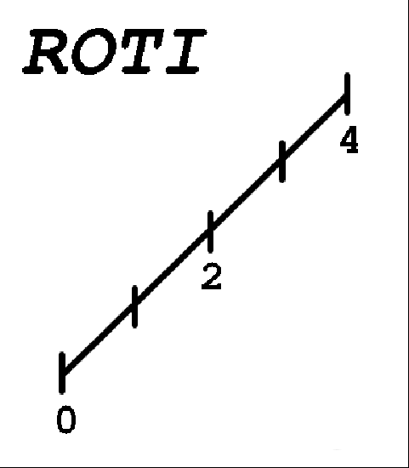
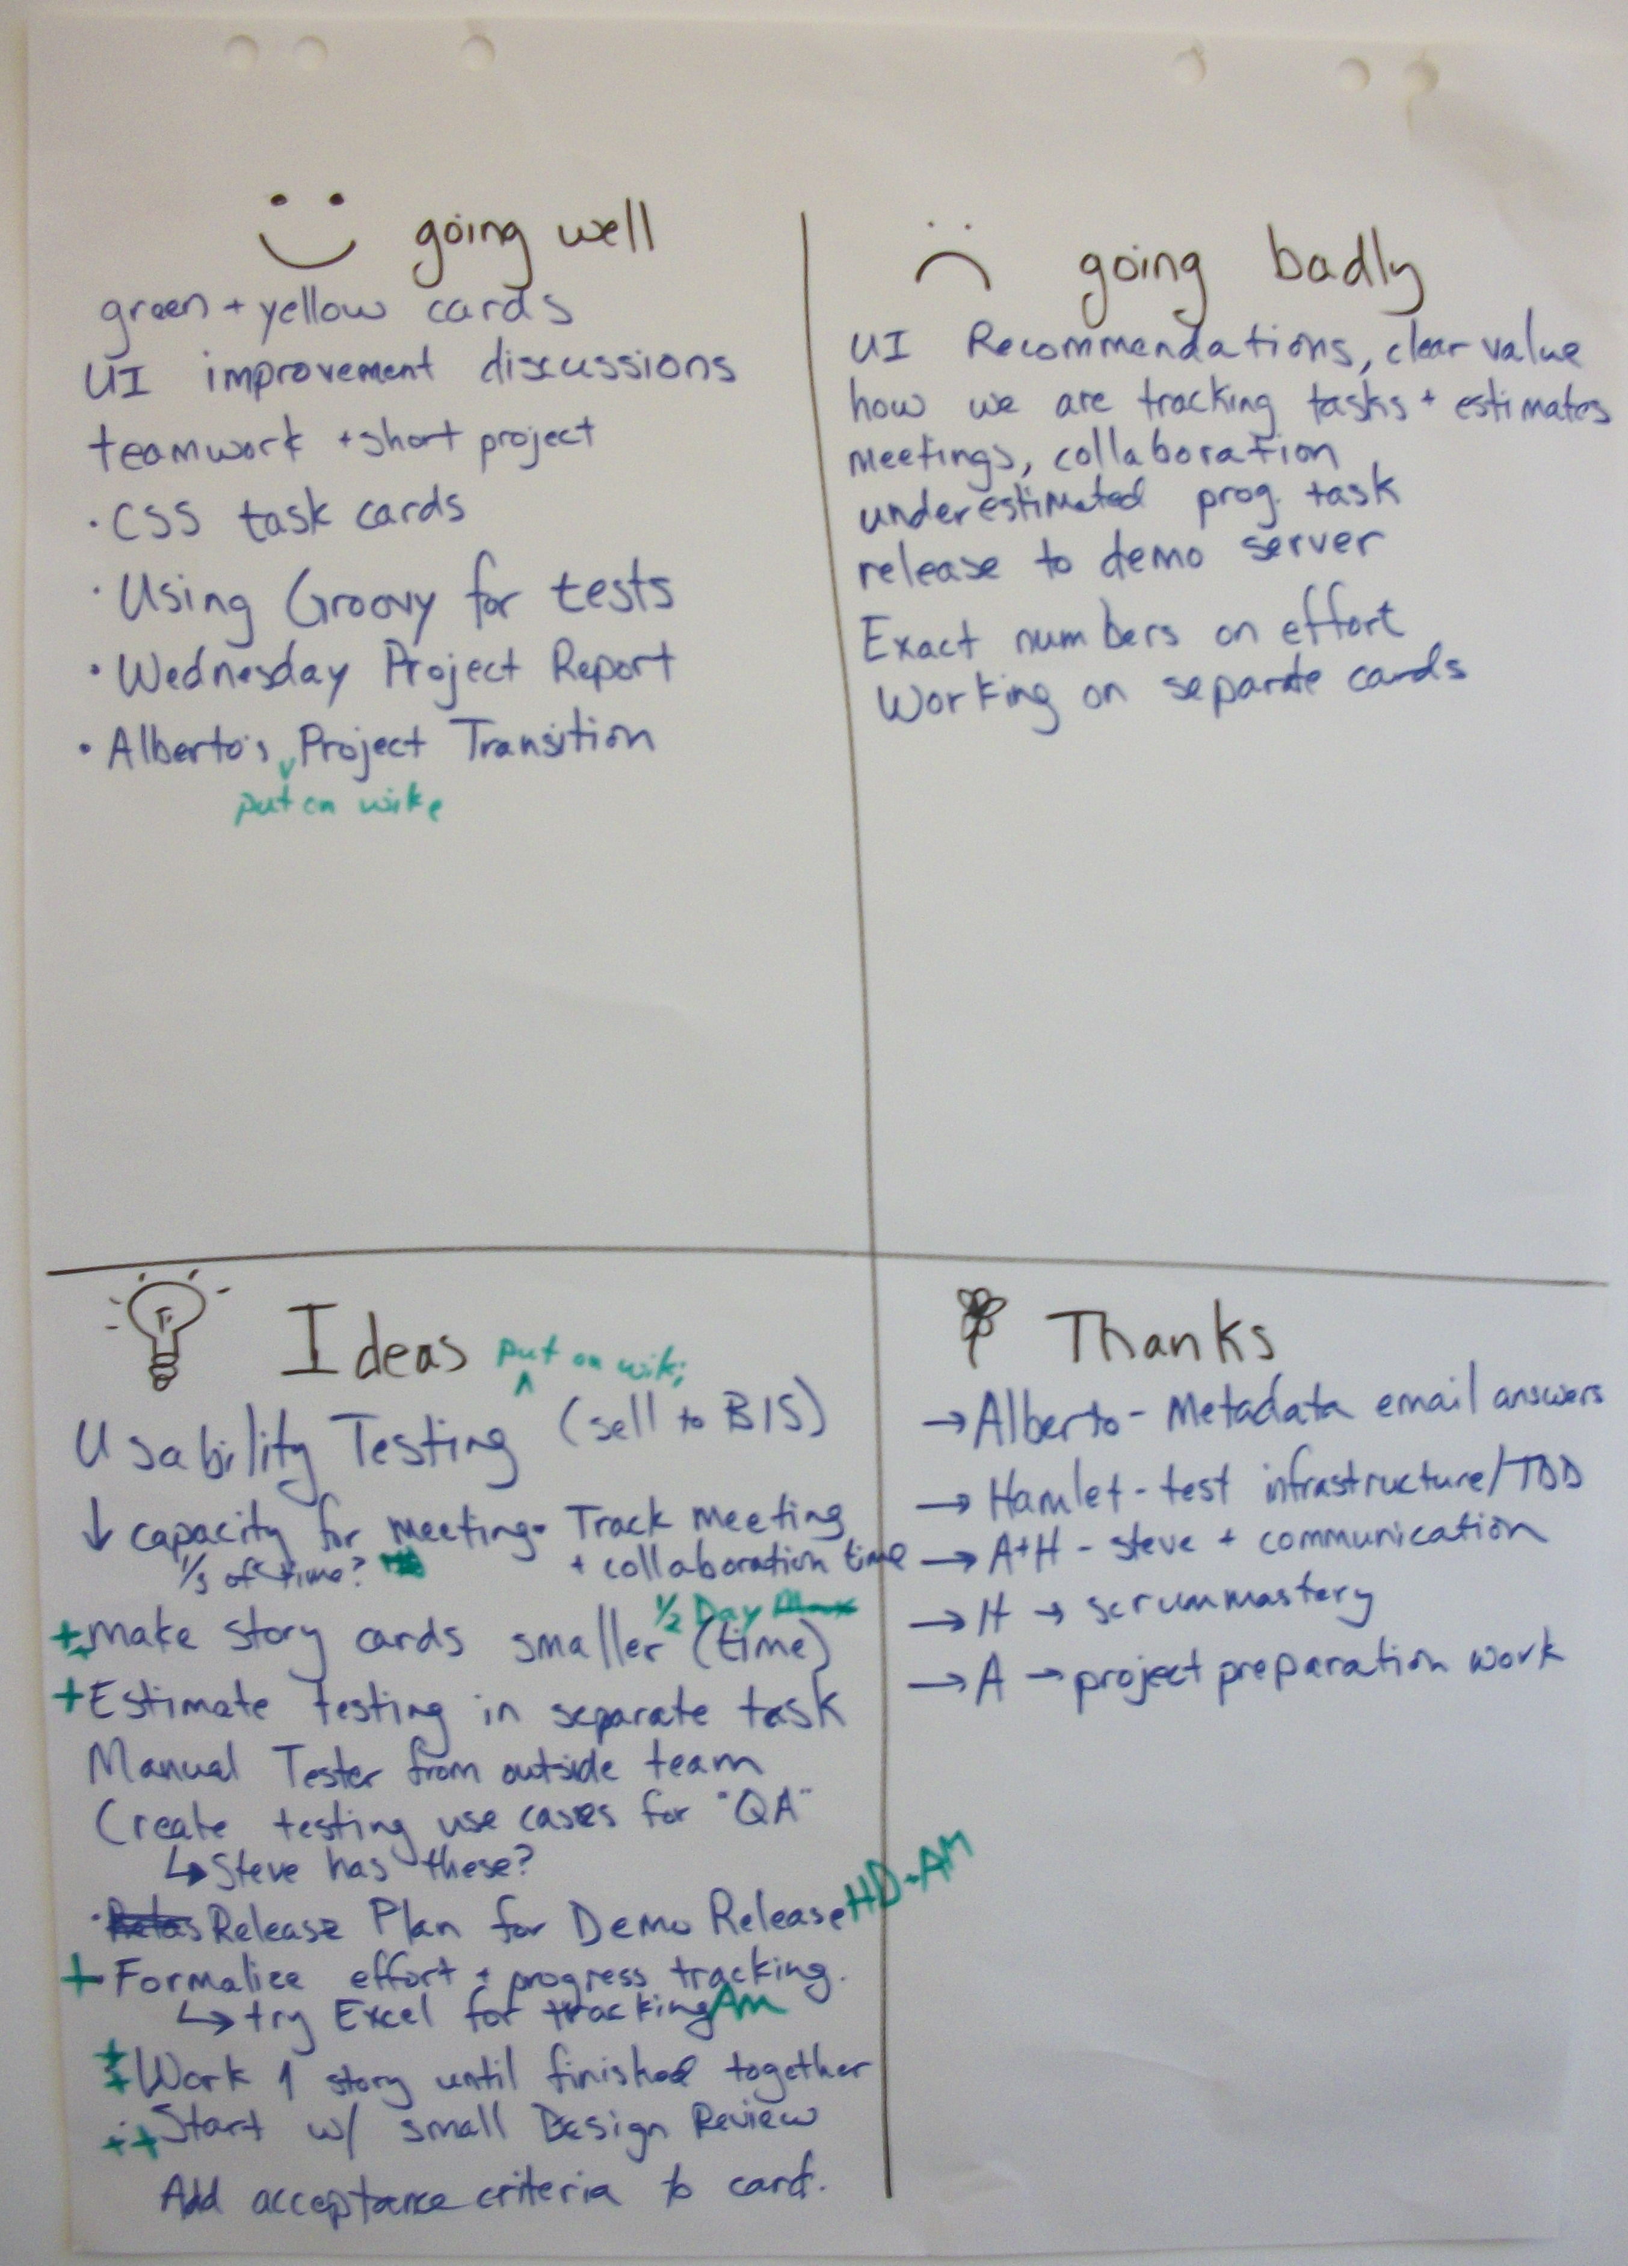
Next Steps
Create feedback cycles
Hold Retrospectives
Notes:
ROTI (Return on Time Invested) is a short way to evaluate any meeting. It should take about 2 minutes at maximum. At the end of a metting, draw this chart on the board. Each person had to rate the meeting. 3 meant it was more valuable than doing your normal work. 1 meant that the project would have been better off had you stayed at your desk and worked. Regardless of your answer, you had to provide one suggestion on how to make the session better next time.
For a better explanation read: http://hamletdarcy.blogspot.com/2010/01/60-second-agility-roti-meetings.html
Retrospectives are also a key part of process improvement.

