Slide 1
Eliminating Software Waste
Hamlet D'Arcy
Canoo Engineering, AG
@HamletDRC

Slide 2
We're here to talk about...
the process of writing software
the waste of writing software
improving how we write software
improving our team

Slide 3
Extreme Programming
Scrum
Waterfall
Lean
Agile
RUP
Kanban

Slide 4

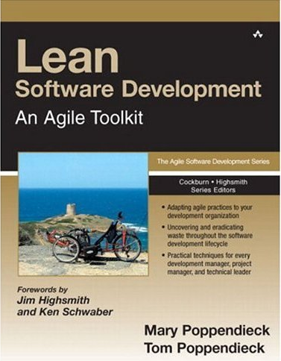
1988 – Japan 2003 – Minnesota
Notes:
Lean History
Grew out of the influential Toyota Production System, a set of philosophies and practices to weed out waste, inconsistency, and overburden from a manufacturing. 1990′s - Poppendieck's applied it to a software project. 2003 they published “Lean Software Development”. The principles have been revised over time.

Slide 5
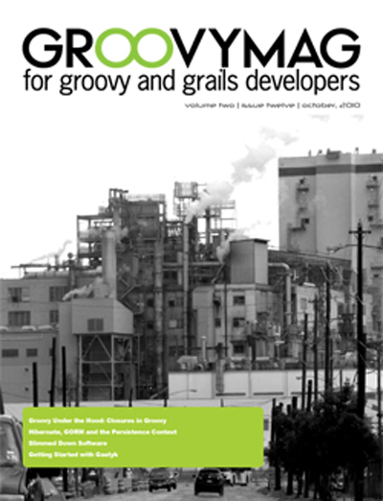
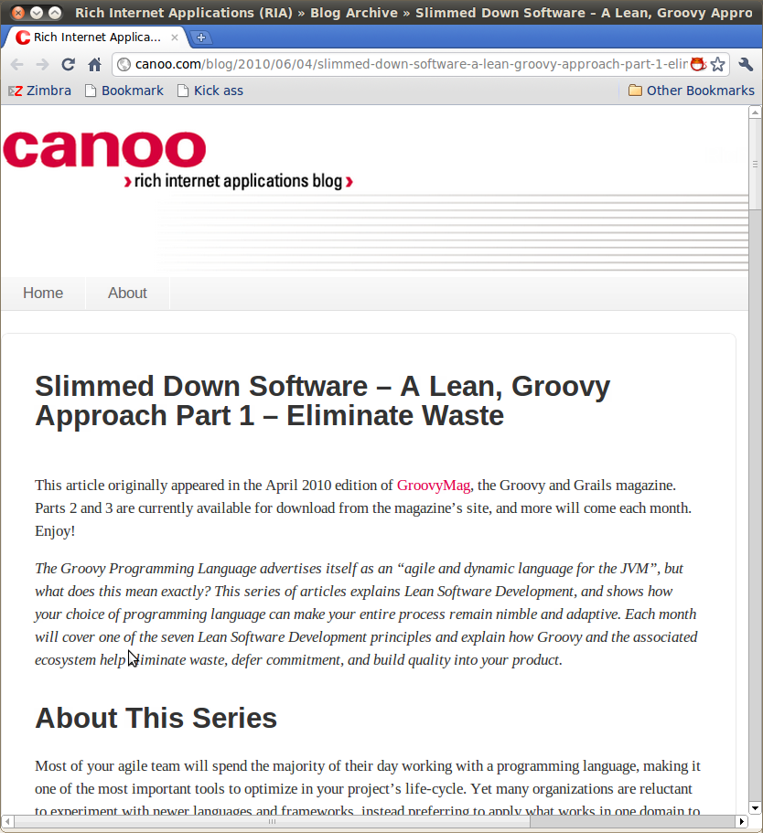
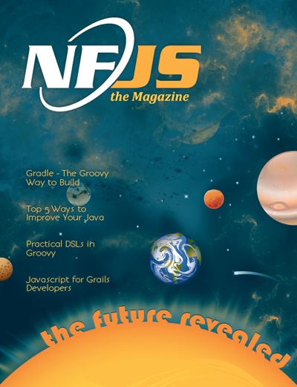
As seen in...
http://groovymag.com
http://canoo.com/blog
http://nofluffjuststuff.com/
Notes:
Some places to find more information:
Waste: http://www.canoo.com/blog/2011/03/08/waste/
http://hamletdarcy.blogspot.com/search/label/craft
http://www.canoo.com/blog/tag/agile/
Lean Groovy Presentation: http://www.infoq.com/presentations/Lean-Groovy
Lean Groovy Blog Posts:
http://www.canoo.com/blog/2011/03/02/lean-groovy-7-optimize-the-whole/

Slide 6
7 Lean Principles
Eliminate Waste
Build Quality In
Create Knowledge
Defer Commitment
Deliver Fast
Respect People
Optimize the Whole

Slide 7
7 Lean Principles
Eliminate Waste
Build Quality In
Create Knowledge
Defer Commitment
Deliver Fast
Respect People
Optimize the Whole

Slide 8
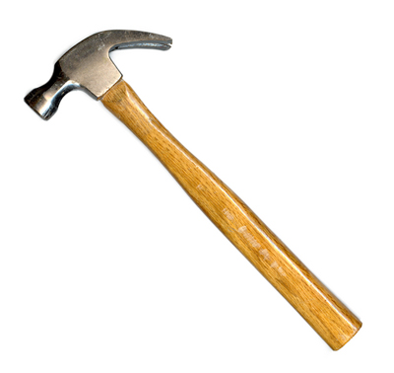
Eliminate Waste
Stop doing things that aren't worth the effort

Slide 9
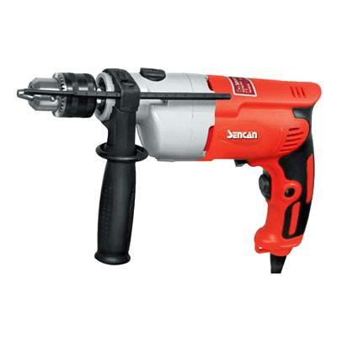
Eliminate Waste
Do the same things with less effort
Notes:
This is deceptively simple. If these two rules are simple, then why is making a lasting change so hard? Why aren’t we hurtling forward at work to ever higher levels of productivity? The reality is that we are good and seeing waste but not good at seeing its causes, and we often eliminate a wasteful practice without finding a suitable replacement.

Slide 10
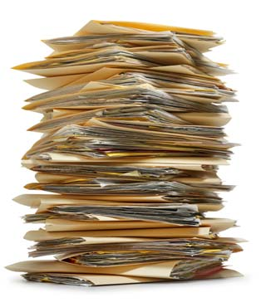
Who reads these?
Which parts?

Slide 11
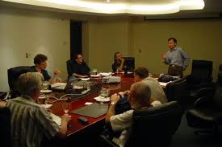
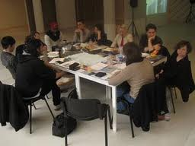
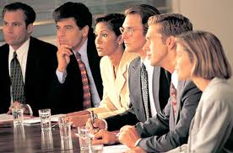
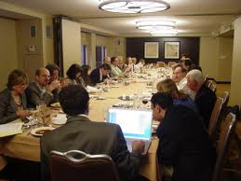

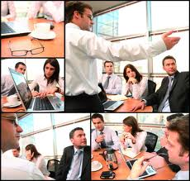
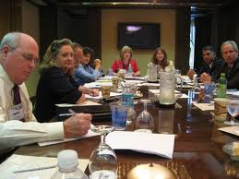
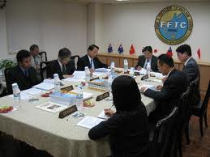
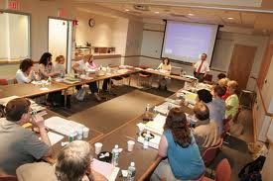
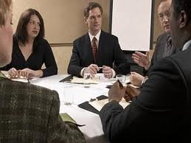
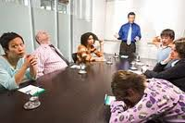

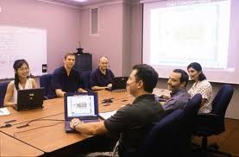
Deja Vu?
Notes:
Excessive meetings form an even better example. Why do some workplaces have so many meetings? This is often a sign of a broken decision making process. fixing a culture of meetings requires you to both find the cause and make a replacement. First identify the real problem, difficulties making decisions, and then experiment with new ways to solve the problem. Perhaps you need to discuss and embrace decision forms other than “unanimous”, or learn to hold shorter, more specific meetings, or just create a team decision board and handle issues in the team room instead of the conference room.

Slide 12
How to Make a Decision
Consensus
Majority
Plurality
Dictatorship
Gradients of Agreement
Notes:
Consensus – The most common in IT. Everyone agrees.
Majority – Decision is made when most people agree
Plurality – Decision is made by largest common group
Dictatorship – Decision is made by one person
Gradients of Agreement – From Agile Coaching
Identify the stakeholders for a decision. Not everyone gets to be involved with every decision. Tread lightly. Consensus gives everyone the illusion of equal power over an unproductive process.

Slide 13
Recognizing Waste
In-Process Inventory
Over-Production
Extra Processing
Transportation
Motion
Waiting
Defects
Partially Done Work
Extra Features
Relearning
Handoffs
Task Switching
Delays
Defects
Notes:
To reduce cost and be more effective we must eliminate waste. By now you know we do this in two ways: find the real cause of software waste and find suitable replacements to eliminate the cause. To help us understand waste we can turn to the Lean community for inspiration. Lean is a broad and growing movement, and was first brought to the software world by Mary and Tom Poppendieck in the book Lean Software Development[1]. Lean provides, among other things, a set of categories for recognizing waste. Learning how these categories apply to software is a good first step for improvements.

Slide 14
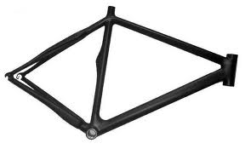
Partially Done Work
Notes:
So you own a bicycle factory and you make 1000 mountain bike frames with the plan to later make the handlebars and ship the whole units. When your customers decide they want road bikes instead you’re stuck with 1000 useless frames. It would have been better to produce one entire bike at a time. Then, you would never be left with excess inventory.

Slide 15

Partially Done Work
Notes:
Or maybe, instead of a bicycle tycoon, you are a humble developer needing to write a new fangled Service Oriented Architecture. Someone (usually a consultant) says “You need to design Contract First” so you spend two weeks creating ten different WSDL service descriptors by hand. Guess what happens when the architecture group decides to switch to REST and plain old XML services? Yup, you just worked for two weeks and have nothing to show for it. In-process inventory is a risk and a cost, whether it is half built bicycles or partially complete web services. Changing requirements and technologies will leave you with wasted effort sooner or later. When this happens to me I think, “I wish I’d spent two weeks at home instead, it would have had the same value to my company.” Partially done work manifests in many ways in software development.

Slide 16
Partially Done Work
Code without Tests
  TDD? ATDD?
Notes:
Work that has been started but not delivered eats up the time investment from developers but does not provide value to the client. Any work that has been started but not completed is a form of waste, and we must optimize our life-cycle to keep our user stories out of this state!
Done isn’t done until the unit and acceptance tests pass. Having used Groovy as a testing language on several projects in the last few years, my team’s experience is that the same test coverage and quality can be reached with Groovy in less time than it takes using Java.

Slide 17
Partially Done Work
Code without Tests
  TDD? ATDD?
Code Not Checked In
  Continuous Integration (https://ci.canoo.com/teamcity/)? Code on a branch?

Slide 18
Partially Done Work
Code without Tests
  TDD? ATDD?
Code Not Checked In
  Continuous Integration (https://ci.canoo.com/teamcity/)? Code on a branch?
Undeployed Code
  Automated acceptance tests? Automated deployments?

Slide 19
Partially Done Work
Code without Tests
  TDD? ATDD?
Code Not Checked In
  Continuous Integration (https://ci.canoo.com/teamcity/)? Code on a branch?
Undeployed Code
  Automated acceptance tests? Automated deployments?
Concurrent, single-person projects

Slide 20
Recognizing Waste
Partially Done Work
Extra Features
Relearning
Handoffs
Task Switching
Delays
Defects

Slide 21
Extra Features
65% of software features are rarely to never used (Standish Group)

Slide 22
Extra Features
65% of software features are rarely to never used (Standish Group)
Avoid Big Design Up Front
  YAGNI, KISS
  Evolutionary Architecture? Evolutionary Design?

Slide 23
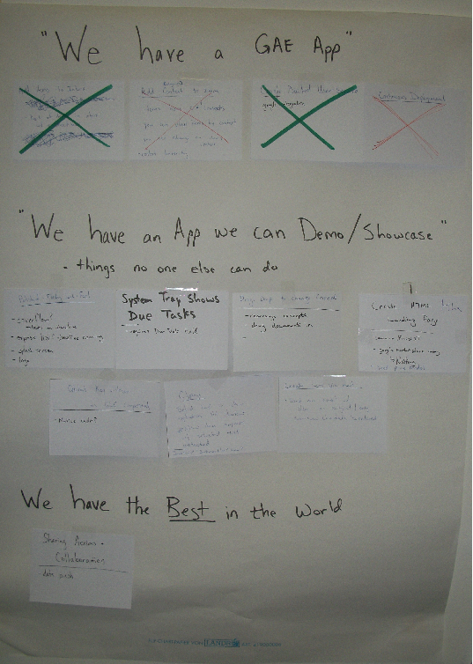

Notes:
A minimal marketable feature set for the Canoo Finish product

Slide 24
Extra Features
65% of software features are rarely to never used (Standish Group)
Avoid Big Design Up Front
  YAGNI, KISS
  Evolutionary Architecture? Evolutionary Design?
  Define a Minimal Marketable Feature Set

Slide 25
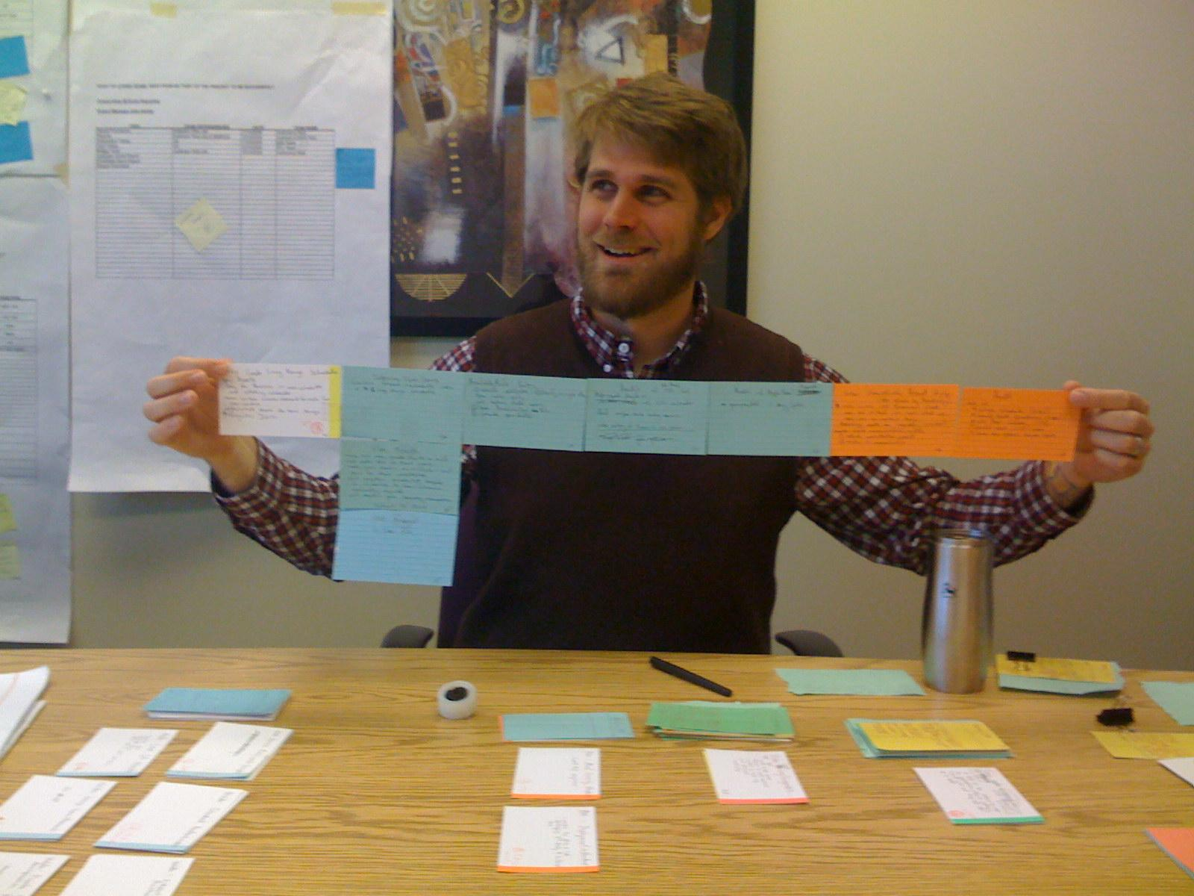

Slide 26
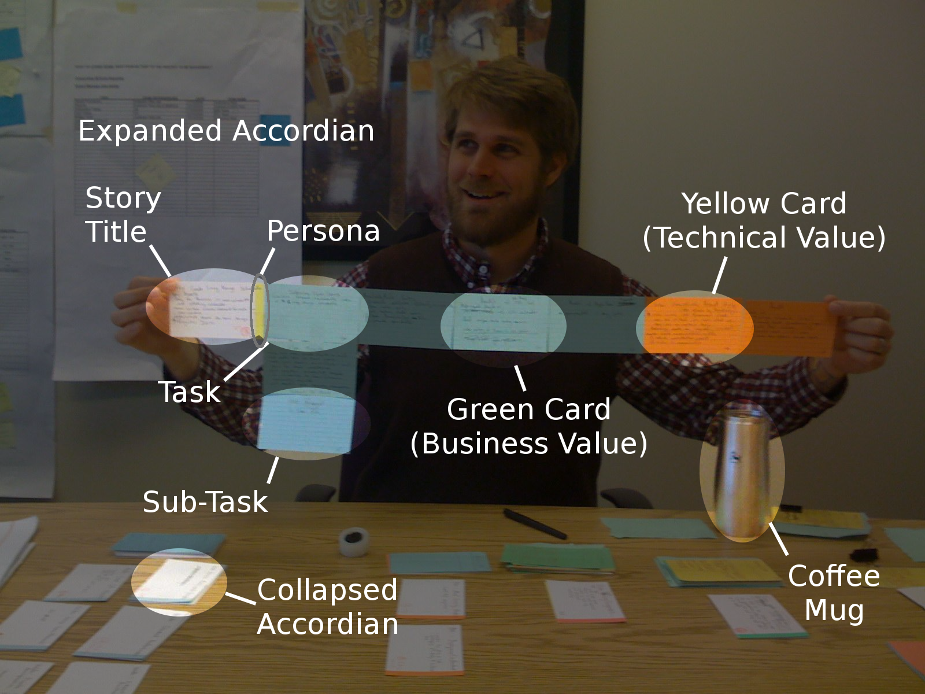

Slide 27
Extra Features
65% of software features are rarely to never used (Standish Group)
Avoid Big Design Up Front
  YAGNI, KISS
  Evolutionary Architecture? Evolutionary Design?
  Define a Minimal Marketable Feature Set
  Prefer Low-Ceremony Processes, like story cards

Slide 28
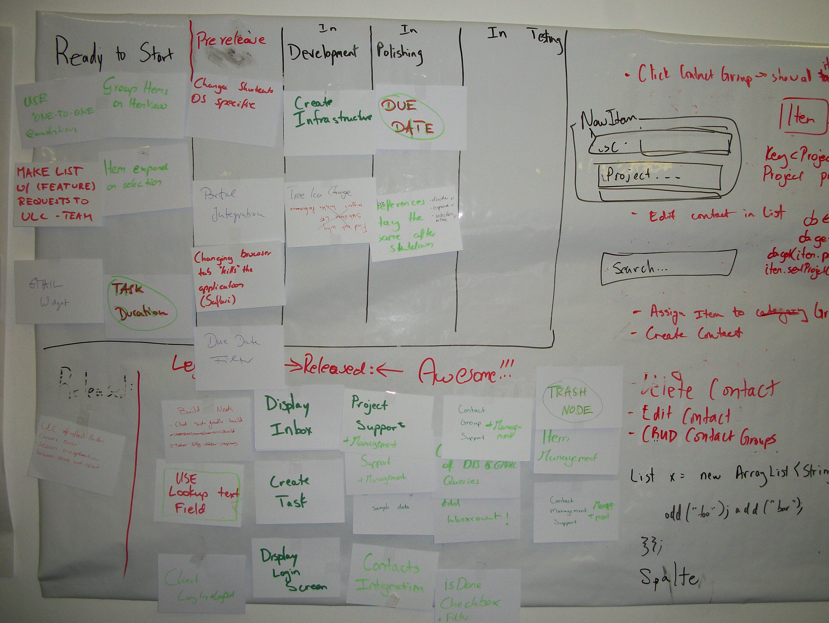
Flow of Value

Slide 29
Extra Features
65% of software features are rarely to never used (Standish Group)
Avoid Big Design Up Front
  YAGNI, KISS
  Evolutionary Architecture? Evolutionary Design?
  Define a Minimal Marketable Feature Set
  Prefer Low-Ceremony Processes, like story cards
  Deliver full features to users quickly

Slide 30
Recognizing Waste
Partially Done Work
Extra Features
Relearning
Handoffs
Task Switching
Delays
Defects

Slide 31
Relearning
How do you not lose or forget information?
How do you chronicle successes and failures

Slide 32
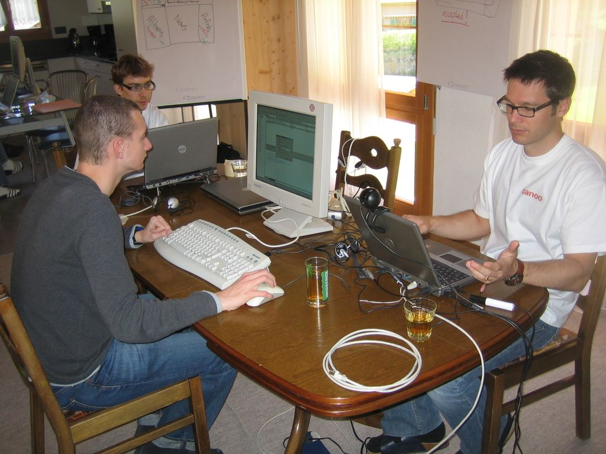
Notes:
A Team Room (sort of)

Slide 33
Relearning
How do you not lose or forget information?
How do you chronicle successes and failures
Team rooms create tacit knowledge

Slide 34
Relearning
How do you not lose or forget information?
How do you chronicle successes and failures
Team rooms create tacit knowledge
Automated tests create explicit knowledge
  Every defect is fixed with a test

Slide 35
Relearning
How do you not lose or forget information?
How do you chronicle successes and failures
Team rooms create tacit knowledge
Automated tests create explicit knowledge
  Every defect is fixed with a test
  Can your documents have comments? Can they be marked out-of-date?

Slide 36
Recognizing Waste
Partially Done Work
Extra Features
Relearning
Handoffs
Task Switching
Delays
Defects

Slide 37
Handoffs
Transferring information between people is lossy

Slide 38
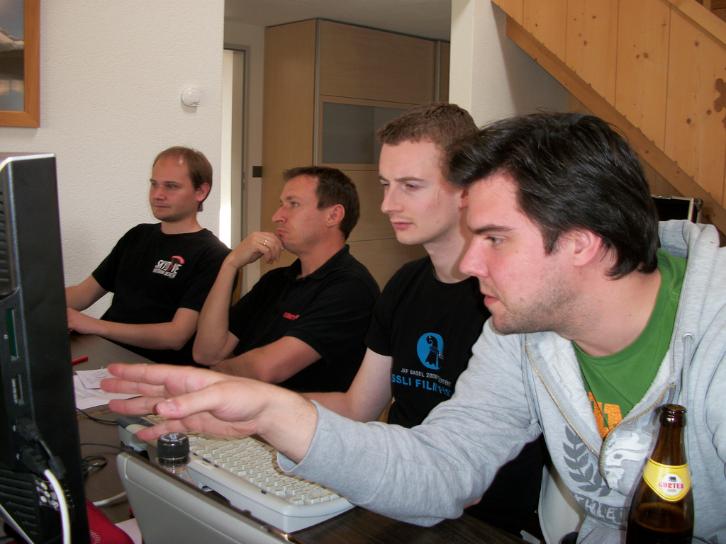

Slide 39
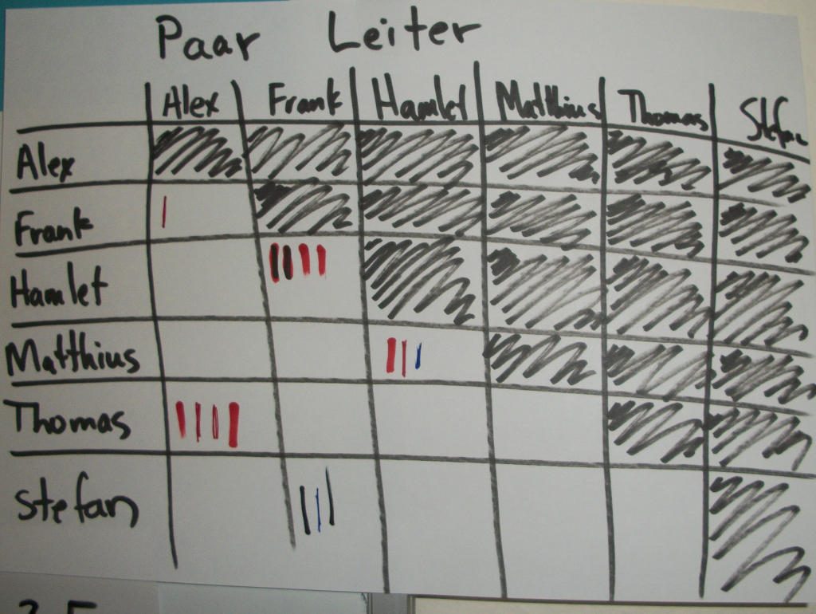

Slide 40
Handoffs
Transferring information between people is lossy
Team Rooms & Pairing minimize handoffs
  'Pair Ladders' can be used to promote fair pairing

Slide 41
Handoffs
Transferring information between people is lossy
Team Rooms & Pairing minimize handoffs
  'Pair Ladders' can be used to promote fair pairing
Open Source & Non-Proprietary software reduces handoff cost

Slide 42
Recognizing Waste
Partially Done Work
Extra Features
Relearning
Handoffs
Task Switching
Delays
Defects

Slide 43
Task Switching
3 one-week tasks always take longer than 3 weeks to deliver

Slide 44
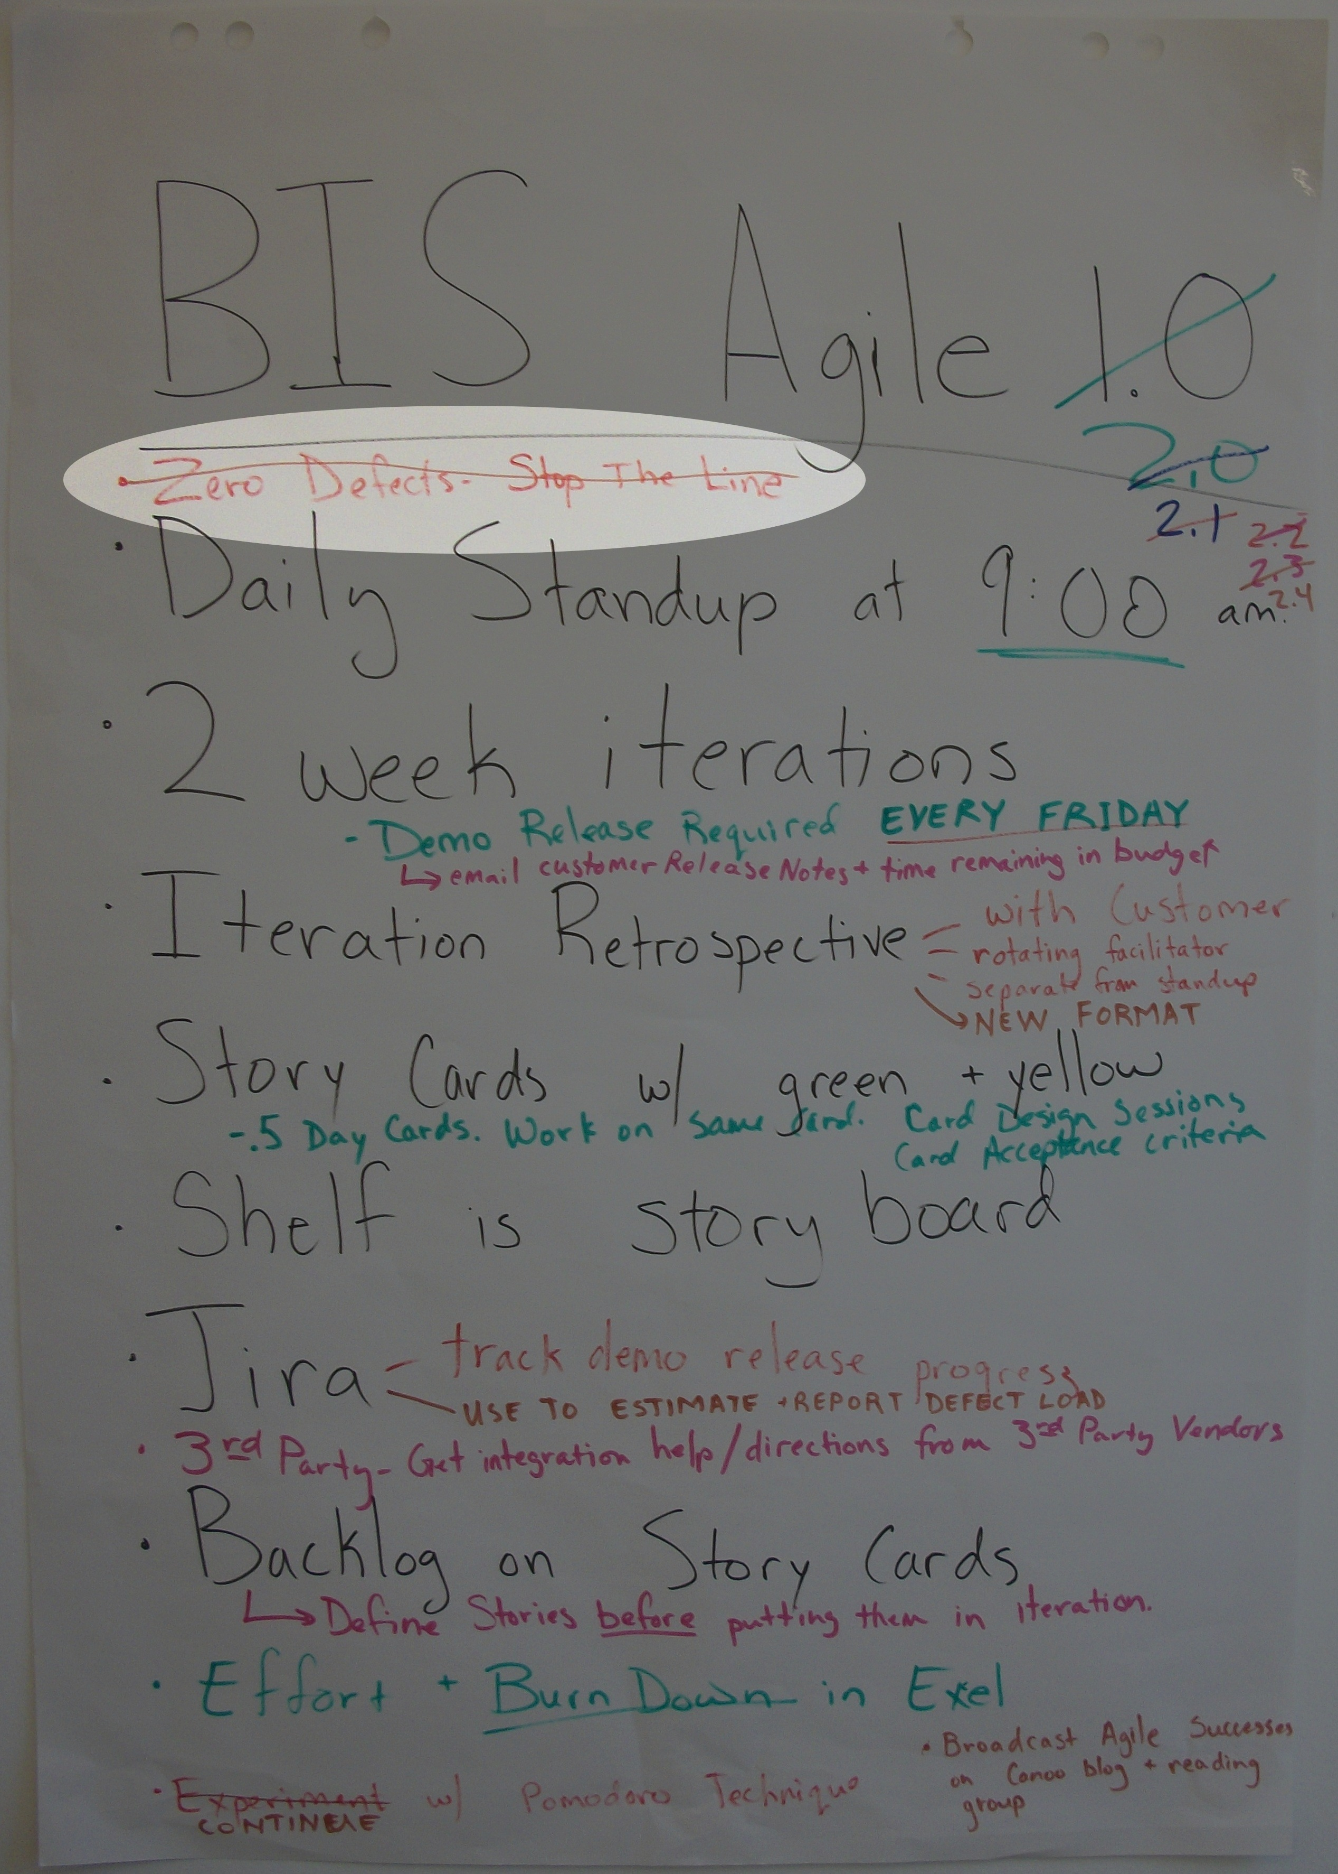
Zero Defects
Stop the Line

Slide 45
Task Switching
3 one-week tasks always take longer than 3 weeks to deliver
Maintenance work often requires a task switch
  Maintenance Team?
  Defect Fridays?

Slide 46
Recognizing Waste
Partially Done Work
Extra Features
Relearning
Handoffs
Task Switching
Delays
Defects

Slide 47
Delays
Time waiting is time wasted

Slide 48
Delays
Time waiting is time wasted
Avoid large tasks
Beware documentation tasks
Create a Value Stream Map

Slide 49
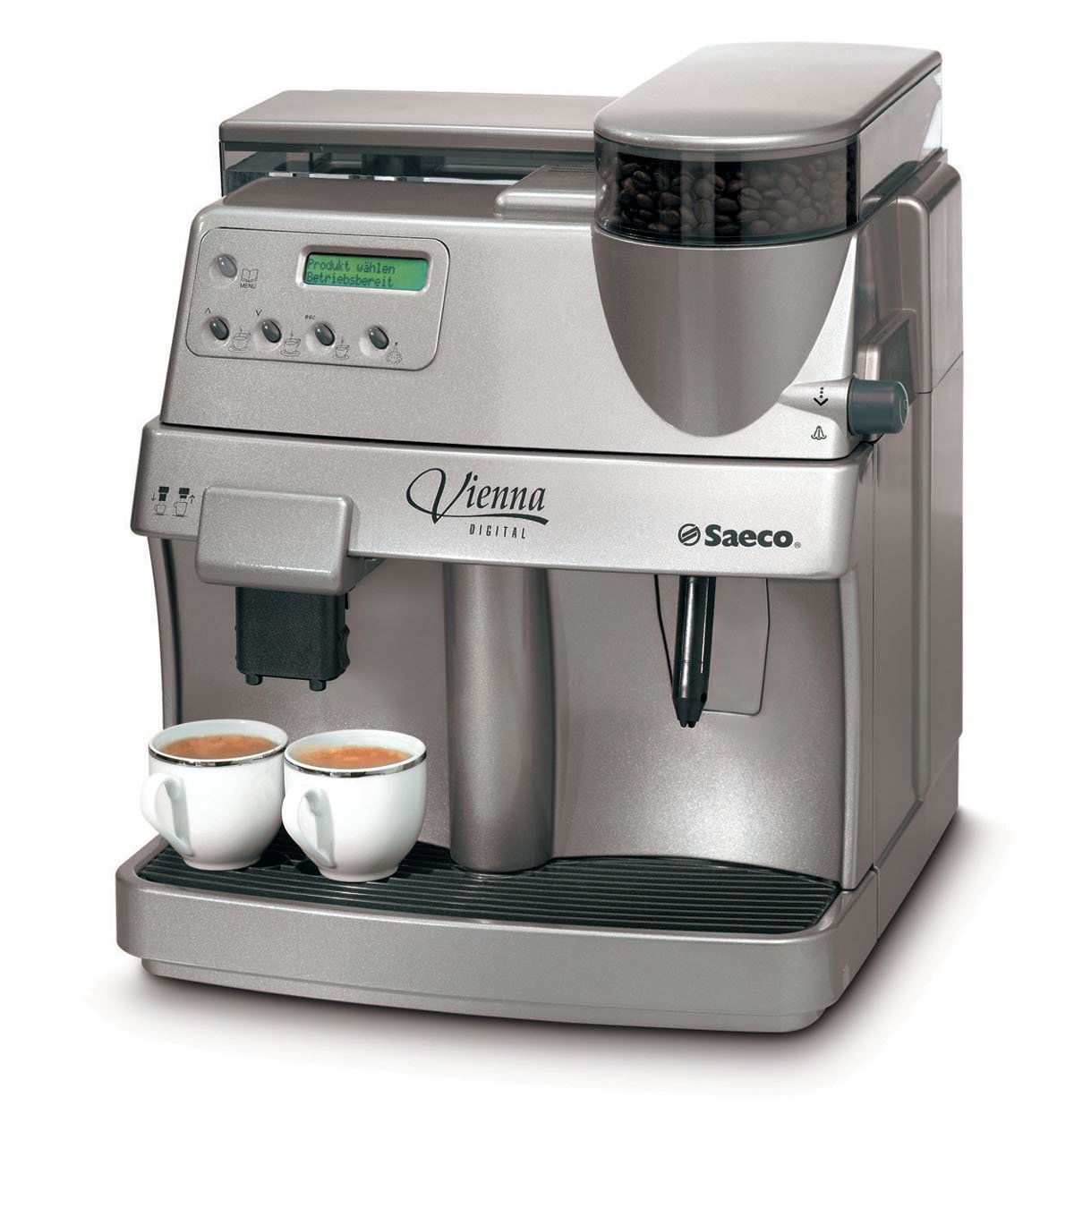



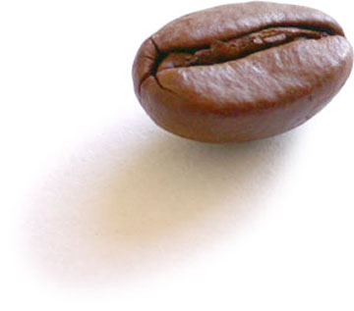
Value Stream Mapping
refill water
120 / 10
refill beans
120 / 10

Slide 50
Value Steam Mapping
174 Seconds Average
= CHF 43,000 a year
150 Seconds Average
= CHF 37,500 a year
Notes:
One particularly useful Lean practice for eliminating waste is Value Stream Mapping. Sit down at a whiteboard with your development team and write out your software process: the steps and time it takes to move an idea from inception to customer delivery. Where are the bottlenecks? What are the delays? Why does it take so long? Visualizing and quantifying your process helps everyone clearly see problem areas.

Slide 51
Recognizing Waste
Partially Done Work
Extra Features
Relearning
Handoffs
Task Switching
Delays
Defects

Slide 52
Defects
Better use of meetings or documentation cannot produce higher quality
Quality comes from people caring

Slide 53
Defects
Better use of meetings or documentation cannot produce higher quality
Quality comes from people caring
Focus on prevention not discovery
  Code Quality Tools (Pylint, Pychecker, Pyflakes?)
  Code Reviews
  Pair-Programming as Code Review

Slide 54
Usability Defects
User interfaces do have defects
Use Paper Prototyping and Guerrilla Usability
Integrate user testing into your software lifecycle

Slide 55
Recognizing Waste
Partially Done Work
Extra Features
Relearning
Handoffs
Task Switching
Delays
Defects

Slide 56
There is a big difference between eliminating waste and not creating it in the first place.
- Alan Shalloway

Slide 57
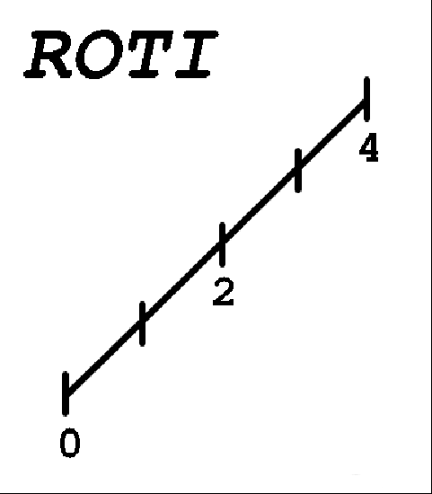
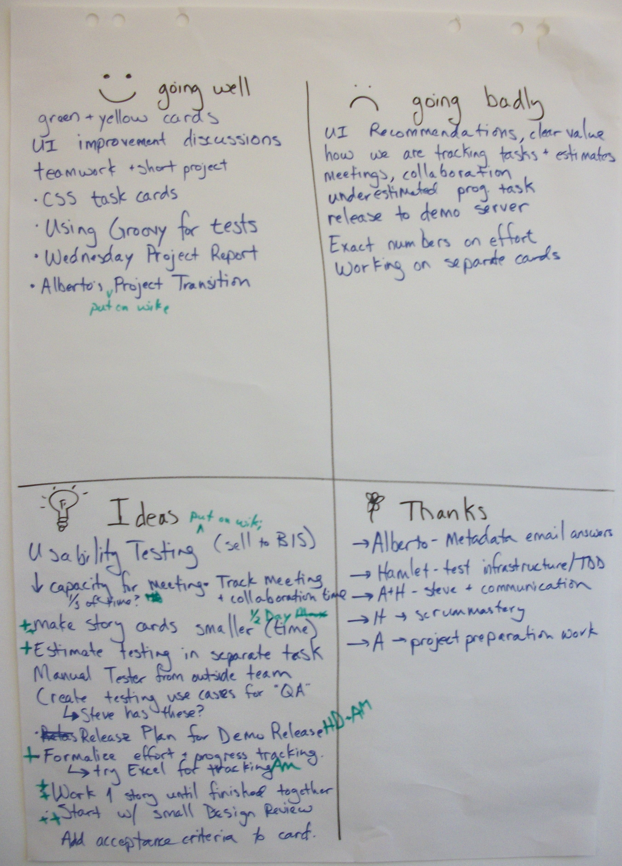
Next Steps
Create feedback cycles
Hold Retrospectives

