Slide 1
Code Generation on the JVM
Hamlet D'Arcy
@HamletDRC
http://hamletdarcy.blogspot.com

Slide 2
Agenda
Lombok
Spring Roo
Cofoja
Groovy AST Transformations
    GContracts
    CodeNarc
    Spock

Slide 3





About Me

Slide 4
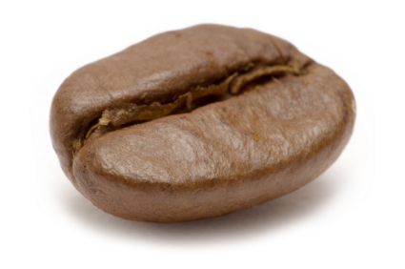

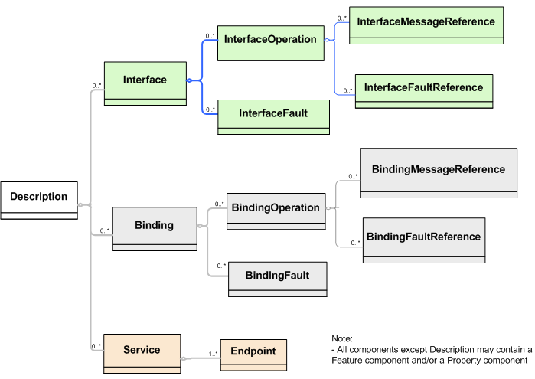
I hate code generation too!
Bean
Generation
Stub
Generation
WSDL
Generation

Slide 5



… but it isn't all bad.
cofoja

Slide 6
Project Lombok

Slide 7
public class Person {
private String firstName;
private String lastName;
void setFirstName(String fName) {
this.firstName = fName;
}
public String getFirstName() {
return firstName;
}
public void setLastName(String lName) {
this.lastName = lName;
}
public String getLastName() {
return firstName;
}
}
import lombok.Getter;
import lombok.Setter;
public class Person {
@Getter @Setter private String firstName;
@Setter @Setter private String lastname;
}

Slide 8
public class SynchronizedExample {
private final Object $lock = new Object[0];
public void doSomething() {
synchronized($lock) {
return ...;
}
}
}
import lombok.Synchronized;
public class SynchronizedExample {
@Synchronized
public void doSomething() {
return ...;
}
}

Slide 9
@Getter / @Setter
@ToString
@EqualsAndHashCode
@NoArgsConstructor
@RequiredArgsConstructor
@AllArgsConstructor
@Data
@Cleanup
@Synchronized
@SneakyThrows
@Log
val

Slide 10
Generates Java Boilerplate
Compile Time Only
  – For Eclipse and javac
Removable with delombok
Read the fine print
  – You should know what is generated

Slide 11
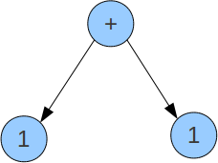
How it Works

Slide 12
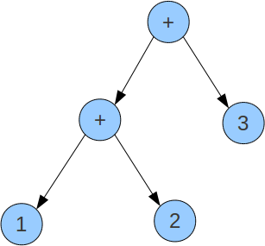
How it Works

Slide 13
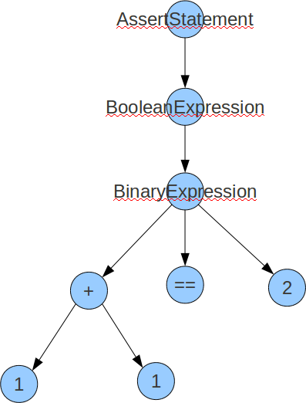
How it Works

Slide 14
How it Works
Annotation Processor
Eclipse Handler
Javac Handler

Slide 15
// javac
private void generatePropertyChangeSupportField(JavacNode node) {
if (fieldAlreadyExists(PROPERTY_SUPPORT_FIELD_NAME, node)) return;
JCExpression exp = chainDots(node.getTreeMaker(), node, "this");
JCVariableDecl fieldDecl = newField()
.ofType(PropertyChangeSupport.class)
.withName(PROPERTY_SUPPORT_FIELD_NAME)
.withModifiers(PRIVATE | FINAL)
.withArgs(exp)
.buildWith(node);
injectField(node, fieldDecl);
}
// ECJ
private void generatePropertyChangeSupportField(EclipseNode node) {
if (fieldAlreadyExists(PROPERTY_SUPPORT_FIELD_NAME, node)) return;
Expression exp = referenceForThis(node.get());
FieldDeclaration fieldDecl = newField()
.ofType(PropertyChangeSupport.class)
.withName(PROPERTY_SUPPORT_FIELD_NAME)
.withModifiers(PRIVATE | FINAL)
.withArgs(exp)
.buildWith(node);
injectField(node, fieldDecl);
}
Alex Ruiz – Custom AST Transformations with Project Lombok
http://www.ibm.com/developerworks/java/library/j-lombok/

Slide 17
How it Works
`-- contacts
|-- Person.java
|-- Person_Roo_Configurable.aj
|-- Person_Roo_Entity.aj
|-- Person_Roo_JavaBean.aj
|-- Person_Roo_ToString.aj
`-- web
|-- PersonController.java
`-- PersonController_Roo_Controller.aj

Slide 18
How it Works
public class Person implements ConfigurableObject {
...
public String toString() {
return Person_Roo_ToString....Person$toString(this);
}
...
}
public class Person_Roo_ToString {
static String Person_Roo_ToString....Person$toString(
Person ajc$this_) {
StringBuilder sb = new StringBuilder();
...
return sb.toString();
}

Slide 19
Moves Java Boilerplate to .aj files
  – Uses AspectJ's inter-type declaration (ITD) features
  – “Roo doesn't believe in magic!”
Compile Time Only
  – Not a runtime
  – Not an Annotation Processing library
  – No dynamic proxy objects
Removable with rollout mechanism
There is a lot of code on disk
  – Is this Roo's fault?

Slide 20
cofoja

Slide 21
How it works
Contract Applies-To Advice Inheritance
@Invariant Class Around &&
@Requires Method Before ||
@Ensures Method After &&

Slide 22
How it works
Annotation Processor
  Compiles strings to bytecode
  Writes a '.contract' file
Instrumentation Agent
  Weaves .contract file at JVM loadtime
Offline Bytecode Rewriter
  Produces pre-weaved .class files
cofoja

Slide 23
How it works
javac
-cp cofoja-1.0.jar
-processor com.google.java.contract.core.apt.AnnotationProcessor
Kettle.java
java -ea -javaagent:./cofoja-1.0.jar Kettle
or
java -cp cofoja-1.0.jar
-Dcom.google.java.contract.classoutput=compiled
com.google.java.contract.core.agent.PreMain
Kettle.class

Slide 25
class Event {
String title
}

Slide 26
class Event {
String title
}
class Event {
String title
public void getTitle() {
title
}
public String setTitle(String t) {
this.title = t
}
}

Slide 27
class Event {
@Delegate Date when
}

Slide 28
class Event implements Comparable, Clonable {
Date when
boolean after(Date when) {
this.when.after(when)
}
boolean before(Date when) {
this.when.before(when)
}
Object clone() {
this.when.clone()
}
int compareTo(Date anotherDate) {
this.when.compareTo(otherDate)
}
int getDate() {
this.when.date
}
int getDay() {
this.when.day
}
int getHours() {
this.when.hours
}
int getMinutes() {
this.when.minutes
}
int getMonth() {
this.when.month
}
int getSeconds() {
this.when.seconds
}
long getTime() {
this.when.time
}
int getTimezoneOffset() {
this.when.timezoneOffset
}
int getYear() {
this.when.year
}
void setDate(int date) {
this.when.date = date
}
void setHours(int hours) {
this.when.hours = hours
}
void setMinutes(int minutes) {
this.when.minutes = minutes
}
void setMonth(int month) {
this.when.month = month
}
void setSeconds(int seconds) {
this.when.seconds = seconds
}
void setTime(long time) {
this.when.time = time
}
void setYear(int year) {
this.when.year = year
}
String toGMTString() {
this.when.toGMTString()
}
String toLocaleString() {
this.when.toLocaleString()
}
}
class Event {
@Delegate Date when
}

Slide 29
class Event {
@Lazy ArrayList speakers
}

Slide 30
class Event {
@Lazy ArrayList speakers
}
class Event {
ArrayList speakers
def getSpeakers() {
if (speakers != null) {
return speakers
} else {
synchronized(this) {
if (speakers == null) {
speakers = []
}
return speakers
}
}
}
}
Also handles:
  Initial values
  Volatile fields

Slide 31
@Immutable
class Event {
String title
}

Slide 32
Class is final
Properties must be @Immutable or effectively immutable
Properties are private
Mutatators throw ReadOnlyPropertyException
Map constructor created
Tuple constructor created
Equals(), hashCode() and toString() created
Dates, Clonables, and arrays are defensively copied on way in and out (but not deeply cloned)
Collections and Maps are wrapped in Immutable variants
Non-immutable fields force an error
Special handling for Date, Color, etc
Many generated methods configurable
@Immutable
class Event {
String title
}

Slide 33
Code Generation Transformations
@ToString
@EqualsAndHashCode
@Canonical
@Lazy
@InheritConstructors
@TupleConstructor

Slide 34
Class Design Annotations
@Delegate
@Singleton
@groovy.transform.Immutable

Slide 35
Logging Improvements
@Log
@Log4j
@Slf4j
@Commons

Slide 36
Declarative Concurrency
@Synchronized
@WithReadLock
@WithWriteLock

Slide 37
Easier Cloning and Externalizing
@AutoClone
@AutoExternalize

Slide 38
Safer Scripting
@TimedInterrupt
@ThreadInterrupt
@ConditionalInterrupt

Slide 39
@Package Scope
@Grab
@Category
@Mixin
@Bindable
@IndexedProperties
@ListenerList
@Vetoable
@Newify
… and many more as libraries

Slide 40
GroovyCodeVisitor
public interface GroovyCodeVisitor {
void visitBlockStatement(BlockStatement statement);
void visitForLoop(ForStatement forLoop);
void visitWhileLoop(WhileStatement loop);
void visitDoWhileLoop(DoWhileStatement loop);
...
}

Slide 41
GroovyCodeVisitor
… source in groovy/src/examples/groovyShell
public interface GroovyCodeVisitor {
void visitBlockStatement(BlockStatement statement);
void visitForLoop(ForStatement forLoop);
void visitWhileLoop(WhileStatement loop);
void visitDoWhileLoop(DoWhileStatement loop);
...
}
def s = new ArithmeticShell()
assert 2 == s.evaluate(' 1+1 ')
assert 1.0 == s.evaluate('cos(2*PI)')

Slide 42
static analysis for Groovy
class SystemRunFinalizersOnExitAstVisitor extends AbstractAstVisitor {
def void visitMethodCallExpression(MethodCallExpression call) {
if (call.objectExpression in VariableExpression) {
def target = call.objectExpression.variable
if (target == "System" && call.method in ConstantExpression) {
if (call.method.value == "runFinalizersOnExit") {
addViolation(call)
}
}
}
super.visitMethodCallExpression(call);
}
}

Slide 43
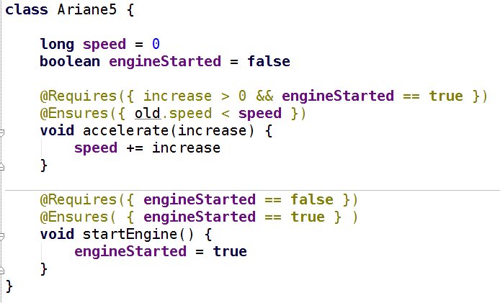
GContracts – Contract Driven Development

Slide 44
Spock – Groovy Testing Framework
… from “Hijacking Goto Labels”
def "Does simple math work?"() {
expect:
def s = new ArithmeticShell()
s.evaluate(input) == output
where:
input | output
'1 + 1' | 2
'cos(2*PI)' | 1.0
}

Slide 45
Groovy is a compiled language
...oh yes it is
Compiled changes visible in .class file
...visible to all JVM users
Language semantics are a library feature
...not hardcoded into the language

Slide 46
How it Works
Local AST Transformations
Global AST Transformations
AST Builder
ANTLR Plugins?

Slide 47
Local AST Transformations
class Event {
@Delegate Date when
}
@GroovyASTTransformationClass("org.pkg.DelegateTransform")
public @interface Delegate {
...
}
@GroovyASTTransformation(phase = CompilePhase.CANONICALIZATION)
public class DelegateTransform implements ASTTransformation {
public void visit(ASTNode[] nodes, SourceUnit source) {
...
}
}

Slide 48
Global AST Transformations
Transform.jar
| - transforms
| - global
| - CompiledAtASTTransformation.class
| - CompiledAtASTTransformation$_visit_closure1.class
| - ...
| META-INF
| - services
| - org.codehaus.groovy.transform.ASTTransformation
| - org.codehaus.groovy.source.Extensions
@GroovyASTTransformation(phase = CompilePhase.SEMANTIC_ANALYSIS)
public class SpockTransform implements ASTTransformation {
public void visit(ASTNode[] nodes, SourceUnit sourceUnit) {
...
}
}

Slide 49
AST Builder
def ast = new ExpressionStatement(
new MethodCallExpression(
new VariableExpression("this"),
new ConstantExpression("println"),
new ArgumentListExpression(
new ConstantExpression("Hello World")
)
)
)
def ast = new AstBuilder().buildFromCode {
println "Hello World"
}

Slide 50
AST Templates
… from “GEP 4 - AstBuilder AST Templates”
def wrapWithLogging(MethodNode original) {
new AstBuilder().buildFromCode {
println "starting $original.name"
$original.code
println "ending $original.name"
}
}

Slide 51
… from “Groovy ANTLR Plugins for Better DSLs”
given "some data" {
...
}
when "a method is called" {
...
}
then "some condition should exist" {
...
}

Slide 52
What to do next
Groovy Wiki
Groovy Mailing List is amazingly helpful
Use your creativity and patience
54 Pages of AST in GINA2 MEAP:

Slide 53
Agenda
Lombok
Spring Roo
Cofoja
Groovy AST Transformations
    GContracts
    CodeNarc
    Spock

Slide 54
Thanks!
Twitter: @HamletDRC
Blog: http://hamletdarcy.blogspot.com
Work Blog: http://www.canoo.com/blog
JetBrains.tv Screencasts:
    http://tv.jetbrains.net/tags/hamlet
YouTube Screencasts:
    http://www.youtube.com/user/HamletDRC
Share-a-Canooie – http://people.canoo.com/share/
Hackergarten – http://www.hackergarten.net/

