Slide 1
Slimmed Down Software
A Lean, Groovy Approach
Hamlet D'Arcy
Canoo Engineering AG
@HamletDRC

Slide 2


Notes:
About Us
About Me

Slide 3
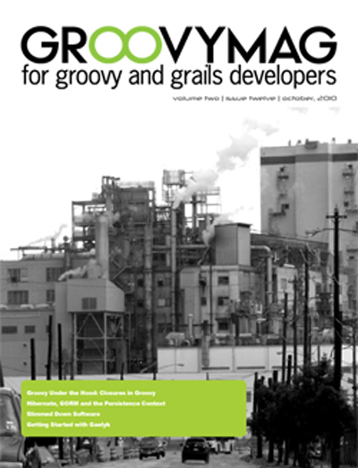
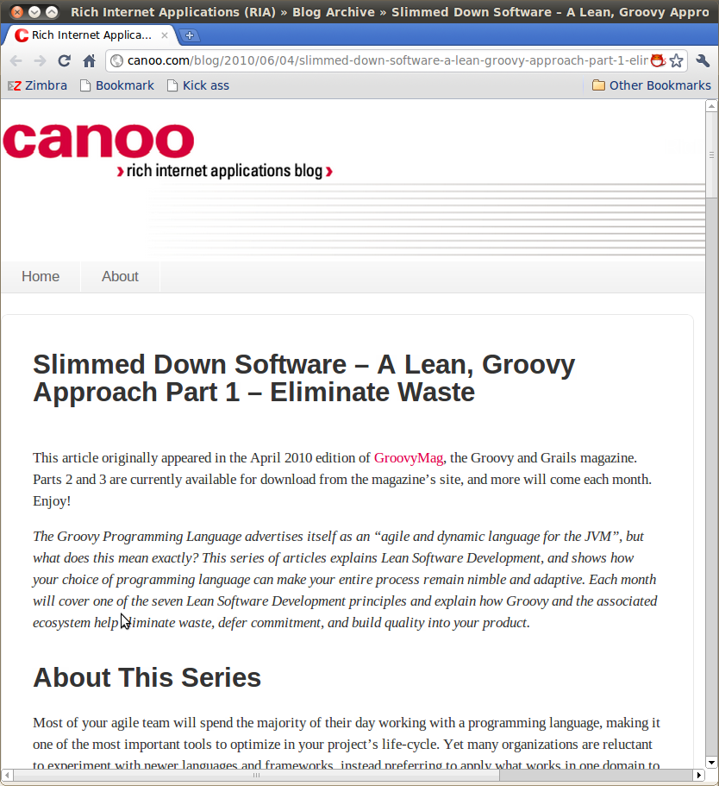
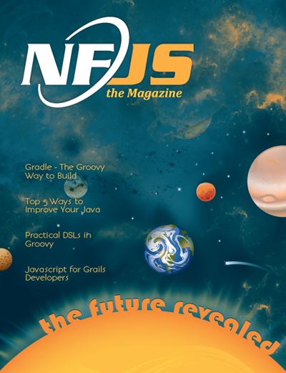
http://groovymag.com
http://canoo.com/blog
http://nofluffjuststuff.com/
Notes:
3 Places you can find more information about this article series.
Introduction
Explain Lean Software Development... show how programming language can make your entire process agile. Covers 7 Lean principles and explains how Groovy and the associated ecosystem intersect.
Identify which domains in your project are most in need of a little Groovy magic as well as to help you sell Groovy to a skeptical or unconvinced audience.

Slide 4

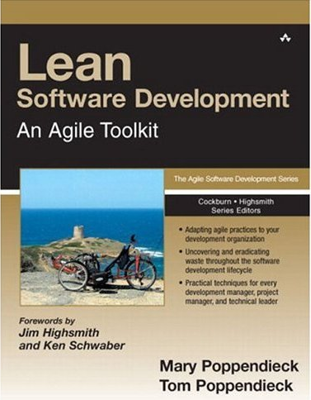
1988 - Japan
2003 - Minnesota
Notes:
Lean History
Grew out of the influential Toyota Production System, a set of philosophies and practices to weed out waste, inconsistency, and overburden from a manufacturing. 1990′s - Poppendieck's applied it to a software project. 2003 they published “Lean Software Development”. The principles have been revised over time.

Slide 5
Lean Principles
Eliminate Waste
Build Quality In
Create Knowledge
Defer Commitment
Deliver Fast
Respect People
Optimize the Whole

Slide 6
Lean Principles
XP Values
Eliminate Waste
Build Quality In
Create Knowledge
Defer Commitment
Deliver Fast
Respect People
Optimize the Whole
Communication
Simplicity
Feedback
Courage
Respect

Slide 7
Lean Principles
XP Values
XP Principles
Eliminate Waste
Build Quality In
Create Knowledge
Defer Commitment
Deliver Fast
Respect People
Optimize the Whole
Communication
Simplicity
Feedback
Courage
Respect
Feedback
Assuming Simplicity
Embracing Change
Notes:
These principles and values are not specific enough to be helpful.

Slide 8
Lean Principles
Eliminate Waste
Build Quality In
Create Knowledge
Defer Commitment
Deliver Fast
Respect People
Optimize the Whole
Notes:
1.Eliminate Waste – Reduce work in progress and half done work
2.Build Quality In – Instead of settling for finding defects, optimize your process to create fewer defects
3.Create Knowledge – Create fast feedback cycle and encode project information in executable form
4.Defer commitment – Delay decisions until the last responsible moment
5.Deliver Fast – Increase velocity by working in small batches and removing bottlenecks
6.Respect People – Create an environment that lets every single person contribute
7.Optimize the Whole – Measure up and avoid sub-optimization
It is easier to embrace Lean across all levels of an organization, from CEO to Janitor. The principles are specific enough to align a team but broad enough to appeal across an organization. I once spent a three-hour car ride discussing eliminating waste with the senior manager and director of my development group, and then arrived at work to help an eager development team make practical changes to reach the goals we had discussed. Compare that to a methodology with principles of “Honesty” and “Communication”. I have yet to find a use for vague principles beyond their ability to make me feel a little better about a crummy process.

Slide 9
Lean Principles
Eliminate Waste
Build Quality In
Create Knowledge
Defer Commitment
Deliver Fast
Respect People
Optimize the Whole

Slide 10
Eliminate Waste?
versus
Map m = [1: 'a', 2: 'b', 3 : 'c']
Map m = new HashMap();
m.put(1, "a");
m.put(2, "b");
m.put(3, "c");
Notes:
Groovy is simply less code.

Slide 11

Eliminate Waste?
versus
Map m = [1: 'a', 2: 'b', 3 : 'c']
Map m = new HashMap();
m.put(1, "a");
m.put(2, "b");
m.put(3, "c");

Slide 12

Phase 1
Phase 2
Phase 3
stop doing things that aren’t worth the effort
do the same things with less effort
Profit!
Notes:
This is deceptively simple. If these two rules are simple, then why is making a lasting change so hard? Why aren’t we hurtling forward at work to ever higher levels of productivity? The reality is that we are good and seeing waste but not good at seeing its causes, and we often eliminate a wasteful practice without finding a suitable replacement.

Slide 13
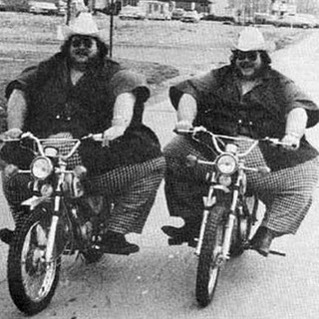
Memba Them?!
Notes:
Consider the classic resolution of losing weight. We say to ourselves, “I’m going to eat less junk food this year” without asking why we have this tendency in the first place. Caffeine and lack of sleep are both known to contribute to overeating, but we don’t often focus on these causes.
Or how about riding a freaking moped everywhere instead of walking?

Slide 14
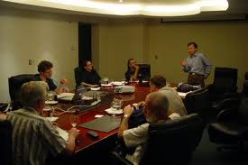
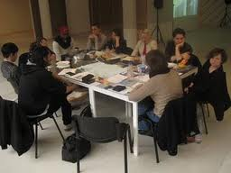

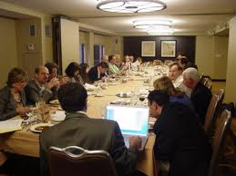


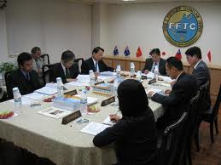
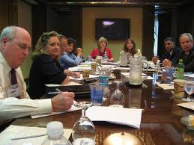

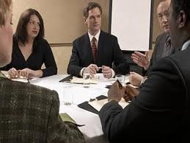

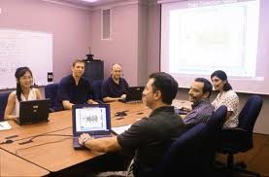

Deja Vu?
Notes:
Excessive meetings form an even better example. Why do some workplaces have so many meetings? This is often a sign of a broken decision making process. fixing a culture of meetings requires you to both find the cause and make a replacement. First identify the real problem, difficulties making decisions, and then experiment with new ways to solve the problem. Perhaps you need to discuss and embrace decision forms other than “unanimous”, or learn to hold shorter, more specific meetings, or just create a team decision board and handle issues in the team room instead of the conference room.

Slide 15
How to Make a Decision
Consensus
Majority
Plurality
Dictatorship
Gradients of Agreement
Notes:
Consensus – The most common in IT. Everyone agrees.
Majority – Decision is made when most people agree
Plurality – Decision is made by largest common group
Dictatorship – Decision is made by one person
Gradients of Agreement – From Agile Coaching
Identify the stakeholders for a decision. Not everyone gets to be involved with every decision. Tread lightly. Consensus gives everyone the illusion of equal power over an unproductive process.

Slide 16
Endorse
Agree with
reservations
Block
Mixed feelings
Disagree but go
with majority
From “Agile Coaching”

Slide 17
Write Only Process Improvement
Working software over
comprehensive documentation
as long as that software is
comprehensively documented.
… from http://www.halfarsedagilemanifesto.org
Notes:
The antithesis of removing waste is what I call “Write Only Process Improvement”. As a group tries to adopt a better process, they are only allowed to add new practices without removing unneeded ones. This is the bane of agile pilot groups around the world. Your team is certainly free to try a Scrum style iteration with story cards, a burndown chart, and iterative planning. But you still need to adhere to the enterprise standards of full requirements documents, weekly status reports, and quarterly deployments. Feel free to add whatever you want to the process, just don’t dare remove anything. This arrangement requires duplicate work, quickly consumes the time of the Scrum Master, and leads to the conclusion that agile methods are slower than the alternative. Of course a new practice is slower if you’re not allowed to abandon the old way of doing things. The Agile Manifesto has a wonderful parody site called the “Manifesto for Half-Arsed Agile Software Development”. While the original manifesto claims to value “Working software over comprehensive documentation”, the parody adds the line “as long as that software is comprehensively documented.” This rings perfectly true for so many Agile pilot projects: please try your new process, but be sure to follow the old one as well. New practices are adopted despite “Write Only Process Improvement”, never because of it. http://www.halfarsedagilemanifesto.org/

Slide 18
Recognizing Waste
In-Process Inventory
Over-Production
Extra Processing
Transportation
Motion
Waiting
Defects

Slide 19
Recognizing Waste
Partially Done Work (In-Process Inventory)
Extra Features (Over-Production)
Relearning (Extra Processing)
Handoffs (Transportation)
Task Switching (Motion)
Delays (Waiting)
Defects (Defects)
Notes:
To reduce cost and be more effective we must eliminate waste. By now you know we do this in two ways: find the real cause of software waste and find suitable replacements to eliminate the cause. To help us understand waste we can turn to the Lean community for inspiration. Lean is a broad and growing movement, and was first brought to the software world by Mary and Tom Poppendieck in the book Lean Software Development[1]. Lean provides, among other things, a set of categories for recognizing waste. Learning how these categories apply to software is a good first step for improvements.

Slide 20

Partially Done Work
Notes:
So you own a bicycle factory and you make 1000 mountain bike frames with the plan to later make the handlebars and ship the whole units. When your customers decide they want road bikes instead you’re stuck with 1000 useless frames. It would have been better to produce one entire bike at a time. Then, you would never be left with excess inventory.

Slide 21
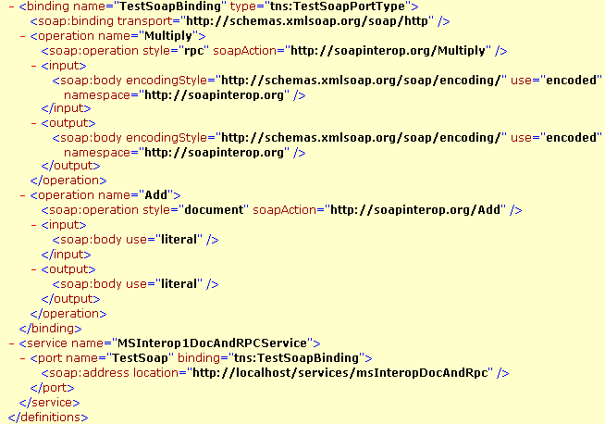
Partially Done Work
Notes:
Or maybe, instead of a bicycle tycoon, you are a humble developer needing to write a new fangled Service Oriented Architecture. Someone (usually a consultant) says “You need to design Contract First” so you spend two weeks creating ten different WSDL service descriptors by hand. Guess what happens when the architecture group decides to switch to REST and plain old XML services? Yup, you just worked for two weeks and have nothing to show for it. In-process inventory is a risk and a cost, whether it is half built bicycles or partially complete web services. Changing requirements and technologies will leave you with wasted effort sooner or later. When this happens to me I think, “I wish I’d spent two weeks at home instead, it would have had the same value to my company.” Partially done work manifests in many ways in software development.

Slide 22
Demo

Slide 23
Q&A

Slide 24
Code Sample
// This is Helvetica: 18 pt or higher please
public class TransferServiceImpl implements TransferService {
public TransferServiceImpl(AccountRepository ar) {
this.accountRepository = ar;
}
…
}
SpringOne 2GX 2009. All rights reserved. Do not distribute without permission.

Slide 25
Color Palette
R: 153
G: 204
B: 0
R: 0
G: 153
B: 153
R: 180
G: 180
B: 180
R: 138
G: 202
B: 136
R: 0
G: 65
B: 19
R: 101
G: 174
B: 255
R: 0
G: 60
B: 126
R: 211
G: 211
B: 211
R: 128
G: 128
B: 128
SpringOne 2GX 2009. All rights reserved. Do not distribute without permission.

